Slide 1
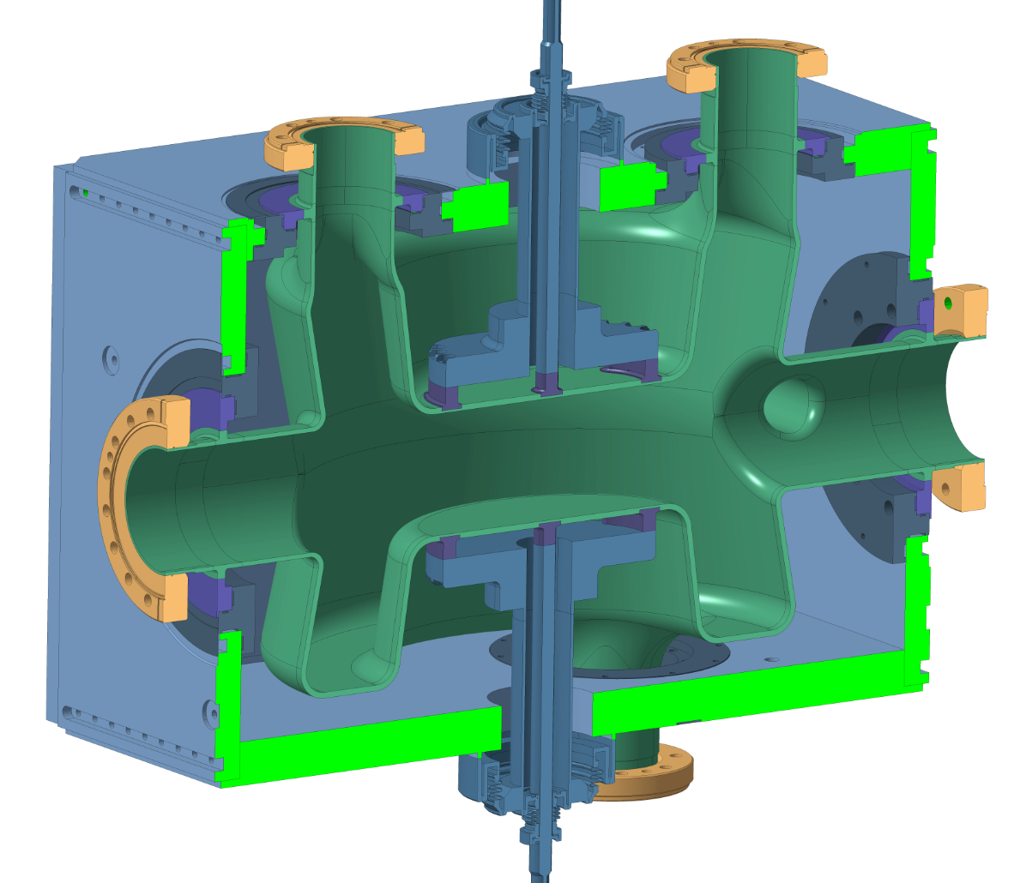
Helium Vessel &
Cavity Dressing
SPS Crab Cavity
Paula Freijedo Menendez
On behalf EN-MME WP4 Team
4th April, 2017

Slide 2
Introduction
Superconducting Radio Frequency (SRF) Crab Cavities will be operated in superfluid helium at 2K, contained in a titanium Helium Vessel.
Two Helium tanks, which will accommodate the Crab Cavities inside, will be installed in the SPS Cryostat by the end of this year.
The aim of this presentation is to show an overview about the design of the Helium Vessel and its validation with the manufacturing of a prototype, as well as the different steps concerning the fabrication, assembly & welding operations to be performed on the Helium vessel and the cavity in the coming weeks.

Slide 3
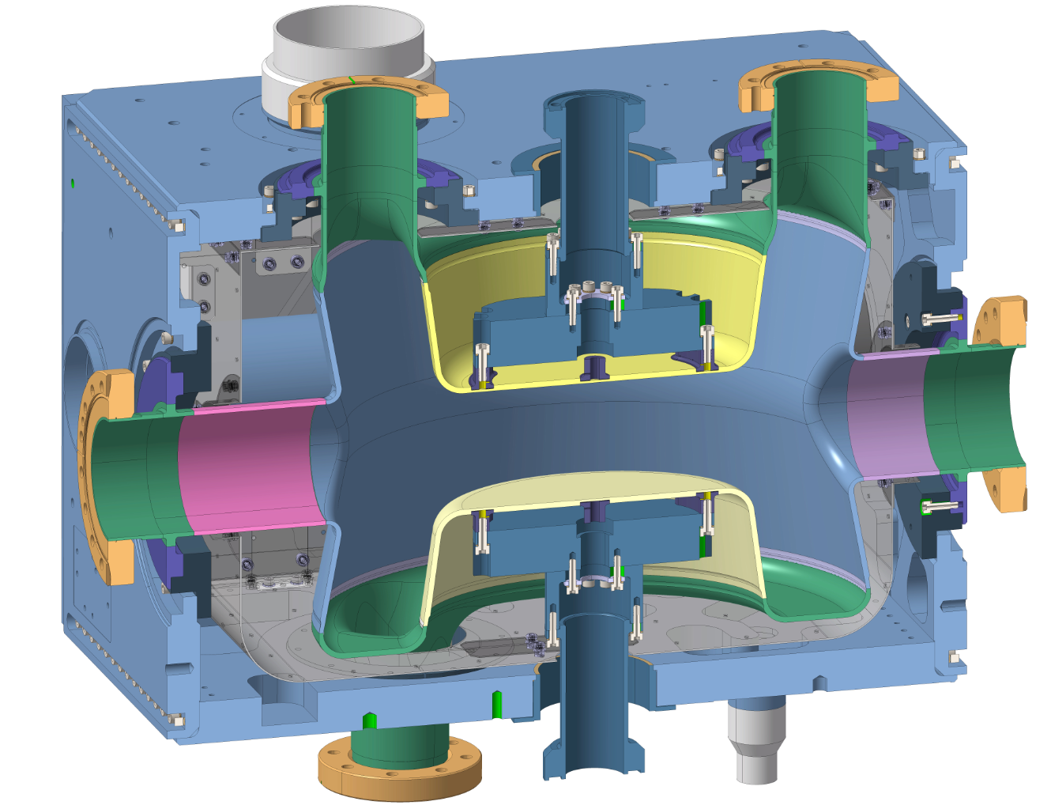
DESIGN
Bimetallic transition Ti/S.S
Helium tank
Enclosure Superfluid
Helium
Titanium gr.2
Reinforcement for
the cavity
Cold Magnetic
Shield
Bare Cavity
Niobium
Interfaces in NbTi
fixed on the tank
Adaptation
Pieces
Titanium gr.2
Pre-tuning pieces
Titanium gr.2
Mechanical resistance provided by the Bolts in titanium gr.5
Leak tightening provided by the welds, section weld has been limited to minimize the deformation
Manufacturing of a Prototype for validation

Slide 4
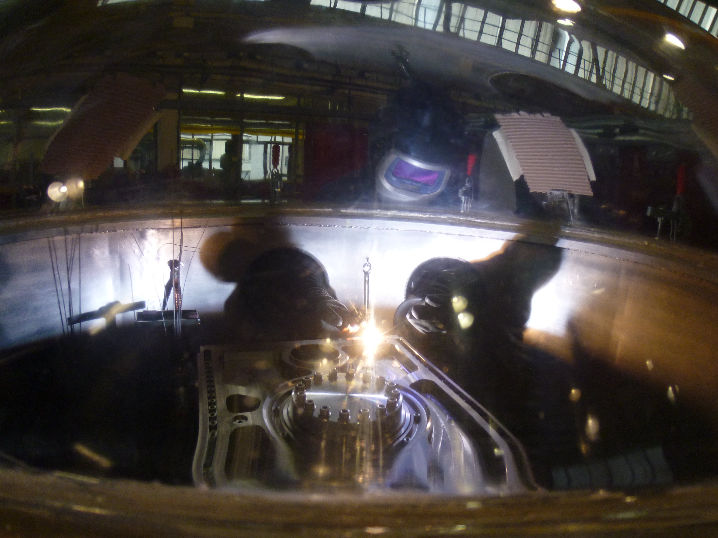
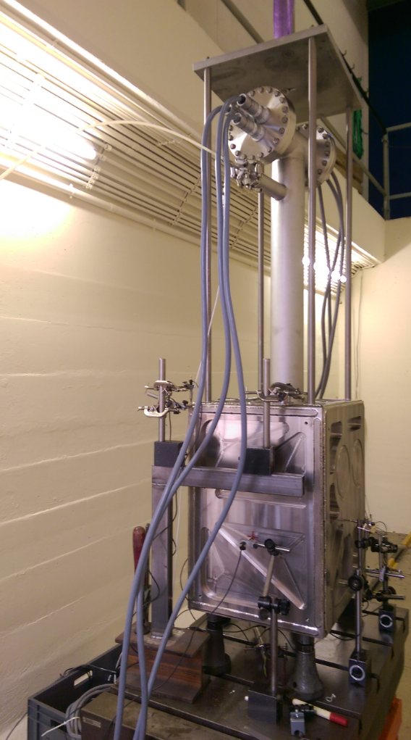
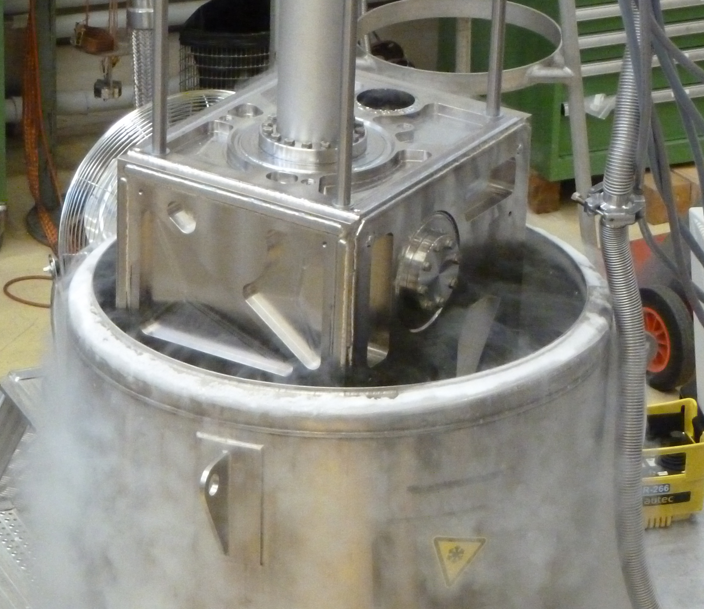
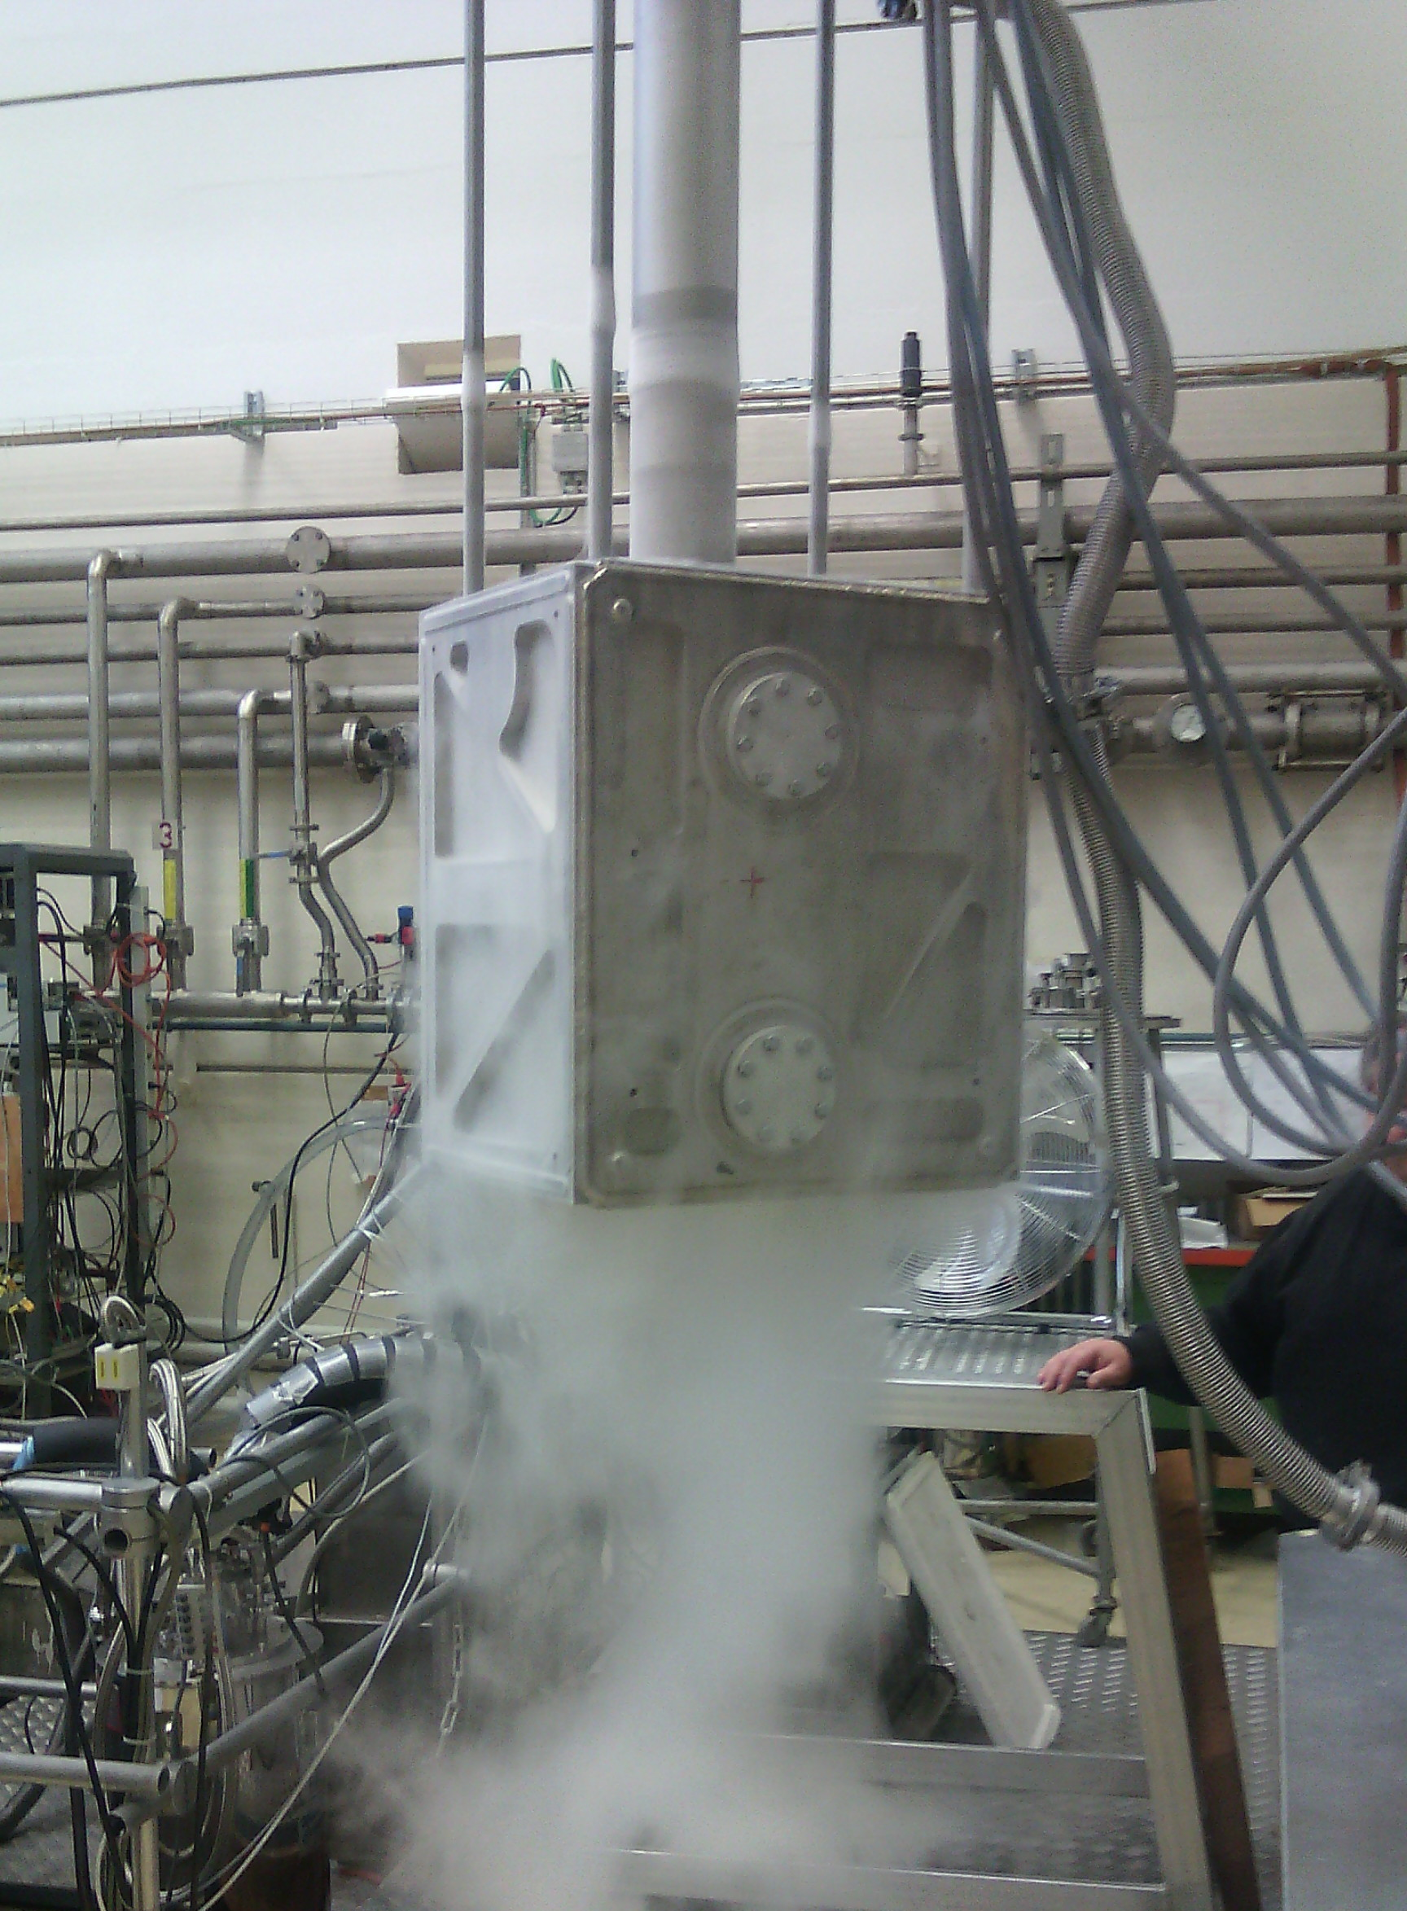
MANUFACTURING OF PROTOTYPE in 2016
Proto built in titanium gr.2 with identical dimensions
to validate:
Design
Mounting and Welding sequence
Deformations
Tests done after manufacturing:
Leak test
Pressure test
Leak test
Cool down test
Leak test
No leak, No damage & No permanent deformations found after tests.
The bolts’ preload remained constant through all the tests. Around 20% of such load was lost due to elastic interaction during assembling

Slide 5
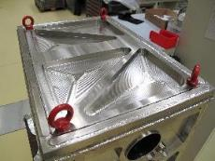
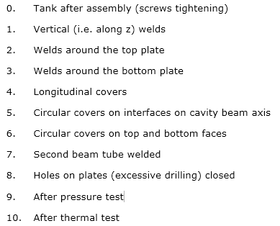
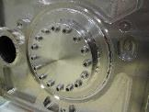
Main Key: Deformation
One of the most important reason for manufacturing a prototype has been to measure the deformations in order to predict the future effect on the cavity.
Dimensional Control steps
All results have been already assessed and the deformation expected should be limited.
Final maximum deformation measured in order to 0.1 mm
Analysis of Deformation EDMS 1570346 by Carlo Zanoni

Slide 6
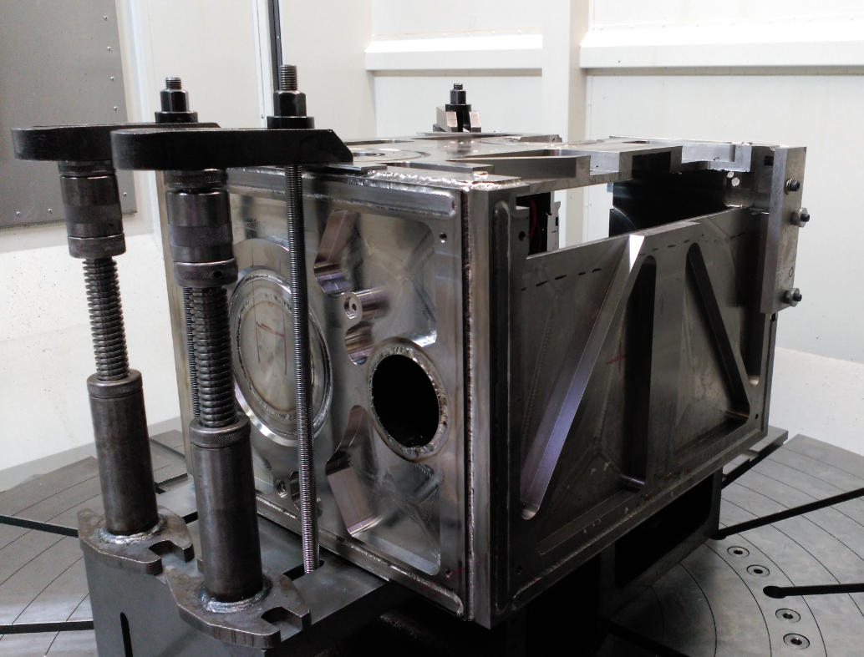
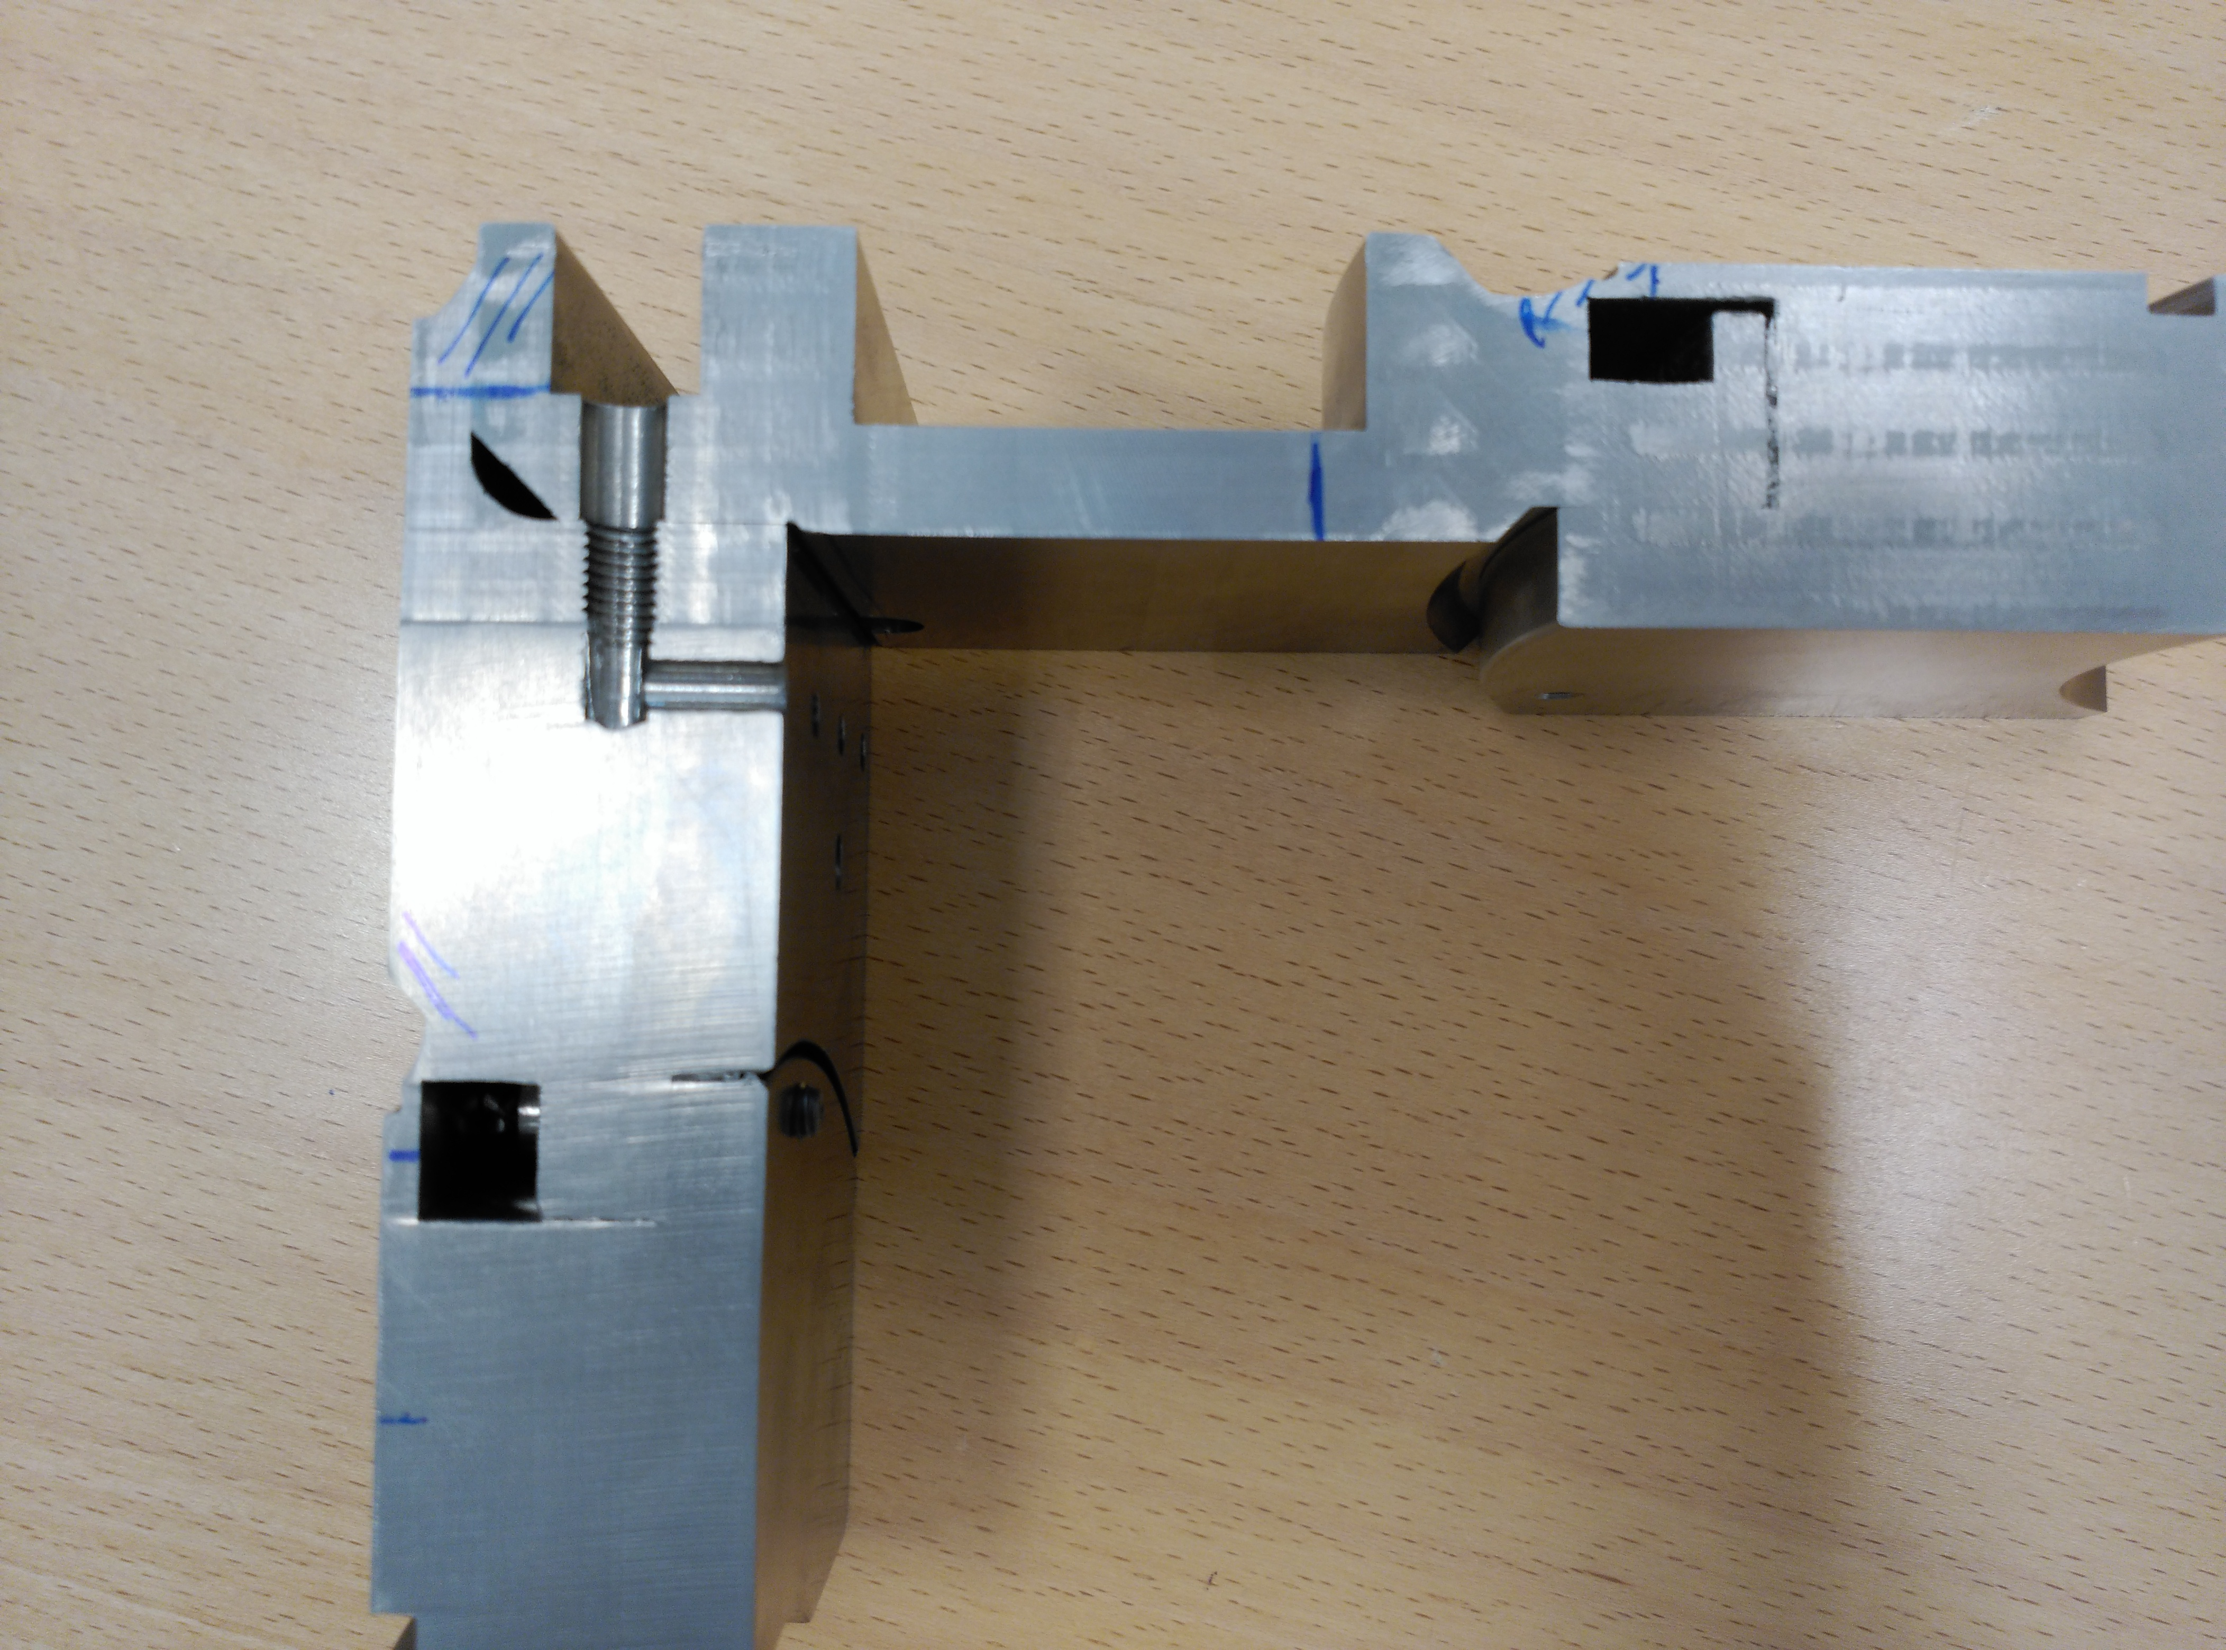
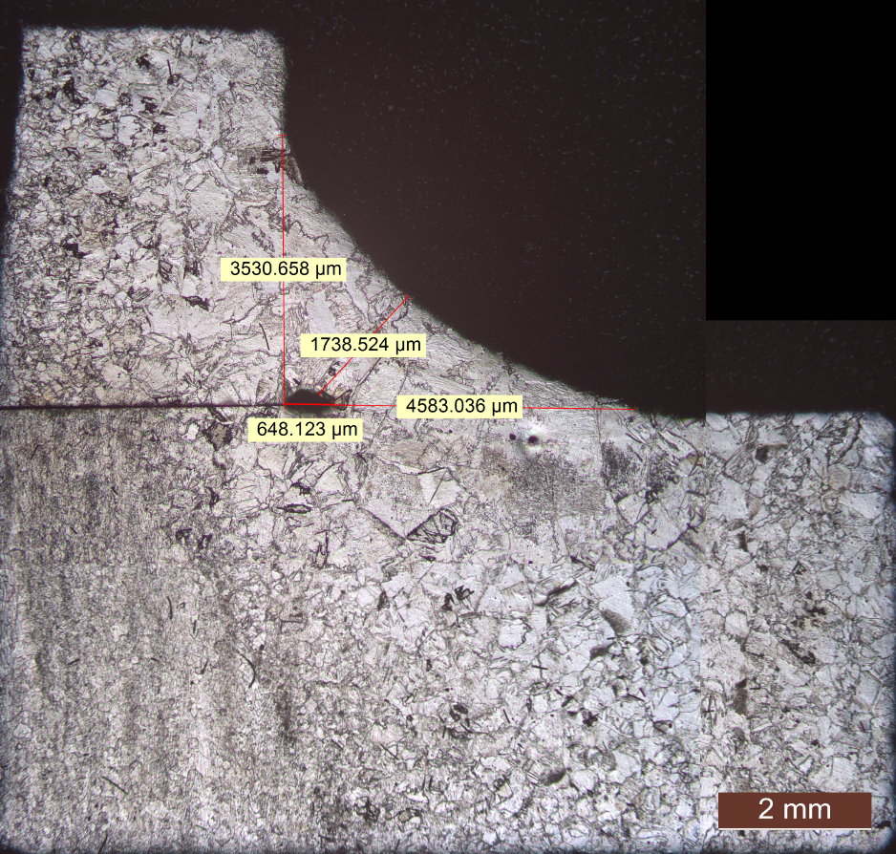
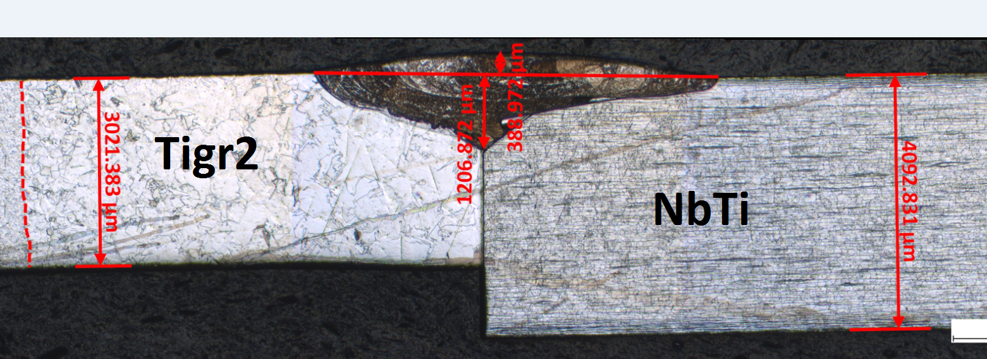
Welding Qualifications
The tank has been cut after testing to check the welds
No STRUCTURAL weld is required, only He-TIGHT welds
by TIG Manual Process
- Samples from all different welding configurations
have been tested.
- The following tests have been carried out on the samples:
Metallographic examination
Hardness Test
Destructive Test required by EN15613:
International Standard for Qualifications Welding Procedures
based on Pre-production welding test
Test Report EDMS 1716204 by Konrad Eiler

Slide 7
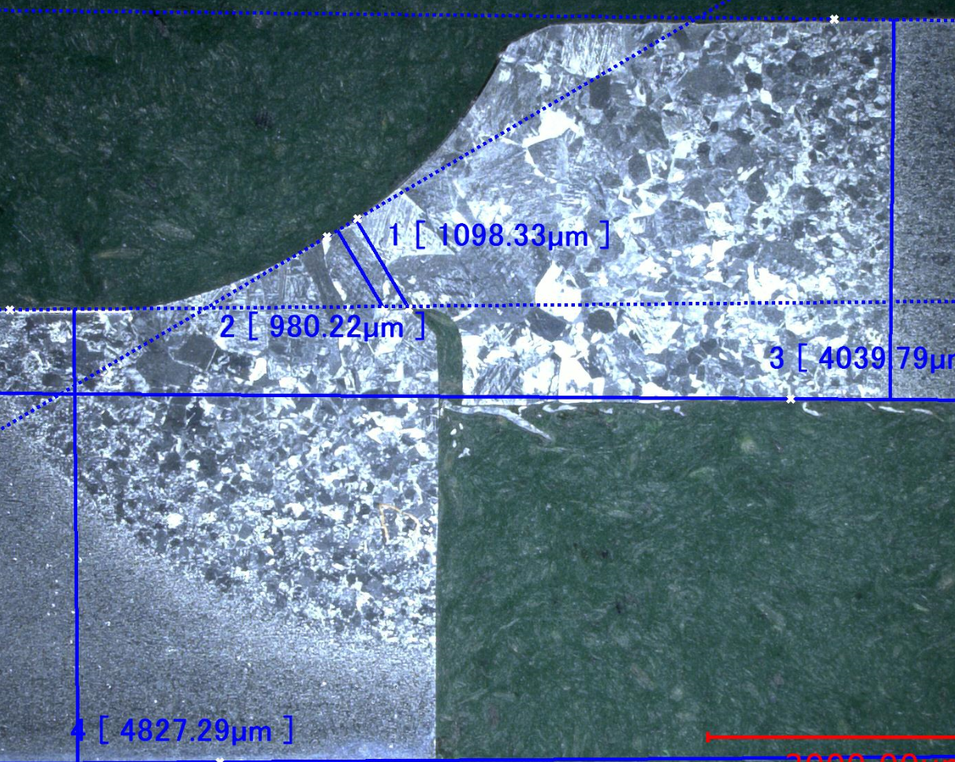
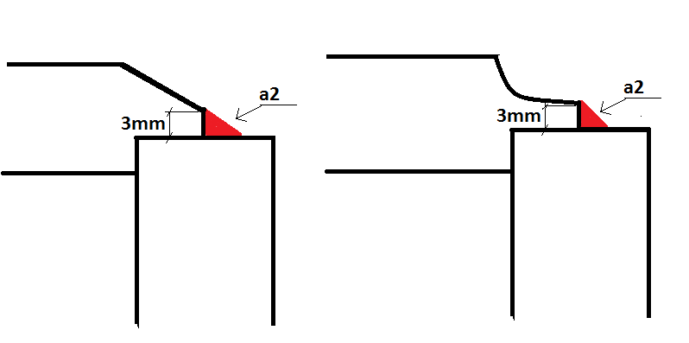
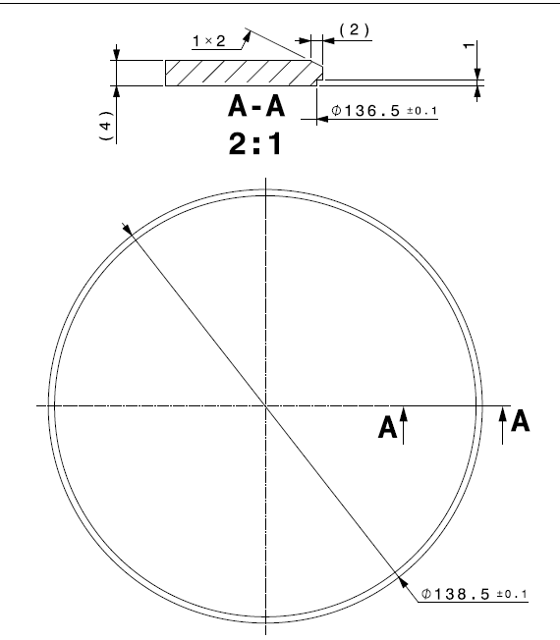
Lessons learned
Validation & Consolidation of the Helium Tank design and Fabrication Sequence
Qualifications of the Welds
Small changes have been introduced to improve the welding results and minimize the temperature effect given by the welds.
Local reduction of the mass
Incorporation of groove

Slide 8
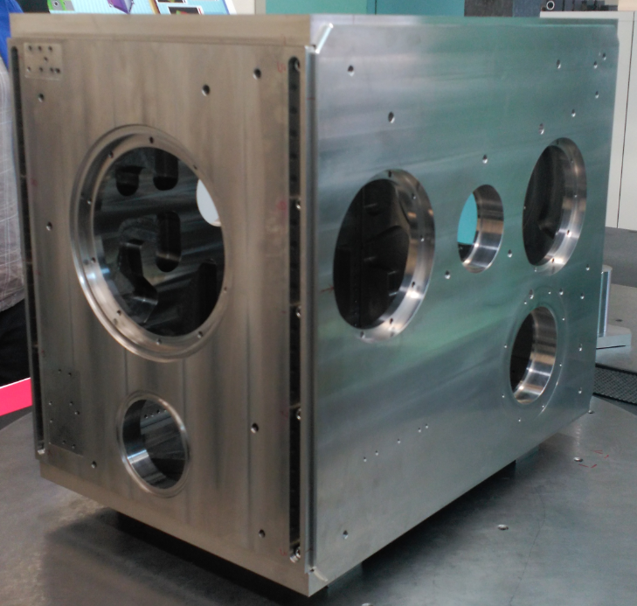
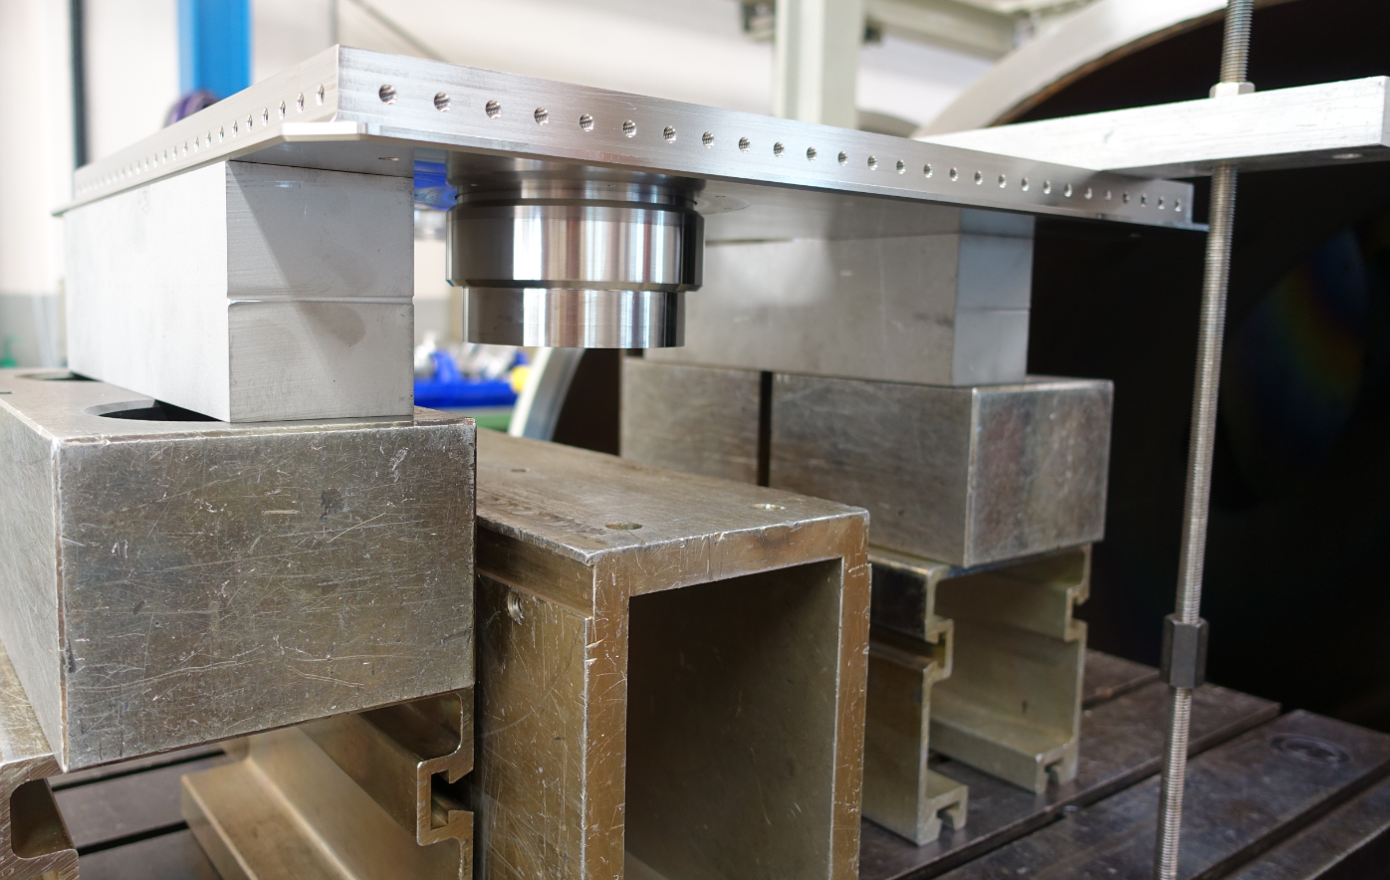
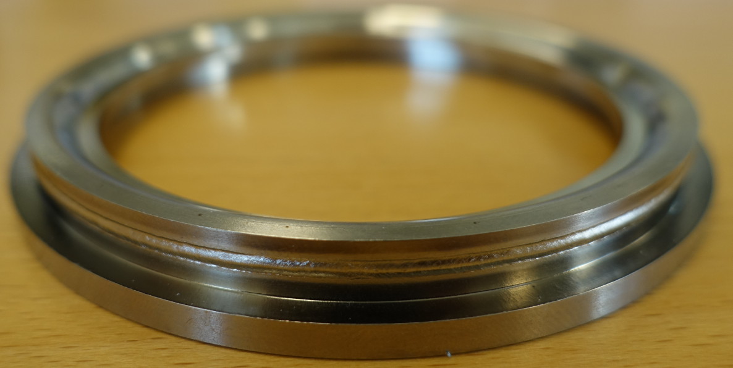
MANUFACTURING FOR SPS Test: Status
Machined Material ready for assembly
Pre-assembly + Dimensional Control (Report EDMS 1762125)
BIMETALLIC TRANSITIONS (provided by High Energy Metals) qualified by
Metallographic & Ultrasonic Examination and tested by Leak Test + Cold down test + Leak test
Bimetallic Transitions welded on plate by EBW
WELDING TEST for the bellows (Pick-up & Tuning system) with the representative configuration not tested in the proto:
Mounting Sequence has already started

Slide 9
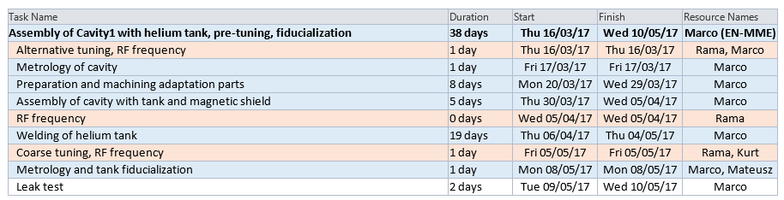
PLANNING
According to the planning: CCT_SPS
Assembly & Welding sequence on-going
will be finish by the expected date by beggining of May.

Slide 10
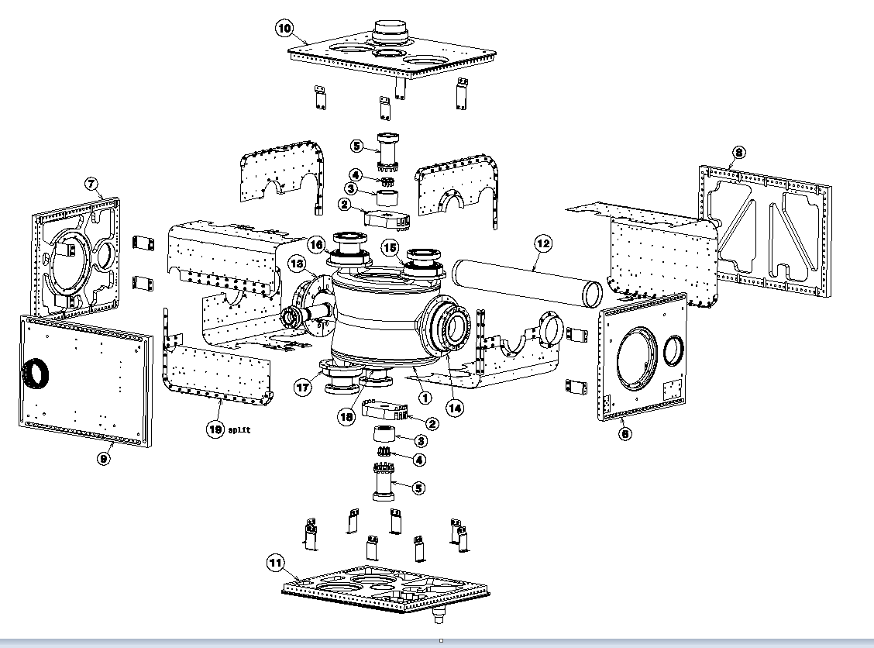
WHAT´s THE NEXT
CAVITY DRESSING
ASSEMBLY: DQW CAVITY + COLD MAGNETIC SHIELD + He TANK

Slide 11
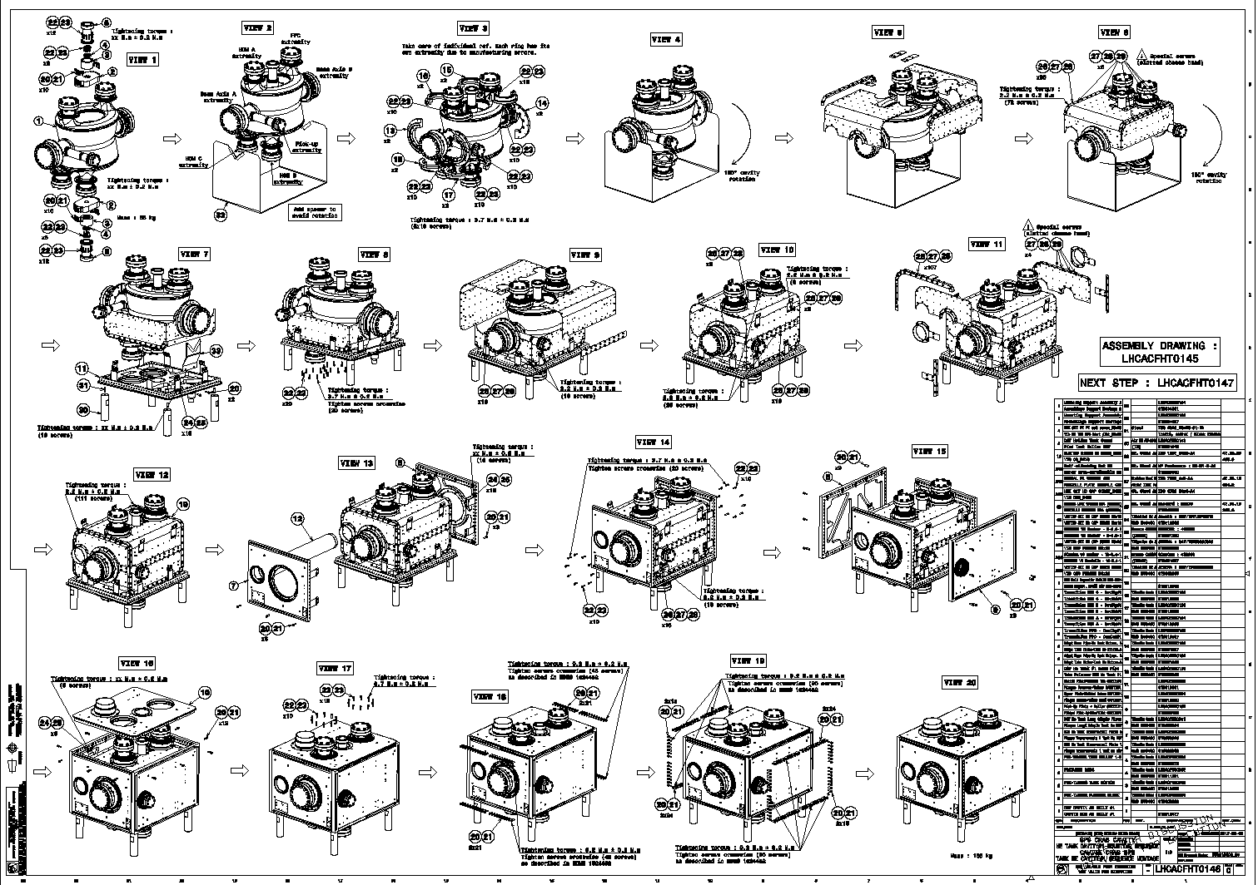
MOUNTING SEQUENCE following the DRAWING LHCACFHT0146
Drawings done by Raphael Leuxe & Laurene Giordanino

Slide 12
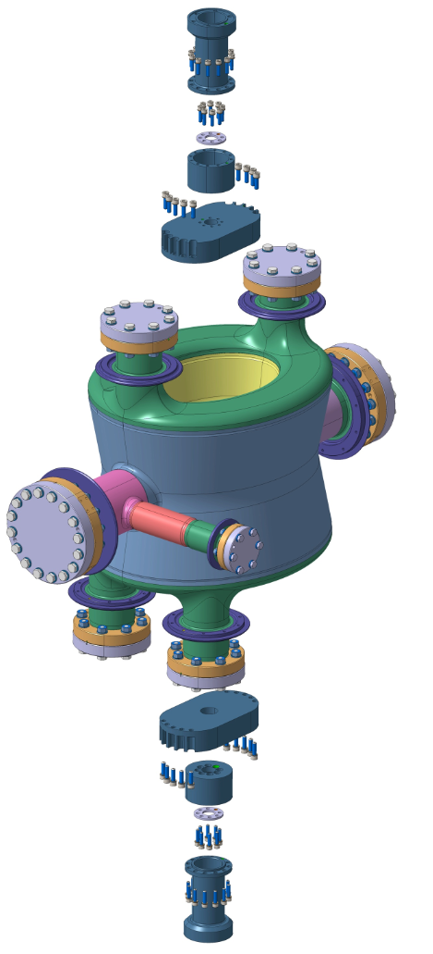
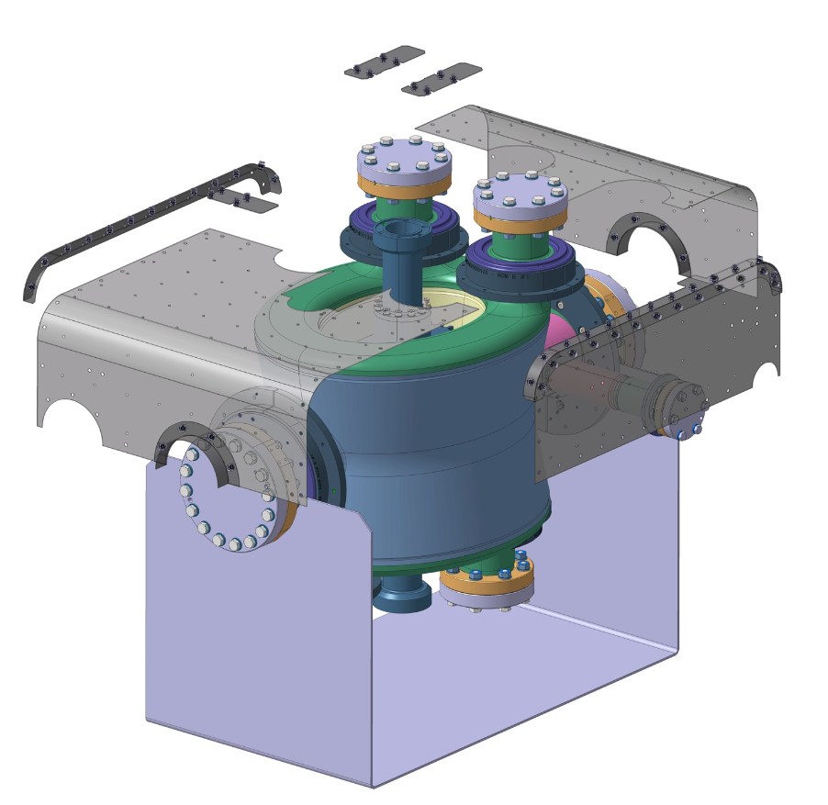
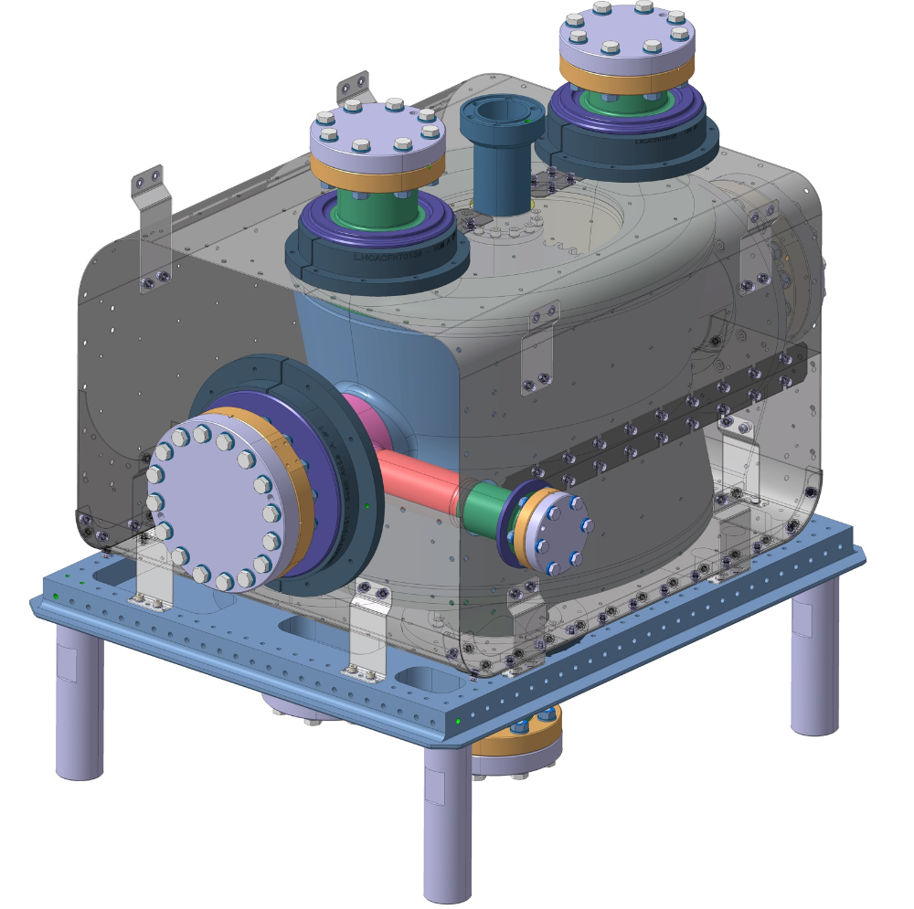
First step:
Pre-Tuning pieces
Adaptation & Transition Pieces for the Extremities
Second Step:
Cold Magnetic Shield Assembly
180° Cavity Rotation
Assembly in the bottom plate
180° Cavity Rotation
RF measurements will be done during Assembly & Screwing

Slide 13
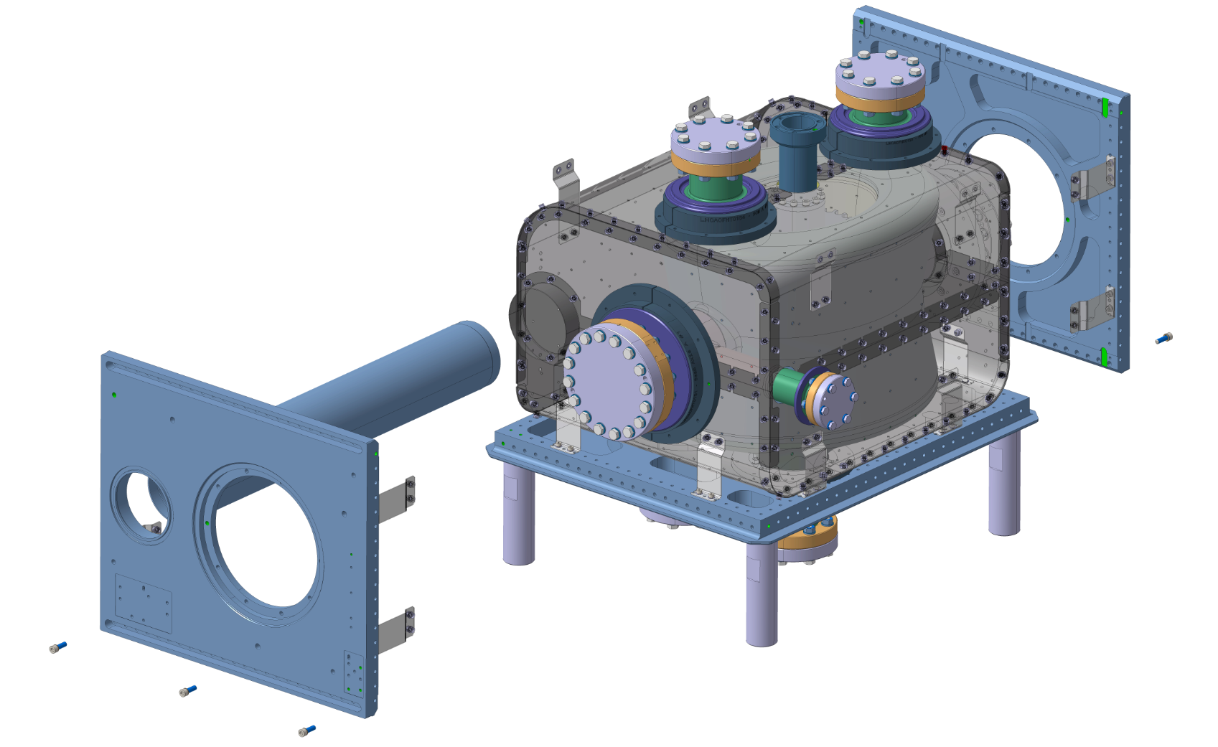
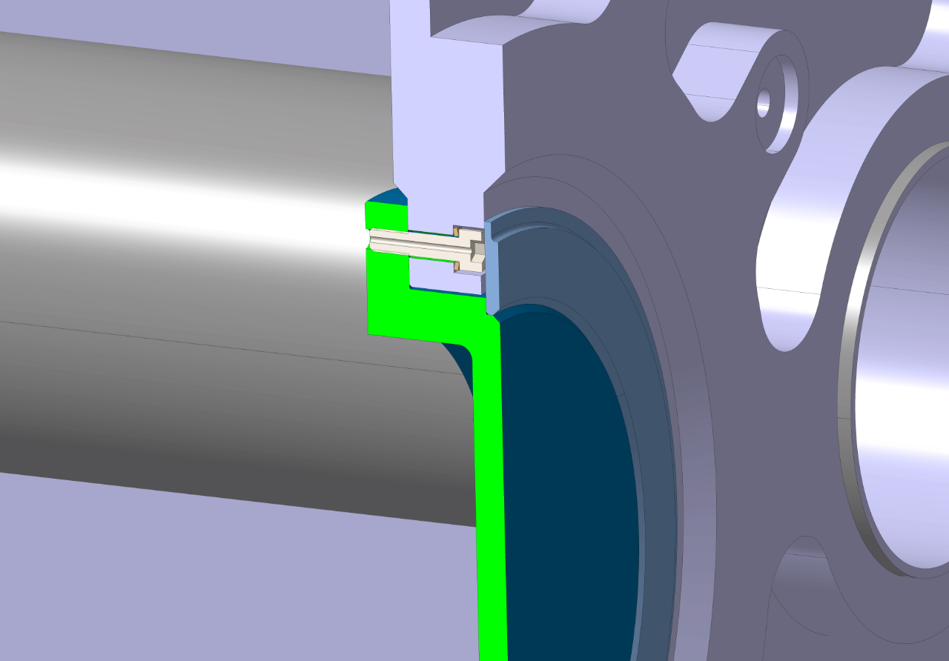
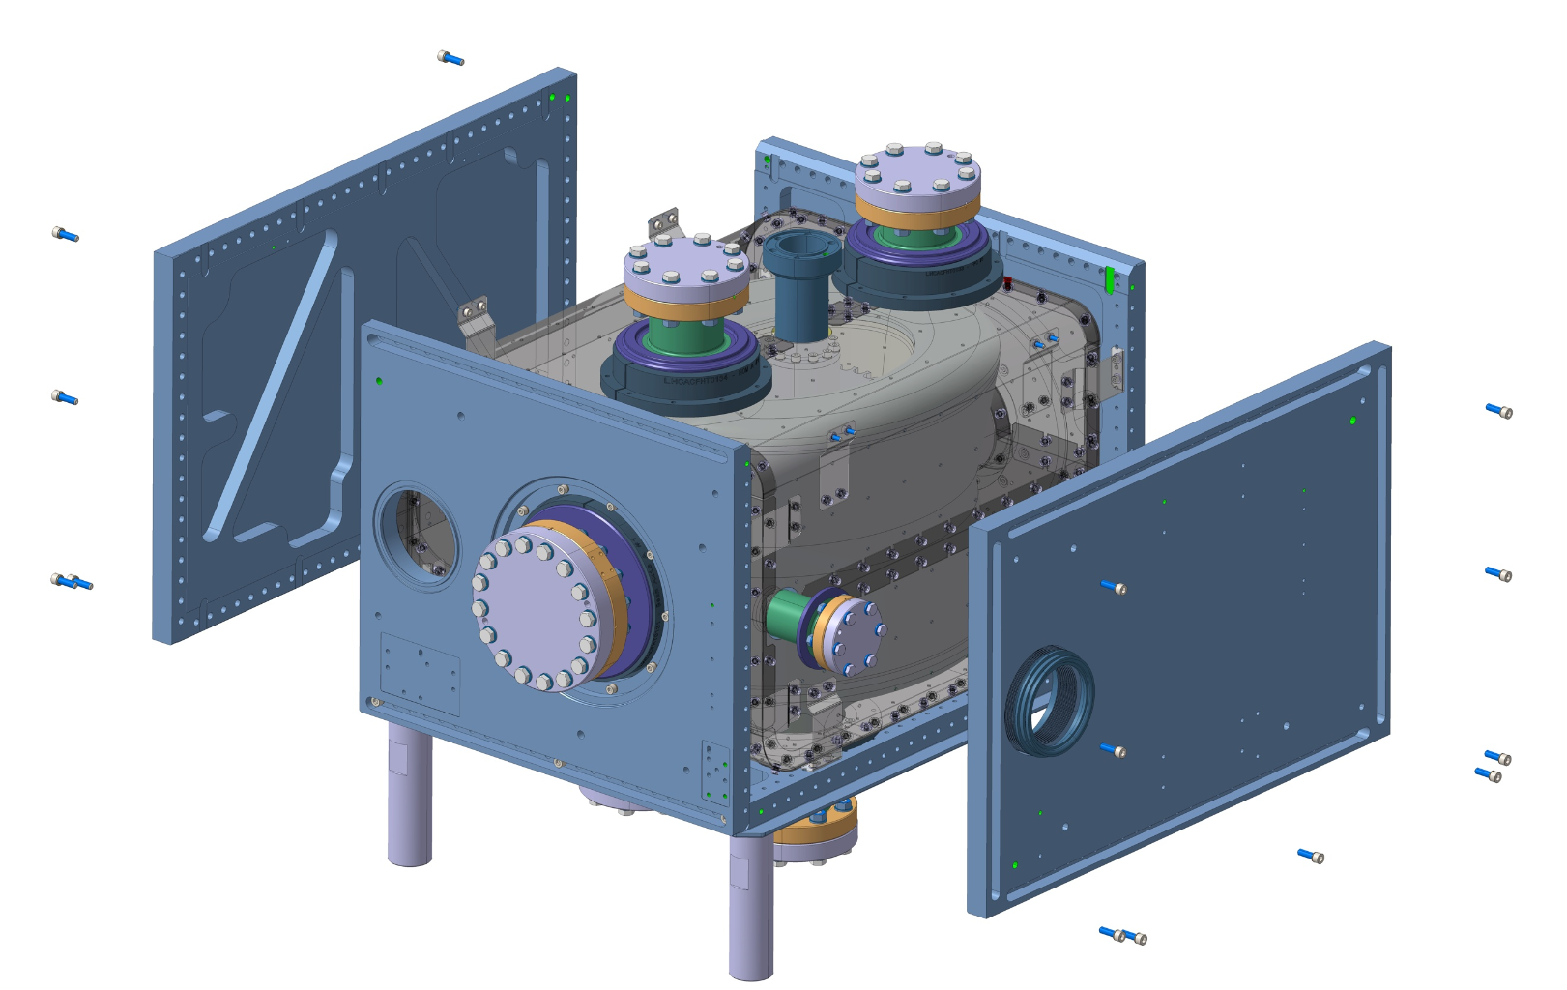
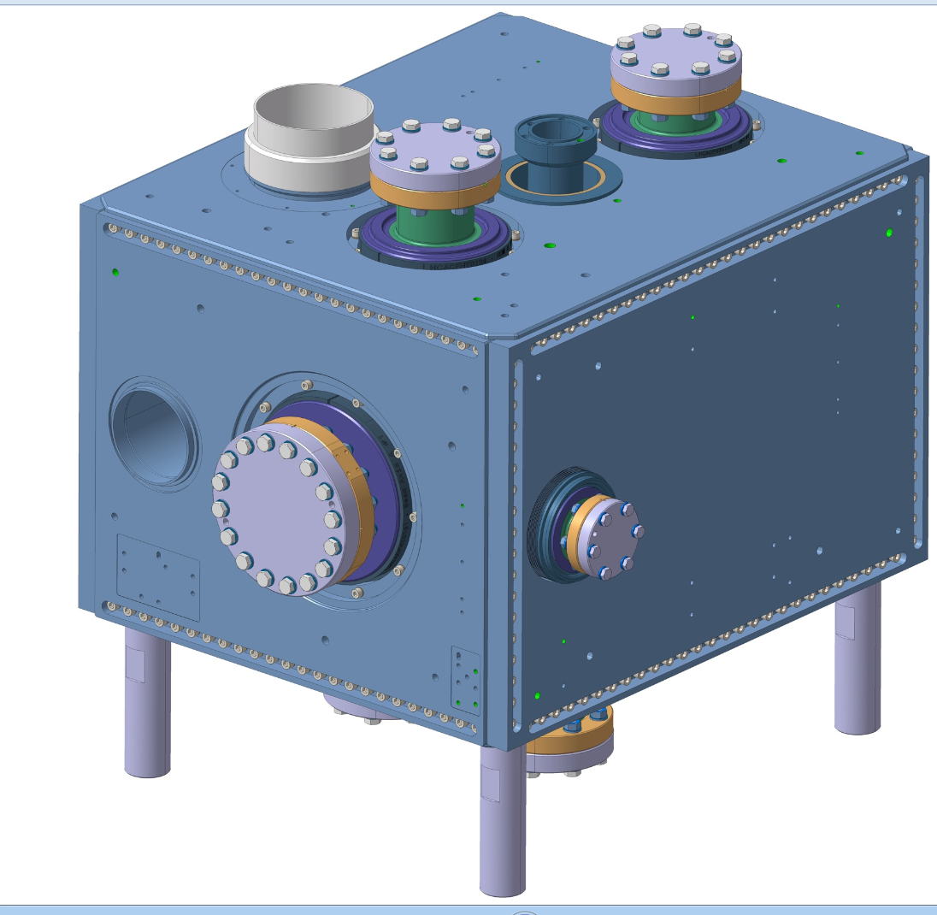
Next Step:
Longitudinal Plates with the second beam tube
and screwing
Final Steps:
Assembly of Transversal plates
Assembly of the top plate and screwing
Initial Screw preload 3000N
Use of Molykote only for assembly of Ti bolts in NbTi pieces to avoid the cold welding
Tightening Instructions EDMS 1524452 by Luca Dassa

Slide 14
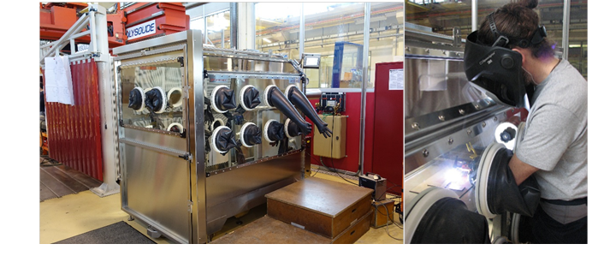
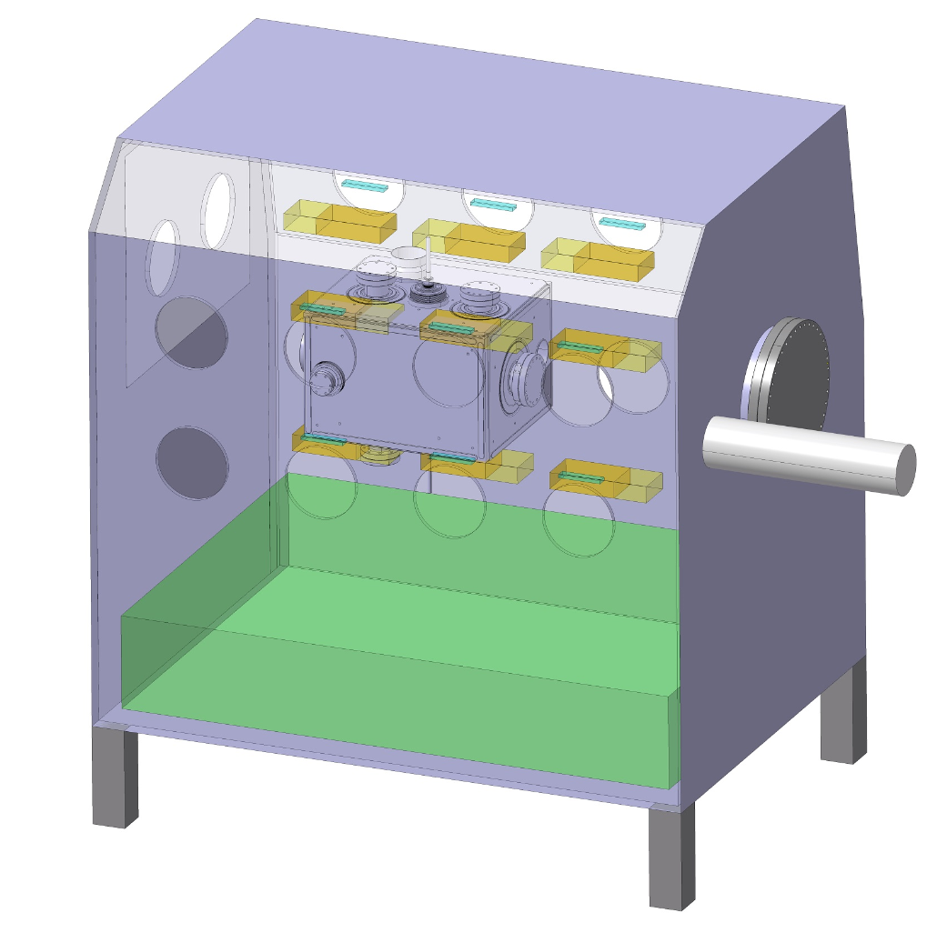
ELECTRON BEAM WELDING Bellows & Bimetallic transition before assembly
Assembly
TIG (Tungsten Inert Gas) MANUAL WELDING in the Glove-Box
New glove-box with capacity for both design:
DQW & RFD
Dimensions 1600x1400x1600
Volume 4.2m³
Purity: Argon
Analysis O2 + H20
Values possible to achieve
2ppm O2
30ppm H20

Slide 15
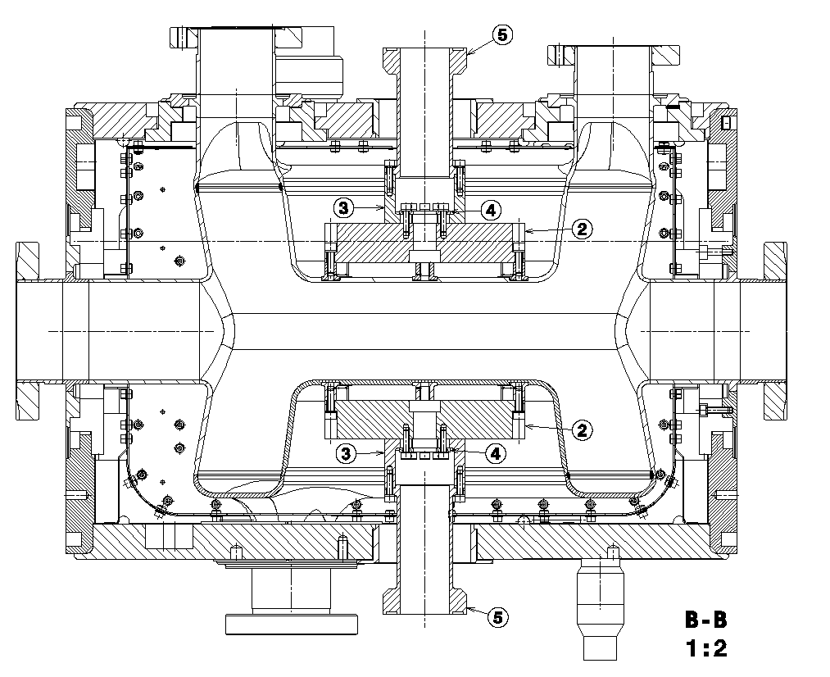
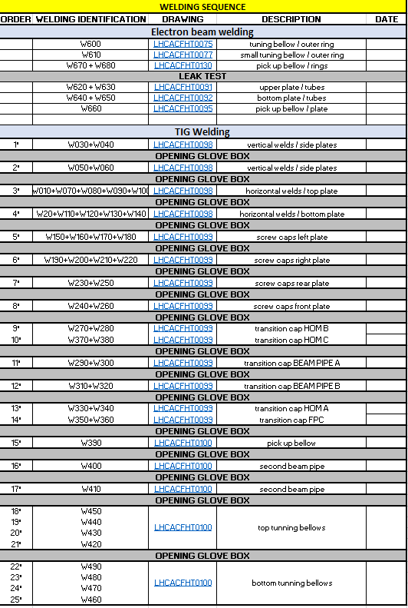
WELDING SEQUENCE following the drawings LHCACFHT0147-148 & 149
16 times expected opening of the globe box
12 hours needed to purge with Argon +
30 min for achieving the O2 level required

Slide 16
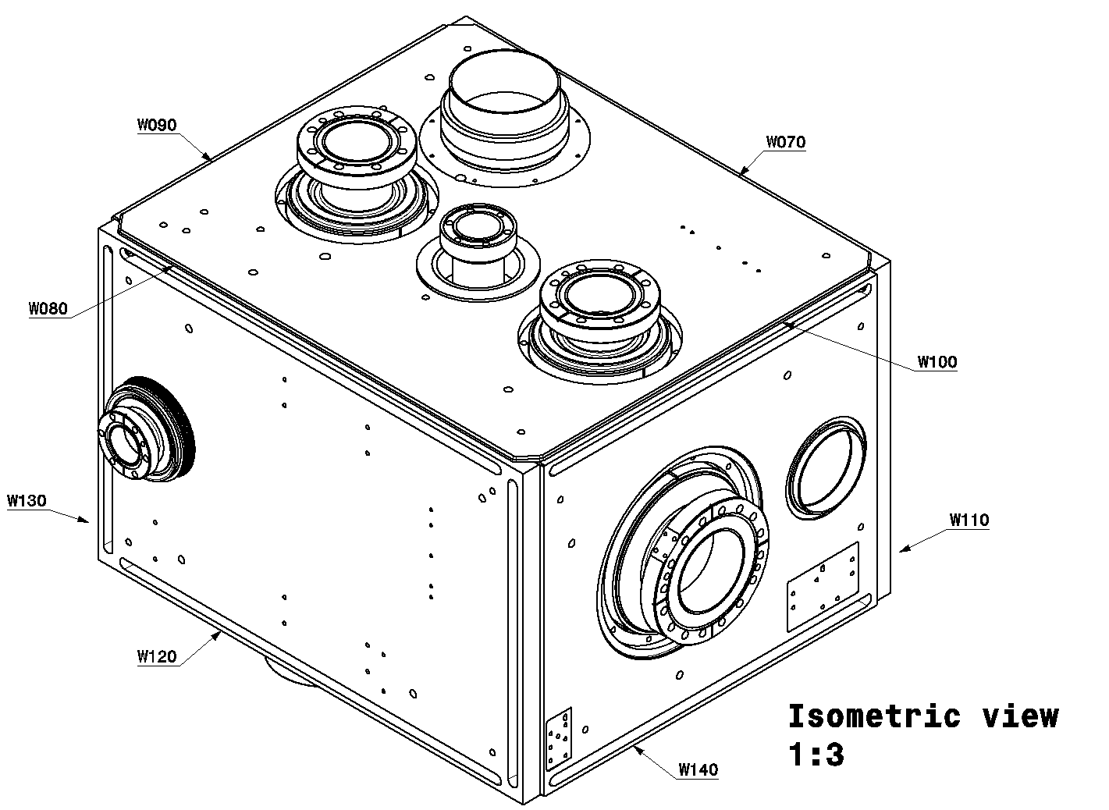
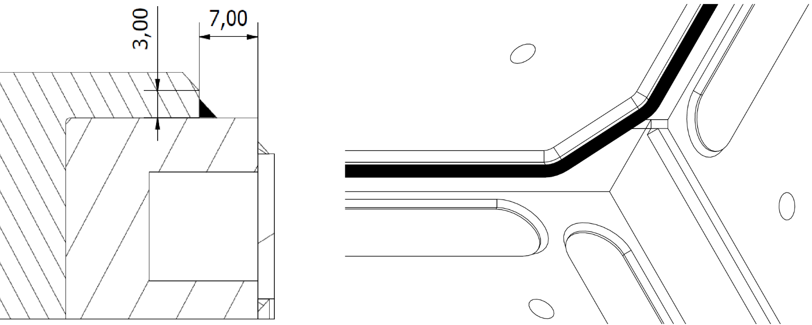
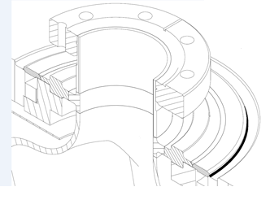
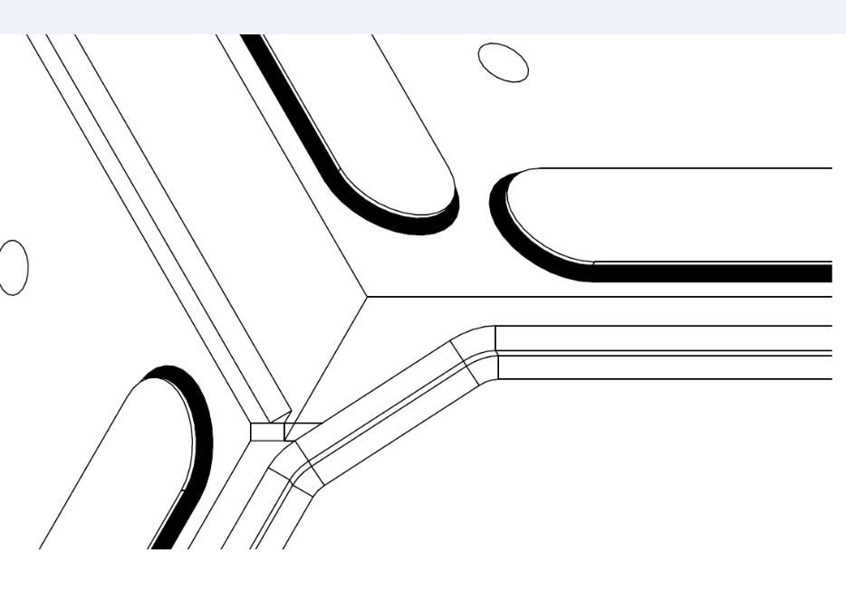
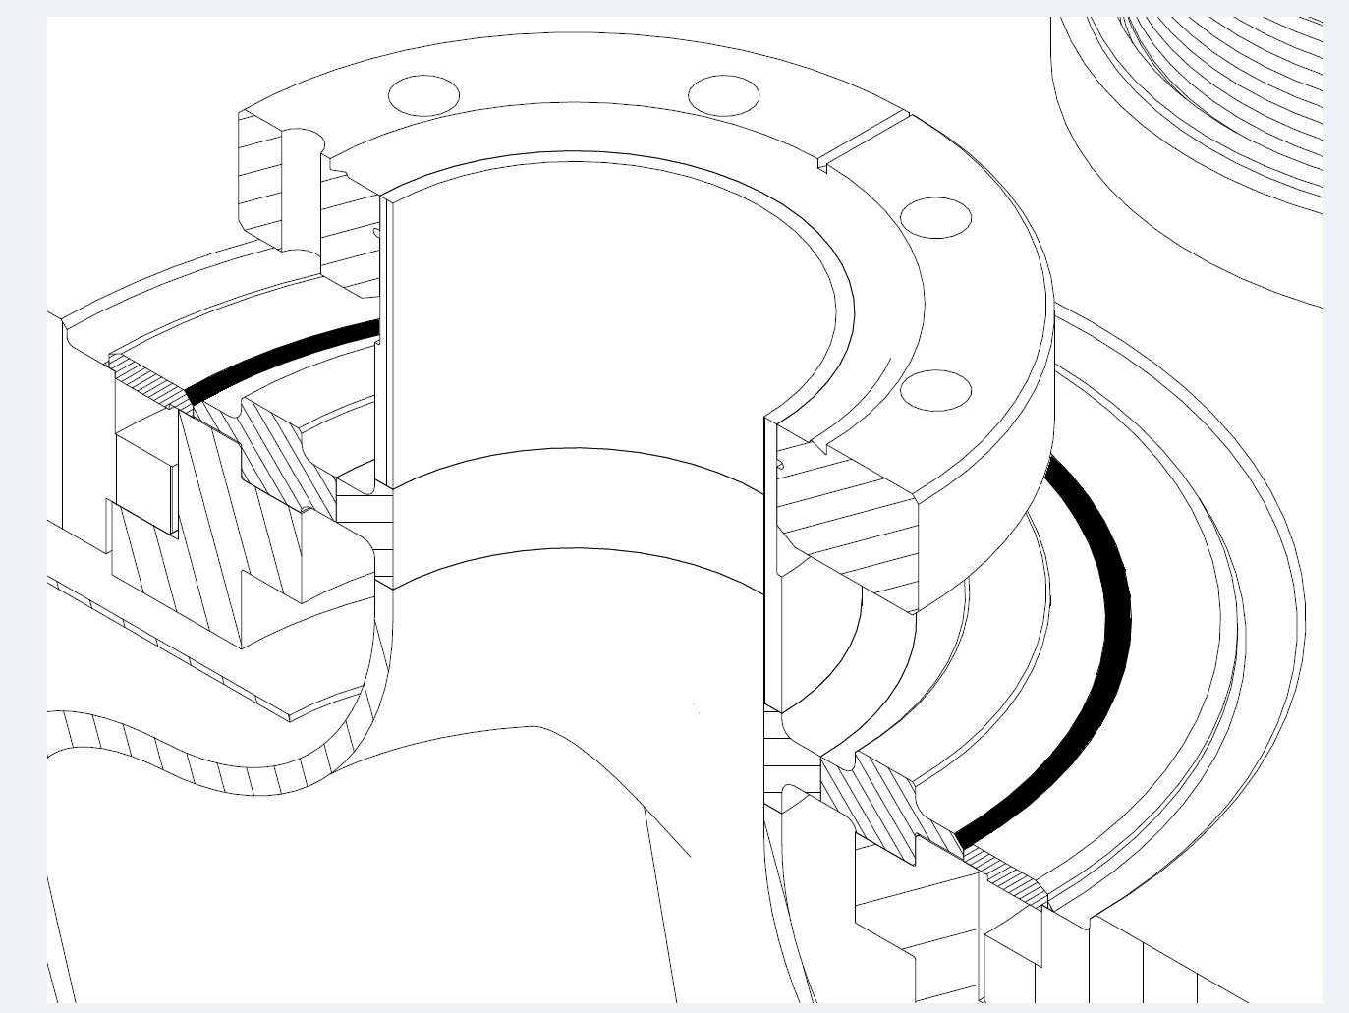
First Step:
Vertical + Top + Bottom welds
NEXT STEPS
Screw Longitudinal Covers
Screw Circular Covers
Ti/Ti Weld
NbTi / Ti Weld

Slide 17
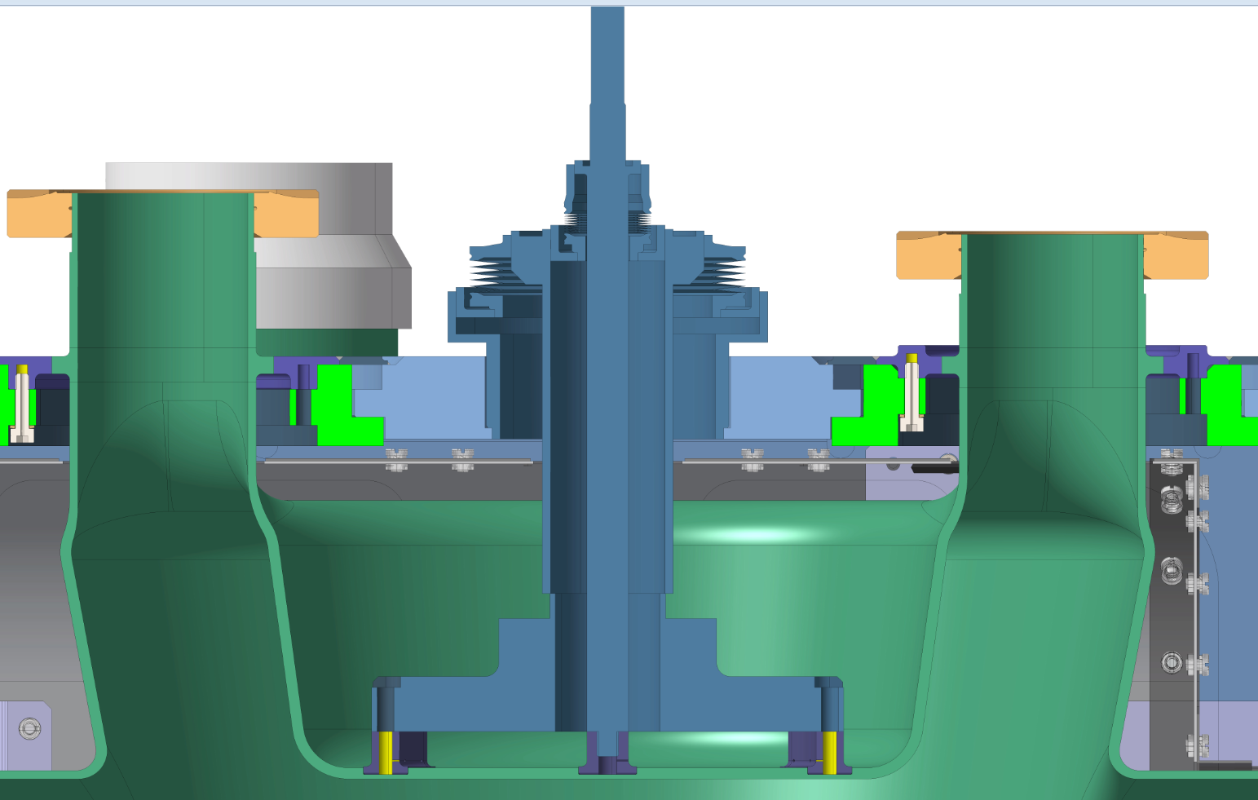
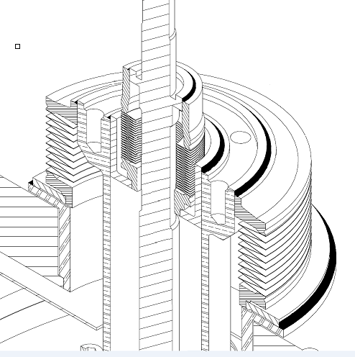
Final Step Assembly + Welding TUNING SYSTEM
Some actions have been taken for the protection of the bellow during the TIG welding:
Design optimized to avoid the welding arc directly
on the bellow
Ceramic proctection between the bellow and the piece
Last Weld

Slide 18
Tests during and after Manufacturing
Assembly checks
Dimensional control
RF measurements
Leak Test

Slide 19
Conclusions
Manufacturing of He Tank prototype has been very useful to:
    fully validate the design;
    improve and consolidate the foreseen assembly sequence;
    qualify the welding procedure;
    assess different scenarios (deformations and other issues have been detailed checked)
    Production of SPS He tank ongoing and acc. the planning

Slide 20
Thank you!

