Slide 1

SPS cryogenic proximity equipment and SM18 validation
Crab Cavity review
3-5 April 2017
CERN – Geneva, Switzerland
K. Brodzinski, A. Lees and S. Claudet
on behalf of involved team

Slide 2
Outlook
General layout
Proximity equipment cryogenics
  Service box
  Water heater
  Helium pumps
Crab cavity module 2 K cooling circuit
Heat load evolution
SM18 test
  cryo equipment progress
  planning
Conclusions

Slide 3
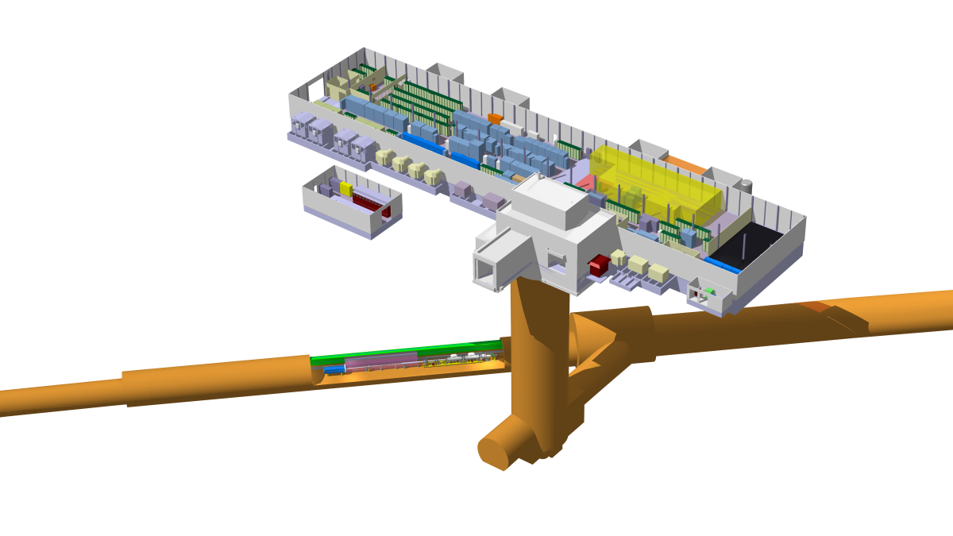
General layout
Legend:
VB1 – valve box 1
VB2 – valve box 2
SB – service box
CCM – crab cavity module
Cryogenic He transfer line
Warm He pipework
Cryogenic LN2 transfer line
Compressor station
GHe storage
Proximity equipment
LN2 storage
BA1
Flex lines
He heater
CCM
100L LHe
He pump
SB
BA5
LN2 phase separator
90m transfer line
VB2
150L LHe
VB1
150L LHe
refrigerator
Main functions of the proximity equipment:
makes direct refrigeration interface to the crab cavity module
allows for operation of the cavities with superfluid helium at 2 K

Slide 4
Service Box
Function of the service box is to make direct interface between cryogenic infrastructure and the crab cavities module. It will provide required control of main thermodynamic parameters for CCM and safety systems for internal circuits and the vacuum volume.
VB2
pump
heater
SB
CCM
Safety system
Status and perspectives:
Contract signed in autumn 2016 with AS Scientific Products Ltd. (UK).
First complete design proposal received on 20 March 2017
Delivery contractual date 31 July 2017
SB will be connected with CCM for SM18 and SPS tests.
CCM interface
Cryo infra interfaces
AS will provide also 3 flex lines to connect SB with cryo infrastructure. The lines will be delivered in summer 2017 and will serve only in SPS (no installation in SM18).
Adjustable feet
by AS Scientific Ltd.

Slide 5
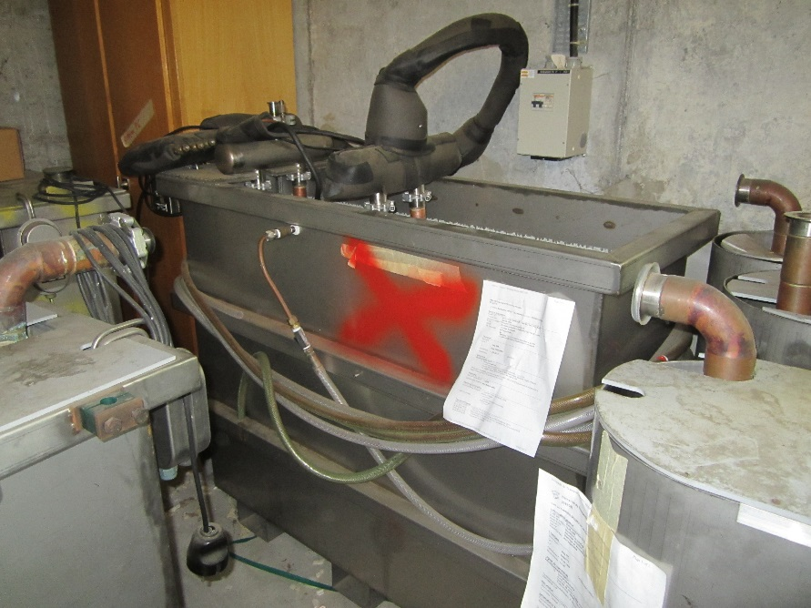
Water heater
10 kW water heater is being refurbished for:
Electrical connection 2 x 5 kW heating elements
Helium supply interfaces
Water supply system
Instrumentation
VB2
pump
heater
SB
CCM
5 kW heating power is enough to warm up ~3.2 g/s of helium between 2 K and 300 K i.e. 2 x 5 kW gives full redundancy for heating cartridges.
Status and perspectives:
Functional test is to be done by end of June 2017 and will be ready for transport to SPS from September 2017. Installation is planned during YETS 2017.

Slide 6
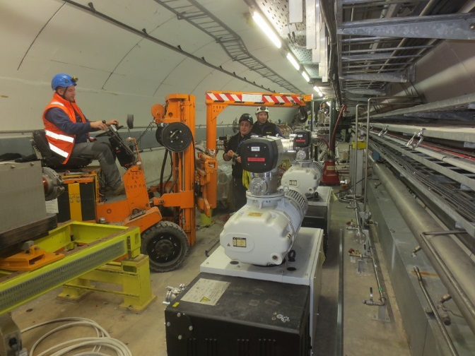
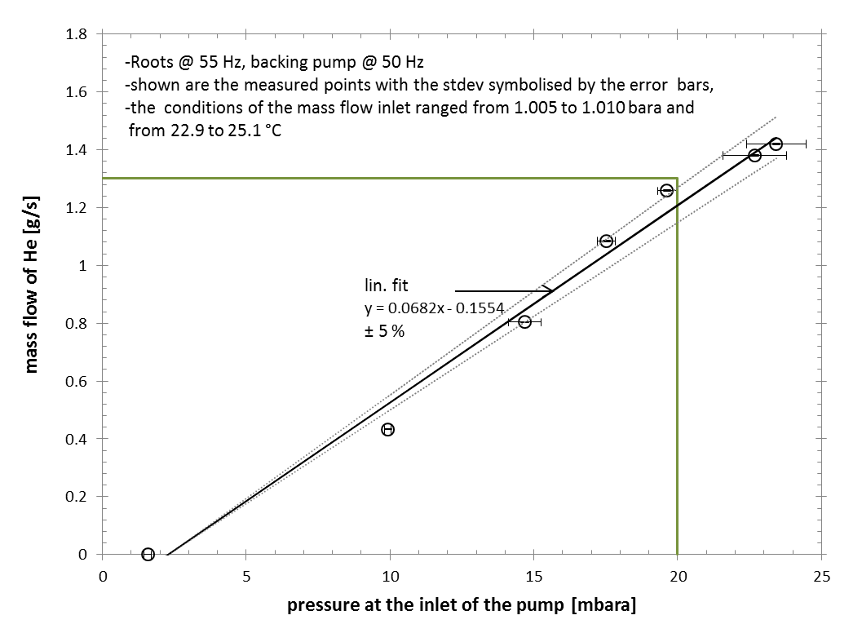
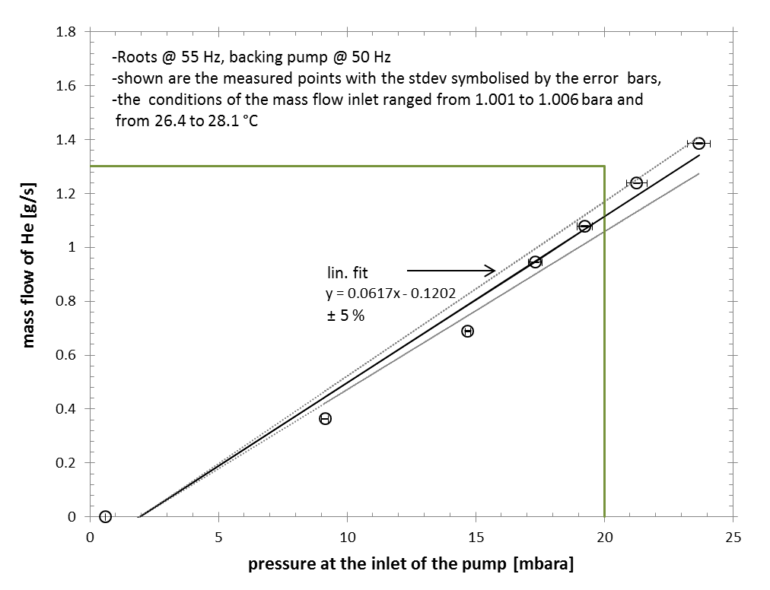
Pumps
VB2
pump
heater
SB
CCM
The check shows that assuming inlet pressure of 20 mbar two pumping units are capable to pump ~2.3 g/s of helium, what gives ~3.5 g/s at 30 mbar (2 K saturation)
Capacity margin study – see slide 9
Status and perspectives:
The pumps were transported to BA6 and are positioned in final location
Water circuit installed (small adaptation needed)
Electrical supply, control connection and helium process piping to be done next YETS
10.03.2017

Slide 7
CC cryo-module circuits (2 K)
Return / Pumping collector
VB2
pump
heater
SB
CCM
EHs
Cool down circuit
Normal operation supply line
Thermal heat load:
38.2 W at 2 K
260 W at 80 K
by Federico Carra EDMS #1729079
Level gauge pipes

Slide 8
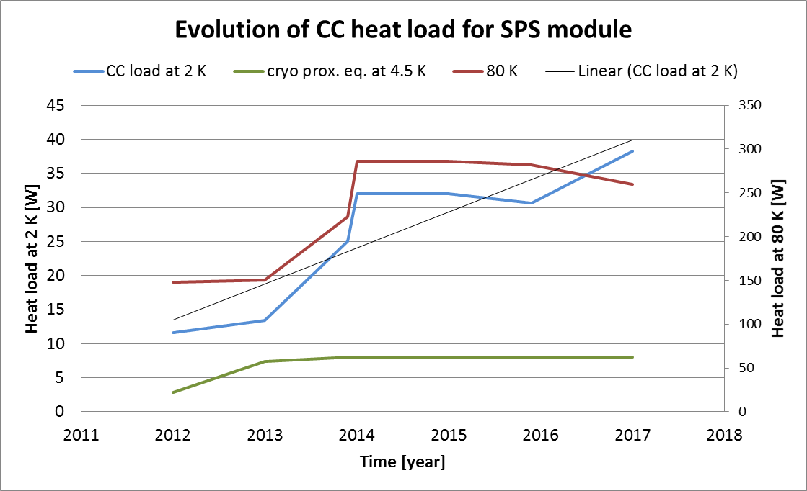
Heat load evolution
DQW static HL: 16.8 W @ 2 K
DQW dynamic HL: 20.4 W @ 2 K
Cryo prox. equipment: 8 W @ 4.5 K

Slide 9
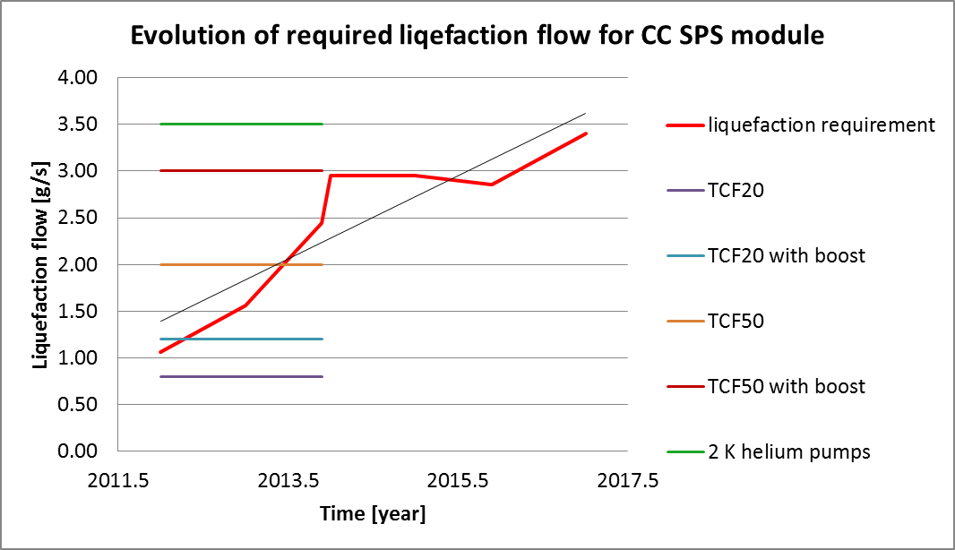
Heat load evolution
Warning !
Factor 1.5 applied for contingency on needed flow
New 4.5 K cold box will have liquefaction capacity of ~7 g/s and will allow for using of full capacity of 2 K pumping units (~3.5 g/s @30 mbar) as well as to cover client and distribution heat load with safety factor of ~1.5.
Warning! No additional helium pumps can be added to the infrastructure respecting present planning and integration constraints.

Slide 10
SM18 test preparation
Recall:
SM18 test is planned to be done before transport of the crab cavity module to SPS tunnel,
Both, SB and CCM will be tested in SM18 with rigid connection from SM18 cryo infrastructure i.e the flex lines feeding SB will be directly installed in SPS,
Present cryo SM18 infrastructure requires additional valve box to adapt for connection of SB or CCM jumper directly (the valve box will allow to test next CCM without SB, which will be installed in SPS).
SM18 valve box status and perspectives:
Contact signed in Autumn 2016 with Cryo Diffusion (France),
Design of the box is underway with delivery time in July 2017 -> compatible with SM18 shutdown window for installation in August 2017.
Courtesy of A. Lees

Slide 11
SM18/SPS installation definition
As SB makes direct interface to the CCM related definition for connection of interfaces is needed:
Positioning of the SB at SM18 and SPS to be done by CRG and MME,
Jumper interface SB to CCM – design CRG+MME, connection to be done by MME,
SM18 infra or flex lines to SB – design CRG, connection to be done by CRG
Connection of He supply/return lines by CRG
Connection of jumper interface to CCM – by MME

Slide 12
SM18 cryo planning requirements
The tentative planning for SM18 tests has been studied between CRG and RF.
CRG confirms that above blue timeline of 27 days was already optimized and is considered as a success oriented plan.

Slide 13

Conclusions and perspectives
Globally, the work on cryogenic proximity equipment is progressing well: pumps installed in SPS, water heater is being refurbished, service box – design done and production starts soon,
SM18 valve box – delivery compatible with installation during SM18 shutdown in August 2017,
CCM heat load considerably increased (by ~25 % between 2016 and 2017) – near to the helium pumping limit … major upgrade of the pumping system and planning update will be necessary if the heat load continues to increase,
Thanks to all partners for collaboration on this project (mainly BE-RF and EN-MME)
Thank you for your attention!

