Slide 1

CC-LLRF preparation and RF commissioning for SPS
P. Baudrenghien, B. Kremel, J. Simonin, N. Stapley,
BE-RF on behalf of WP 4

Slide 2
Outline
SPS CC LLRF electronics
SPS-BA6 (Surface) LLRF infrastructure
SM18 commissioning plans
SPS Hardware commissioning plans (w/o beam)
Reminder: LHC CC Operational scenario
SPS beam commissioning plans
Calendar

Slide 3
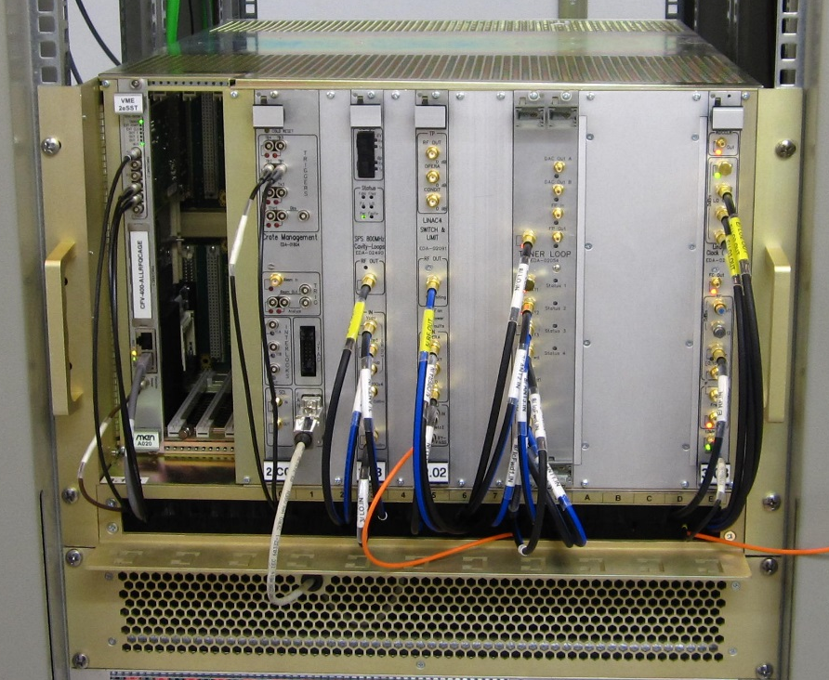
SPS CC LLRF electronics
We use the VME platform first introduced in the LHC LLRF (2007), also used in HIE-Isolde (2015), Linac4 (2016) and some SPS upgrades (2014-2017)
We have adapted electronics designed for Linac4 (352.2 MHz RF) for operation at 400.8 MHz
The system contains 1 crate with five modules per cavity

Slide 4
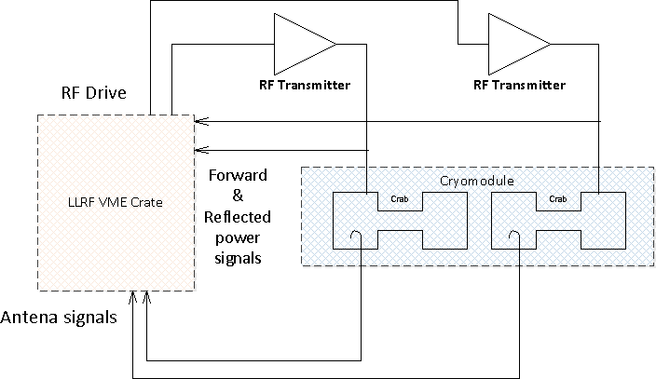
Planned LLRF system overview (1/2)

Slide 5
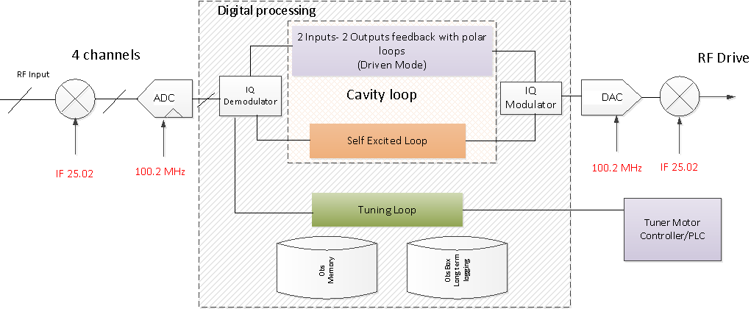
Planned LLRF system overview (2/2)
The Tuning loop is on charge of cavity tuning
The Cavity Loop is on charge of the field regulation (RF feedback).

Slide 6
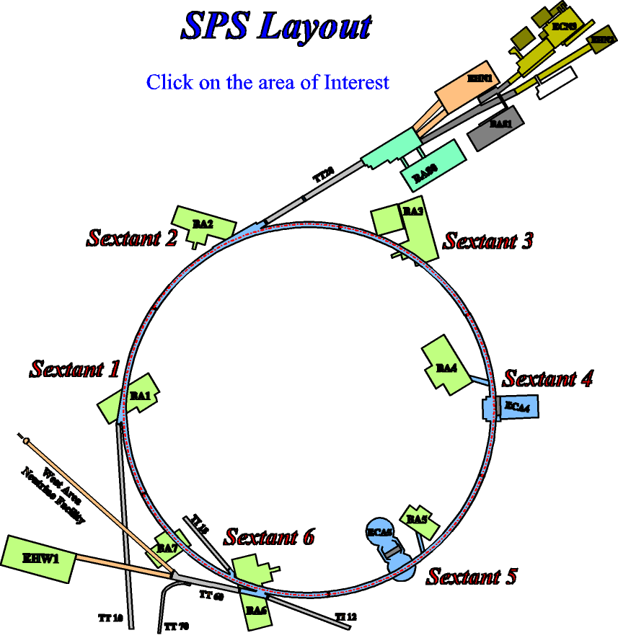
SPS BA6 infrastructure (1/2)
A 400.8 MHz reference must synchronize the CC (BA6) and the LLRF controlling the accelerating cavities in BA3 (~4 km apart). It will be transmitted on fibers. We will use a duplex transmission to compensate the phase drifts caused by frequency and temperature changes. Same system as used in the AWAKE experiment (BA3-BA4)
The LLRF will be installed in a small Faraday Cage in the surface building BA6
The TX will be installed next to the Faraday Cage
BA3
BA6

Slide 7
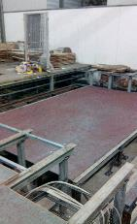


SPS BA6 infrastructure (2/2)
Space on Surface ($200 m^{2}$)
Faraday cage platform
Routing $∼150m$ in length
The loop delay LLRF-TX-Cavity-LLRF will be similar in the LHC implementation (1.5-2.5 us), we can simulate different loop delays

Slide 8
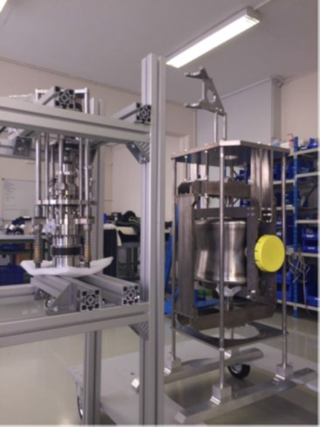
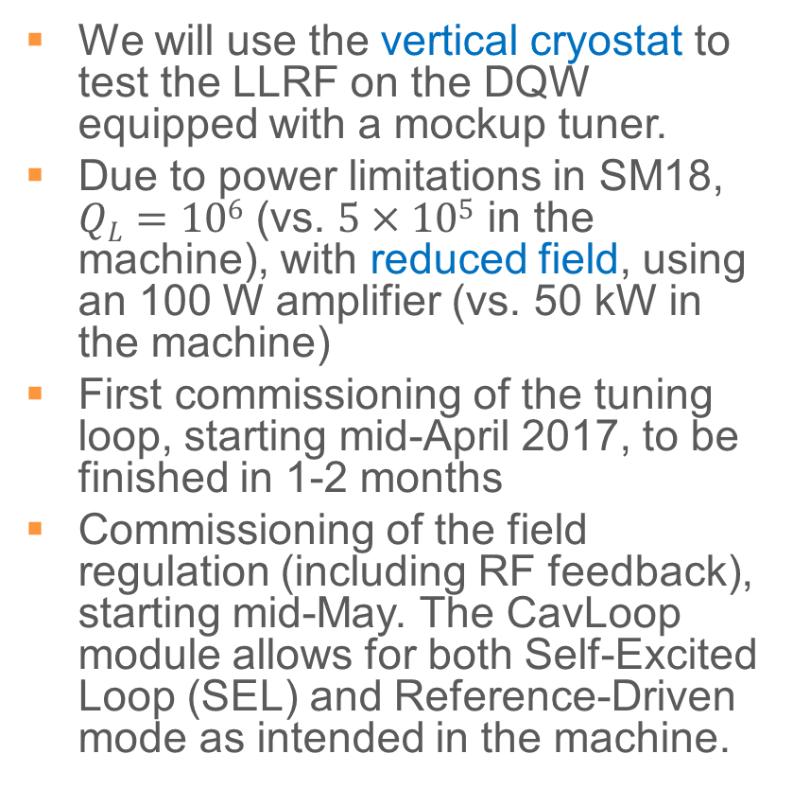
SM18 commissioning plans
We will use the vertical cryostat to test the LLRF on the DQW equipped with a mockup tuner.
Due to power limitations in SM18, $QL=106$ (vs. $5×105$ in the machine), with reduced field, using an 100 W amplifier (vs. 50 kW in the machine)
First commissioning of the tuning loop, starting mid-April 2017, to be finished in 1-2 months
Commissioning of the field regulation (including RF feedback), starting mid-May. The CavLoop module allows for both Self-Excited Loop (SEL) and Reference-Driven mode as intended in the machine.

Slide 9
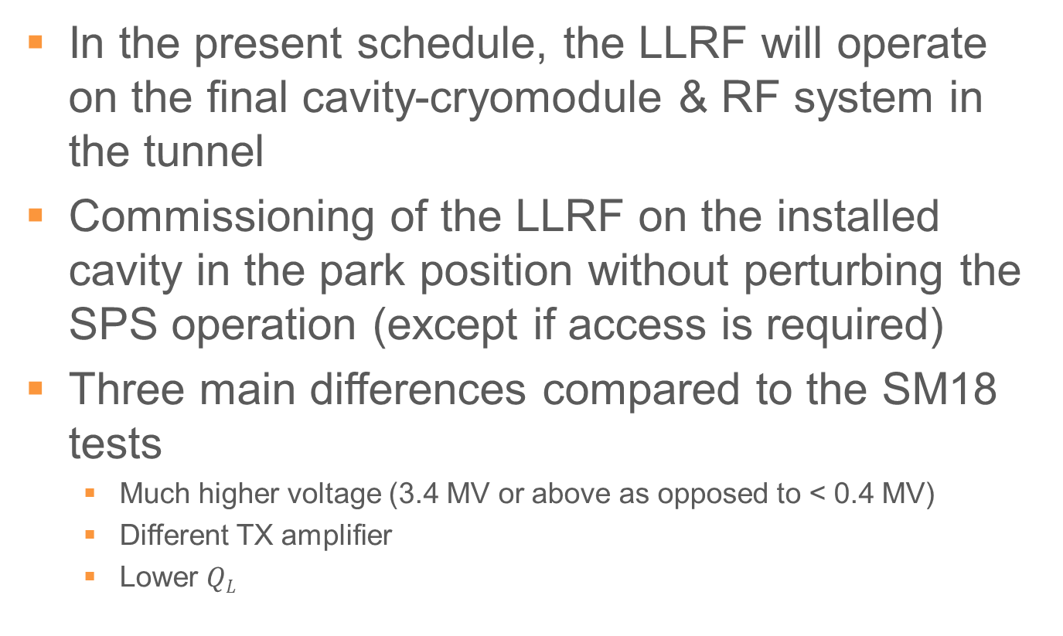
SPS Hardware commissioning plans (no beam)
In the present schedule, the LLRF will operate on the final cavity-cryomodule & RF system in the tunnel
Commissioning of the LLRF on the installed cavity in the park position without perturbing the SPS operation (except if access is required)
Three main differences compared to the SM18 tests
Much higher voltage (3.4 MV or above as opposed to < 0.4 MV)
Different TX amplifier
Lower $QL$

Slide 10
Baseline LHC-CC Operational scenario
The crab RF is always ON, with strong RF feedback and frequency controls at all time. Cavities are on-freq at all time.
During filling, ramping or operation with transparent crab cavities:
Small cavity field as required for the active Tuning system
We use counter-phasing to make the total field invisible to the beam
A strong RF feedback keeps the Beam Induced Voltage negligible if the beam is off-centred.
ON flat top:
We re-phase the two cavities
Any adiabatic field manipulation is possible by synchronously changing the voltage or phase in each cavity (luminosity levelling for example).

Slide 11
SPS beam commissioning plans (1/2)
SPS energy range 26-450 GeV, the 2 x 4620 harmonic of the SPS revolution frequency is therefore 400.530-400.788 MHz,
Injection energy is outside the tuning range
We will drive the CC with a fixed frequency (adjusted to the energy 55, 120, 270 GeV), and rephase the SPS beam to that frequency on a corresponding plateau (flat top) in the SPS cycle. Similar to the cogging done before SPS-LHC transfer
The main RF commissioning steps involve
We want to make the CC “invisible” during LHC filling and ramping using counter phasing. What is the minimal voltage for tuning? How “invisible” are they really?
How precisely can we regulate the CC field for RF gymnastics? Slowly reducing counter phasing to zero. What (detrimental) effect on beam?
Test the centering of the beam using a measurement of TX power (beam loading compensation)
Effect of CC RF noise on emittance growth (coast). Finalize RF noise specifications for the future LHC LLRF
What is the margin against Coupled-Bunch instabilities caused by cavity impedance at the fundamental? Can intentionally be degraded by mis-alignment of RF feedback to evaluate threshold

Slide 12
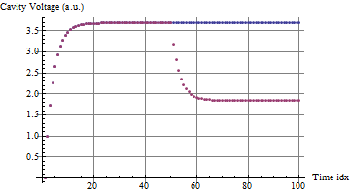
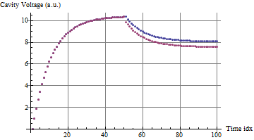
SPS beam commissioning plans (2/2)
Coupled feedback around a cavity pair
Motivation: For machine protection, following a cavity quench, the LHC beam dump system requires 3 turns (270 μs) to react. During that time the crabbing will propagate around the ring-> significant losses
The LLRF can help minimizing the losses during the 3 turns transient till the beam is dumped
In the case of a crabbing cavity trip, it would ramp the un-crabbing voltage down, tracking the total crabbing voltage
Will be tested in the SPS, using the two cavities in counter-phasing
Kly1 ignores Cav2 voltage drop
Kly1 tries to track Cav2 voltage drop
Cavity 1
Cavity2

Slide 13
Calendar
SM18 tests (vertical cryostat) Mid-April 2017- Dec 2017
Setting-up the Tuner Loop April 15th – June 15th
Setting-up the RF feedback June 16th- Nov
BA6 LLRF infrastructure Sept 2017-Jan 2018
Installation of the Faraday cage Sept 2017
Installation of racks, patch panels, fibers, network, VME crates,… in the cage Nov 2017-Jan 2018
Commissioning of phase-compensated link BA3-BA6 Feb 2018
SPS Hardware tests (parked cavity) Feb 2018-April 2018
re-adjust tuner loop Feb-March
Re-commission RF feedback with TX and high cavity field March-April
SPS Beam commissioning 2018 run

