Slide 1
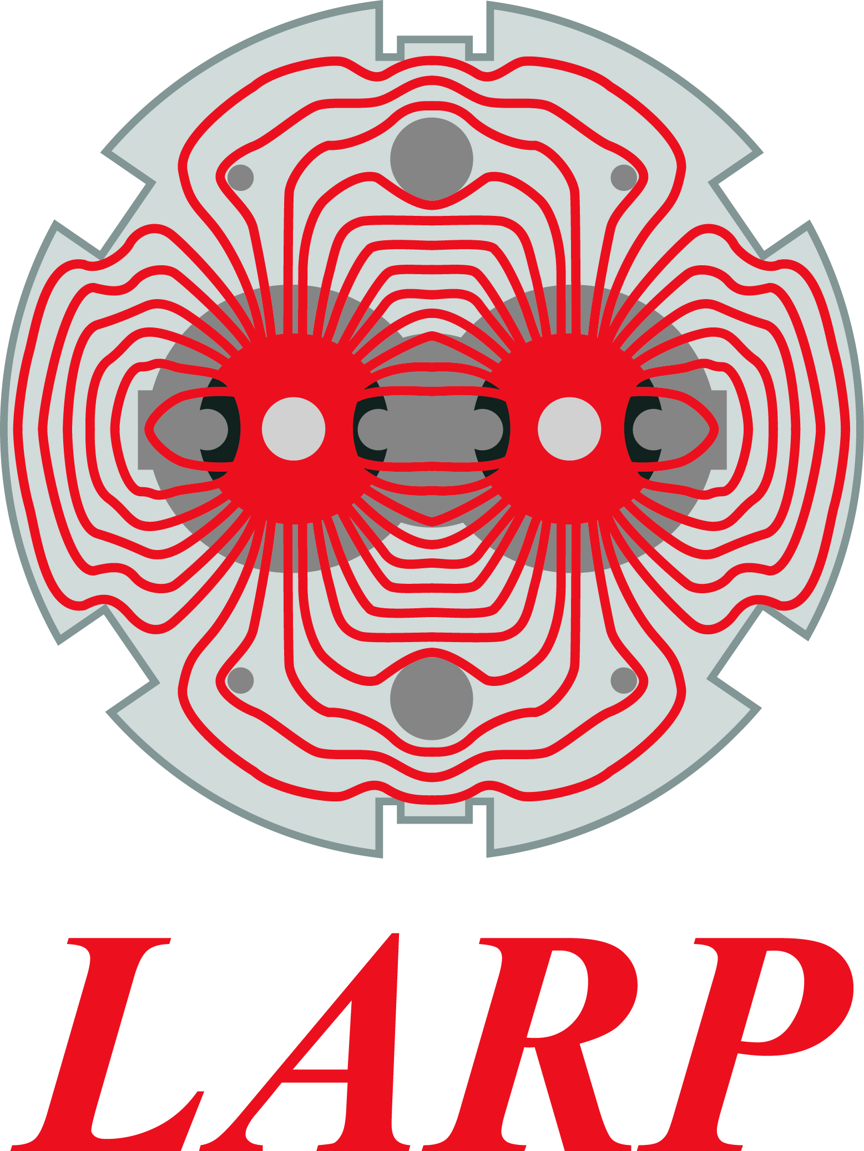
SPS Crab Cavity Test Stand:
Safety review summary
International Review of the Crab Cavity Performance for HiLumi – 3rd-5th April 2017
Christelle Gaignant
HL-LHC Deputy Project Safety Officer

Slide 2
Content
Hazards and Risks: Identification process
Areas of focus
Safety review
  Motivations
  Scope
  Conclusions and recommendations
  Follow-up
Lessons learnt

Slide 3
Hazards and Risks: Identification Process
A team of experts and stakeholders gathered all along the year 2016
Composed of:
WP representatives, CERN equipment groups, Safety Officers, HSE unit
Representing ~15 participants
Meeting monthly over 1 year
Objectives
List hazards
Identify areas to focus on
Propose risk control measures

Slide 4
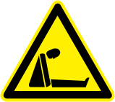
Areas of focus: Cryogenic and mechanical aspects
2 cryogens (LHe, LN₂) with different behaviors in different locations
The cryomodule (CM) is a pressure vessel
The table is a moving object supporting the CM, cryo connections and RF power cables
Accidental cryogen release underground and related ODH risk identified
New source of risk in the SPS!

Slide 5

Areas of focus: Radiations from the cavities
EIS: Element Important for Safety
Ensure protection of personnel against beam hazards (EIS-beam) and hazards due to the operation of accelerators (EIS-machine)
Ex.: beam stoppers, RF equipment, …
More information on EDMS 1211886
New objects and
Few data available
Concurrent RF powering and access underground excluded
New EIS-machine in the SPS!

Slide 6
Safety review: Motivations
SPS is an operating machine for physics, not a test facility.
SPS deliver beam to different users: the North Area (˜10 beam lines), AWAKE, HiRadMat, the LHC.
The crab-cavities test stand generate (new) hazards.
It is paramount to get reassurance that imported risks are reduced to an acceptable level and that the Test Stand is compatible with SPS operations and access.

Slide 7
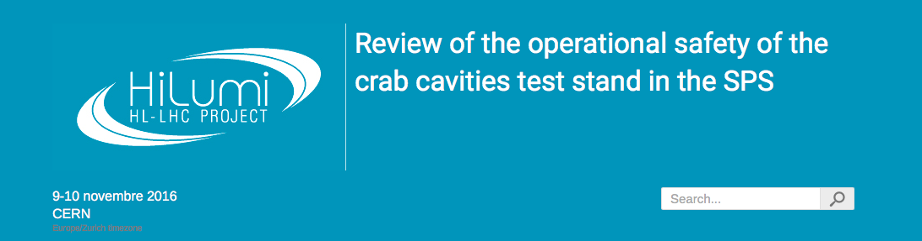
Safety review: Organisation
9-10 November 2016
CERN
https://indico.cern.ch/event/573824/timetable/#20161109
Safety review supported by the A&T Sector Management
Chaired by the SPS CSAP chairperson, composed of 7 reviewers
> 30 invited
CSAP: Complex Safety Advisory Panel
Each CSAP shall advise the Complex Manager and the relevant Complex executive committee on the safe operation of the Complex concerned with the aim that implementation measures and operational procedures are consistent at Complex level.…
More information on EDMS 1403719

Slide 8
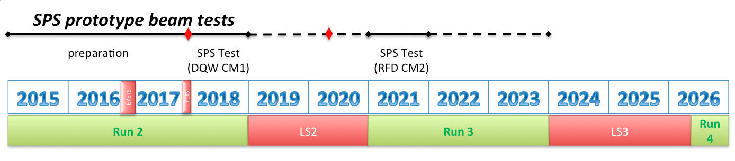
Safety review: scope (wrt time)
Scope: Commissioning, operations and maintenance of the crab-cavity SPS test stand
  Until LS2, i.e. 1srt cryomodule with DQW cavities
Outside of scope:
  Installation (standard CERN procedures for works during stops)
  Fabrication (under departmental responsibility)
Schedule extracted from R. Calaga’s talk

Slide 9
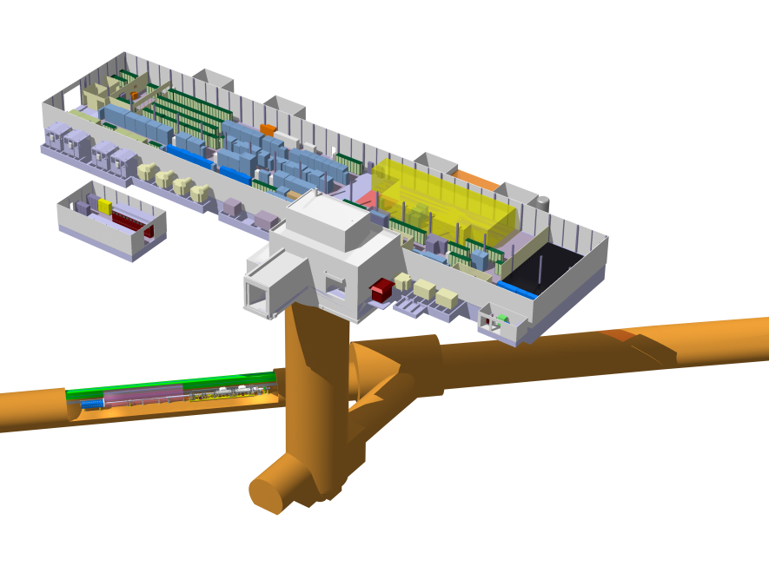
Safety review: scope (wrt locations)
SPS Surface building (BA6)
Shaft
Underground areas: alcove, access tunnel, LSS6
Courtesy: Giovanna Vandoni

Slide 10
Safety review: scope (wrt systems)
SPS Test Stand
SPS Machine
RF and powering
Cryomodule
Cryogenic distribution
Table
Access Safety System
ODH detectors and flashing lights
Evacuation
Procedures, Information and Training

Slide 11
Safety review: conclusions
The review accepted the risk control measures proposed by the WP (design, interlocks, procedures, …)
No show-stoppers, the WP can go forward
All recommendations are on EDMS 1706929.
The reviewers “were also positively impressed by amount of work and thinking that went into safety aspects of the crab cavity project.”

Slide 12

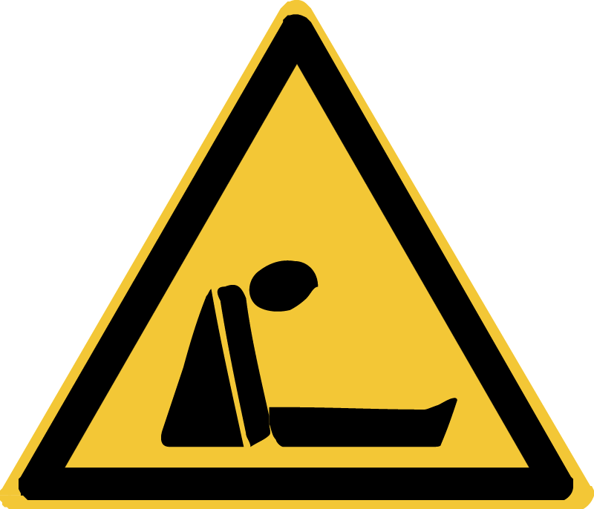
Safety review: main conclusions (1/3)
SPS Surface building (BA6)
Provide a noise assessment
For LSS6 see next slides
Underground areas: alcove
Provide a more complete analysis of the LN₂ hazard

Slide 13
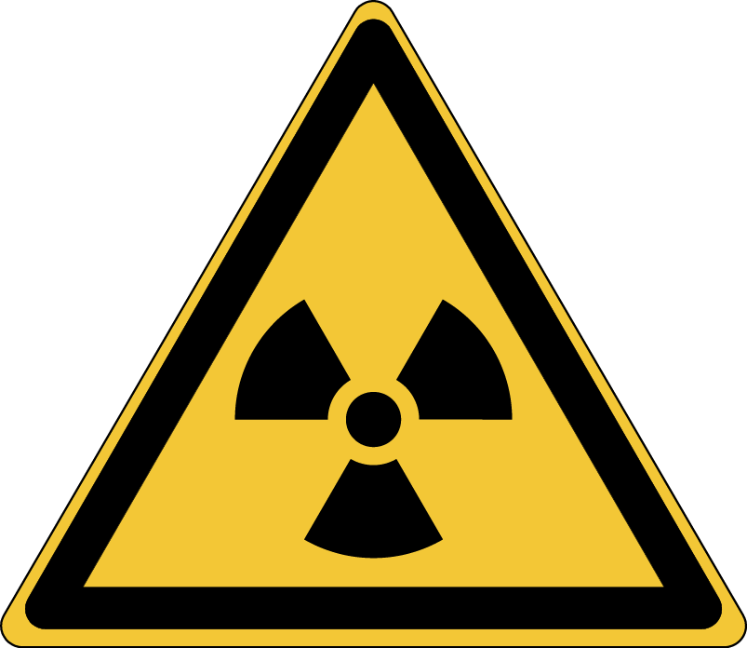
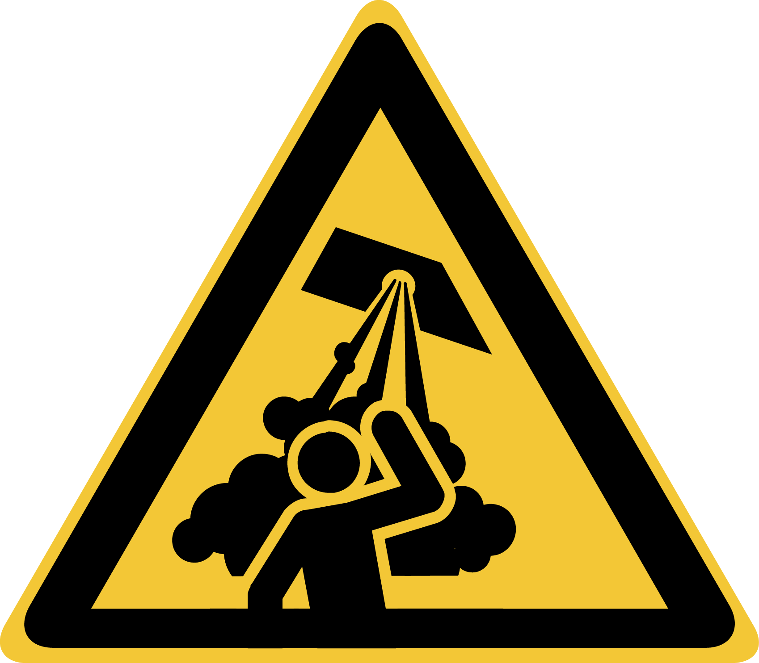
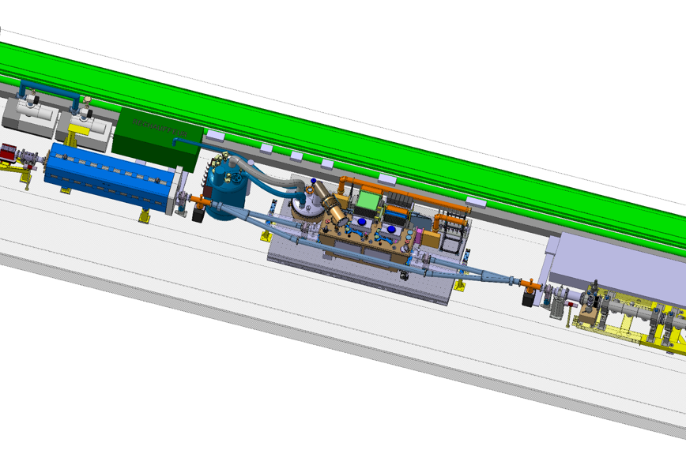
Safety review: main conclusions (2/3)
Underground areas: LSS6
Interlock RF powering with SPS access safety system
- Pressure test derogation acknowledged
- The system as a whole (CM + service box) must be tested in SM18 (pressure tests at 300K, and first cool down) before going to the tunnel.
The schedule is very tight but it should not influence on the safety clearance.

Slide 14
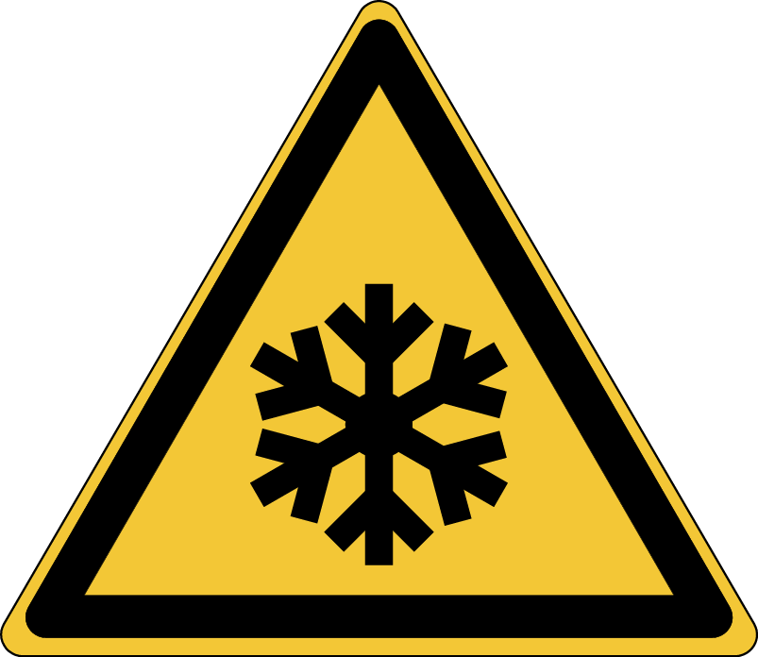
Safety review: main conclusions (3/3)
Underground areas: LSS6
  - Produce a risk assessment for the cryo-module
  - Provide a quantitative analysis of the He MCI.
  - Optimize ODH detectors and flashing lights layout based on a He spill map
  - Foresee cryo lock-out for interventions, and no exceptional transport when the CC are cold.

Slide 15
Safety review: follow-up
Cryomodule
  Pressure tests and first cool down in SM18 => included into the current planning
  Produce a risk assessment for the cryo-module => On-going
Cryogenics
  Provide a noise assessment => On-going
  Provide a more complete analysis of the LN₂ hazard => On-going
  Provide a quantitative analysis of the He MCI => On-going
  Optimize ODH detectors and flashing lights layout based on a He spill map => Layout defined and checked on the field during EYETS
  Foresee cryo lock-out for interventions, and no exceptional transport when the CC are cold. => Operational procedures/instructions to be released before SPS restarts with CM, in spring 2018
  RF powering
  Interlock RF powering with SPS access safety system => ECR end of 2017
Progress report at SPS CSAP before summer 2017

Slide 16
Lessons learnt along the process
The Safety review helped to:
  Ensure that major issues had been identified
  Confirmed the minimum safety requirements to be met
  Highlighted what was not sufficiently covered
Devoting time in safety assessment and reflection is worthy and fruitful
Safety by design is a useful investment for efficient and cost-effective operations of our systems.

Slide 17
Thank you for your attention
Acknowledgements: Rama Calaga, Giovanna Vandoni, Karel Cornelis, Thomas Otto, Florence Pirotte, Malika Meddahi, José Gascon, Tomasz Ladzinski, Timo Hakulinen, Krzysztof Brodzinski, Simon Marsh, Helmut Vincke, James Ridewood, Laurent Tavian, Antonio Perin, Gunnar Lindell

Slide 18
Spare slides

Slide 19
Pressure vessel
SPS CRYOMODULE - A PROPOSAL FOR COMPLIANCE WITH CERN SAFETY REQUIREMENT – EDMS 1494776
  Summary „These cryomodules have to comply with HSE unit Safety Requirements which have been defined in document EDMS #1375354. Based on these requirements, the present document makes a proposal to:
    Achieve compliance with the Pressure Equipment Directive (PED) Essential Safety Requirements (ESR);
    Use as construction standards PED harmonized standards.“
Safety Request Form - Safety compliance of Prototype Crab Cavities Cryomodules for SPS – EDMS 1541969
  „other conventional requirements for cryogenic pressure equipment, such as the hydrostatic proof test at 1.43 times the maximum allowable pressure, will be replaced by alternative methods to ensure the structural integrity of the equipment, as the traditional proof test would harm the operability of the crab cavities. The alternative methods proposed still align with the requirements of the PED and therefore, are valid.“

Slide 20
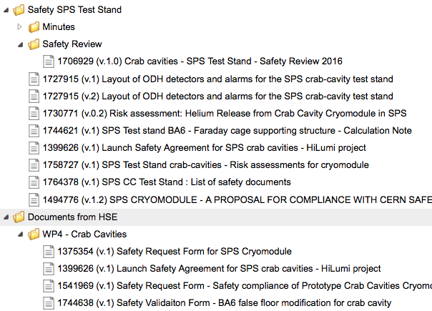
Documentation on EDMS (1/2)
https://edms.cern.ch/project/CERN-0000169596

Slide 21
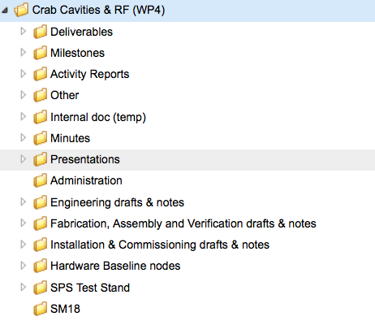
Documentation on EDMS (2/2)
https://edms.cern.ch/project/CERN-0000096385

