Slide 1

Crab cavities,
Cryogenics consideration for the SPS and HL-LHC
Serge Claudet, on behalf of Cryo teams dedicated to this aspects
Int’l Review Crab Cavities – CERN – 3rd & 4th April 2017

Slide 2
Outline
Introduction,
status and perspectives for SPS (+concerns)
Introduction,
status and perspectives for HL-LHC (+concerns)
Concluding remarks

Slide 3
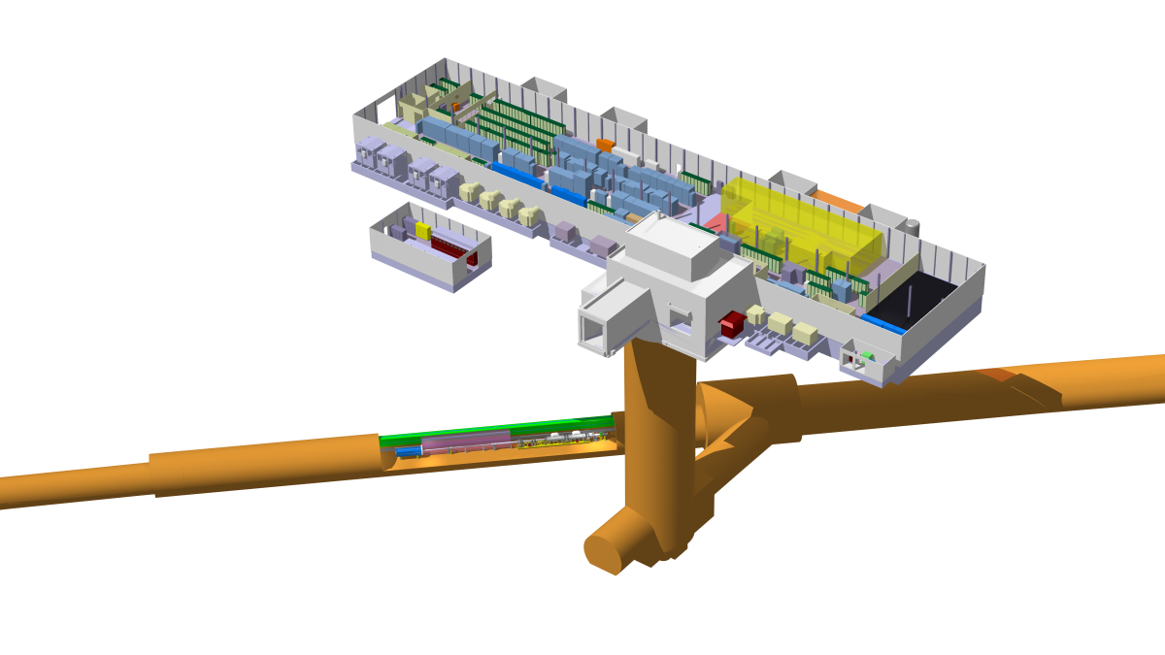
BA6 general cryogenic layout
A completely new cryogenic infrastructure to be installed and operational in 2 years, with very limited access to install and commission the equipment
Cryogenic He transfer line
Legend:
VB1 – valve box 1
VB2 – valve box 2
SB – service box
CCM – crab cavity module
Warm He pipework
Cryogenic LN2 transfer line
Compressor station
GHe storage
LN2 storage
BA1
VB2
150L LHe
SB
CCM
100L LHe
BA5
LN2 phase separator
90m transfer line
He Pump
He Heater
Past EYETS: All long items
(80m cryoline, piping, cables)
VB1
150L LHe
Future YETS: All local items
(various cryogenic boxes)
Cold Box

Slide 4
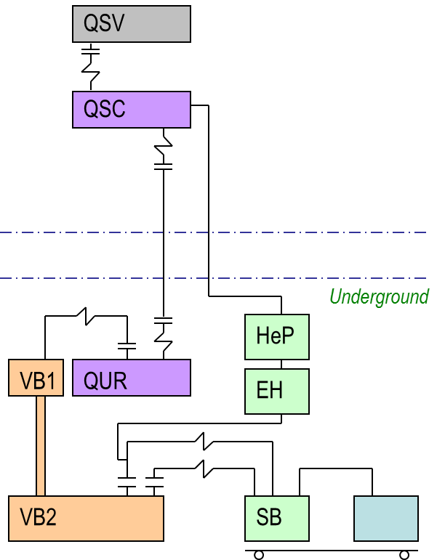
Helium main systems – status
Production plant (QSC+QUR) – Contract F702
status: Process revised with +15% w.r.t Tech. Spec. for SPS-BA6 needs, Design Review foreseen in May’17, Fabrication Q3/Q4’17, delivery mid Jan’18
Distribution system (VB1+transfer line+VB2) – IT4189
status: 80m line installed, kick-off for valves boxes tomorrow, design Q2’17, production summer’17 for delivery expected Oct’17 for meca-instrum test in workshop, installation end Jan’18
Proximity equipment (SB and flex transfer lines – DO-30000, HeP, EH)
status: SB+flex designed, delivery in summer 2017,
HeP in place
EH identified (local connections required for both)
Storage tanks GHe + LN2 (Recovered + to be Rented) status: Integration and site acceptance in final phase, delivery before Q4’17
GHe storage tanks
Warm compressor station
Cold Box
Cryo-distribution

Slide 5
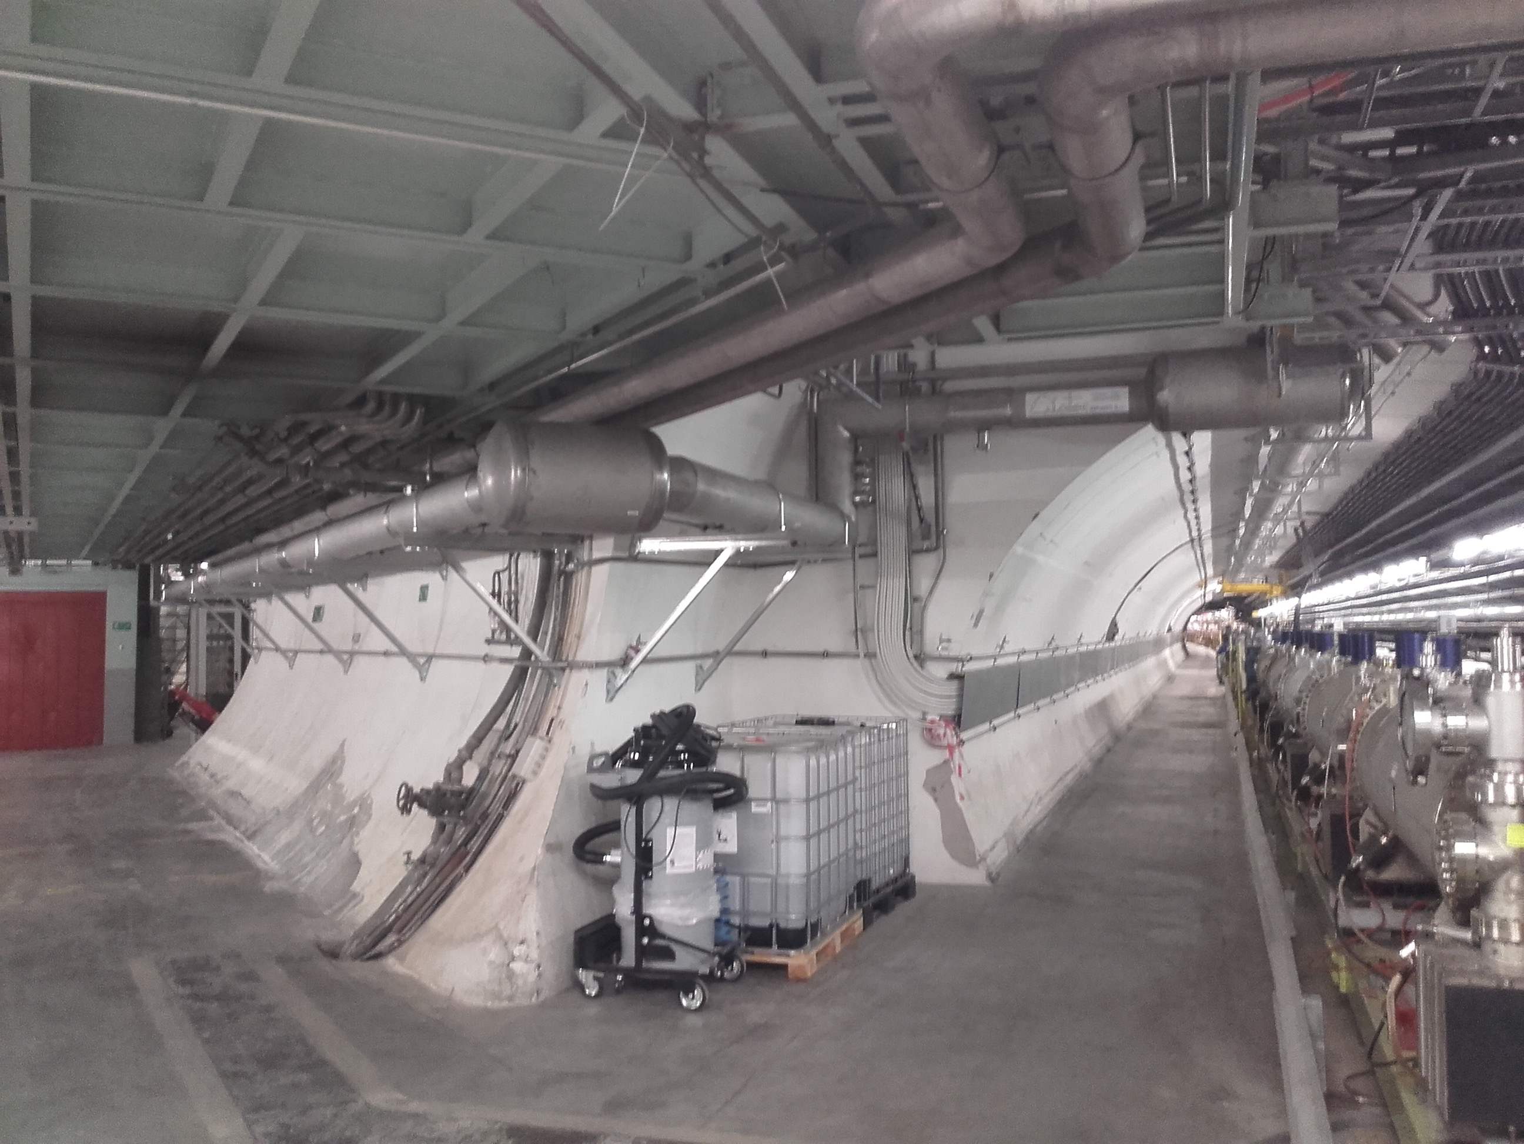
Hi-Lumi LHC: New Cryoline @ SPS – BA6
80 m cryo distribution line installed during Feb-Mar 2017
From Cold-Box & Valve Box 1
To Valve Box 2 & RF Cryostat
In addition: warm piping in shaft, cabling anticipated with EN-EL, He pumps

Slide 6
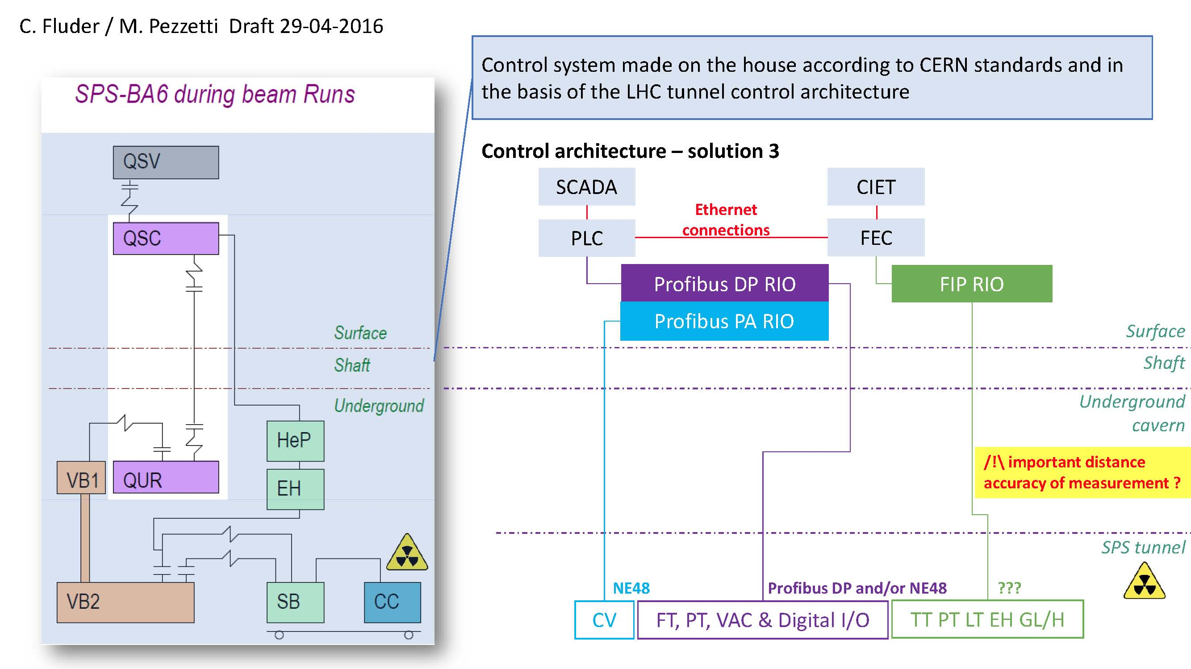
Baseline for controls architecture
Definition anticipated Q2’16 for obvious schedule control credibility (cable and racks already installed during EYETS early 2017)

Slide 7
Global SPS cryo planning – status
Schedule updated Autumn 2015, being followed, target to be ready for 21st Feb’18
Cryo for Crab Cav. At SPS
Resp: J. Metselaar + O. Pirotte
Warm piping foreseen EYETS, LN2 infrastructure for 2017
Infrastructure
Resp: L. Delprat + S. Claudet
Contract F702, delivery Mid Jan’17
Refrigeration
Resp: H. Derking + S. Claudet
Ph1 done, Ph2 being launched
Distribution
Transf. line
VB1+VB2
Resp: K. Brodzinski
Order in place for Service Box, delivery summer’17
Proximity

Slide 8
Work and perspectives for next 12 months
Storage tanks, Interconnecting piping, LN2 lines and box:
  Work to be done as much as possible (surface) during 2017
Mobile liquefyer:
  On tracks, confident as based on “industrial standard product”
Valve boxes:
  To be delivered at surface Oct’17 for checks, cabling and preparation
Instrumentation and controls:
  Being ordered “CERN supplied items” to match our standards (technical & Quality)
Installation, cabling, safety/legal and basic tests (Pressure, elec, interlocks)
  WILL HAVE TO BE DONE ON SITE, even if minimised
Training and procedures:
  At least preliminary versions to start with

Slide 9
CONCERNS for SPS-BA6
There is not much margin for crab cavities to be tested with beam in SPS in 2018, but nobody would like to be the one preventing this to happen !!!
The Cryo team is just focussed on delivering the required functionalities by 21st Feb’18
Concepts and major procurements: Done
Design of major sub-systems: Done or being done
Fabrication: Started or being started
Deliveries: expected just in time
Installation phase: to be looked at in details
Commissioning: necessary, at least the minimum required
in LHC, no access during cool-down or warm-up between 300K and 80K
Compulsory consolidations foreseen in 2019/2020 during LS2 !
We believe all teams have a similar approach, so Jan-Feb 2018 will be extremely dense-populated with strong (competing!) commitments…
Realistic considerations will have to be added to “success oriented”
(Safety of personnel with co-activities, protection of hardware, schedule)

Slide 10
Outline
Introduction,
status and perspectives for SPS (+concerns)
Introduction,
status and perspectives for HL-LHC (+concerns)
Concluding remarks

Slide 11
P1/P5 Cryogenic architecture
18 kW equivalent at 4.5 K, including 3 kW at 1.8 K
Warm compressor station
SHE
After internal Cost to Performance review (Performance - Cost - Risk)
QSVB
GHe storage tanks
Surface piping
SHM
QSCG
QSAG
Dryer
QSP
Surface cold box
SLN
SD
SLN
Quench tank
QSDQ
QSRG
QSDN
Liquid Nitrogen tanks
Surface
QPP
QPLG
Vertical transfer line
Shaft
Underground
US
Cold compressors box
QURCG
DFHX
DFHM
(existing)
DFBL
UR
UL
QUIG
DSHX
DSHM
Interconnection box
DSL
LHC tunnel
Q1
Q2a
Q2b
Q3
CP
D1
D2
CC
CC
Q4
Q5
Q6
QRP
QXL
Not standard components (pressure, commissioning)
HRL

Slide 12
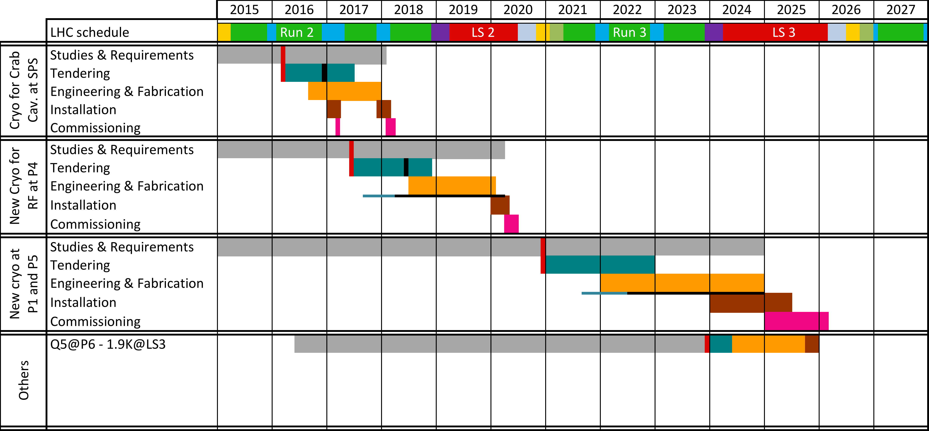
HiLumi Cryogenic masterplan
Today
Significant time ahead of us for efficient studies and coordination of interfaces
Just-in-time for SPS-BA6, last studies for LHC-P4 before decision,
Some more time for us for LHC P1/P5, but interfaces required by others

Slide 13
Work and perspectives for next years
Cooling capacity:
  So far estimates, about 10% of total requirements per point
  Project baseline to consider full CC scheme for cryoplant design
Design pressure:
  A delicate aspect: a low pressure item (2-3 B_abs) in the middle of magnets (15-20 B_abs).
  Experience with LHC (RF, Electrical feedboxes DFB’s)
  BUT this time consideration to have over-pressure safety devices in cryo-distribution line (not at all a standard, risk for CC lifetime?)
Operating Pressure:
  Absolute value (30mbar) and acceptable fluctuations (+/- 1mbar) to be evaluated
  Feasible to control a fixed value (pressure control valve) for fixed heat loads
Physical interfaces (jumpers from Cryoline QXL):
  So far “double jumper” to be considered as baseline, not an issue
  Could be wise to installed for all CC in one go, with caps/capilleries for easy connection when desired

Slide 14
Concluding Remarks
For SPS-BA6:
  We are fully motivated and committed (21st Feb’18)
  So far just in time, but significant concerns for the co-activities Jan-Feb 2018
  We would consider wise to evaluate how to make the best use of 2018 for the crab cavities project (SPS if possible, back at surface if not possible, other?)
For HiLumi P1/P5:
  We have a bit of time ahead of us, not to be wasted!
  We believe so far that we should consider full CC scheme from scratch (not much to gain to be to strict, higher risks to have a small 2nd phase later)
  Decisions to be taken by the end of 2020 (based on what we will have at that time)

