Slide 1

Crab Cavity Pre-series, series strategy and planning
Ofelia Capatina (CERN, EN-MME) on behalf of the WP4 members
International Review of the Crab Cavities Performance, 4 April 2017

Slide 2

SM18 Area
Cavity cold testing, clean room facilities & cryomodule qualification
SPS Test Prototype Module before LS2
LHC Point 5 (horizontal)
2 cavities / IP side/ beam
to be installed during LS3
LHC Point 1 (vertical)
2 cavities / IP side/ beam
to be installed during LS3

Slide 3
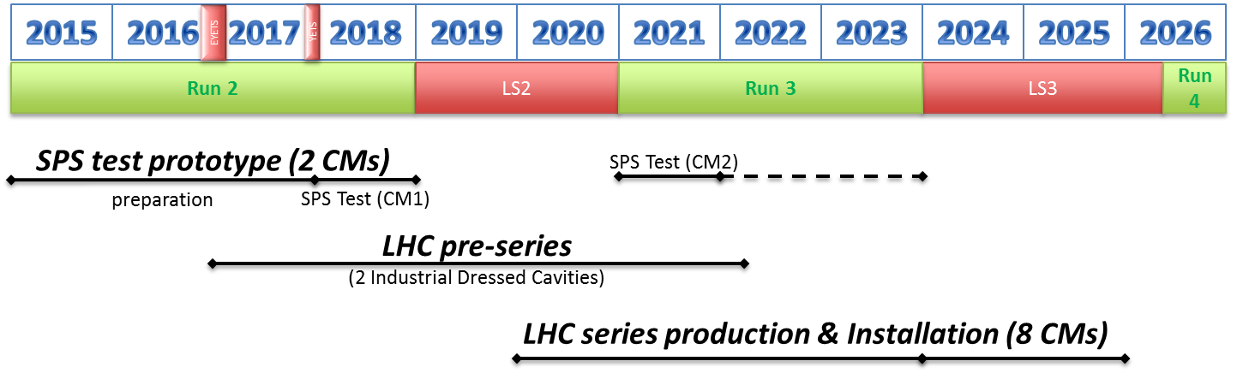
General plans
2 cryomodules for SPS tests
  1 cryomodule with 2 identical cavities (type «vertical» - DQW)
    Design as much as possible coherent with LHC
    To be tested in SPS in 2018
  1 cryomodule with 2 identical cavities (type «horizontal» - RFD)
    Design to be done as LHC prototype
    To be tested in SPS after LS2, in 2021
2 cavities pre-series for LHC (one of each type)
8 cryomodules (4 of each type) for installation in LHC during LS3
+ 2 spares (1 of each type)

Slide 4
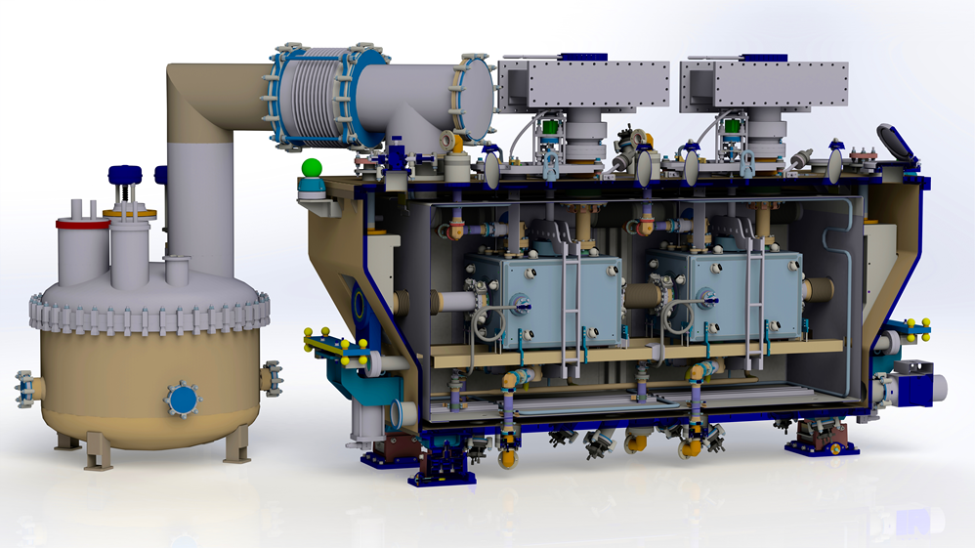
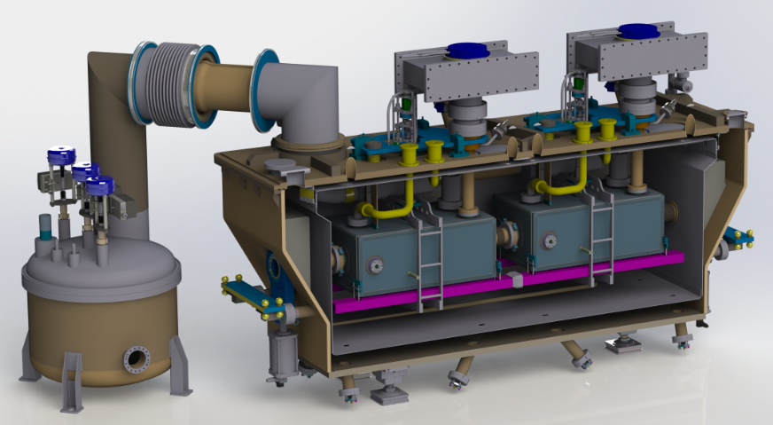
Cryomodules
SPS DQW cryomodule + service module
RFD

Slide 5
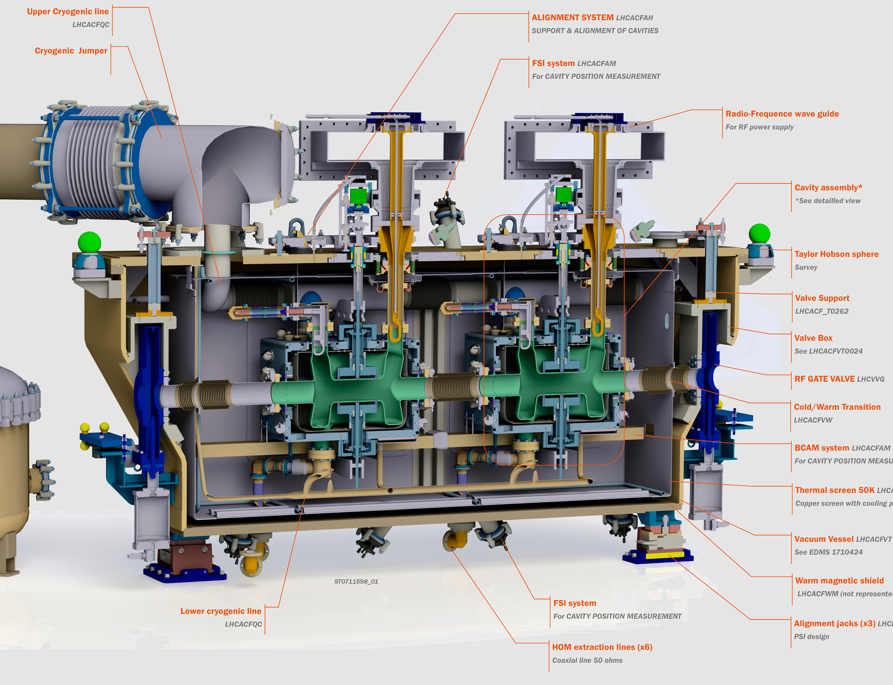
DQW cavity manufacturing sequence

Slide 6
From SPS to LHC
Dressed Cavities
  DQW
    Cavity, helium vessel, magnetic shield, tuning system, FPC: no changes foreseen
    HOMS: design optimisation with increase dimensions
  RFD
    Cavity: optimisation for manufacturing will be endorsed soon

Slide 7
From SPS to LHC
Cryomodules updates (both types)
  Vacuum
    Implement beam line adjacent to the cavities
    Beam screens in lines at 2K – additional cooling circuit (4.5K to 20K)
    RF fingers at all bellows positions
    Additional instrumentation for beam vacuum monitoring in between the 2 extremity valves (close to 300K) + protection with rupture disc
    Ecloud studies to be considered in the CWT
    Insulation vacuum barrier in the jumper instead of simple support
See talk T. Jones

Slide 8
From SPS to LHC
Cryomodules updates (both types)
  Cryogenics
    Heat load specification for the LHC to be defined
    Instrumentation will be reduced
    Protection of the cryolines: if no hard stoppers should be integrated in the cryomodule with helium release in the tunnel
      if hard stopper will continue being integrated in the service module
    Slope of 1.23% to be taken into account
    Helium level gauges should be exchangeable from outside the vacuum vessel

Slide 9
From SPS to LHC
Cryomodules updates (both types)
  Survey
    BCAM system will be removed (only FSI will be kept)
    Remote alignment of the cryomodule jacks requirement TBC
  Transport
    Additional blocking system during long-distance transport – only for RFD cryomodules assembled in Daresbury

Slide 10
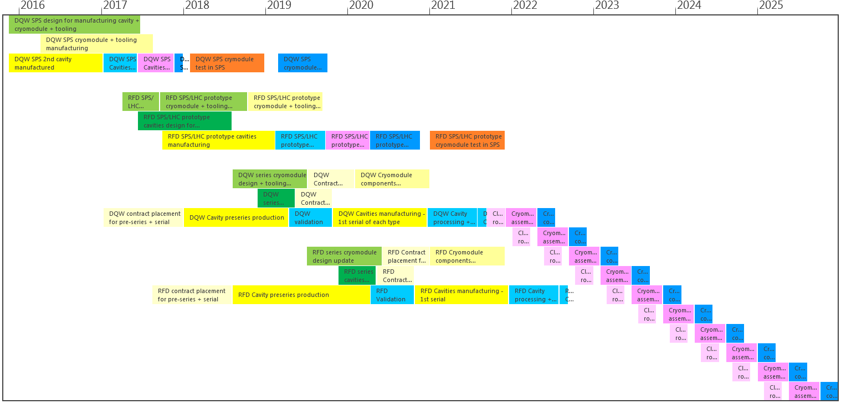
Cavities and CM General schedule
DQW
SPS
RFD
Preseries + series
Design
Manufacturing
Processing & cold tests
Assembly
SPS Tests

Slide 11
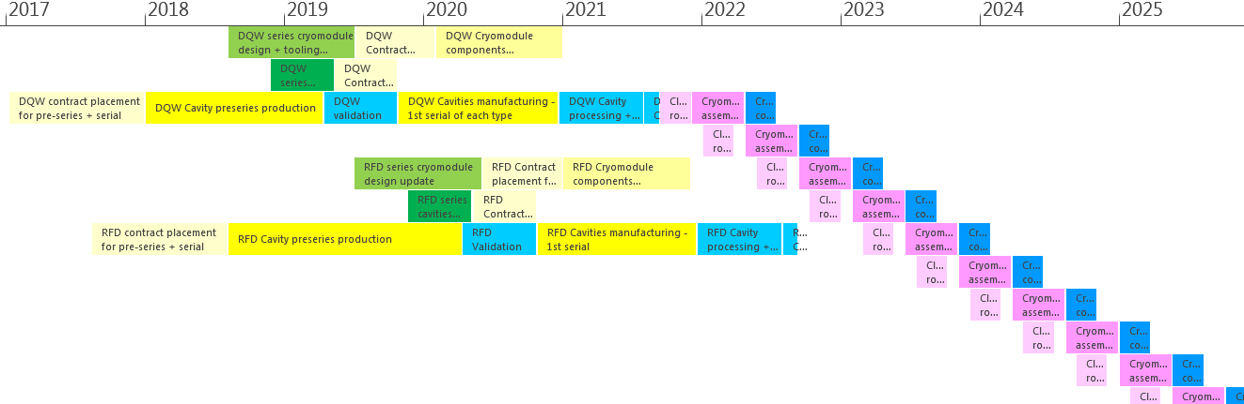
Schedule preseries and series
March 2025 start tunnel installation last cryomodule
2x Preseries cavities to be manufactured in Industry (by the same companies that will produce series cavities)
Preseries DQW contract to be started in 2018 by CERN
Series production of 10 fully dressed DQW cavities followed up by CERN
Preseries RFD contract by US
Series production of 10 fully dressed RFD cavities followed up by US
  including processing + cold test of bare and dressed cavities
(8x + 2x spare) Cryomodule components manufacturing by CERN
Cryomodule assembly + cold tests at CERN (UK assembly of LHC prototype for RFD)
Only one existing infrastructure considered for series production strategy (processing, clean room, assembly benches,
cold tests)
See talk T. Jones
See talk C. Zanoni
See talk L. Ristori

Slide 12
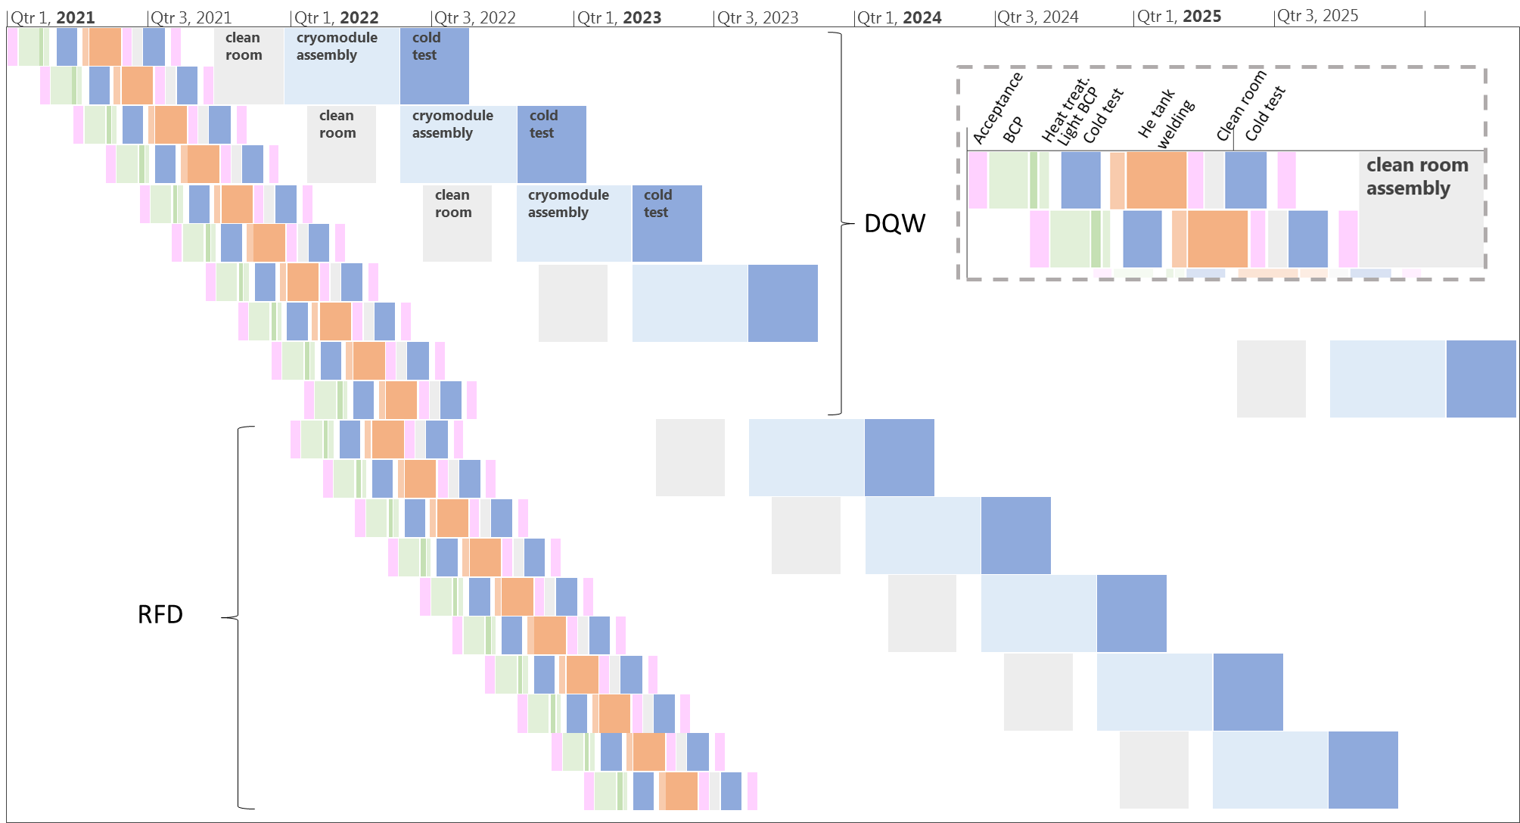
Schedule series

Slide 13

Schedule series
DQW spare
US contribution
RFD spare
Infrastructure needed at CERN (existing):
One BCP stand
One thermal treatment furnace
Two vertical tests stands (one for bare and one for dressed cavities)
One clean room string assembly zone (SM18)
One cryomodule assembly zone (SM18)
One cryomodule cold test stand in bunker (SM18)

Slide 14
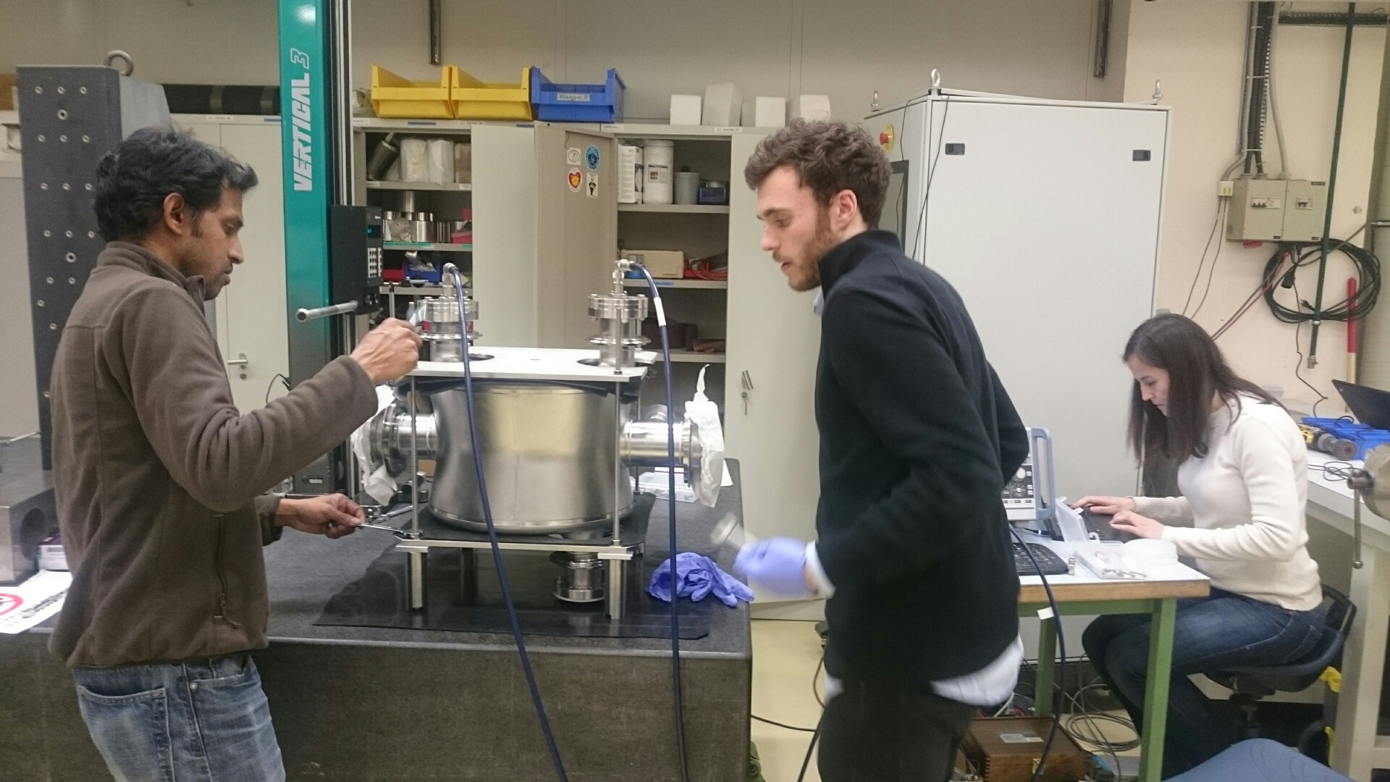
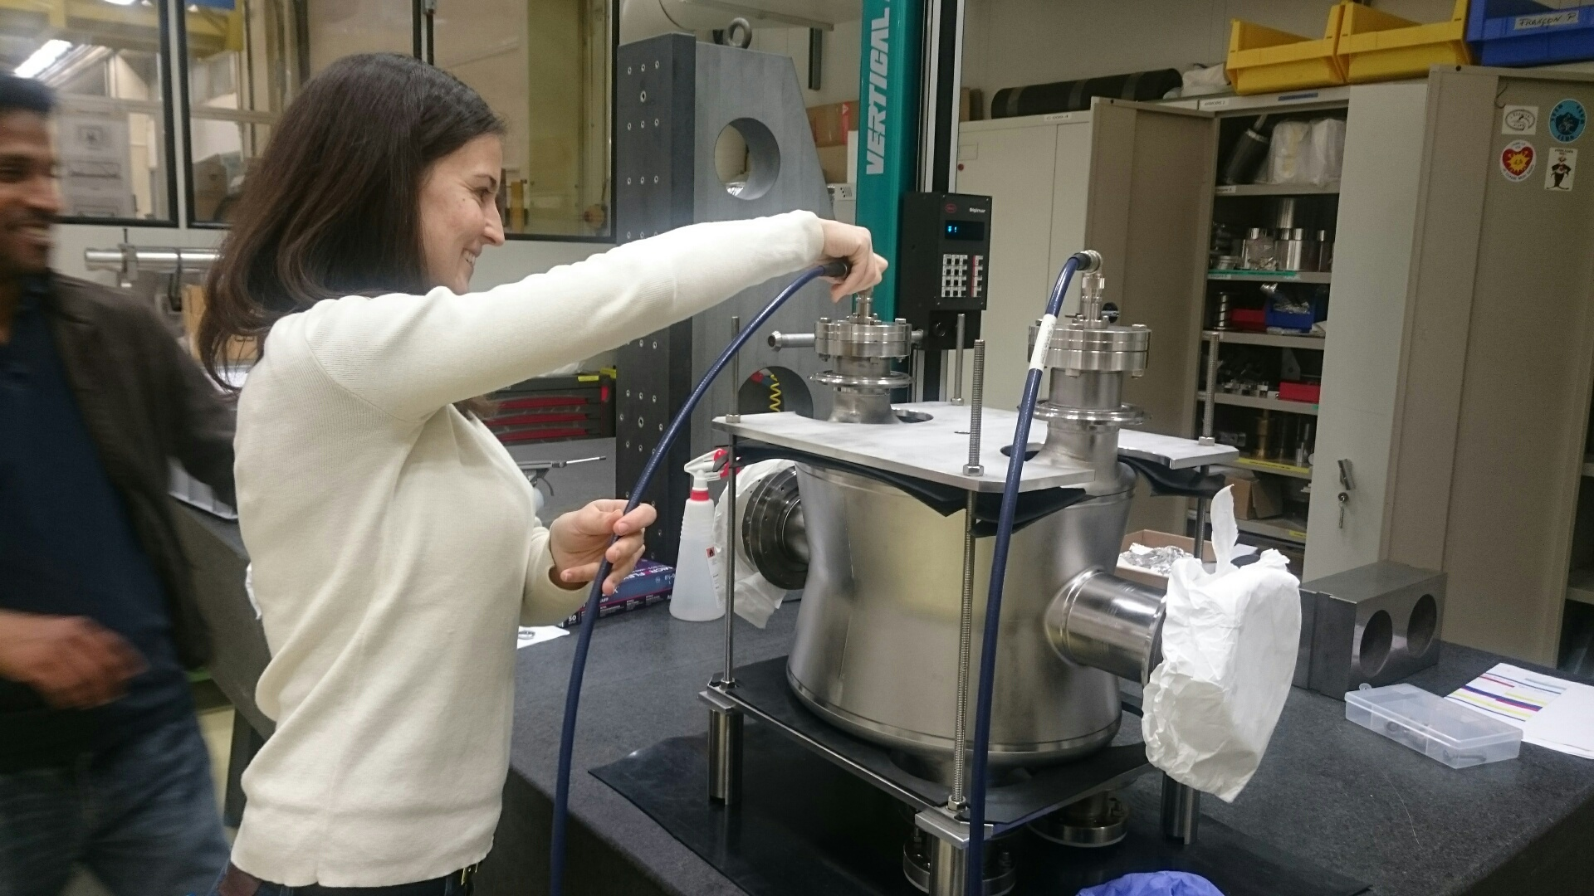
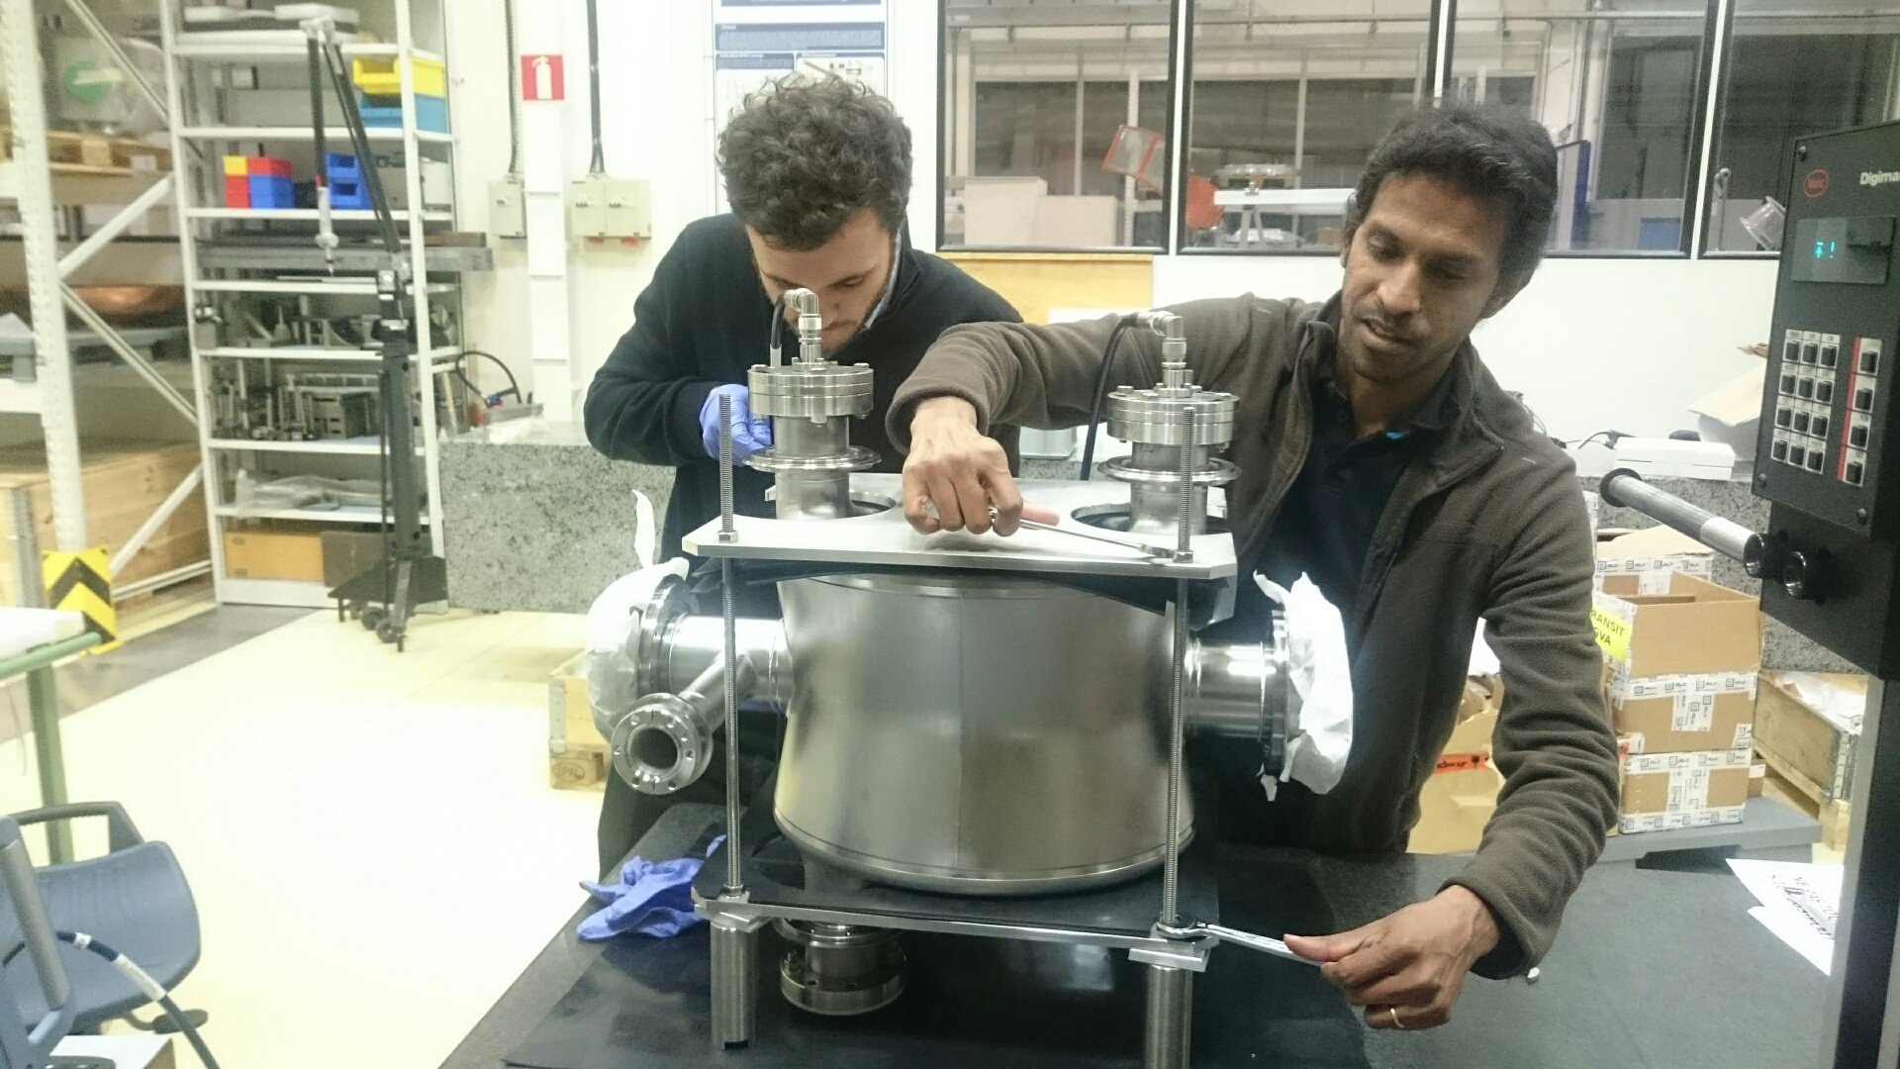
Thank you!
Teamwork and commitment
13 December 2016, 9:40 PM

