Slide 1
UK RFD Pre-Series cryomodule
Thomas Jones on behalf of the UK-CERN team
International Review of Crab Cavity Performance Meeting, 4th April 2017

Slide 2
Current UK Involvement
  Funding in place for the build of one pre-series cryomodule at the Daresbury Laboratory which will be tested on SPS, with compatibility with LHC installation.
  Currently responsible for the delivery of the following for the SPS cryomodule;
    Thermal shield design
    2K and 300K magnetic shield design
    Design and Modal analysis of overall cavity support system
    Fluid analysis for cavity BCP
    Assist with cleanroom procedure development
    HOM, FPC Test box, Bulk RRR measurements
    + any additional mechanical engineering tasks as and when required
  It is anticipated the design of these components/processes will be as similar as possible for the pre-series LHC module.

Slide 3
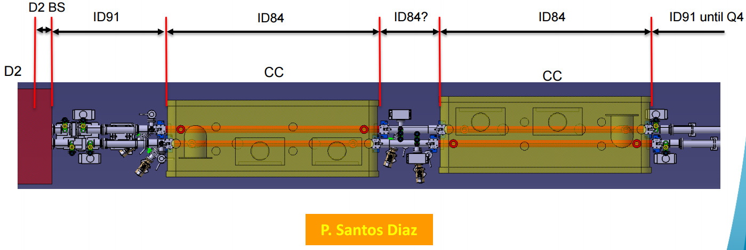
Delivery of Pre-Series Cryomodule for RFD Crab Cavities at STFC Daresbury Laboratory
SPS-CM for DQW will be used as a baseline design
Plans for RFD-CM prepared to match HL-LHC schedule
Pre-Series CM will be compatible with SPS as well as HL-LHC
CERN and STFC will continue to work as a single team

Slide 4
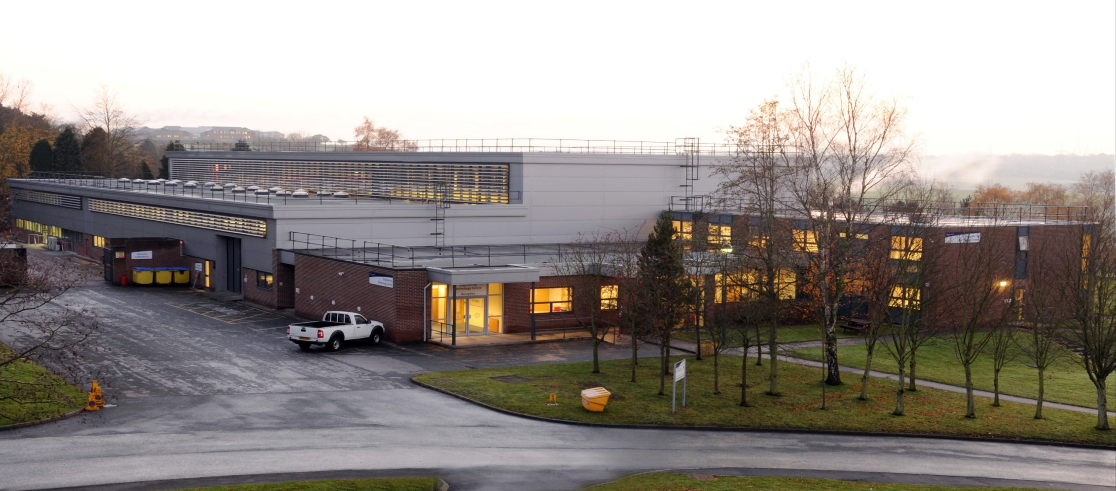


Engineering Technology Centre
(Systems Integration Building)
4
QUALITY MANAGEMENT SYSTEM – ISO 9001 : 2008

Slide 5
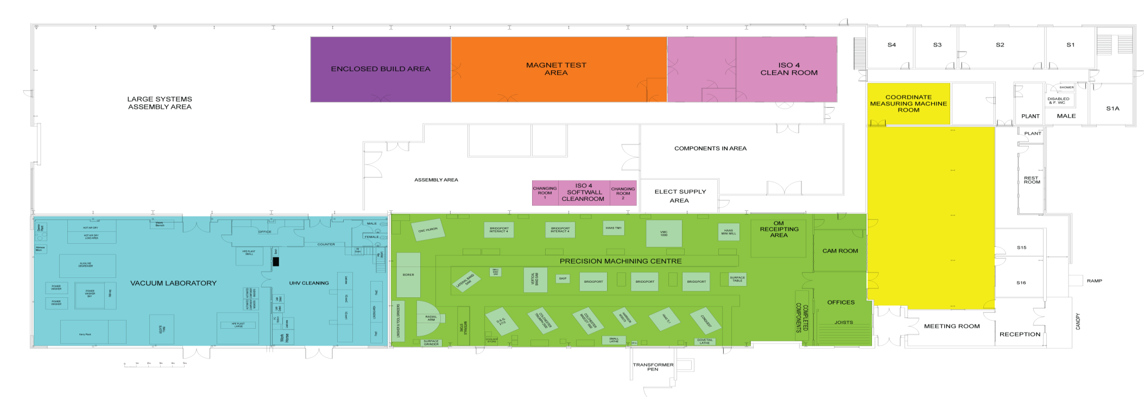
ETC - Floor Plan
23 m
10 m
Survey
Magnet Test
ISO 5/6
Cleanroom
ISO 3/4
Cleanroom
21 m
CMM
Large Systems Assembly
Area
30 Tonne Crane coverage
Soft wall
Clean Room
Electrical
Lab.
15 m
Vacuum
Laboratory
Ovens
Precision Machining Centre
UHV Cleaning
Meeting
Room
30 m
40 m
Reception
92 m
5

Slide 6
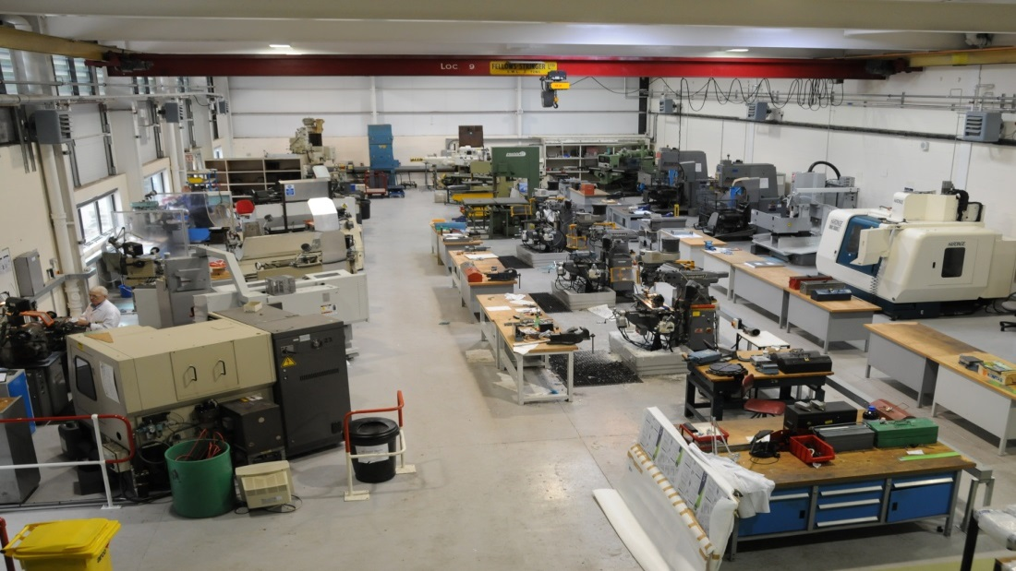
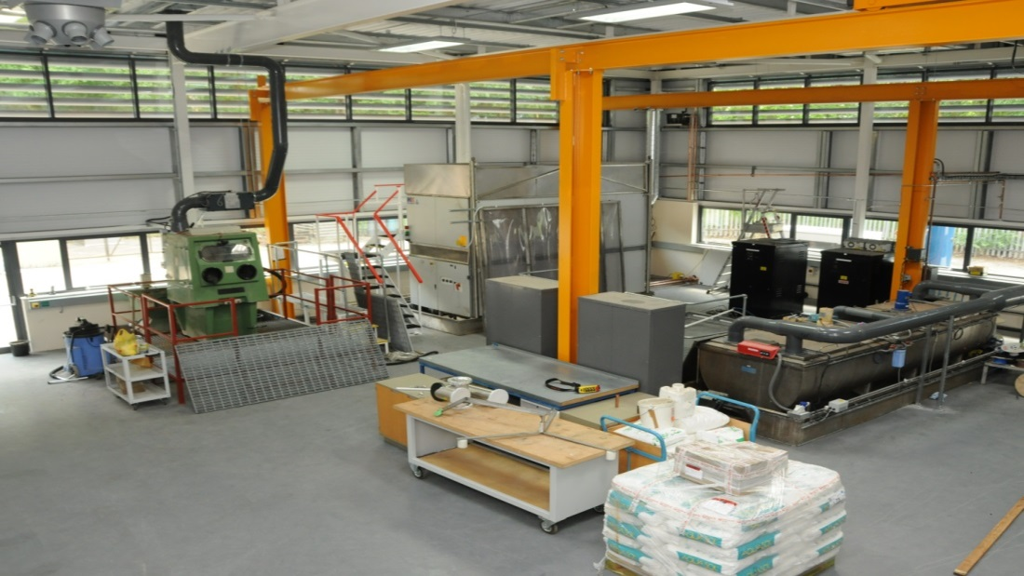
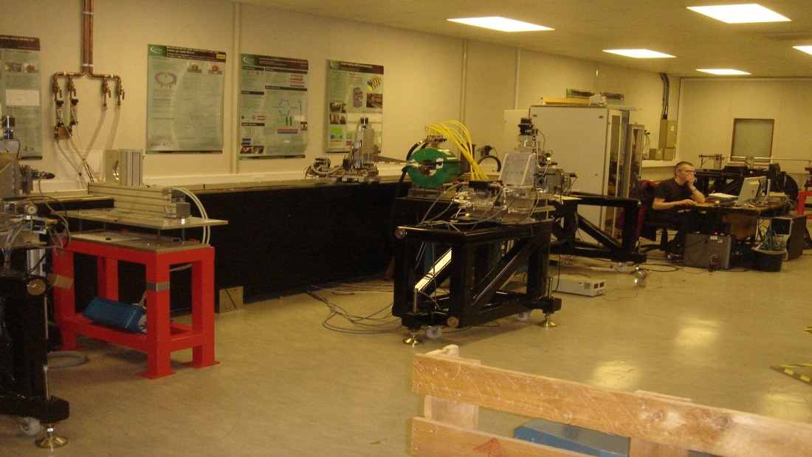
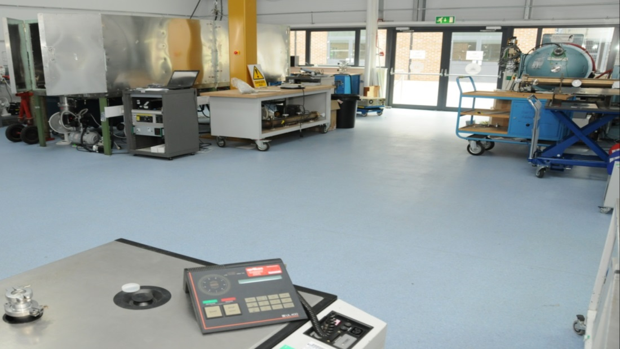
Machine Centre
Cleaning in Vacuum Lab
Ovens in Vacuum Lab
Magnet Test Lab

Slide 7
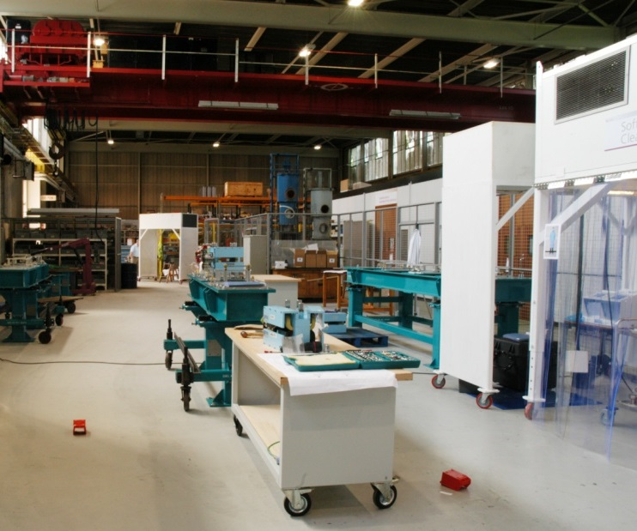
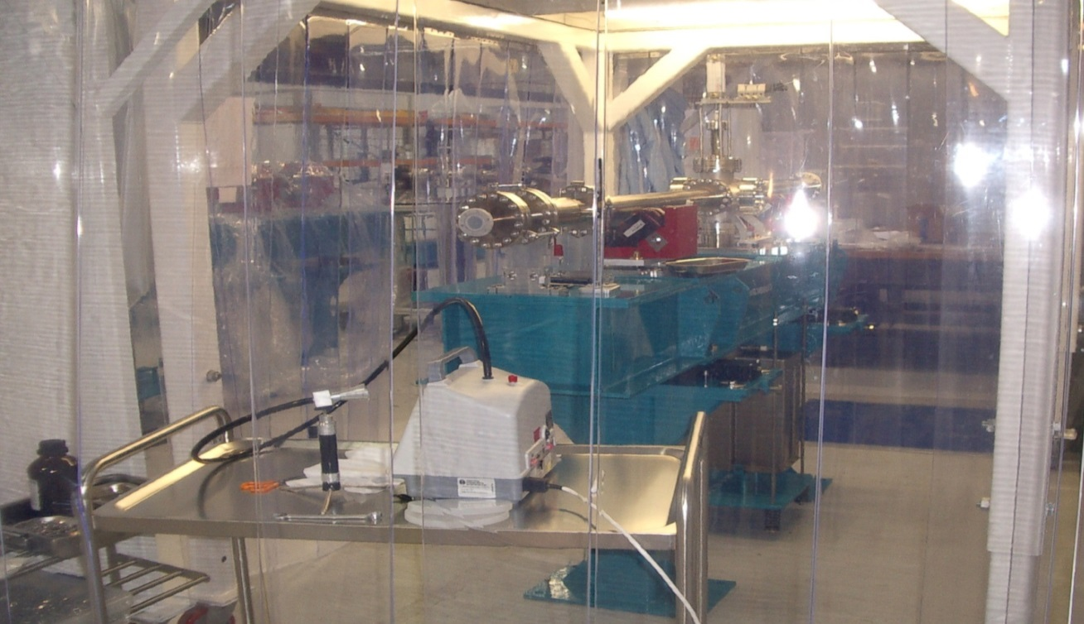
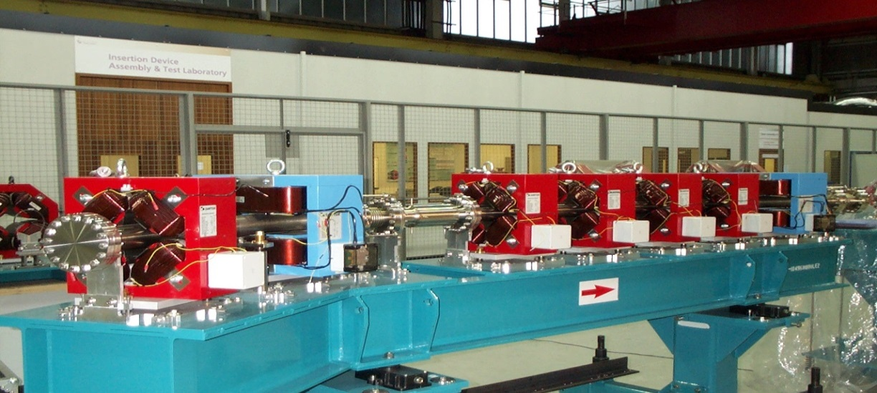
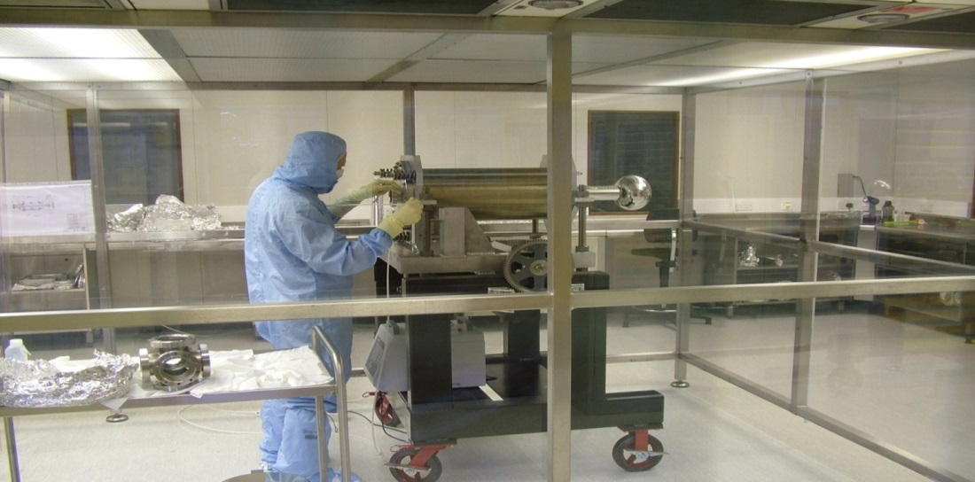
Assembly Hall
30 Tonne Crane
30T Crane
Softwall cleanroom
Large ISO 4 Cleanroom
Assembly Hall
ISO 3/4 Cleanroom

Slide 8
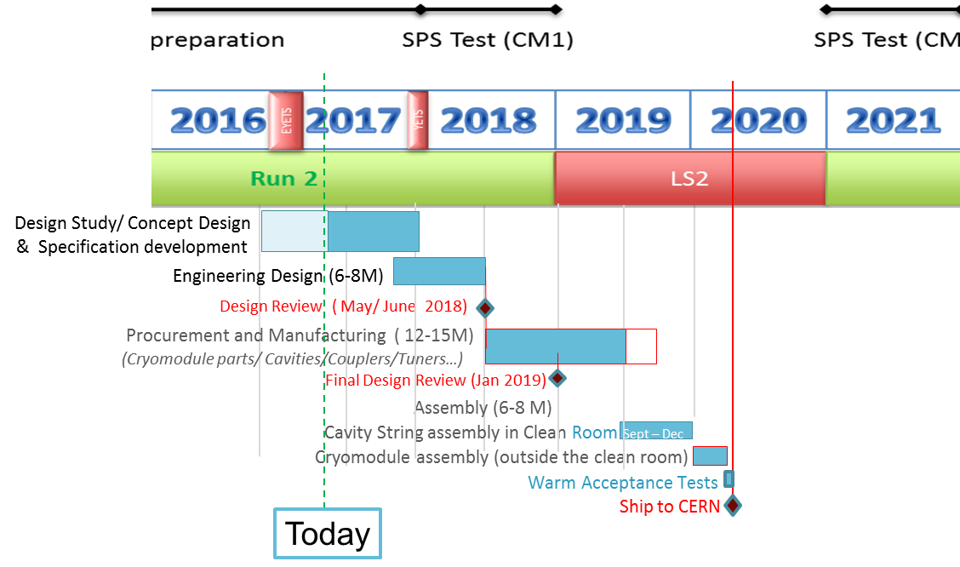
Schedule Compatible with HL-LHC

Slide 9
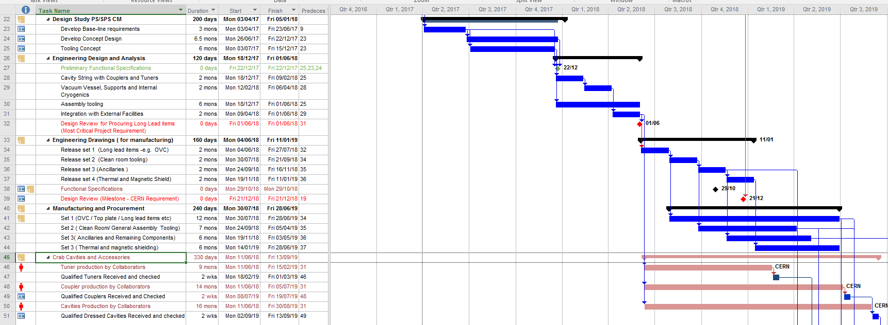
UK Planning
Slides courtesy of Shrikant Pattalwar - STFC - 04/04/17

Slide 10
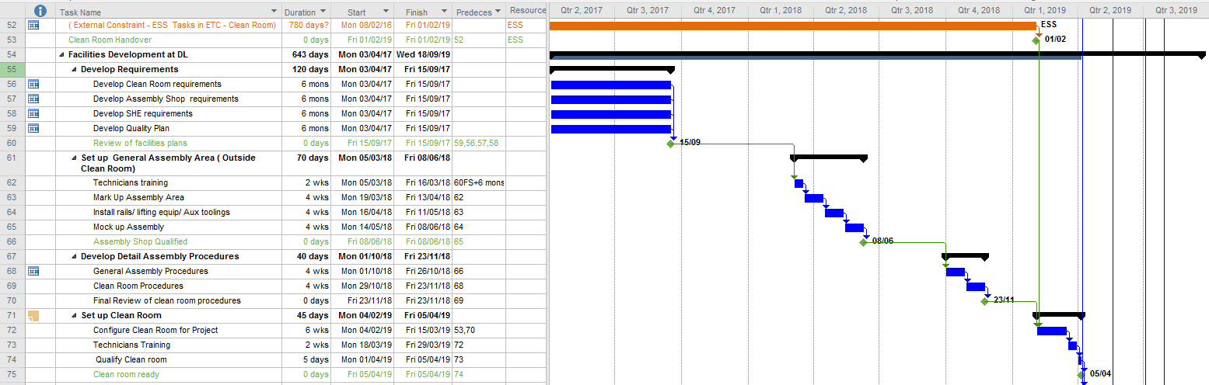
UK Planning
Risk: The Clean room is booked till Jan 2019 for ESS tasks which may be delayed
Mitigation: The delay will be known well in advance and ESS tasks will be shifted to alternative locations in time to give a priority to HL-LHC
Slides courtesy of Shrikant Pattalwar - STFC - 04/04/17

Slide 11
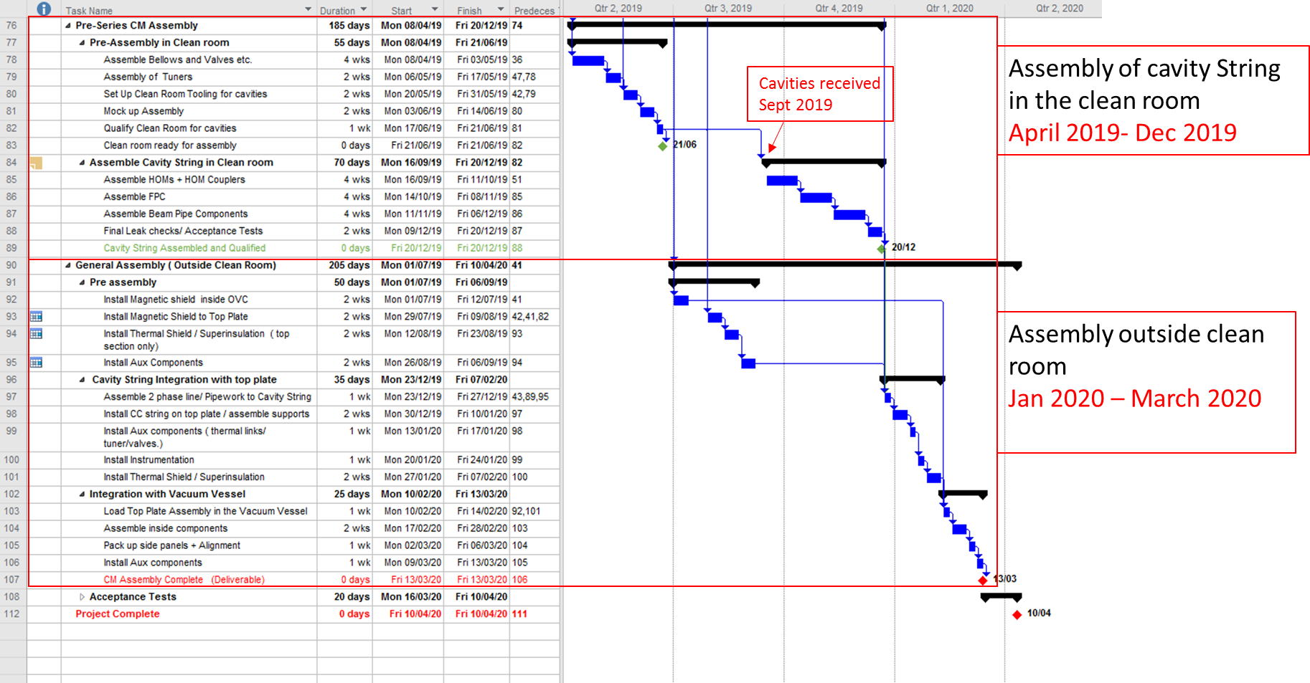
UK Planning

Slide 12
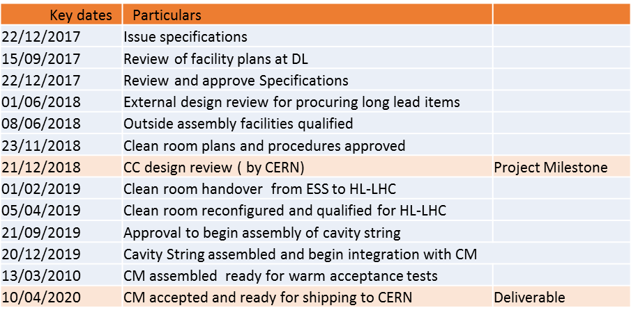
Key Dates

Slide 13
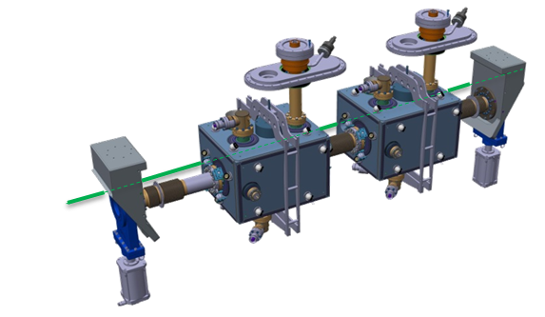
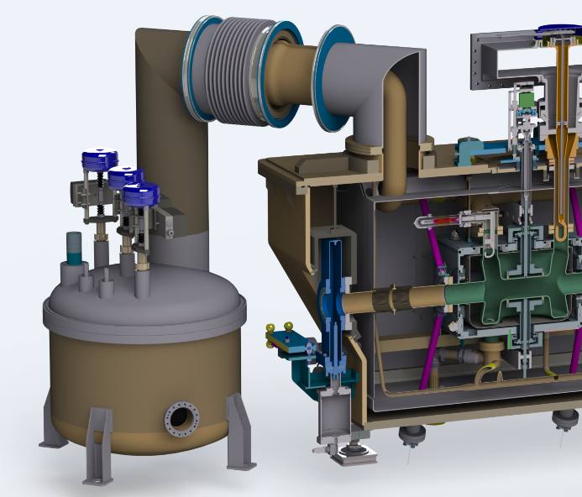
Areas that require updates
Second beam pipe to be introduced incorporating cold to warm transition and beam screen.
External vacuum valve configuration needs updating to be compatible with LHC vacuum requirements.
Cryogenics service module update, beam screen cooling at 4.5k etc.

Slide 14
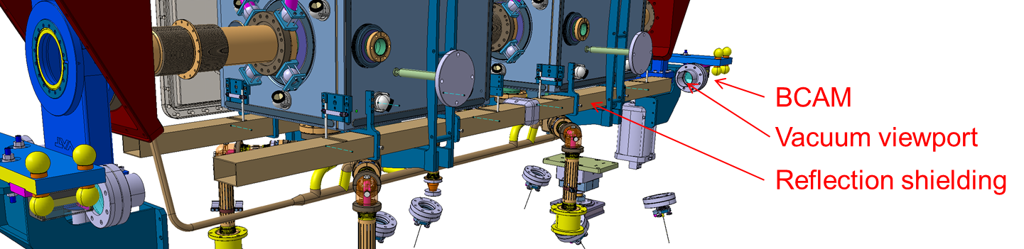
Areas that require updates
BCAM system will not be required for LHC, however, requirements for hybrid module to be determined.
Infra-structure and assembly tooling to be updated from DQW SPS to RFD LHC (and modification to suit Daresbury Laboratory facilities).
Cryomodule length will be increased (OVC, Mag and thermal shields, tooling etc) for RFD integration.

Slide 15
Design studies required
HOMs designs will be re-visited for improved integration after data from SPS for realistic HOM power.
Study of active vs passive jacking of the module. Position of jacking system.
Size of beam pipes in module to be determined by AP. Configuration of RF screening in bellows needs to be determined.
Safety devices for cryogenic lines are on service module, for LHC the desire is for these to be on the cryomodule.

Slide 16
Design studies required
Interchangeable helium level probes? On all equipment in LHC they are interchangeable.
Cooling capacity in LHC to be determined but limiting factor will be helium vessel design. For SPS this is 35W at 2K. The helium vessel is designed with a factor of safety of 2, to be confirmed.
Effect of -1.23% tunnel slope on the cryomodule.
Support structure analysis for RFD cavity.
Cold to warm transitions need more detailed studies for electron-cloud and finalize the ac-Coating zones.

Slide 17
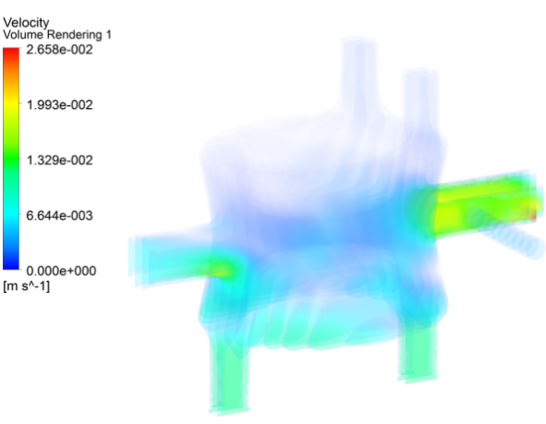
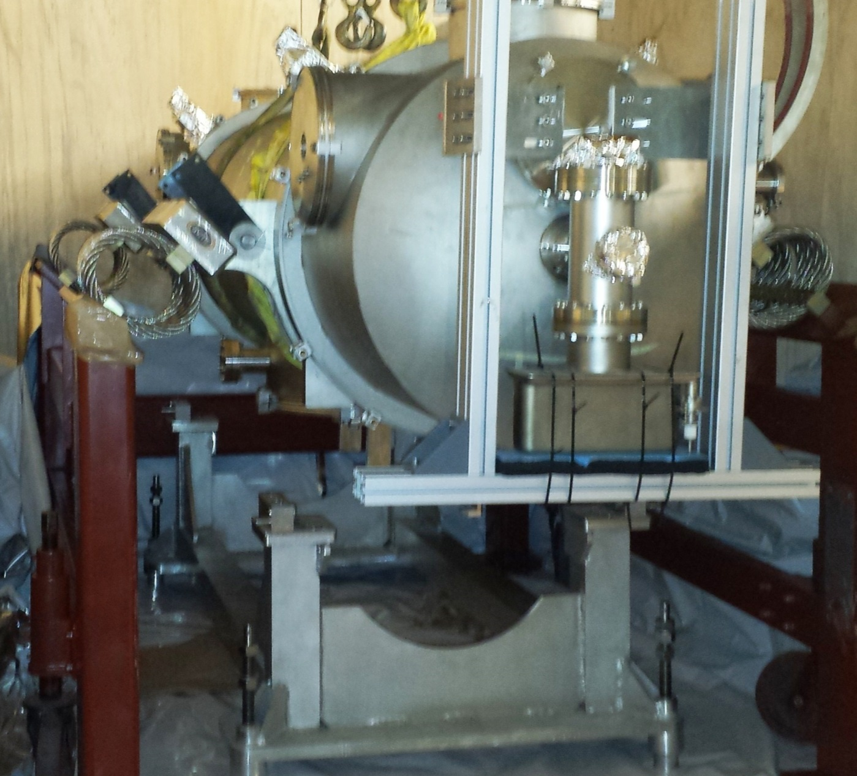
Design studies required
Any studies required for BCP processing of RFD cavity as the geometry is more complex.
Transportation of module from Daresbury to CERN
Transportation and installation of module into LHC tunnel (cranes required etc)
Material selection for radiation resistance
Cavity design updates required for LHC

Slide 18
Fixed designs
Baseline is that each cryomodule will contain 2 cavities
It is anticipated that cavities will not require active alignment
Helium tank design should remain fixed
Tuner principle (Warm actuation, cold connection).
Thermal shield is helium cooled for SPS, this will be the same in LHC. Will this be changed from Cu to Al?

Slide 19
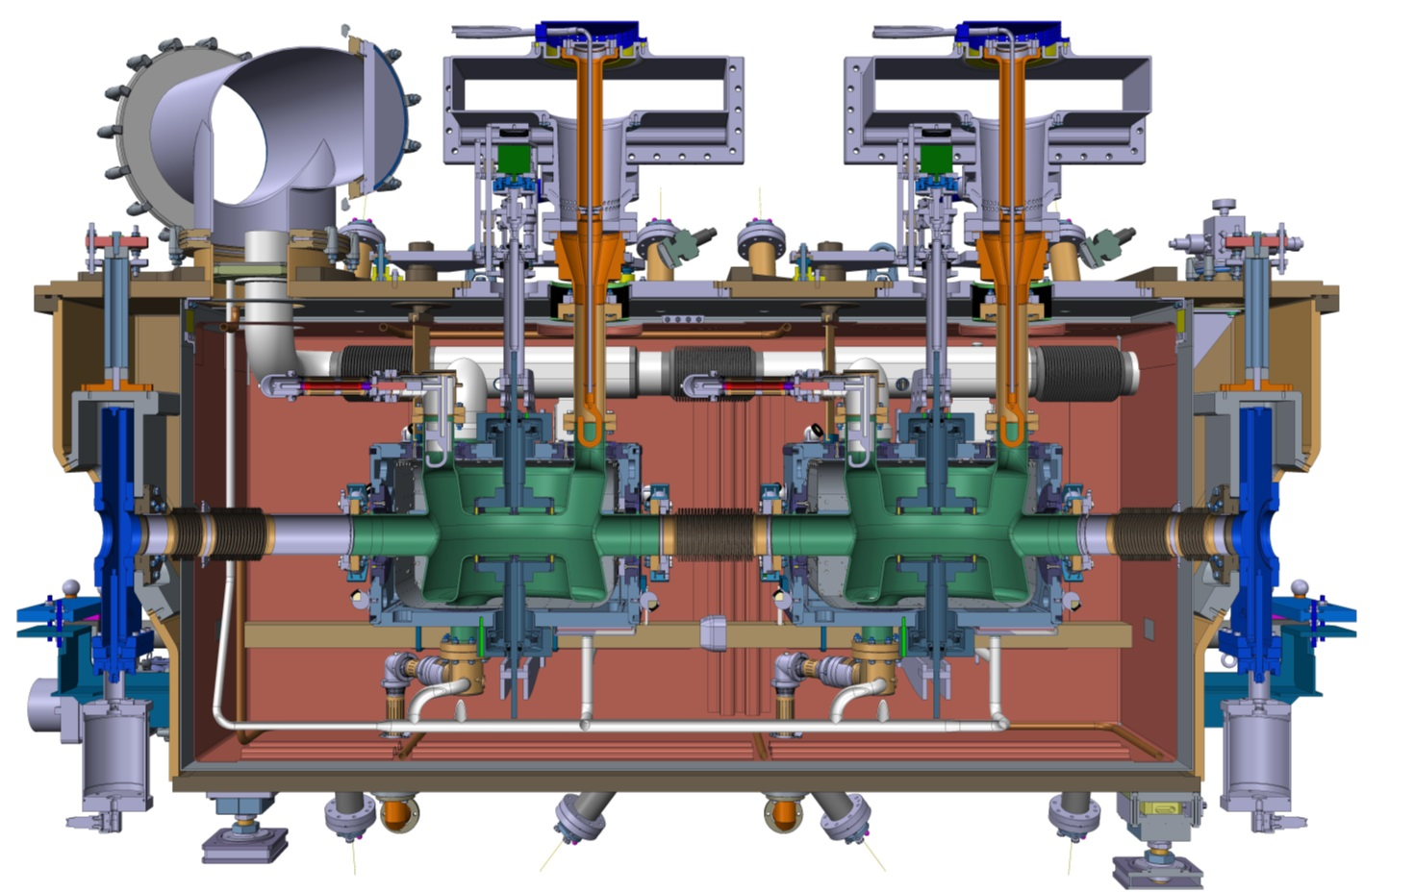
Fixed designs
Fundamental power coupler
FSI system
Cavity support system
Magnetic shielding design and configuration

Slide 20
Additional points
Testing at Daresbury will be minimum vacuum/pressure testing plus cryogenic cycling. There is also the possibility for some LLRF testing.
Need to determine a procurement plan, which institution is ordering which components?
Integration in LHC tunnel;
  Handling equipment requirements
  Space constraints
  Survey and alignment in LHC tunnel
  …..

Slide 21
Any Questions?

