Slide 1
Crab Cavity Contribution from the U.S.
HL-LHC Accelerator Upgrade Project
v3
Leonardo Ristori
Crab Cavities L2 Manager
Crab Cavity Performance Review – Cern, April 4, 2017

Slide 2
Outline
Scope
High-Level Strategy
Requirements & Acceptance Criteria
Roadmap for Project Documents
Project Schedule (LARP + AUP)
Resources, Funding Profile
Status
Conclusions

Slide 3
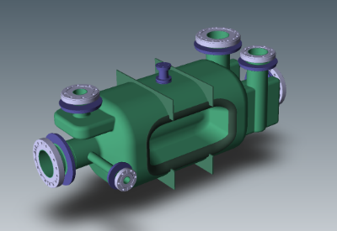
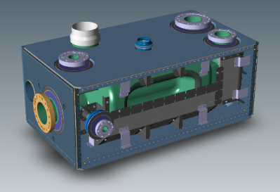



HL-LHC AUP: Crab Cavity Scope
Prototypes: Two Dressed and Tested RFD Crab Cavities
Deliverables: 8 (Threshold) + 2 (Objective) Dressed and Qualified RFD Crab Cavities
  8 for tunnel + 2 spares
  In order to qualify 10 cavities, a production of 12 cavities will be launched
V-HOM
RF Pickup
H-HOM
Bare RFD Cavity
Jacketed RFD Cavity
(front wall removed to show internal components)
RF Ancillaries
Includes:
Nb Cavity
Brazed joints to SS flanges
NbTi Transition Rings
Includes:
Bare Cavity
Magnetic Shield
Helium Tank
Tuner interface
Dressed RFD Cavity
Includes:
Jacketed Cavity
H-HOM
V-HOM
RF pickup

Slide 4
High-Level Strategy for RFD Contribution
HL-LHC AUP Project HQ is at Fermilab (L1, L2 and most L3’s)
Strategy for development of RFD crab cavity will be identical to most SRF projects worldwide today
Procurement of major components in industry (cavity, helium tanks, magnetic shields, couplers)
  Lowest bottom line cost for built-to-print hardware in med-large quantities
  Contractual commitment with laboratory (most importantly fixed cost)
  Parallel manufacturing capabilities for shortest lead times
  Well established QA system (traceability, travelers, quality control)
  Immune from funding changes and guidance from government (e.g. stand-downs)
Treatments and qualification in laboratory
  Chemical processing, heat treatments, cleaning, clean-room assembly, cold tests, troubleshooting/re-processing of low-performance cavities.
  Optimal for small-medium projects < 100s
  State of the art facilities
  Up to date preparation recipes for maximum performance

Slide 5
RFD Manufacturing Flow Plan
Only for prototypes
Cavity Procure - Phase 1 Samples + QA evidence
(Industry)
FNAL in control of interfaces between each box (the arrows)
Raw Material Procurement
(Industry)
Braze Joints
Procurement
(LAB TBD)
Cavity Procure – Phase 2
(Industry)
Bare Cavities
Proc. + Test
(ANL+FNAL)
Magnetic Shields Procurement
(Industry)
RF Ancillaries Procurement
(LAB tbd)
Bare Cavities Jacketing
(Industry)
Dressed Cavities Proc. + Test
(ANL+FNAL)
Shipment to CERN
Prototypes cavities are considered strictly HL-LHC prototypes for the HL-LHC AUP project.
Nevertheless there is an opportunity (schedule dependent) for installation in SPS of the prototypes

Slide 6
Cavity Manufacturing
Contract awarded based on cost + technical merit
  Typically 40/60 but for this project possibly even more weight could be associated with merit (tbd in Fermilab)
Contract to include:
  Promised Dates
  CERN DWGs (build to print)
  Fabrication Spec (Concentrate of multiple CERN/LARP documents) – most challenging, needs to include hold-points, certifications, documentation needed by CERN for later operation in HL-LHC
Phase I + Phase II
  Allow down-selection after Phase I
  Development of samples for Forming and EBW, demonstrate existence of QA system
  Construction of Cavity

Slide 7
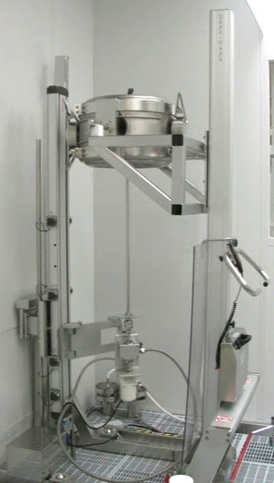
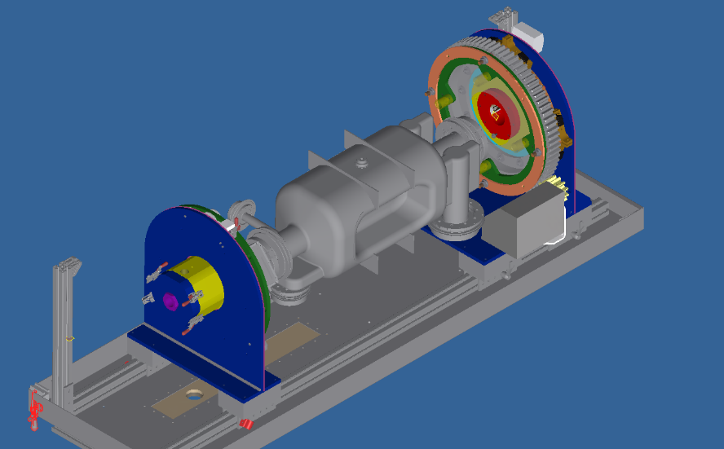
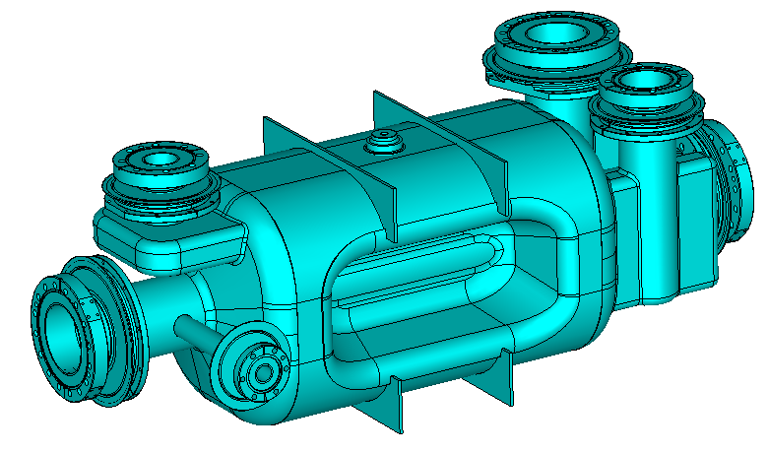
Cavity Processing - joint FNAL/ANL facility at ANL
Chemistry only after completion of bare cavity (different from what was done on RFD at JLab)
Processing in horizontal orientation with rotation and possibly also tilting
  Allows more uniform removal
  Better acid circulation and drainage
Use of a high pressure rinse set-up using multiple ports similar to what is done at ANL for SSR1 and HWR
  Allows minimizing field emission
  Horizontal, Vertical and Manual HPR available at ANL/FNAL

Slide 8
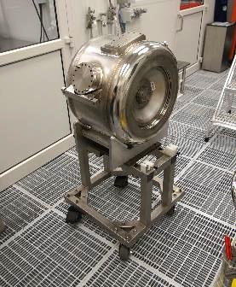
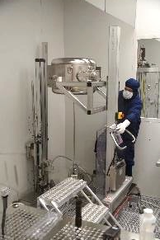
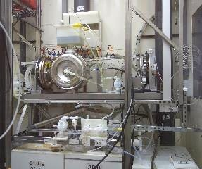
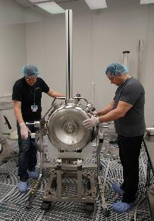
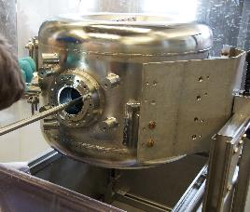
Cavity Processing of Jacketed cavities
Pictures show processes and tooling for jacketed spoke resonators (similar devices) at FNAL/ANL facilities
Only small adaptation of tooling necessary

Slide 9
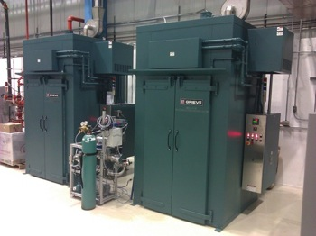
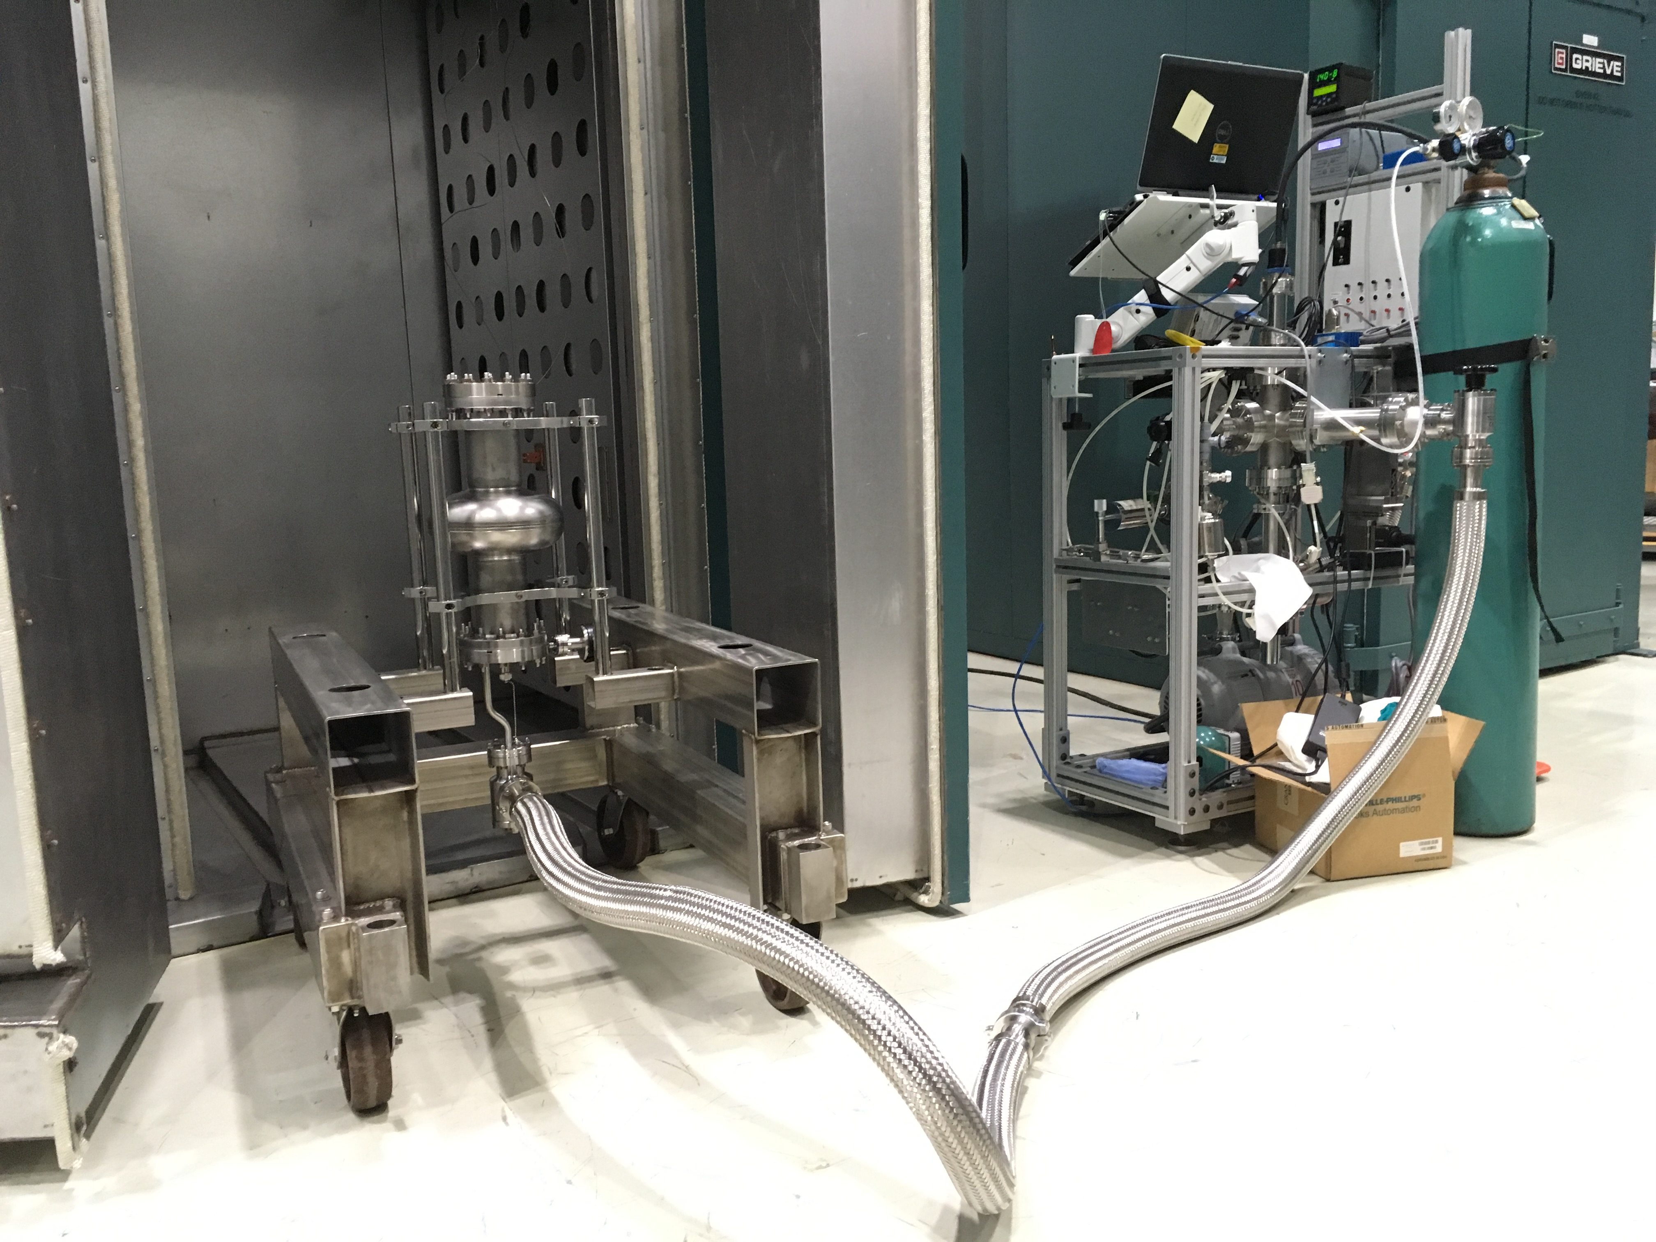
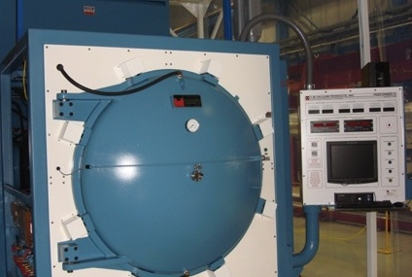
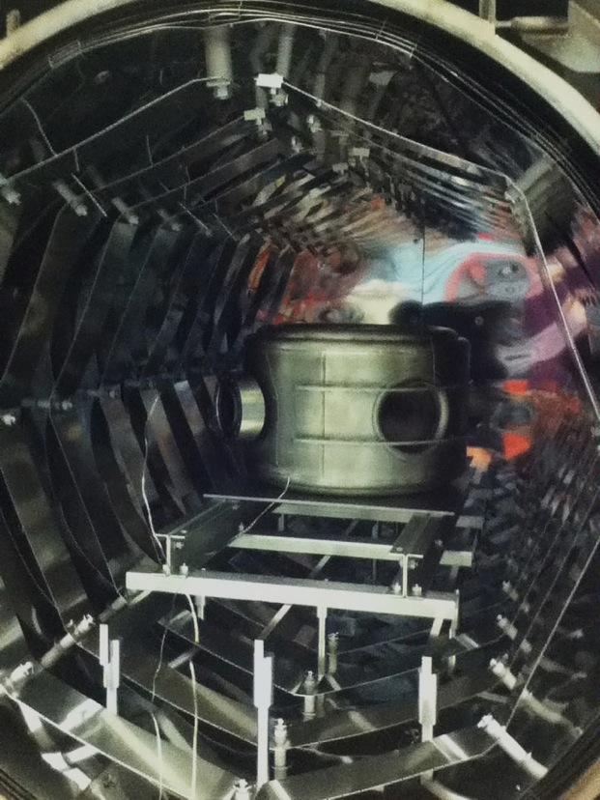
Heat Treatments
Hydrogen Degassing Baking (600/10h - 800’C/2h)
  temperature and time selected based on type of cavity
Pre-VTS 120’C Bake for 48h
  performed with active vacuum pumping to reduce water content and reduce testing times
Low-Temp Bake Ovens
Hydrogen Degassing Oven

Slide 10
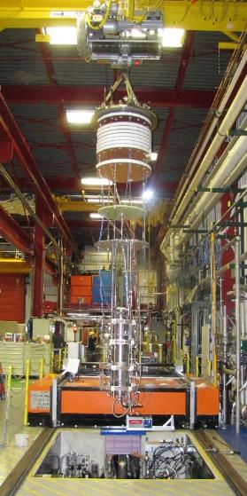
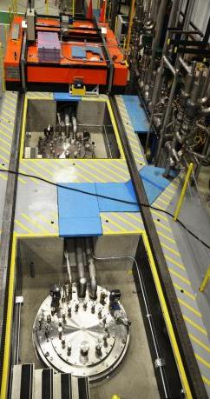
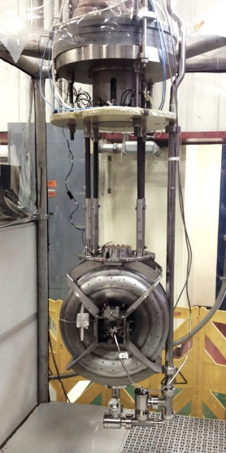
Fermilab Vertical Test Stands
VTS1, VTS2 and VTS3 pits
Cryogenic RF measurements of bare and dressed cavities
  Useable cryostat diameters: VTS1 = 63cm (25”), VTS2&3 = 86cm (34”) {Jacketed RFD ~ 60cm}
  325-650-1300-3900 MHz
  Temperatures down to 1.4K
  Other frequencies possible with low-level RF effort (already launched in FY17)

Slide 11
Acceptance Criteria
Document exists for SPS (EDMS1577565), not for HL-LHC
  Includes criteria for all components of a dressed cavity (raw materials, bare cavity, magnetic shields, helium vessel, HOMs,..)
  Some negotiation will be necessary for successful (and meaningful) transfer to industry.
    The cost of certain examinations will be prohibitive the way it is specified now (e.g. 100% X-ray)
  Certain margins on performance will need to be defined to allow meeting the requirements in HL-LHC after installation (e.g. quench at 3.41 MV should not PASS)
  On the other hand, certain values that are “preferred” for operation should not constitute a hard rejection of a deliverable (e.g. R_{s} , discussion needed)

Slide 12
Requirements and Acceptance Criteria
Qualification in VTS at 2K prior to shipment to Cern
To be discussed asap…
Parameter | SPS Requirement (from EDMS1577565) | Proposed Acceptance THRESHOLD | Proposed Acceptance OBJECTIVE
Frequency | 400.730 - .790 MHz | 400.790 ± 0.1 MHz (no tuner) | -
Voltage | ≥ 3.4 MV | ≥ 4.1 MV (+ 20 %) | ≥ 5 MV
FE | - | Onset above 3.4 MV | Onset above 4.1 MV
P | ≤ 3W | ≤ 10 W | ≤ 5 W
Q₀ | ≥ 10¹⁰ | ≥ 2.7 10⁹ | ≥ 5.4 10⁹
Rs | ≤ 10 nΩ | ≤ 40 nΩ | ≤ 20 nΩ
What other performance parameters should influence acceptance/rejection of delivery? HOMs ?
In the event of a cavity not meeting the THRESHOLD criteria, an explicit approval from CERN will be necessary to consider the cavity a deliverable

Slide 13
RFD Results (PoP + SPS Prototypes)
Satisfactory/Excellent results on PoP and SPS Prototypes, no major show stoppers for cavity manufacturing
Frequency shifts of trimming, welding, processing etc, are understood for the SPS prototypes, solid ground for construction in AUP project
Nevertheless, the RFD has a challenging shape (see high FE on first pass at JLab), impeccable processing is critical for success

Slide 14
Road Map for Project Documents
FRS
ICD
A.C.
WBS Dictionary
Cost Estimates
Risk Register
Some documents need substantial input from CERN
Others needed primarily for interactions DOE←→AUP
For RFD Cavities:
CD-1: FRS, A.C., ICD
CD-2: Baseline Cost, Schedule, Risk
CD-3b: Procurement of Raw Materials and Brazed Joints
CD-3c: Procurement of Bare Cavities
Aug 2017

Slide 15
Interactions – External Dependencies
External Dependencies
  Design review after testing of prototypes, must converge
  Technical Specifications from CERN (→ FNAL procurement documentation)
  Drawings (constitute bulk of interface document)
  316LN material (provided by CERN)
  Some qualification of coupons, joints by CERN (discussed privately, to be made official)

Slide 16
Project Schedule
Schedule Drivers
  Each cavity is processed+tested in “bare” and “dressed” condition (lowest risk → longer schedule)
    Cavities could remain in Industry if bare cavity test is skipped
  ~ 6 months lead time for raw material procurement
  ~ 1 year lead time for bare cavity fabrication
  ~ 6 months lead time for helium vessel welding
Important dates:
  2x dressed prototypes tested at FNAL: Nov 2019
  8x dressed production RFDs qualified: Dec 2022
    (~ 6 month float compared to CERN need-by-date)
  Design for prototypes finalized ASAP no later than Dec 2017
  Design for HL-LHC reviewed, approval of documentation (FRS, A.C, Drawings, Fabrication Spec) by: Feb 2020

Slide 17
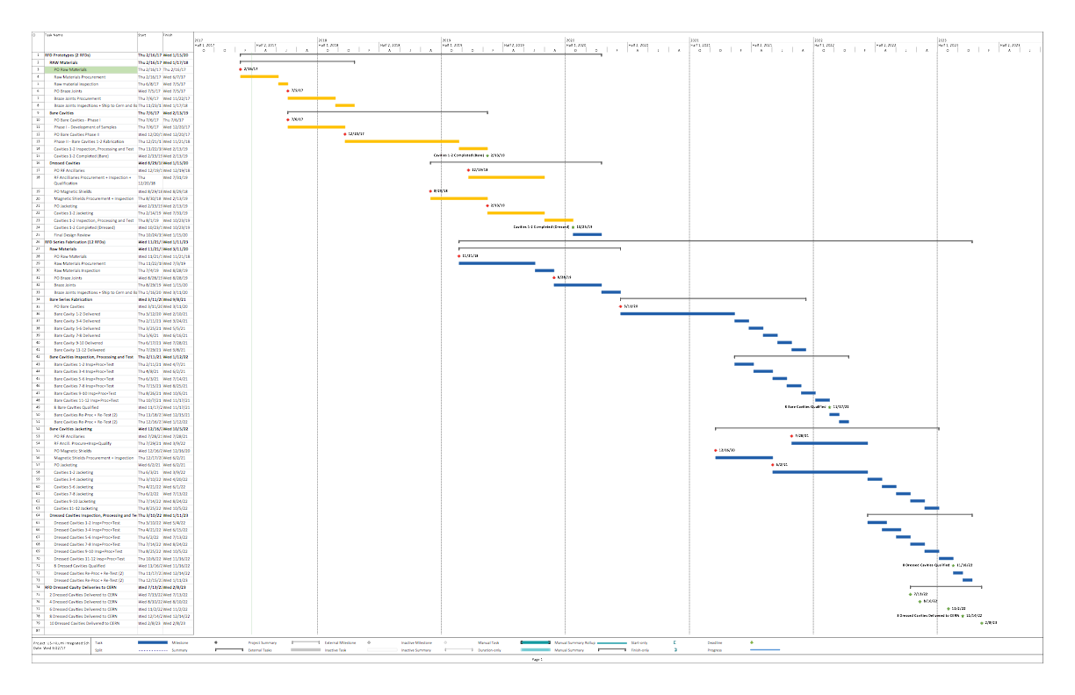

Crab Cavity Project Schedule
FY17
FY18
FY19
FY20
FY21
FY22
FY23
PROTOTYPES
Bare Cavity Tests
SERIES
Dressed Cavity Tests

Slide 18
Resources
LARP → AUP Transition
  RFD effort supported under LARP until end of FY17
  AUP to become official in FY18 and will include prototypes and deliverables for HL-LHC
Currently ~ 4 FTE effort supported by LARP → peak of ~ 8 FTE in FY21

Slide 19
Status
Held Cost-Schedule-Risk Internal Review in Dec 2016
Prepared Cost Estimate (45 BOEs) and undergoing 1st revision to include recent budgetary quotes
Purchased Raw Niobium and Nb-Ti for 2 prototypes
Purchased Amplifier for Fermilab VTS, initiated procurement of VTS tooling and hardware
Currently in preparation: CDR, Risk Registry
Need convergence asap on Functional Requirements and Acceptance Criteria
  Working meetings scheduled the next two days to start discussions

Slide 20
Risk Mitigation Examples
Cavity Quality and Documentation: mitigated by funding (ideally 2 vendors) with Phase I (Certifications and Samples for forming and EBW) and Phase II (Actual construction of cavity by 1-2 vendors)
Technical Performance: production for 12 dressed cavities will be launched with successful vendor of prototypes, to aim at 10 deliverable products.
Processing recipe (e.g. BCP rotation, revolution, flow,..) to be confirmed with prototypes after trials with cavities currently in circulation
Other Risks and their response plan are being identified in the project Risk Registry
If during project execution the yield turns out higher than assumed and adequate contingency is earned back, additional ”up-scope” could be delivered to CERN

Slide 21
Conclusions
The scope was finalized (8+2 Dressed RFDs + HOMs)
The strategy for development is identical to most other SRF projects of this kind/size (procurements in industry + processing and testing in laboratory)
Performance requirements and acceptance criteria are this month’s hot topic, we need to converge.
Recent results for RFD are very promising for AUP and HL-LHC
Several project documents need to be prepared, we have a roadmap for CD-1…CD3
The project schedule provides a delivery of 8 dressed RFDs to Cern in Dec 2022.
Resources were estimated
Risk is being addressed

