Slide 1
Safety regulation for pressure equipment and crab cavity project in the framework of High Luminosity LHC Project
Luca Dassa on behalf of the engineering team
International Review of the Crab Cavity Performance for HiLumi on 3-5 April 2017 (CERN)

Slide 2
SPS approach (with details)
Proposal for LHC installation

Slide 3
SPS approach (with details)

Slide 4
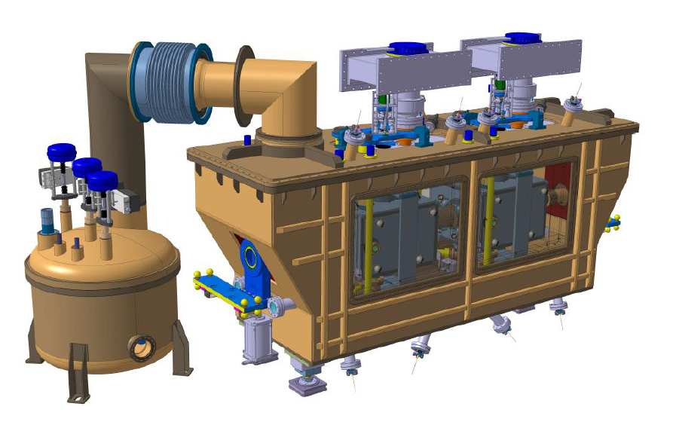
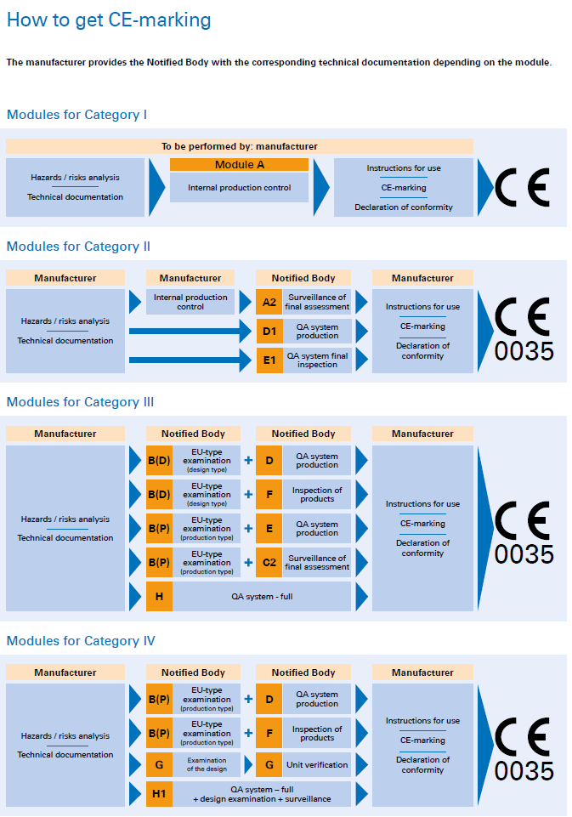
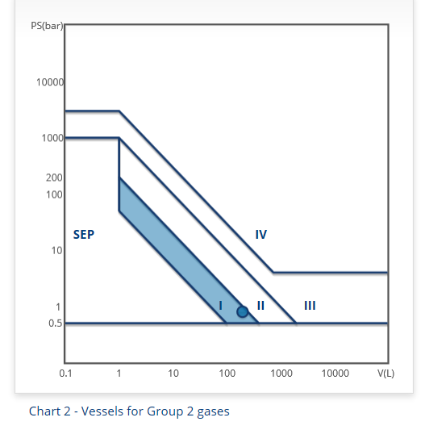

The cryomodule (1)
Pressure components:
Dressed cavities
HOMs
Cryogenic lines
Thermal shield
SPS cryomodule
PS = 0.8 barg
V= 200 l
Gas group 2
CERN:
SR-M
GSI-M-2
GSI-M-4
https://espace.cern.ch/safety-rules-regulations/en/rules/
PED 97/23/EC -> EC declaration of conformity
Courtesy of: TUV
Courtesy of: http://www.eucertification.com/ce-certification-2/ped/pressure-vessel-calculator

Slide 5
The cryomodule (2)
manufacturing experts
designers
engineers
materials not considered in harmonised standards
proof test with high risk to impact on RF performances
management
HSE unit
Crab SPS prototype cryomodule
According to PED Annex 2, the cryomodule belongs to risk category I
equipment liable to have major Safety implications (GSI-M-4)
exempted from EC-marking
the equipment shall meet the Essential Safety Requirements (ESRs) stated PED 97/23/EC.
EU harmonized standards used whenever possible
If not possible, ASME Section VIII Div. 2 + compensatory measures in view of compliance with the ESRs of the PED.
Hydrostatic proof test will be replaced by alternative methods
Everything discussed and approved by 14/09/2015
Valid only for SPS cryomodule
Review and discussion with HSE unit (EDMS 1494776 + EDMS 1541969)

Slide 6
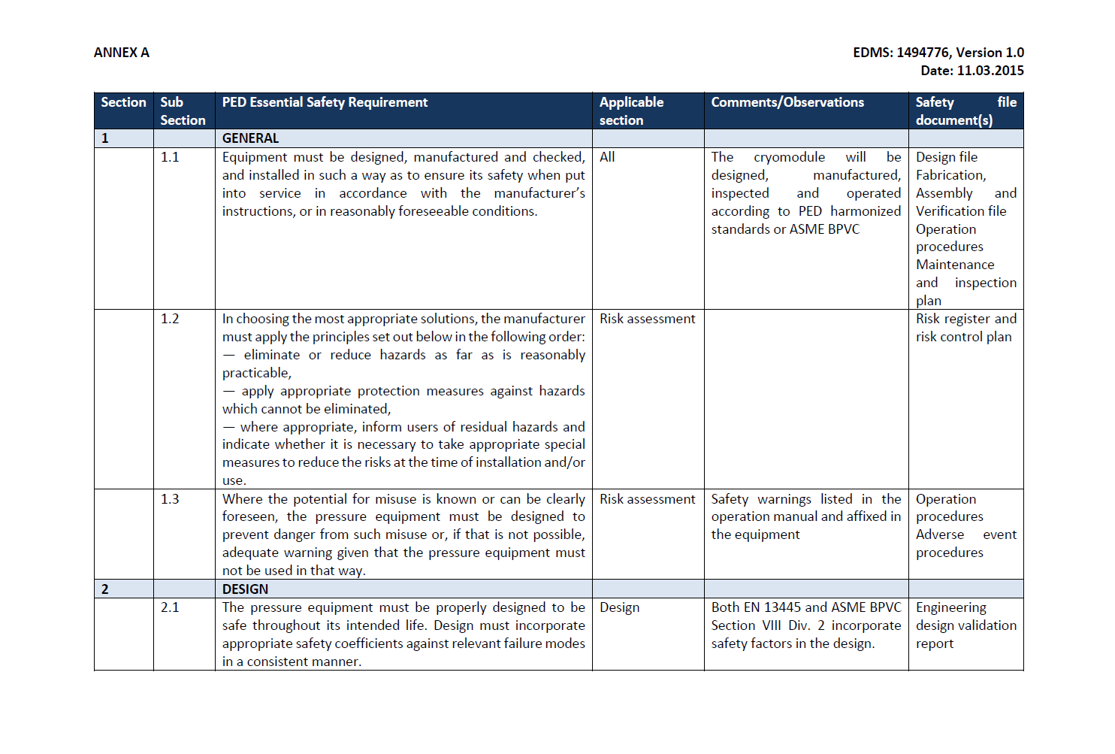
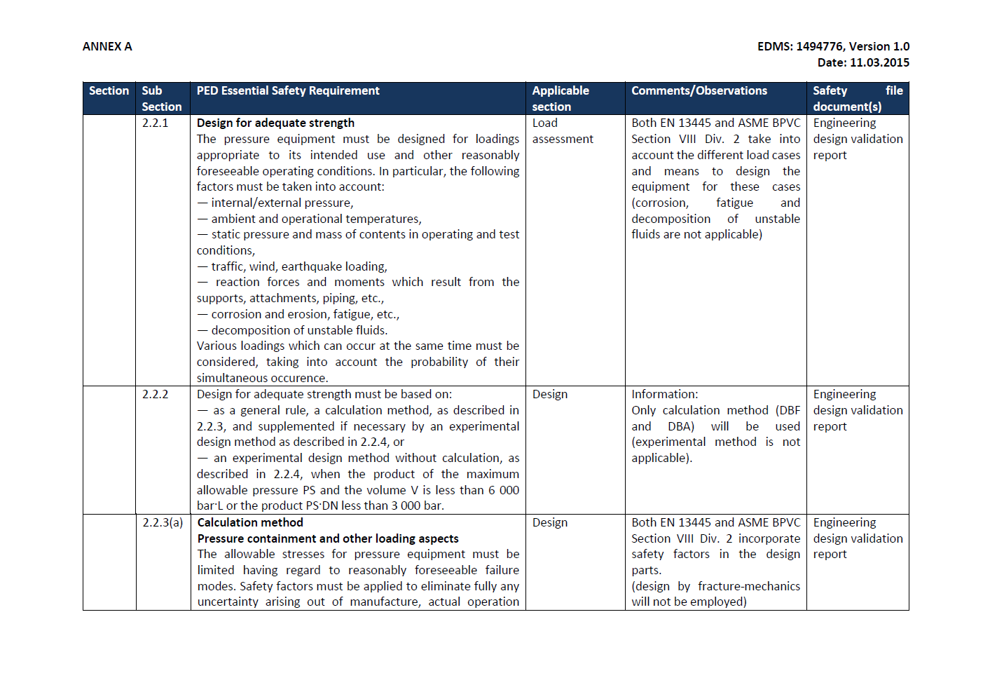
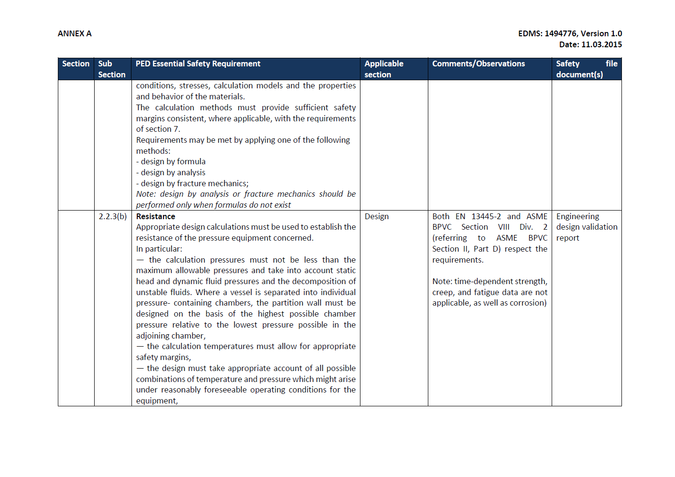
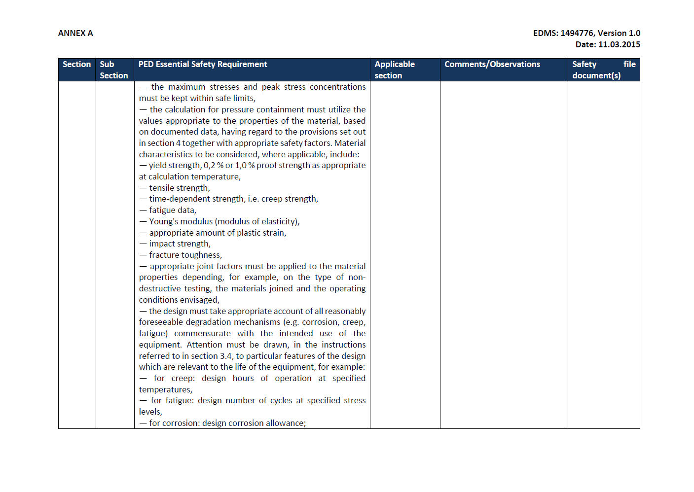
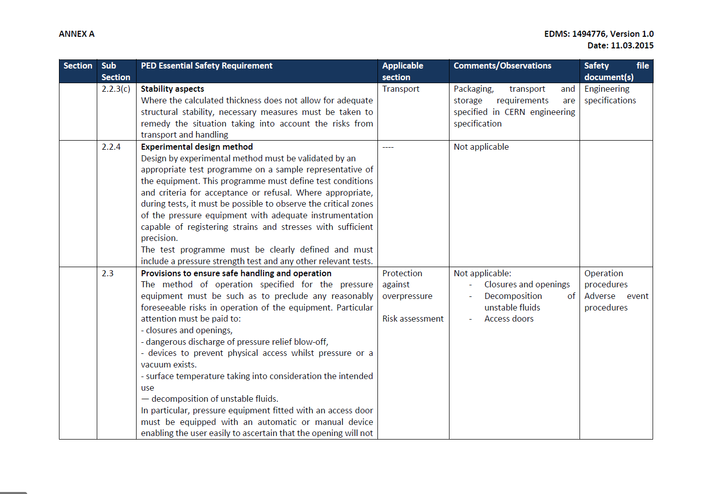

Slide 7
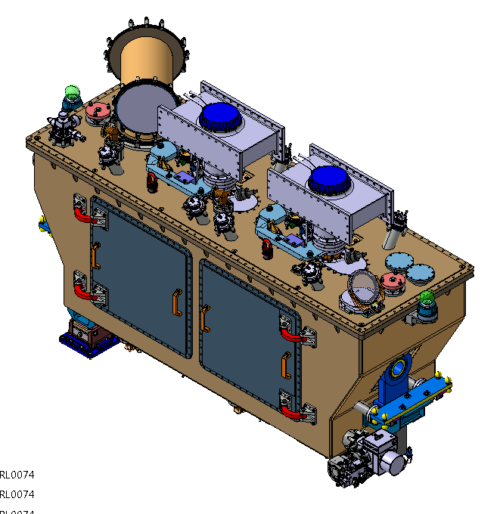
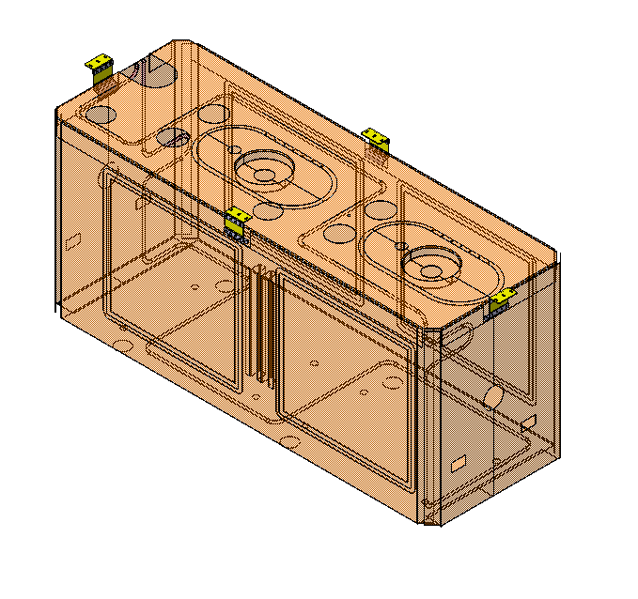
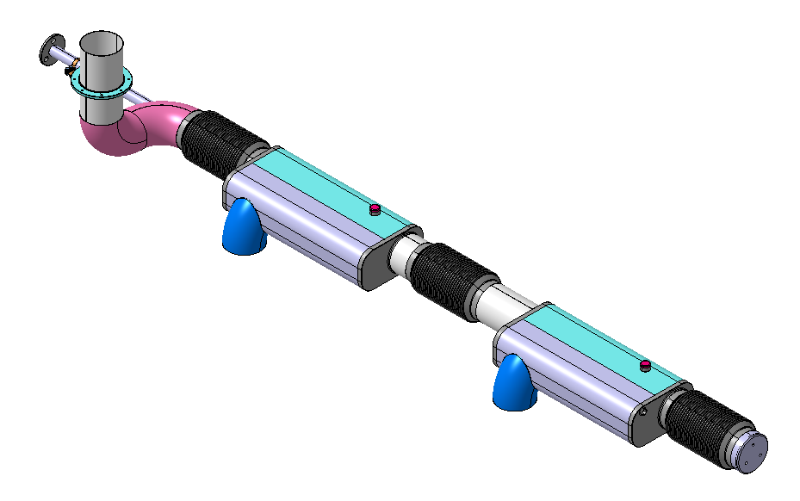
Pressure bearing components (1)
Standard approach for these components (not treated in following slides)
See later for proof test
Connection between titanium vessel and stainless steel cryogenic line using transition obtained by explosion bonding
Vacuum vessel
Thermal shield
Cryogenic lines

Slide 8
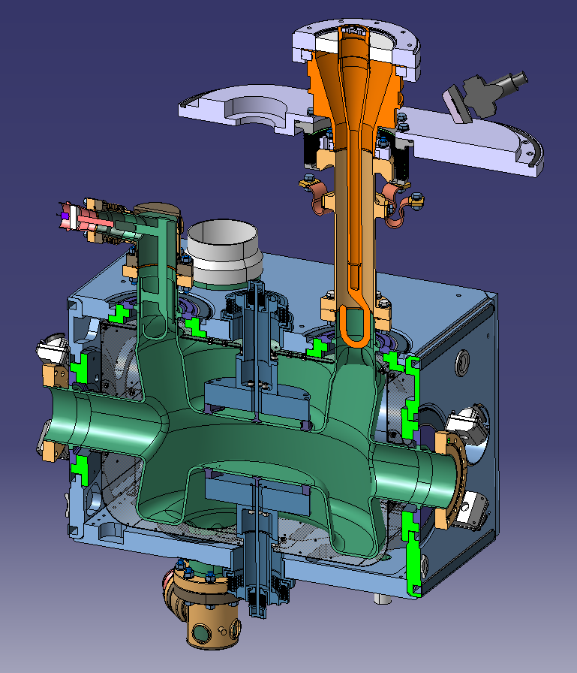
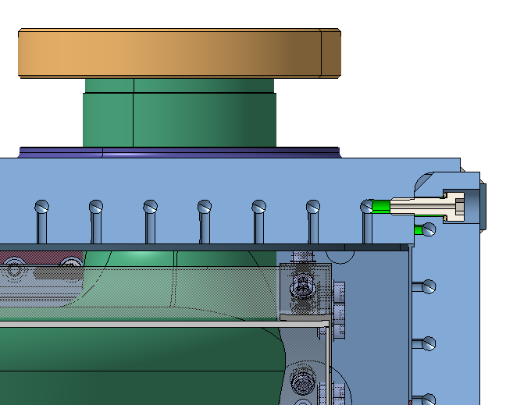
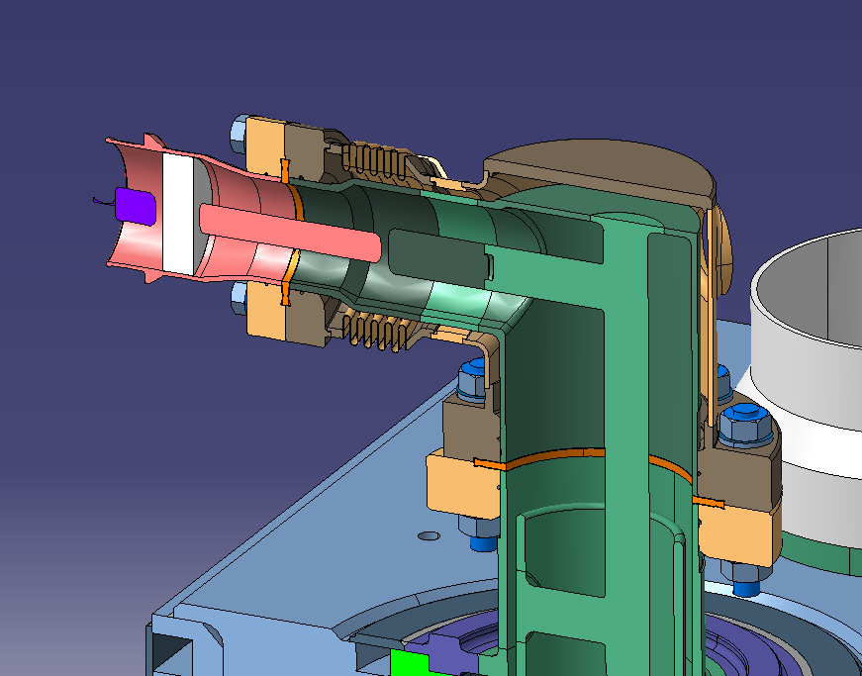
Pressure bearing components (2)
FPC
Leak tightness: welded joint (not pressure bearing joints!)
HOM
Edge welded-bellows (5x)
Bolted pressure vessel: dressed cavity
HOM
Welded pressure vessels: actively cooled HOMs

Slide 9
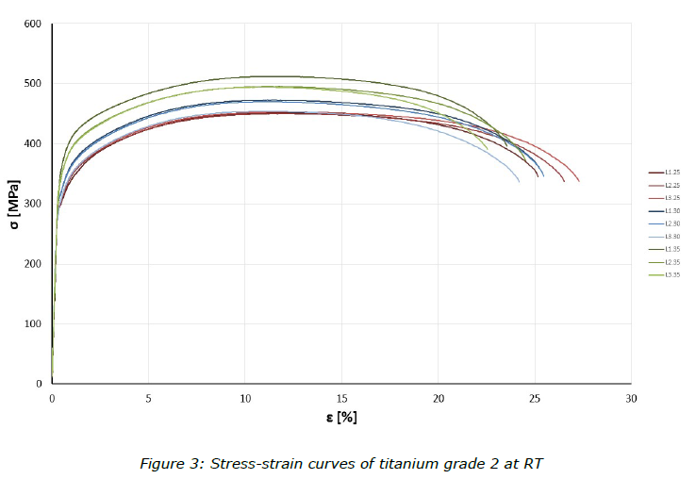
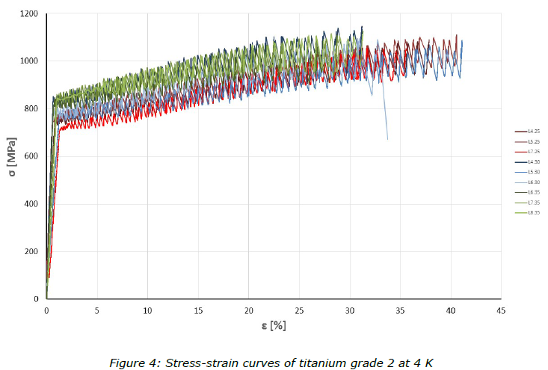
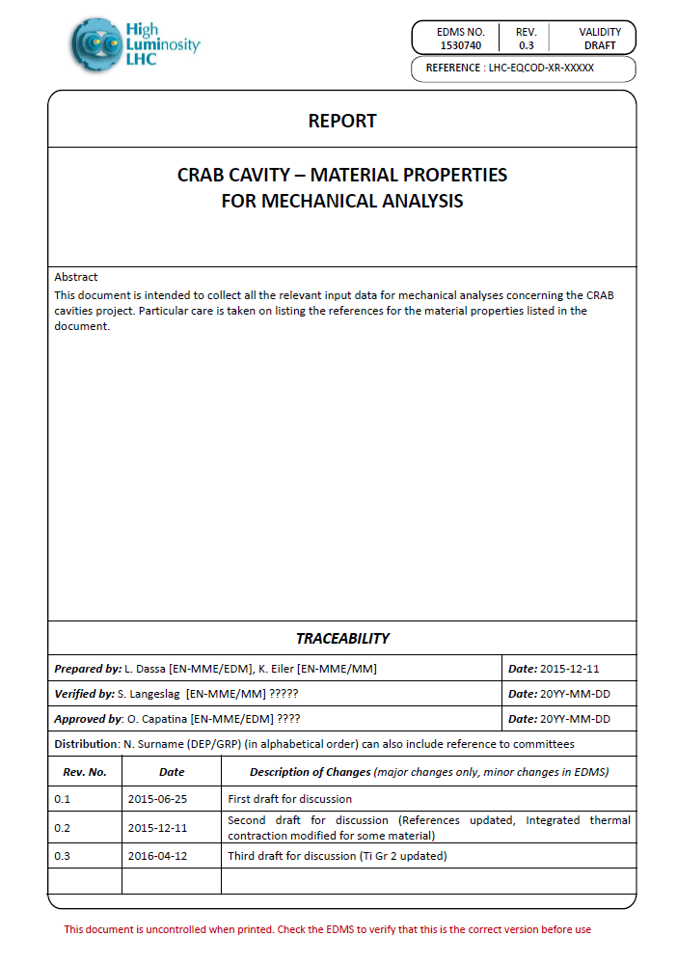
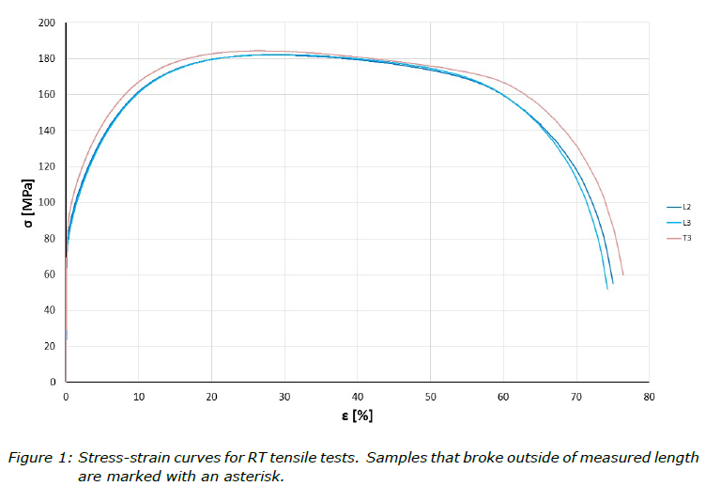
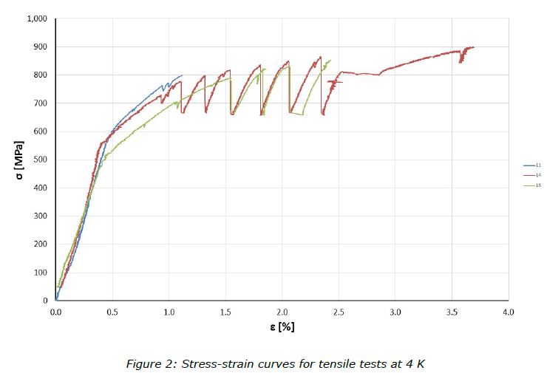
Material tests
Materials:
Ti Gr. 2, Ti Gr. 5, high purity Nb and 55Ti-45Nb not considered in the Harmonised Standards
conformity with the ESRs required
compliance with PED would require PMA
  For Ti -> PMA (DESY) + material certificate + internal tests (EDMS 1538192)
  For Nb and NbTi -> PMA on similar material (DESY XFEL) -> material certificate + internal tests (EDMS 1722302 for Nb and EDMS 1493400 for NbTi )

Slide 10
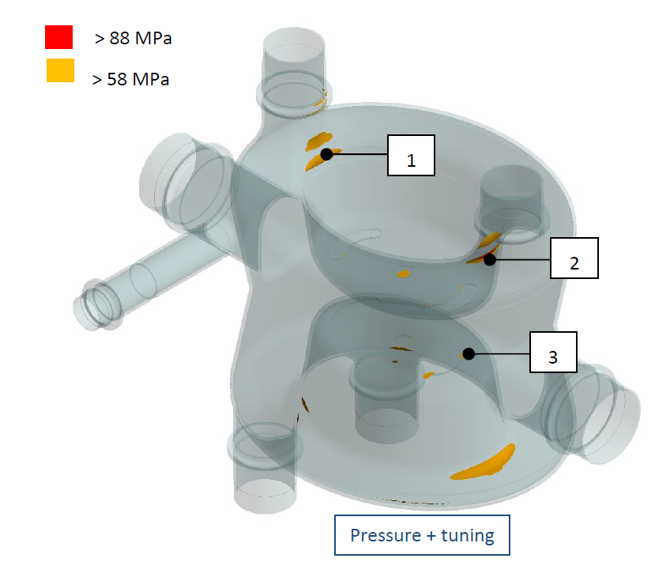
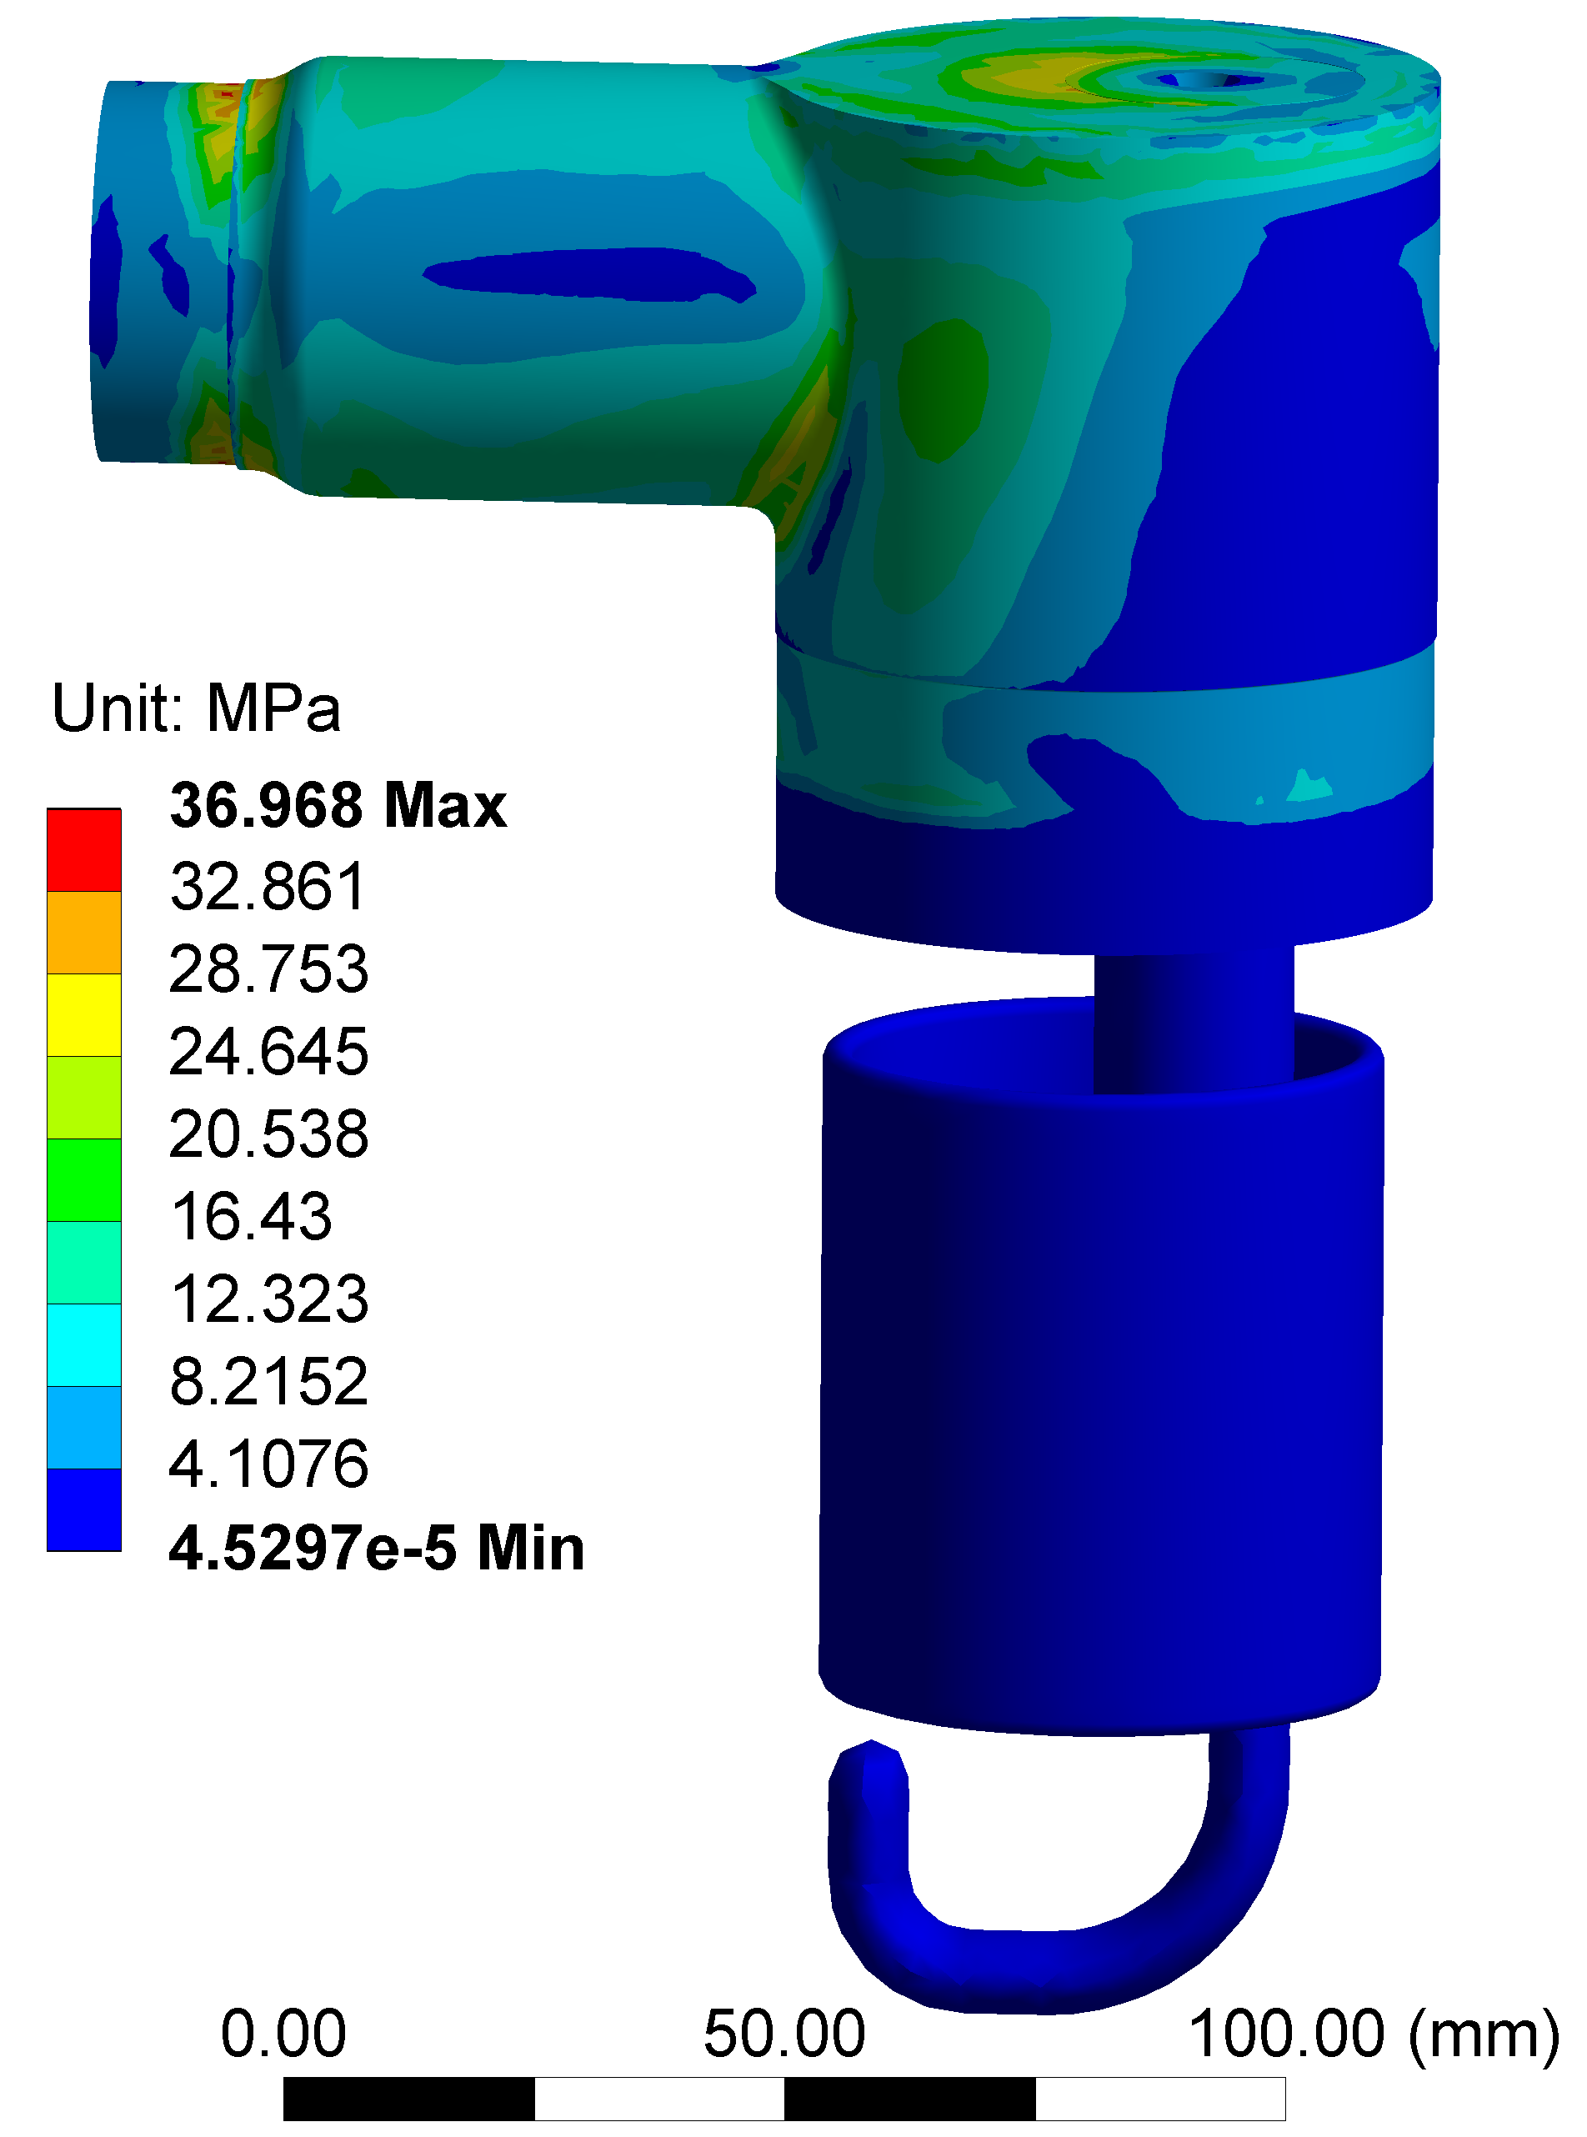
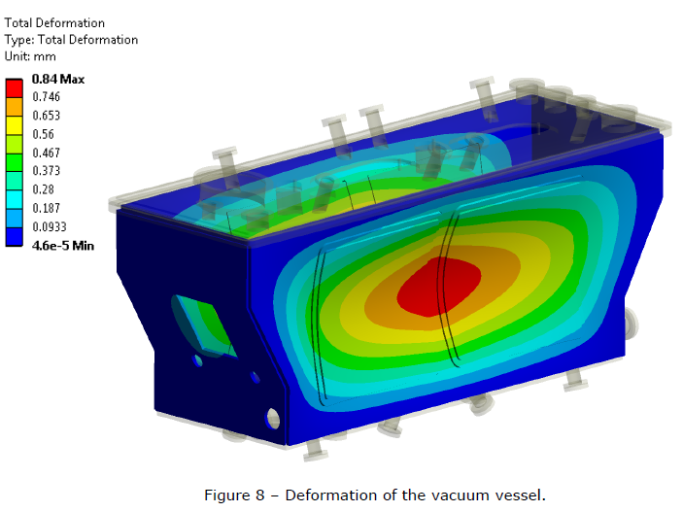
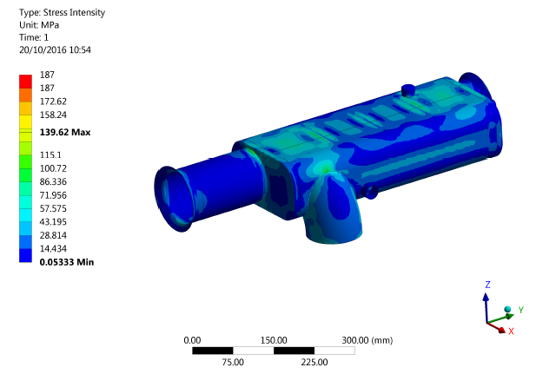
Design
Loads:
  PS = 1.8 bar abs
  T= 300 K
  Static pre-tuning = 0.2 mm
  Loads not considered:
  Dynamic fine tuning (only at cold)
Other remarks
  Fatigue life: not applicable (cycles < 500)
  Pressure test: derogation
Cavity, bolts, weld assessment -> EDMS 1549819
HOM assessment -> EDMS 1433086
Vessel assessment -> EDMS 1712011
Biphase line assessment -> EDMS 1727787

Slide 11
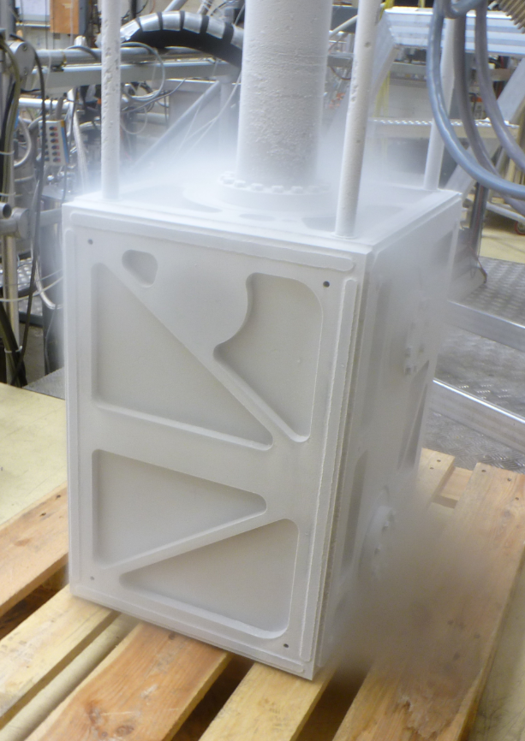
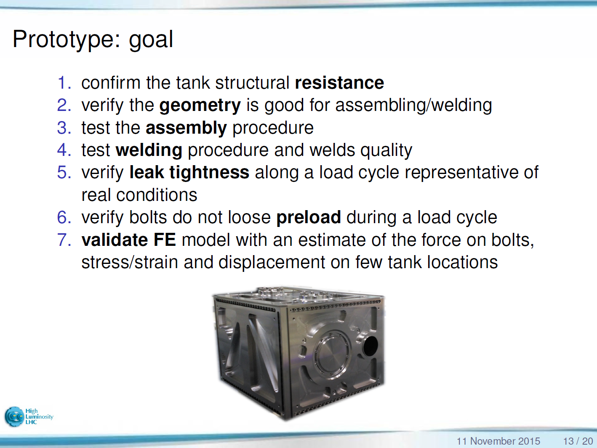
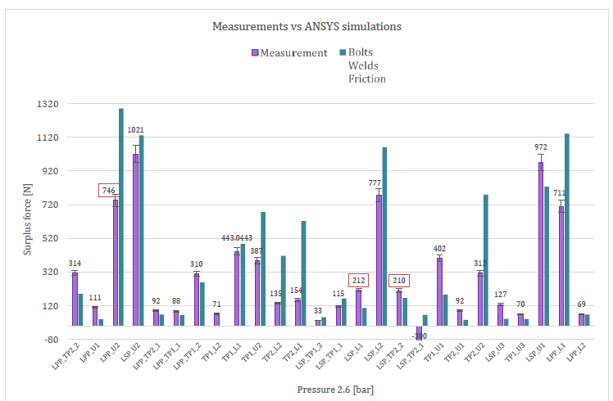
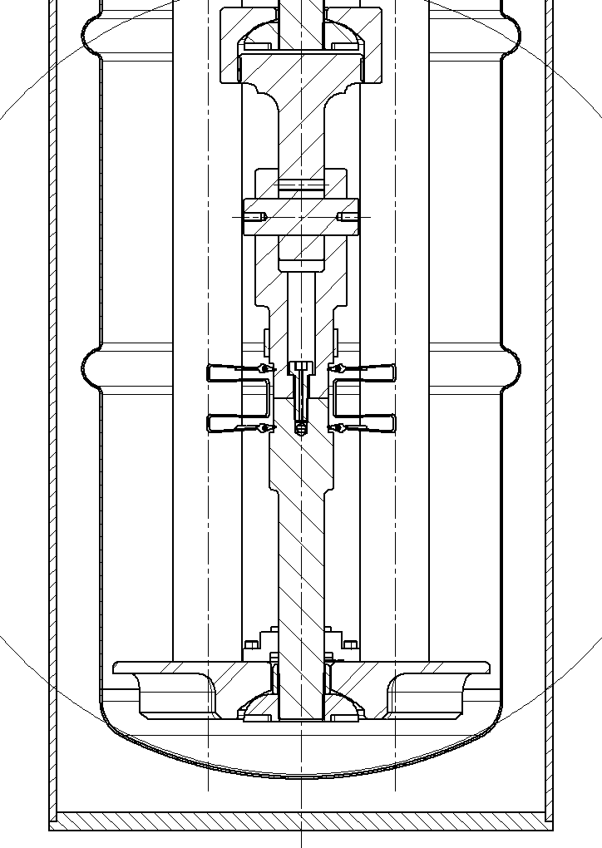
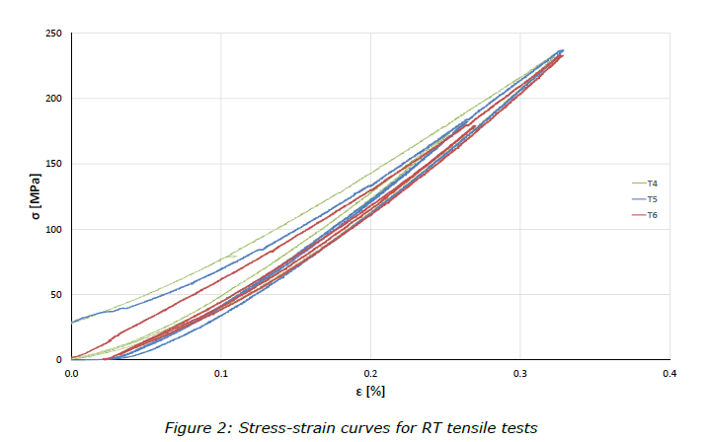
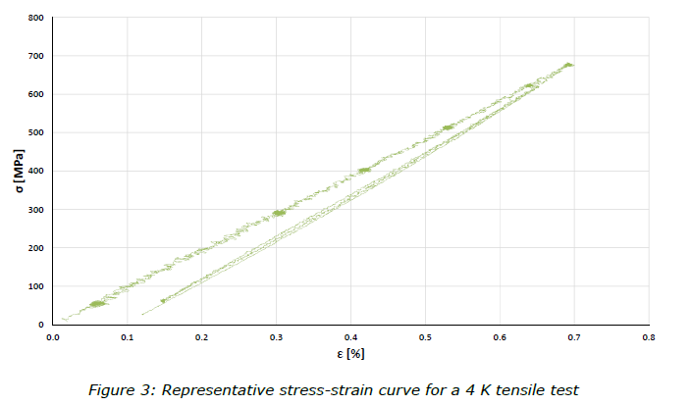
Preliminary tests on components
Courtesy of C. Zanoni, 11/11/2015 - SPS Cryo-module Engineering Review
Report EDMS 1721359
Bolted He vessel = unusual pressure vessel
Report EDMS 1705731

Slide 12
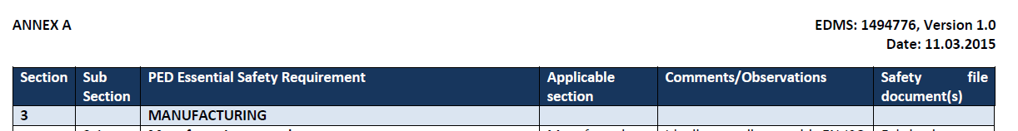
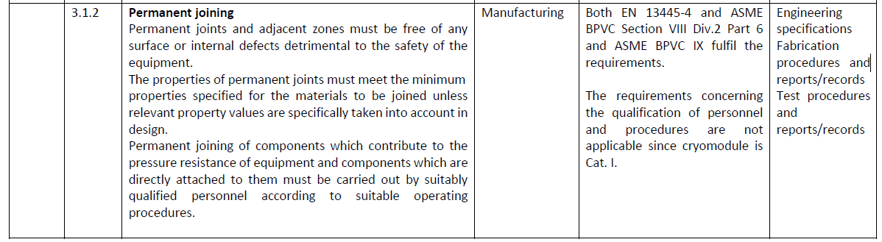
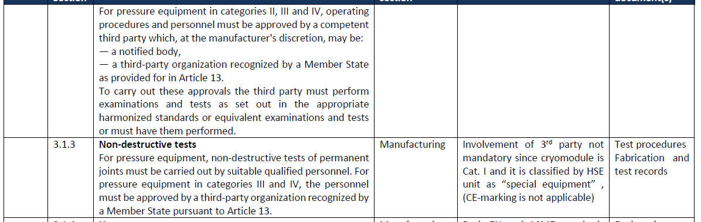
Manufacturing & Inspection (1)
Back to the EDMS 1494776
complex joints / not standard (not only for pressure)
exotic materials
Ti welded joints are not bearing pressure loads!
Vacuum brazing (not for pressure equipment), electron-beam welding, TIG (GTAW) welding
Nb, NbTi, Ti

Slide 13
Manufacturing & Inspection (2)
Specification (EDMS 1389669)
No standard available for Nb welded joints
Acceptance criteria on imperfections: part of standards related to Al alloy have been retained and modified
Additional requirements for acceptance criteria due to RF restrictions
Qualifications and the acceptance criteria according to harmonized standards (in compliance with the Essential Safety Requirements from PED) whenever possible
Nb
qualification of each weld is performed in-house: for Nb according to harmonized standard (EN15614-11)
Nb
Guidelines from other projects: i.e. HG (former SPL) cavities for Nb welded joints and from other labs
welding qualification according with the harmonized standard EN15613, not wrt the mechanical properties, but wrt to the configuration in the helium tank
welder and the operator are already qualified by the welding qualification itself
Specification (EDMS 1389669)
List of applicable EU harmonized standard standards with equivalent American standards
Ti
Ti
Not pressure bearing joints
Ti

Slide 14
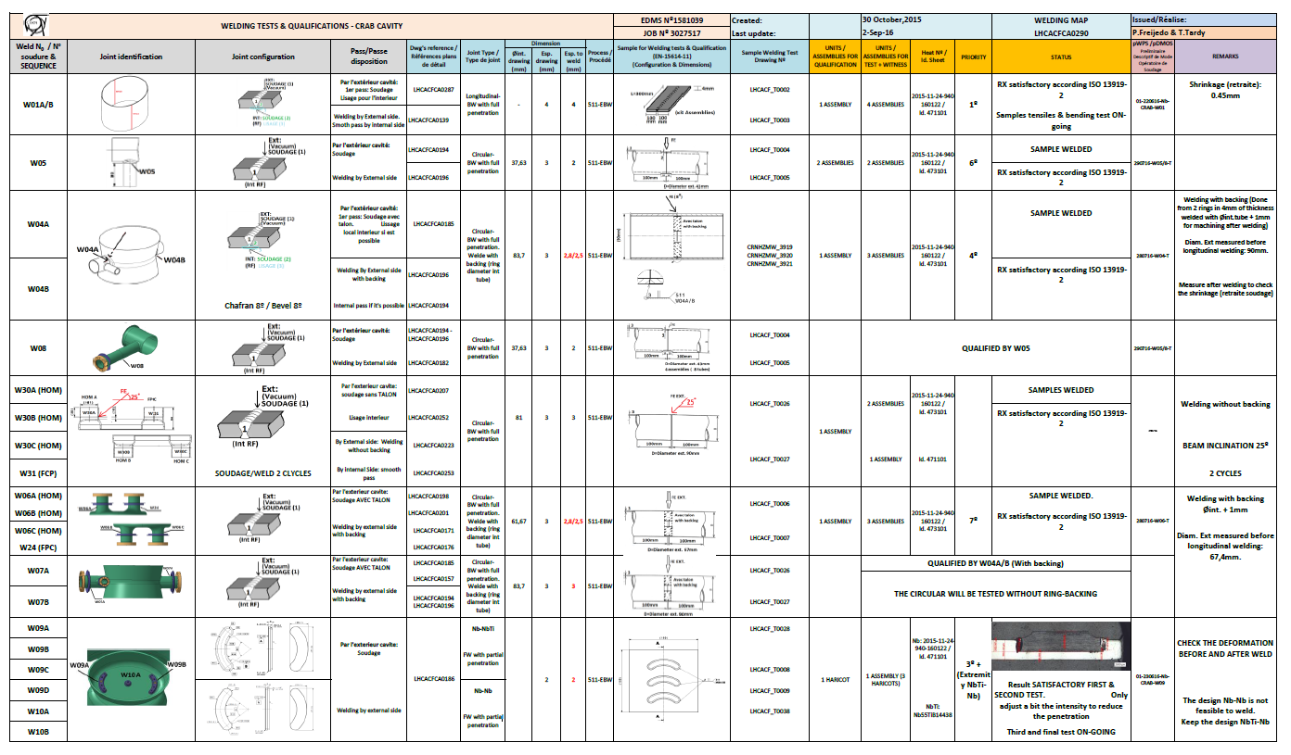
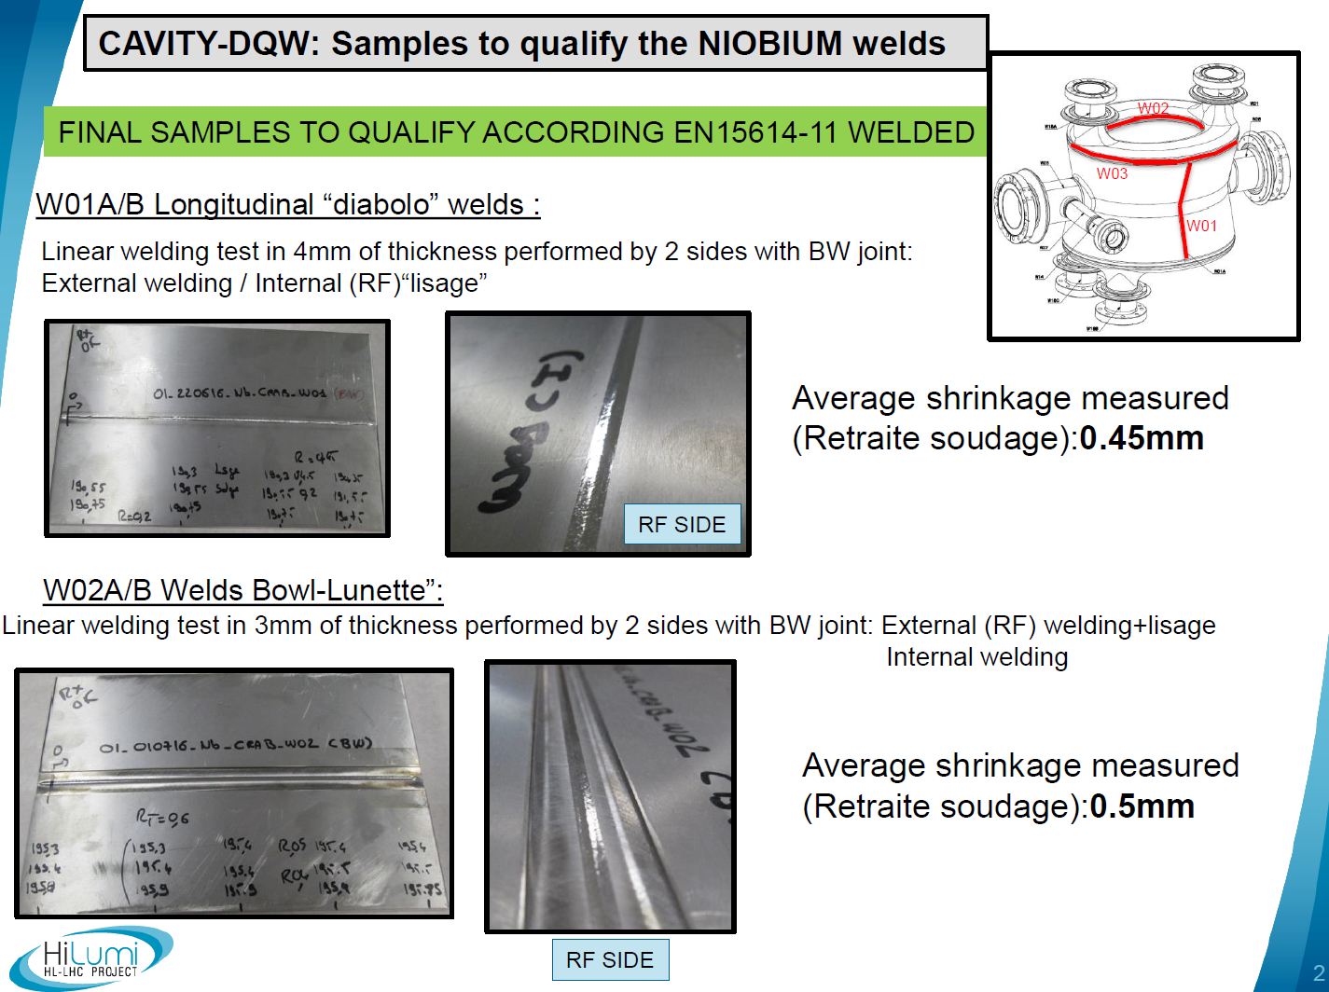
Manufacturing & Inspection (3)
Bare cavity
EDMS 1581039 CERN documentation for welding qualification and tests
EDMS 1685099 Welding Book Crab Cavity DQW. Extremities and Final assembly. : ASSETS HCACFCA004‐CR000001 & CR000002.
EDMS 1758810, WELDING DOCUMENT CRAB CAVITY DQW
Material traceability:
EDMS 1549318 Summary of materials for Crab Cavity and He tank manufacturing at CERN
Ti vessel:
welding book in progress

Slide 15
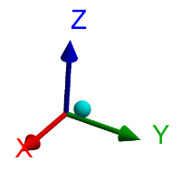
Proof test
Results of preliminary analysis shows that there could be risk of plasticization in some critical area during proof test.
There are NO RISKS for people safety!
De-tuning of the cavities at ambient temperature must be avoided
The mechanical properties of the material used for manufacture of the bare cavities is being verified by dedicated mechanical tests.
Alternative method proposed: pneumatic proof test at the maximum allowable pressure (0.8 barg) at ambient temperature.
Done in SM18 with service box
First cool-down and proof test preformed in SM18
Accepted by HSE CERN unit
(see EDMS 1494776 + EDMS 1541969)

Slide 16
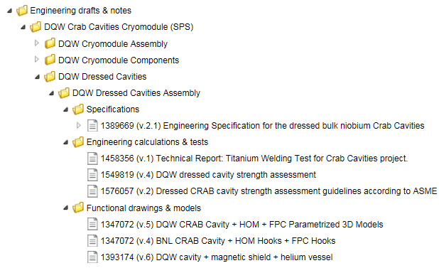
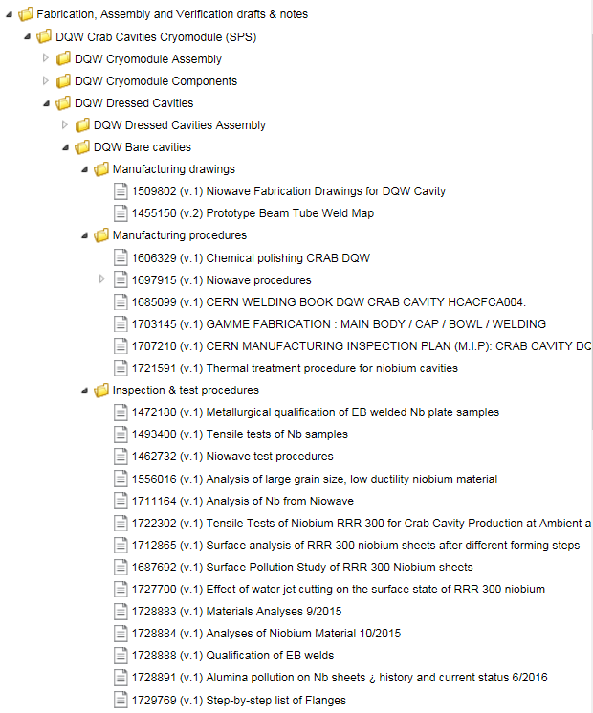
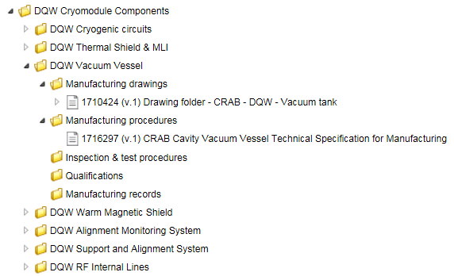
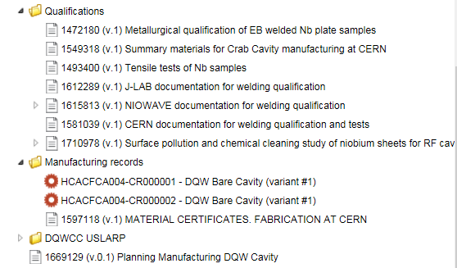
Documentation
only for bare cavity
design
CERN-0000115183
CERN-0000115182
cryomodule components
And similar for other components…

Slide 17
SPS Crab Cavity Test Stand: Safety review
Approach accepted
All recommendations are in EDMS 1706929
See the talk :
“SPS Crab Cavity Test Stand: Safety review summary, Christelle Gaignant, International Review of the Crab Cavity Performance for HiLumi – 3rd/5th April 2017”

Slide 18
Proposal for LHC installation

Slide 19
LHC crab cavities
main reference: EDMS 1494776 “A proposal for compliance…” (for SPS cryomodule) + EDMS 1541969 “Safety Request Form - Safety compliance…”
risk due to pressure -> Category definition -> He volume on the LHC cryomodule -> we assume that we have the same volume (reasonable assumption: each cryomodule protected by a safety valve) as per SPS cryomodule -> Category 1
If so, the same safety requirements as per SPS cryomodule apply -> no need for Notified Body
Approach not yet discussed by HSE unit.
Clarification will be requested to HSE unit according to the statement of EDMS 1698982 and based on evaluation done in EDMS 1494776
We don’t see any reason to have for LHC series production a different approach from the SPS cavities

Slide 20
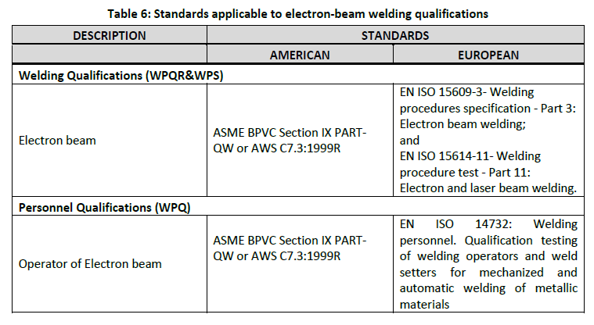
Specifications for LHC crab cavities
Based on the hypothesis done in previous slide:
  Specification for dressed cavities (document EDMS 1389669) available and already presented to US LARP
  CERN take care of the global «certification» of the machine
  no CE marking is required, no notified body
  Possibility to use ASME or EU standard. Big effort has been done to state equivalence between standard (also using ITER experience) -> see example:
  US LARP has been updated about it

Slide 21
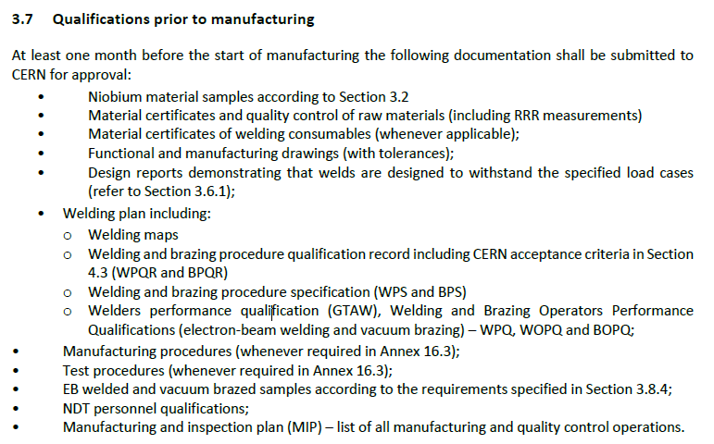
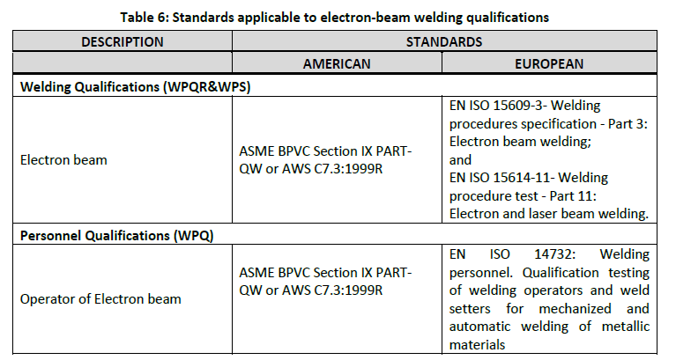
Companies involved in LHC crab cavities
No exotic requirements
CERN has performed all the steps that will be required to companies
CERN is available to help and to clarify the spec, if needed
Notified body not required
Example for bare cavity (from Specifications EDMS 1389669)

Slide 22
Thank you…

Slide 23
Back-up slides

Slide 24
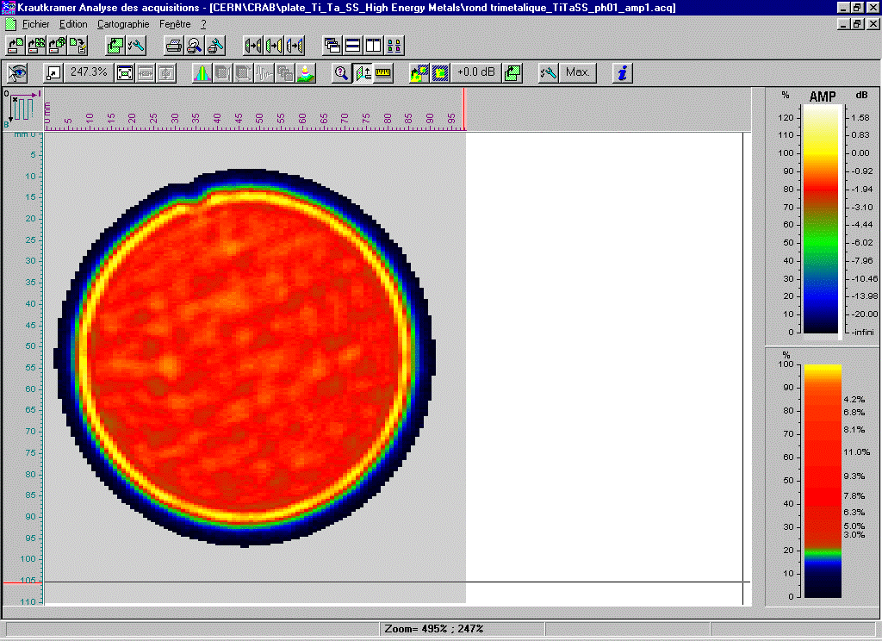
Material tests (2)
Explosion bonding (Nickel interlayer) -> EDMS 1705993
Explosion bonding (Copper interlayer) -> EDMS 1724598
Explosion bonding (Tantalum interlayer) -> EDMS 1739621
Tests
Leak
Traction
Metallographic
Ultrasonic
+ thermal cycles on the real component + leak test

Slide 25
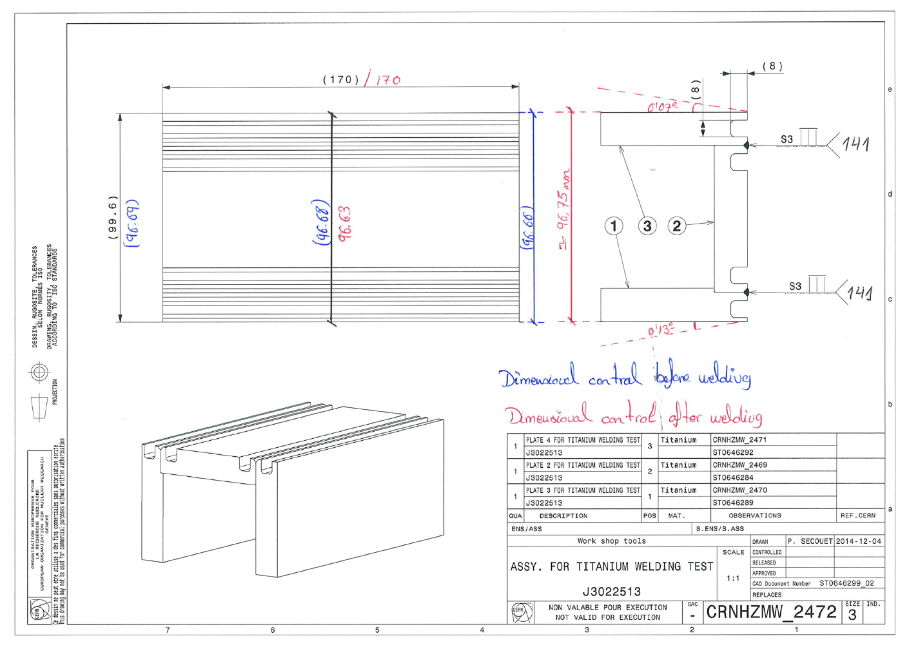
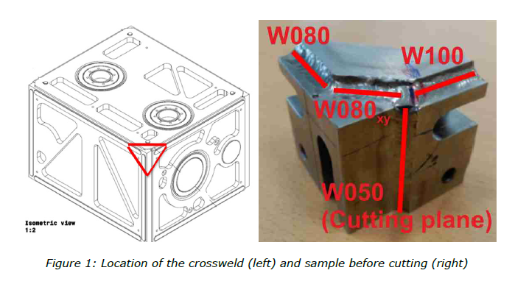
Test on welded joints
EDMS 1458356 Technical Report: Titanium Welding Test for Crab Cavities project.
EDMS 1716204 Metallographic Weld Analyses for Crab Cavity Helium Tank Prototype
EDMS 1562825 WELDING HELIUM TANK PROTOTYPE CRAB CAVITY‐DQW

Slide 26
Cryogenic circuits and safety protection
individual safety device for each cryogenic device (cold box, VBx, transfer line, SB)
exception: CCM (by integration reasons protection on SB)
Flex lines
Safety devices according to ISO-4126:
Helium guarded safety valve at 1.8 bara, sized to cover insulation vacuum break with 1.5 contingency factor
Dedicated rupture disc at 2.1 bara, sized to cover beam vacuum break with 1.5 contingency factor
Two DN150 discs (since common vacuum, one on SB and one on CCM) set at 1.05 bara (contingency factor of 2 considered)
Courtesy of K. Brodzinski, Crab cavities SPS Test Stand Safety Review – CERN – 9 November 2016

Slide 27
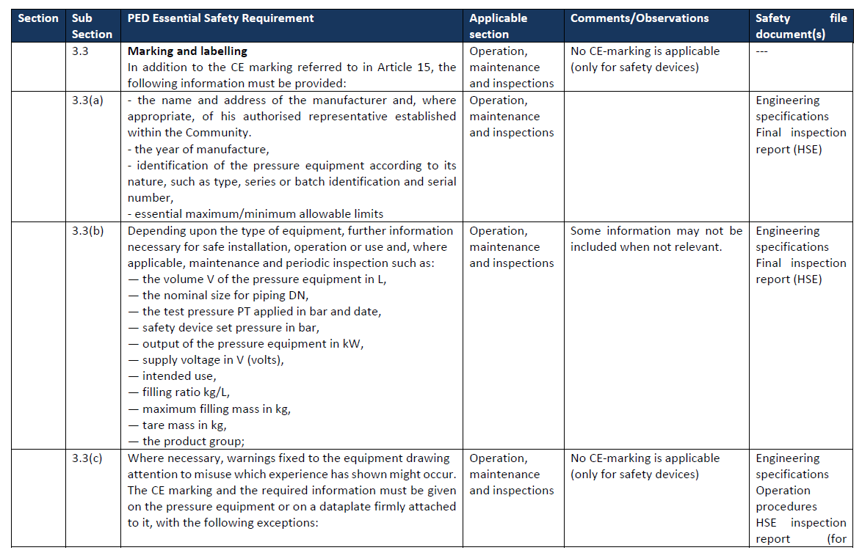
Certification
Back to the EDMS 1494776

Slide 28
Full diagram of SPS installation
Flex lines
Courtesy of K. Brodzinski, Crab cavities SPS Test Stand Safety Review – CERN – 9 November 2016

Slide 29
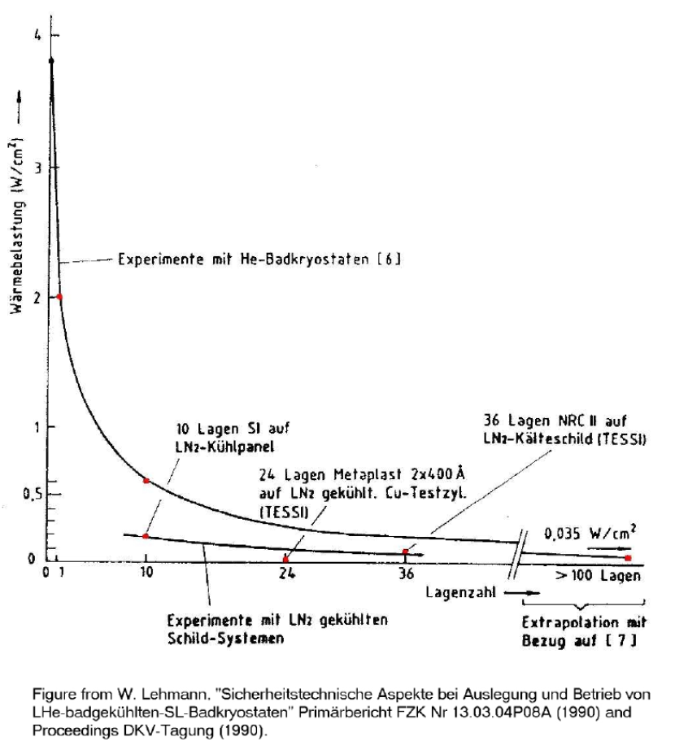
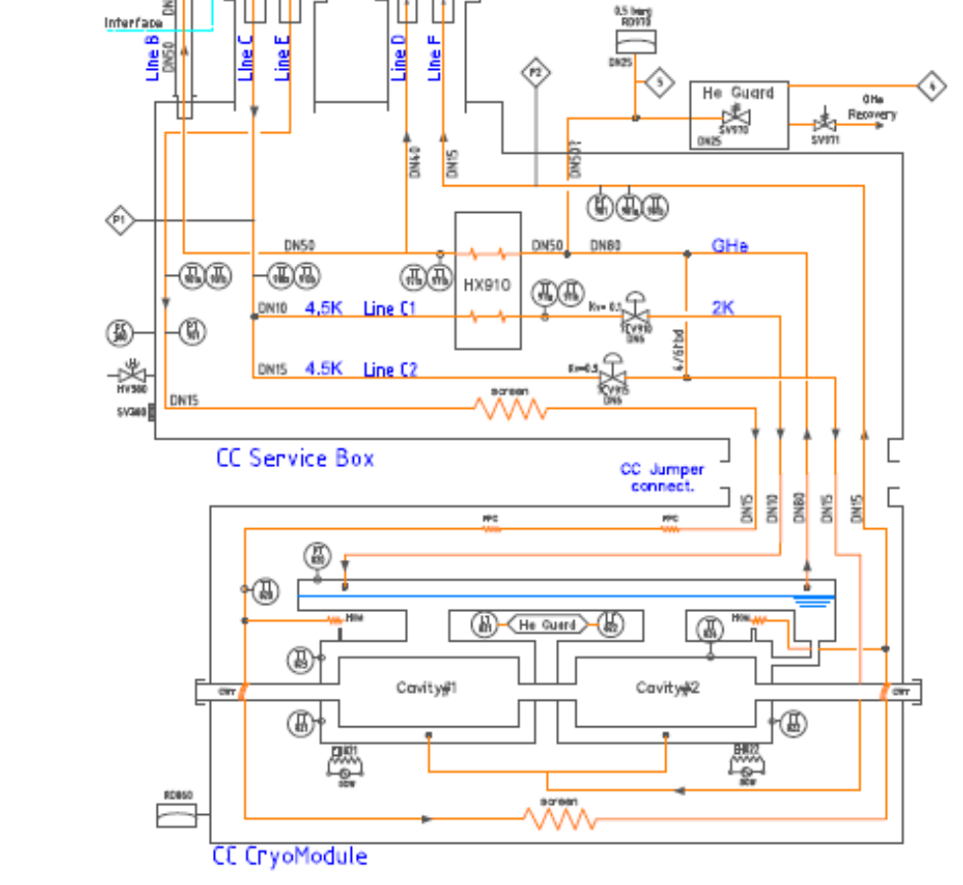
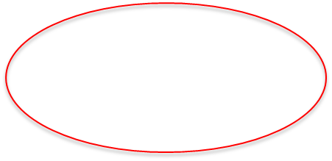
MCI – CCM internal lines
Assumption: complete break of a beam pipe (D=90 mm)
Heat load due to N2 condensation inside the cavity = 40 kW/m2
Safety devices according to ISO-4126:
Helium guarded safety valve at 1.8 bara with diam.=25 mm, sized to cover insulation vacuum break with 1.5 contingency factor
Dedicated rupture disc at 2.1 bara with diam.=25 mm, sized to cover beam vacuum break with 1.5 contingency factor
Courtesy of K. Brodzinski, Crab cavities SPS Test Stand Safety Review – CERN – 9 November 2016

Slide 30
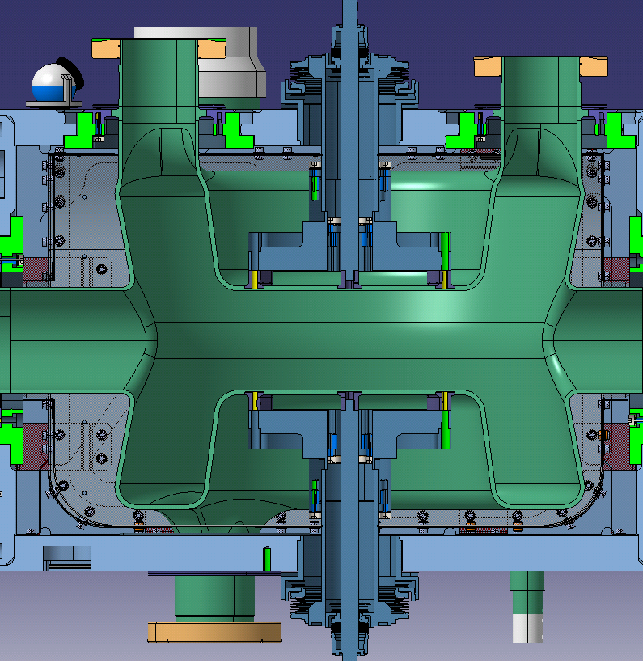

MCI for the vacuum jacket
Vacuum jacket MCI: beak of a tuner bellow (He release section of ~3000 mm2)
Two DN150 discs (since common vacuum, one on SB and one on CCM) set at 1.05 bara will be installed (sizing includes contingency factor of 2 considered for first calculation, detailed analysis is still to be completed)
Courtesy of K. Brodzinski, Crab cavities SPS Test Stand Safety Review – CERN – 9 November 2016

Slide 31

Courtesy of C. Zanoni, 11/11/2015 - SPS Cryo-module Engineering Review

Slide 32

Courtesy of C. Zanoni, 11/11/2015 - SPS Cryo-module Engineering Review

Slide 33


Courtesy of C. Zanoni, 11/11/2015 - SPS Cryo-module Engineering Review

Slide 34

Courtesy of C. Zanoni, 11/11/2015 - SPS Cryo-module Engineering Review

Slide 35
LHC crab cavities (1)
EDMS 1698982, S. Baird, head of the HSE Unit: Conformity approach for Pressure Equipment for the High Luminosity LHC Project (June 10th, 2016)
SR-M, GSI-M-2, GSI-M-4 -> PED (2014/68/EU) -> Category? -> CE marking -> general approach
Approach by exception -> per equipment basis -> unique in-house technical competency -> no Notified Body (it would not add any risk mitigation) -> HSE-SEE will act as de facto Notified body
Responsibility for design, manufacture, testing and quality insurance remains with HL-LHC Project team / technical justification shall be prepared by the equipment owner-work package leader
Formal derogation not required if the HSE-SEE classes the equipment as being “liable to have major safety implications”
Technical requirements
Organizational and quality assurance requirements
Example: see WP3 and EDMS 1753780 (07/02/2017)
Is the LHC crab cryomodule concerned???

Slide 36



EDMS 1698982, S. Baird, head of the HSE Unit: Conformity approach for Pressure Equipment for the High Luminosity LHC Project (June 10th, 2016)

