Slide 1
AN OUTLOOK ON LHC OPERATION AND ON FUTURE PROJECTS AND STUDIES
CERN, 22th November 2016
Italian teachers program
E. Todesco
HL-LHC IR magnets WP leader
Magnet, Superconductors and Cryostats Group
Technology Department
CERN, Geneva, Switzerland

Slide 2
CONTENTS
The present: LHC in the 10’s
  LHC energy
  The race towards luminosity
The 20’s: the HL-LHC project
  Aiming at 3000 fb⁻¹
The 30’s: FCC studies
  Aiming at 100 TeV centre of mass

Slide 3


LHC IN THE 10’s:
ENERGY
In run I, LHC energy has been 3.5 TeV and 4 TeV
  Unforeseen limitation, due to weakness in the interconnections
    This caused the 2008 incident
  In 2008 one sector was pushed to 6.6 TeV showing a training longer than expected – only in 3000 series magnets
Major consolidation in LS1
  Shunt being added to cure interconnection the problem [J. P. Tock, F. Bordry, et al., EUCAS conference, to be published on IEEE Trans. Appl. Supercond.]
Cross-section of the intreconnection and
radiography showing missing continuity
[F. Bordry, J. P. Tock and LS1 team]
The training of sector 56
[HC and MP3 team]

Slide 4
LHC IN THE 10’s:
ENERGY
2014: decision to train LHC at 6.5 TeV
    Compromise between time, risk and energy for physics reach
    1-2 week to train one sector, in the shadow of hardware commissioning
  Expected ∼100 quenches, we went to 6.5 TeV with 174 quenches
    A bit worse then expected, but we got there
  First data about the whole LHC
    3000 series confirmed to be weaker (~1/3 of the magnets quenched)
    First data about the whole LHC: magnet production not uniform
  Effort sto understand what happened are ongoing
In 2015 and 2016 very smooth run at 6.5 TeV
  1200 dipoles working at 7.7 T, with 20% margin
At the end of 2016, two sector to be pushed towards 7 TeV
  This would mean working with the dipoles at 14% margin
  According to these results, LHC energy may stay at 6.5 TeV or go towards 7 TeV

Slide 5
LHC IN THE 10’S:
THE RACE TOWARDS LUMINOSITY
Equation for the luminosity
Accelerator features
  Energy of the machine 7 TeV
  Length of the machine 27 km
Beam intensity features
  N_{b} Number of particles per bunch 1.15×10¹¹
  n_{b} Number of bunches ~2808
  Beam geometry features
  ε_{n} Size of the beam from injectors: 3.75 mm mrad
  β* Squeeze of the beam in IP (LHC optics): 55 cm
  F: geometry reduction factor: 0.84
Nominal luminosity: 10³⁴ cm⁻² s⁻¹
(considered very challenging in the 90’s,
pushed up to compete with SSC)

Slide 6
LHC IN THE 10’S:
THE RACE TOWARDS LUMINOSITY
Equation for the luminosity
We will outline some of the luminosity limits
  Beam beam (limit on N_{b}/ε_{n})
  Electron cloud (limit on n_{b})
  Squeeze (limit on β* ε_{n})
  Injectors (limit on N_{b}, n_{b}, ε_{n})

Slide 7
LHC IN THE 10’S:
THE RACE TOWARDS LUMINOSITY
The beam-beam limit (Coulomb)
  N_{b} Number of particles per bunch ε_{n} transverse size of beam
  One cannot put too many particles in a “small space” (brightness)
    Otherwise the Coulomb interaction seen by a single particle when collides against the other bunch creates instabilities (tune-shift)
  This is an empirical limit, also related to nonlinearities in the lattice
    Very low nonlinearities → larger limits
    LHC behaves better than expected – boost to 50 ns operation in RunI

Slide 8

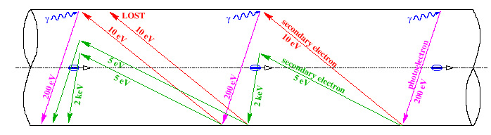
LHC IN THE 10’S:
THE RACE TOWARDS LUMINOSITY
The electron cloud
  This is related to the extraction of electrons in the vacuum chamber from the beam
  A critical parameter is the spacing of the bunches: smaller spacing larger electron cloud – threshold effect
    So this effect pushes for 50 ns w.r.t. 25 ns
  Spacing (length) ↔ spacing (time) ↔ number of bunches n_{b}
  7.5 m ↔ 25 ns ↔ 3560 free bunches (2808 used)
Mechanism of electron cloud formation [F. Ruggiero]

Slide 9
LHC IN THE 10’S:
THE RACE TOWARDS LUMINOSITY
RunI (2011-2013) has been based on 50 ns spacing
  This limited the number of bunches to 1300 bunches
  Was cured by scrubbing of surface with intense beam
RunII (2015-2017) has been based on 25 ns
  Most of the run with 2200 bunches
    2800 bunches not reached due to other limitations (injectors, transfer lines)
    Operation has been smooth, with large heat loads but managebles
Reduction of beam losses during the scrubbing run
[G. Rumolo, et al., LMC August 2015]

Slide 10
LHC IN THE 10’S:
THE RACE TOWARDS LUMINOSITY
Optics: squeezing the beam
  Size of the beam in a magnetic lattice
  Luminosity is inverse prop to ε and β*
In the free path (no accelerator magnets) around the experiment, the β* has a
nasty dependence
with s distance to IP
The limit to the squeeze is the magnet aperture
  Key word for magnets in HL LHC: not stronger but larger

Slide 11
LHC IN THE 10’S:
THE RACE TOWARDS LUMINOSITY
Optics: squeezing the beam
  Size of the beam in a magnetic lattice
LHC was designed to reach β* = 55 cm with 70 mm aperture IR quads
In RunI, less energy → larger beam → higher β*
  But lower emittance, so at the end we manage to run at 60 cm
In RunII, we started at 80 cm
  Then we progressiveley moved down to 60 and then to 40 cm
  This is possible thanks to very good aperture (larger than expected) and smaller beam emittance (2.0 mu instead of 3.75)

Slide 12
LHC IN THE 10’S:
THE RACE TOWARDS LUMINOSITY
The injector chain limits
  Emittance ε_{n} vs intensity N_{b}
  This relation also depends on the bunch spacing n_{b}
  50 ns allow larger intensities and smaller emittances
Pushing up these limits is the aim of the injector upgrade
nominal
2012
PSB space charge limit with Linac2
PSB space charge limit with Linac2
Limits imposed by the injectors to the LHC beam [R. Garoby, IPAC 2012]

Slide 13
LHC IN THE 10’S:
THE RACE TOWARDS LUMINOSITY
  In RunI, we reached at 4 TeV 70% of nominal luminosity at 50 ns operation
  In Run II, we reached at 6.5 TeV 150% of nominal luminosity at 25 ns
  For the moment, no evident bottlenecks in operation

Slide 14
CONTENTS
The present: LHC in the 10’s
  LHC Energy
  The race towards luminosity
The 20’s: the HL-LHC project
  Optics and intensity
The 30’s: FCC studies
  Aiming at 100 TeV centre of mass

Slide 15
HL-LHC
THE PATH TOWARDS 3000 FB⁻¹
CERN Project, EU funds for the design study, preliminary design report done www.cern.ch/hilumi [L. Rossi]
  The target: after reaching 300 fb⁻¹ in 2022, we need 3000 fb⁻¹ in 2024-2035
We need to gain a factor four-five (250-300 fb⁻¹ per year, from the beginning of HL-LHC)
  Peak lumi 10³⁵ cm⁻² s⁻¹ is not acceptable
  for the experiments (pile up)
A levelling is proposed at 5×10³⁴ cm⁻² s⁻¹
  To have this the LHC must be able to reach
  a peak lumi 2×10³⁵cm⁻² s⁻¹
20 larger than nominal:
  Factor ~5 from the beam
  Factor ~4 from optics (reducing β*)

Slide 16
HL-LHC
LUMINOSITY LEVELLING
The luminosity levelling aims at compensating the faster decay in luminosity induced by higher peak lumi
  That’s why we need
  a factor 20 but we use
  only a factor 5
  Many ways to do levelling
    With crossing angle
    With separation
    With β*
Main result: similar integrated lumi but lower pile up
  That’s the desiderata of experiments
Luminosity levelling principle (with a factor 10 shown)

Slide 17
HL-LHC:
LOWER BETA*
How to get a factor four from the optics ?
To reduce β* towards 15 cm (factor four from 55 cm nominal) one needs larger aperture quadrupoles
  β in the quads is ∝ 1/β∗
  Scaling with square root: a factor two in aperture,
  i.e. 150 mm aperture quadrupoles
    First upgrades aimed β*=25 cm [F. Ruggiero, et al, LHC PR 626 (2002)]
The quadrupole will rely on Nb₃Sn technology
  Collaboration CERN-US-Hilumi
  Based on US-LARP (LHC accelerator research program) efforts during the past 10 years
  Important leap in technology, with huge impact on CERN future (FCC)

Slide 18
HL-LHC: MAGNET TECHNOLOGY
FOR LOWER BETA*
Superconductivity takes place in some materials below thresholds values for magnetic field, current density and temperature
  Thresholds called critical surface
  Phenomena known since 100 years, applications since 50 years
    Related to quantum mechanics
  In a SC electromagnet, the coil must
  tolerate field and current density
  to produce that field
  This sets a limit of ~8 T for Nb-Ti
    LHC is built on this limit
  Nb₃Sn has a wider critical surface,
  with possibility of increasing up to ~16 T
  For HL-LHC we will operate at 11.5 T peak field

Slide 19
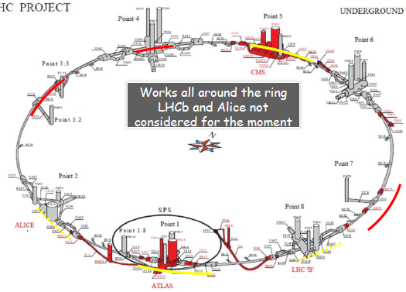
HL-LHC:
NOT ONLY MAGNETS AND CRABS
HL LHC is not only new magnets in ~1 km of the the main ring, but also
  Cryogenics upgrade
  Collimation upgrade
  “Cold” powering
  Crab cavities

Slide 20
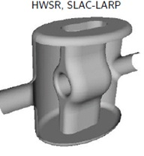
HL-LHC:
CRAB CAVITIES
When going to very low β*, (below 25 cm) the geometric factor considerably reduces the gain
  Crab cavity allows to set this factor to one by turning the bunches in the longitudinal space [R. Calaga, Chamonix 2012]
  Hardware being built, successful test in some electron machines [WP4, E. Jensen, collaboration with many institutes]
  First compact crab cavities with good performance have been built
θ_{c}
Crab crossing
One possible option for the design of crab cavity

Slide 21
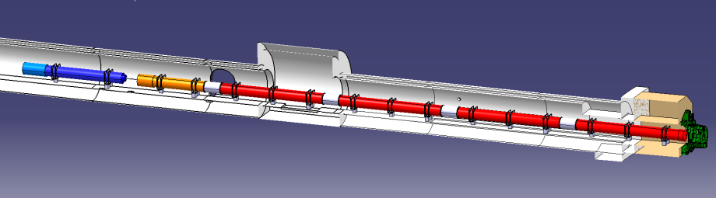






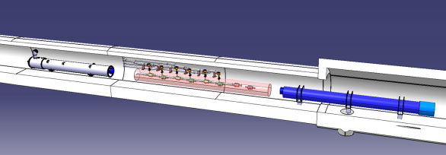



HL-LHC
As LHC, HL-LHC is an international collaboration
  Hardware assigned to several labs for design and model
D1
Cor
Q3
Q2b
Q2a
Q1
ATLAS
CMS
Q4
CC
D2
First baseline from Q1 to Q4, and contributions [F. Bordry, Washington FCC week]

Slide 22
HL-LHC:
INTENSITY
How to get the factor five from the beam ?
  25 ns option
LIU: LHC Injector Upgrade project [M. Meddahi]
LHC Run II
PSB space charge limit with Linac2
Emittance vs intensity at 25 ns [R. Garoby, IPAC 2012]

Slide 23
CONTENTS
The present: LHC in the 10’s
  LHC Energy
  The race towards luminosity
The 20’s: the HL-LHC project
  Optics and intensity
The 30’s: FCC studies
  Aiming at 100 TeV centre of mass

Slide 24
THE HIGH ENERGY FRONTIER
First ideas
  Installing a 16.5+16.5 TeV proton
  accelerator in the LEP tunnel
  Main ingredient: 20 T operational field dipoles
    Proposal in 2005 for an LHC tripler, with 24 T magnets [P. McIntyre, A. Sattarov, “On the feasibility of a tripler upgrade for the LHC”, PAC (2005) 634].
CERN study in 2010 www.cern.ch/he-lhc
  R. Assmann, R. Bailey, O. Bruning, O. Dominguez Sanchez, G. De Rijk, M. Jimenez, S. Myers, L. Rossi, L. Tavian, E. Todesco, F. Zimmermann, « First thoughts on a Higher Energy LHC » CERN ATS-2010-177
  E. Todesco, F. Zimmermann, Eds. « The High Energy LHC » CERN 2011-003 (Malta conference proceedings)
Motivations [J. Wells, CERN 2011-3]
  The energy frontier is always extremely interesting and for many processes cannot be traded with more luminosity at lower energy
“The results of the LHC will change everything, one way or another. There will be a new “theory of the day” at each major discovery, and the arguments will sharpen in some ways and become more divergent in other ways. Yet, the need to explore the high energy frontier will remain.”

Slide 25
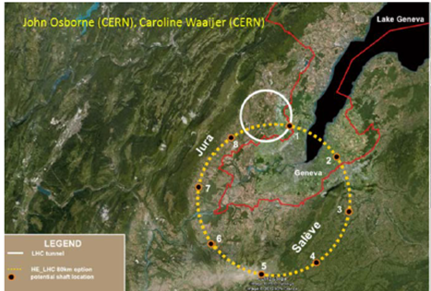

THE FUTURE CIRCULAR COLLIDER
The FCC study
  Tunnel of 100 km with 16 T magnets to reach 50+50 TeV with proton collisions – plus possibility of e-e, e-h machine
Study group Future Circular Collider (FCC) established in 2013 [M. Benedikt, F. Zimmermann]
  Opening event of the collaboration in Washington, March 2015 http://indico.cern.ch/event/340703/
A new tunnel in the CERN area

Slide 26
THE FUTURE CIRCULAR COLLIDER
A baseline is being established [D. Schulte, Washington FCC week]
  Luminosity as in HL LHC
  Emittance as in HL LHC
  Moderate bunch charge
  25 ns operation
  β* of 1 m
  Pile up 50% larger than HL LHC
  No leveling
  Looks reasonable
Goal of 250 fb⁻¹ per year
There is also an ultimate scenario
  a kind of HL FCC , very challenging parameters, especially for radiation dose
There is also an option for 5 ns operation

Slide 27
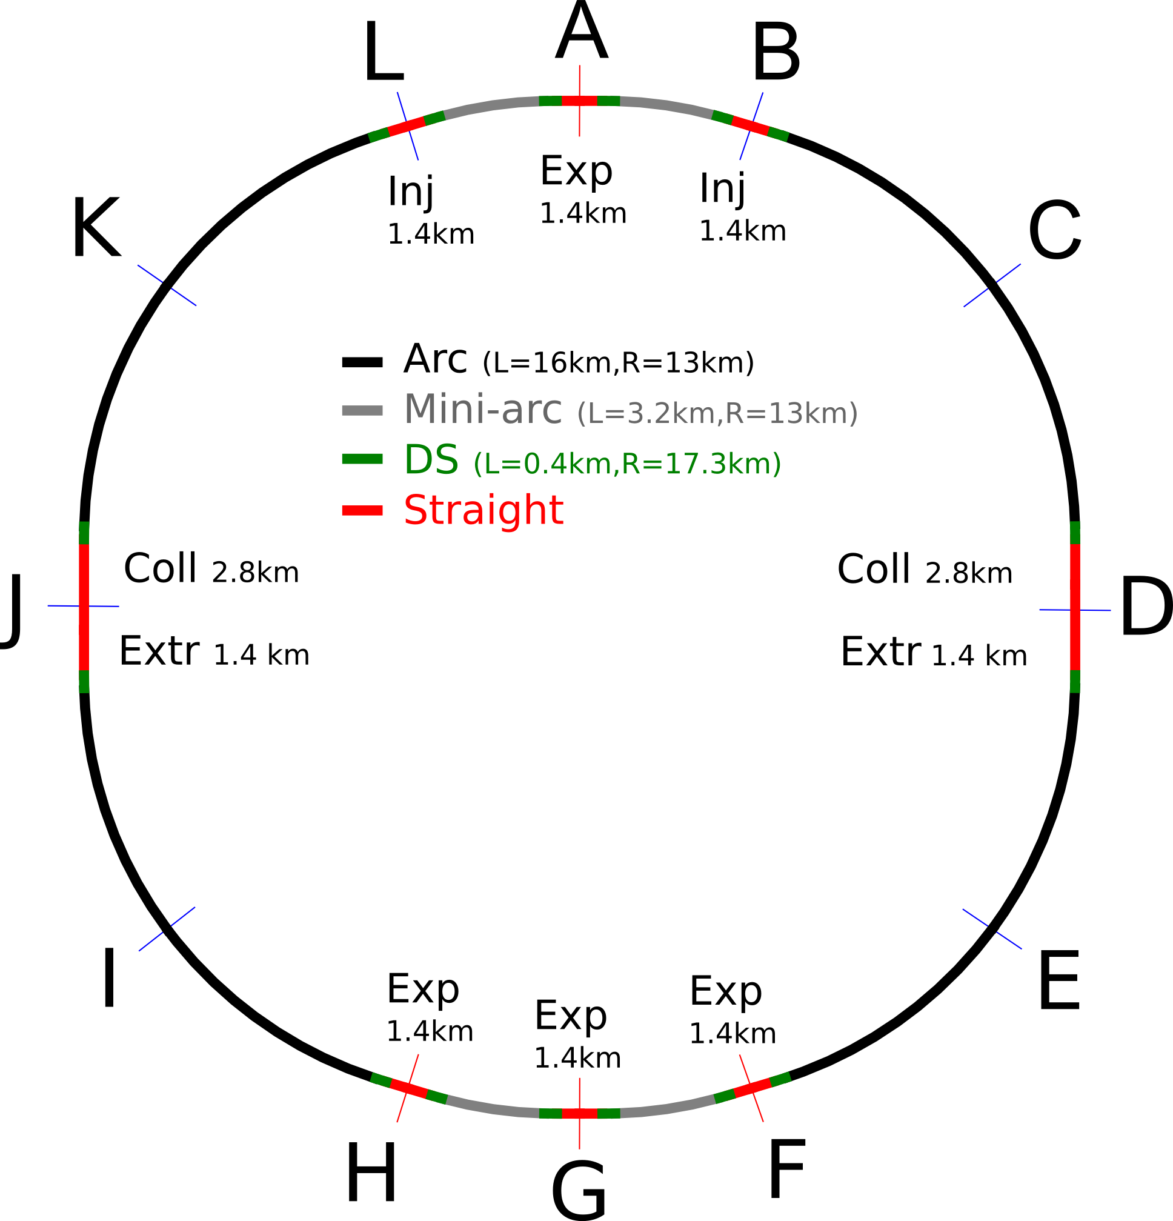
THE FUTURE CIRCULAR COLLIDER
A baseline is being established [D. Schulte WG]
  16 T magnets with Nb₃Sn technology (about 5000 dipoles)
    Aperture of 50 mm
  Double cell length from 100 to 200 m
  5 MW of synchrotron radiation on beam screen
    It was 7 kW in the LHC
    50 K beam screen
  Electrical consumption critical
    100 MW only of synchrotron
  Shielding the magnet is essential
    Tungsten insert of 1-2 cm
    Reason for larger aperture
  Radiation dose OK
    Becomes very critical for the ultimate
Layout baseline [D. Schulte]

Slide 28
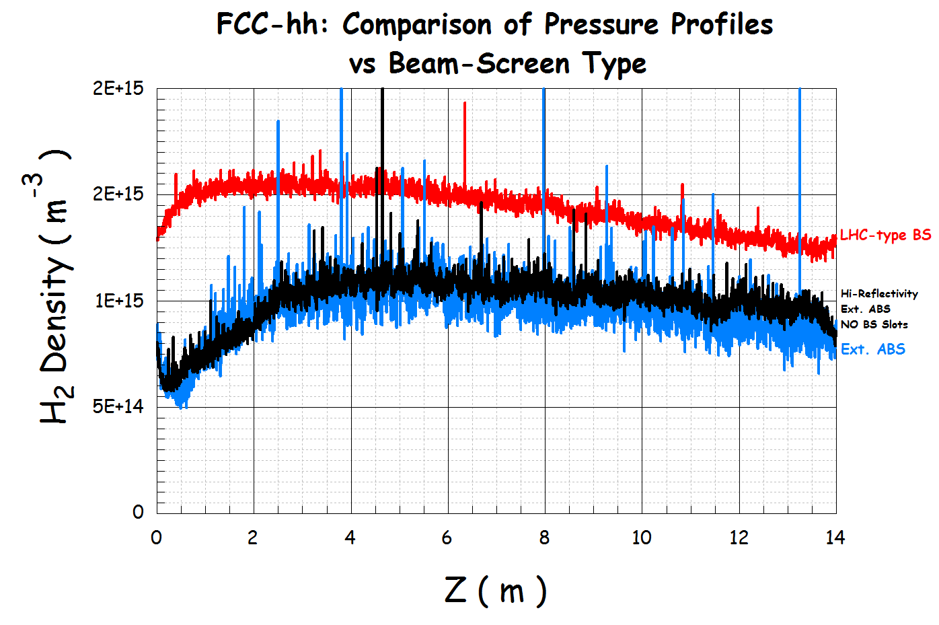

THE FUTURE CIRCULAR COLLIDER
First thoughts about a very challenging beam screen
Vacuum quality [R. Kersevan]
Beam screen geometry [R. Kersevan, C. Garion]
Heat transfer [L. Tavian]

Slide 29
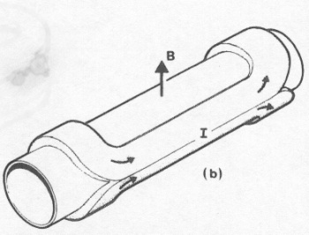
THE FUTURE CIRCULAR COLLIDER: MAGNETS
One of the main challenge are the magnets
  First choice: current density – keep the same as the LHC
  B [T] ~ 0.0007 × coil width [mm] × current density [A/mm²]
  LHC: 8 [T]~ 0.0007 × 30 × 380
  Accelerators used current density of the order of 350−400 A/mm²
  This provides ~2.5 T for 10 mm thickness
    80 mm needed for reaching 20 T
    60 mm needed for reaching 16 T
    Coil size is still manageable
  Present record is 13.5 T
    Short model of acc magnet
  CERN is building FrescaII
    13 T with potential of going to 15 T
    [G. De Rjik]
FCC
Operational field versus coil width in accelerator magnets

Slide 30
THE FUTURE CIRCULAR COLLIDER: MAGNETS
What material can tolerate 400 A/mm² and at what field ?
  For Nb-Ti: LHC performances - up to 8 T
  For Nb₃Sn: possibly reach 16 T with grading
    Studies led by D. Tommasini and L. Bottura - international collab.
    Cost is an issue with present prices
  If we want to reach 20 T, last 4 T made by HTS
    Today in Bi-2212 and YBCO we have not so far from there
Engineering current density versus field for Nb-Ti and Nb₃Sn (lines) and operational current (markers)

Slide 31
CONCLUSIONS
The Fathers of the LHC designed a wise machine with the potential of reaching ultimate performance
  At full performance one can expect 60 fb⁻¹ per year (four times 2012), and 300 fb⁻¹ at the horizon of the 20’s
    These 300 fb⁻¹ are the lower estimate for the life of the inner triplet magnets
The aperture of the triplet is a bottleneck to performance
  So in any case better to replace with larger aperture. This will come in ~2024
Coupled with crab cavities, larger triplet can give a factor four boost to luminosity
  Together with the injector upgrade, one can get another factor five from beam intensity
HL LHC can provide 3000 fb⁻¹ at the horizon of the 30’s

Slide 32
CONCLUSIONS
HL-LHC can provide 3000 fb⁻¹ at the horizon of the 30’s
  Enabling technologies: large aperture magnets and crab cavities
  The could be the first application of Nb₃Sn to accelerators, pushing the operational field from 8 to 12 T
  With another jump of 4 T, we can go to 16 T, the ultimate of Nb₃Sn
A 100 km tunnel would allow reaching 50+50 TeV
  With 100 km ne would need 16 T magnet, which is not so far from our capabilities
  No bottlenecks have been identified from the point of view of beam dynamics
  The same magnets in the LHC tunnel would make an LHC doubler

