Slide 1

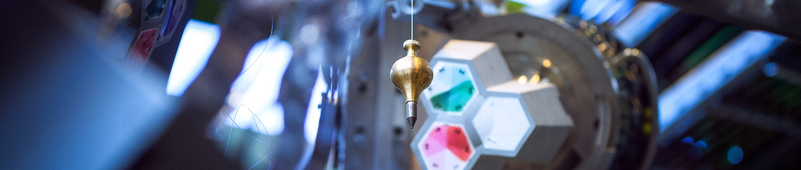
Welcome to the
10th inverted CSC
CERN, March 6-8, 2017 https://indico.cern.ch/e/iCSC-2017
Sebastian Lopienski
CERN School of Computing director
Notes:
I warmly welcome you all, lecturers and attendees alike, to this Inverted CERN School of Computing (iCSC) 2017. There are three reasons why I feel particularly happy and privileged to be writing these words.
First, this year we have a very rich program, based on proposals received from students of the main CSC 2016 (Mol, Belgium) and the Thematic CSC 2016 (Split, Croatia). It consists of 11 hours of lectures and one hour of hands-on workshop (a novelty!). Topics include Artificial Intelligence; Distributed Consensus & Fault Tolerance; Anomaly Detection; Evolutionary Computation; VM Image Management; and Data Visualizations. I’m sure you will find them both relevant and interesting!
Secondly, this is already the 10th edition of the Inverted CSC. It was founded by one of my predecessors, Francois Fluckiger, in 2005 (initially, the Inverted School did not take place every year). His idea was give the floor to former students of the main CERN School of Computing, so that they could share their knowledge and expertise with their colleagues. The fact that we've reached the 10th edition this year, and that we actually received more proposals for lectures than we were able to accommodate, proves that this idea is still valid.
And finally, on a more personal note, the Inverted CSC remains close to my heart. I was one of the lecturers of its first edition back in 2005, giving a lecture about software security - even though I worked on something else at that time. I still remember how this experience had pushed me to develop further my knowledge and passion in security, and - consequently – heavily influenced my professional life. I hope this year’s iCSC will have a similar positive impact on the careers of the lecturers!
I wish to thank the lecturers for their significant work put in preparing the lectures; the mentors for their input and feedback; Cath Noble (the School’s Administrative Manager) for the support behind the scenes; and finally, you - the attendees - for your interest.
Please join me in enjoying this great learning and knowledge-sharing experience!
Sebastian Lopienski
* Just like the main CSC, iCSC is not a conference (where people present what they’ve done) but a “real” school (where selected speakers give series of lectures)
* iCSC lectures this year (as in previous years) will provide state-of-the-art knowledge on important, very relevant and trending topics that are likely to have impact on many aspects of computing in the coming years. These topics include: Artificial Intelligence; Distributed Consensus & Fault Tolerance; Anomaly Detection; Evolutionary Computation etc.
* More generally: computer science is (obviously) a constantly evolving domain; new techniques, paradigms or approaches can revolutionise how we (computer engineers, physicists) work; and iCSC helps sharing knowledge and learning early the details of such trends.
* Thematic CSC applications close this weekend, so just before the iCSC - but main CSC applications will open very soon (mid-March), so interested people should apply!

Slide 2
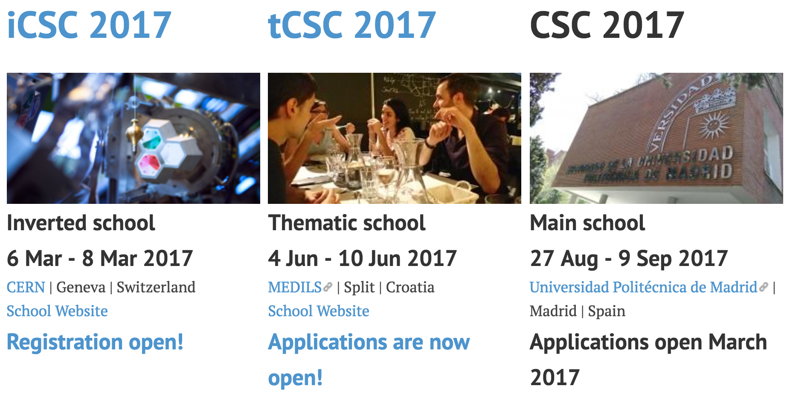
Three CERN Schools of Computing

Slide 3
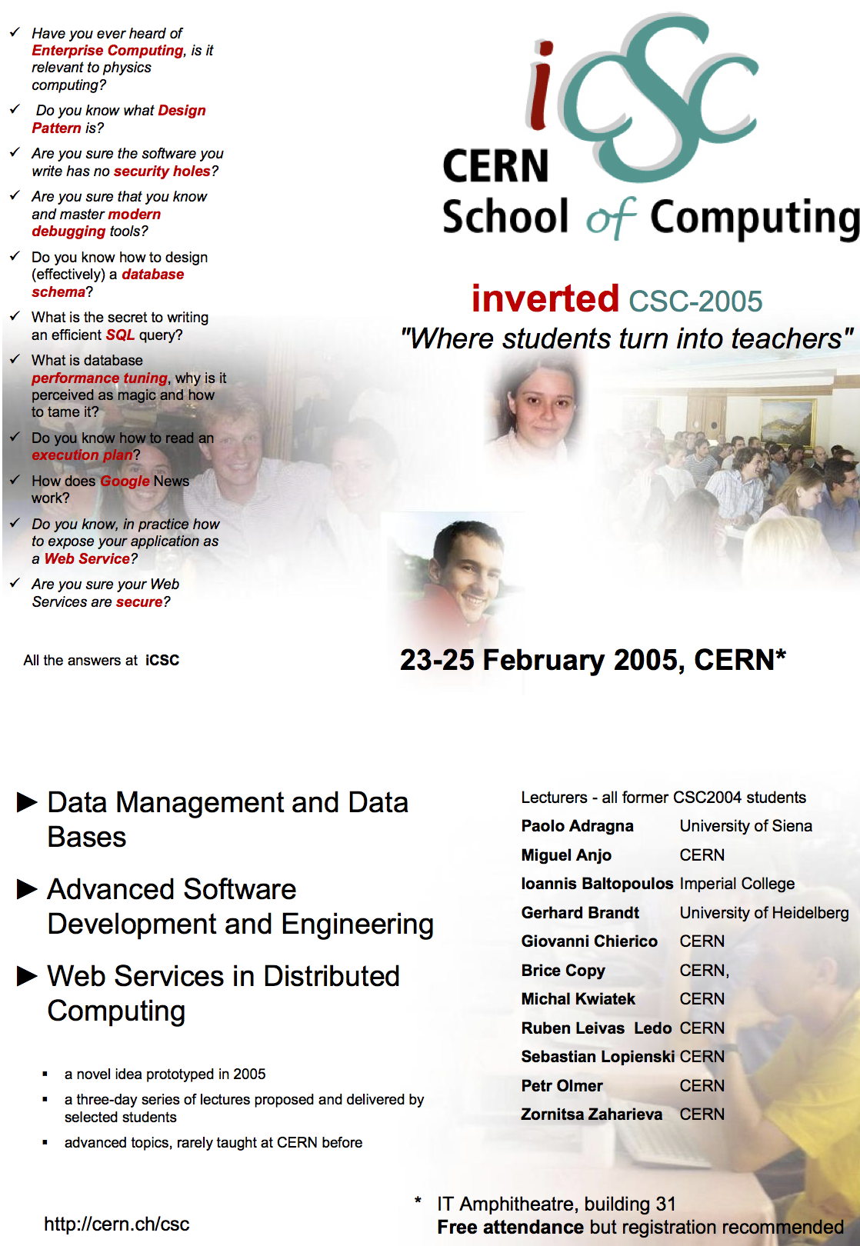
Back in
2005…
“Where students turn into teachers”

Slide 4
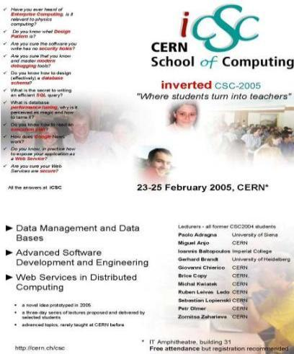
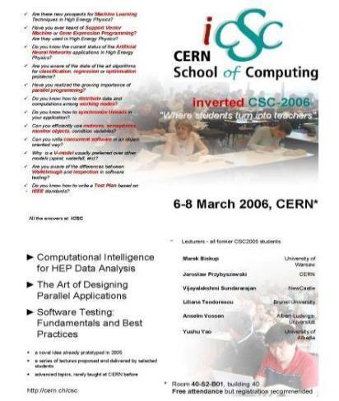
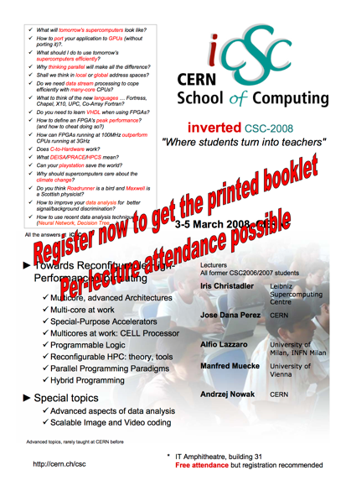
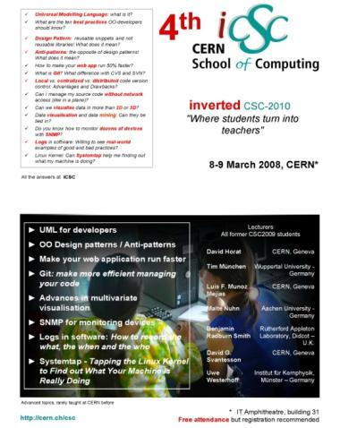
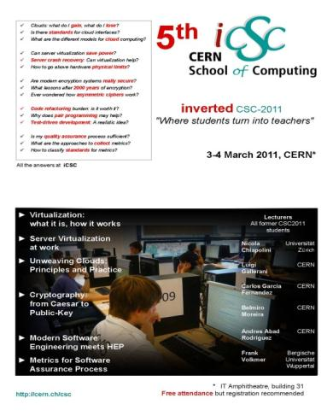
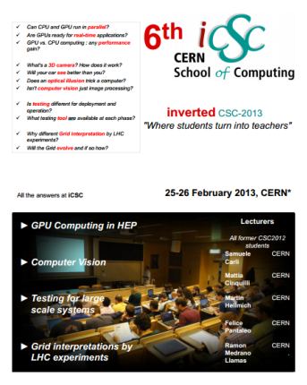
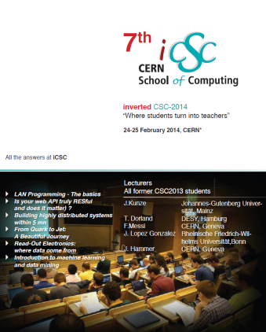
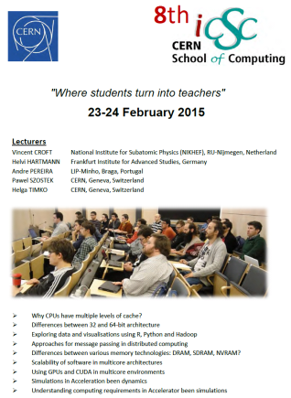
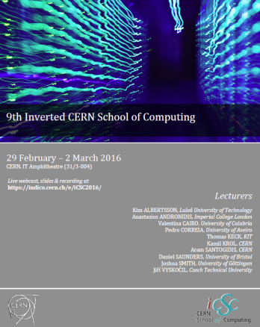
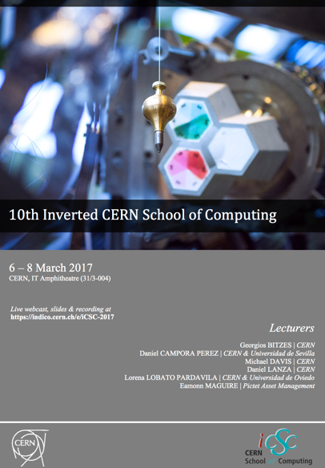
2017: the 10th edition of the iCSC
2005
2006
2008
2010
2011
2013
2014
2015
2016
2017

Slide 5
Past Inverted Schools
  iCSC 2005: 3 days 11 lecturers 16 hours
  iCSC 2006: 2.5 days 6 lecturers 12 hours
  iCSC 2008: 2.5 days 5 lecturers 12 hours
  iCSC 2010: 1.5 days 7 lecturers 8 hours
  iCSC 2011: 1.5 days 6 lecturers 6 hours
  iCSC 2013: 1.5 days 4 lecturers 7 hours
  iCSC 2014: 1.5 days 5 lecturers 9 hours
  iCSC 2015: 2 days 5 lecturers 10 hours
  iCSC 2016: 3 days 10 lecturers 16 hours
  iCSC 2017: 2.5 days 6 lecturers 12 hours

Slide 6

iCSC lecturers becoming full CSC lecturers
  Sebastian Lopienski (iCSC 2005)
  Andrzej Nowak (iCSC 2008)
  Benjamin Radburn-Smith (iCSC 2010)
  Thomas Keck (iCSC 2016)

Slide 7

2017

Slide 8
Inverted CSC 2017
Received 11 proposals of lectures for a total of 22 hours
by students from:
  CSC 2016 (Mol, Belgium)
  tCSC 2016 (Split, Croatia)
  CSC 2015 (Kavala, Greece)
6 proposals retained – 12 hours
  including 1 hour of experimental hands-on workshop
Notes:
Interestingly, some lecturers proposed two different topics
We were not able to accommodate all proposals.

Slide 9
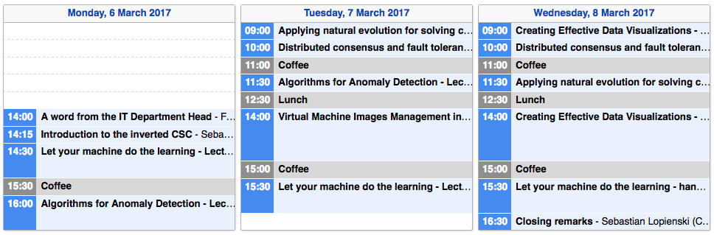
Schedule https://indico.cern.ch/event/591368/timetable
Artificial Intelligence hands-on workshop!

Slide 10
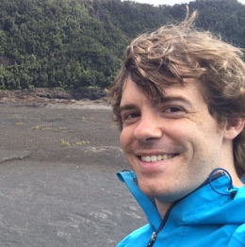
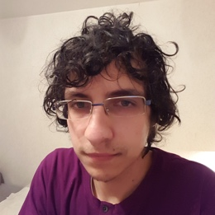
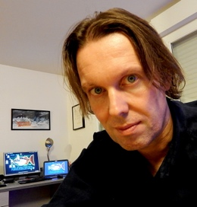
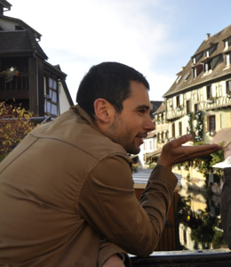
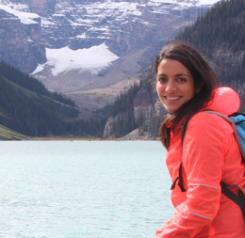
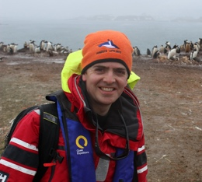
Topics
Artificial Intelligence
Distributed Consensus & Fault Tolerance
Anomaly Detection
Evolutionary Computation
VM Image Management
Data Visualizations

Slide 11
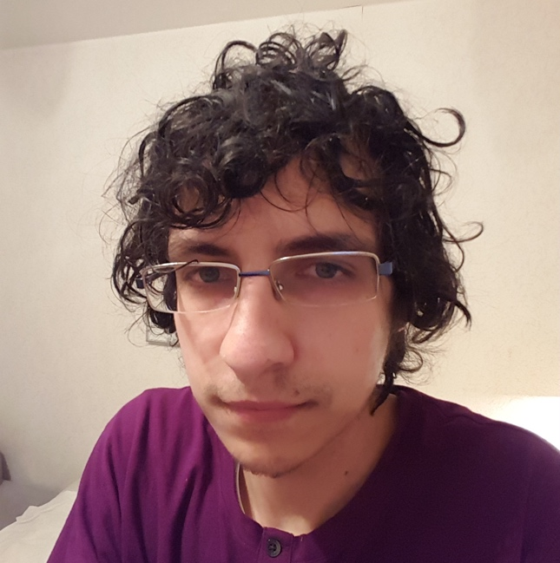



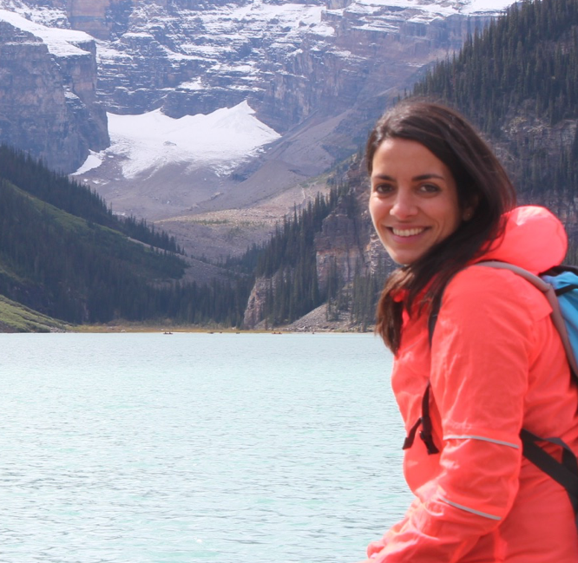
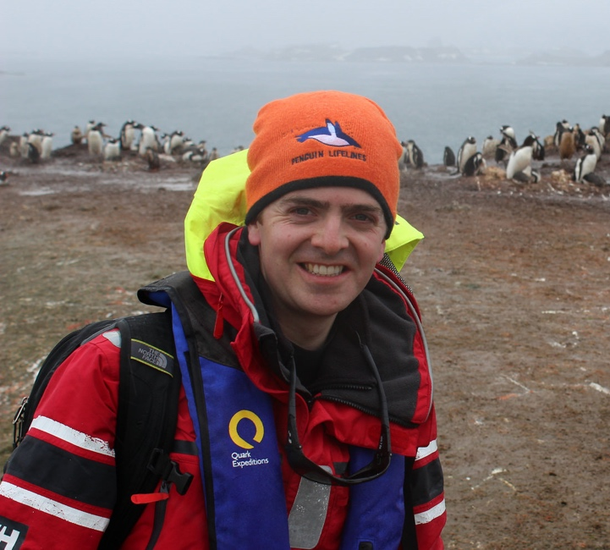
Lecturers https://indico.cern.ch/event/591368/page/9113-speaker-biographies
Georgios Bitzes
CERN
Daniel Campora
Universidad de Sevilla
(Spain) and CERN
Michael Davis
CERN
Daniel Lanza
CERN
Lorena Lobato Pardavila
University of Oviedo
(Spain) and CERN
Eamonn Maguire
Pictet Asset Management
(Geneva, Switzerland)
Notes:
Students of tCSC 2016 and CSC 2016
2 Ph.D., 1 Ph.D. student (AFAIK)

Slide 12
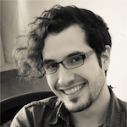
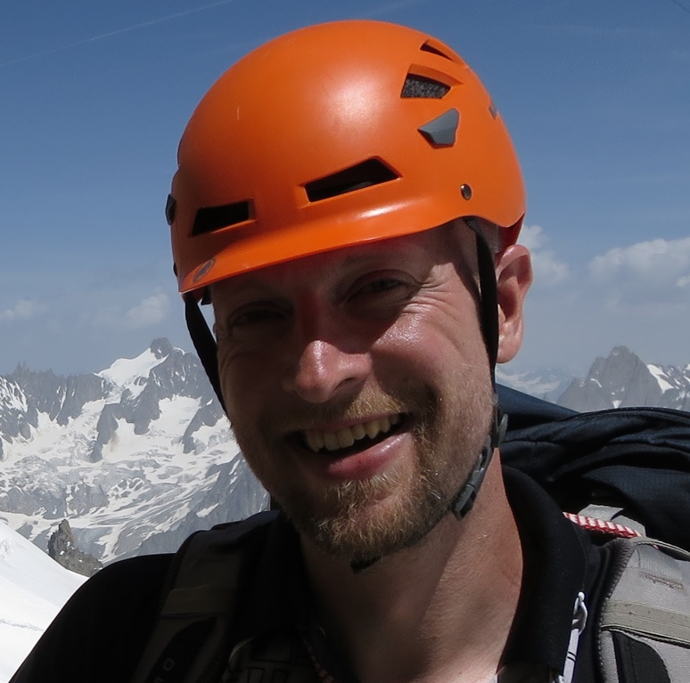
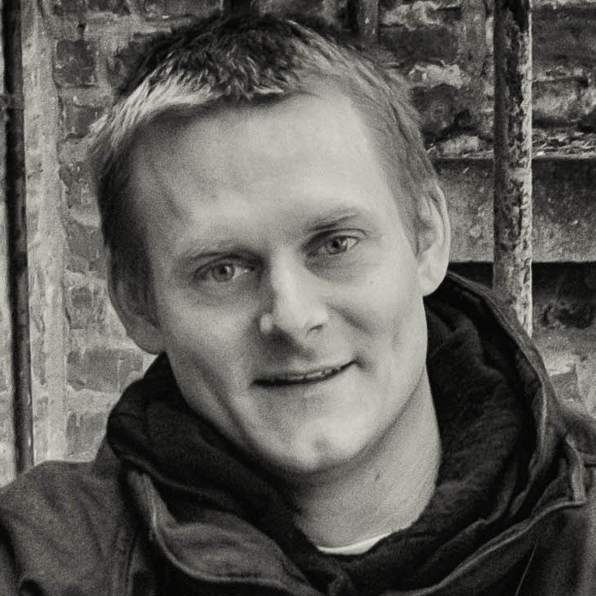
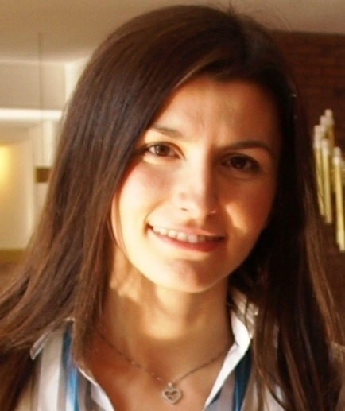
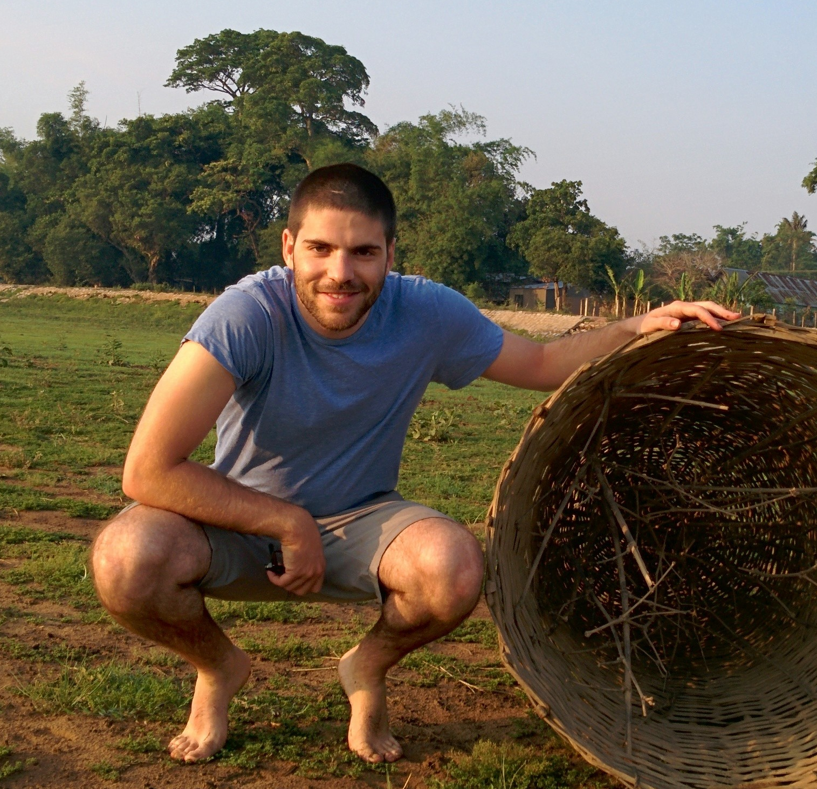
Conveners (session chairs)
Alejandro Aviles
Frank Berghaus
Broen van Besien
Ina Gkotse
Xavier Valls

Slide 13
Mentors (providing advice&feedback to lecturers)
Danilo Piparo Nikos Kasioumis Sebastian Lopienski Alberto Pace
Sebastien Ponce Olivier Couet Enric Tejedor Ivica Puljak

Slide 14
CSC Administrative Manager
Cath Noble

Slide 15
Previous CSC Director
Alberto Pace

Slide 16

Logistics
You can attend only selected lectures
  but please be on time for the start,
  and avoid leaving in the middle of a lecture
Please silence your phone
Please use the microphone when asking questions
  lectures are webcast and recorded
Enjoy coffee and snacks
  an opportunity to discuss with lecturers and colleagues

Slide 17
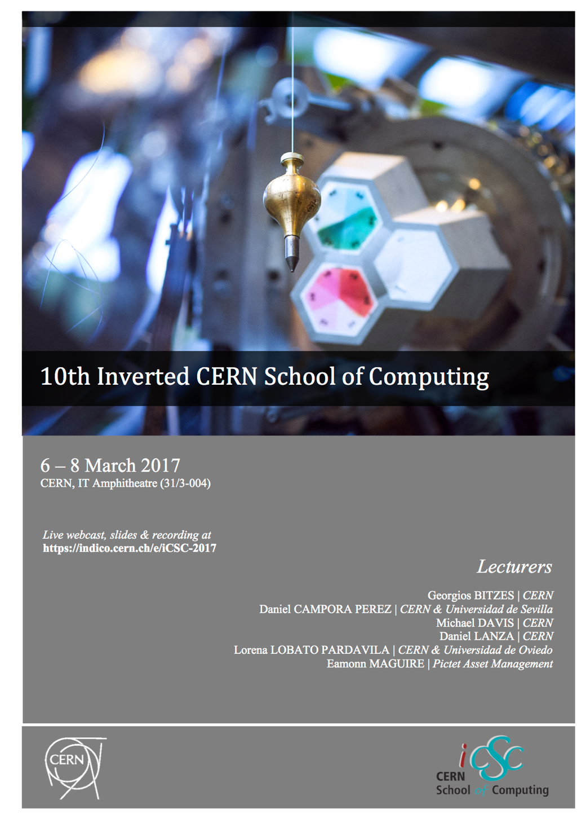
iCSC booklet
For those registered participants
… and others, if enough copies

Slide 18
Enjoy the School!

