Slide 1

Autopilot for Linac4 H- Ion Source
Linac4 H- Ion Source
The Problem
CERN Infrastructure
Inspector & Services
Autopilot
Autopilot’s regulations
  Power Amplitude Regulation
  Freq Regulation
  Power Slope Regulation
  Gas Slope Regulation
  Low Gas Detection
Autopilot Demo
Cesiation under Autopilot
Conclusion
Notes:
Good morning from me. My name is Georgios Voulgarakis.
Today I am going to present to you Autopilot, a high-level control and optimization software.
First, a quick introduction of the Linac4 H- Ion Source.
Then the description of the problem to be solved & an introduction to Inspector & Inspector-Services extension.
Then I present the regulations of Autopilot, with a short demo of a single regulation.
At last, a demo of the full blown potential of the Autopilot, with the conclusion and future challenges.

Slide 2
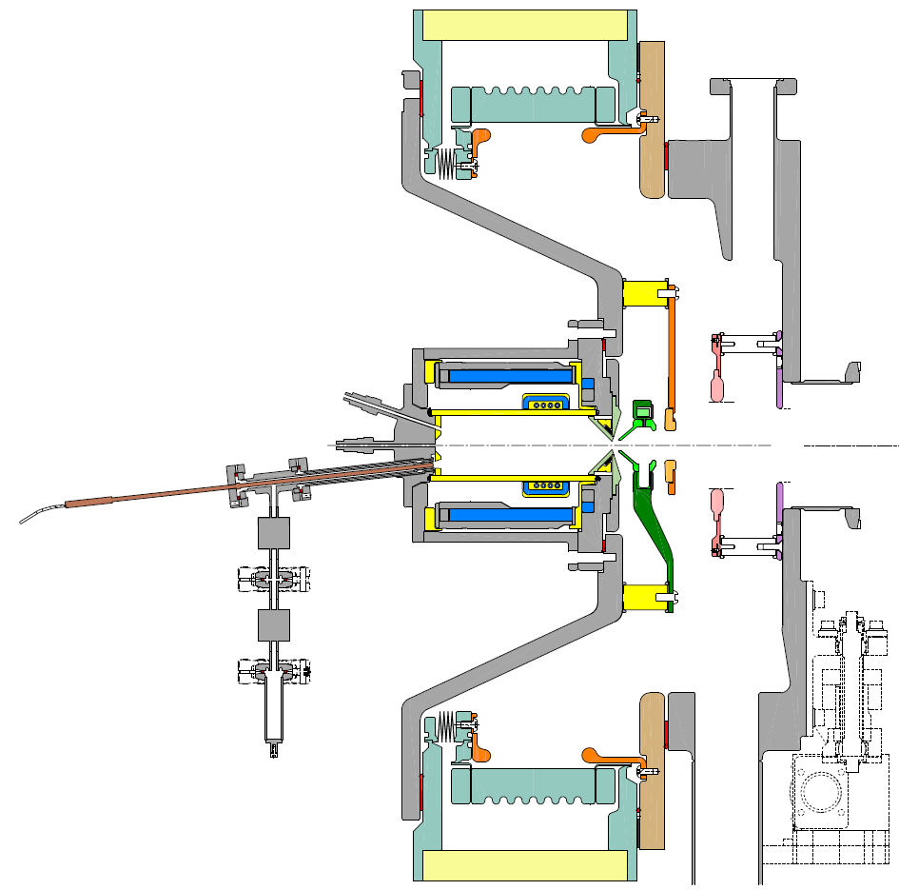
Source
RF coil
Puller - Dump
Gas Injection / Piezo Valve
Ground
View port
Einzel
Transfer line
Heating jackets
Cs valve
Cs oven
Plasma chamber
Notes:
Here we can see a schematic of the Linac4 H- Ion Source.
We can divide it into 2 sections. 1st part is the plasma chamber, and 2nd is the extraction electrodes.
Within a pulse:
We add H gas into the chamber by regulating a piezo valve.
We then apply RF onto the RF coil to ignite and sustain the plasma.
The RF we apply has variable power and frequency within the pulse.
Then, by applying HV on the extraction electrodes, and we extract beam out of the plasma chamber.
Periodically, the source is injected with tiny amounts of cesium, which helps improve the performance of the source.
Cesiation is done approximately once every month.

Slide 3
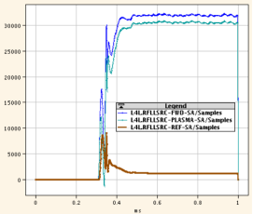
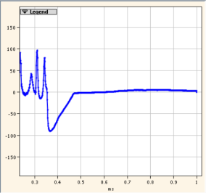
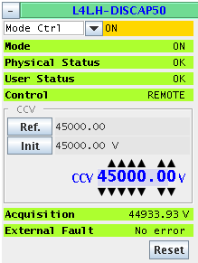
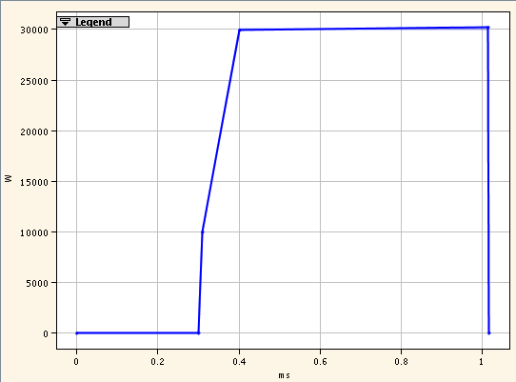
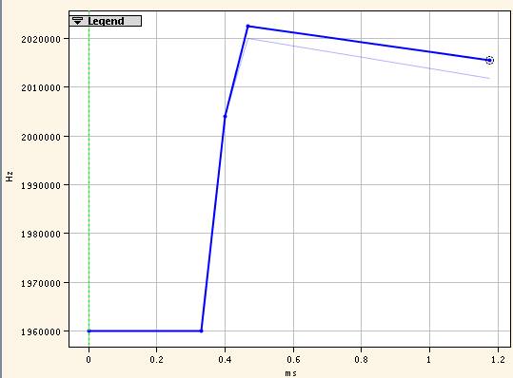
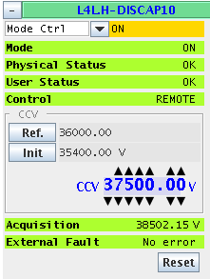

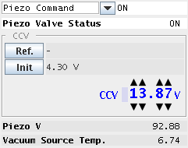
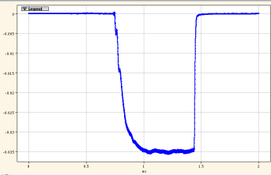
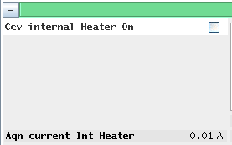
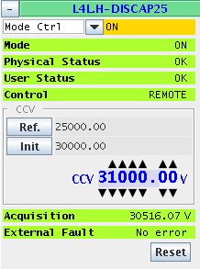
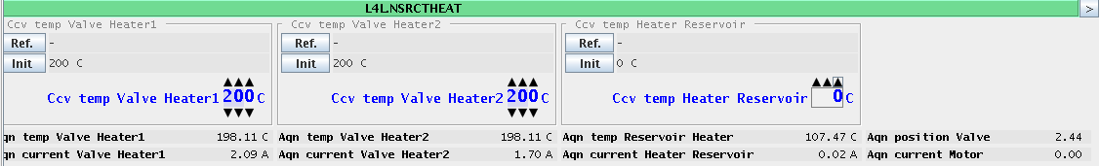
Source
Phaze
RF power
ACQ
RF power
RF Freq
Gas Piezo
Motor / Temp
Notes:
To those who are familiar with CERN User Interfaces, this picture helps explain what component of the source, each “knob” controls.
First we change the voltage on the piezo valve to control the amount of gas inside the chamber.
Then we ignite and control the plasma, by varying the RF applied to the antenna.
Increasing the power of the RF, and at the same time changing the Frequency of the RF helps ignite the plasma.
Then for the extraction we apply a high voltage to the source, the puller & the einzel electrodes.
At last, for the cesiation procedure, we control the heaters (jackets – transfer line – Cs reservoir) and the valve motor.

Slide 4
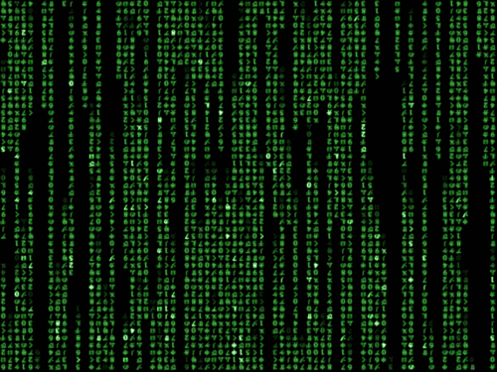

The Problem
Linac4 Ion Source:
Requires cesiation once a month
operating conditions gradually evolve over time
Manual operation requires constant human intervention
The Solution
Autopilot can:
Optimize the ion source performance by regulation of H₂ injection, RF power and frequency.
Describe the performance of the source with performance indicators, which can be easily understood by operators.
Identify failures & try to recover,
send warning in case of deviation
from nominal operation.
Notes:
So. The source runs manually.
As the source runs, conditions are changing (like temperature or Cs is being used up…).
And all these, mean that the source needs re-tuning, as the time goes by!
This means that every now and then, the source has to be checked, and:
some gas added/removed,
RF power and frequency tuned,
figuring out if something has gone wrong (ie HV sparked).
So in the end, an operator’s time is wasted looking on a screen, trying to figure out if something is not right…
This is where Autopilot comes into the play.
Autopilot can regulate the gas injection, the RF power and frequency, so the source is delivering nice, flat, intense beam!
By also looking at the “most common failures”, Autopilot has been programmed to identify when various failures occurred, and when so, try to recover.
If recovering is not an option, it can alert the operator, to take corrective action.
At last, Autopilot is able also to derive performance indicators, which can be easily understood by operators.

Slide 5
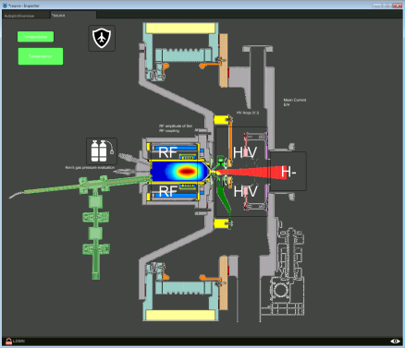


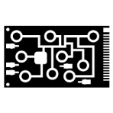

CERN Computing Architecture
CCC
Application Layer
Inspector -Services
Autopilot
Knobs / Working Sets
Injection Control Architecture
Middle Layer
Logging
LHC Software Architecture
Data Access Object
Acquisition Core
OASIS
JAPC
(Java API for Parameter Control)
Front End Computers
Device Layer
OASIS
Scope
FESA
Front End Software Architecture
Notes:
Let’s take a look at CERN’s Computing Architecture.
We have 3 basic layers: Application, Middle & Device layer.
On the bottom, we have the actual devices. Sensors, FPGs, Scopes, all the low-level devices.
These communicate with front-end computers.
Then, all the data are transported from the front end computers to a centralized, middle layer, which helps abstract device specific implementations, and also performs logging.
Then, on the top layer, we have the applications, which using the abstraction provided by the middle layer, can control devices, show data, perform actions.
This is where Inspector, Inspector-Services extension, & Autopilot reside.
They are all high level applications, and they have the same level of control as an operator in the Control Room has.

Slide 6
Inspector - Services
Inspector:
A rapid panel design software
Which follows a client-server type architecture
User can Read – Write data from-to devices
Service:
Service is (java) code!
Which implements an algorithm
Is stored in a Code Repository Server
Is executed in a Service Server
Can be controlled by an Inspector panel
Can be deployed and executed in a unique and centralized manner
Allows multiple operators to interact at runtime, coordinating between them
Notes:
In the previous slide, I mentioned Autopilot & Inspector – Services.
Autopilot helps automate the operation of the source, so the operator can lay back and relax!!
But there is a lot of programming background, before we even start implementing the most simple regulation of Autopilot…
This background, is the Inspector & Inspector-Services.
I will not go into details about how the software works, but this slide here, contains 75% of my total work…
Briefly, I want to say the following:
The RF group from CERN has developed inspector, which is a rapid panel design software.
This means that User Interfaces (or panels) can be designed in a matter of minutes.
There is a client and server side of inspector. On the client side, the panel is displayed. On the server side, data crunching takes place.
Through Inspector, device data can be displayed & basic algorithms can be LOCALLY designed and executed.
I have created the Inspector-Services extension, which revolves around the concept of SERVICE.
A service is code which implements an algorithm,
Is stored in a code repository
Is executed CENTRALLY in a dedicated server
Its execution flow can be controlled by an inspector panel
Centralized execution means that multiple operators can control the same Service

Slide 7
Autopilot
Autopilot is a collection of algorithms-services, which aim to automate the mandatory optimization and cesiation processes and to derive performance indicators.
Autopilot Services – Regulations:
Virtual Measurement:
evaluate performance indicators (e/H, etc..) at each pulse
Freq Regulation:
Regulate the RF frequency for optimum coupling
Power Amplitude Regulation:
Regulate the RF power for –operator- defined H- current
Power Slope Regulation:
Regulate the RF power slope for flat H- current
Gas Slope Regulation:
Regulate the gas for minimal RF power required to deliver constant H- beam
Low Gas Detection:
Increase the gas in case of gas starvation
Notes:
Inspector, Services and Autopilot... How are these combined?
Autopilot is a collection of SERVICES, which automate aspects of the operation of the Linac4 H- Ion Source.
Autopilot is USING Inspector (with the Services extension) framework.
In essence, Inspector-Services provides the building blocks, to make Autopilot!
And what Services make up this collection?
We have the Virtual Measurement, which is deriving various performance indicators, and is able to combine live data, to create virtual measurements (ie e/H).
There is the RF frequency regulation, which ensures optimum plasma coupling.
We have the RF Power Amplitude Regulation, to deliver a constant H- current
We have the RF Power Slope Regulation, to produce a flat (or squared) H- current
The Gas Slope Regulation controls the amount of gas inside the source.
And at last the Low Gas Detection, which is responsible to figure out if gas starvation takes place, and add gas in the source to cure the problem.
All these Regulations-Services are turn-by-turn in nature, and a cycle for the Linac4 is specified at approx. 1.2 seconds.
Don’t worry if you forget their names and functions, we will see each one in more detail later.

Slide 8
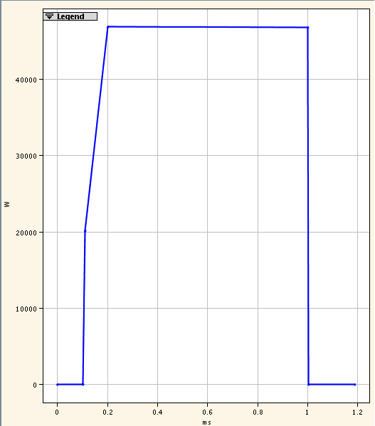
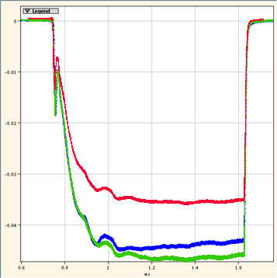
Power Amplitude Regulation
Deliver a specified, constant H- current, by regulating the RF amplitude.
RF Power Amplitude
H- current
Notes:
Let’s start with the easiest regulation (according to me!).
Control the RF power amplitude, so we deliver a constant (operator specified) H- current.
First things first: more power, more current. Less power, less current!
How can we describe the H- current with a scalar number?
Select the plateau of the pulse, and get the mean over this plateau!
In what way should we control the RF power?
Select the steady state (top part of the pulse), and change its amplitude!

Slide 9
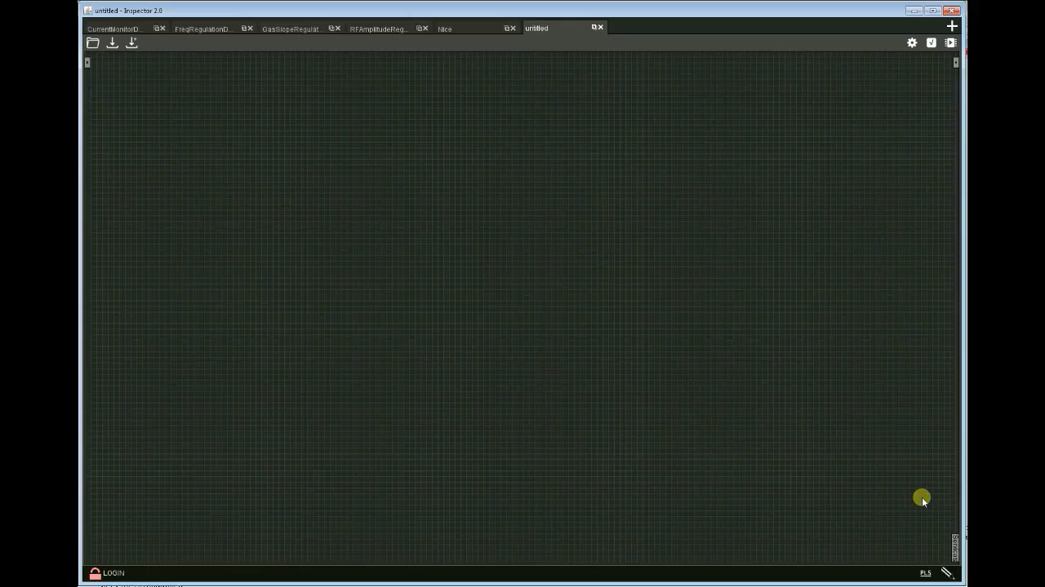
Power Amplitude Regulation Demo
Notes:
So, using Inspector-Services, we implement the Power Amplitude Regulation, into a Service.
The Service runs in a dedicated server, controlling the RF!
Let’s take a look at how we can debug its operation, through the Inspector environment!
***Start the video***
What we have to do is:
Create the service execution control element (to start/stop the service)
Create the graphical element where the operator will specify the H- current target
Visualize the RF power and the evolution of the delivered H- current VS time.

Slide 10
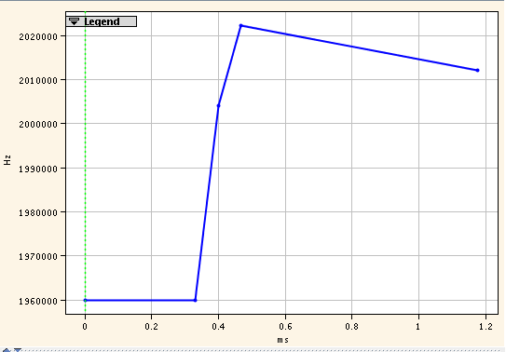
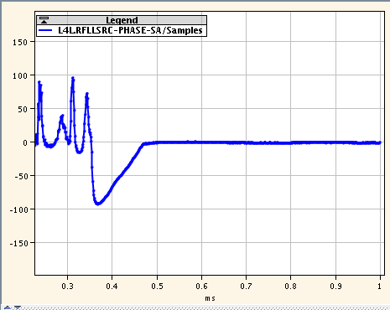
Freq Regulation
Ensuring optimum coupling by regulating the RF frequency
RF Power Frequency
RF Phaze Measurement
Notes:
So, stable H- current amplitude is taken care of...
What about the plasma coupling?
Autopilot can do something about it as well!
Autopilot’s Frequency Regulation can look at the RF phaze signal, and tune the RF frequency applied to the plasma.
Our goal is to have an RF phaze measurement close to 0 (after Start of Ejection Timing).
The procedure is:
From the RF phase, we select the signal after the SEJ (Start of Ejection Timing).
We fit a line into the selected signal
We tune the RF frequency amplitude and slope, based on the slope and offset of the fitted line.

Slide 11
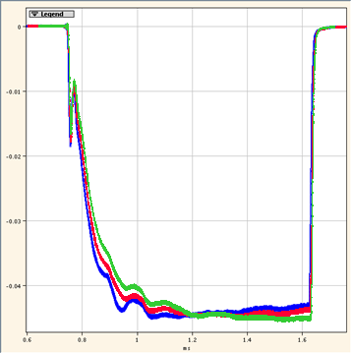
Power Slope Regulation
Maintain zero tilt (slope) of the H- current, by regulating the RF tilt (slope)
RF Power Amplitude
H- current
Notes:
So, we now have a nicely coupled plasma, and an H- current stable in amplitude.
What else can we ask? We can ask for a flat H- current. (Without any tilt)
First, let’s define this flatness...
To do this:
we select the plateau region from the H- current pulse
we fit a line, and we calculate what is the slope of the line.
Flat means that our target is a slope of 0, in the fitted line.
What can we control to achieve this?
We can change the slope of the RF steady state (top part of the RF pulse), by tilting it back and forth.
This tilt on the RF power will produce a change on the slope of the H- current.

Slide 12
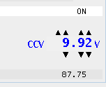
Gas Slope Regulation
Maintain just enough gas in the chamber, that minimum RF power is needed.
RF Power Amplitude
Notes:
So we now have a nicely coupled, stable in amplitude & flat H- current!
What’s next?
Next is to regulate the amount of gas inside the source.
We have observed that optimum source performance is achieved when we have just enough gas inside the source, that with a flat RF power, we get back a flat H- current.
Put that into perspective with the previous regulation.
Gas inside the source, flat RF power, produce flat H- current.
Therefore, the target for the Gas Slope regulation, is to regulate the gas (through the piezo valve), so no tilt on the RF is needed.
This means that the Gas Slope Regulation, should work in tandem with the result of the RF Power Slope Regulation.
Gas Slope Regulation checks the tilt needed on the RF power.
It then changes the gas accordingly, and waits for the RF power slope regulation to settle.
**Change tone**
In the end, the RF Power Regulation is acting fast to ensure a nice shape on the H- current, while the Gas Slope Regulation is slower, and aims at optimizing the amount of gas inside the source!

Slide 13
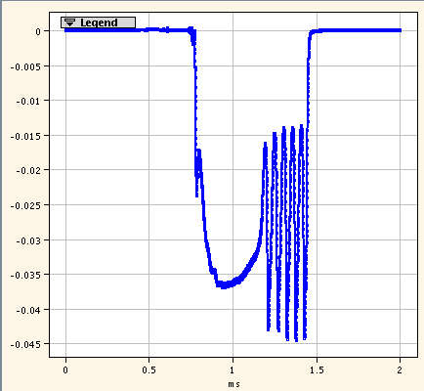
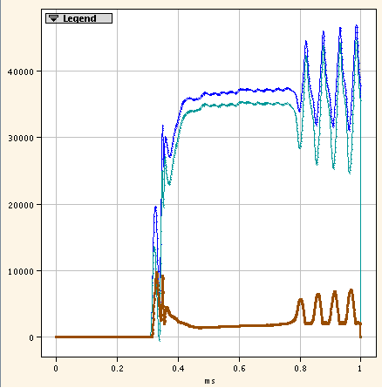
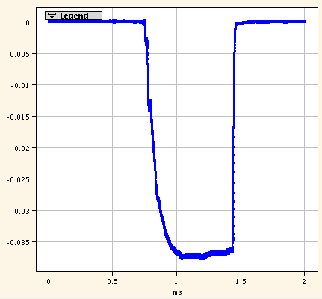
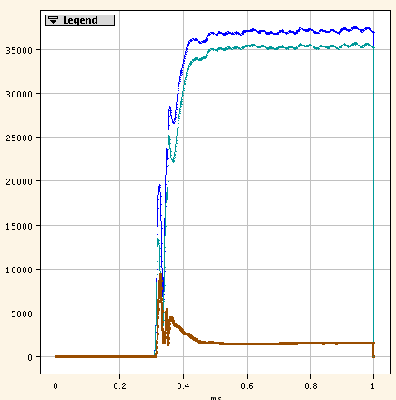
Low Gas Detection
Ensure we do not starve the plasma from gas.
Notes:
The last regulation is the Low Gas Detection.
A requirement for an operational source delivering beam, is that we always have enough gas inside the source!
Low Gas Detection will:
monitor the reflected RF power.
If oscillations appear, then this means that we are in gas starvation, and we should add more gas.
Autopilot will then gradually increase the gas inside the source, until these oscillations disappear.

Slide 14
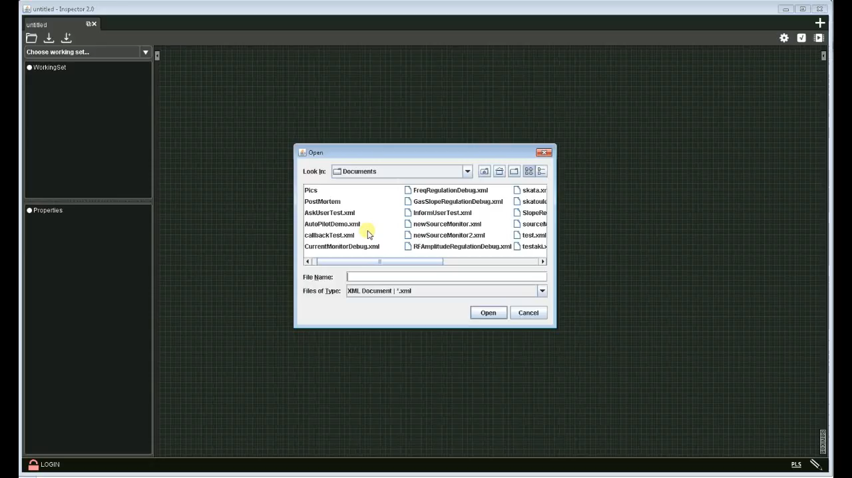
Autopilot Demo
Notes:
Now follows a full blow demonstration of the Autopilot, on Linac4.
All Autopilot regulations are active.
In graphs we can see the phase (per pulse), the RF power (per pulse), the H- current (per pulse), and the evolution of the piezo valve VS time.
***Start video***
Throughout the video you will see that the phase is kept close to 0.
Initially the gas is not optimal and the RF will acquire a slope, to compensate for a small tilt in the H- current.
Then, you will see that the piezo voltage will start decreasing, until we reach a point where no slope is needed, to maintain the nice, zero slope, H- current shape!
Note that the video is fast forwarded! (original length was ~5 mins to reach stability)

Slide 15
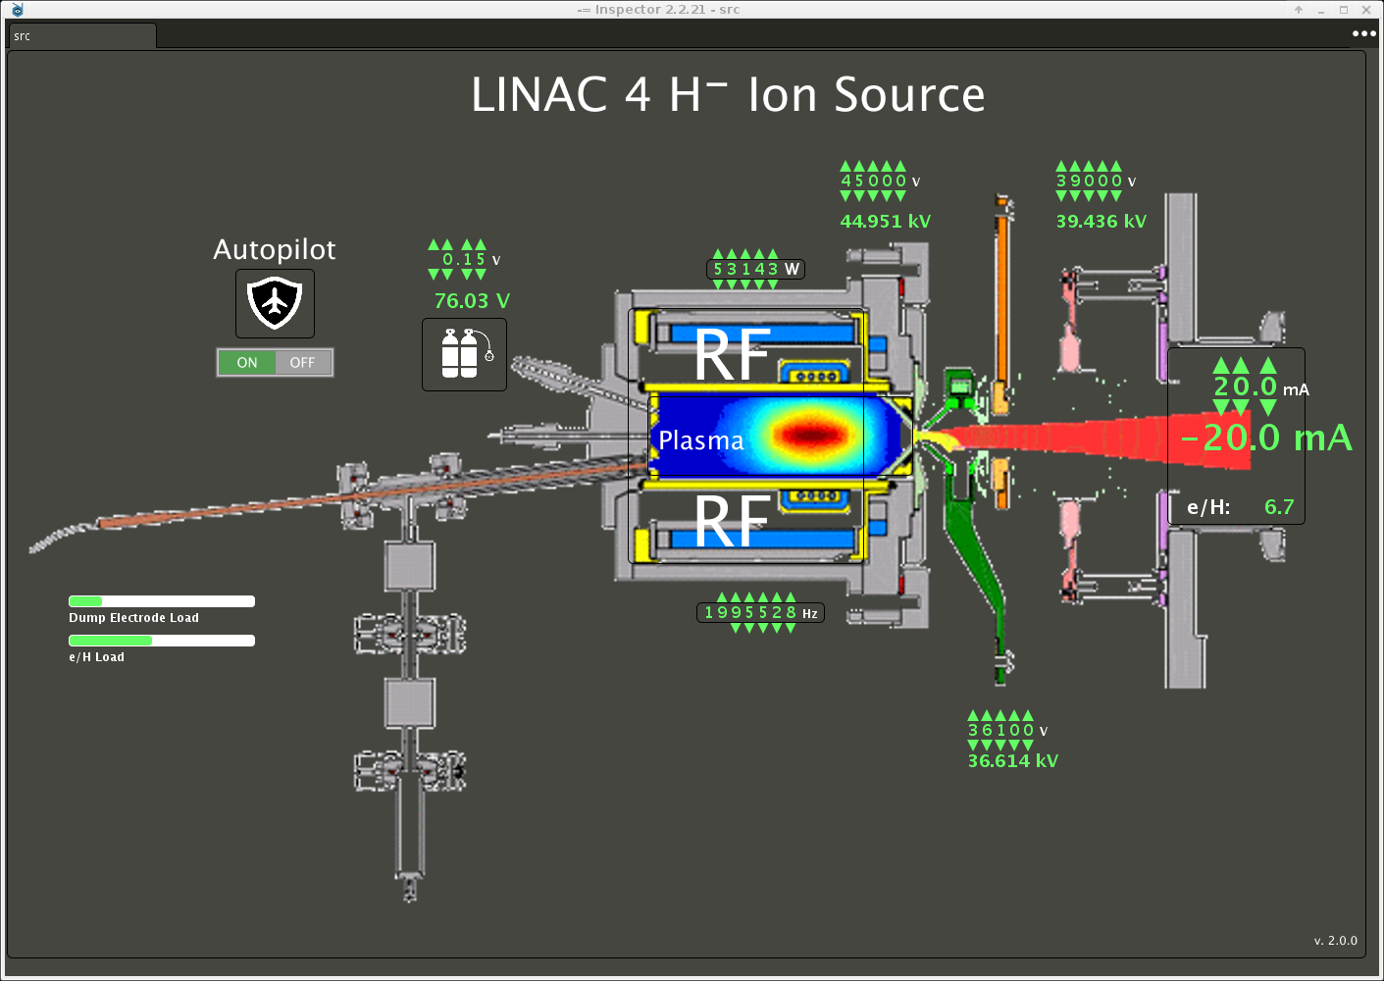
The Operator Interface

Slide 16
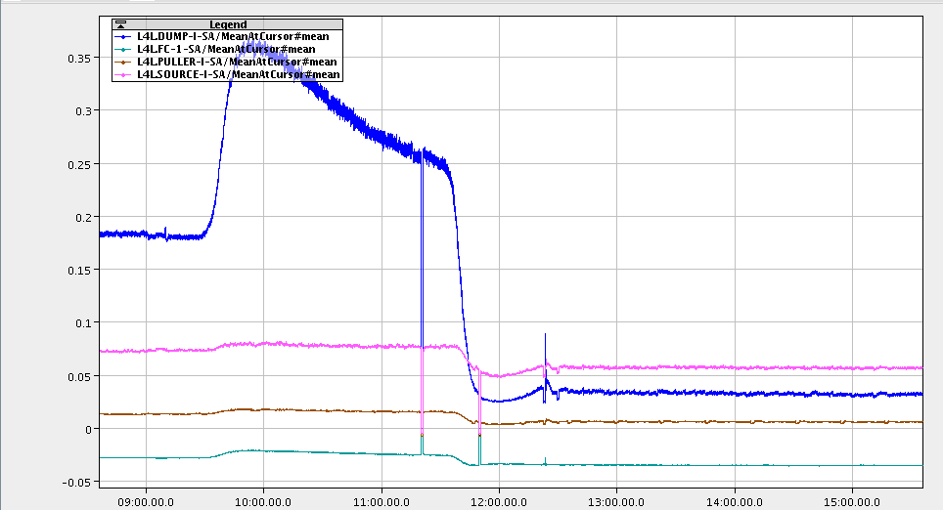
Cesiation under Autopilot
High Idump results in RESTRICTED_PERFOMANCE
Valve Opened
Cesium coating the source surface
Valve closed
Quality Beam deliverable
e/H too high - > Dump current too high -> RF power maxed out -> H- current reduced, yet stable
Autopilot kept conditions optimal, despite temperature variations caused by heating of Cs.
Notes:
At last, let’s take a look at what Autopilot can do about the cesiation procedure:
Cesiation is a “Checklist Standardized” procedure, for which Autopilot provides a Service (Automatic Cesiation Service).
During cesiation we can use all the standard Autopilot regulations, with some minor adjustments.
The cesiation procedure can be divided into what I call “Cesiation phazes”:
First we have the Heating up phaze:
During this phaze the Cs Oven & transfer lines heated up.
Impurities are being released due to heating, which results in an increase on the dump current.
During this phaze, we can still deliver H- beam, but its intensity is reduced.
Then we have the Valve opening. After this, we are not allowed to deliver beam.
Then, with the valve open, we have the phaze called Coating of the source.
This is when a drastic reduction of the dump current takes place.
After the improvement of the dump current has levelled-off, we know that we have enough cesium.
Typically, we would continue adding cesium (approx another 45’), to have a longer lasting effect, thus entering a phaze called To last longer.
In this case, we opted to skip this phaze.
Next we have the Valve closing.
Once this is finished, we can deliver beam.
At last, the Cooldown follows, where we switch off the heaters, and wait for the source to cool down.
Once this happens, we can consider the whole cesiation procedure terminated.

Slide 17
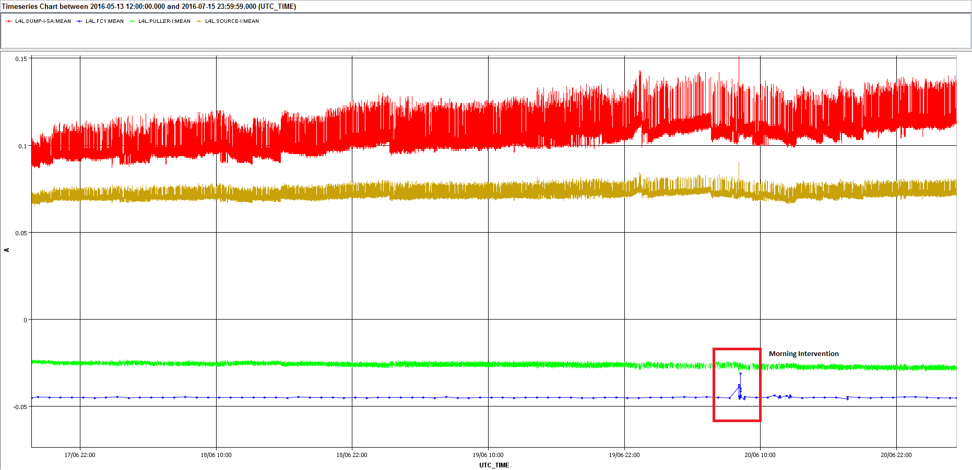
Stability
Notes:
At last, let’s take a look at a continuous, uninterrupted run of Autopilot.
As you can see in the graph, over 3 days Autopilot was able to deliver a stable H- current beam.
Blue is the H- current, red is the dump current, green the puller current and brown is the source current.
As you can see, while all the other 3 currents are changing, the H- current is kept stable.
Note only on 20/6, at 10:00 in the morning, the anomaly is due to some morning playing around with the source!

Slide 18
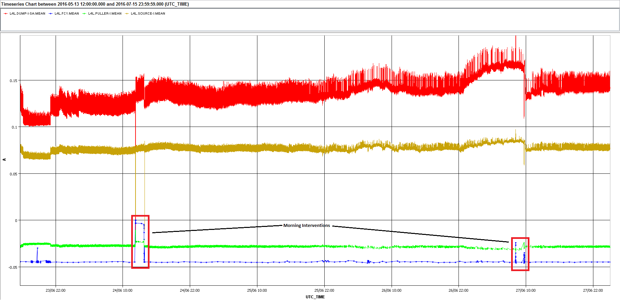
Stability
Notes:
Same picture here, over a period of 4 days, with 2 morning interventions taking place!

Slide 19
Conclusion & Outlook
Future Challenges:
Extend Autopilot capabilities, by including a high level failure tracker and report generator.
During the stability run, starting on September, the aim is to use Autopilot 24/7, throughout the run, in order to verify the long-term stability of the regulations.
Standardize and automate various measurement procedures and techniques such as emittance measurement.
Notes:
And, to conclude... What does the future hold?
As always, new challenges!
These include:
the design of a high level failure tracker and report generator, for even greater ease of operation.
Exposing crucial information on a (web) page, available throughout CERN.
A long-term, uninterrupted testing of Autopilot.
And using the Inspector-Services framework, to automate more tasks, such as various measurement procedures.
That’s all from me.
Thank you for your attention!

