Slide 1
MUONS
Jose L. Abelleira on behalf the JAI-FCC team
University of Oxford
1 December 2016
Thanks to Ilaria Besana and Francesco Cerutti (CERN)

Slide 2
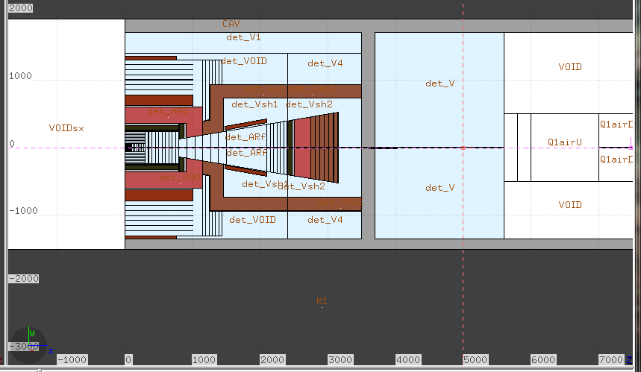
2 step simulation
1ST STEP
Dump muons
-muon threshold more than 100 MeV, but it may be much larger.
-switch of electromagnetic, as this does not contribute to the muons

Slide 3
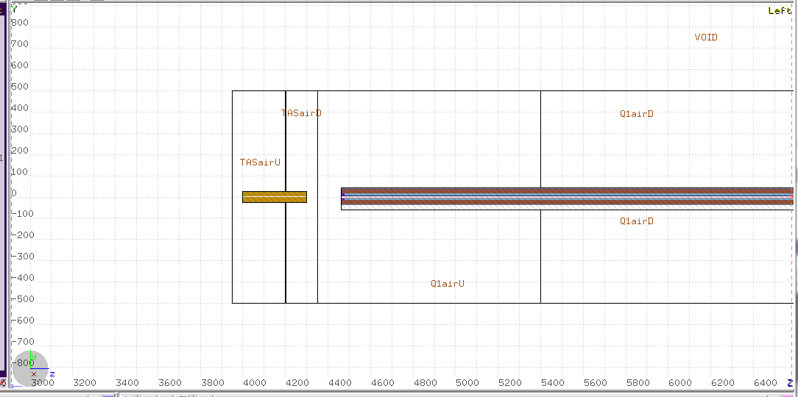
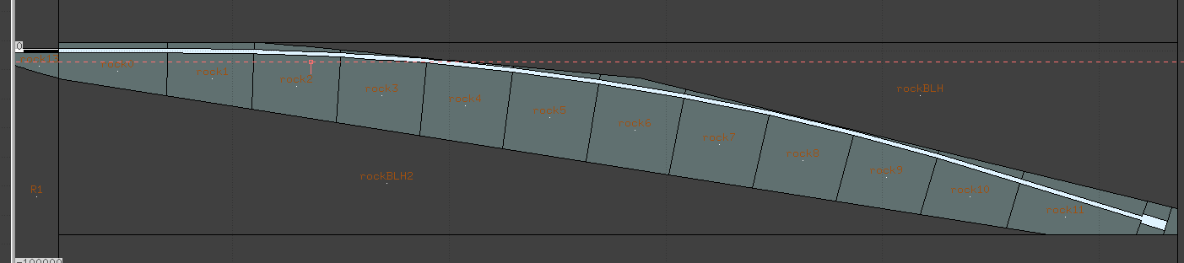
2nd step
BLACK HOLE REMOVED
Transport muons

Slide 4
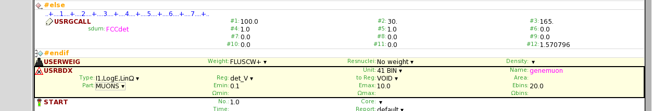
1st step
Card to dump the muons
Generated the executable, debugging

Slide 5
publications
-FCC week Berlin: talk
-IPAC Copenhagen: proceeding

