Slide 1

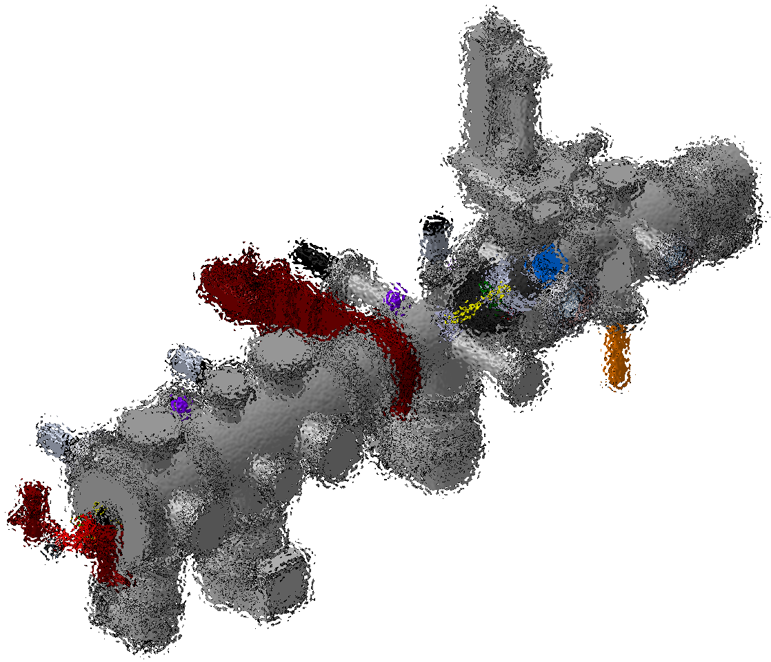
Implementation of the recommendations from the Design Review at CERN
Beam Gas Curtain
Elena Barrios Díaz
2 December 2016

Slide 2

Global overview

Slide 3
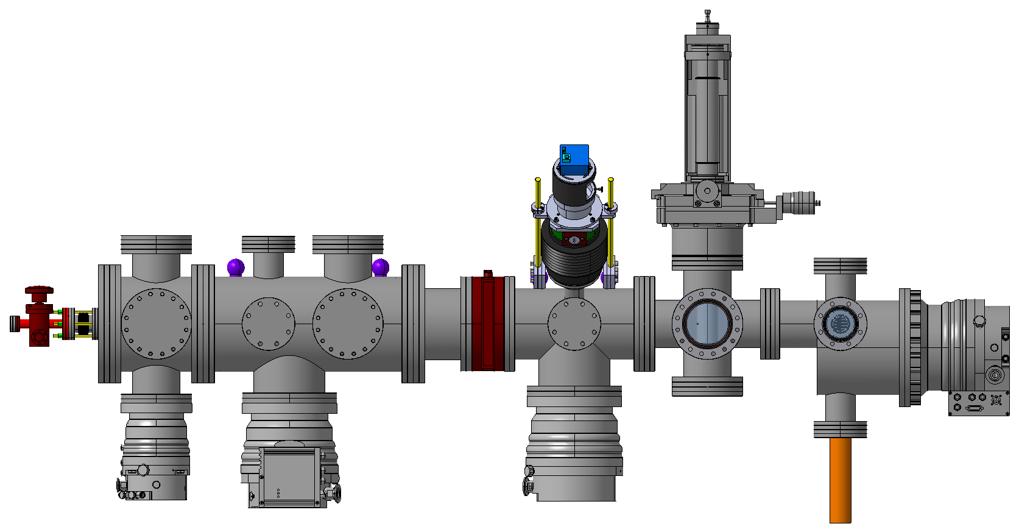
Sections of the BGC system
Expansion
section
Interaction
section
Dumping
section

Slide 4
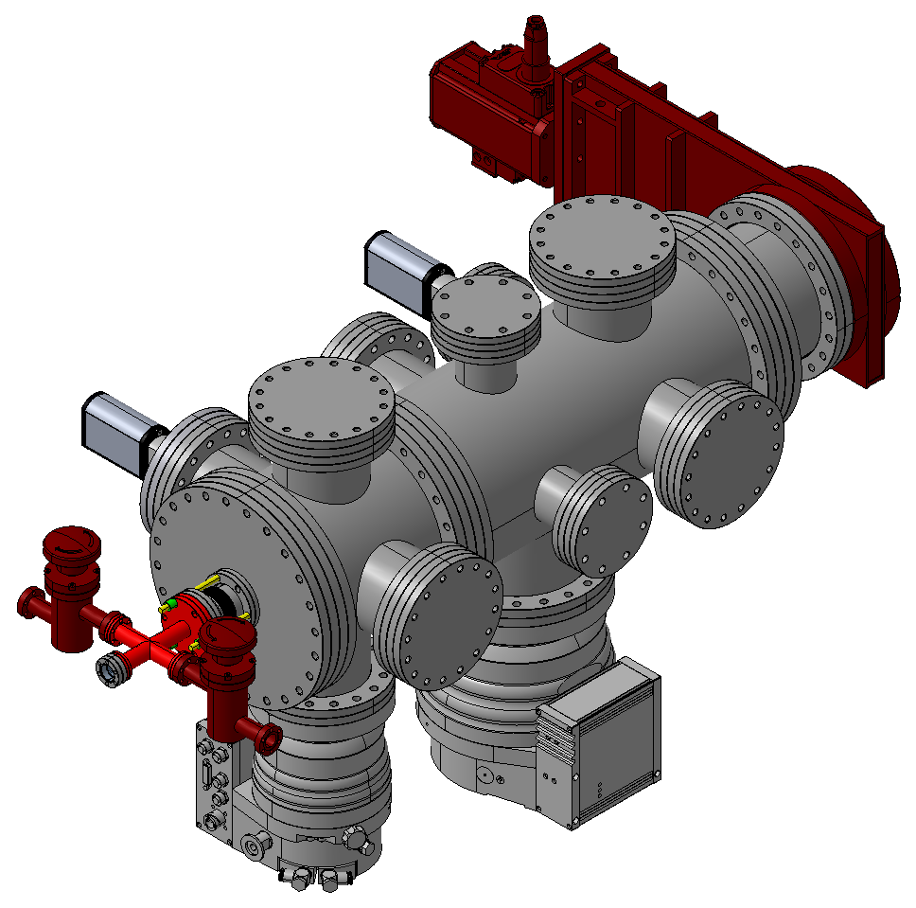
Expansion section
Gate valve
Pressure sensors
Gas inlet valve
Skimmers chamber
Nozzle chamber
Laser system viewport
Nozzle pumping valve
Turbopumps

Slide 5
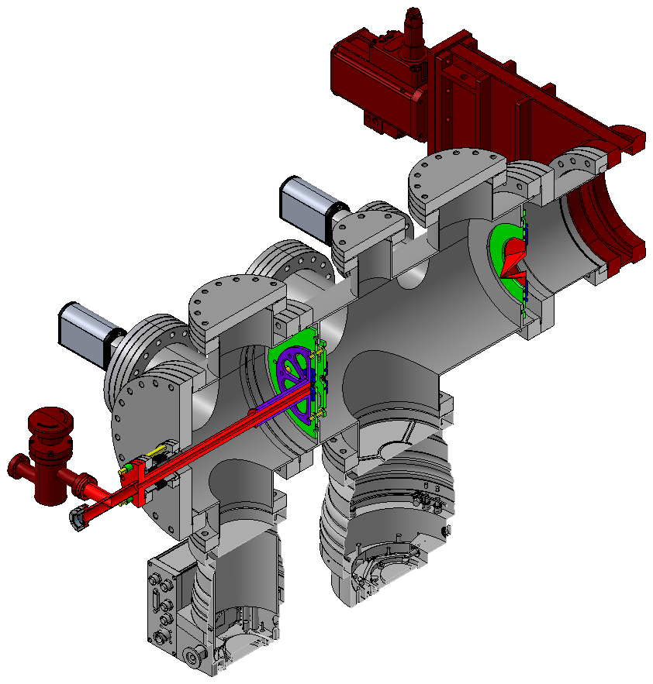
Expansion section
Ø = 180 μm
1st skimmer
□ = 4 x 0.4 mm
Ø = 30 μm
3rd skimmer
Nozzle
2nd skimmer
Ø = 400 μm

Slide 6
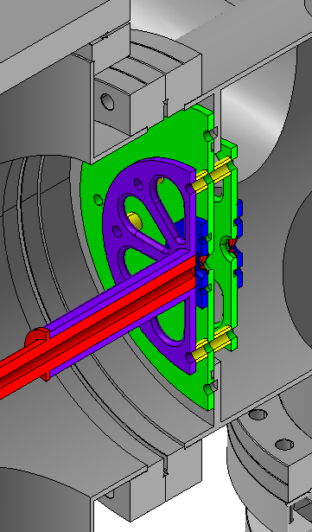
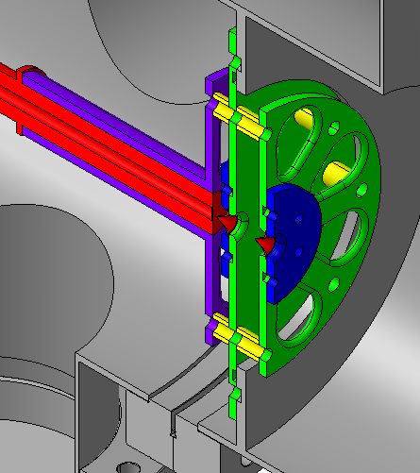
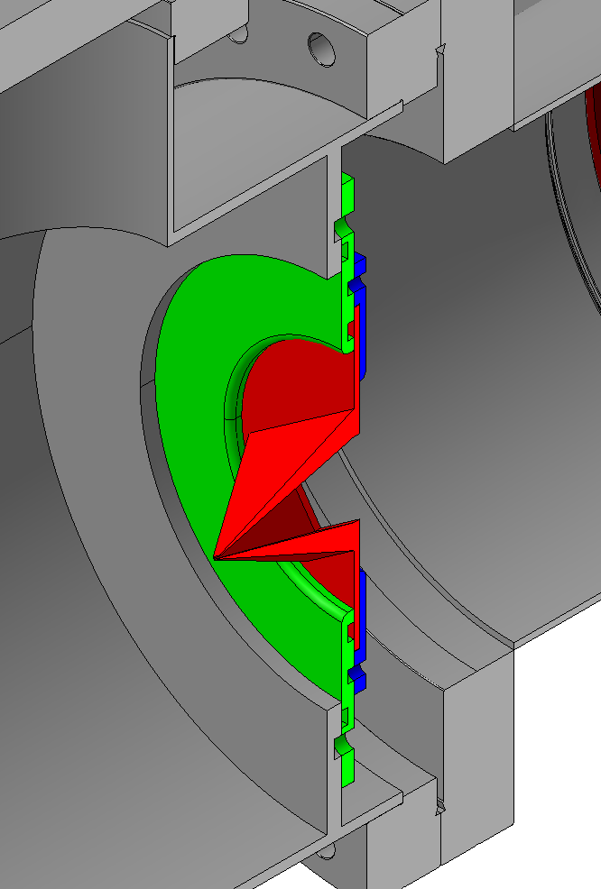
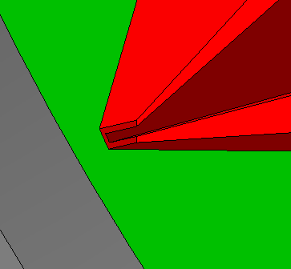
Expansion section
Front view
Back view
Ø = 30 μm
Nozzle
Ø = 180 μm
1st skimmer
Nozzle holder
2nd skimmer
Ø = 400 μm
Nozzle tube
3rd skimmer
□ = 4 x 0.4 mm

Slide 7
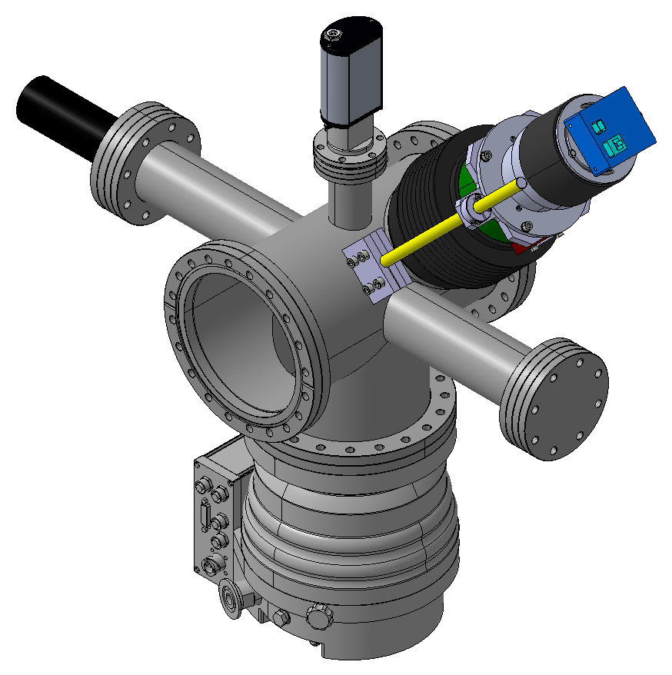
Interaction section
Pressure sensor
Electron
gun
Optical system
Electron collector
Turbopump

Slide 8
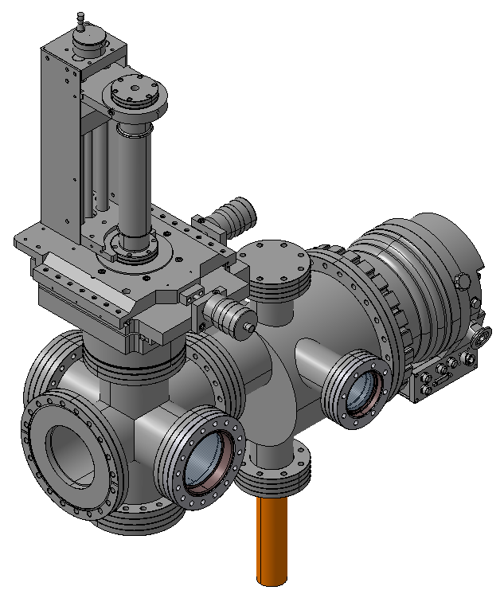
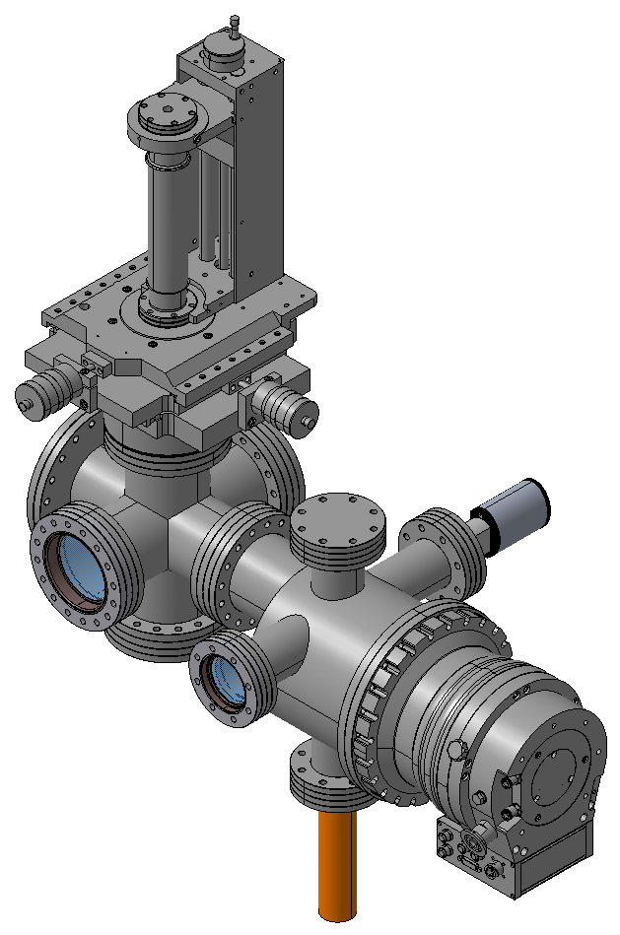
Dumping section
Front view
Back view
3D movable gauge
Pressure sensor
Retractable mirror
Turbopump

Slide 9
Vacuum system
Baseline pumps
800 L/s
700 L/s
700 L/s
300 L/s

Slide 10
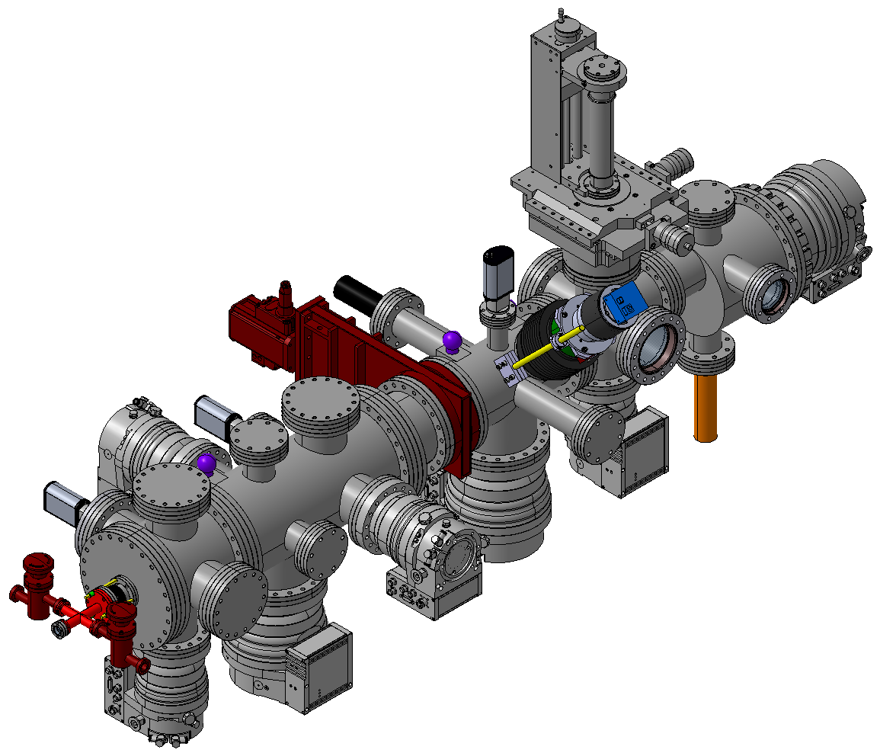
Vacuum system
Baseline and optional pumps
800 L/s
300 L/s
300 L/s
700 L/s
300 L/s
700 L/s
300 L/s

Slide 11
Expected pressures
Static Pressure < 10⁻⁹ mbar
Dynamic Pressure Ranges (Order of Magnitude)
High
10⁻⁹ mbar
High
10⁻⁹ mbar
10⁻³ mbar
10⁻⁶ mbar

Slide 12
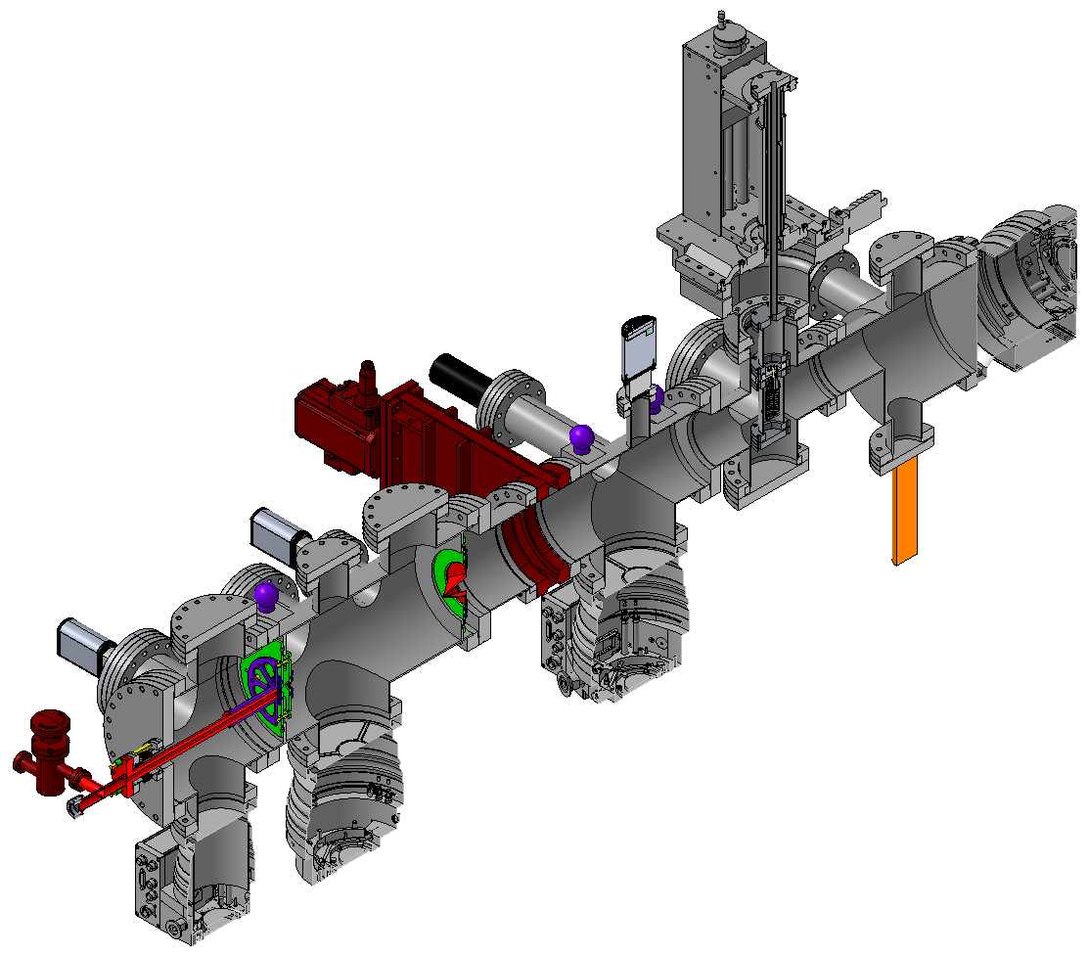
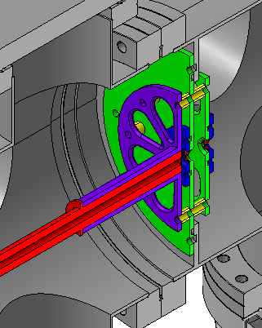
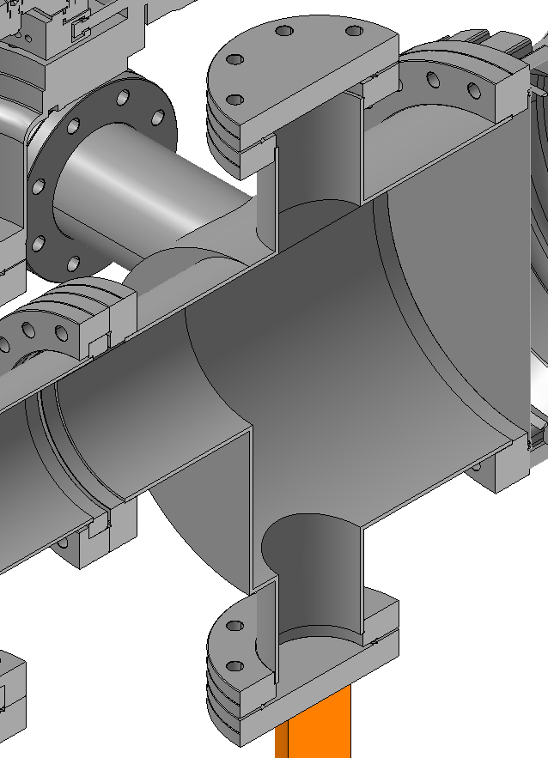
Main changes
Nozzle tube diameter
Dumping chamber shape

Slide 13
Thank you

