Slide 1

HL-LHC Re-Baseline and Status
V. Baglin on behalf of WP12
HL-LHC VSC Seminar, CERN, 9th December 2016

Slide 2
OUTLINE
Introduction
HL-LHC beam screens
HL-LHC Layout
LS2
LS3 & Studies
Summary

Slide 3
1. Introduction

Slide 4
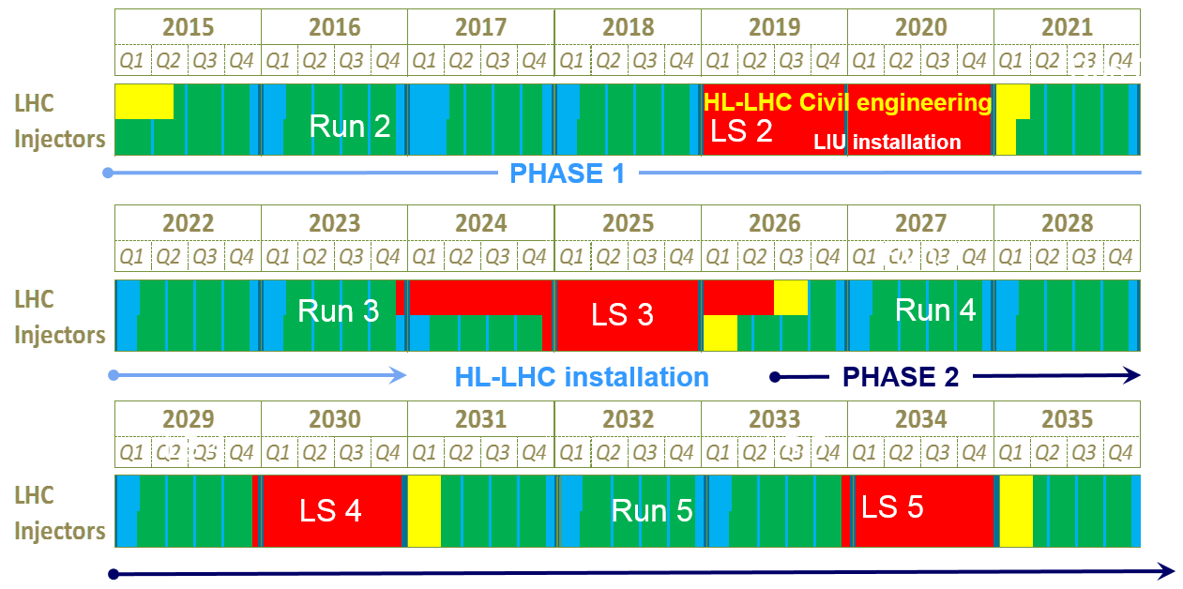
LHC roadmap: according to MTP 2016-2020
LS2 starting in 2019 => 24 months + 3 months BC
LS3 LHC: starting in 2024 => 30 months + 3 months BC
Injectors: in 2025 => 13 months + 3 months BC
Physics
Shutdown
Beam commissioning
Technical stop
~ 100-
120 fb⁻¹
(Extended) Year End Technical Stop: (E)YETS
30 fb⁻¹
~ 300 fb⁻¹
Goal of 3’000 fb⁻¹ by mid 2030ies
F. Bordry

Slide 5
LHC / HL-LHC PLAN
Technical limits to lumi increase (Machine & Experiments)
Remember:
2 technical limits !
L. Rossi
Today
Notes:
Change with new one

Slide 6
Goal of High Luminosity LHC (HL-LHC) as fixed in November 2010
From FP7 HiLumi LHC Design Study application
The main objective of HiLumi LHC Design Study is to determine a hardware configuration and a set of beam parameters that will allow the LHC to reach the following targets:
A peak luminosity of L_{peak} = 5×10³⁴ cm⁻²s⁻¹ with levelling, allowing:
An integrated luminosity of 250 fb⁻¹ per year, enabling the goal of L_{int} = 3000 fb⁻¹ twelve years after the upgrade.
This luminosity is more than ten times the luminosity reach of the first 10 years of the LHC lifetime.
Ultimate performance established 2015-2016: with same hardware
and same beam parameters: use of engineering margins:
L_{peak ult} ≅ 7.5 10³⁴ cm⁻²s⁻¹ and Ultimate Integrated L_{int ult} ∼ 4000 fb⁻¹
LHC should not be the limit, would Physics require more…
Concept of ultimate performance discussed from 2013:
L_{ult} ≅ 7.5 10³⁴ cm⁻²s⁻¹ and Ultimate Integrated L_{int ult} ∼ 4000 fb⁻¹
LHC should not be the limit, would Physics require more…
Notes:
Ultimate : the pink box must substitute/overlap the blue one

Slide 7

HL-LHC Baseline Parameters
Back-up scenario
Tech. Coord. Committee, V6.1
Parameter | LHC | HL-LHC | 8b+4e
Beam energy [TeV] | 7
Bunch spacing [ns] | 25
Bunch population [10¹¹] | 1.15 | 2.2 | 2.2
Number of bunches | 2808 | 2748 | 1968
Beam current [A] | 0.58 | 1.09 | 0.82
Crossing angle [μrad] | 285 | 510 | 480
Beam separation [s] | 9.4 | 12.5 | 12.5
Betatron function at interaction point β* [m] | 0.55 | 0.2 | 0.2
Normalised emittance ε_{n} [μm] | 3.75 | 2.5 | 2.2
ε_{L} [eVs] | 2.5 | 2.5 | 2.5
rms bunch length [m] | 0.075 | 0.081 | 0.081
Peak Luminosity without crab cavities [10³⁴ cm⁻²s⁻¹] | 1 | 6.5 | 5.8
Virtual luminosity with crab cavities without levelling [10³⁴ cm⁻²s⁻¹] | (1.18) | 12.6 | 11.5
Levelled luminosity with crab cavities [10³⁴ cm⁻²s⁻¹] | - | 5 | 3.8
Events per crossing | 27 | 132 | 140
Integrated luminosity [fb⁻¹/year] | 45 | 260 | 190
Efficiency requires long fill times (6-10 h)
LIU
New IT Quads & ATS
Crab Cavity
with levelling
VSC to review performance compatibility with HL-LHC to identify consolidation and build new systems compatible with HL-LHC

Slide 8
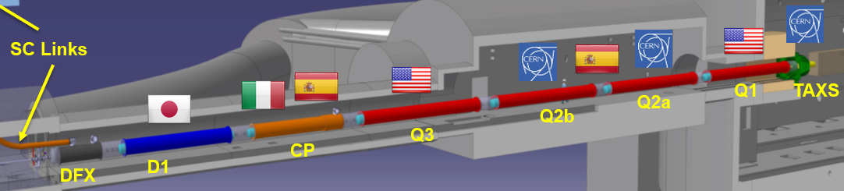
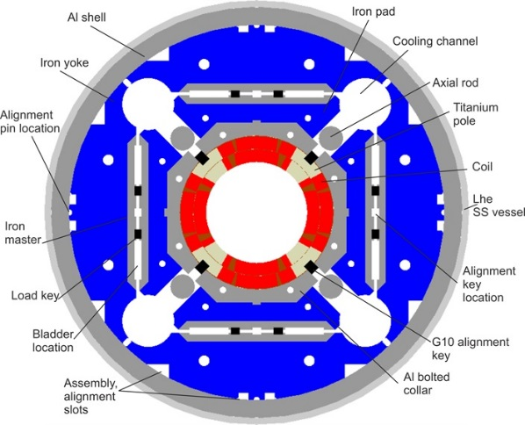
NEW focussing quadrupole and merging dipole
Decrease beta (i.e beam size) at collision point (beta*) from 55 cm to 15 cm
ATLAS
CMS
All superconducting magnets at 1.9 K with a beam screen at 5-20 K or 40-60 K
Q1, Q2, Q3, CP (corrector package)
  Nb₃Sn (new technology)
  150 mm ID, gradient = 130 T/m, peak field 11.5 T
D1, D2
  NbTi (classical technology)
  150 mm, 5.6 T
Present IT+D1 to be completely removed (radiation to personnel !!)
E. Todesco

Slide 9
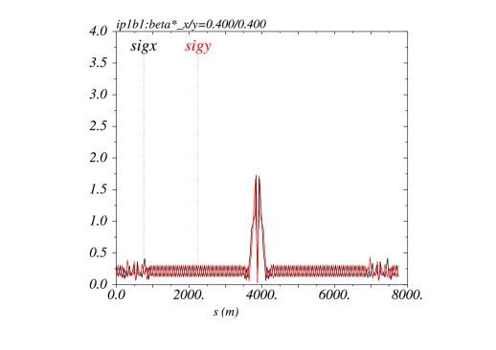
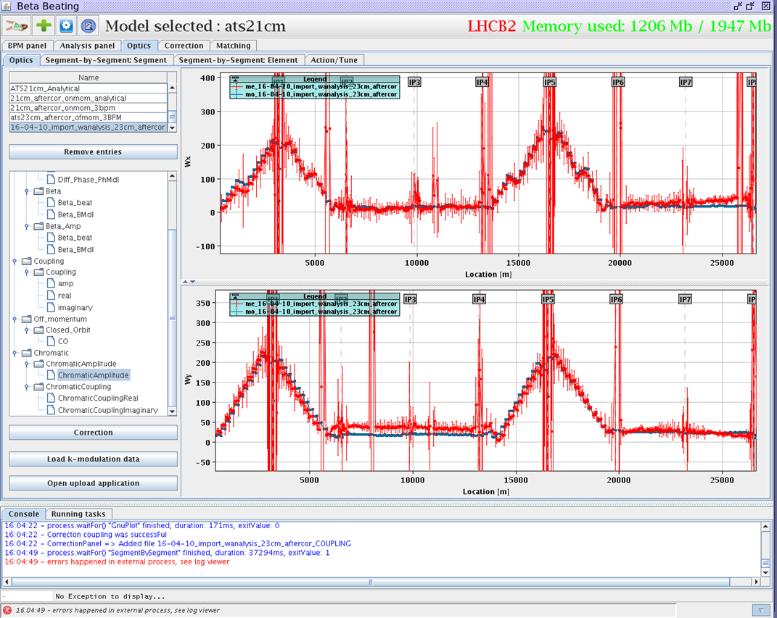
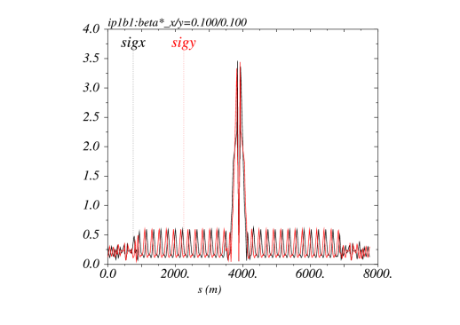
Achromatic Telescopic Squeezing (ATS)
New optic scheme
Use of the available aperture to blow-up the β function in the arcs in order to reduce further β* at the collision point
Recent MD studies have shown that β* =12 cm could be reached with probe beams
Chromaticities are under controlled all around the ring
LHC: 40 cm
HL-LHC: 10 cm
S. Fartoukh

Slide 10

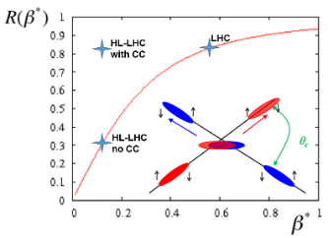

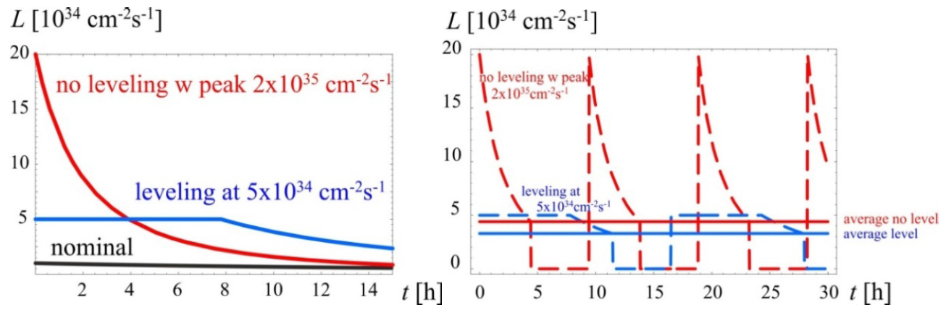
Crab cavities - luminosity
Increase instantaneous luminosity by a factor 3 by “crabbing” the bunches
Requires luminosity levelling to minimise number of event per crossing
R. Calaga
B. Palmer
Crab cavities maximise luminosity and can be used for luminosity levelling:
  when luminosity is too high, CC are almost off and are slowly turned on to compensate proton burning ➔ allow to optimise integrated luminosity

Slide 11
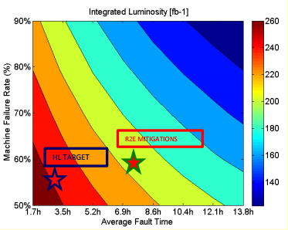
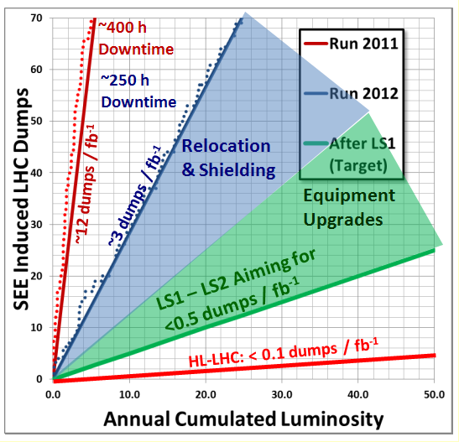
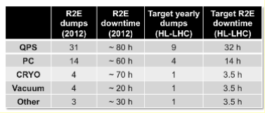
Availability and Downtime
D. Wolmann
M. Brugger
Upgrade of interlocking system (integration to avoid spurious dump)
Reduction of (generous) of interlock levels
R2E
Robust and reliable equipments
Identification of “fast” repair scenario
Etc.
VSC performances:
Still on track for HL-LHC !
Year | Issue count | Average downtime | Beam dump
2015 | 6 | 2.5 h | 1
2016 | 2 | 0.7 h | 0

Slide 12
High Luminosity Work Packages after FP7 DS:

Slide 13
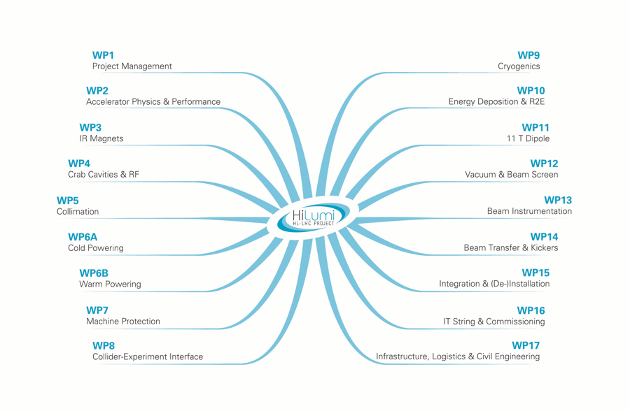
Organisation
https://espace.cern.ch/HiLumi/default.aspx
+ survey
WP17 subWPs:
CE
EL
CV
Access&Al.
Tech Mon
Survey-Align
Transport
(SM18 Upr)
Log&Storage
Op. Safety
+ Controls

Slide 14
Main HL-LHC events in 2016
Joint LARP CM26/Hi-Lumi meeting, May 2016
  https://indico.fnal.gov/conferenceTimeTable.py?confId=11049#20160518.detailed
2nd HiLumi Industry Day, October 2016
  https://indico.cern.ch/event/557233/timetable/#20161031.detailed
Joint LIU / HL-LHC meeting, October 2015
  https://indico.cern.ch/event/437662/
Cost and Schedule Review, October 2016
6th HL-LHC collaboration meeting, November 2016
  https://indico.cern.ch/event/549979/timetable/#all.detailed
TDR-v0, Del-D1.10: http://hilumilhc.web.cern.ch/science/deliverables
Reviews and regular meetings such as Technical Coordination Committee and with WPs

Slide 15
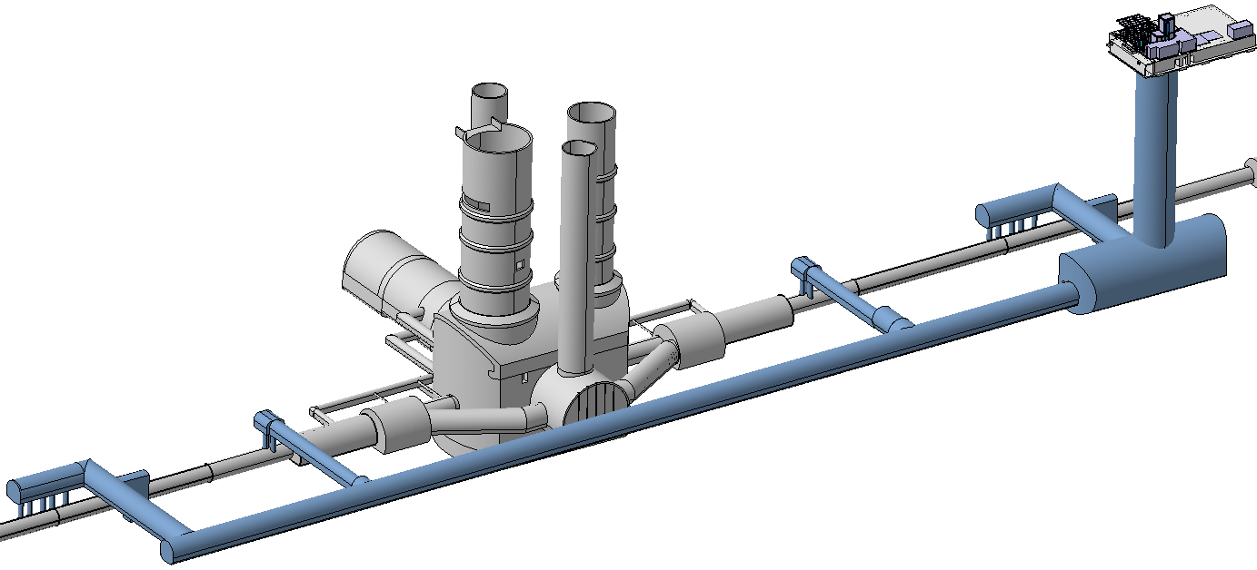
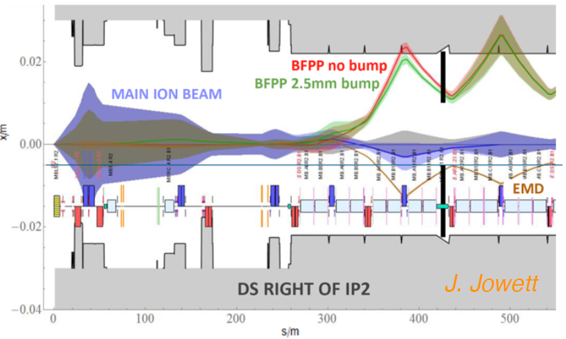
Decisions before June 2016 - Rebaselining
Underground double decker to allow access during HL-LHC operation
Reduction of SC link length, reduction of Q4 operating current, one circuit for triplet powering (WP6 A/B)
Increase length of triplet due to gradient reduction from 140 to 130 T/m
Use of a magnetic bump in P2 for ion collisions avoiding 11 T magnets in the DS
CC
IT+CP+D1
P. Fessia
D1+CP+IT
CC
J. Jowett
Notes:
Picture Paolo tunnel

Slide 16
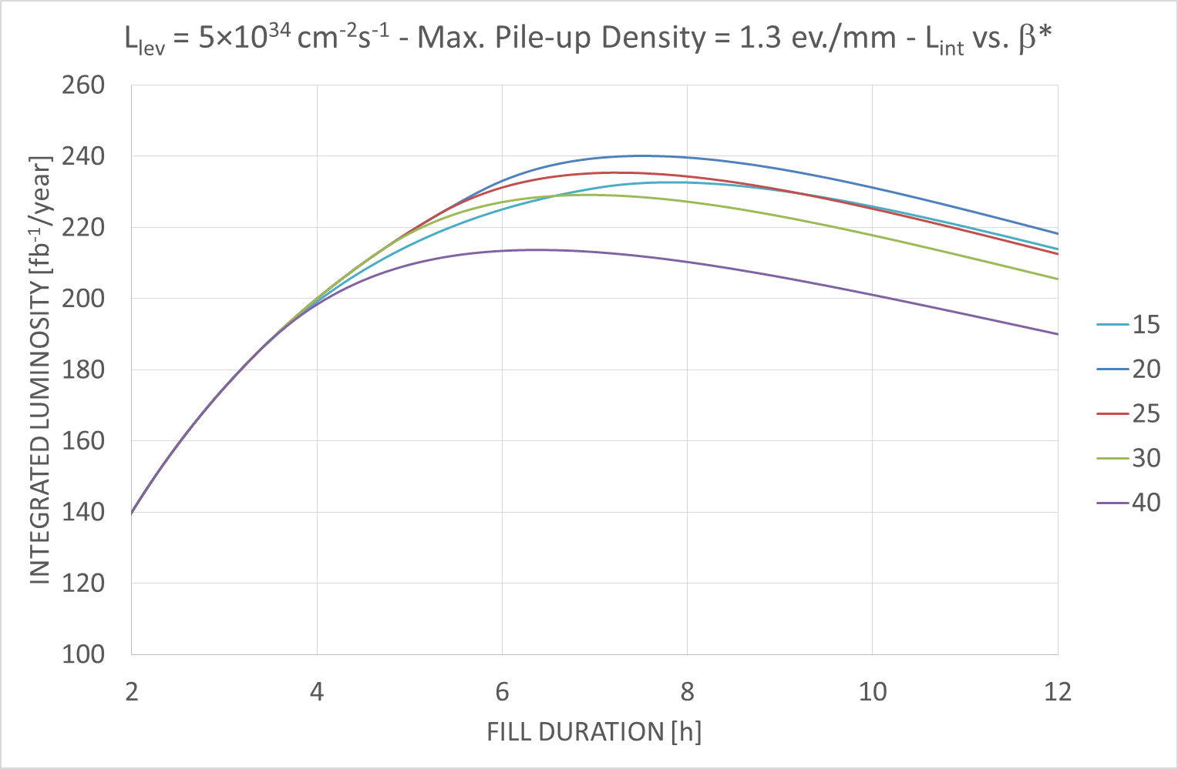
June 2016 - Rebaselining
Objective: includes ~ 120MCHF extra cost for civil engineering (caverns, buildings) at without increase on HiLumi project CtC ➔ impact on all WP
WP4: reduction from 4 to 2 cryomodules per IP side (the reduction is reversible)
  Optimum at Beta* = 20 cm with larger pile-up densities (> 1.3 Event/mm)
160 days of physics
50% performance efficiency
Nominal
WP2
Notes:
Picture Paolo tunnel

Slide 17
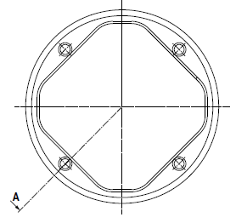
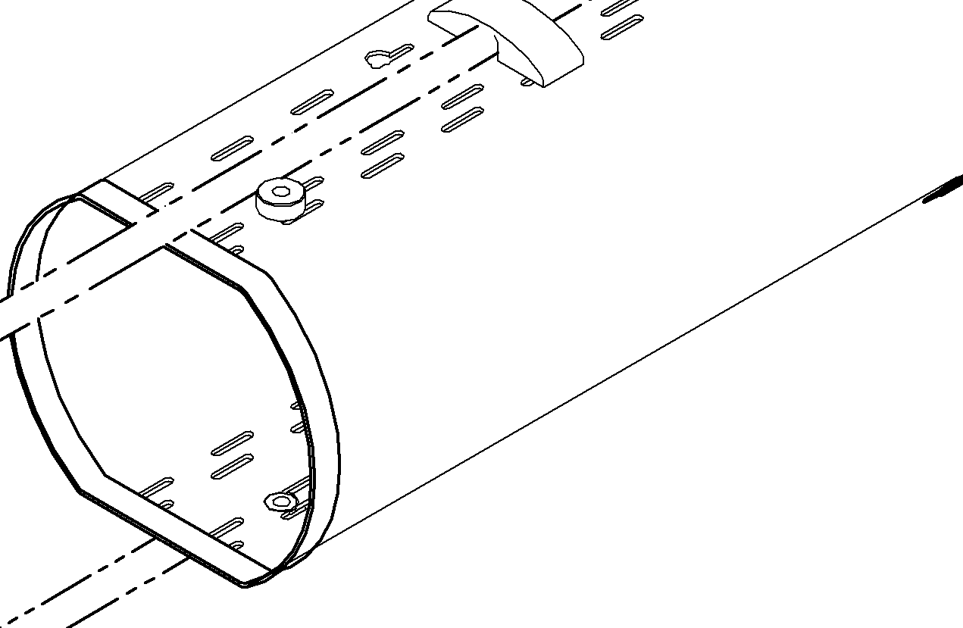
June 2016 - Rebaselining
WP3: replace MQYY, as new HL-LHC Q4, with LHC Type MQY at 1.9 K (instead of 4.5K in LHC)
  If needed, the 90 mm aperture MQYY could be installed after HL-LHC construction (i.e. LS4 ?)
  CB aperture reduced to ID 63 with race track shape beam screen (instead of octagonal)
  ➔ Impact on flat beams performances (beta* limited to 40/15 cm)
Q4: octagonal shape,
CB ID: 79.8
Q4: racetrack shape,
CB ID: 63
Notes:
Picture Paolo tunnel

Slide 18
June 2016 - Rebaselining
WP3: optimisation of the QPS system
  Minimum configuration, maintaining all systems, with redundancy
WP5: optimisation of the collimation system
  TCLD collimators in P7 reduced from 4 to 2 (impact on WP11)
  Reduction of spares
WP8: new TANB in LSS8
WP9: new cryobox layout
WP11: optimisation of the 11 T magnet system
  11 T magnets in P7 reduced from 4+1 to 2+1
  11 T magnets in P2 replaced by 2+1 connection cryostat
WP12: optimisation of vacuum layout, internalisation of resources
Other WP: minor impact
The impact of the re-baselining over the whole project is still in evaluation
Notes:
Picture Paolo tunnel

Slide 19
A Word from the Project Leader
Dear colleagues,
Further to the 2nd Cost & Schedule Review (Oct. 2016), it is my pleasure to send you the final report prepared by the CMAC members chaired by Norbert Holtkamp.
I believe the outcome of the review for the project was really excellent. We will work hard to study and implement, as far as we can, the recommendations. I am glad to underline that the reviewers warmly congratulated the HiLumi teams for taking the recommendations of the 1st C&SR very seriously. We need to continue along the same line.
I take this opportunity to thank you all for the review preparation, the outstanding efforts and for the quality of the work. Please transmit our wholeheartedly thanks to all the collaborators with less exposure who also contributed to this successful achievement.
Best regards,
Prof. Lucio Rossi
High Luminosity LHC Project Leader
CERN – Accelerator & Technology Sector

Slide 20
HL-LHC Budget (CtC) : 950 MCHF (2015 CHF)
Committed 7% of the budget
Σ_{WP}: 17+3+9+4+6A+5 = 75%
Main drivers: civil engineering, magnets, cryo, RF, cold powering, collimation

Slide 21
Detailed general plan with critical path
L. Tavian
Run2 objectives
LS2 objectives
LS3 objectives

Slide 22
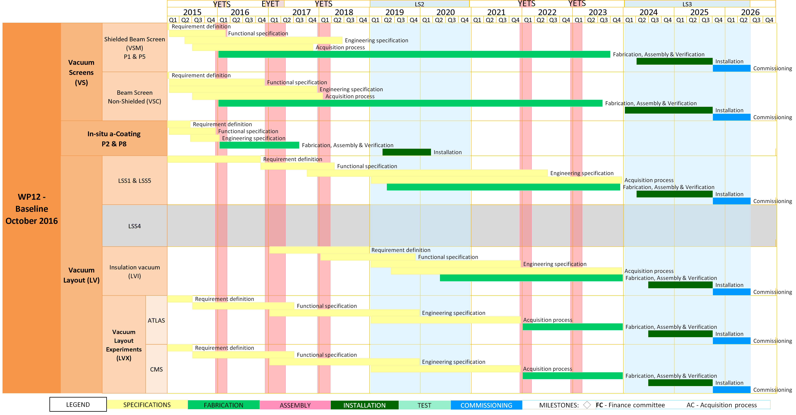
WP12: Schedule
Step 1: Vacuum Screens & in-situ coating
Step 2: Layout completion
Today
Courtesy of Planning team

Slide 23
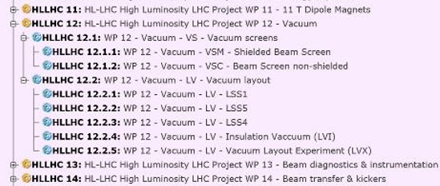
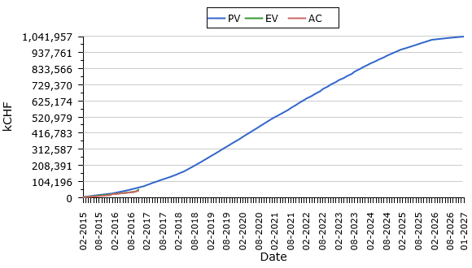
WP12 Cost to Completion
Covers 2015 till 2026 – Updated following last C&S review
Includes studies, design, prototyping, procurement, assembly, testing and installation for:
EVM needs to be filled:
  Definition of work unit
  Follow-up of:
    PV
    EV
    AC
Next C&S review: ~ Feb-March 2018
  Shielded beam screens
  Non-shielded beam screens
  In-situ treatment of IT2 & 8
  Room temperature vacuum system in LSS1, 5
  RT vacuum system in exp. areas 1 & 5 (without exp. beam pipes)
  Insulation vacuum
Typical LHC dashboard

Slide 24
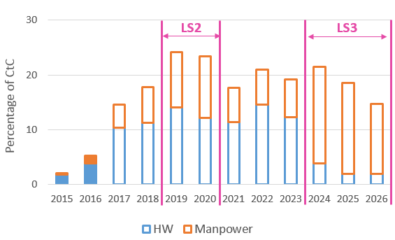
WP12 Cost to Completion: Status
We are at the beginning !
The inputs are all integrated/updated in APT (activity planning tool)
Spending are followed with CET (thanks Germana & Laura)
Already a good start …. still 95 % to go !
We shall continue our effort to engage money for HW and Manpower

Slide 25
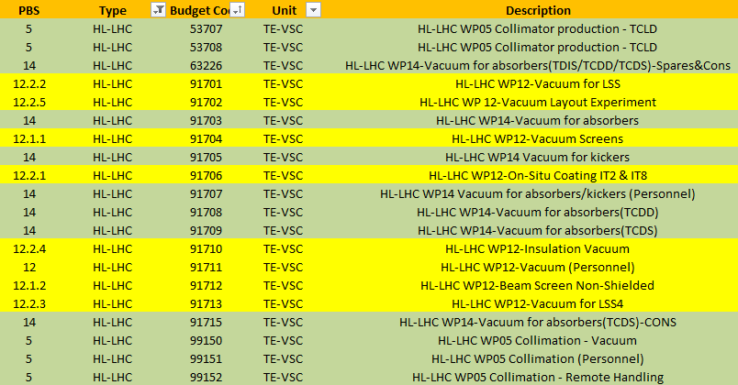
HL-LHC Budget Codes
Follows the PBS
For WP12 scope only (yellow band):
  HL-LHC money
  CONS money
For other WP scope (green band)
Please use:
91701 VSC Prj: HL-LHC WP12-Vacuum for LSS for HL-LHC activities related to the room temperature beam vacuum system.
91702 VSC Prj: HL-LHC WP 12-Vacuum Layout Experiment for HL-LHC activities related to the LHC experiments (i.e. between Q1 and Q1), machine side.
91704 VSC Prj: HL-LHC WP12-Vacuum Screens for HL-LHC activities related to the cryogenic beam vacuum system.
91710 VSC Prj: HL-LHC WP 12-Insulation Vacuum for HL-LHC activities related to the insulation vacuum system.
91711 HL-LHC WP 12-Vacuum (Personnel) for HL-LHC personnel (P and M4P).
In case of doubts, please do not hesitate to contact me,
Please respect the appropriate use of BC !

Slide 26
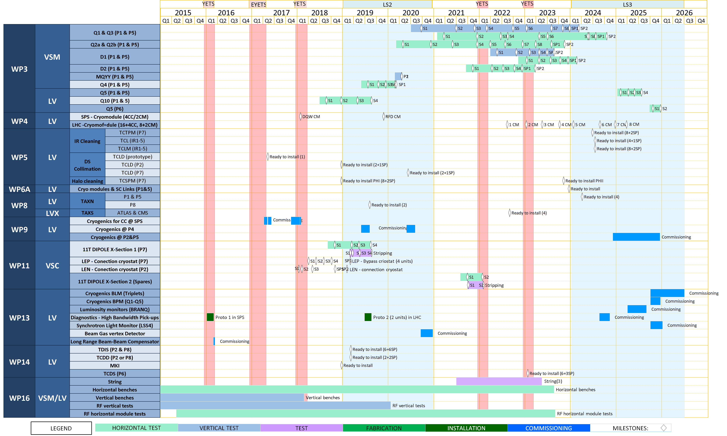
Schedule – WP12 Contribution to other WP
Identification of major milestones (beam screens etc.)
Courtesy of Planning team
Today

Slide 27
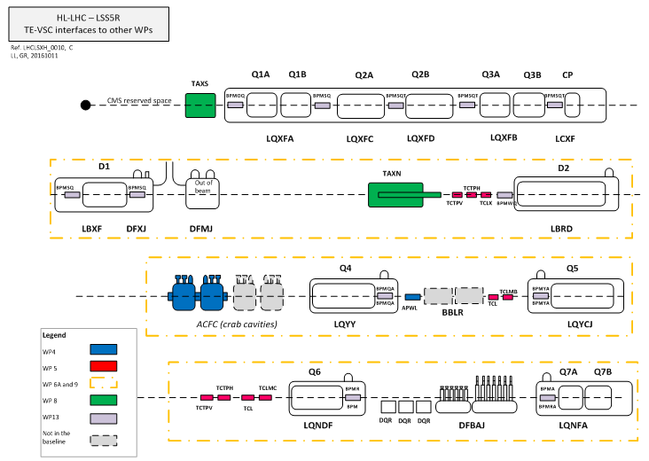
Interfaces Contribution Synoptic
All WP12 contribution CtC are defined: budget codes created or to be created
Planning or realisation needs to be consolidated

Slide 28
2. HL-LHC Beam Screen

Slide 29
2.1 Design Studies

Slide 30
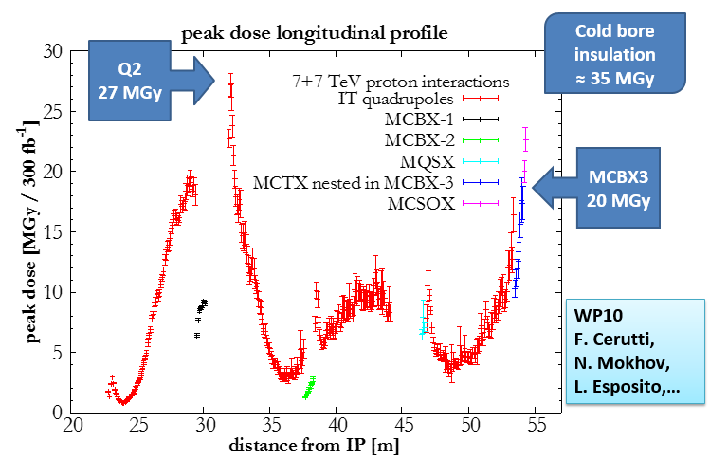
The 1st technical trigger of the upgrade:
Radiation damage in low-beta triplet region
L. Rossi
The Shielded Beam Screens (BS) are key devices of the HL-LHC project

Slide 31
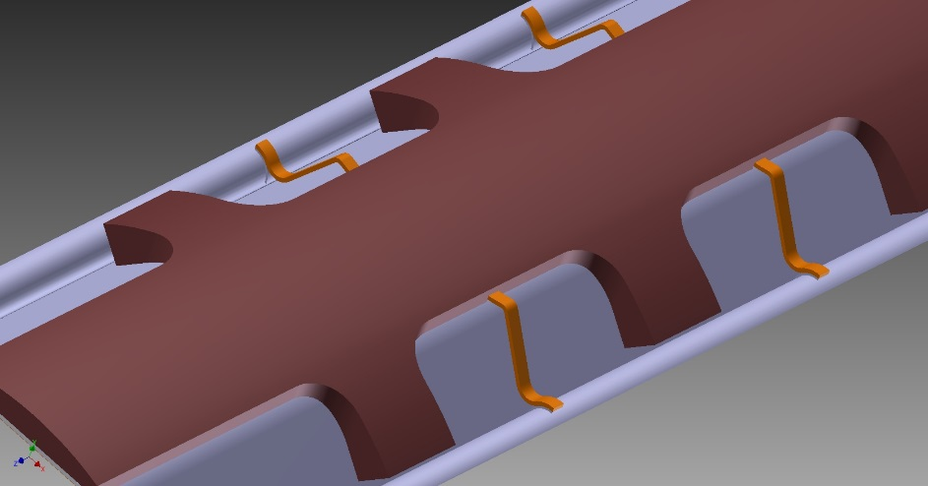
Shielded Beam Screen Concept
Assembly of the beam screen
Elastic supporting system:
Low heat leak to the cold bore tube at 1.9K
Ceramic ball with titanium spring
Cold bore (CB) at 1.9 K:
4 mm thick tube in 316LN
Tungsten alloy blocks:
Chemical composition: 95% W, ~3.5% Ni, ~ 1.5% Cu
mechanically connected to the beam screen tube: positioned with pins and titanium elastic rings
Heat load: 15-25 W/m
Thermal links:
In copper
Connected to the absorbers and the cooling tubes or beam screen tube
C. Garion
Beam screen tube (BS) at ~ 50 K:
Perforated tube (~2%) in High Mn High N stainless steel (1740 l/s/m (H2 at 50K))
Internal copper layer (80 μm) for impedance
a-C coating (as a baseline) for e- cloud mitigation
Cooling tubes:
Outer Diameter: 10 or 16 mm
Laser welded on the beam screen tube

Slide 32
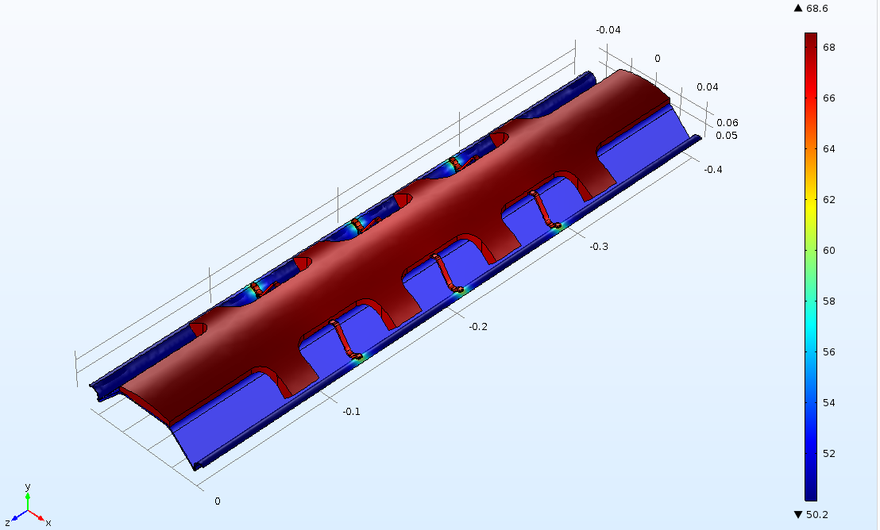
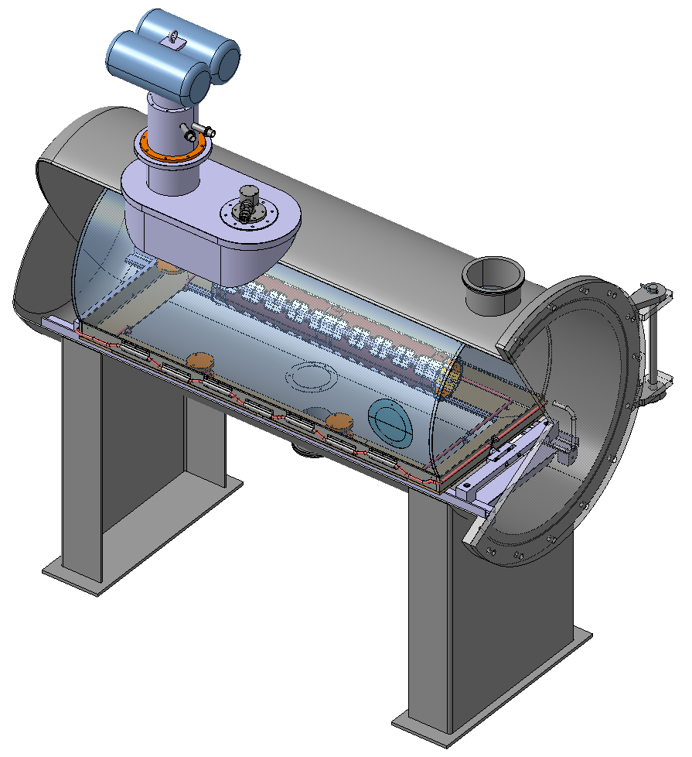
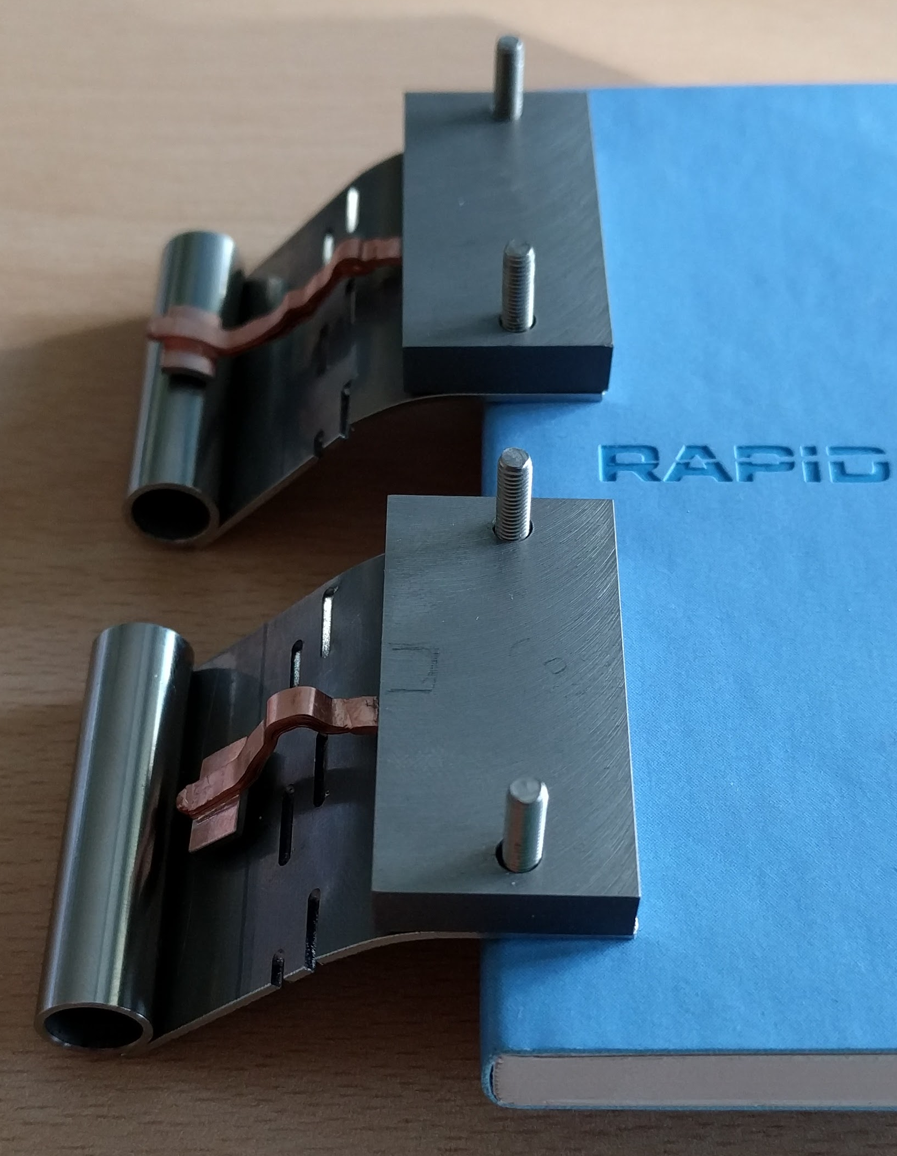
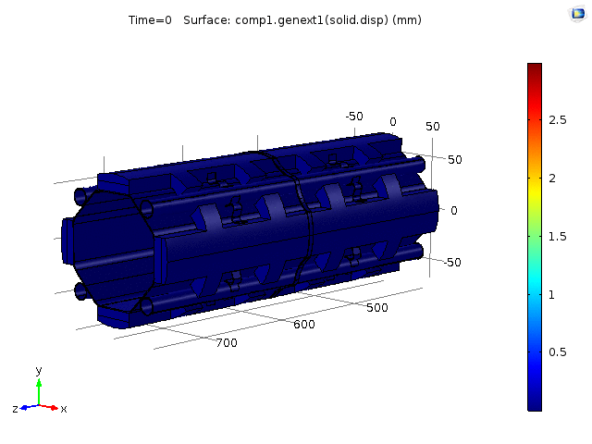
Progress & next Milestones
  Thermal and quench models of the beam screen/ cold bore assembly are developed
    ➔ Under validation against experimental investigations (mid 2017)
  Thermal tests (in collaboration with WP 9):
    Thermal link evaluation
    Global evaluation
M. Moronne
C. Garion
Set-up for the thermal tests of a 80 cm long beam screen / cold bore system
  Quench tests (in collaboration with WP 3):
    2m long beam screen prototype is being prepared for quench tests in MQXF model in spring 2017

Slide 33
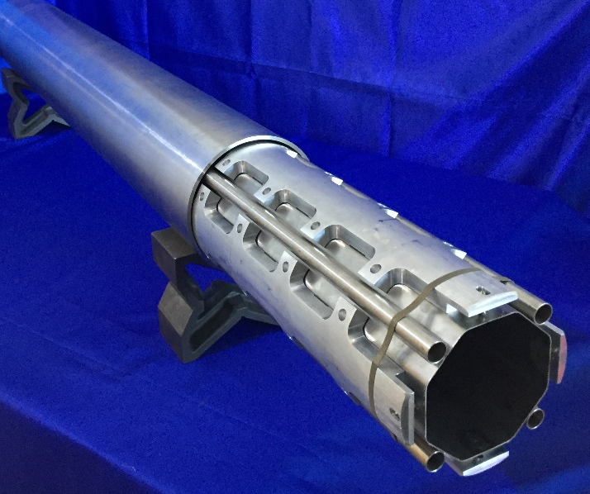
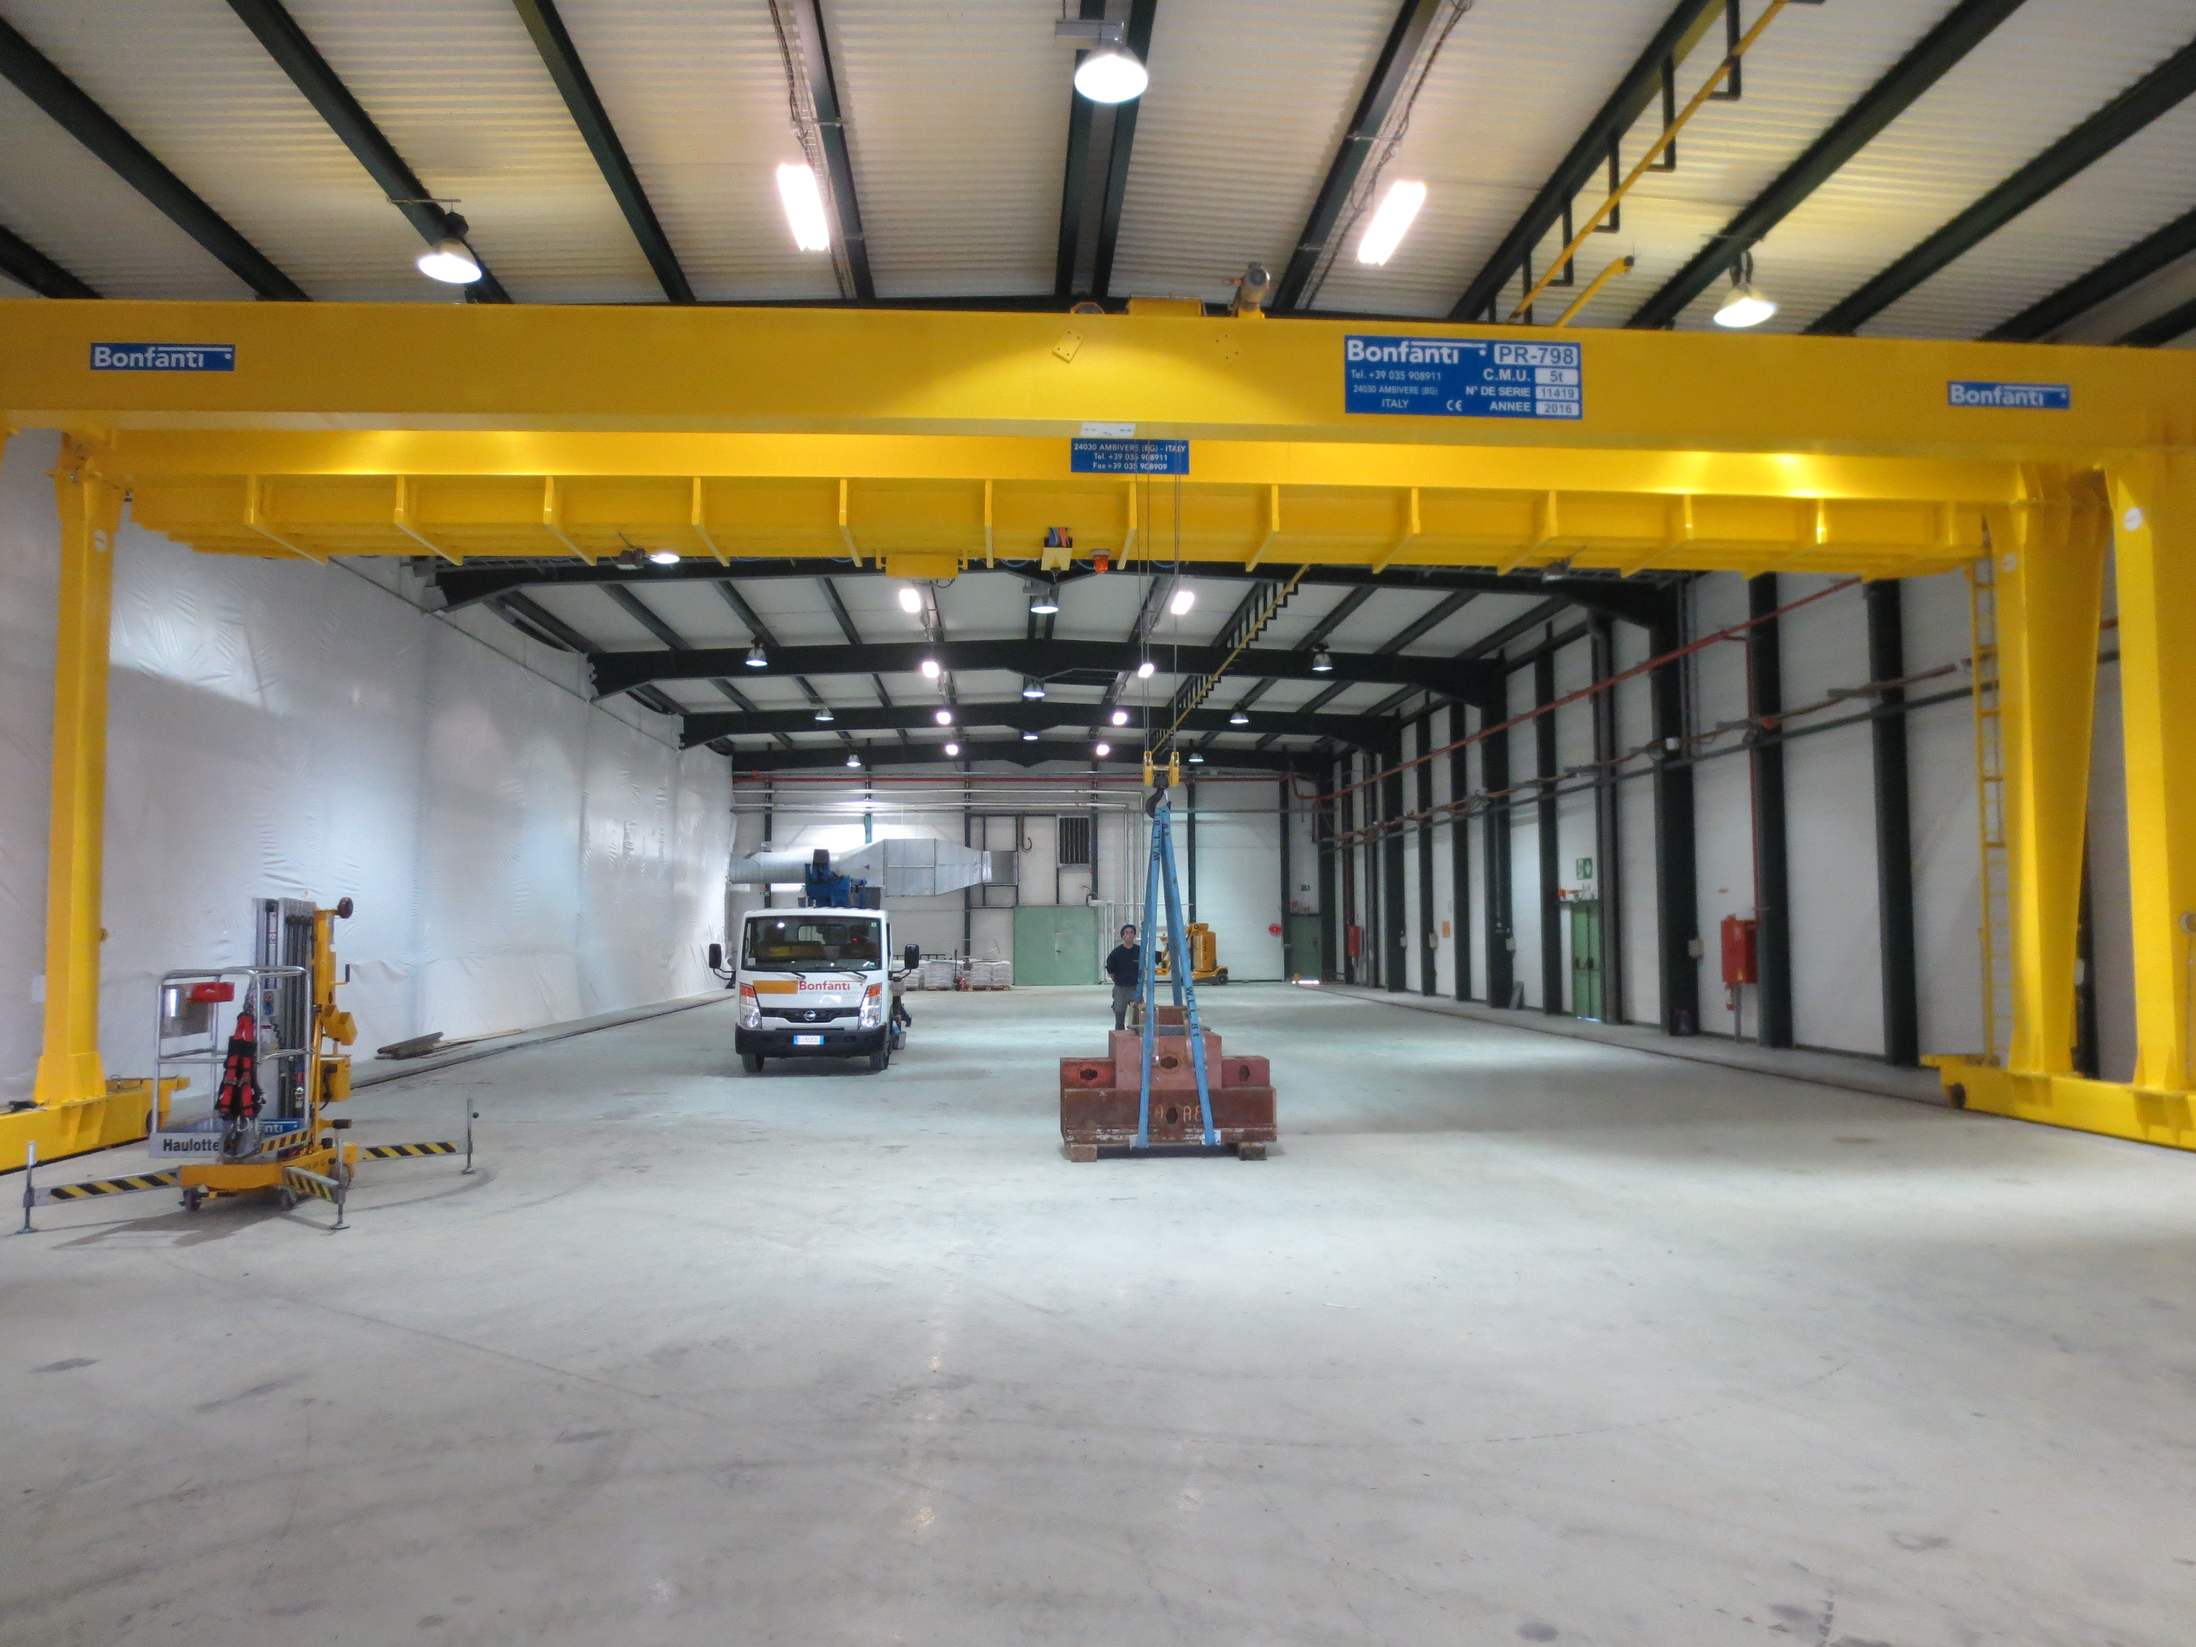
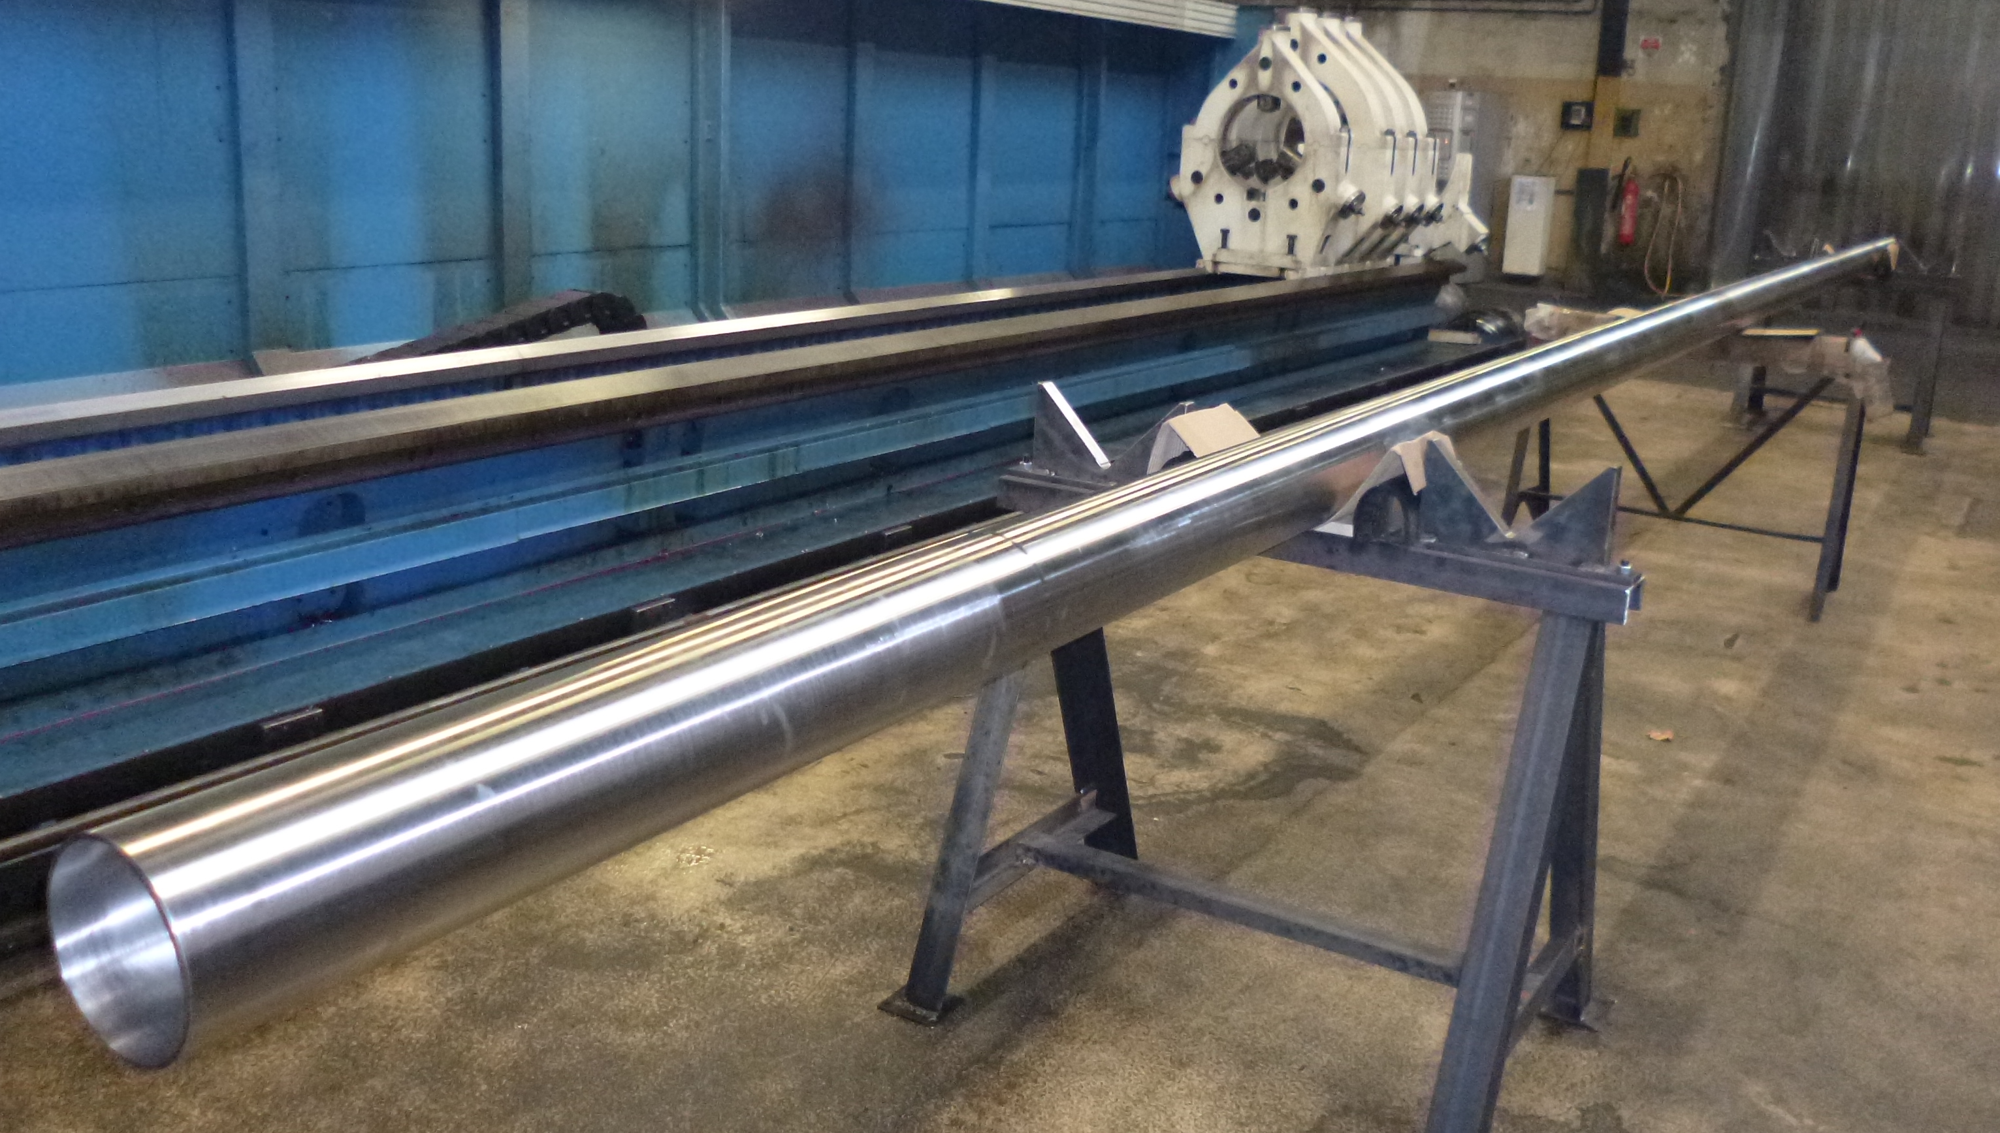
Progress & next Milestones
  Beam screen and cold bore mechanical design completed
    CB prototypes produced, tolerances to be fixed by end 2016
    Beam screen prototypes to be produced, tolerances to be frozen by end 2017
  Beam Screen Finishing Facility ready by mid 2107
  BS:
    Stainless steel for BS &Cooling tube ➔ ordered, delivery Q3 2017
    Co-lamination ➔ contract to be placed, delivery Q4 2017
    Beam screen punching, forming, welding:
      ➔ proto Q3 2017, first tube 2018
  CB:
    Raw material delivery end 2017
    Production starts 2018
C. Garion
A. Vidal
10 m long CB prototype
Reception test of the gantry crane

Slide 34
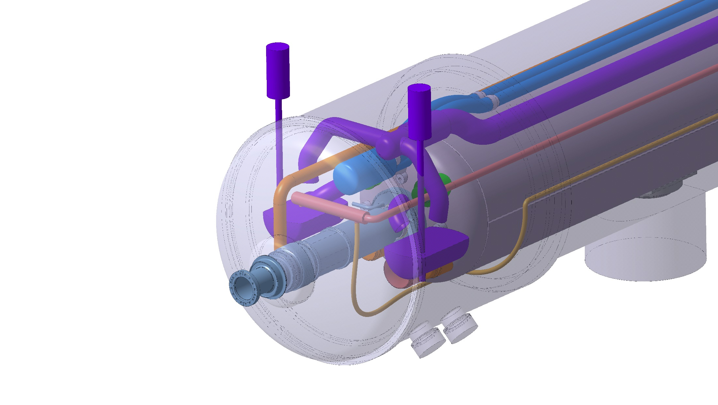
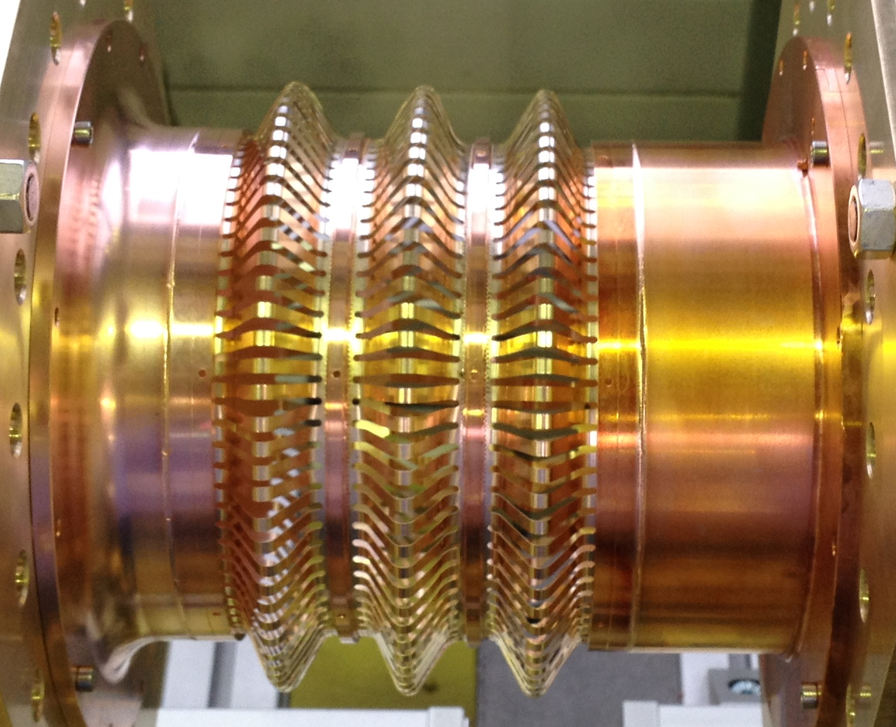
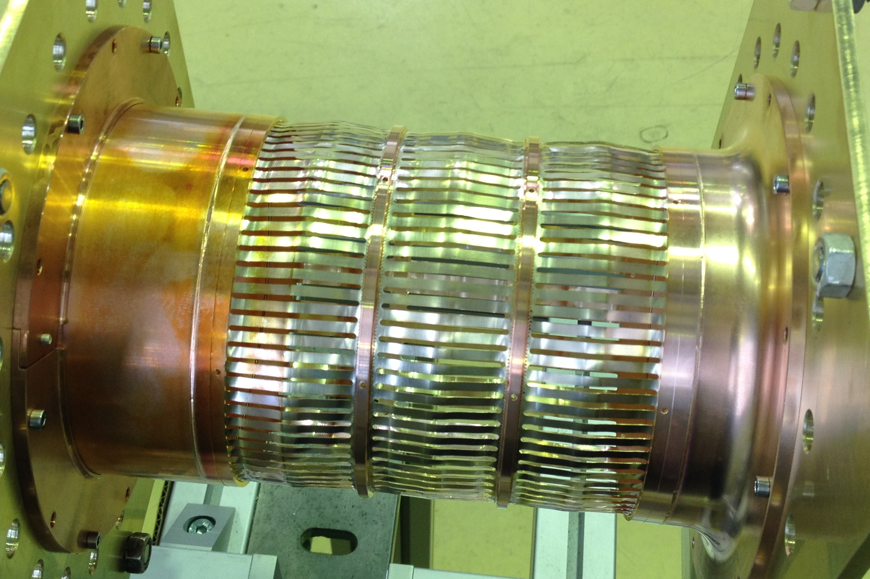
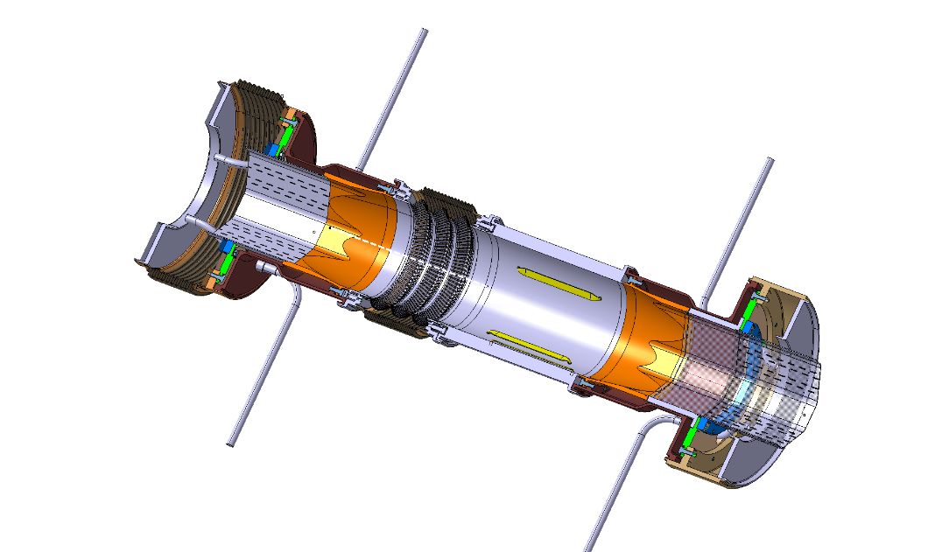
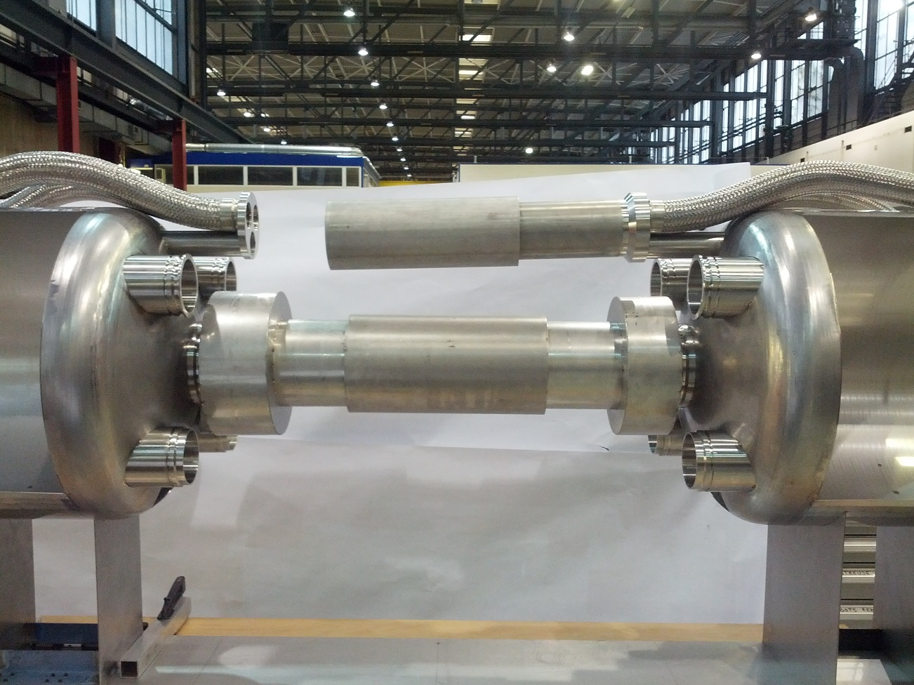
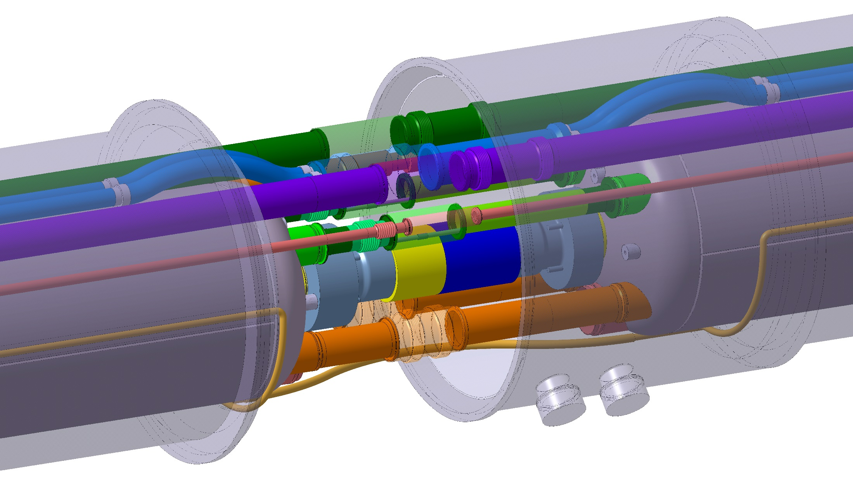
Cold warm transition and interconnect design
  Interconnection baseline with deformable RF bridge
Q1 cold/warm transition
Deformable RF fingers considered as baseline
M. Sitko, J. Perez Espinos
WP3
10 m long CB prototype
Mock-up under construction

Slide 35
2.2 a-C Coating
Performances Studies

Slide 36
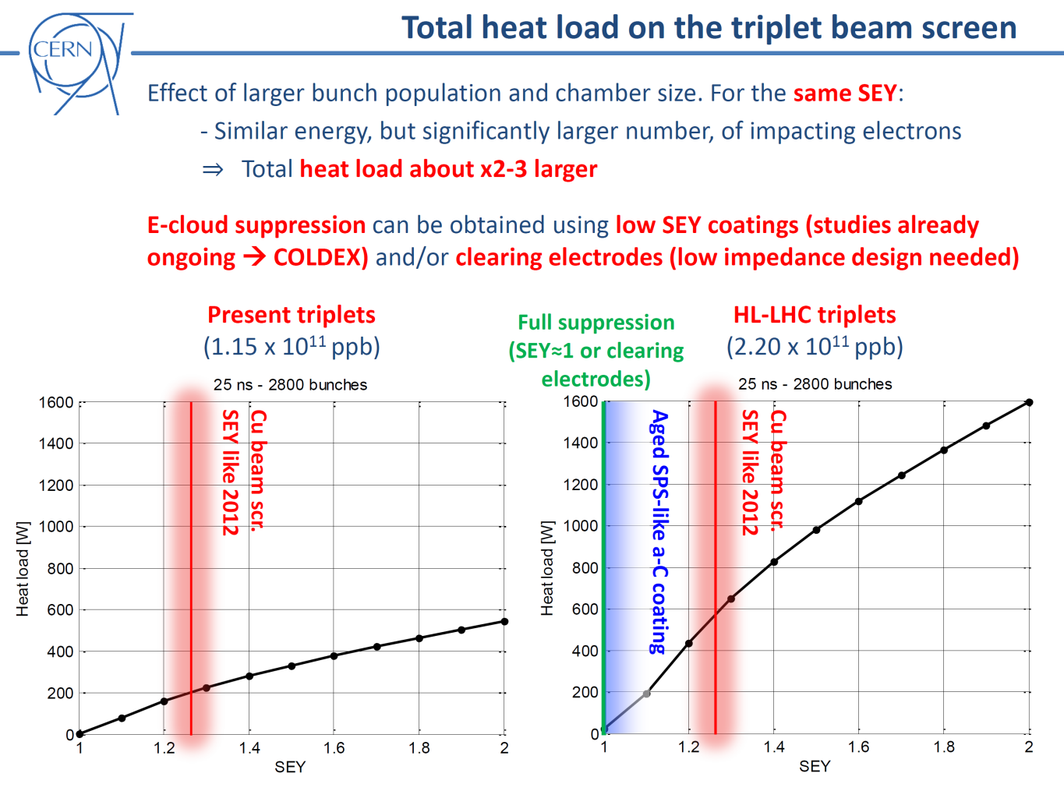
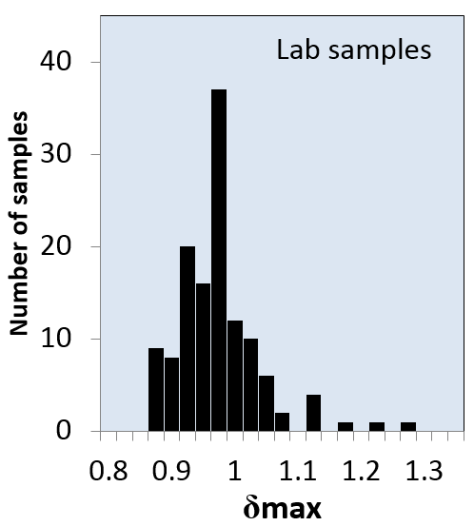
The 2nd technical trigger of the upgrade:
Cryogenic heat load
  Too large heat load (>600 W) originating from electron cloud are predicted for HL-LHC IT beam screens.
  It will be associated with larger (than LHC) background to the experiments.
  a-C coating is proposed to mitigate electron multipacting reducing electron cloud to acceptable values.
  Performances at cryogenic temperature of a-C shall be compatible with HL-LHC parameters
G. Rumolo, G. Iadarola
The a-C coating is a key technology for the HL-LHC project
M. Taborelli

Slide 37
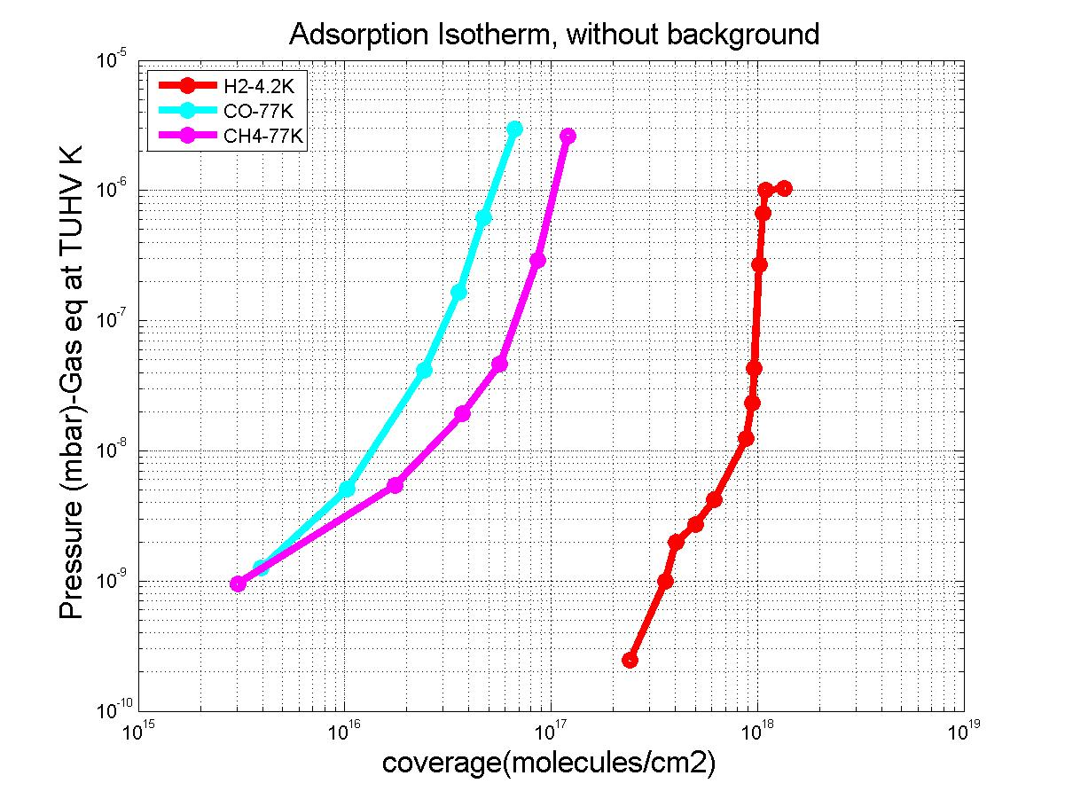
Adsorption Isotherms at 4.2 and 77 K
  ~ 500 nm thick coating
  H₂, CO and CH₄
  At 4.2 K, the capacity is much more than one monolayer (10¹⁵ H₂/cm²)
The capacity decrease with increasing temperature
The coating is porous
Capacity ~ 100 x Cu
A-L. Lamure
Next steps:
  Pumping speed & adsorption isotherms and isosteres in the 20-100 K range, set-up available by spring 2017
V. Baglin - HL-LHC VSC Seminar, CERN, 9th December 2016

Slide 38
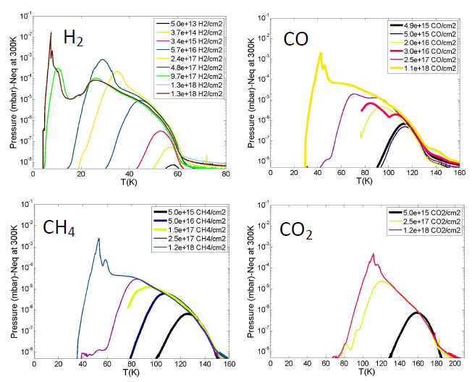
a-C Coating Thermal Desorption Spectroscopy
  The larger the coverage, the lower the desorption temperature.
  Binding energies are in the range 100-500 meV and decrease with surface coverage
A-L. Lamure
 | H2 | CH4 | CO | CO2
Peak in 40-60 K | Any coverage | For coverage > 10¹⁷ CH₄/cm² | For coverage > 2 10¹⁶ CO/cm² | For coverage > 10¹⁸ CO₂/cm²
Potential modification of the proposed BS operating temperature
V. Baglin - 77th IUVSTA Workshop, Fuefuki, Japan,Aug 17-21, 2016
V. Baglin - HL-LHC VSC Seminar, CERN, 9th December 2016

Slide 39
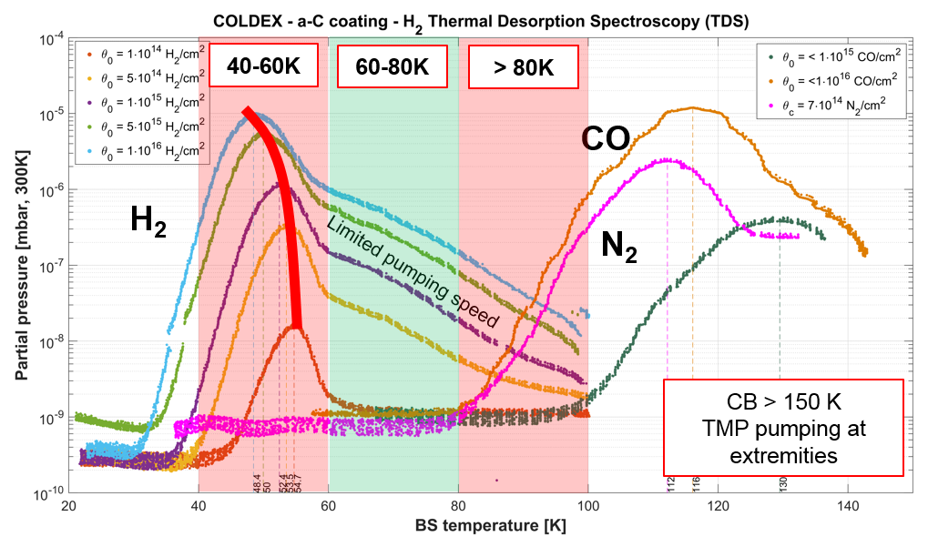
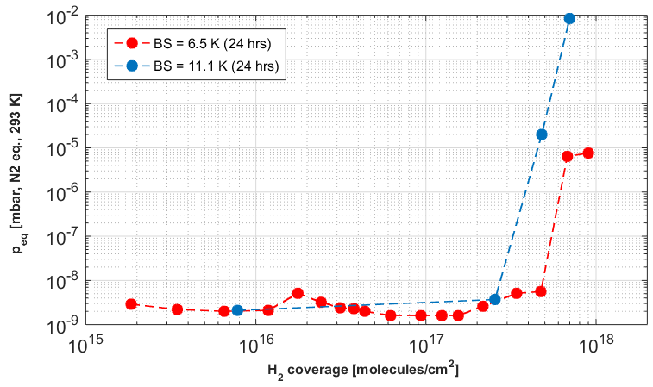
a-C Coating Studies with COLDEX
H₂ is desorbed in the range 40-60 K
N₂ and CO are desorbed above 80 K
The activation energy (temperature) for desorption (release) is dependent on the coverage
A possible new operating temperature window for the beam screen could be ~ 60-80 K
The cryosorption capacity for H₂ is ≥ 2∙10¹⁷ H₂/cm² below 10 K
It is intermediate between metallic surfaces and common cryosorbers
R. Salemme
V. Baglin - HL-LHC VSC Seminar, CERN, 9th December 2016

Slide 40
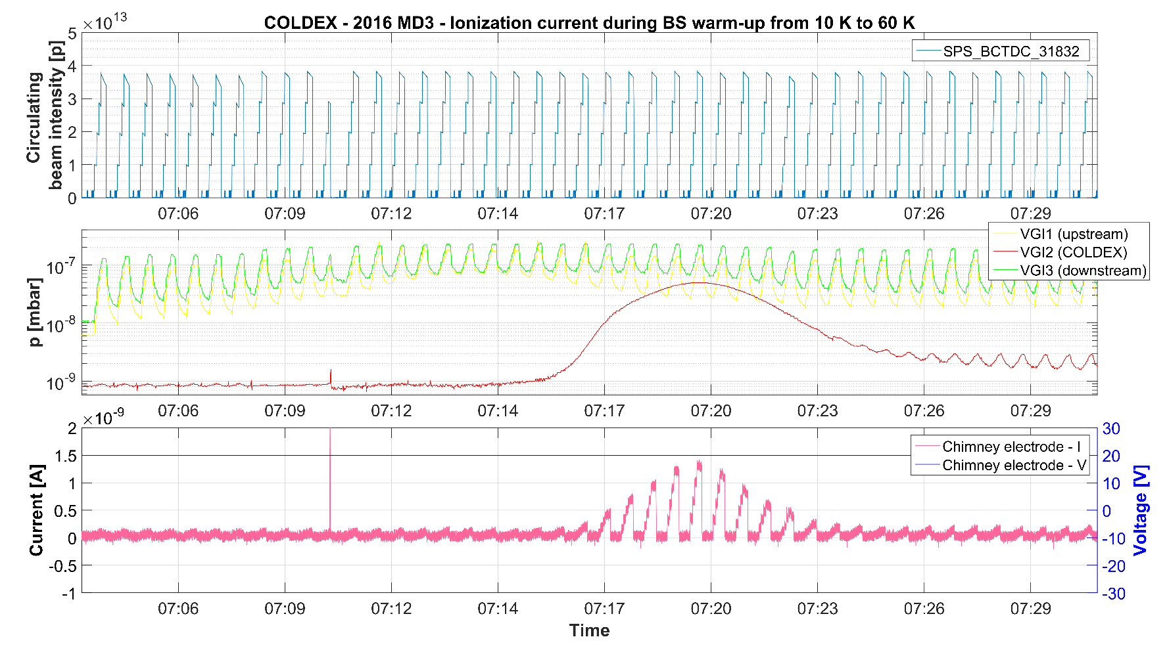
Observation of Beam-Gas Ionisation with COLDEX
COLDEX’s electrode is sensitive enough to measure beam gas ionisation!
Sensitivity ~ 0.1 nA i.e. ~4∙10⁶ e⁻/(mm² s)
Beam
circulating
intensity
P at extremities
a-C,
pressure bump
Electron/ion
current
R. Salemme, PhD Thesis
V. Baglin - HL-LHC VSC Seminar, CERN, 9th December 2016

Slide 41
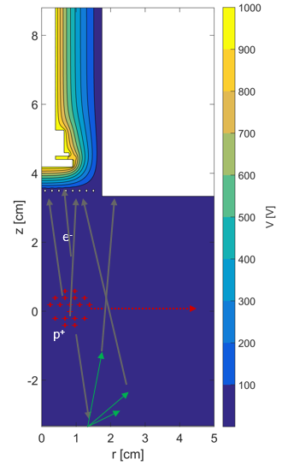
a-C Coating Performances Studies with COLDEX
No dynamic pressure larger than 10⁻⁹ mbar due to ESD is observed for:
  bare surface
  surface coverages of:
    ~3 10¹⁶ H₂/cm² , ~2 10¹⁶ CO/cm^{2,} ~3 10¹⁶ CO₂/cm²
Measured dynamic heat load are within:
  0.2 +/- 0.1 W/m for all studied cases
No multipacting electron activity is measured above 0.1 nA
δ_{max} < 1.1
Electron pick-up inserted through RT chimney
Shielded by a grid
Circular, D = 18 mm
SEY ≤ 1.1
2015 detection limit
2016 detection limit
R. Salemme, PhD Thesis
V. Baglin - HL-LHC VSC Seminar, CERN, 9th December 2016

Slide 42
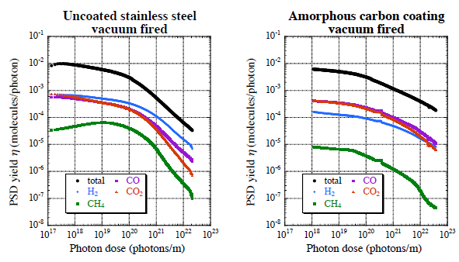
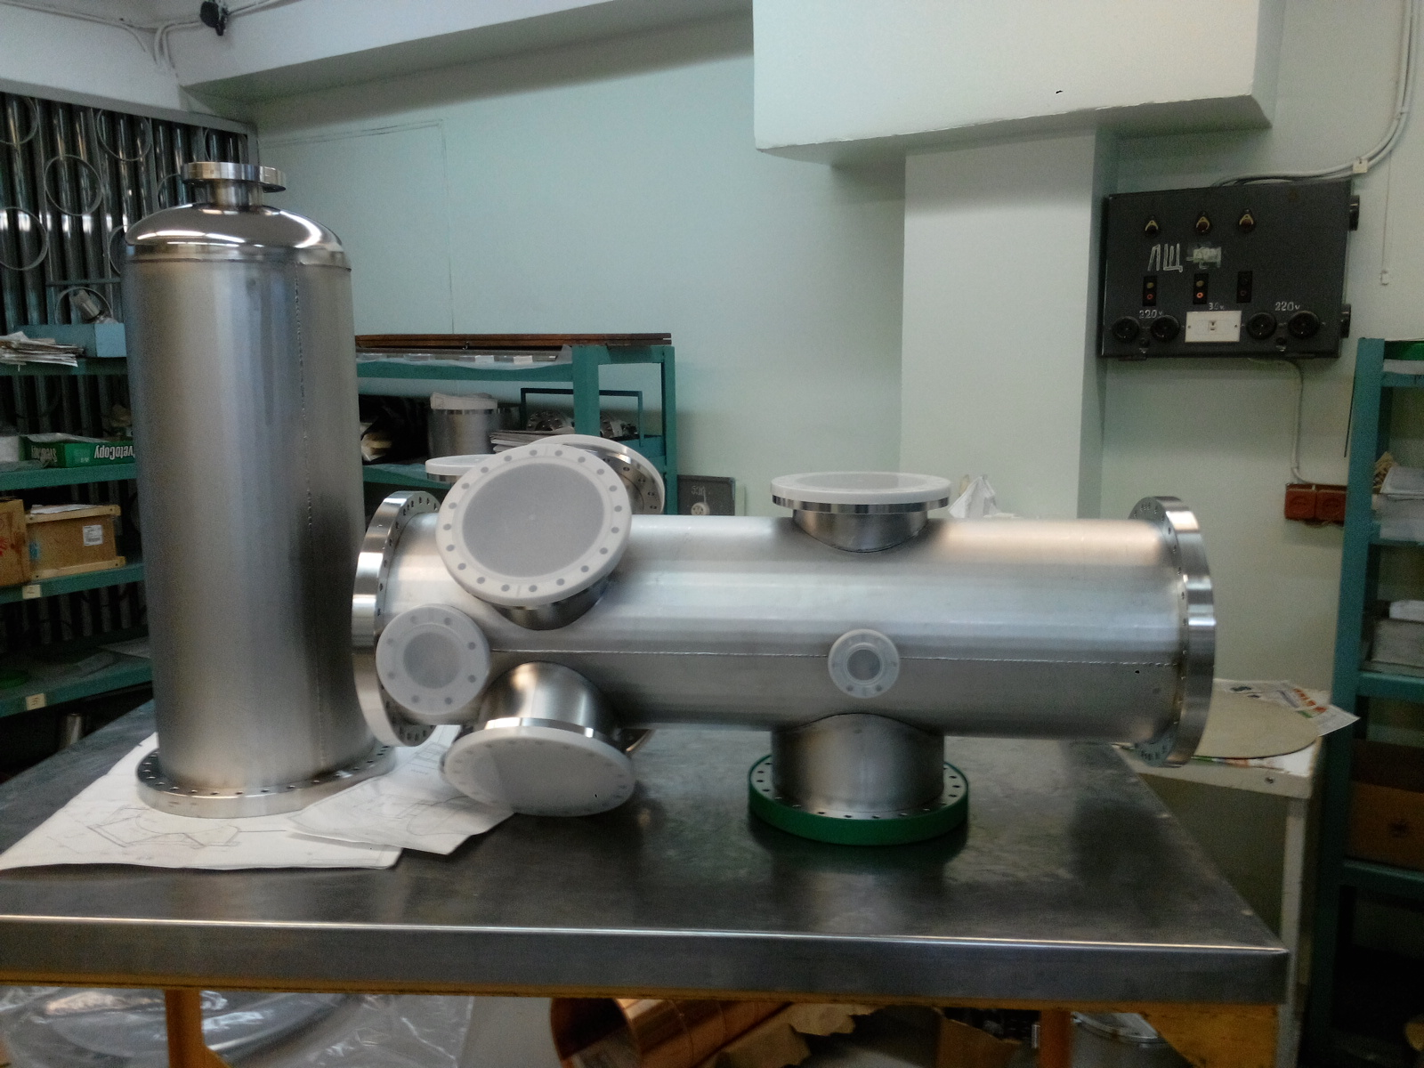
a-C coating and Synchrotron Radiation
In-situ bakeout at 120 deg
KEK Collaboration:
  4 KeV critical energy (x100 LHC)
  Desorption yields of a-C coating larger than stainless steel
  Conditioning with beam
M. Ady
BINP Collaboration:
  Set-up under construction
  Unbaked sample at room and cryogenic temperature
  ~ 50 eV critical energy
  Results expected by ~ mid-end 2017
V. Baglin,
A. Krasnov (BINP)

Slide 43
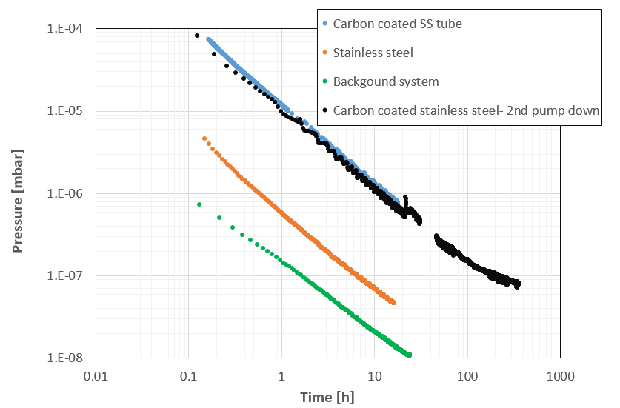
a-C Coating and Thermal Outgassing
Unbaked a-C coated stainless steel tube, 450-500 nm thick:
  Mass spectrum is water dominated
  ~ x 30 unbaked stainless steel
  2nd pump down very similar to 1st one
After 10h pumping:
  Stainless steel = 2 10⁻¹⁰ mbar.l/s/cm²
  a-C coating = 6 10⁻⁹ mbar.l/s/cm²
x 30
I. Wevers

Slide 44
Laser Engineered Surface Structures: LESS
A studied alternative to a-C coating. Principle: laser treatment of a tube at atmospheric pressure
Collaboration with university of Dundee and ASTEC
Challenges: validate vacuum performances before LS2:
  Outgassing thermal and stimulated
  Produce a tube and realise implementation on the field
Test liners validated in SPS BA5 and to be installed in COLDEX
A. Abdolvand et al.,
Dundee University’ s samples
δ_{max}< 1 !
Large H₂O
outgassing
Electron cloud suppression by 4 order of magnitude as compared to Cu
E. Garcia-Tabares Valdivieso
I. Wevers
H. Neupert

Slide 45
3. HL-LHC Layout

Slide 46



The Insertion Region (till Q4)
Connection to LHC (UL)
Service gallery (UR)
UA Gallery
Service cavern
BBLR
Collimators
SC Links
Q4
D2
TAXN
DFM
DFX
D1
CP
Crab cavities
Q3
Q2b
Q2a
Q1
TAXS
P. Fessia
WP15

Slide 47





The Inner Triplet region with in-kinds
Connection to LHC (UL)
Service gallery (UR)
SC Links
Q2a
Q1
TAXS
Q2b
CP
Q3
DFX
D1
DFM
P. Fessia
WP15

Slide 48


The MS region with in-kinds
UA gallery
Service cavern
(BBLR)
Q4
Crab cavities
D2
Collimators
TAXN
P. Fessia
WP15

Slide 49

Layouts
LHCLSXGH0003 and LHCLSXGH007 for insertions 1 and 5
LSS1 and 5, right and left are available !
  LHCLSXH_0001 ; LHCLSXH_0002 ; LHCLSXH_0009 ; LHCLSXH_0010
Studies TAXS-Q1
connection
New VAX location
TAXN-D2 with 2in1 collimation
Studies for DFX
Studies for Crab modules
P. Fessia
WP15

Slide 50

Vacuum Chambers Apertures
Input beam aperture table from WP2
New vacuum chambers and vacuum modules to be designed / produced for D1-Q4 region
Additional inner diameters standards: 91 and 248.1 mm
P. Santos Diaz

Slide 51



New VAX area in IR1 and 5
Move the instrumentation in front of Q1 to the experiment’s cavern to reduce radiation to the personnel: robustness, remote handling and tooling are required
Installation in LS3 during TAS exchange, the impact on the experimental vacuum chamber beam pipe is under study
TAXS-Experiments & Q1-TAXS areas studies are coordinated by WP8
Unbaked a-C coated TAXS
Pumping and bellow to decouple room temperature TAS from cryogenic temperature triplet
Sectorisation to decouple experiment’s vacuum from machine vacuum
~ 520 mm
TAXS
Q1
TAXS
Courtesy L. Krzempek
~ 16 m
J. Perez. Espinos, G. Pigny
WP8

Slide 52


TAXN – D2 area
Tertiary collimation to protect IT from incoming beams
Longitudinal layout defined but without 5th axis for collimation (except TCTPV)
TAXN
D2
P. Santos Diaz
New designs:
  2 beam in one vessel for TCL and TCTH (responsibility of the collimation project, WP5).
  New bellows and RF transitions.
  New chambers, supports etc.
Base line (in collaboration with survey): minimise radiation to the personnel during intervention
  Supports of vacuum equipment are aligned by survey during installation.
  Vacuum components are exchangeable without re-alignment of the supports+ chamber system
  Smoothing, when needed, during LS

Slide 53


Layout D2-Q4: crab cavities area
D2
CC
CC
P. Santos Diaz
Q4
Room temperature sectors (except CC modules): bakeable and NEG coated
2 sectorised CC modules: unbaked, operating at cryogenic temperature (2K)
3 types of sector valves assemblies (VAB)

Slide 54



Crab Cavities Cryomodule: Status
Interlocked valve
Ports are equipped with vacuum gauges and roughing valves for monitoring and maintenance of the cryomodule
Mock-up ST0782198_01*
Courtesy of T. Capelli
P. Santos Diaz
The 2nd beam pipe is held at 2 K and has its diameter limited by space
Needs to be designed with a beam screen type system
Cold warm transitions (CWT) have to be designed
Detailed studies are needed to comply with vacuum stability and pressure level (background to experiments)

Slide 55
4. LS2
J-2(365)

Slide 56

HL-LHC activities during LS2 & LS3
Presented during LS2 days (L. Tavian, G. Bregliozzi)
  In-situ a-C coating of IT in LSS2 and 8
  Support to other WP
  LS2 days: https://indico.cern.ch/event/564604/
  Detailed activities during LS2 are in PLAN and during LS3 are drafted
L. Tavian
LS2 days
 | LHC | LS1 | HL-LHC
 | Vacuum Sectors | Vacuum Sectors | Vacuum Sectors | LS2: Length (m) | LS3: Length (m)
Cryogenic temperature | 92 | 92 | 80 | 210 | 770
Baked Room temperature | 185 | 146 | 183 | 850 | 2680
Unbaked Room temperature | 6 | 2 | 6 | 400 | 500
* HL-LHC options are excluded

Slide 57


a-C coating: In-Situ Implementation
Length to be in-situ coated: ~45 meters per “string” (Q1, Q2, Q3, DFBX & D1) of LSS2 and LSS8
~ 45 metres
Only 150 mm to insert a “coating device”.
Development of a “modular sputtering source” that can be inserted in a 150 mm slot and pulled by cables along D1 and the triplets

Slide 58



In-situ a-C Coating Status
Magnetron sputtering of a graphite cathode using permanent magnets with Ti underlayer + molecular dragging (@ 1W/cm; p_{Ar}= 0.1 mbar).
δ_{max}< 1.1 along 4 m!
P. Costa Pinto
P. Demolon

Slide 59

Crab Cavities Cryomodule: SPS Test
A layout is defined with a-C coating as antimultipactor
Sectorisation implemented during this EYETS!
Y chamber and bypass assembly designed, to be produced
Final installation: 2017-18
C. Pasquino, J. Hansen, Q. Deliege
WP4 -S. Mehanneche

Slide 60




TCSPM collimators
  Low impedance collimators: with coated Molybdenum Carbide Graphite (MoGr) and in jaw beam position monitors
  To be installed in LSS7 and LSS3, partially in LS2
  Evaluation under irradiation, evaluation of impedance and outgassing under way …
F. Carra
  HiRadMat tests showed that MoGr and CuCD jaws could withstand the respective design failure
  Three stripes of different coatings, MoGr, Mo, ceramic, for impedance measurements with beams next year !
S. Redaelli – EN/MME

Slide 61



11 T – DS collimator in IP7
  Arc Dispersion Suppressor areas (Q7 to Q11) serve as “energy spectrometer” : a collimator is needed to reduce background to ALICE with ion operation and to reduce beam loss on the cold masses with proton beams
  Using NbSn₃ technology, the dipole field can be increased up to 11 T
  A standard LHC dipole can be replaced by two 5.8 m long 11 T magnets and one collimator (TCLD)
Q. Deliege
By-pass cryostat
11 T
11 T
WP5&11 – F. Savary

Slide 62

DS collimator in IP2
  Arc Dispersion Suppressor areas (Q7 to Q11) serve as “energy spectrometer” : a collimator is needed to reduce background to ALICE with ion operation and to reduce beam loss on the cold masses with proton beams
  A TCLD by-pass and two connecting cryostats are placed instead of LHC empty cryostat I
J. Jowett
By-pass cryostat
WP5&11 – F. Savary

Slide 63


TANB
  Protects the D2 from increased luminosity in LHCb
  Integration proposed to be validated
P. Santos Diaz
F. Cerutti
F. Sanchez Galan

Slide 64

Beam Gas Vertex Detector
Aim
  Use tracks from beam-gas interactions to reconstruct beam spot in a non-invasive way
  Provide bunch-by-bunch size with a 5% resolution within 1 minute
    Demonstrator aims at 5% within 5 minutes
  Provide average beam size with absolute accuracy of 2% within 1 minute
    Demonstrator aims at 10% within 5 minutes
Demonstrator
  Collaboration with Aachen University, EPFL & LHCb
  Installed during LS1 on Beam 2
  Fully commissioned in 2016
WP13 – R. Jones

Slide 65



TDIS
  TDI is one of the weakest component of LHC: to be replaced by TDIS !
  New improved design taking into account previous issues
  3 blocks: 2 x SGL graphite + 1 x (Al + Cu)
  Impedance: no coating on graphite – Ti coating on Al
  TDI: ~ 6000 l/s vs TDIS: ~ 13 500 l/s
    ➔2 time more pumping speed
  Material outgassing: 10⁻⁸ mbar.l/s
G. Bregliozzi
  Improved cooling system
  Improved RF fingers design
  no interferometer but LVDT
WP14 – A. Perillo-Marcone - L. Gentini

Slide 66




Kickers heating, and electron cloud
  Ceramic tube can still be an issue with SEY values 6 – 10.
    ➔ Required SEY ~ 1.4
  Cr₂O₃ coated ceramics by Polyteknik: SEY ≈ 2, conditioned to < 1.4
    ➔Test in SPS BA5 liner in 2017
  Increase tank thermal emissivity (coating, electrochemistry, Laser)
  Ferrite Curie temperature & outgassing optimization
  Looking for position in machine for passive prototype to be installed in YETS2017-2018
Cr₂O₃ coated side
Uncoated side
M. Barnes
NEG coated bypass tubes
E. Garcia-Tabares Valdivieso

Slide 67
5. LS3 & studies

Slide 68


WP5: Collimation baseline
  Low impedance collimators
  Masks, Primary, secondary, tertiary collimators
  Innovative 2 beam in one TCT & TCLX to solve interferences between TAXN-D2
L. Gentini
S. Redaelli

Slide 69



WP5 option: hollow e-lens
  Hollow electron beams running coaxially to the proton beam will provide an active control of beam halo population and beam loss rate. Installation 2 lenses in LS3
  Used at Tevatron and RHIC
  Received a positive feedback at a recent review: could be integrated in HiLumi baseline
D. Perini
Gun + Solenoid
G. Stancari
e-beam
superconducting
solenoid
p-beam
S. Redaelli
Correctors
  5T field
  3 m long
  RT vacuum system, bakeable
Collector
D. Perini

Slide 70


WP5 study: cristal collimation
  Objective is to improve ion cleaning
  Allows reduction of the number of collimators and larger gaps:
    ➔ collimation has much less impact on impedance budget
  Two crystals are already installed in LSS7 (more to come), equivalent bending radius is 310 T at 7 TeV.
  Channelling observation with protons and ions beams
  A factor ~ 10 better cleaning that actual collimation system is observed with crystals
S. Redaelli
D. Mirarchi

Slide 71


WP13 studies: gas jet monitor & BBLR
  Aims to provide a non-invasive method of aligning electron beam devices with the proton beam
  Application with hollow electron lens or long-range beam-beam compensator
  First design done
  Supersonic gas jet
  Long range beam beam compensation study
  Wire embedded TCTW
  Installed this EYETS in IR5
  350 A in the wire
R. Jones
A. Rossi – WP5

Slide 72


WP18: String Test in SM18
  Validation of: cryogenics, vacuum, quench and protection, powering, accelerator relevant operation etc.
  2021-2023
M. Bajko

Slide 73
6. Summary

Slide 74
Summary
  The HL-LHC baseline has significantly evolved since 2015
  The design of the HL-LHC vacuum system baseline is progressing very well.
    Cold bore and beam screen design to be frozen soon, for production in 2018.
    Interconnects and cold warm transitions to be designed, for production in 2019.
    Performance evaluation at cryogenic temperature of a-C shall continue, evaluation of LESS shall start.
    Vacuum layout definition to continue.
  Many activities during LS2 are linked to the HL-LHC project
    Production of in-situ coating is on good track for implementation during LS2

Slide 75
Acknowledgments
  This presentation reflects the work of many people from the group. Particular credits should go to:
  P. Chiggiato, P. Cruikshank
G. Riddone, L. Ludvig
  BVO:
  G. Bregliozzi, J.A. Ferreira Somoza, C. Pasquino, J. Sestak
DLM:
  C. Garion, Q. Deliege, C. Duclos, P. Gach, J. Gargiulo, C. Guyenet, J. Hansen, N. Hovenga, H. Kos, N. Kos, L. Krzempek, H. Massaoudi, M. Morrone, J. Perez Espinos, H. Rambeau, M. Sitko, A. Vidal.
ICM:
  P. Gomes
SCC:
  M. Taborelli, J. Cave, P. Costa-Pinto, L. Leggiero, M. van Gompel, H. Neupert, V. Nistor, E. Valdivieso
  VSM:
  V. Baglin, B. Jenninger, S. Calatroni, B. Henrist, E. Kepes, R. Kersevan, A-L Lamure, S. Meunier, P. Lancon, R. Salemme, P. Santos Diaz, I. Wevers,

Slide 76
Thank you for your attention

