Slide 1
The Conference
L. Bottura and L. Rossi
Program Committee Meeting
CERN, 27 April 2017

Slide 2
Outline
The conference
Sponsors and exhibits
Outreach and communication
Program outline and events

Slide 3
The conference
September 17-21, 2017, at the International Conference Center of Geneva (CICG)
Four days technical program (+1 satellite/visits)
Papers published as a part of a special issue of IEEE Trans. Appl. Sup. (flat-rate fee of 62 USD/attendee, plus 20,000 USD in travel support for students and young scientists)
Expected participation in the range of 900 people
Conference fee 730 CHF (675 EUR)

Slide 4
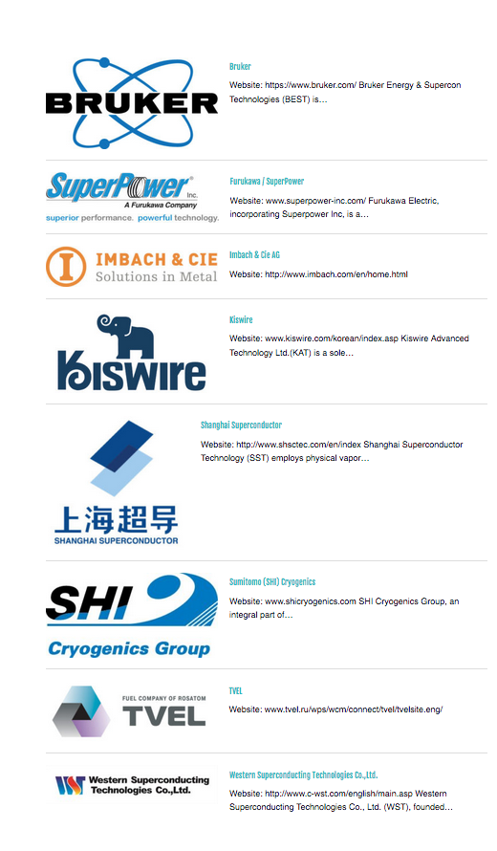
Sponsors and exhibitors
8 sponsors
  Bruker
  Sumitomo (SHI)
  Kiswire
  SuperPower
  TVEL
  WST
  Shangai Superconductor
  Imbach & Cie
18 industrial exhibitors

Slide 5
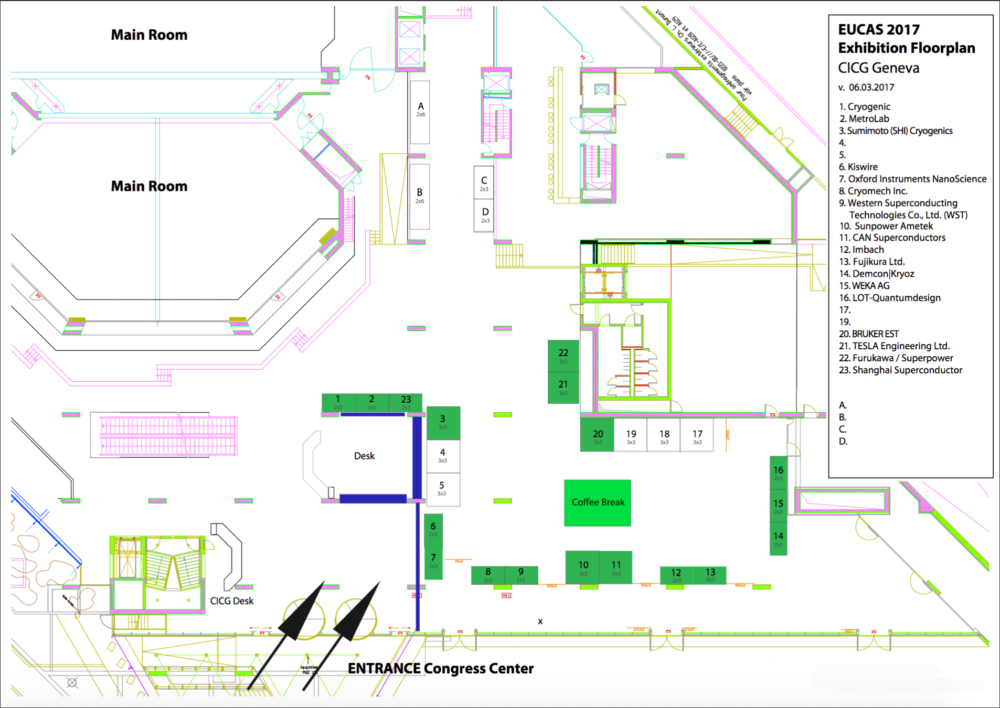
Exhibit floorplan

Slide 6
Outreach and communication
August-November 2017: Cryomagnets prepared for external exhibit and exposed in Geneva. Board with the program of events, (CERN organization - V. Prieto Hermosilla).
September 2017: Special issue of the CERN Courier on superconductivity (CERN organization - P. Charitos). Additional copies could be printed and distributed at the EUCAS, outreach at UNIGE, Autumnales (IoP).
September 1st-15th, 2017: S’cool lab special sessions (4*24) in the two weeks preceding the conference (CERN organization - Julia Woithe).
September 1st-15th, 2017: Café de Science, 2 to 3 sessions (CERN organization)
September 12th, 2017: Public conference on electricity, magnetism and superconductivity, CERN globe (CERN organization, conference held by UNIGE-Physiscope).
September 19th, 2017, 18:00: Outreach talk by CERN DG at University of Geneva, UniDoufour, (UNIGE organization – S. Hulo Veseley).
September 17th-21st: EUCAS 2017
September 2017: Physiscope regular sessions (as from regular program – details TBD).
September 2017: Café de l’UNIGE, 2 to 3 sessions (UNIGE organization - D. Dumoulin).

Slide 7
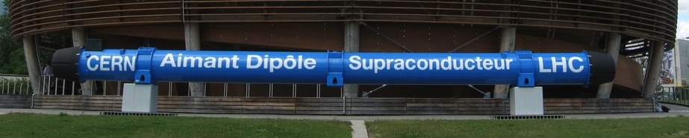
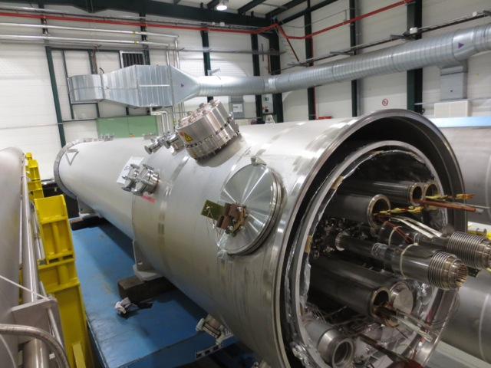
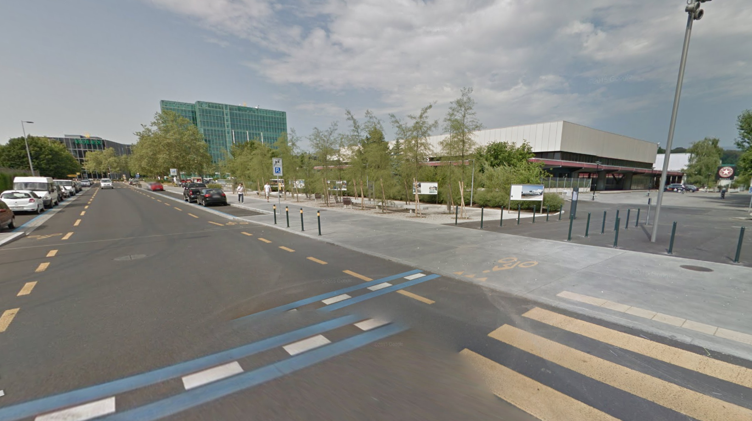
Outreach and communication

Slide 8
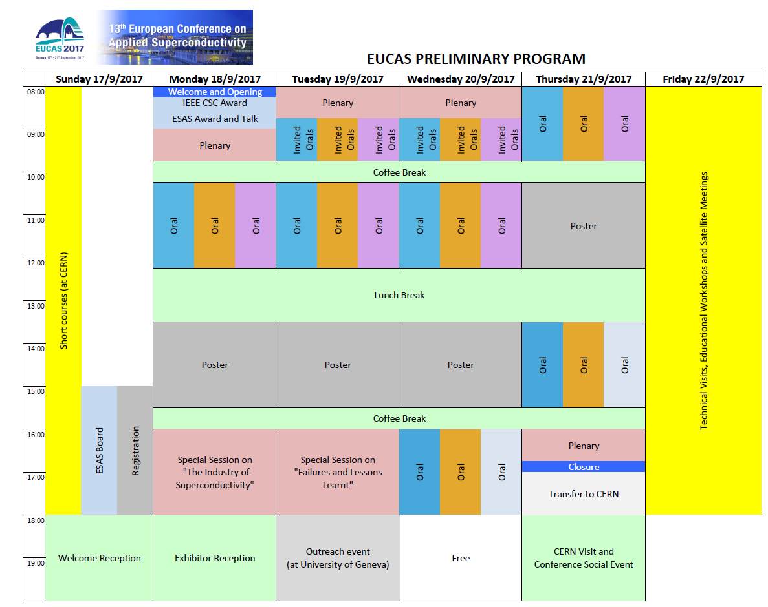
Short Courses
Satellite meetings, mini-workshops, visits

Slide 9
Short courses
1. High Temperature Superconductors: the path from the materials to the technical conductors
Carmine Senatore (University of Geneva), Matteo Alessandrini (Bruker BioSpin), Kenneth Günter (Bruker BioSpin)
2. Design of Superconducting magnets for particle accelerators and detectors
Paolo Ferracin (CERN) and Herman ten Kate (CERN and University of Twente)
3. Superconducting electronics - from Josephson effects to quantum computing
Paul Seidel (Friedrich Schiller University of Jena) and Pascal Febvre (Université Savoie Mont Blanc)
4. Superconducting RF Cavities
Erk Jensen (CERN)
5. Superconducting Power Devices
Mathias Noe (Karlsruhe Institute of Technology), Mark Ainslie (University of Cambridge) and Antonio Morandi (University of Bologna)

Slide 10
Awards
Short Courses
Satellite meetings, mini-workshops, visits
ESAS
Industry

Slide 11
Industry session

Slide 12
Awards
Award Luncheon
Short Courses
Satellite meetings, mini-workshops, visits
ESAS
Industry
Welcome
Exhibitors
Event
PC/plenary dinner

Slide 13
Social Event @ CERN
The 21th September 2017, following the closure of EUCAS-2017
Departure from CICG (16:30)
Visit of CERN installations (2 points)
Buses organized by visit circuit, with some (limited) selection possibility
Gala dinner in SM18 (Superconducting Magnets, RF and cryogenics test hall) with special exhibits and “attractions”

Slide 14
Social Event @ CERN Timeline
16:00 – close EUCAS-2017
16:30 – board buses (by itinerary)
17:30 – 19:00 CERN visit (two points)
19:00 – arrival at point 18
22:00 – closure of social event, bus leave back to CICG and town

Slide 15
Social Event @ CERN: Visit examples
Experimental areas: CMS, ALICE, LHCb, AMS
Superconductor installations: Large Magnet Factory (180), Superconductors Laboratory Facilities (163), FAIR test installations (180), CryoLab (165)
CERN accelerators: AD (antimatter), LEIR (ions and isotopes)
CERN Infrastructures: CCC, Data Center, Special manufacturing workshops
CERN General areas: Microcosm, Globe, SynchroCyclotron

Slide 16
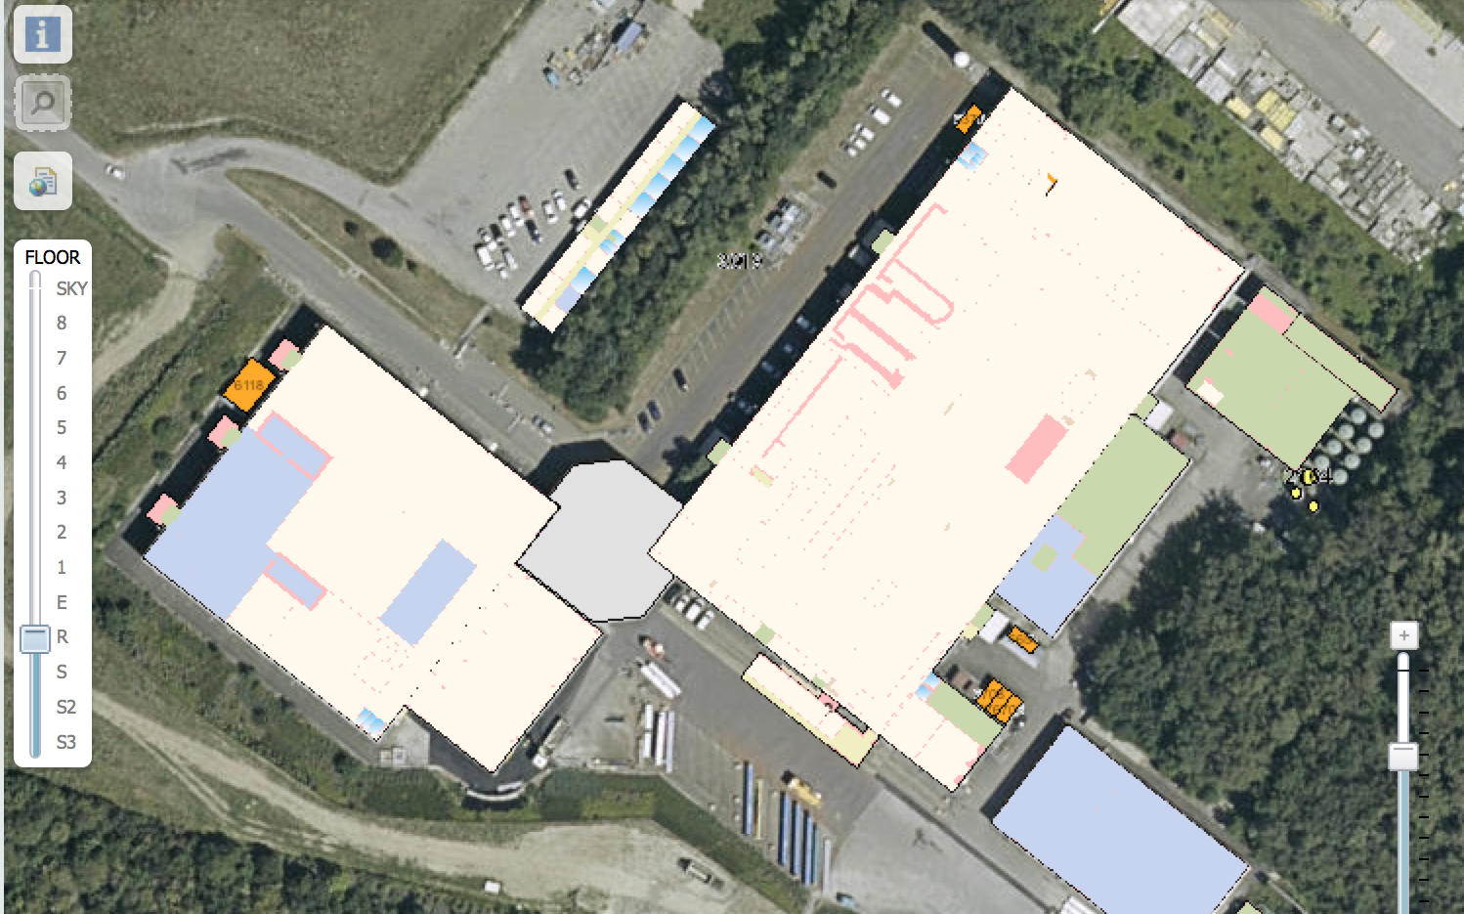
Social Event @ CERN: Dinner and show
Bus arrival and departure
Technical trail
1000 m²
SMA-18
SM-18
SMS-18
1200 m²
900 m²

Slide 17
Awards
Award Luncheon
Short Courses
Satellite meetings, mini-workshops, visits
ESAS
Industry
Welcome
Exhibitors
Event
PC/plenary dinner

Slide 18


