Slide 1
Oxford Site Report
HEPSYSMAN
Kashif Mohammad, Pete Gronbech, Vipul Dawda

Slide 2
Grid Current Batch System
HTCondor with ARC CE
  t2arc01 : Production CE attached to 2.6K logical cpus
  t2arc00 : Permanent test CE attached to two WNs
    Planning to test CS7 on t2arc00 in next few weeks
    Vip is going to do his hands dirty with this exercise
  Completely configured with Puppet
  condor_health_check with auto-nagios working very well
  Automatic deletion of status files in ARC CE doesn’t work all the time.
  Keep removing old status files manually. /var/spool/arc is almost 100GB all the time.

Slide 3
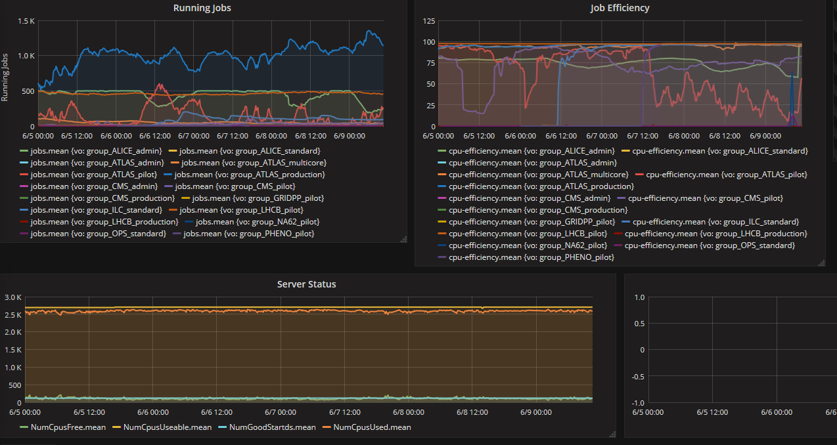
Batch System Status

Slide 4
Storage
Nothing exciting or new
Running dpm 1.8.11
Need to plan upgrade to 1.9 to fix hanging semaphore issue
  Is it easy to upgrade ?

Slide 5
IPv6
Frozen in Ewan’s time
Physics has been assigned /56 network and we have divided it into multiple /64 network
  2001:630:441:0900::/64 – 2001:630:0441:09ff/64
Currently maintaining one ipv6 only UI and one dual stack UI.
Oxford IT Services is not providing ipv6 DNS so we have our own ipv6 DNS
Biggest blocking point is that university edge routers does not support ipv6 natively and support for ipv6 has been configured at software level.
Routers were supposed to be upgraded last year but had been postponed three times since then

Slide 6
Local Batch System
Torque and Maui on local SL6 batch system
  Maui is almost broken
  Torque is not well either
Decided to move to HTCondor for CS7
  Vip has setup a small cluster
  Configured by Puppet
  Waiting for some test users

Slide 7
Move from Lustre to Gluster
Main issue was to upgrade Lustre 2.5 to 2.8/Higher
No direct upgrade path available
Not happy with the complexity and need to build a kernel module every time a new kernel becomes available.
Open source future was not clear although this has changed recently
So the option was to setup a parallel lustre kernel with new MDS and MGS or go for simpler gluster setup
Budget constraints and loosing Sean and Ewan also played a role in the decision

Slide 8
Gluster
Purchased six Dell R730xd with Twelve 8TB disks
We got a very good deal from Dell
Gluster has no meta data server and setup was very straight forward
  Too easy, some times wondered whether I am doing something wrong ☺
We have a 400TB Atlas file system and 200TB Lhcb file system, both with separate MDS.
Needed to reuse some of the hardware from old file system
Setup gluster file system with new hardware, rsync atlas data, rsync again and then a final rsync
  That was the hardest part as some users kept writing tens of Tera bytes

Slide 9
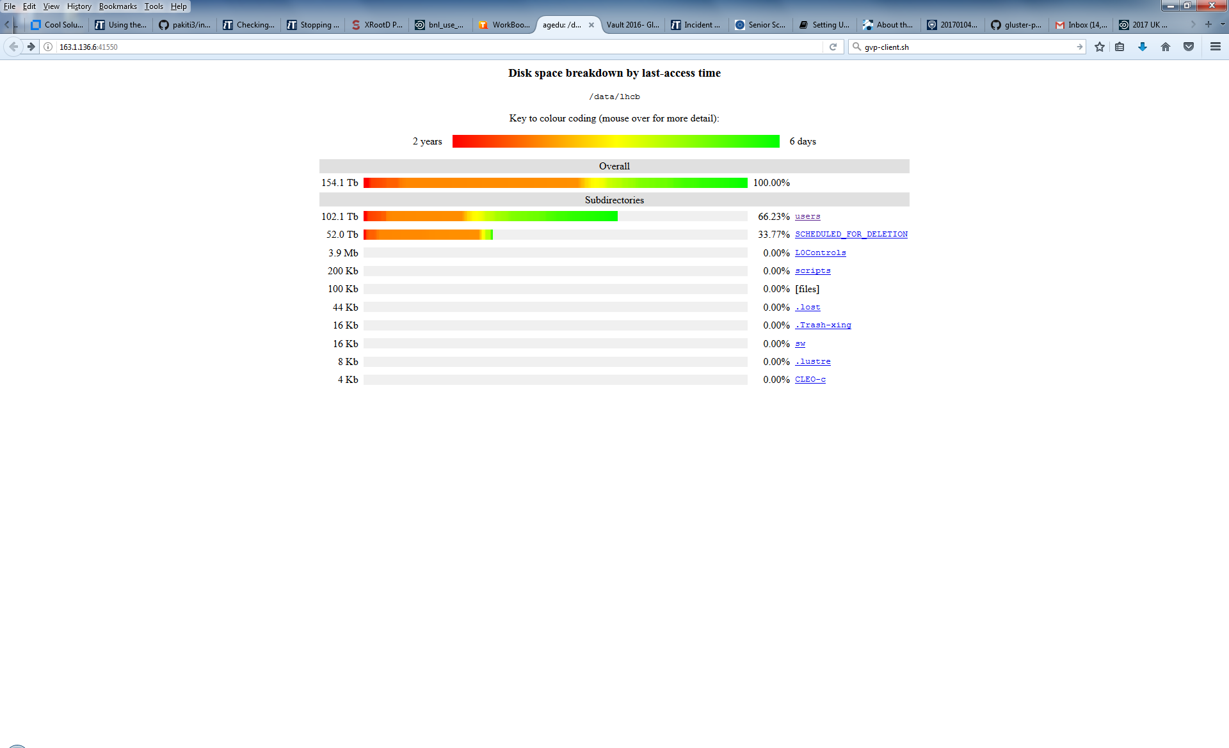
Useful tool: Agedu

Slide 10
New servers setup running Gluster
405TB
360TB
346TB
120TB
expires 2016/7
ATLAS
New ATLAS

Slide 11
rsync / move Atlas data to new Gluster filesystem
405
360TB
120TB
expires 2016/7
ATLAS
New ATLAS

Slide 12
Re use ex Atlas (in warranty) servers to setup new Glustre files system for LHCb
360TB
285TB
120TB
expires 2016/7
ATLAS
New ATLAS
New LHCb

Slide 13
Migrate LHCb data to Gluster
360TB
285TB
120TB
expires 2016/7
90TB
expires 2016/7
ATLAS
New ATLAS
New LHCb
LHCb

Slide 14
Migrate LHCb data to Gluster
360TB
285TB
120TB
expires 2016/7
90TB
expires 2016/7
ATLAS
New ATLAS
New LHCb
LHCb

Slide 15
Re use ex LHCb (in warranty) servers to expand Atlas Gluster filesystem
468TB
360TB
285TB
120TB
expires 2016/7
90TB
expires 2016/7
ATLAS
New ATLAS
New LHCb
LHCb

Slide 16
New Gluster setup for Atlas and LHCb for coming years.
468TB
285TB
New ATLAS
New LHCb

Slide 17
Issues with Gluster
Iozone results were more or less same for lustre and gluster
  Tested gluster on a test setup from a single client
Rsync is still going on for a user so I haven’t run iozone after moving to production
Copying and writing seems to be OK but ‘du’ and ‘ls’ are considerably slower
Enable gluster client profiling as suggested on gluster mailing list
Trying to understand output of gluster profiling output

Slide 18
Gluster profile output
%-latency Avg-latency Min-Latency Max-Latency No. of calls Fop
--------- ----------- ----------- ----------- ------------ ----
0.00 0.00 us 0.00 us 0.00 us 2248 FORGET
0.00 0.00 us 0.00 us 0.00 us 6482 RELEASE
0.00 0.00 us 0.00 us 0.00 us 10138 RELEASEDIR
0.00 177.20 us 130.00 us 336.00 us 5 RMDIR
0.00 99.88 us 51.00 us 205.00 us 49 GETXATTR
0.00 89.01 us 38.00 us 270.00 us 80 SETXATTR
0.00 122.18 us 26.00 us 2613.00 us 67 FTRUNCATE
0.00 42.46 us 14.00 us 147.00 us 788 STATFS
0.01 49.94 us 15.00 us 1463.00 us 2098 INODELK
0.02 183.80 us 53.00 us 20566.00 us 915 LINK
0.03 133.23 us 58.00 us 10501.00 us 1421 RENAME
0.03 89.59 us 34.00 us 172.00 us 2337 SETATTR
0.03 3206.60 us 123.00 us 162298.00 us 70 FSYNC
0.04 70.83 us 24.00 us 13984.00 us 4485 OPEN
0.05 121.46 us 41.00 us 10571.00 us 2958 UNLINK
0.08 59.46 us 16.00 us 14160.00 us 10135 OPENDIR
0.11 10058.75 us 116.00 us 41438.00 us 80 MKDIR
0.17 56.97 us 8.00 us 48827.00 us 22615 STAT
0.32 13526.28 us 146.00 us 134667.00 us 177 SYMLINK
0.53 68.88 us 14.00 us 193130.00 us 57510 WRITE
0.77 35.01 us 6.00 us 29900.00 us 165414 FLUSH
0.86 99.25 us 11.00 us 240350.00 us 65222 FSTAT
0.89 46.96 us 17.00 us 22920.00 us 143087 READLINK
2.38 13498.51 us 113.00 us 550381.00 us 1323 MKNOD
3.50 11551.78 us 41.00 us 433438.00 us 2280 CREATE
11.87 3906.01 us 14.00 us 881696.00 us 22843 READDIRP
32.30 1263.61 us 26.00 us 1282841.00 us 192153 READ
46.00 107.85 us 22.00 us 1192496.00 us 3206311 LOOKUP
Duration: 549 seconds
Data Read: 25139914188 bytes
Data Written: 88562679 bytes

