Slide 1

High-energy, low-|t| elastic proton-proton scattering
István Szanyi
Uzhgorod National University
2016

Slide 2
Introduction
Observation of the “break” phenomenon.
What is the “break” phenomenon ?
Description and “visibility” of the “break”.

Slide 3
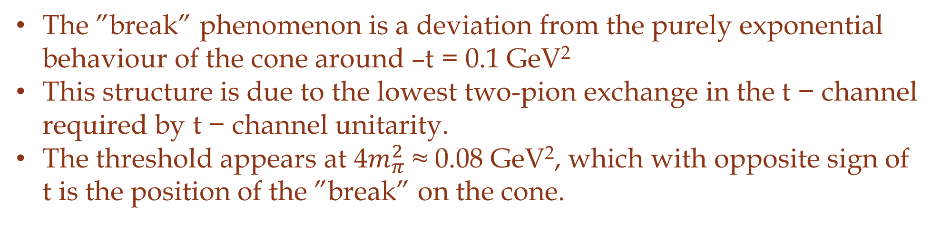
The ”break” phenomenon
The ”break” phenomenon is a deviation from the purely exponential behaviour of the cone around –t = 0.1 GeV²
This structure is due to the lowest two-pion exchange in the t − channel required by t − channel unitarity.
The threshold appears at 4$m_{π}^{2}$ ≈ 0.08 GeV², which with opposite sign of t is the position of the ”break” on the cone.
Feynmann diagram for elastic scattering with a t-channel exchange containing
a branch point at t = 4$m_{π}^{2}$
*L. Jenkovszky , A. Lengyel, arXiv:1410.4106

Slide 4
The ”break” phenomenon
The t − channel threshold may enter both through leading (Pomeron, Odderon) or non-leading (f, ω) trajectories.
At the LHC at low-|t| the Pomeron contribution dominated completely, secondary Reggeons are negligible.
At the ISR energies, secondary Reggeons are not negligible.
*L. Jenkovszky , A. Lengyel, arXiv:1410.4106

Slide 5
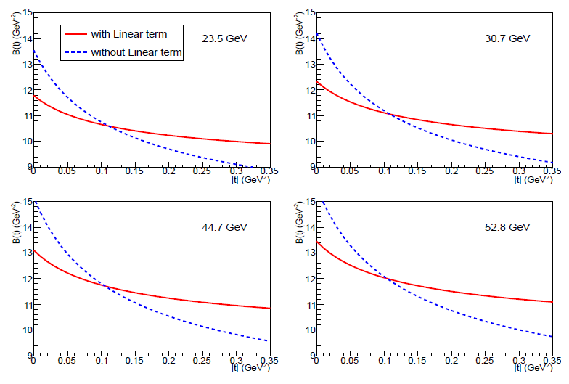
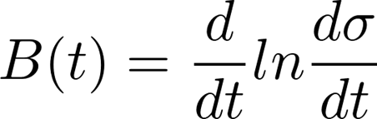

Description and “visibility”
Description of the phenomenon with physical meaning using a two-pion loop singularity in the Pomeron trajectory
$$α(t)\sim \sqrt{{4m}_{π}^{2}−t}$$
Using the expression of the local slope in case of ISR energies to see the deviation from the purely exponential behaviour of the cone
Behaviour of the local slope for different ISR energies
*L. Jenkovszky et al., arXiv:1509.02197v1.

Slide 6
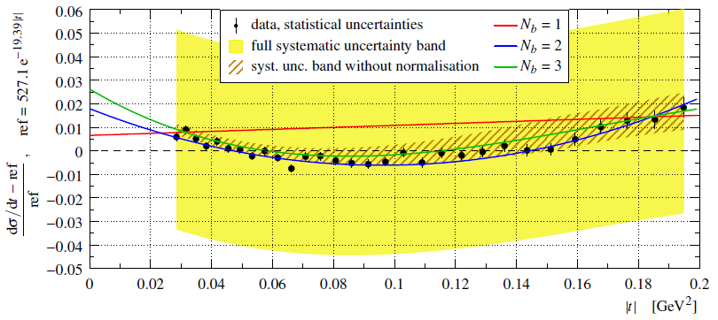
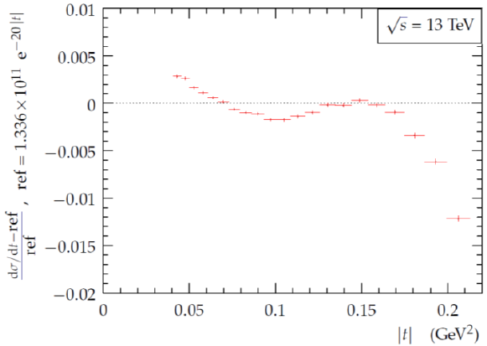
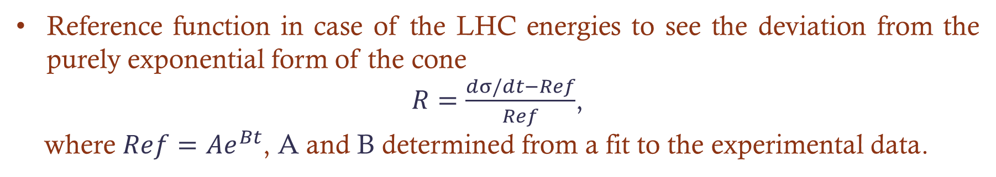
Description and “visibility”
Reference function in case of the LHC energies to see the deviation from the purely exponential form of the cone
$R=\frac{dσ/dt−Ref}{Ref}$,
where $Ref=Ae^{Bt}$, A and B determined from a fit to the experimental data.
Ratio R calculated for 8 TeV*
Ratio R calculated for 13 TeV
(from the presentation of Frigyes Nemes)
*G. Antchev et al., arXiv:1503.08111.

Slide 7
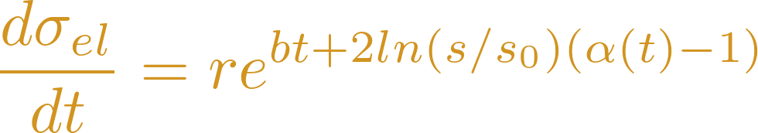


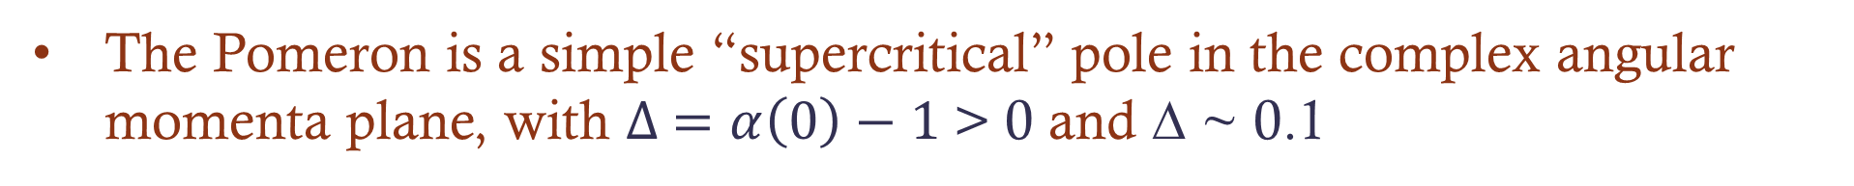
Simple Pomeron Model
Differential cross section:
Pomeron trajectory:
Free parameters:
The Pomeron is a simple “supercritical” pole in the complex angular momenta plane, with $∆ =α\left(0\right)−1$> 0 and ∆ ~ 0.1
*G. Cohen-Tannoudji et al, Lett. Nuov. Cim. 5, 957 (1972).

Slide 8
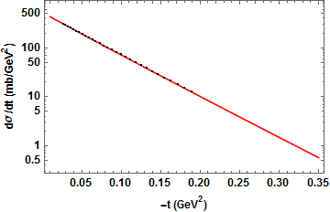

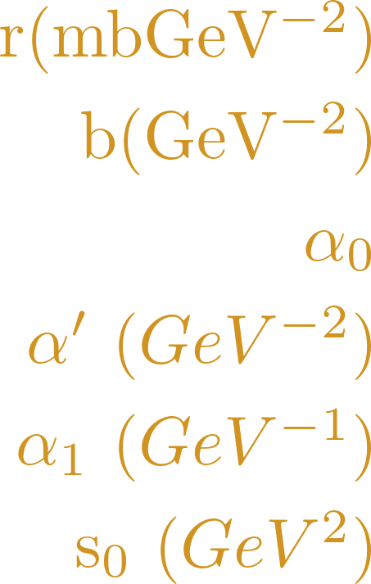
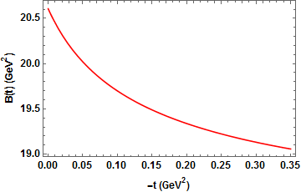

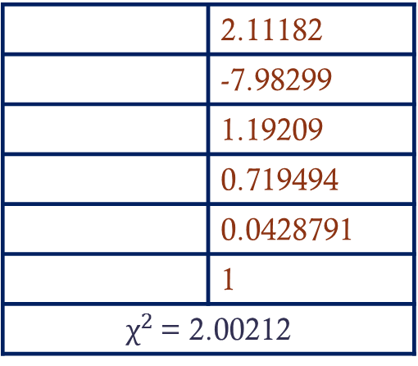

Result of the fit
Number of free parameters is 6.
Fit was done with = 1 fixed.
Used dataset was the TOTEM data at $\sqrt{s}$ = 8 TeV*
All 30 data points were used.
 | 2.11182
 | -7.98299
 | 1.19209
 | 0.719494
 | 0.0428791
 | 1
$χ^{2 }$= 2.00212
The result of the fit
Values of fitted parameters
Behaviour of the local slope at $\sqrt{s}$ = 8 TeV
*G. Antchev et al., arXiv:1503.08111.

Slide 9
Summary
The ”break” phenomenon is observable as at the ISR energies as in case of the LHC energies at 8 and 13 TeV .
To see the ”break” we can use the expression of the local slope or a reference function.
The purpose of this phenomenon is the lowest two-pion exchange in the t − channel.
For the physical description of this pheomenon have to use a two-pion loop singularity in the Pomeron trajectory.

Slide 10
Thank you for your attention!

