Slide 1
Slotted foil based THz source design
Jürgen Pfingstner,
15. December 2016
Many thanks to Helga Holmestad and Robert Fröschl.

Slide 2
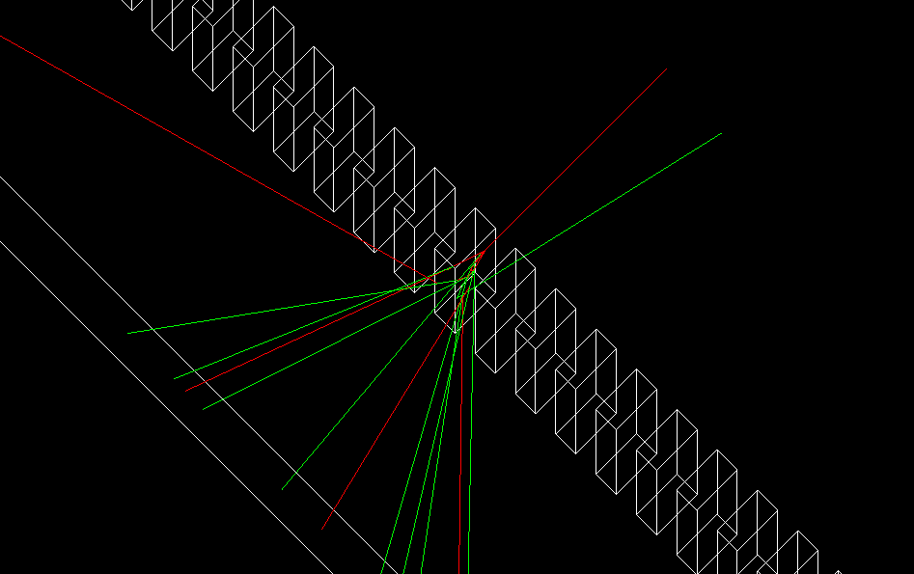
Overview
Introduction
Imprint optics
Foil design
Conclusions

Slide 3
1. Introduction

Slide 4
THz source for SwissFEL
Request from material scientists:
  f_{THz} = 1 – 20 THz (λ_{THz} = 300 – 15μm)
  E_{p} ≈ 100μJ
  Δω/ω₀ < 10% (pref. 5%)
  Phase locked
  f_{rep} = 100Hz
Motivation:
  Vibrations within the material lattice occur manly in the THz regime:
    Free electrons (plasmon)
    Lattice vibrations (phonon)
    Spin coupling (magnon)
    ...
  To study these effects, material excitation with THz source.

Slide 5
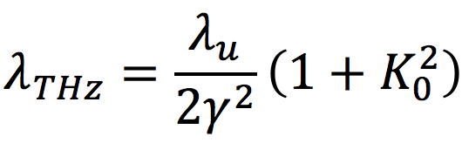
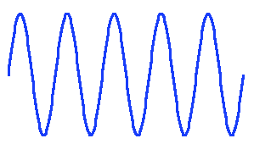
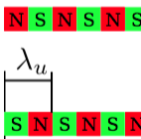
Undulator-based THZ source
Undulator parameter:
Challenge to go to so large λ_{THz}.
Helical undulator (symmetric strong natural focusing).
γ = 50 (E_{b}=25MeV, space charge).
λ_{u} = 6cm (compactness).
K₀ = 0.75 - 4.9 (for tuning); equals to B₀ = 0.09T – 0.88T.
Q = 1nC charge necessary.
Phase locking:
SASE: easy, but no phase locking.
Seeding: THz lasers not quite strong enough.
Comb beam: create bunching before undulator.

Slide 6
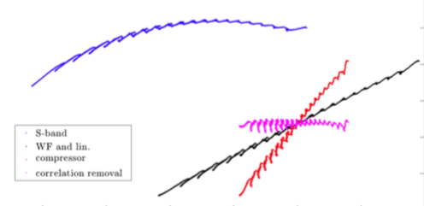
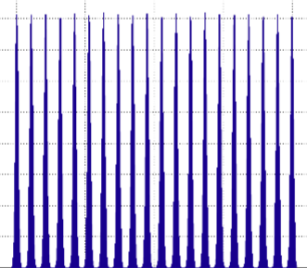


Option 1: Comb beam design
δ=ΔE/E₀
z
comb laser
S-band
gun
S-band
ACC
X-band
lineariser
Variable bunch
compressor
S/X-band
de-chirper
undulator
Current
smearing due to space charge effect
Current

Slide 7
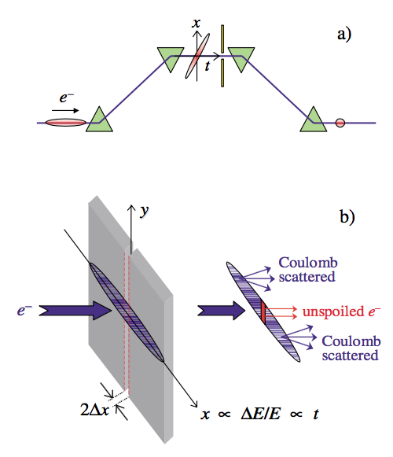
Option 2: Slotted foil based design
Principle pioneered by SLAC for LCLS.
Create beam tilt, due to energy chirp in dispersive region.
Beam is shot on 15um slotted Be foil.
Emittance is strongly increased where beam hits foil.
Only beam in slit participate to FEL process. Used to create very short X-ray pulses.
Could this be used to create a pre-bunched beam for THz generation?
Taken from P. Emma et al., PRL 92(7), 2004.

Slide 8

Imprint tuning
  Create correct micro-bunch distance for 1 - 4Thz.
  For 4-20 THz tune undulator on higher harmonic.
  Minimum 15 micro-bunches to reach Δf/f₀ < 10%.
Compression tuning
Foil tuning
Tuning | via optics | via foil pattern
Imprint | same pattern | changing pattern
Nr. micro-bunches | ≈ 15 | 15 to 60
R₅₆ of optics | changing | 0
Δf/f₀ | ≈ 10% | ≈ 10 % to 2.5%
E_{P} (rough) | 90-120 μJ | 140-100 μJ
Factor matters

Slide 9
2. Imprint optics

Slide 10
Minimum slit separation and beam size at foil
σ_{x,s} = 0
σ_{x,s} ≠ 0
beam
2σ_{x,s}
D ≠ 0
2σ_{x}
slotted foil
D = 0
1. Bunching condition:
d/2 ≥ 3σ_{x,s}
d/2 ≥ 1mm (β=2m)
2. Bandwidth condition (10-5%):
2σ_{x} > 10d to 20d
2σ_{x} > 2cm to 4cm

Slide 11
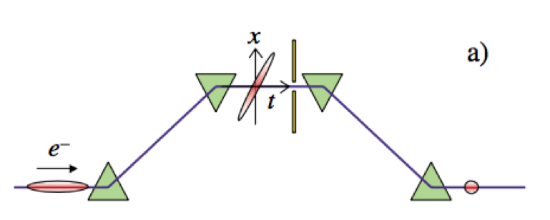
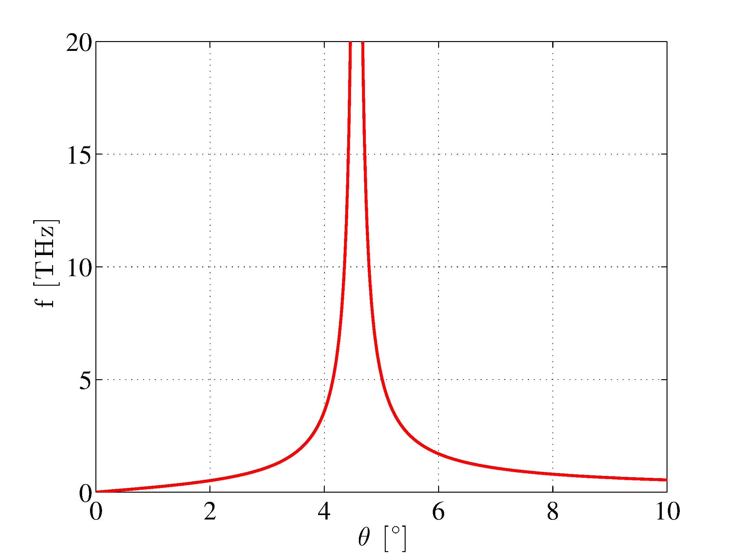
Chicane-type system
Tuning curve (6.5m):
Parameter choice:
h_{max} = 26 (energy chirp, given by de-chirper).
d = 2mm by σ_{x} condition.
θ for tuning (bend angle).
L of chicane (only free parameter).
Longer L give smaller bandwidth
For 6.5m, BW ≈ 7%.
Main effect: bunch compression.
R₅₆ = 4cm to 9.5cm.
D_{x} = 0.24m to 0.37m.
2σ_{x} = 3cm to 4.5cm.
No problem due to σ_{E,incoh} smearing (5μm).

Slide 12
Shorter design 1: optical tuning
To have the same trajectory keep all DP strength the same.
Tuning: Change dispersion in middle DPs, via two QPs per arm.
Same performance in about 2m length.
Problem: also the matching will have to be tuned to keep beam size at foil constant.
Defocusing QP to create large dispersion at foil in short distance
Focusing QP to reduce D’ so that the DP can cancel it.
Detail about optimisation:
  Since h is limited, R56 at full compression is fixed.
  R56 = 2*D*θ
  To have large BW, D has to be large, and θ small.
  Therefore, weaker bends are better.

Slide 13
Shorter design 2: foil tuning
Optics with dispersion at foil, but R56≈0.
Shape dispersion with QPs.
Tuning: only via changing foil pattern, by moving foil.
Advantages:
Fixed optics.
Easy tuning.
Disadvantages:
Large dispersion (1m) and beam (12cm) necessary. Non-linearities.
z
x
foil
DP
QD
QD
0.4 m
DP
QF
QF
2 m
D_{x}
1m
z

Slide 14
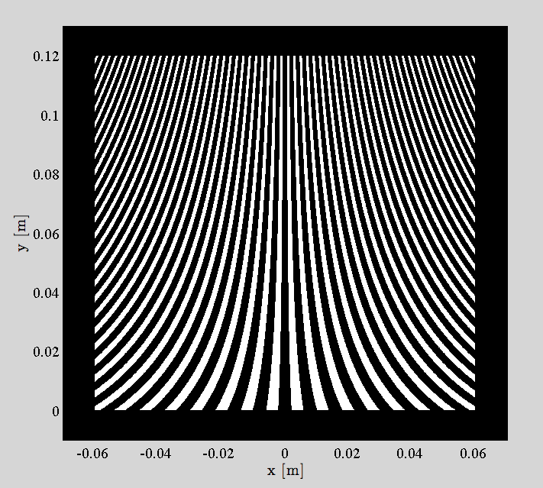
Foil for 1-4 THz imprint
Foil for continuous, linear frequency tuning.
For mechanical stability a minimum thickness is necessary (>1mm assumed).
Vertical size arbitrary.
For 4-20 THz, tuning the undulator to higher harmonic.
Easy tuning by moving the foil instead of beam.
4 THz
3 THz
2 THz
1 THz

Slide 15
Non-linearities
Worry due to large beam size at foil (12cm)
3 issues:
  X: Transverse distortions at foil (RF curvature, lineariser and T₁₆₆).
  Z: Change of final bunching due to longitudinal distortions.
  δ: Energy spread distortion in undulator due to RF curvature, lineariser and de-chirper.
Lineariser:
  Maybe it is possible to make a optical linearisation.
  Compensate non-linear δ with non-linear de-chirper wakefield.
Studies have started, but not ready for presentation yet.

Slide 16
3. Foil design

Slide 17
Foil effect and material options
Two processes are involved:
  Bremsstrahlung decay chain (E>E_{c}).
  Ionization (E<E_{c}).
Effect on beam:
  Energy deposition.
  Angle increase.
Beam energy is in the range of E_{c} depending on material.
Estimates are available, but more secure to have GEANT4 simulation.
Material | Scattering
Be | weak
Al | moderate
Cu | strong
Fe | strong
W | very strong
ρ
Contacted AD people. The local expert is Helga Holmestad. She provided me kindly with here AD degrader foil setup.

Slide 18
Foil simulations (GEANT4)
Beam cannot be stopped by the foil.
Energy loss is moderate, but huge Δε.
Get rid of particles with collimator.
Controlled emittance spoiling seems to be impossible.
Collimator right after the foil.
Favored choice: steel foil of 1mm.
W, 2mm foil, 4 particles, 1mm slit
d_{foil} | ΔW [mJ/bunch] | ΔE_{median} [%] | θ_{sc} [mrad] | r_{x}= θ_{sc}/σxp | r_{y}= θ_{sc}/ σ_{yp}
Be, 0.1mm | 0.03 | 0.08 | 53 | 1302 | 450
Al, 1mm | 0.42 | 1.51 | 180 | 4461 | 1500
Steel, 1mm | 1.23 | 4.79 | 260 | 6421 | 2266
W, 2mm | 7.96 | 47.37 | 1112 | 27506 | 9145

Slide 19
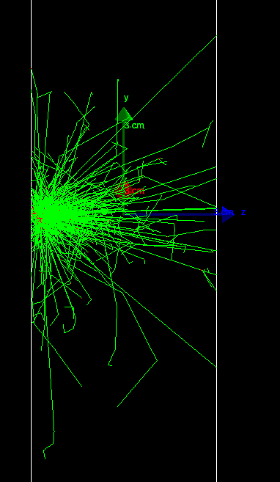
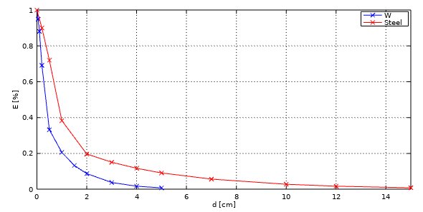
Collimator design/simulations
Foil choice:
  Be foil: beam is all over the place (too large θ_{sc})
  Better to use steel foil (produced narrower cone).
Collimator thickness:
  Simplified simulations with a cylinder of material.
  W: <1% energy after 5cm
  Steel: < 1% energy after 15cm
Possible geometric layout:
  Two tungsten plates to collimate only vertically.
  10cm downstream of foil: σ_{ysc} = 2.6cm
  1cm gap should collimate 96% of the beam.
5cm W block, r=10cm, 100 electrons

Slide 20
Heating
No cooling mechanism:
  Assuming 1mm steel foil.
  Deposited energy per bunch 1mJ.
  1g Fe + 1mJ => ΔT = 0.5mK.
  Heating of 50 mK/s.
Cooling:
  Heating power 0.79W.
  No convection (vacuum).
  To radiate also 0.79W, ΔT from 20° to 69° degree or oxidized steel.
  But heat will also spread via conduction.
Conclusion:
  Foil will warm up a bit (maybe slightly hot).
  Expansion for ΔT=50 is about 1μm.
Other issues (to be studied in more detail)
Activation:
  Discussion with CERN RP expert Robert Fröschl.
  There will be some activation, but surely moderate (low energy electrons, low I_{avg}).
  It has bee okay at LCLS at much higher energy (4.54 GeV).
Ablation:
  There are OTRs all over the place at all energies.
  There has been no problem at LCLS at much higher energy 4.54 GeV.
Transition radiation:
  Fun to look into, but corresponding wake was no problem at LCLS.

Slide 21
4. Conclusions

Slide 22
Summary of slotted foil design
A design of a THz source based on an 26 MeV electron beam and the slotted foil technique was presented.
Micro-bunching is created by removing parts of the beam with the help of a foil.
Two imprint optics were studied, were the one without bunch compression seems to be favorable:
  No change of optics for tuning.
  Creation of fully bunched beams.
Foil was designed with the help of GEANT4 simulations:
  Foil will in any way not stop the particles directly.
  1 mm steel foil seems to be optimal at the moment.
  Two 5cm long tungsten plates 10cm downstream of foil should collimate 96% of the spoiled beam.
There seem to be no show stoppers so far and the design looks rather easy.

Slide 23
Comparison of designs
 | Comb beam | Slotted foil (option 2)
Injector: | Additional laser hardware. Tricky to find proper working point. | Standard injector
Bunching: | Mainly stretching of energy modulation (no bunching). But parameter seem okay. | Easy tuning Fixed optics Challenging design and setup of imprint optics.
Undulator: | A bit longer, since only energy modulation. | Rather shorter, since fully bunched beam.
Length: | About 15m. | About 13m.
Comments: | Optical linearisation is difficult, since tuning with bunch compressor. | Maybe optical linearisation instead of X-band lineariser.

Slide 24
Possible test scenario at CLEAR
Injector:
Much simpler laser system than for Comb beam.
If 50MeV beam instead of 25MeV at SwissFEL.
X-band lineariser probably necessary.
Imprint optics:
Imprint optics, has a dogleg shape for extraction.
Only h/2 and δ/2 compared to SwissFEL. Twice D_{x} is necessary (3m). Should be possible if design is a bit stretched.
Undulator and de-chirper:
Same de-chirper and undulator as for SwissFEL
Space charge conditions a bit relaxed.
THz frequency is changed from 1-20 THz to 4-80 THz.
But same foil can be used since undulator can be tuned to higher harmonic.

Slide 25
Further steps
GENESIS simulations:
  Most important task to finally confirm feasibility and quantify the properties of the THz radiation.
  Have been started, but there was a problem with the space charge calculation.
Design improvements:
  Finish the study of nonlinearities.
  Include resistive wakes in de-chirper and get better wake.
  Check if dielectric de-chirper could be shorter than 3.5m.
  Check transition radiation effect of foil.
Detailed optics design (MADX) of imprint optics.
Tracking studies and final optimisation.

Slide 26
Thank you for your attention!

