Slide 1
Report from SA1 meeting
Gert Svensson, PDC, KTH, Nordic ROC Manager
Nordic ROC and Baltic Grid meeting - Helsinki-
15 June 2009

Slide 2
Operational tools development
Regional dashbord will use Nagios
Nagios based SAM test in test
GOCDB programatic interface XML over HTTP
GSTAT will use Nagios

Slide 3
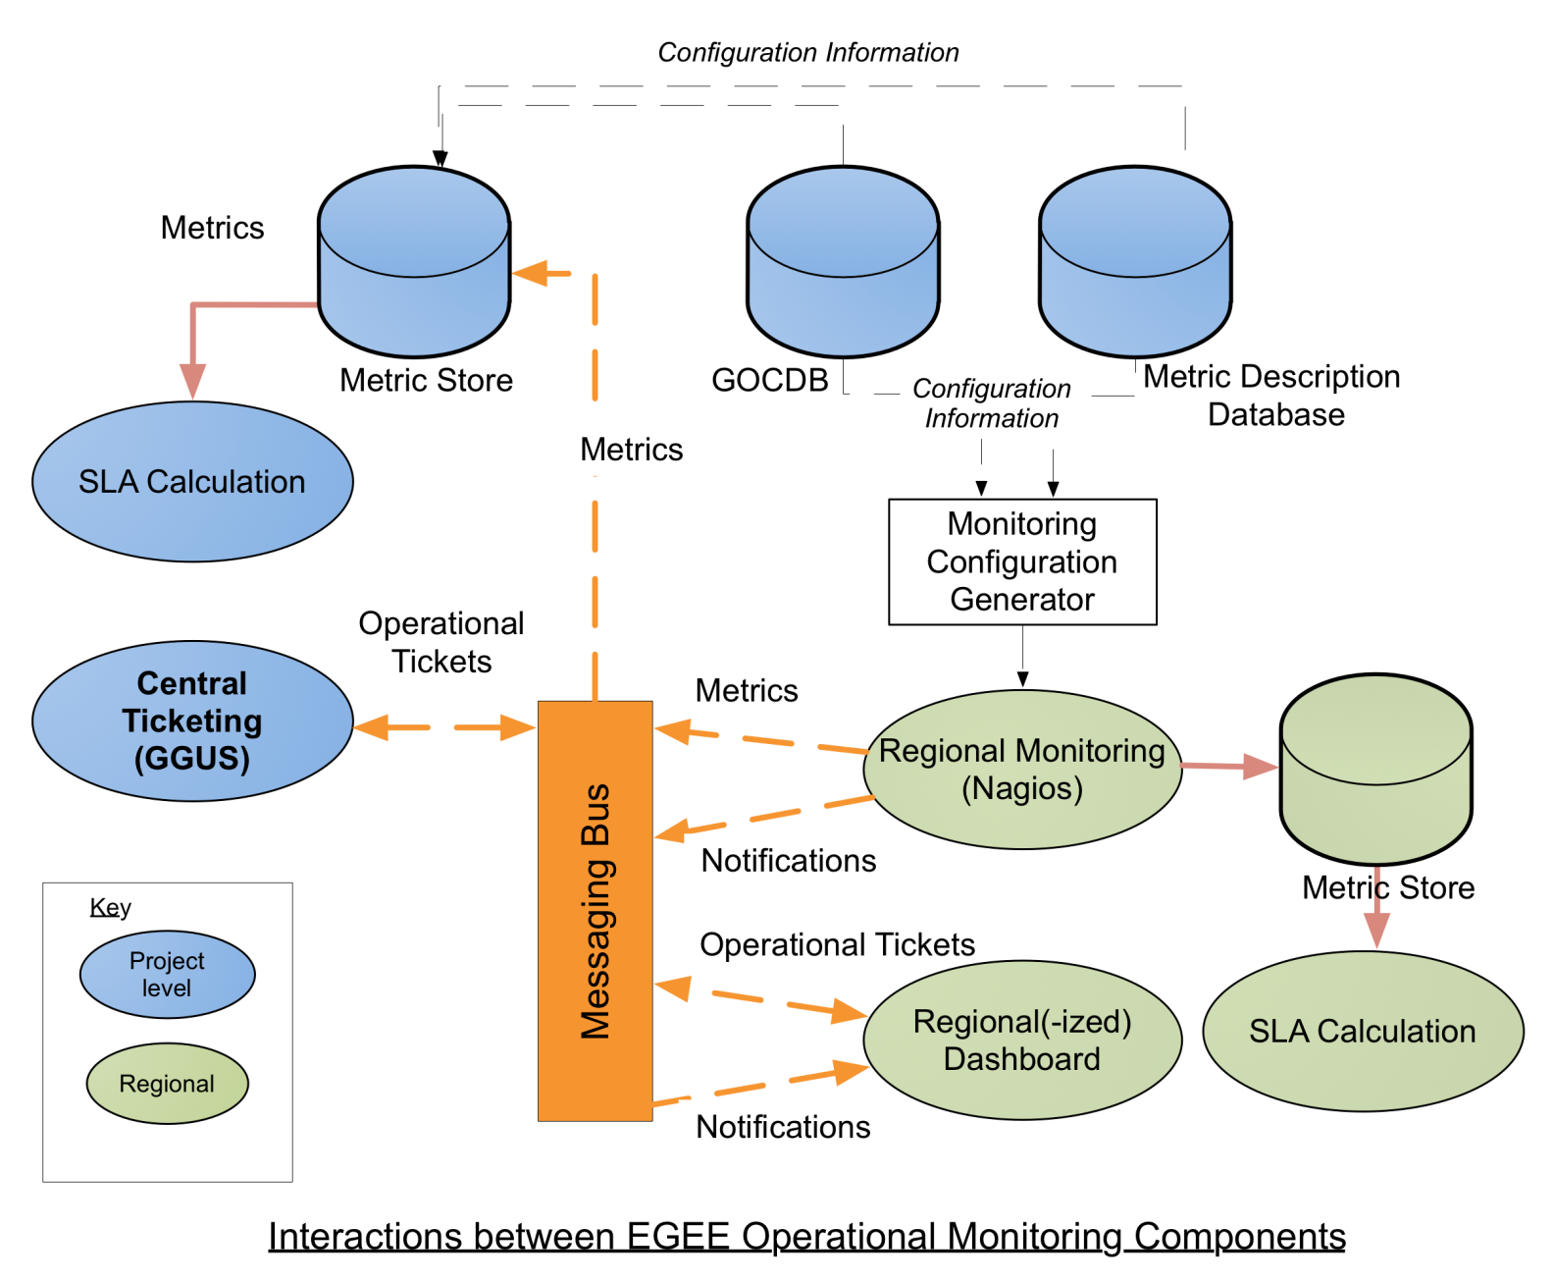
Agreed data flows from Nagios to Regional dashboard

Slide 4
COD
Lots of discussion about central functions in COD
Should be prototyped ASAP

Slide 5
TPM
Lots of discussion about the central functions of TPM
Decided to decentraliza as much as possible but keep some a central TPM rotating over 2 – 3 sites.

Slide 6
HEPSPEC06
The HEPiX WG evaluated a variety of HEP codes and different cpus
They chose one of the SPEC2006 set of benchmarks called SPECall_cpp2006
This reflected the mix of Int and FP found in HEP applications and scaled with cpu speed.
This is not one of those usually published by manufacturers
  So sites have to run it themselves. (A Good Thing!)
Conversion
1 HEPSPEC06 = 250 SpecInt2000
4 HEPSPEC06 = 1k SpecInt2000

Slide 7
APEL Plan
Sites should:
Measure resources using HEPSPEC06
*250
Publish as SI00 as before
Set Glue Flag to say HEPSPEC06 has been used
APEL gathers comparable data from all sites
Monitoring can identify sites which have/have not changed benchmark. Raise tickets etc
CESGA Portal can show usage in either (both?) benchmarks by conversion.
Eventually when most sites have changed, the portal default will change
When GLUE2.0 deployed, publish raw HEPSPEC06 values
  Or possibly reuse SI00

