Slide 1



AD machine status
Tommy Eriksson CERN/BE/OP

Slide 2
Outline
2016 AD performance
Machine issues
Run statistics
EYETS activities 2016/17
Outlook for 2017

Slide 3
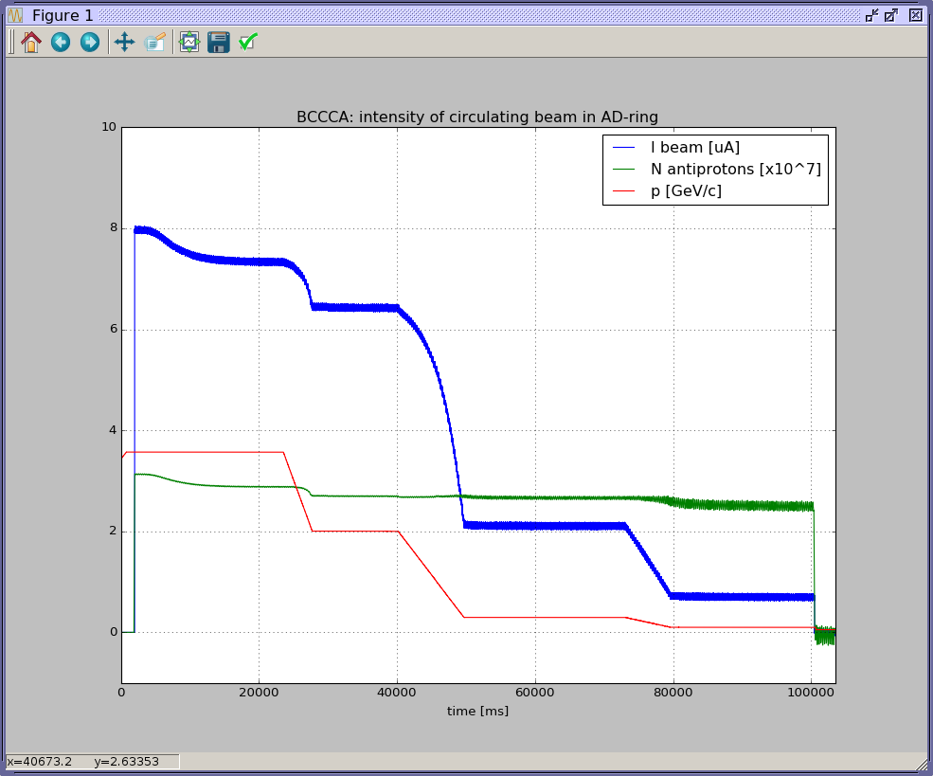
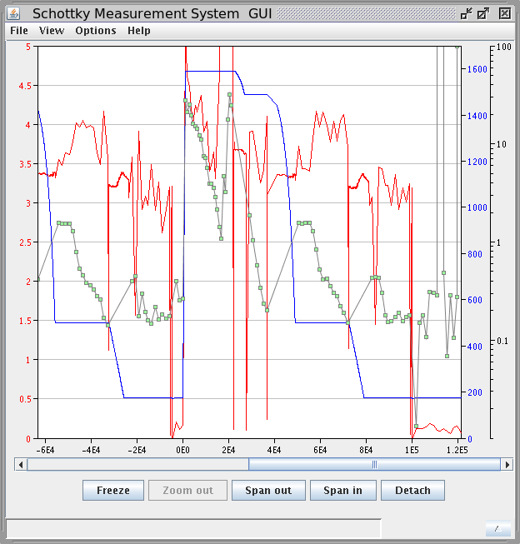
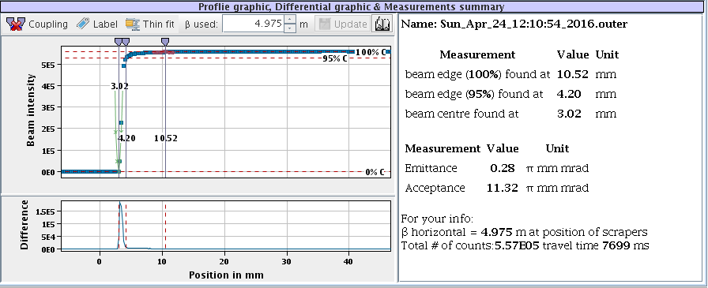
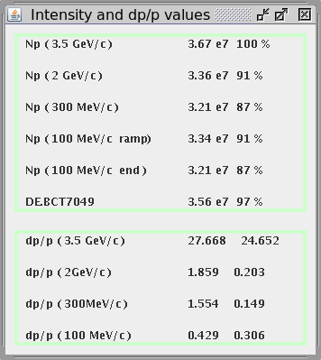
2016 AD performance
Very short start-up due to late ring bake-out (BCCC installation):
  Setting-up with beam in only 11 days
  Start-up as planned 25/4
Good deceleration efficiency and excellent beam quality at 100Mev/c: Eh/Ev < 0.3 um, absence of “halo”, lbunch=130ns => stable throughout the year
Complete overlap e-cooling/bunch rotation at ejection, no stability issues
Some fluctuation of beam intensity over the year (PS beam quality, intensity & trajectory, AD deceleration efficiency)

Slide 4
Machine issues
~ 50/50 downtime AD vs. PS
Downtime spread over the AD systems, some examples:
  C02 RF system: resettable trips, self-recovering trips, controls problems, intermittent longitudinal blow-up
  Orbit jumps
  Injection/ejection kickers: trips sometimes needing specialist resets
  Power converter & controls problems
  Electron cooler trips needing long re-starts
  Recovery from power glitches
RP limits on beam intensity – alarms in hall at some locations. Threshold is very close to nominal (~4E7) AD intensity. => Primary beam intensity reduced on some occasions (but less than last year)
Hor. position fluctuations of ejected beam, suspected to be linked to pulse shape of ejection septum power converter. Varies over time…tentative plan to replace septum next time that vacuum sector is vented.

Slide 5
AD statistics
Running for physics since 2000, some 50000 physics hours realized, (no machine runs in 2005 & 2013):
run time (h) | 2000 | 2001 | 2002 | 2003 | 2004 | 2005 | 2006 | 2007 | 2008 | 2009 | 2010 | 2011 | 2012 | 2013 | 2014 | 2015 | 2016
Total | 3600 | 3050 | 2800 | 2800 | 3400 | 0 | 2925 | 3800 | 3340 | 4600 | 4610 | 4680 | 5480 | 0 | 2185 | 3300 | 5440
Physics | 1550 | 2250 | 2100 | 2300 | 3090 | 0 | 2765 | 3760 | 3140 | 4460 | 4550 | 4530 | 5360 | 0 | 2135 | 3250 | 5375
md | 2050 | 800 | 700 | 500 | 310 | 0 | 160 | 40 | 200 | 140 | 60 | 150 | 120 | 0 | 50 | 50 | 63
Beam available for physics (%) | 86 | 89 | 90 | 90 | 71 |  | 65 | 76 | 81 | 78 | 87 | 84 | 90 |  | 85 | 89 | 86
Uptime AD machine (%) |  |  |  |  | 89 |  | 74 | 81 | 93 | 92 | 91 | 90 | 95 |  | 90 | 92 | 93
Beam distribution:
ASACUSA 1530h
ATRAP 908h
ALPHA 1528h
AEGIS 912h
ACE beamline 499h
BASE 0h
AD md 63h

Slide 6
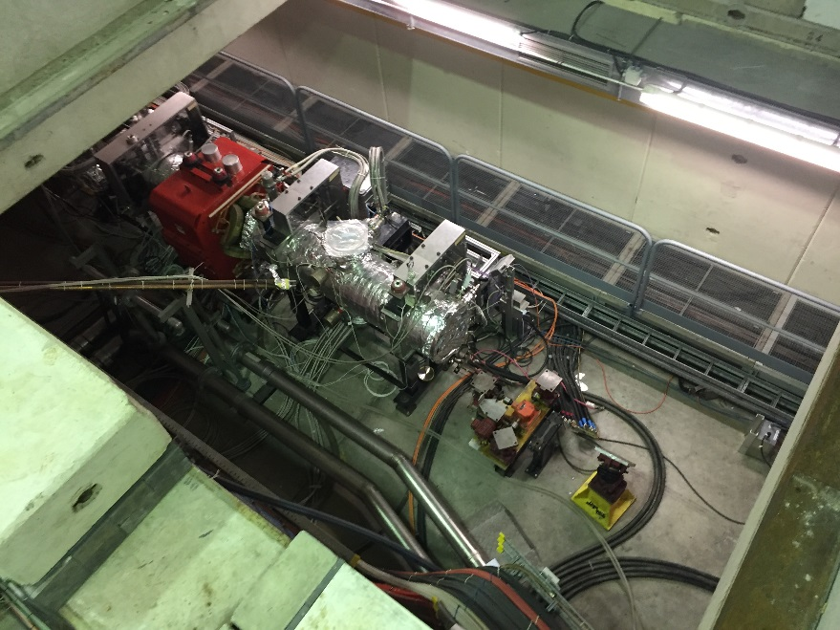
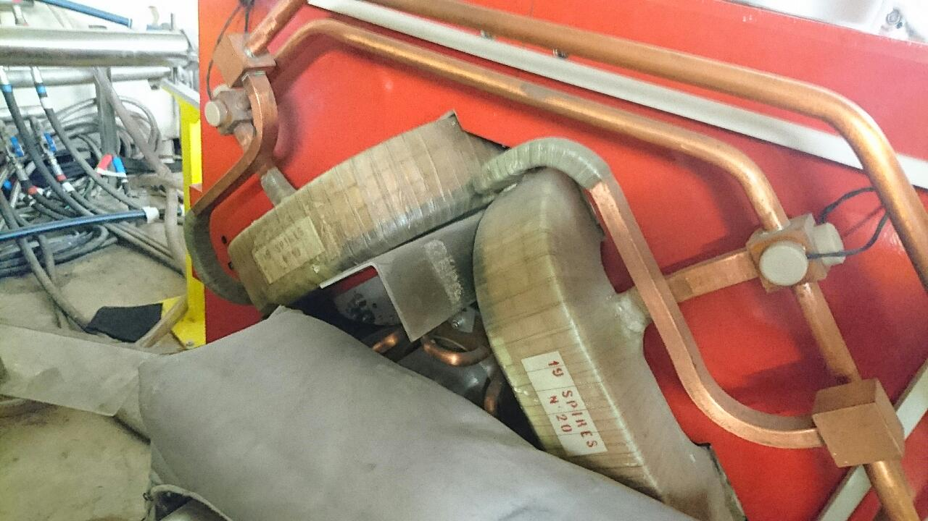
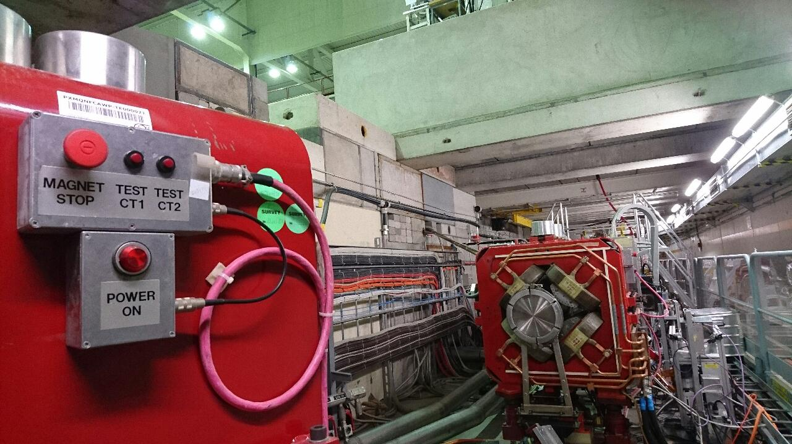
Major EYETS activities
Magnet coil shimming:
Long-term BHN/BHW renovation program, 1-2 per year. No.5 of 24, BHN33 this year
57 main quads need attention, especially QN:s
We profit from BHN33 removal to do also QDN33 this year
DR.QDN33 removed for renovation
DR.QDS01 repair in-situ
DR.BHN33 removed for renovation

Slide 7
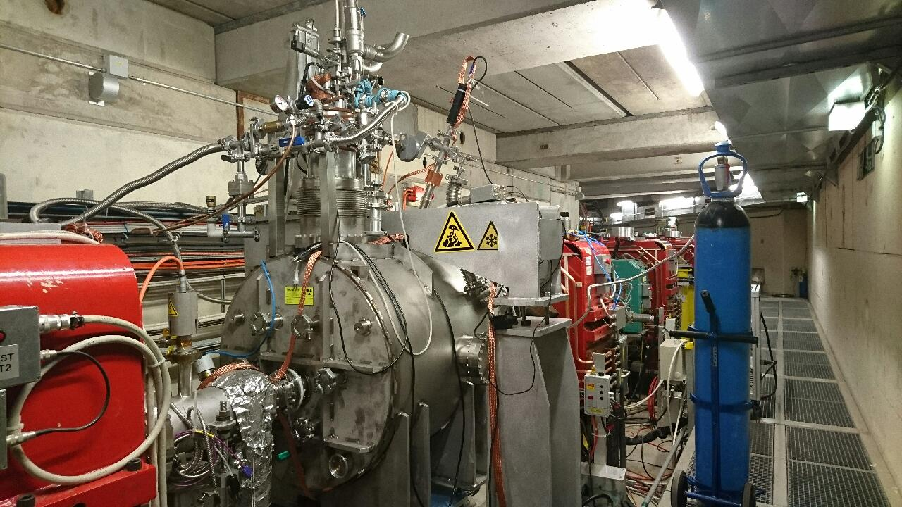
Major EYETS activities
  C10 RF (new interlock system & racks)
  General survey of all AD ring elements
  3 vacuum sectors to be opened: 1B(sector valve leak), 2A(leak), 4(BHN33, QDN33)
  Continued consolidation of many systems during and beyond EYETS: Vacuum system, Stochastic cooling system, new electron cooler, Magnets, Power converters, Kickers, Horn pulser, C02 cavity & low-level, etc.
  Target area consolidation: preparing for major renovation in LS2 including new Targets, Horns, Target/Horn chariots, new ventilation system & building, Horn test bench, magnets, support systems etc.
BCCCT:
  modification of vacuum pumping connections & He equipment.
  Accidental disconnection of He line => purge & recover from air/humidity pollution

Slide 8
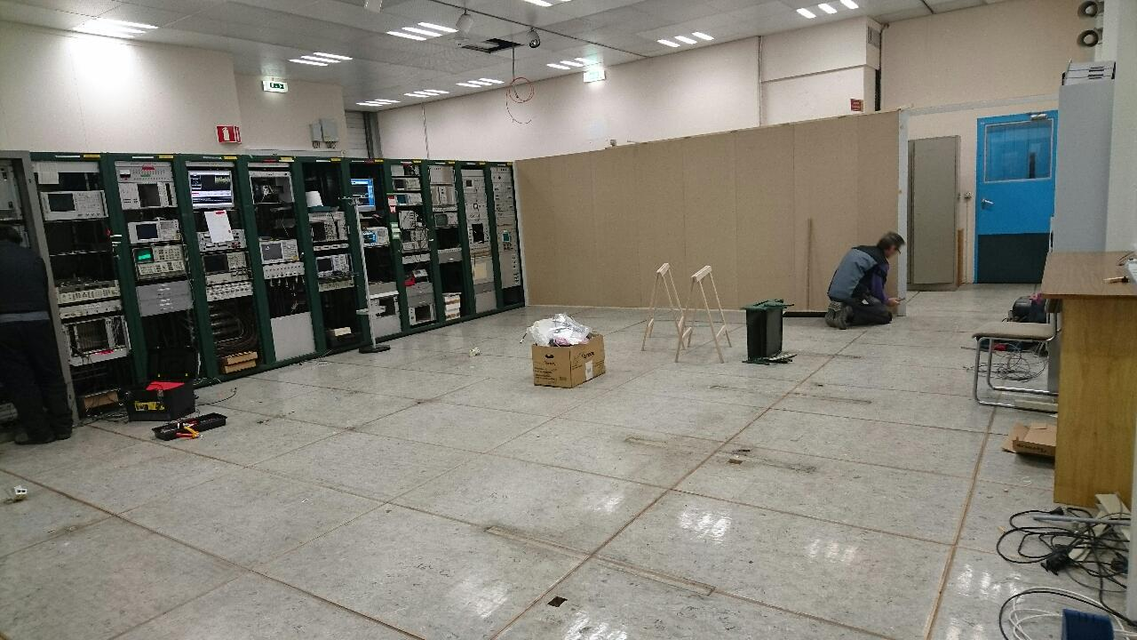
And also…..
  Re-vamp the AD control room !

Slide 9
Key dates 2017
  https://espace.cern.ch/be-dep/BEDepartmentalDocuments/BE/Injector_Schedule_2017.pdf
  Demineralised water system: maintenance 6/2 – 13/2
  He liquefying plant: maintenance period early April
  3-14 April: HW tests & cold checkout
  >17 April PS beam available
  1 May: start physics
  Pbar beam for AD physics 1/5 – 18/12 (33 weeks), including ELENA Pbar shifts

