Slide 1
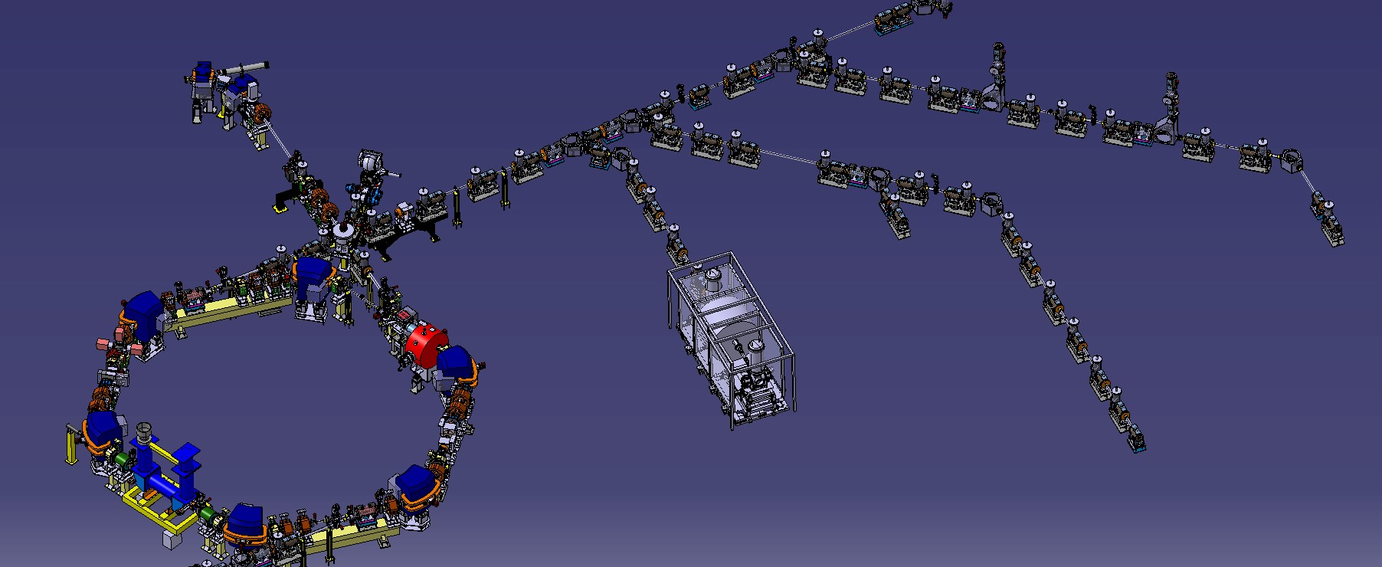
ELENA Project Status
C. Carli on behalf of the AD and ELENA teams ADUC, 17th January 2017
Installations up to Start of Commissioning
Commissioning with (brief) and without Beam
Plans for 2017
Summary

Slide 2
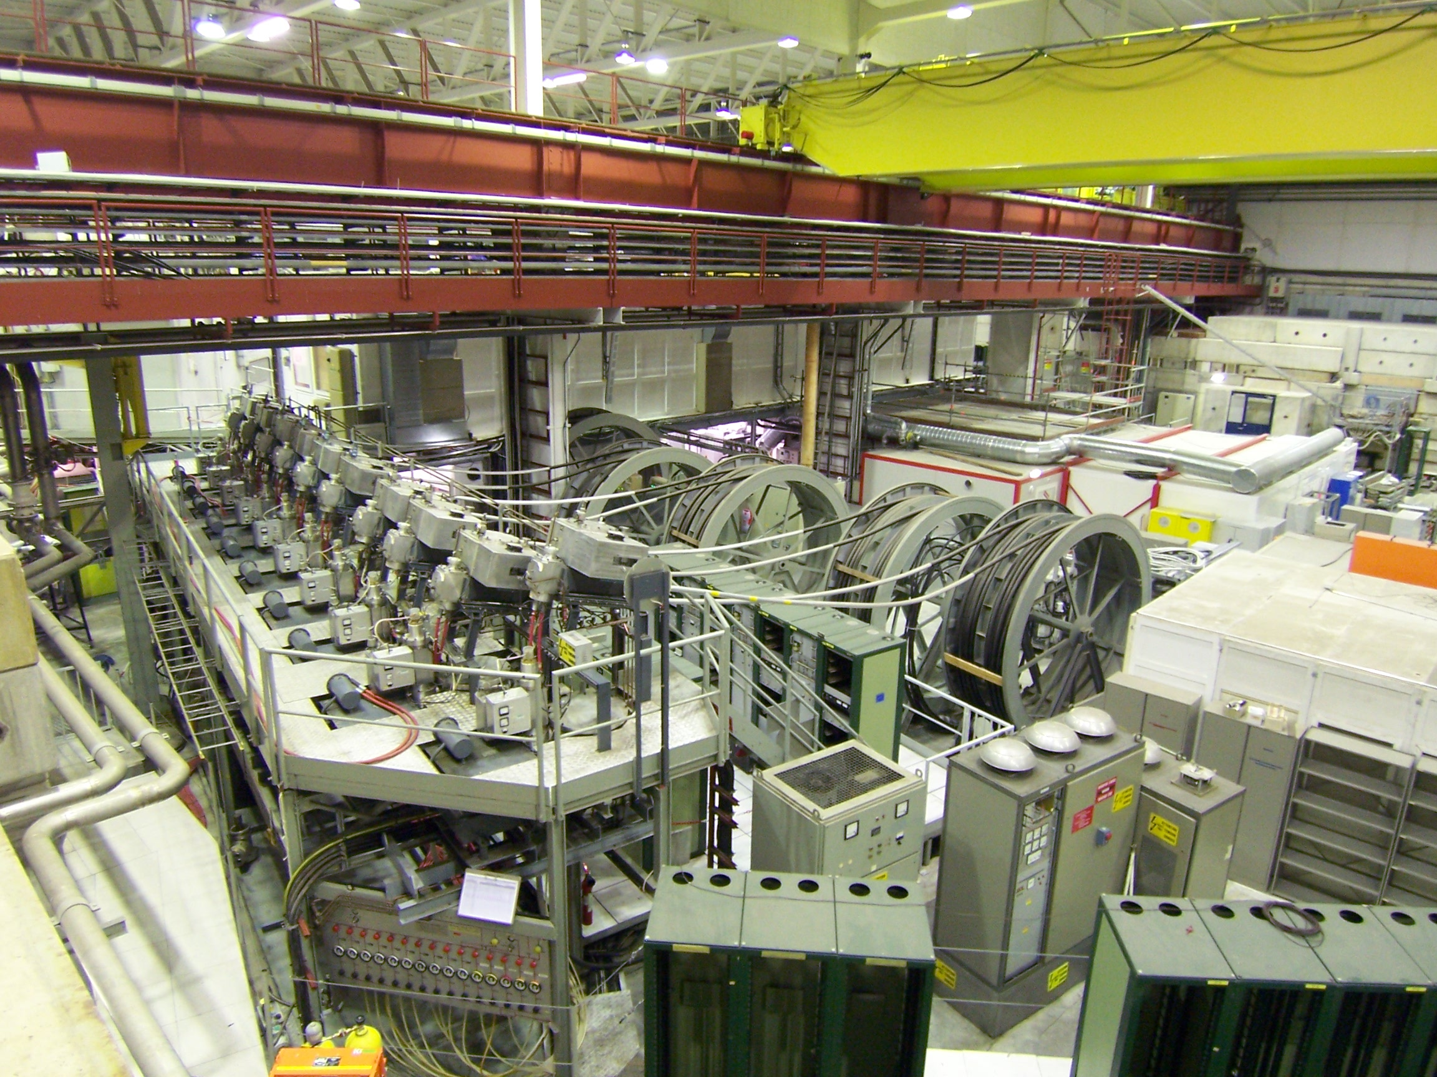
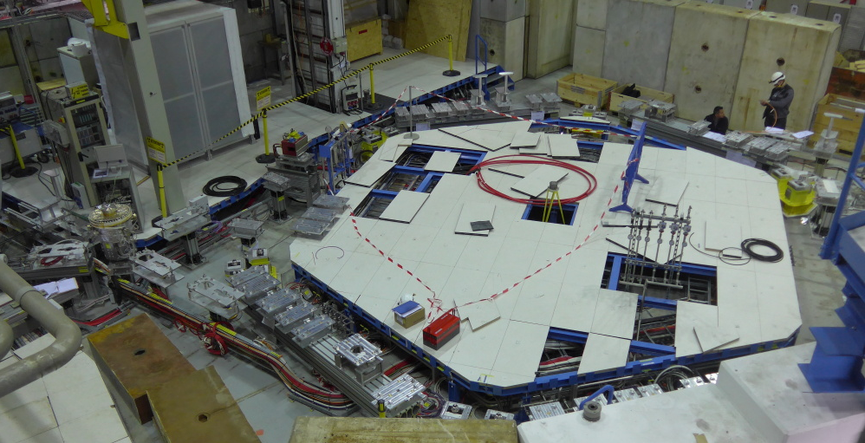
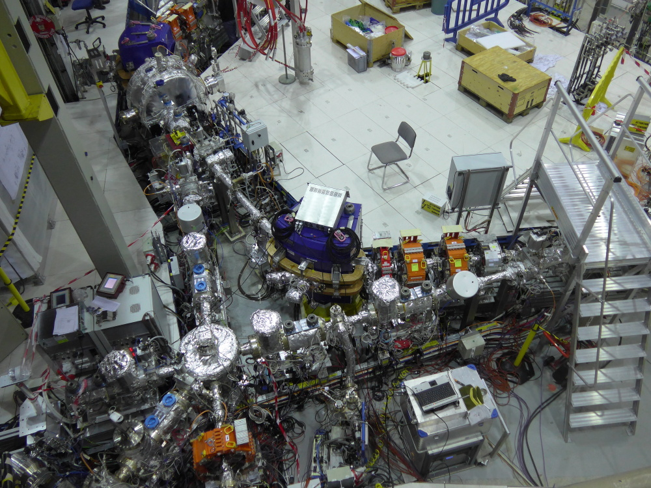
Installations up to Start of Commissioning
(more details in presentation by F. Butin)
December 2014
13th January
Hardware (most of the Ring and a few Lines) needed for Ring Commissioning installed, baked and tested
Ready to start Commissioning with Beam around mid-November
(Electron Cooler temporarily replaced by simple Tube, will be installed in Spring 2017)
Picture taken
on 19th October

Slide 3
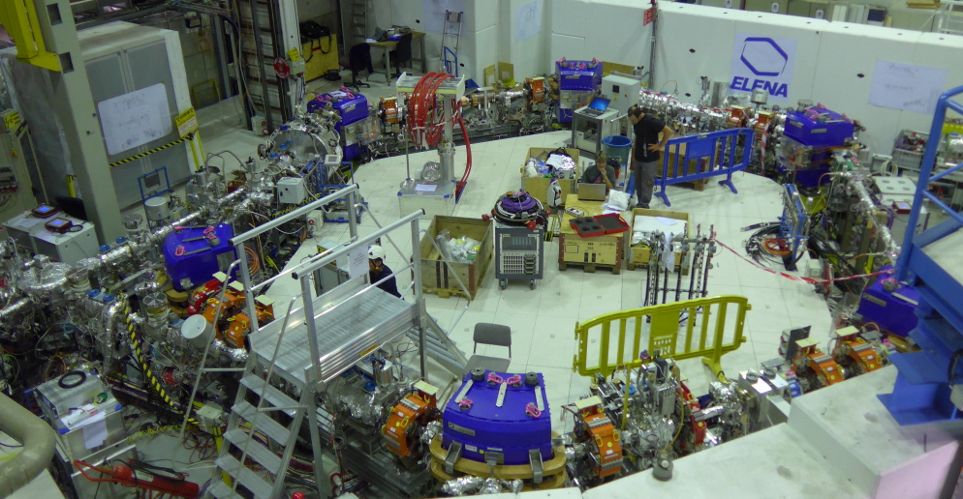
Installations up to Start of Commissioning
(more details in presentation by F. Butin)
Sensitive magn. Pick-up
(Schottky diagnostics
for intensity, LLRF..)
Extraction towards
new experimental zone (fast deflector)
followed by el.-static transfer lines
Injection with magnetic
septum and kicker
Compensation
solenoids
for (not yet
Installed) cooler
Wideband RF cavities
(very similar to new
PSB cavities)
Line
From AD
Extraction towards
“old” experiments
Scraper to
Measure emittance
Short 30.4 circumference Ring, Challenges due to low (100 keV) Energy and Intensity
(low magnetic Fields, Rest Gas Interactions, Beam Instrumentation with weak Signals …)

Slide 4
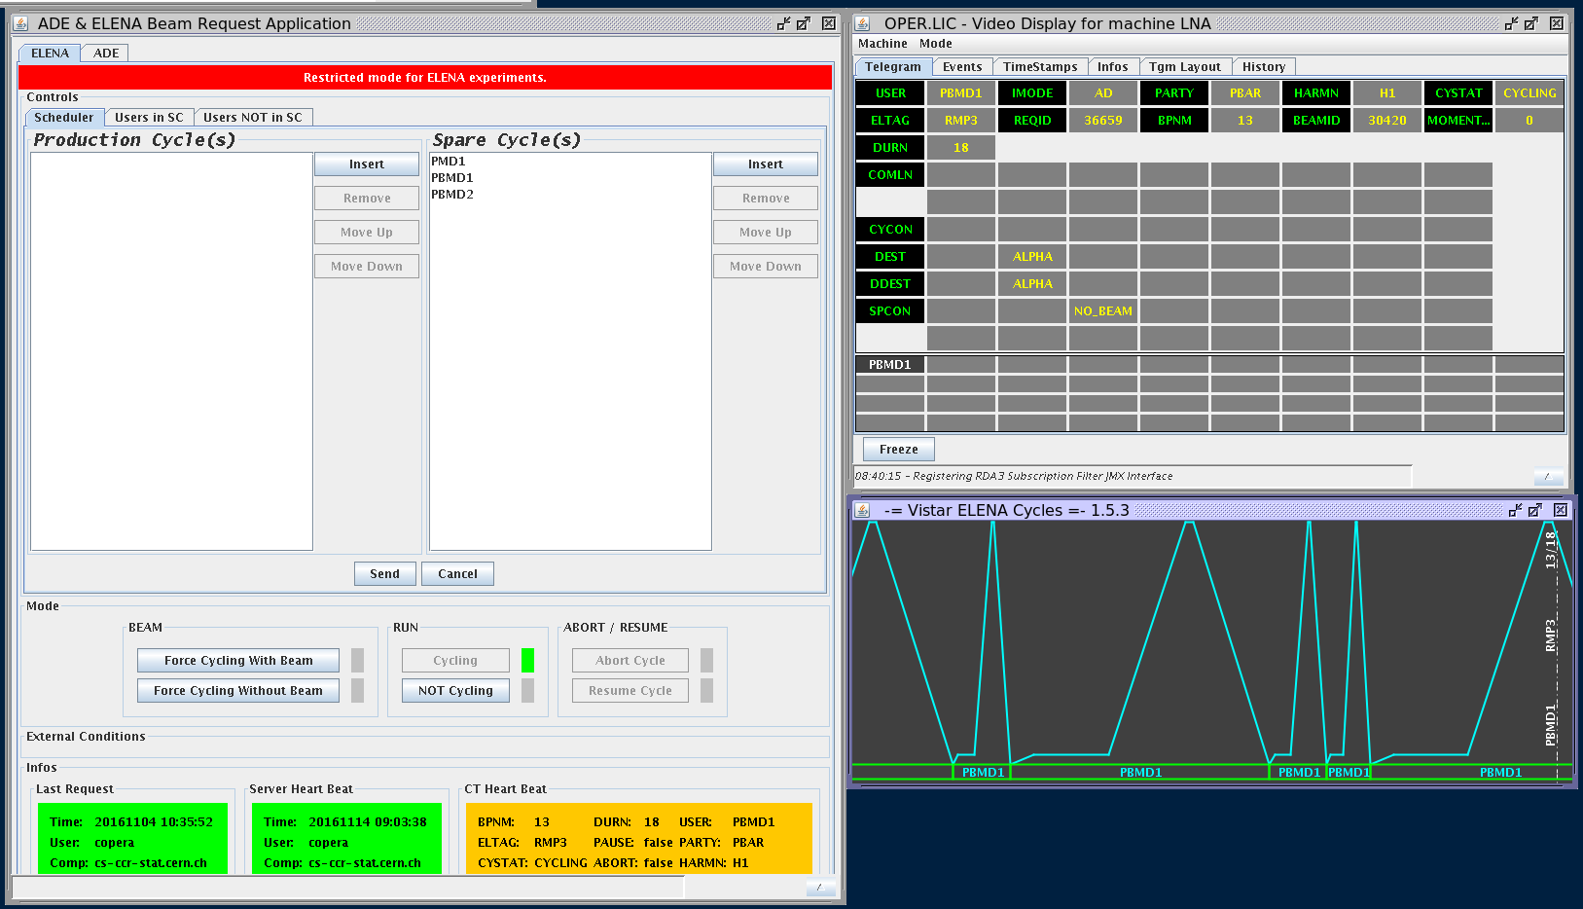
Commissioning with (brief) and without Beam
Last Preparations
Ring Installations completed around end of September, kicker with “internal leak” (no other short term solution)
Bake-outs completed end of October for Ring and Beginning of November for Line from Source
Hardware Tests, Inspections with Safety Unit, Test of the Access System …
Circuit tests
  7th to 11th for magnet circuits (magnets, interlock system and converters)
  4th to 11th November for electro-static circuits for transfer lines
Machine available for Commissioning
(with Beam) Team on 14th November
Still a few Issues to by Solved
General Sequencing and Timing
to be understood

Slide 5
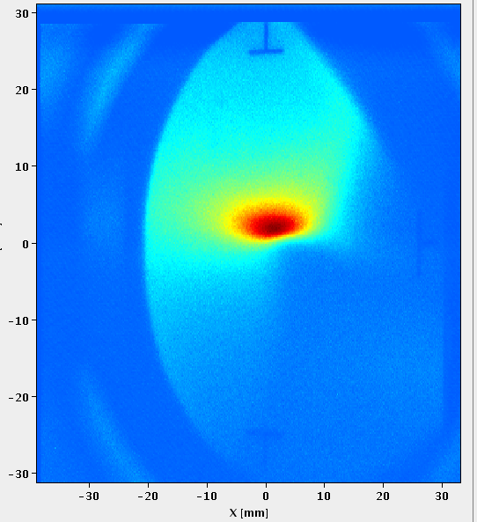
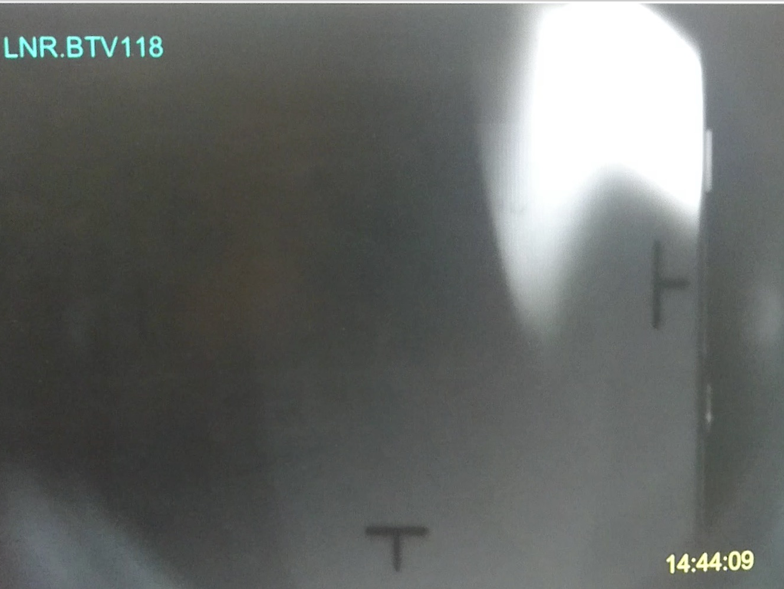
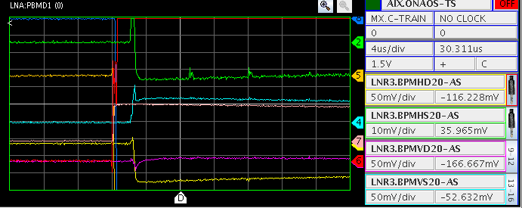
Commissioning with (brief) and without Beam
On 16th November, Beam observed on
“TV Station” between Septum and Kicker
  Instrumentation (two profile monitors)
  in Line from Source to Ring not yet
  available
  Empirical Adjustments leading to
  surprising Settings of Line
  Line Settings to be readjusted often
On Friday 18th November, low
intensity remaining for at least
a few turns
  “Only” injection steering
  No Orbit Correctors required
Position pick-up sum signals
(beam seen a few times spaced by revolution 7 us)
Signal due to losses on Pus
(charging up plates and leading to a
signal, which is difficult to interpret)

Slide 6
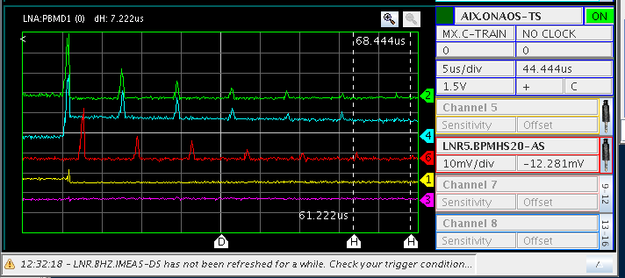
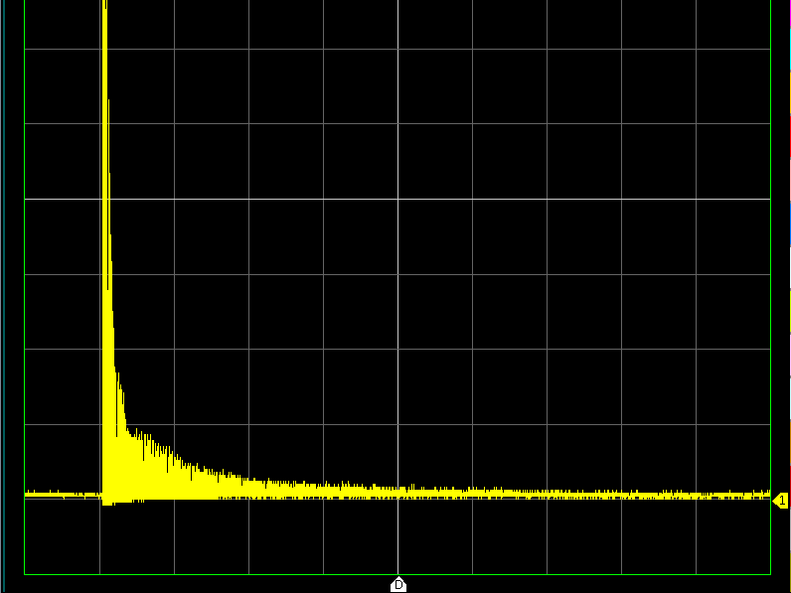
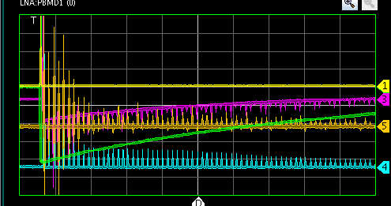
Commissioning with and without Beam
On 22nd November, Beam
observed for a few more turns
On 23rd November, beam
for 10s of turns and likely a few ms
0.5 ms/div
50 μs/div
Position pick-up sum signals

Slide 7
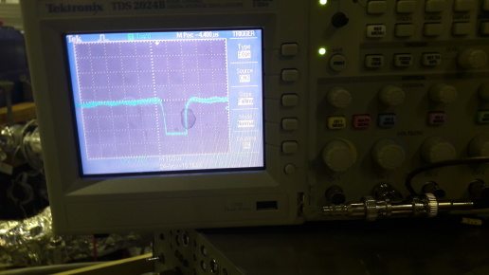
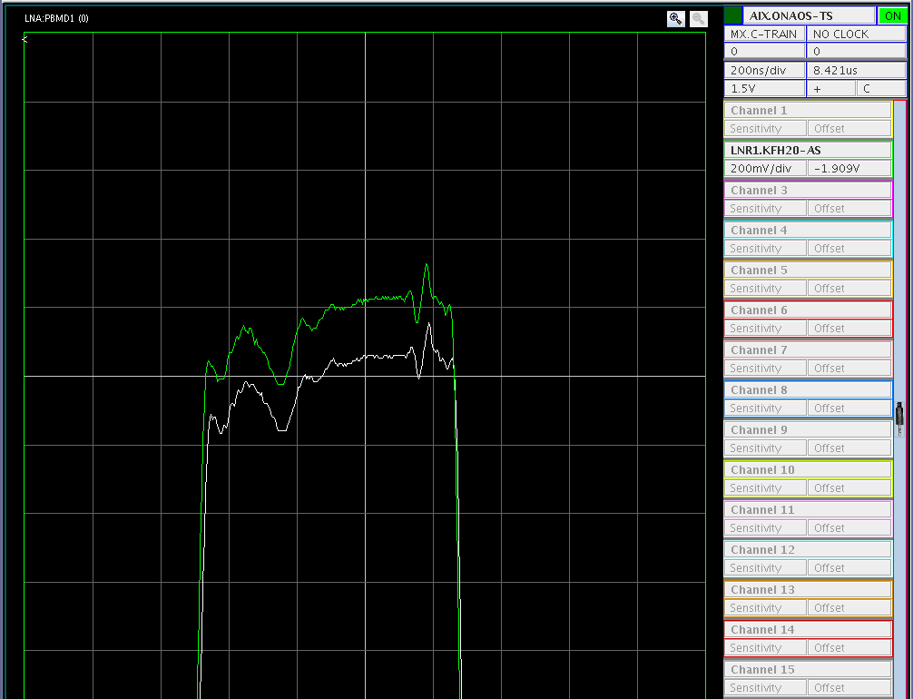
Commissioning with and without Beam
First tests of the prototype profile in
Line from Source to Ring on 24th Nov.
  Only temporary Head Amplifier
  connected to Scope
  Saturation even with lowest H⁻ Beam
  Intensities
  Promising, but still a lot of Work to
  be done
  Horizontal Offset seen?
Injection Kicker shot-to shot Fluctuation
found and cured
  As an example of technical Problems
  encountered and solved
On 25th November, Isolation Transformer
of Source broke
=> No Beam any more before annual CERN
shutdown

Slide 8
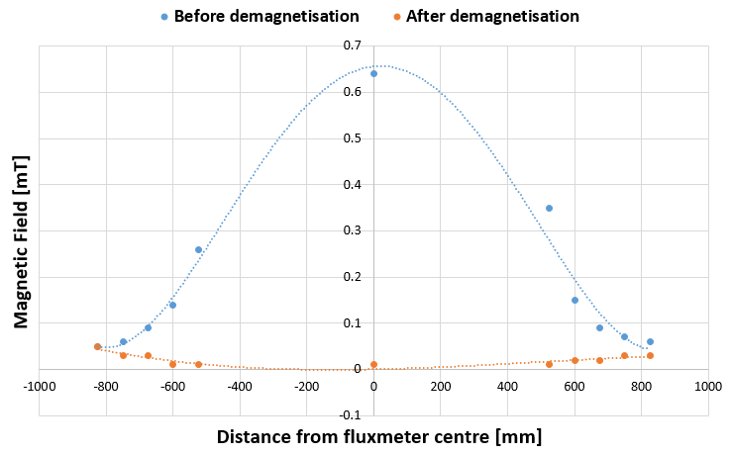
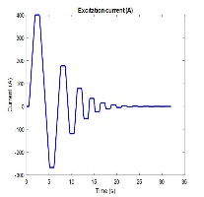
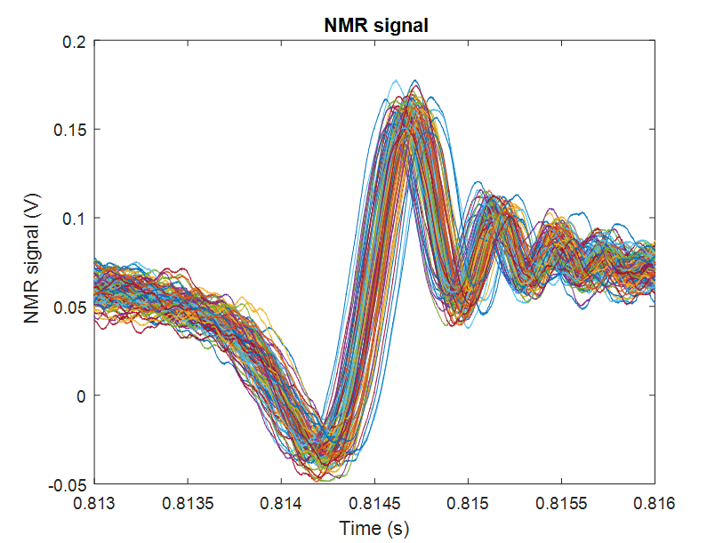
Commissioning with and without Beam
B-train (real time magnetic Field Measurement distributed e.g. to RF)
The B-train system is installed, electronic components are being
checked. White Rabbit output is available at the RF rack.
Nominal calibration coefficients are applied for the time being.
The reproducibility of the NMR markers was evaluated over
100 repetitions:
- Low field (465 G, up to 581 G/s): better than 0.15 G
- High field (3400 G, 2800 G/s): better than 0.15 G
Slide provided by
B-train Team
465 G,
3400 G,
Degaussing reduces the the
integrated remanent field
from 153 to 0.03 mTm.
TTL marker trigger
Notes:
Bottom of the range, optimized custom probe (loss of flexibility, let’s start as it is).
Spurious 3-order harmonic resonance found, may require manual intervention to override internal search mode that sets in automatically , varicap setting can be changed.
FESA restarts (sets different frequency) must be followed up manually.

Slide 9
Plans for 2017
Resumption of ELENA Commissioning with Beam expected on 13th February (with Beam from the Source, still without Electron Cooler)
  Date determined by
    Upgrades of CERN Control System
    Maintenance of Cooling Water Station
    Renovation and Modification of of Control Room
    Installation of new Isolation Transformer for the Source followed by Source Re-commissioning
  Activities, Milestones ..
    Measure hopefully Beam Profile in Line
    Improve Understanding and Setting of Source to ELENA Ring Transfer Line
    Commissioning of the (low level) RF System
    Improve Injection Efficiencies and Understand Beam Survival and Life-time (Easier with bunched Beam once the RF System is available)
    Orbit Measurements and Correction, Tune Measurement and Correction
    Orbit Response Measurements (Power H/V Corrector Magnets and Observe Position Changes with Pick-Ups) to understand Machine Optics
    Test Acceleration, (Re-)Deceleration
    Commission the Scraper to measure Emittances … .

Slide 10
Plans for 2017
Installation of Electron Cooler
  Scheduling depending on Progress and Status of ELENA Ring Commissioning and Availability of Cooler
  (See Presentation by G. Tranquille for details on the Status of the Cooler)
Completion of Vacuum Sector LNI-LNE and LNE50
  Vacuum Sector LNI-LNE comprises lines needed to bring Beam from the Source to the ELENA ring and part of the AD to ELENA Line
  LNE50 is the short Line towards GBAR
  Magnetic pick-up (Measurement of extracted Intensity) to be repaired (delicate!!) for LNE50 Line
  Missing Profile Monitors for both Vacuum Sectors
    Four Monitors foreseen in Sector LNI-LNE
    Two Monitors foreseen in LNE50
    Three Monitors almost completely mounted, many more in the pipeline
    Vacuum Tests after Mounting
  Ideally, Installation of LNE-LNE and LNE50 at the same time than Cooler

Slide 11
Plans for 2017
Commissioning of ELENA Ring with Cooler
  Again, as much as possible with Beam from the Source
    Possibly (probably?) with Protons, if H⁻ Life-Time too Short
  Perturbation of circulating Beam by magnetic System of Cooler?
  Optimization of Cooling, Estimates of Cooling Rates and final Beam Properties
Setting-up of Antiproton Cycle
  Based on Experience gained with Beams from the Source to reduce Time needed
  Obtain Machine Cycle as needed for operations
First Operation for GBAR
  Beam from the Source to Test Deceleration to a few keV
    GBAR possibly ready as early as April 2017
  Later 100 keV Antiproton Beams

Slide 12
Plans beyond 2017
In 2018 Operation for GBAR (Aim of Project “Phase 1”)
  100 keV protons, H⁻ and Antiproton Beams possible
Implementation of Project “Phase 2” during LS2 (2019 and 2020)
  Replacement of the magnetic Lines from the AD to “old” experimental area by electro-static Lines from ELENA
    Dismantling of the magnetic Transfer Lines
    Installation of the electro-static Lines
    Commissioning with H⁻ Beam (does not need to be cooled) from the Source possibly during LS2
  ELENA Activities to be coordinated with other LS2 Activities (LHC, Injectors …)
    Proposal from our Side: Installation Work in 2019 to have margi
    All ELENA Activities communicated (using the “PLAN” tool) to LS2 Committee coordinating Interventions for all CERN Installations
    Waiting for Confirmation or
100 keV Beams from ELENA for all Antiproton Experiments from 2021 on

Slide 13
Summary and Conclusions
Status at the end of 2016
  Installation of ELENA Ring (without Cooler) and Lines needed to start Commissioning completed
  First successful and brief Commissioning Period
    Beam transported from Source to Ring and circulating for many 10s of turns
Plans for 2017
  ELENA Ring Commissioning restarting mid-February interleaved with Installations (Electron Cooler, Completion of LNE50 Line and sector LNI-LNE)
  Setting up of ELENA Cycles with Antiprotons
  First 100 keV Beams (first from the Source and later Antiprotons) for GBAR
Implementation of Project Phase 2 during CERN LS2
  First ELENA 100 keV Antiproton Run for all Experiments in 2021

