Slide 1
Status of the ELENA Electron Cooler
G. Tranquille (on behalf of all the team)

Slide 2
Status of the ELENA electron cooler
Cooler parameters
Design
Magnetic system
Vacuum system
Tentative installation schedule

Slide 3
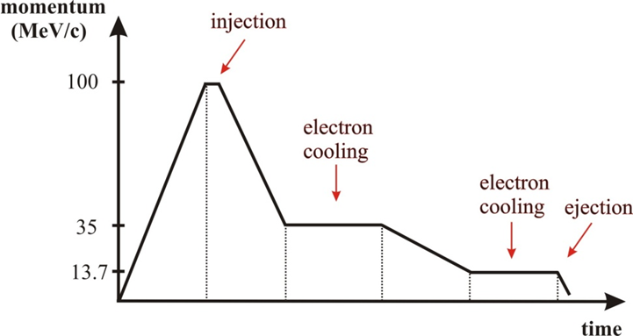
Electron cooling essential in ELENA to counter emittance blow-up caused by the deceleration process.
To prepare bunches with sufficiently low emittance for extraction to the experiments via the long electrostatic extraction lines.
Cooling needed at 2 momenta: 35 MeV/c and 13.7 MeV/c.
Expected emittances prior
to cooling:
@ 35 Mev/c:
ε ~ 50 π mm mrad
(Δp/p) = ± 2 × 10⁻³
Needed emittances at extraction:
ε ≤ ~ 3 π mm mrad
(Δp/p) ≤ ± 1 × 10⁻³

Slide 4
Operate at very low electron energies (down to 55 eV).
Operate at very low magnetic field to minimize disturbance to circulating low energy antiprotons – 100 Gauss in the cooler.
Extremely good vacuum.
Adiabatic expansion of electron beam to reduce transverse temperatures.
Very good field quality – especially in the cooler solenoid (B_{t}/B_{ǁ} < 5 × 10⁻⁴ ).
Orbit correctors and solenoid compensators.
Momentum (MeV/c) | 35 | 13.7
β | 0.037 | 0.015
Electron beam energy (eV) | 355 | 55
Electron current (mA) | 5 | 2
Electron beam density (m⁻³) | 1.38 x 10¹² | 1.41 x 10¹²
B_{gun} (G) | 1000
B_{drift} (G) | 100
Expansion factor | 10
Cathode radius (mm) | 8
Electron beam radius (mm) | 25
Twiss parameters (m) | β_{h}=2.103, β_{v}=2.186, D=1.498
Flange-to-flange length (mm) | 2330
Drift solenoid length (mm) | 1000

Slide 5
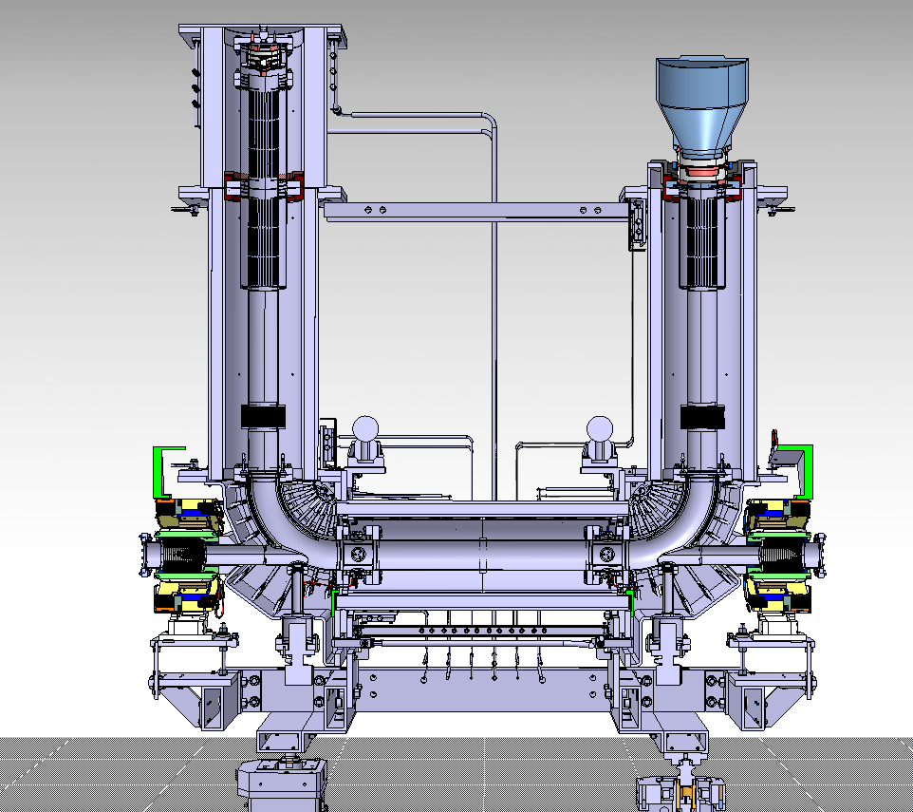
e-Gun
e-Collector
Solenoids
Toroids

Slide 6

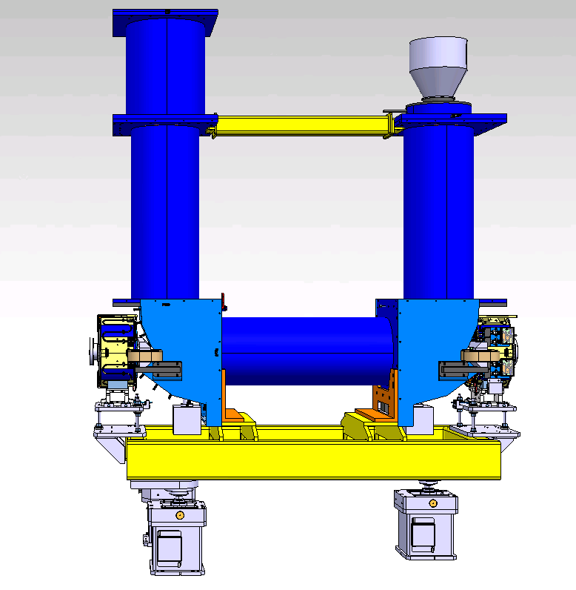

Concept overview of Magnets Elements
Magnets
Supporting system

Slide 7
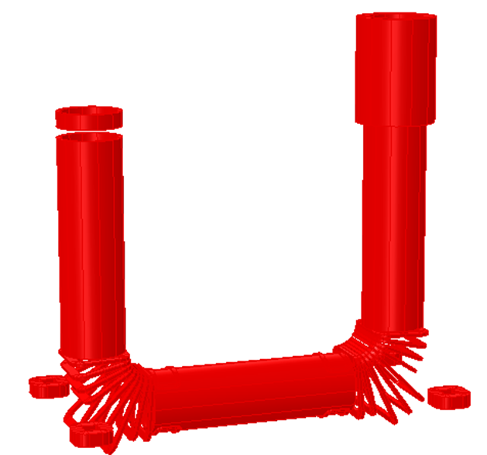
Magnetic system components
Main cooler solenoid
Gun solenoid
Collector solenoid
Expansion solenoid
Squeeze coil at collector
2 x Toroid section consisting of
9 racetrack coils each
Various corrector coils to
ensure good field quality
Orbit correctors
Solenoid compensators

Slide 8
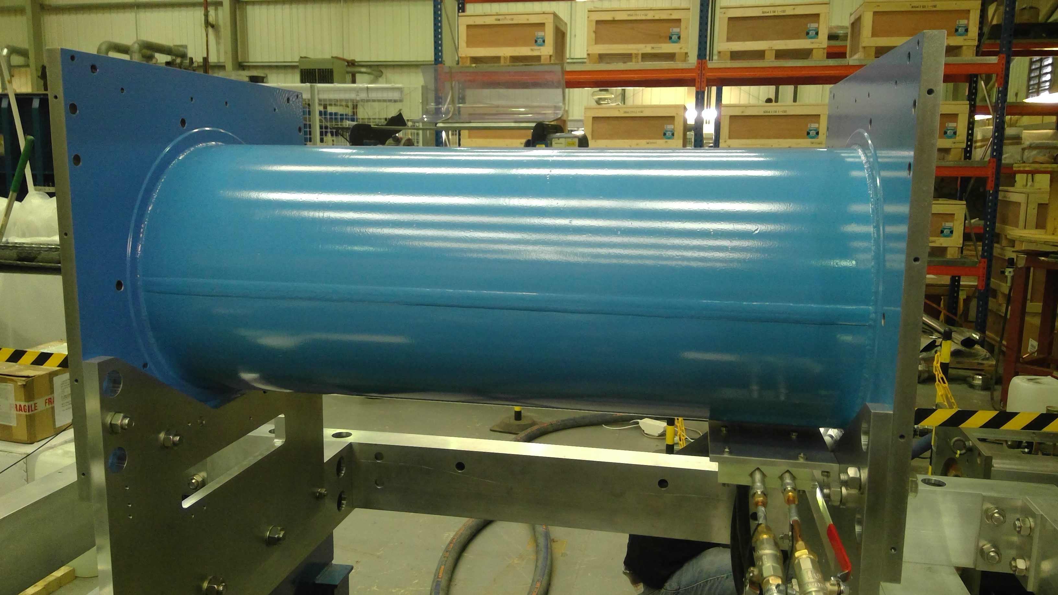
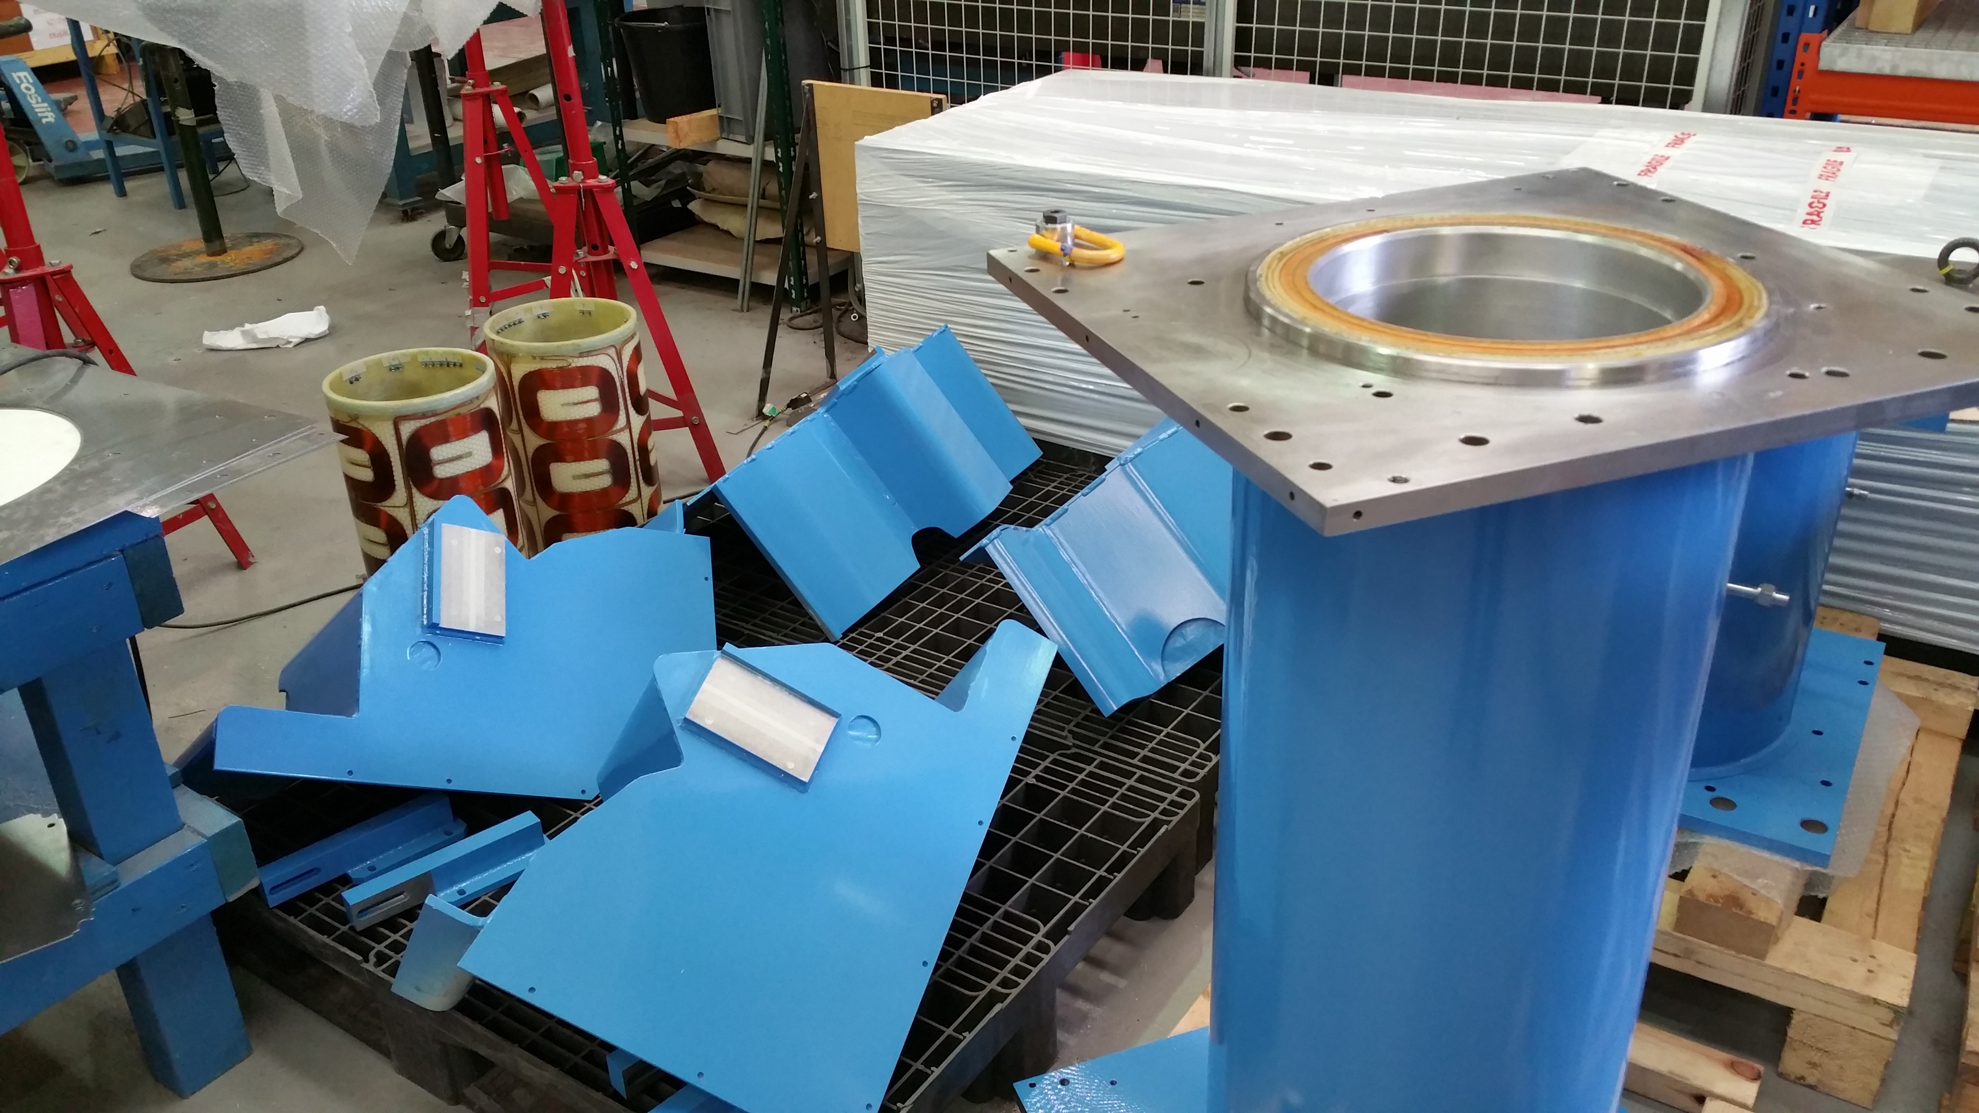
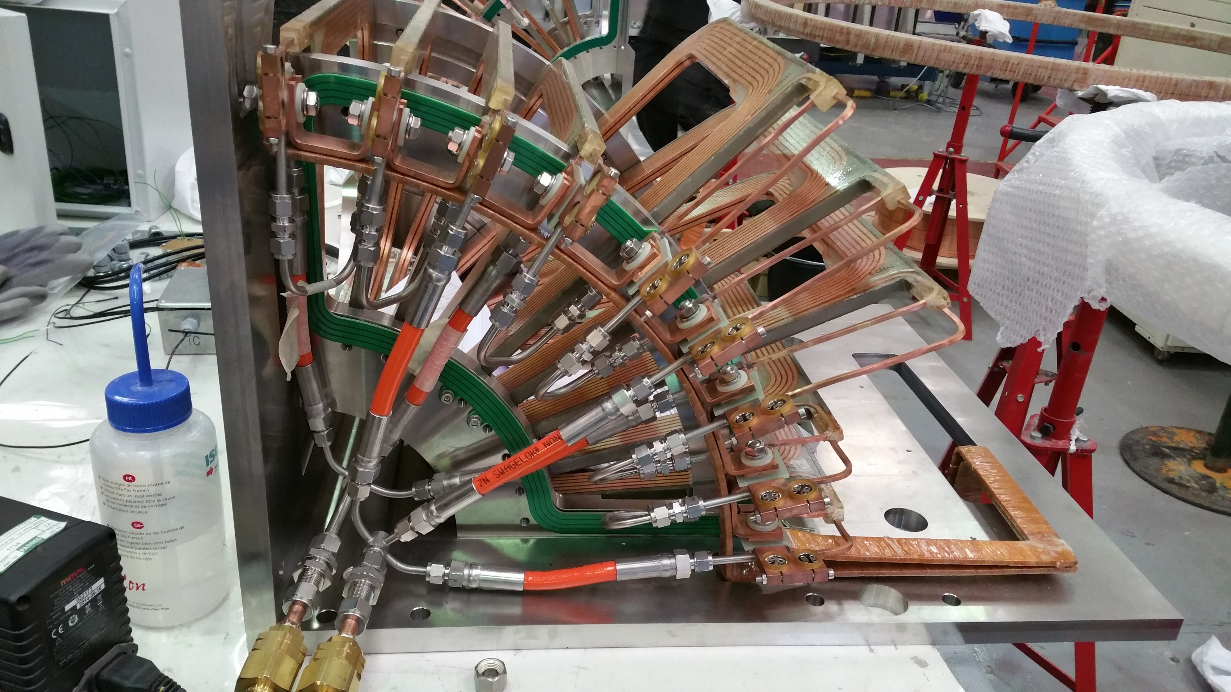
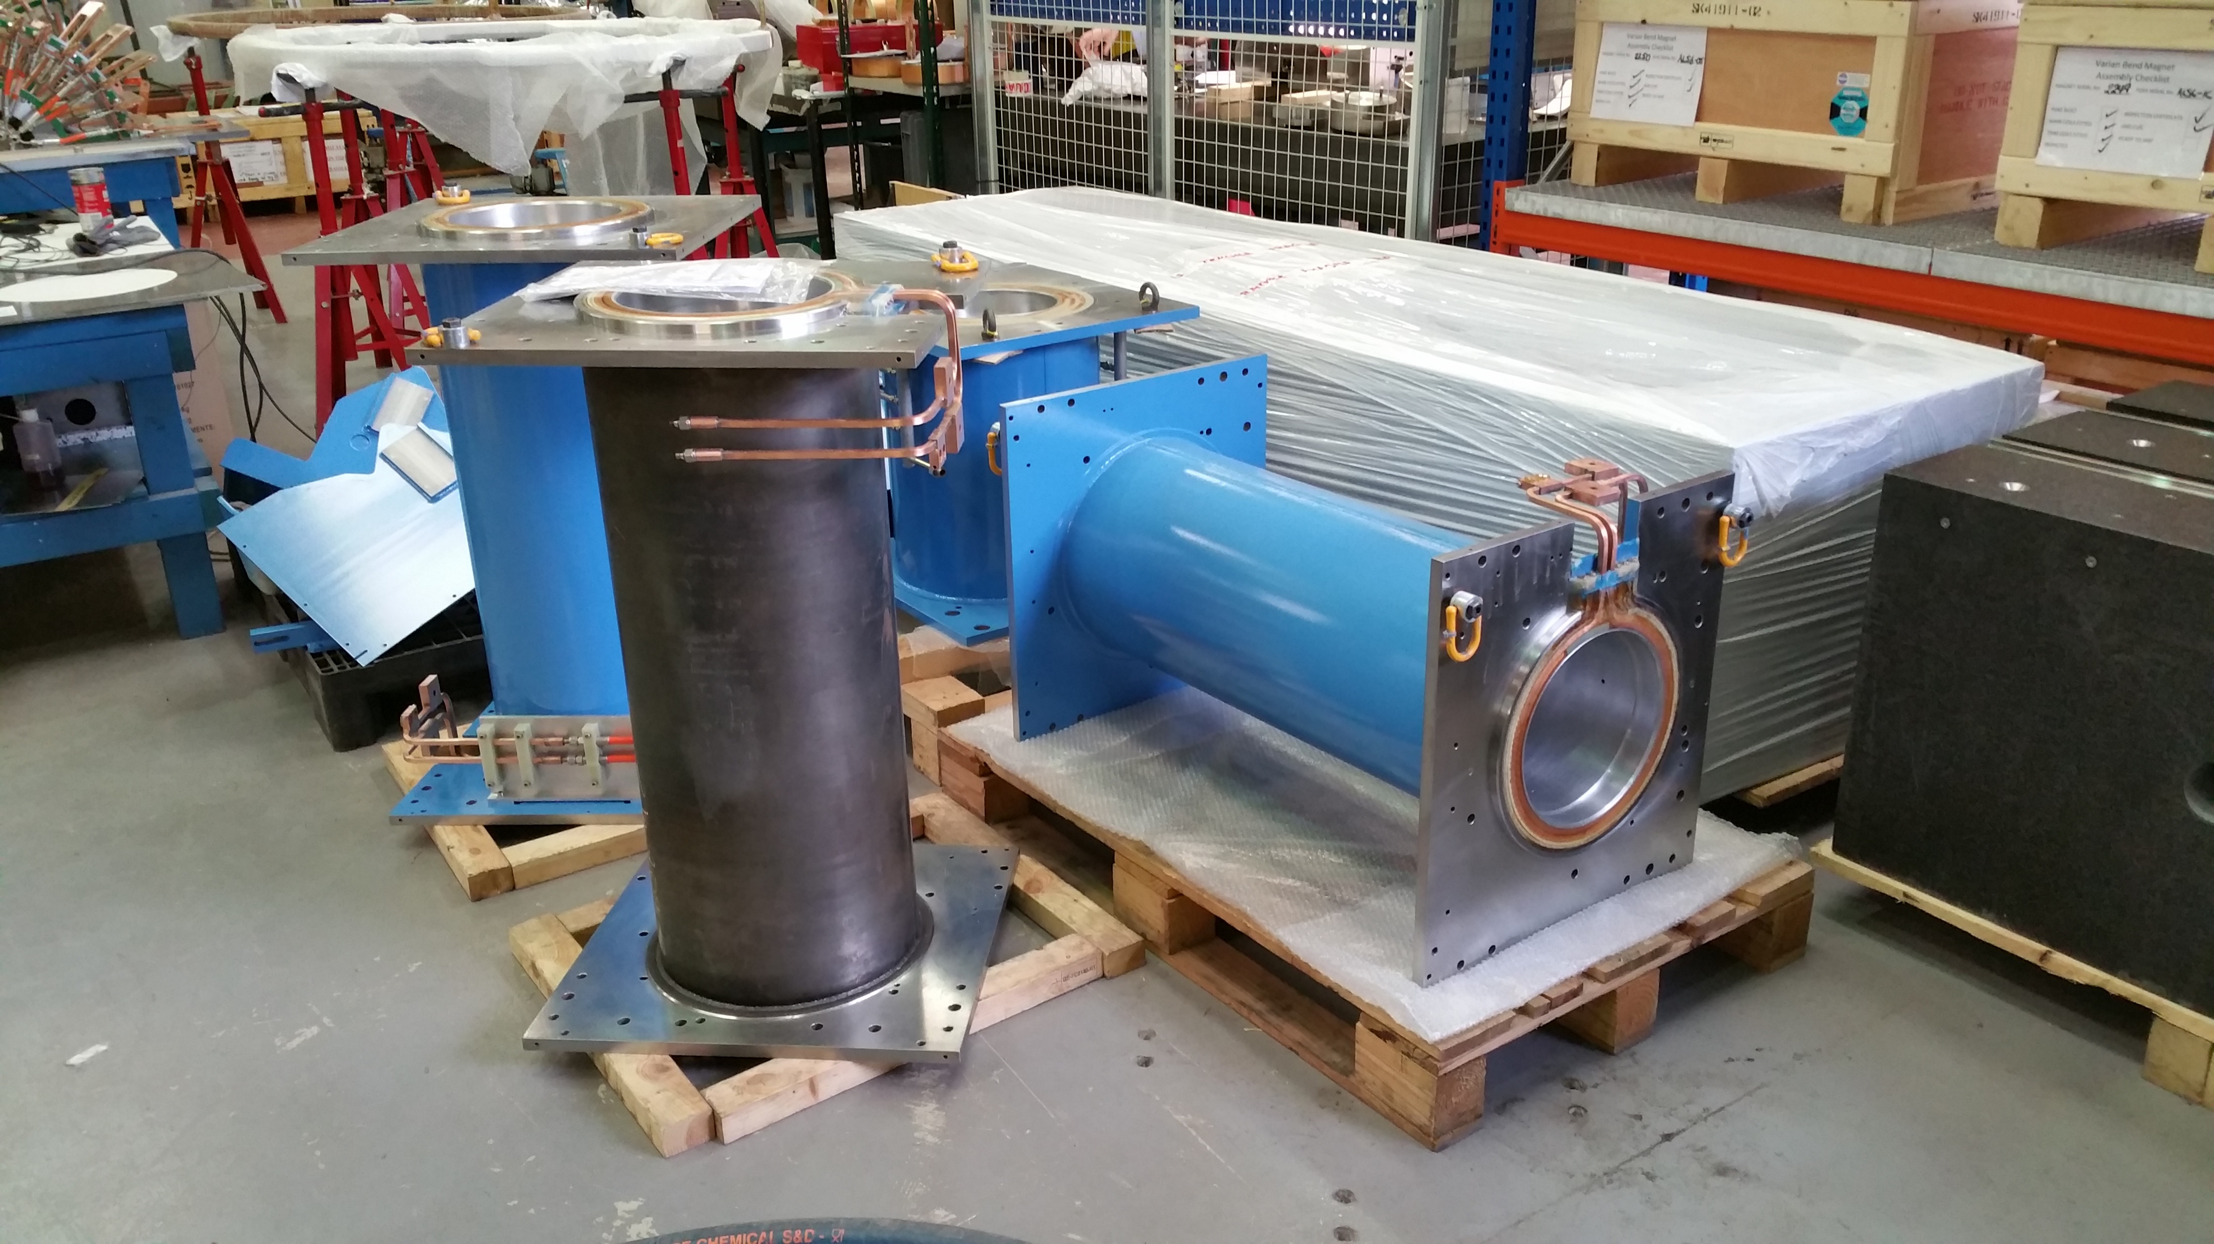
Standard solenoid on measurement bench
Shielding, standard solenoids and expansion solenoid
Toroid assembly

Slide 9
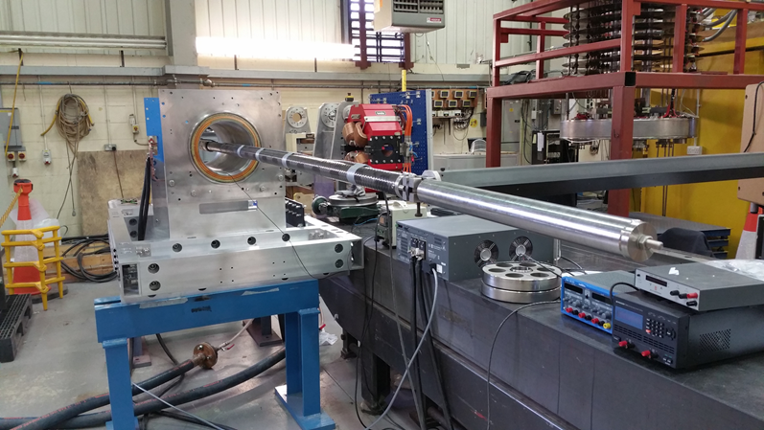
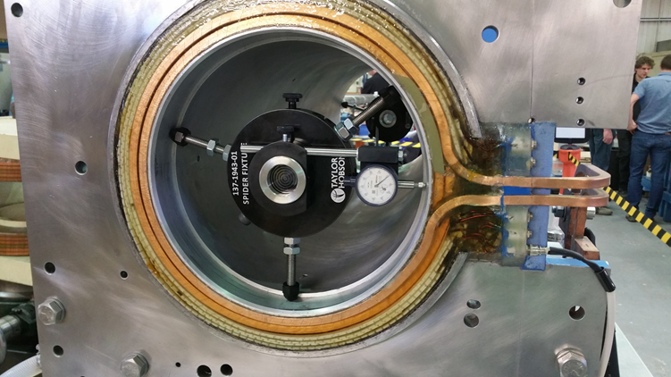
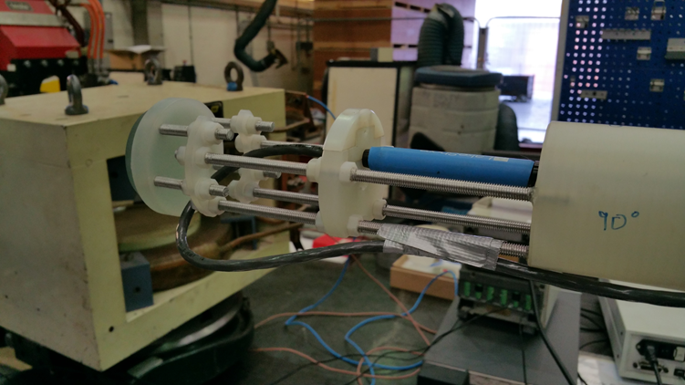
Magnetic measurement the ELENA Electron Cooler
Lakeshore Model 460 Gaussmeter with 3-axis HSE probe (1 mG resolution in range up to 300 G, accuracy of ±0.1%).
Probe holder with mirror for precise alignment. Has 4 possible rotational positions with 3 mounting points (0, 10 and 25 mm).
Counter balanced carbon fibre tube to hold probe holder.
Probe carrier and tube driven and positioned with a CMM arm with ±0.5 mm accuracy.
Precise probe alignment made with an autocollimator and spider fixtures.
Measure each standard solenoid to determine how to place the solenoids during assembly (B_{t}/B‖ ≤ 5x10⁻³).
Check the magnetic model proposed by TESLA Engineering (saddle coils, circular coils, fine-tune coils…).
B_{t}/B‖ ≤ 5x10⁻⁴ in the centre of the drift solenoid (50 mG).
Field map of the electron cooler.

Slide 10
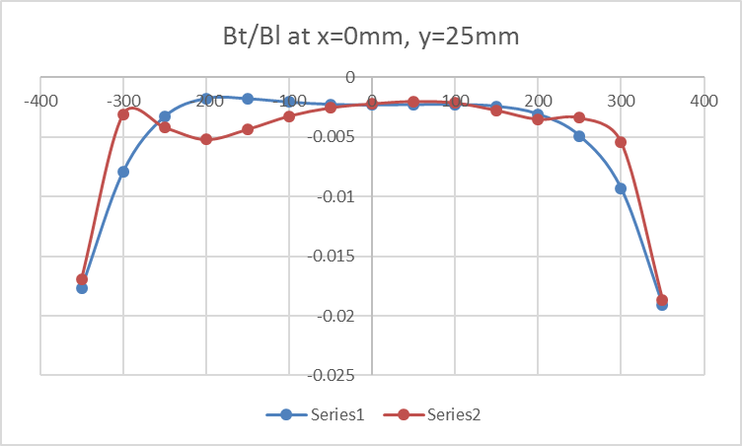
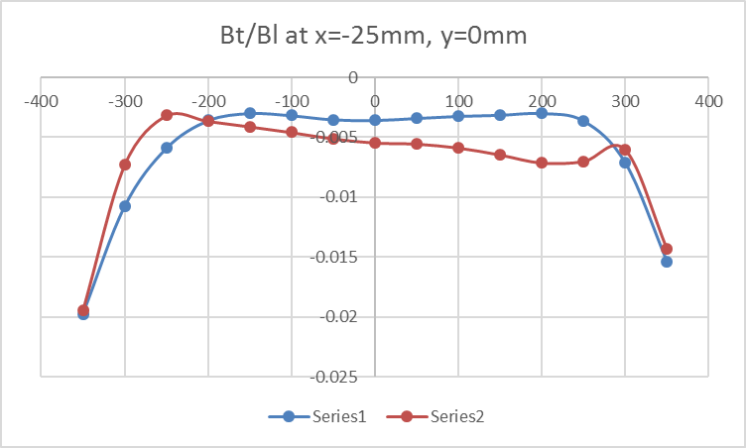
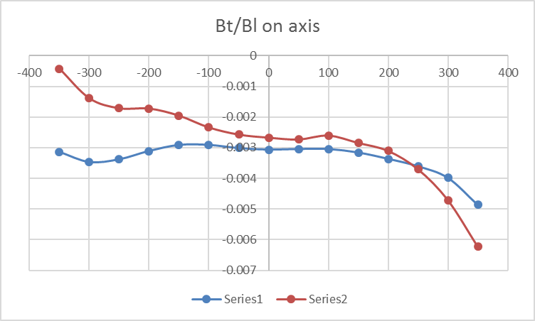
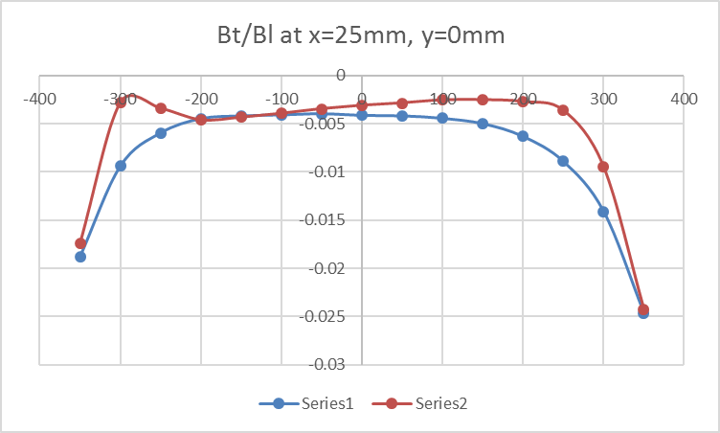
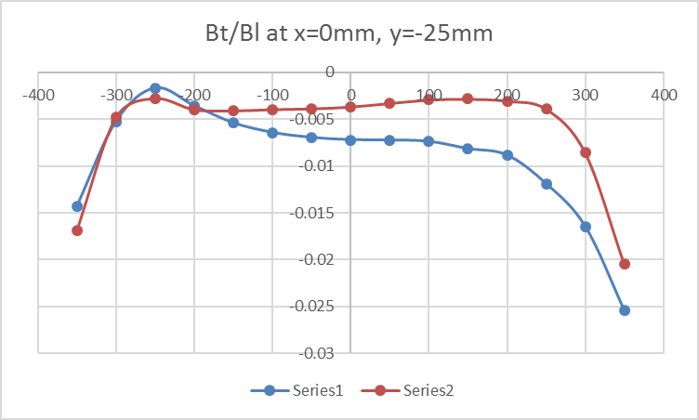
Bt = sqrt(Bx^2 + By^2)
Influence of circular coils on Bt/Bl
For SS#4

Slide 11
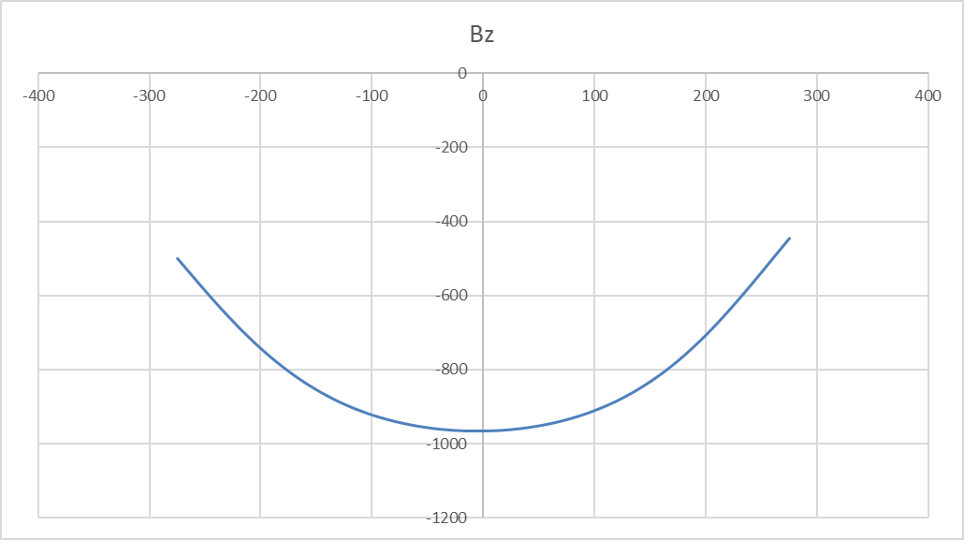
Expansion solenoid

Slide 12
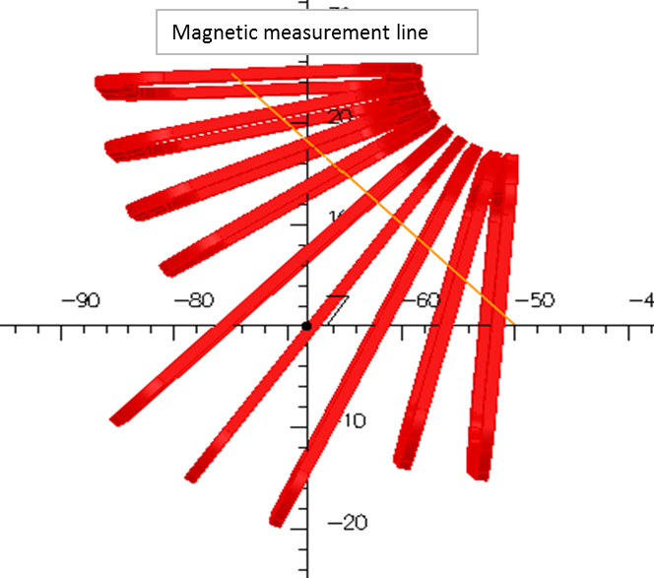
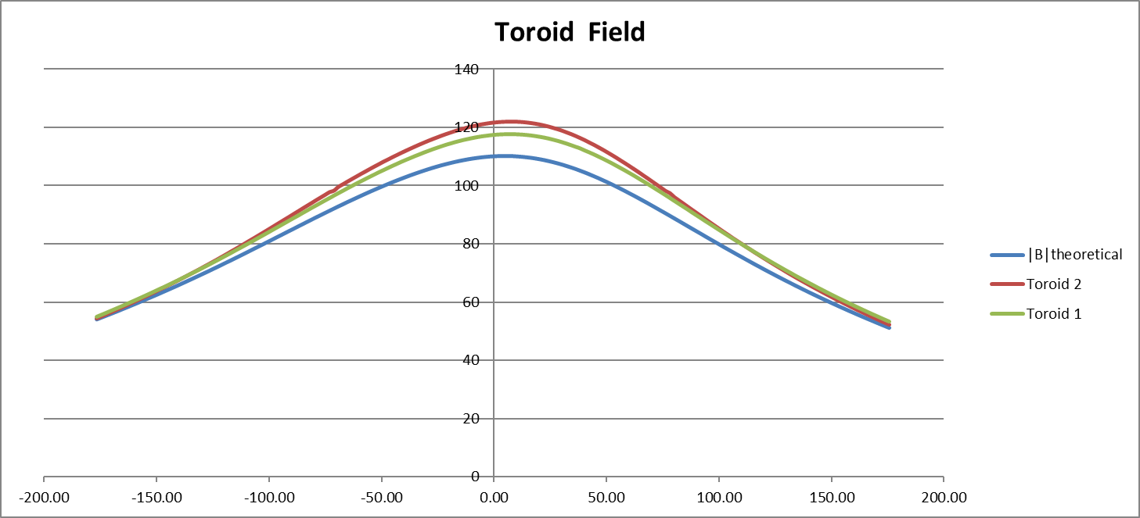
Toroid

Slide 13
Where are we with the magnet measurements?
The green light to go ahead with the magnet construction was only given in June 2015
Three iterations needed before the measurement system was deemed to have the correct performance
All standard solenoids measured with circular coils powered
Selection of “drift solenoid”
Expansion solenoid measured
Has to be re-measured as the shielding end-plate was not in place
Toroids partially measured
Compact correctors measured at CERN
High B2 component due to parallelism error – will be corrected
Mounting of the full assembly on-going

Slide 14

Vacuum Elements
e-Gun
e-Collector
Gun NEG chamber
Vacuum system
Gun & Collector
Vertical chambers
Drift chamber
PUs
Pumping chambers
Toroid chambers

Slide 15
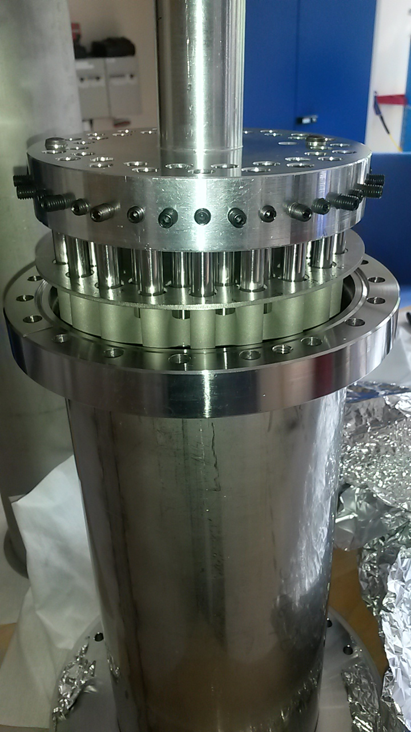
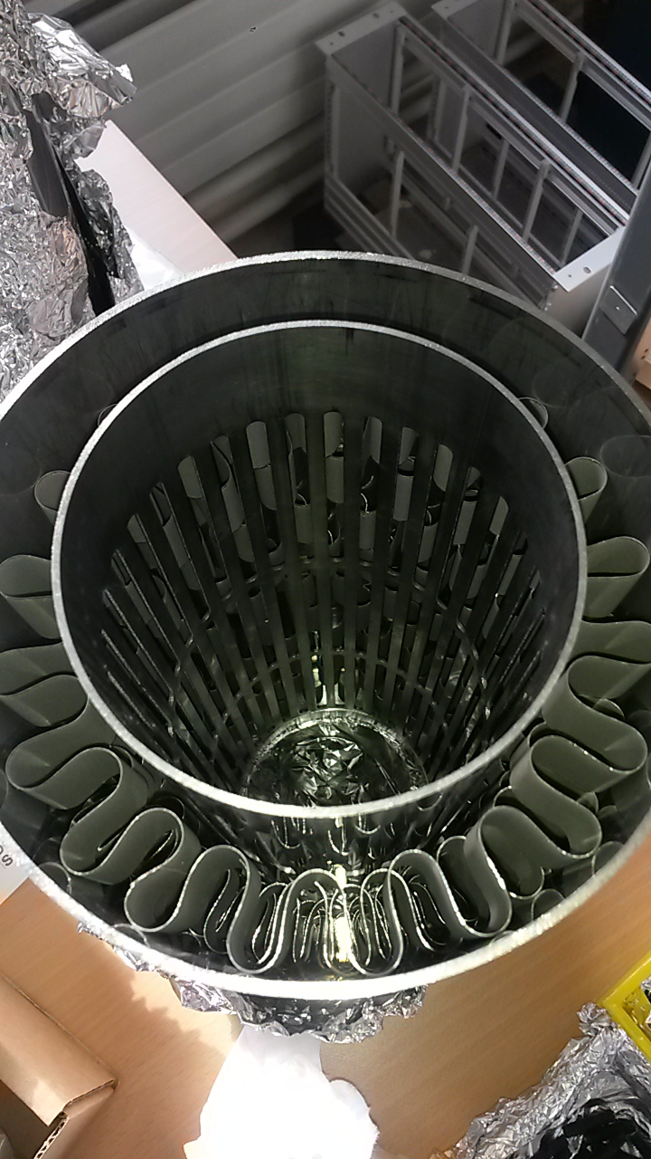
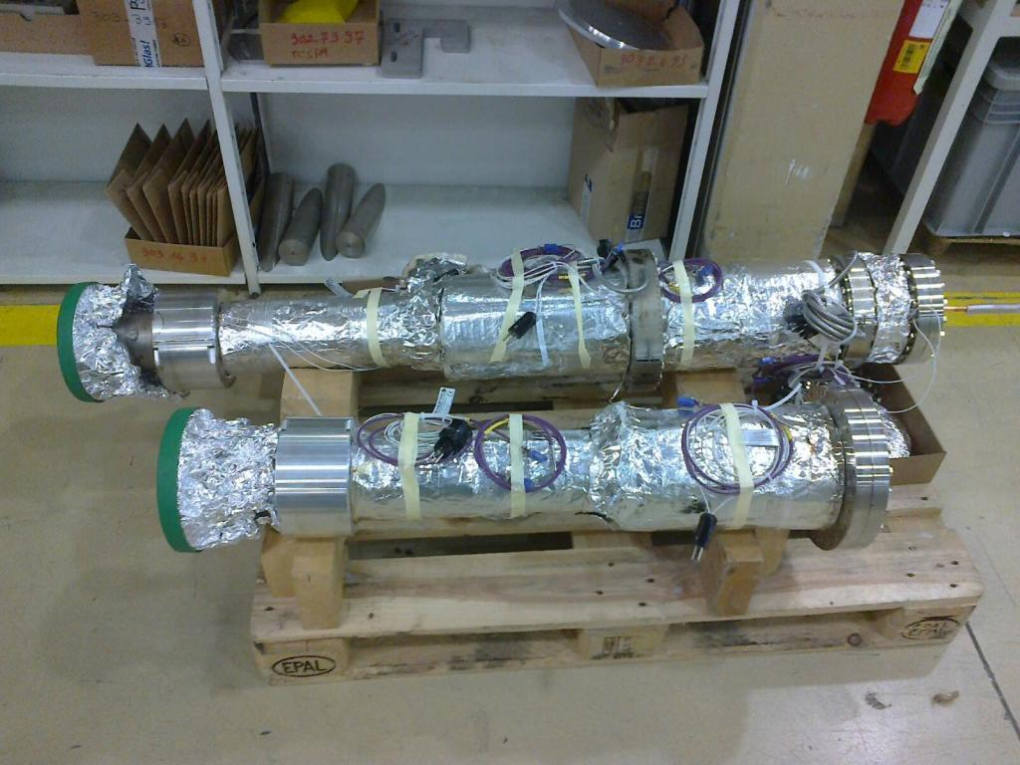
Vertical chambers
Gun NEG chamber

Slide 16
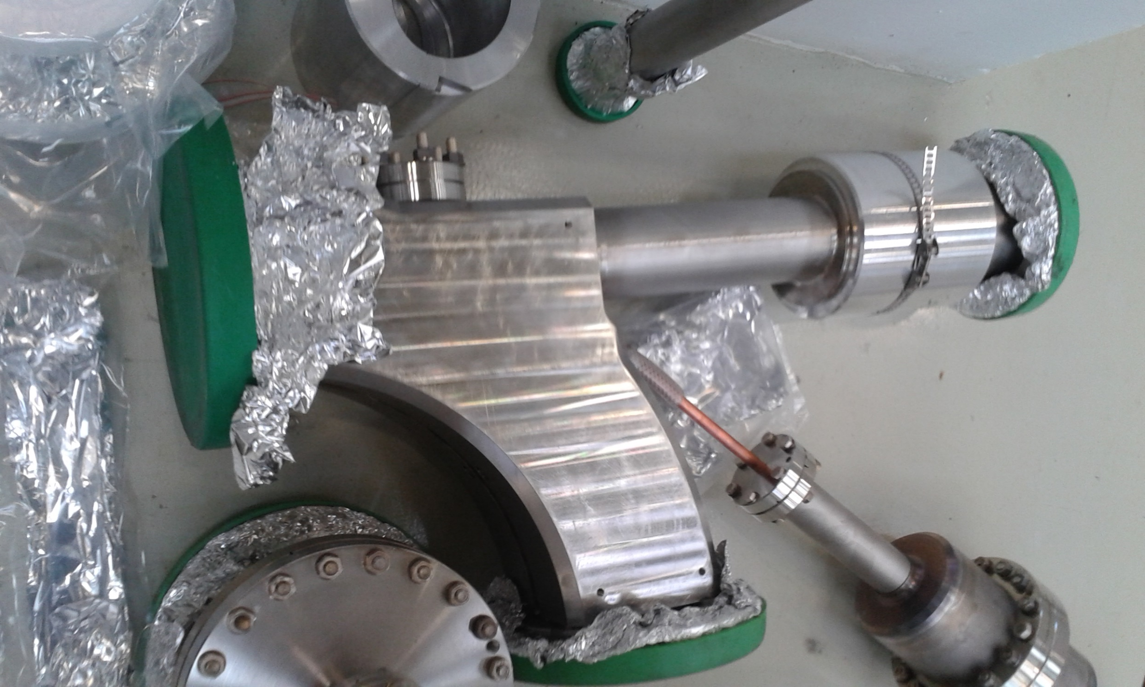
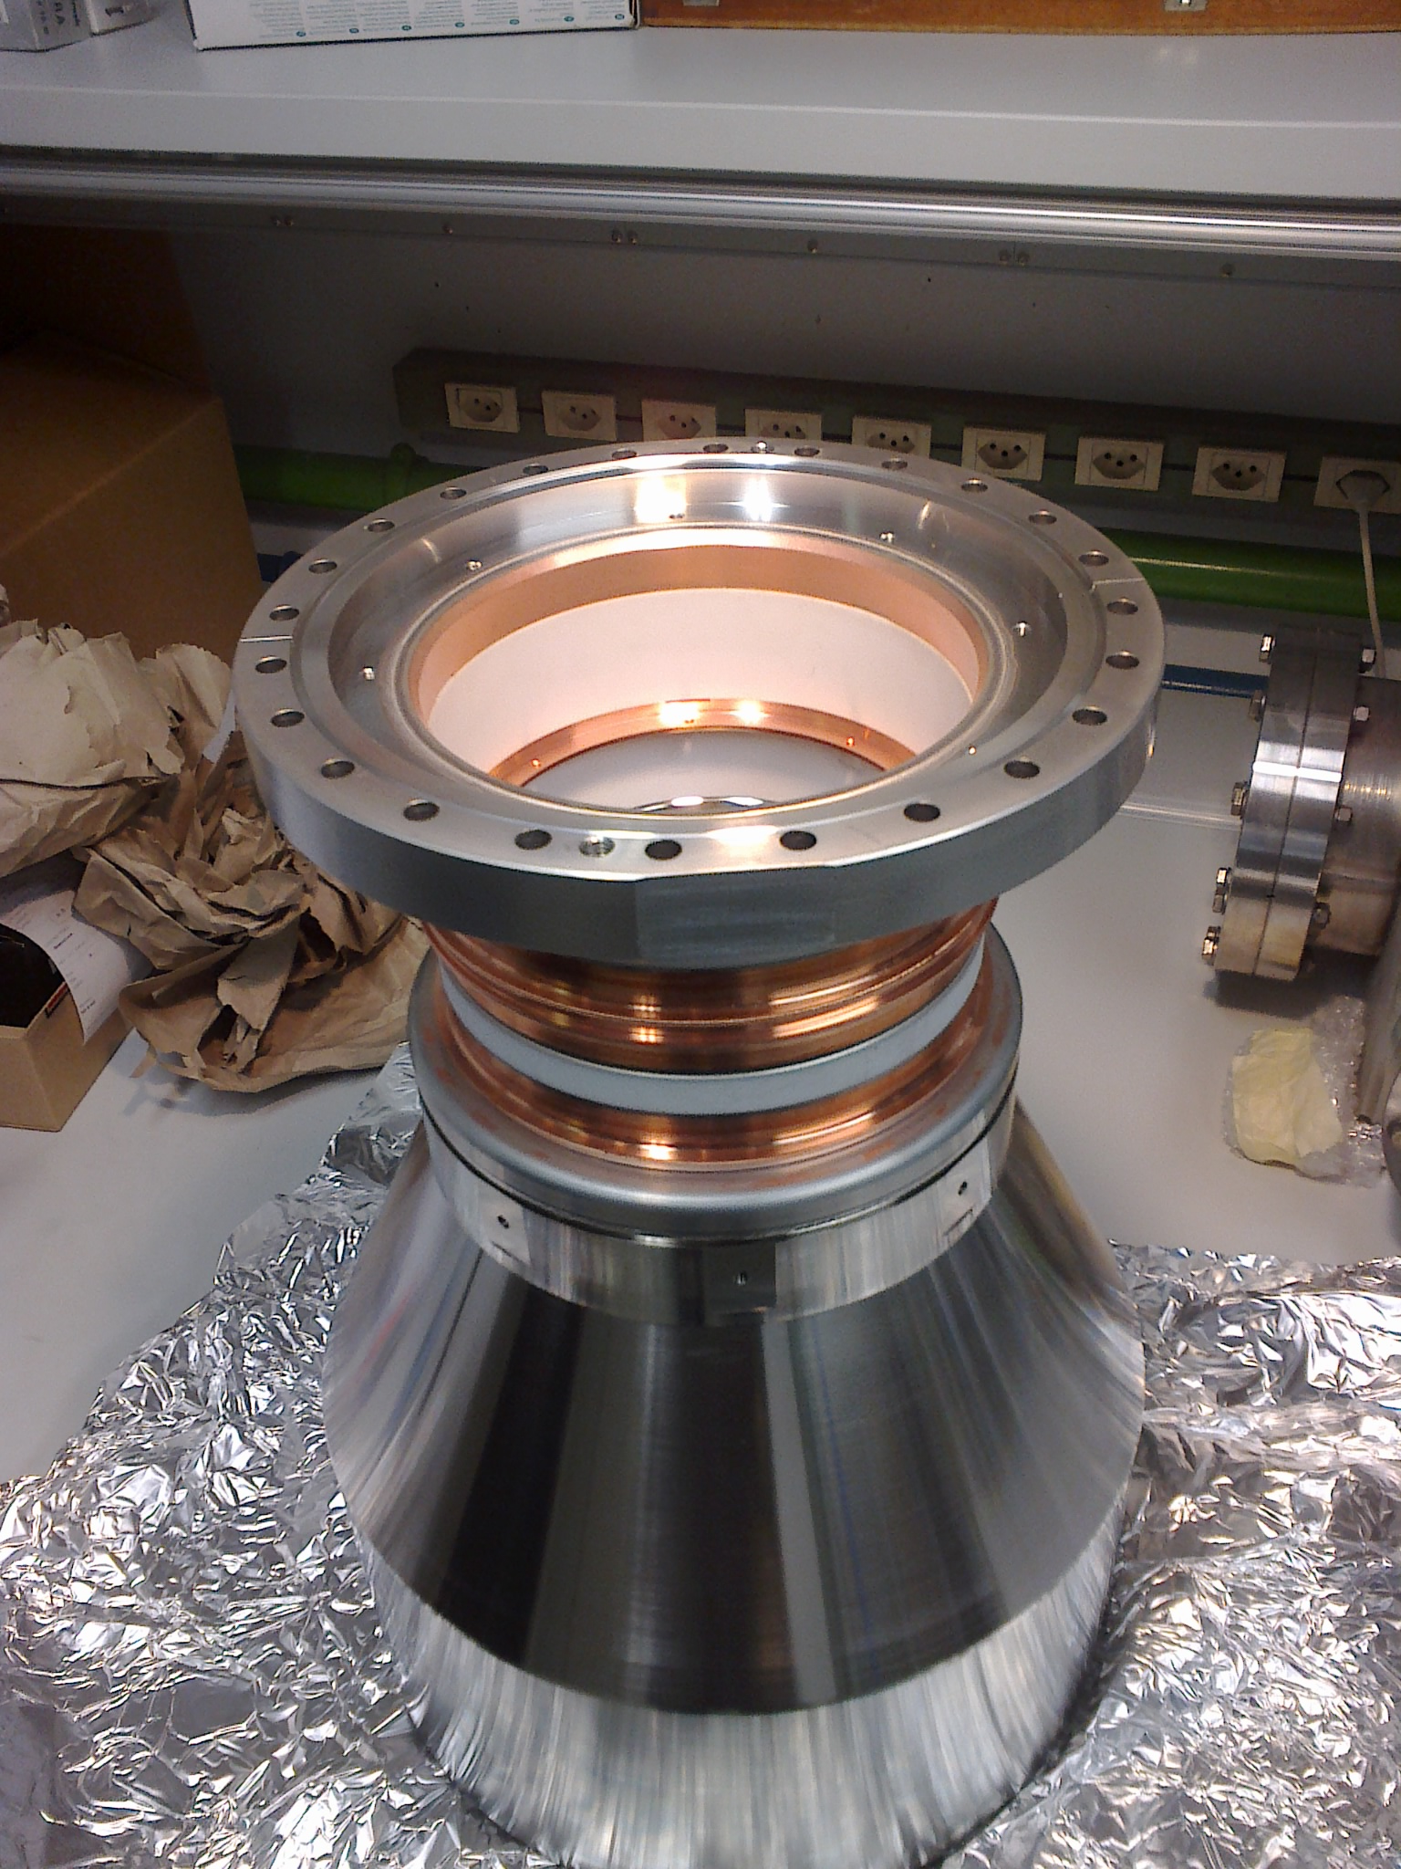
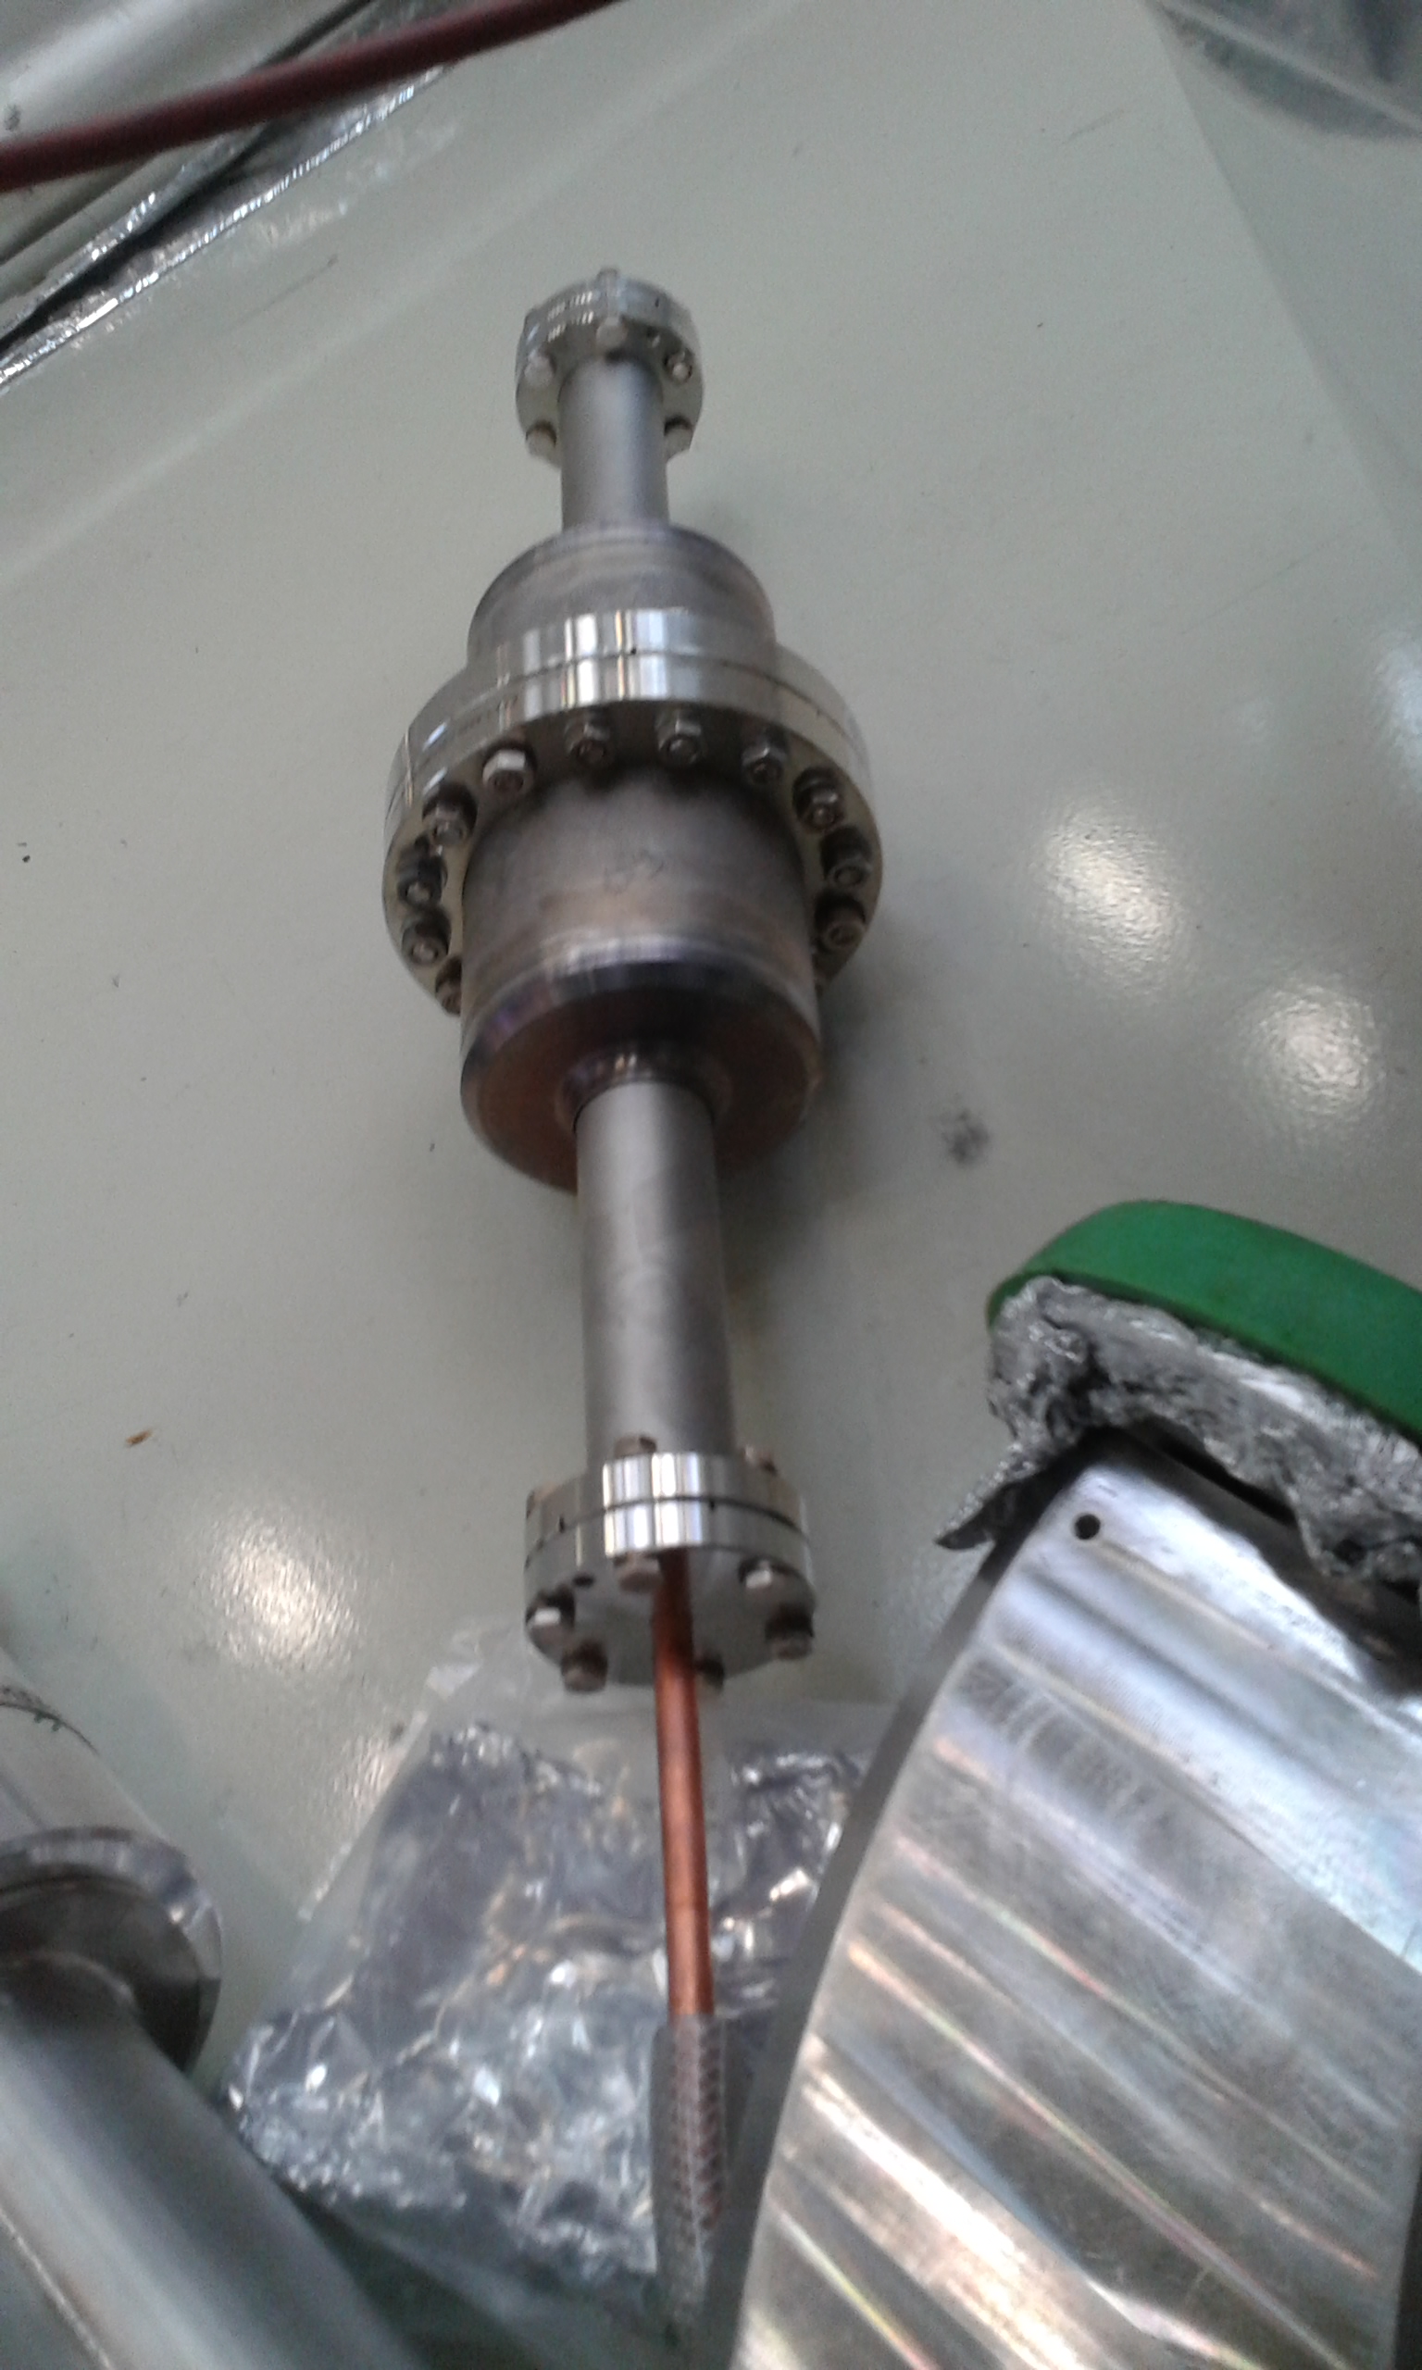
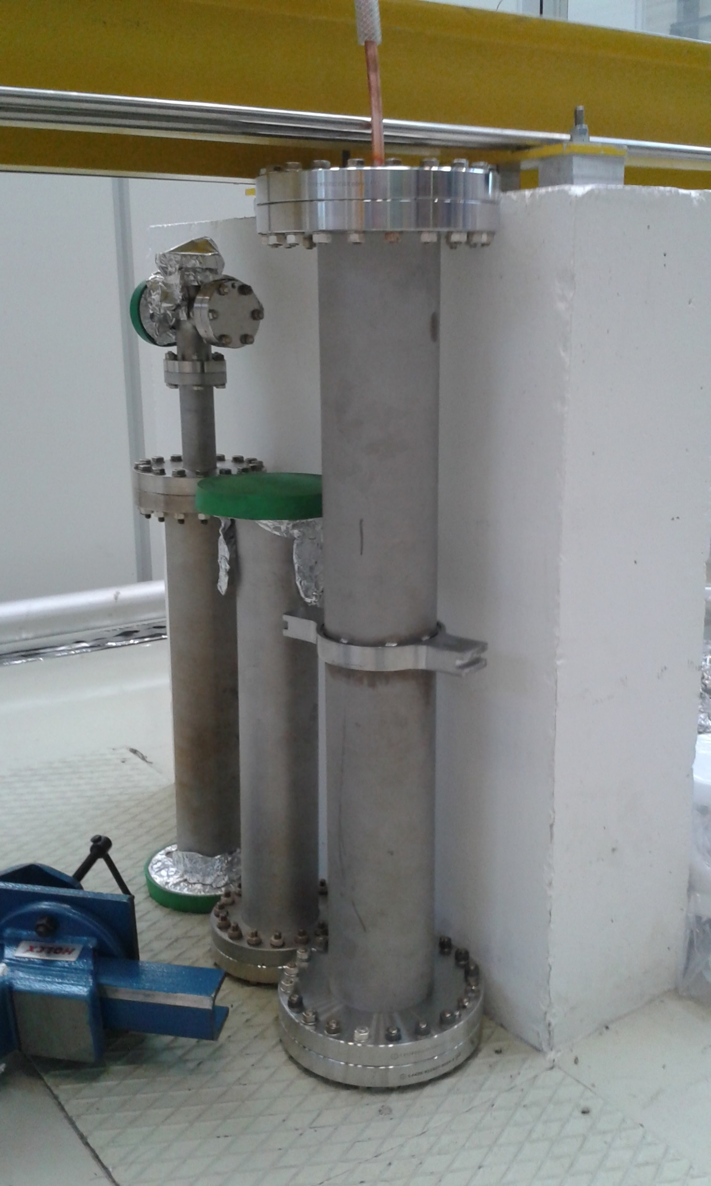
Toroid chamber
Pumping chambers
Collector
Drift chamber

Slide 17
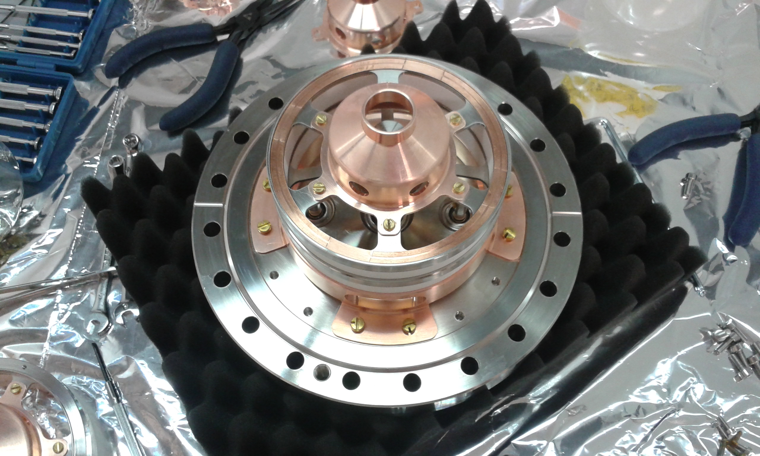
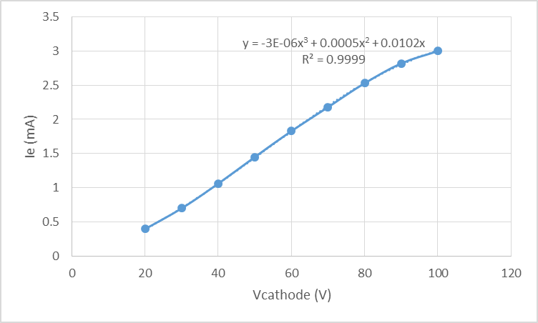
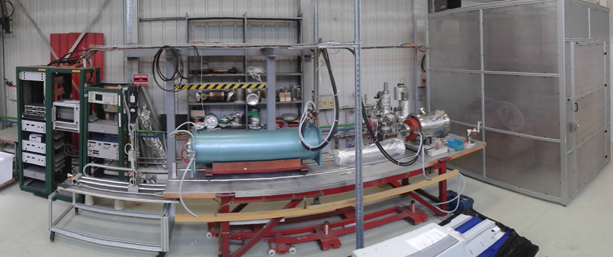
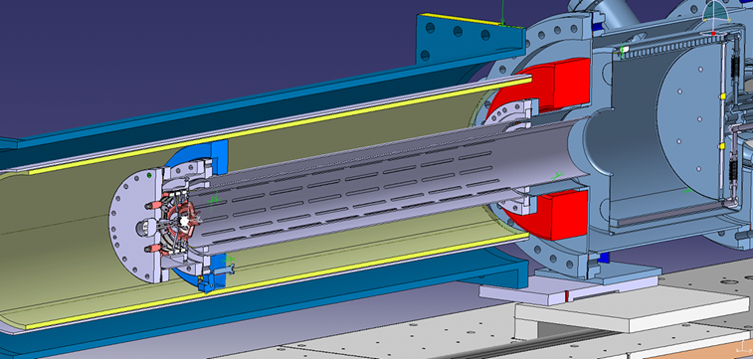
The electron gun

Slide 18


element | NEG | VSC
Electron gun | n/a |  | Undergoing test on the ecool test stand
Collector | n/a |  | Ready
Gun NEG chamber | strips |  | Final acceptance test in March
Vertical chambers | strips |  | Final acceptance test in March
Toroid chambers |  |  | Electrodes to be mounted after NEG coating
+ electrodes |  |  | Final acceptance test in March
Drift chambers |  |  | Final acceptance test in March
Pumping chambers |  |  | Final acceptance test in March
PU |  |  | Mounting and electrical tests still to be done

Slide 19
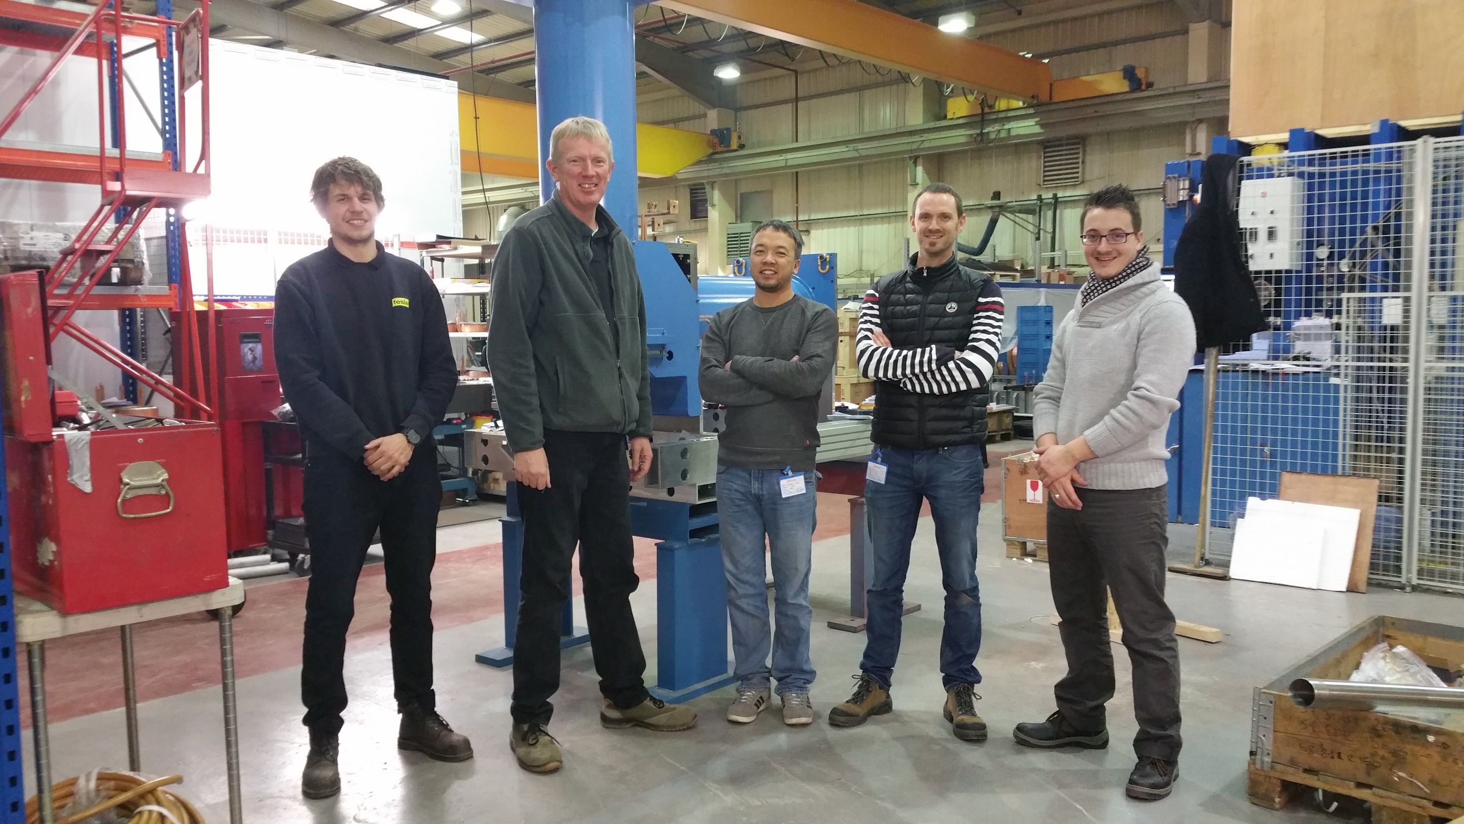
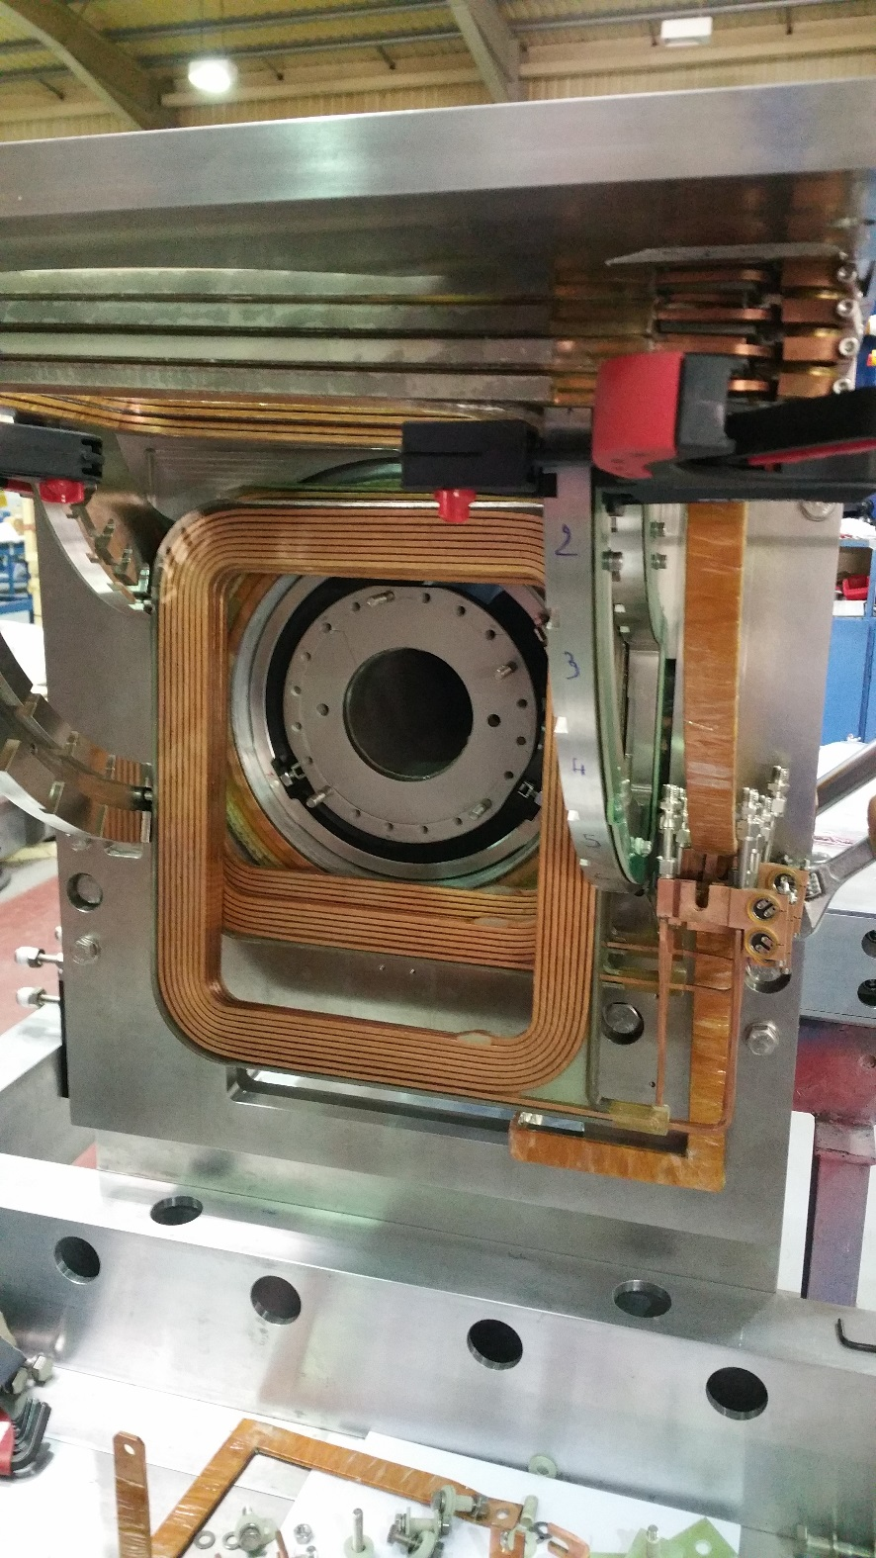
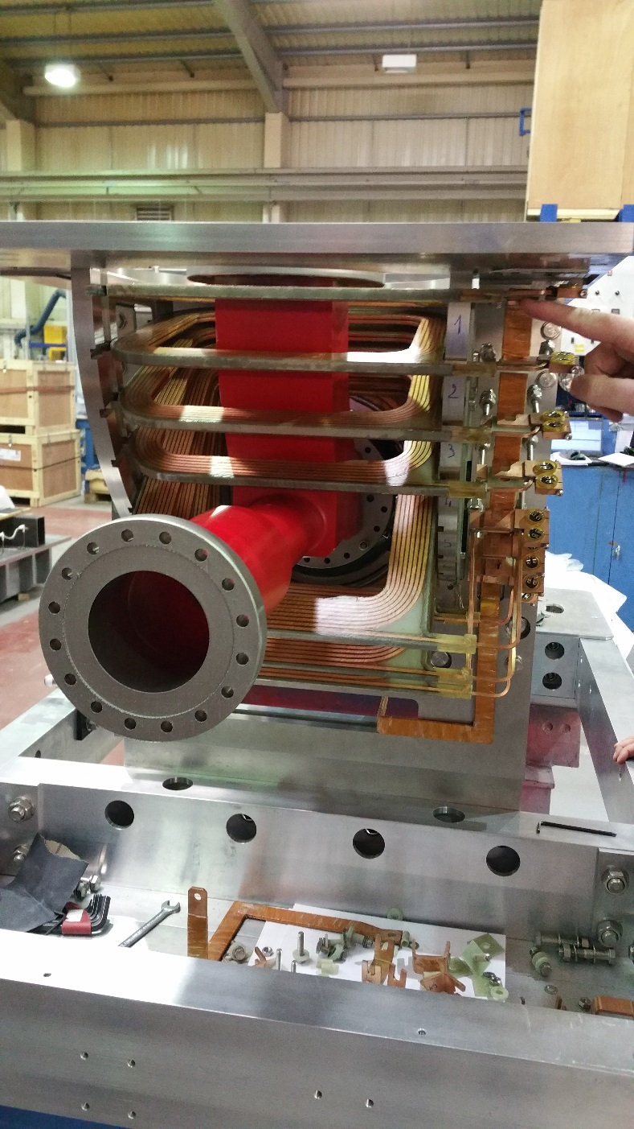
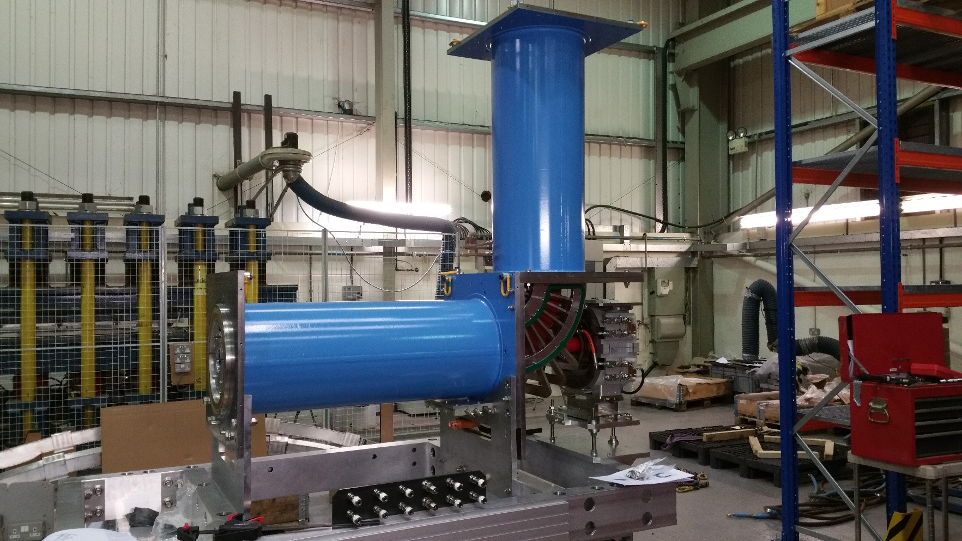
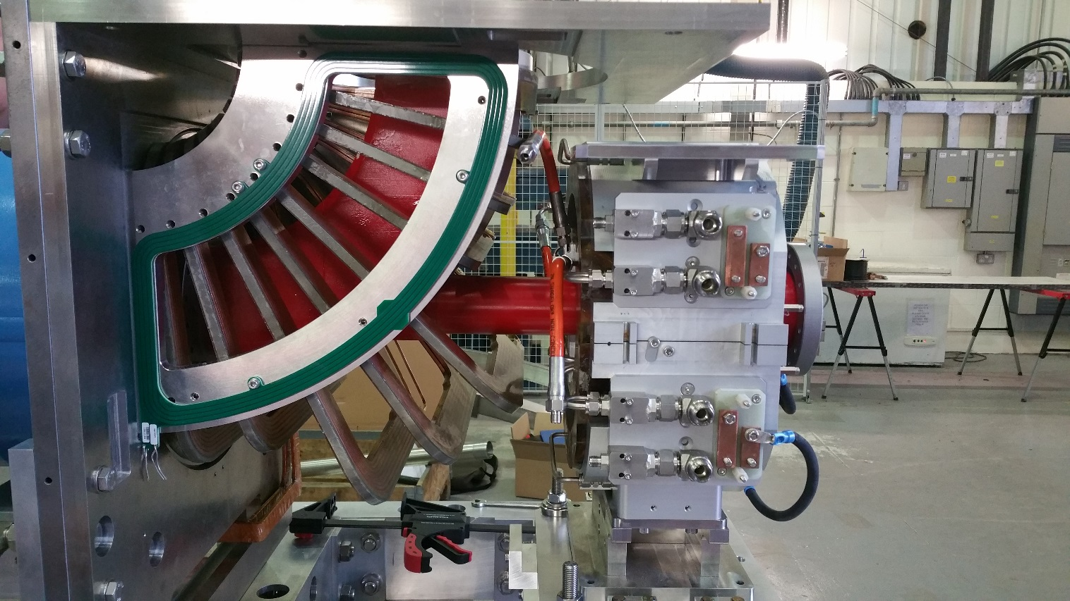
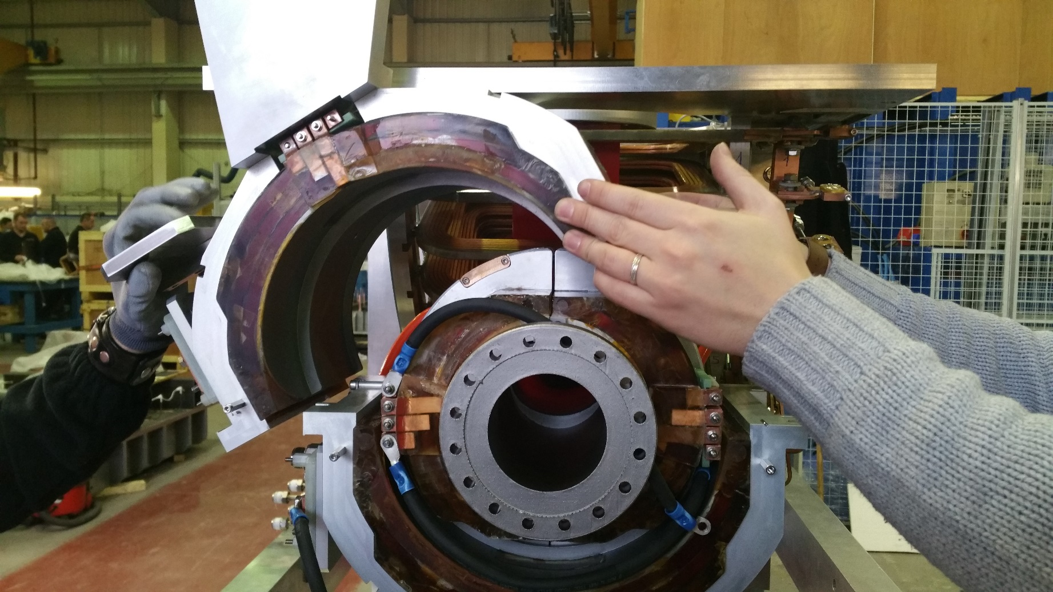
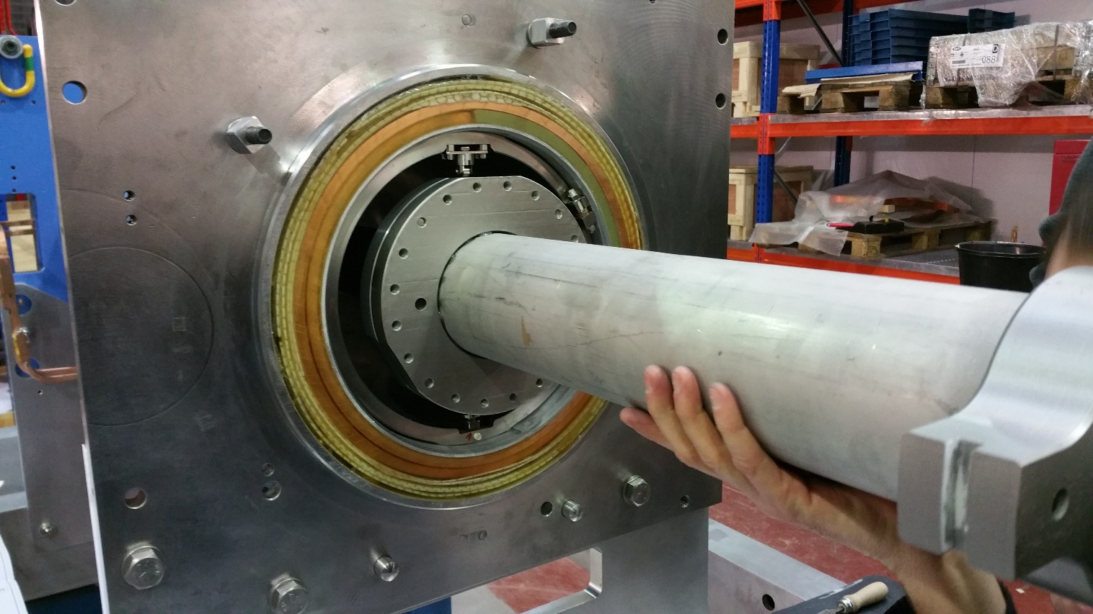

Slide 20
Tentative schedule
IF ALL GOES WELL
finish all magnetic measurements – end February
dismount and ship magnet system and frame to CERN – end March
all vacuum activities can only start after week 10
NEG coat toroid chambers
mount electrodes in toroid chambers
Pus mounted and tested
final vacuum acceptance tests (complete assembly or individual elements?)
At the earliest we will be in a situation to start mounting the cooler in May
2 weeks for the assembly
move into the ring and connect
bake-out
connections (wic, water & electrical)
tests
1 month

Slide 21
QUESTIONS/COMMENTS?

Slide 22
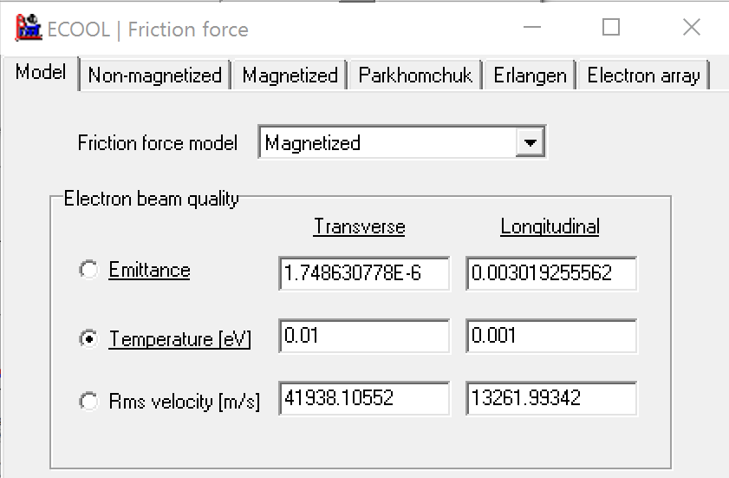
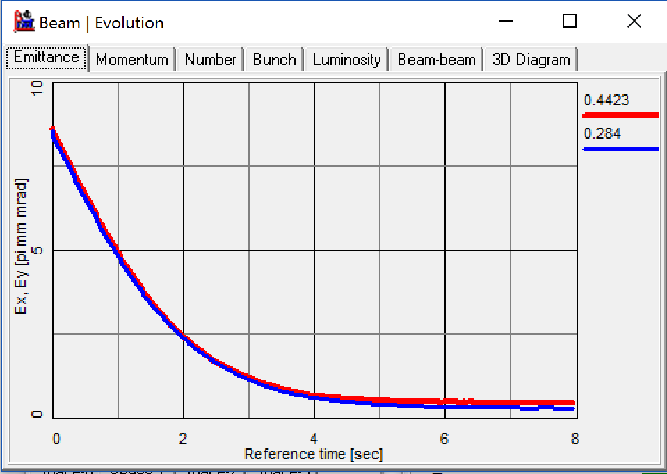
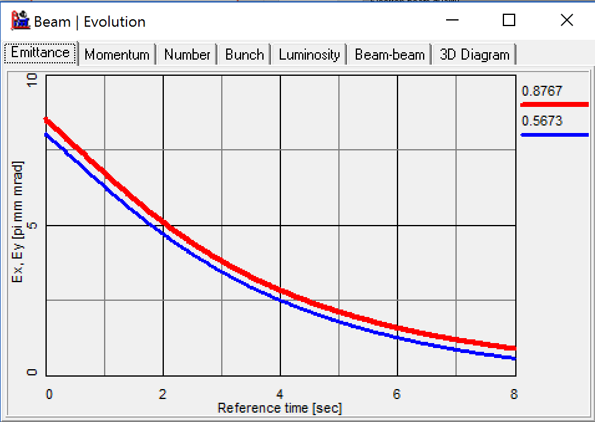
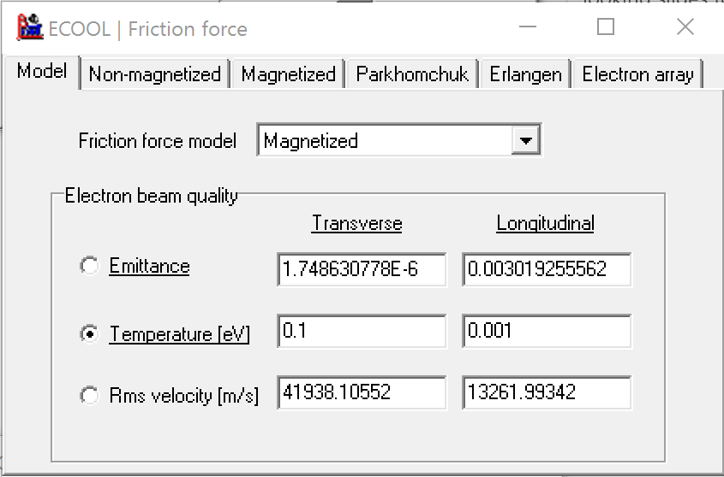
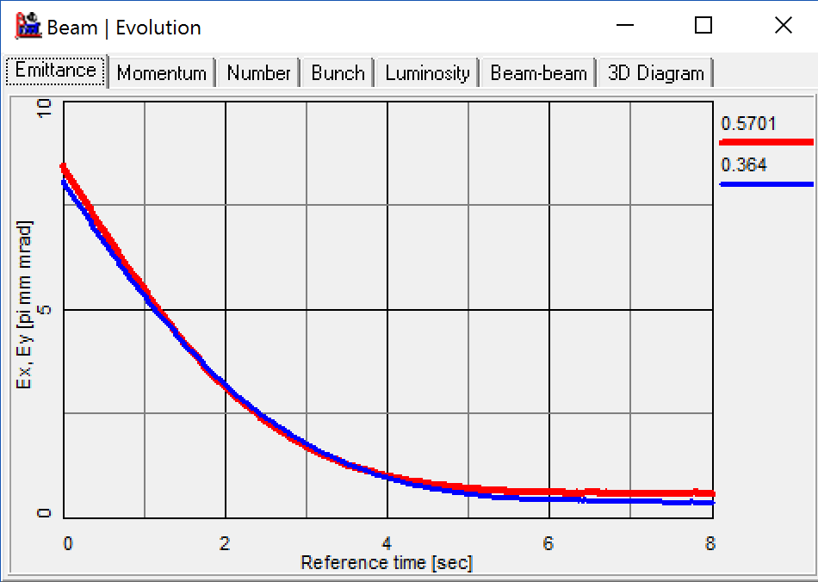
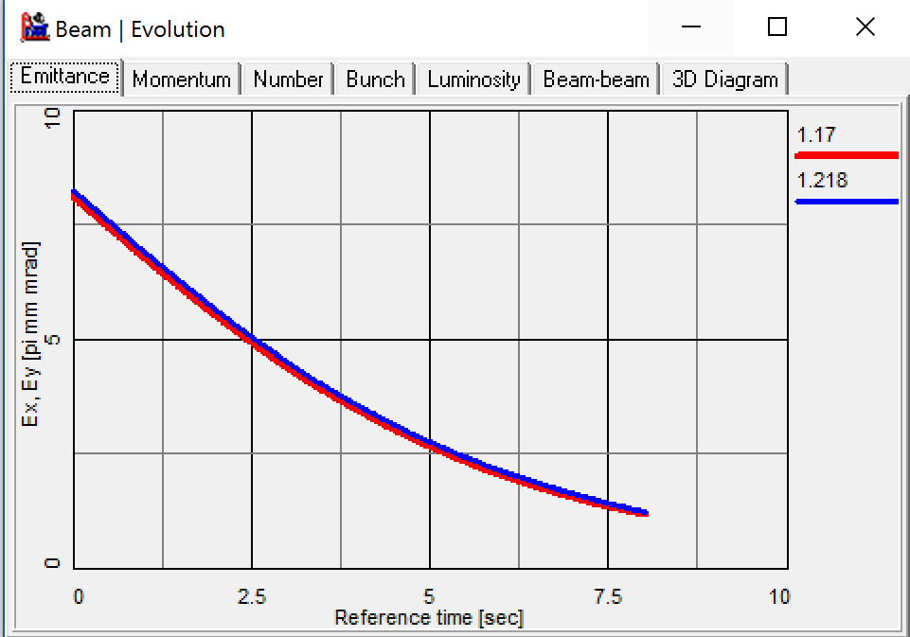
Influence of transverse temperature on the cooling (BETACOOL)

