Slide 1
SHIELD for 10gr exposure with cooling system
N. D’Ambrosio – V. Tioukov

Slide 2
SHIELD for 10 gr exposure
Area in Hall B assigned by LNGS
Structure defined by Valery and Nicola and technical project finalised by D. Orlandi (LNGS engineer )
Optimize the use of polyethylene blocks ( from Darkside), use of the OPERA lead sheets and minimize the costs for the structure
Steel structure defined, tomorrow meeting with Orlandi to define the final optimization and schedule for construction
Network connection with temperature log system accessible by network
(System ready)
Optimize the thermal insulation path of the connection tubes
(refrigeration liquid and Nitrogen)

Slide 3
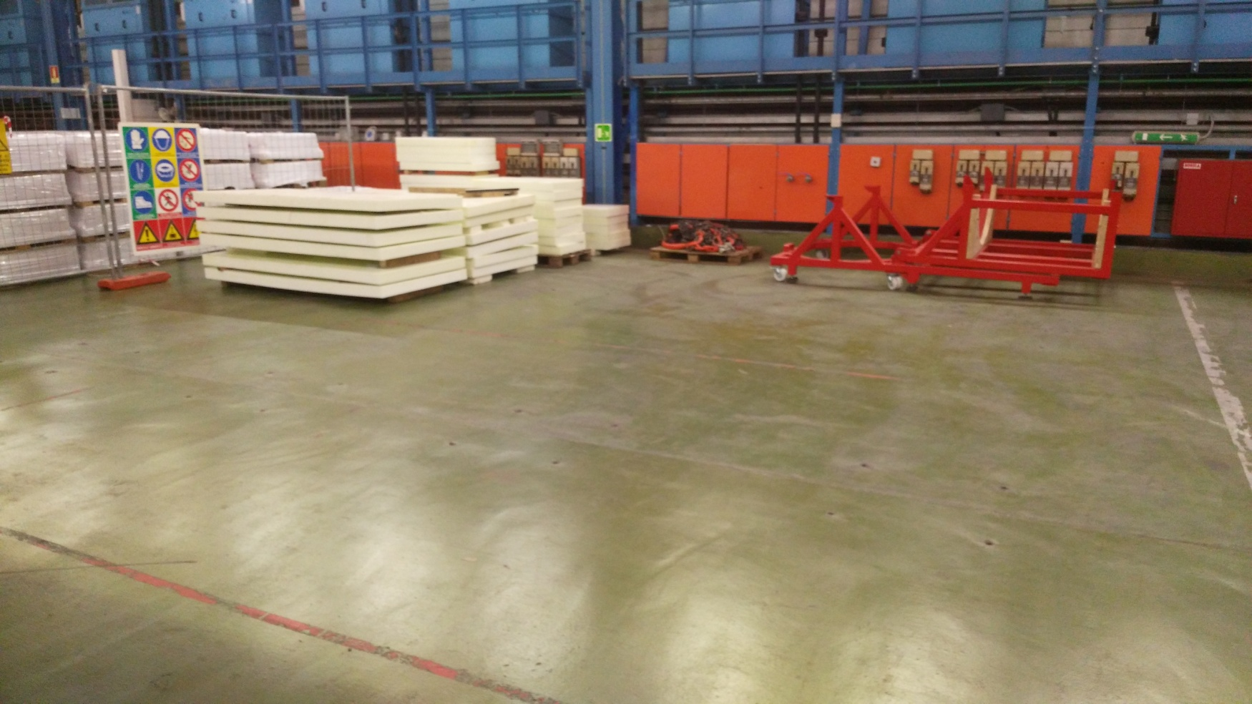
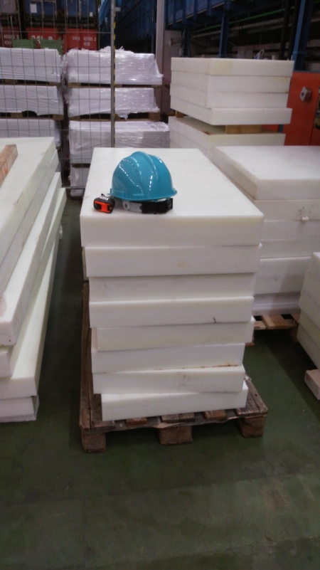
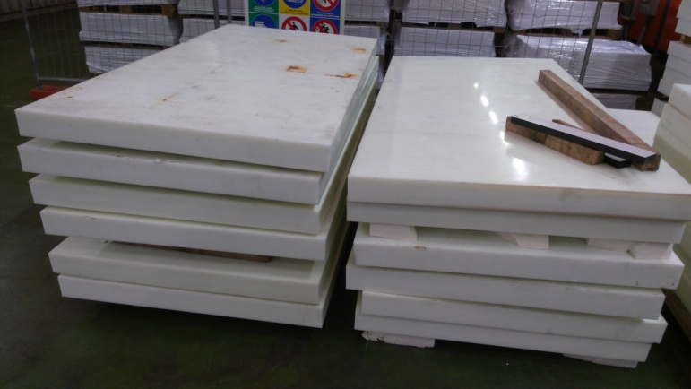
HALL B
Polyetilene blocks
In this area assigned 5 x 5 m² to NEWS
LUNA
XENON
Ex BAM Tunnel
NEWS LAB

Slide 4
SHIELD
SCHEMATIC
view
Connection tubes
and temperature sensors cables
(cooling liquid and nitrogen
circulation)
About 6 connections
…around 4 cm²
Nitrogen box
(avoid umidity and Radon)
About 35x35x 40 cm³
About 135 cm
Steel structure
with lead sheets
80 cm
40 cm
Cooling system
244 cm

Slide 5
Vista da sopra, sezione C-C
La struttura di acciaio
A
A
Interno 40x40x80 cm³

Slide 6
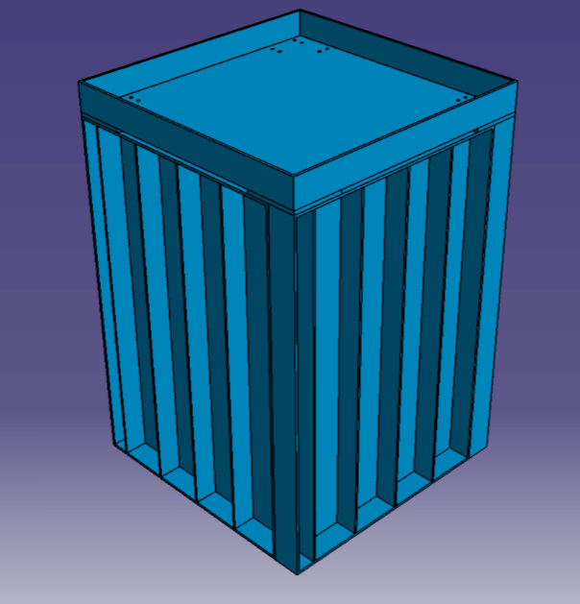
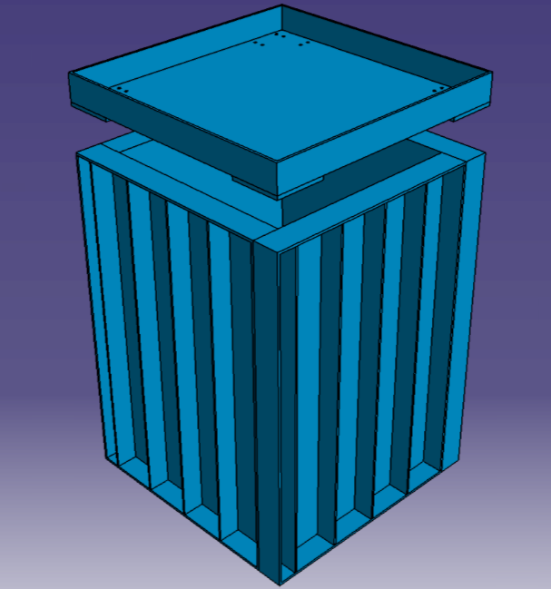
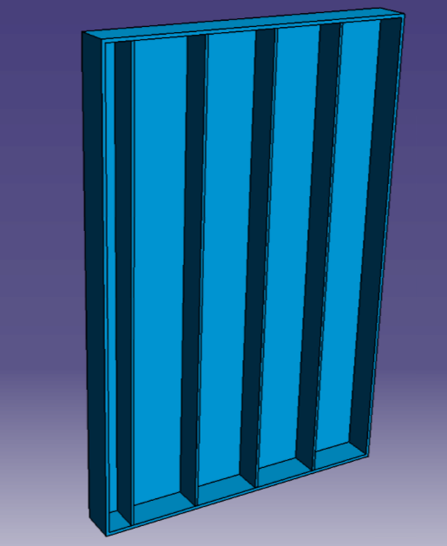
SHIELD : Steel structure
OPERA lead sheets
(..also for TOP and Bottom)
Side view
20 cm
2 lead sheets
Here…
Lead or steel
10cm

Slide 7
Apprximate material budget
Polyethylene
Lead
Total polyethylene weight – about 3000-4000 kg
4 walls 10x92x140 cm - about 1400 kg/wall
bottom 10x80x80 cm
top 10x80x80 cm - about 700 kg of lead, about 1000 – 1100 kg with polyethylene
Totale lead weight: 7000 kg

