Slide 1

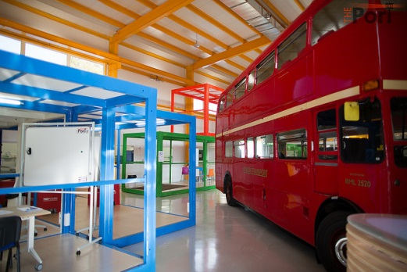
Science Hackathon 2017
Powered by THE Port
Write a research paper, white paper or grant application in 60 hours. Think you can do it?
Takes place at IdeaSquare Feb 10, 11 and 12. Register online at www.theport.ch

