Slide 2
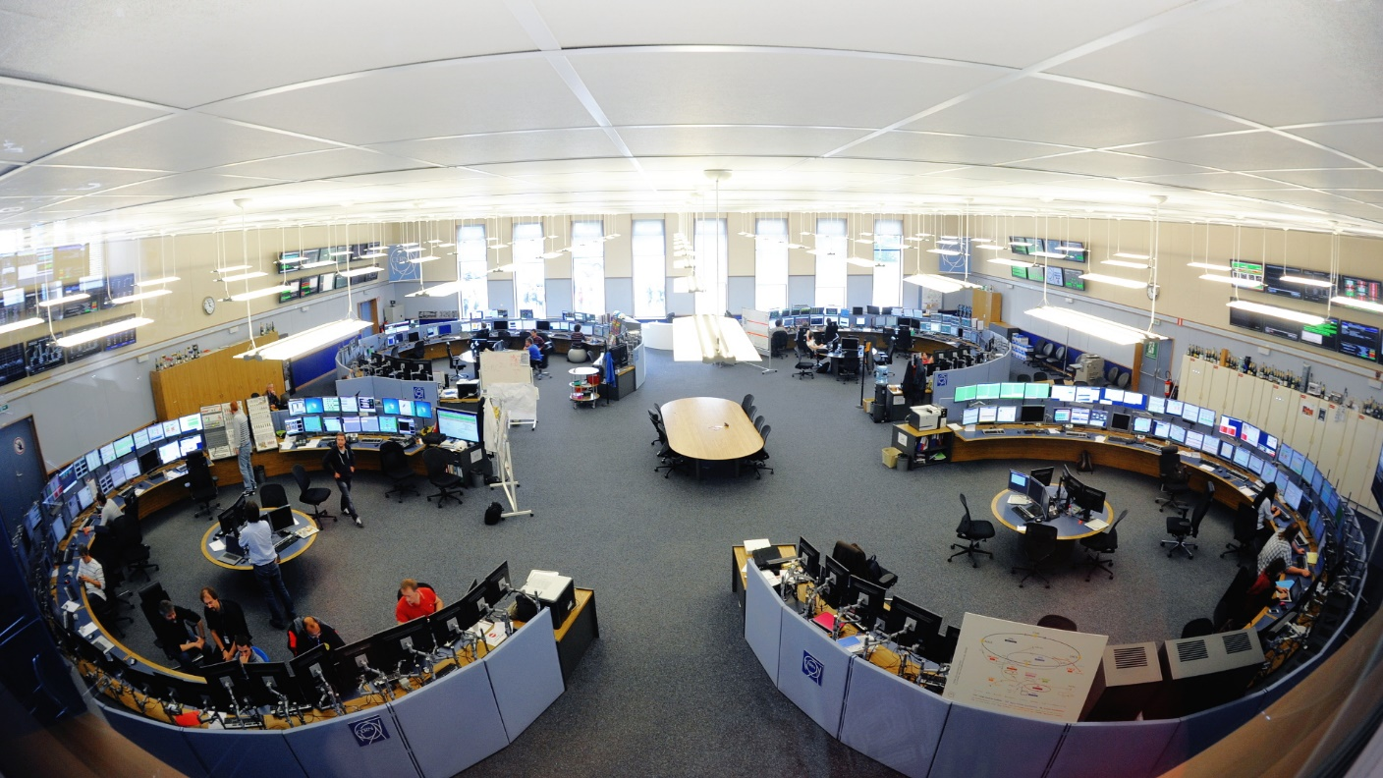
UPGRADES TO THE INFRASTRUCTURE AND MANAGEMENT OF THE OPERATOR WORKSTATIONS AND SERVERS FOR RUN 2 OF THE CERN ACCELERATOR COMPLEX
A. Bland, S.T. Page
CERN
Geneva
Switzerland
THHD3O08
Notes:
Thanks to Luigi Gallerani for the photos

Slide 3
Introduction
Operations
Powering
Workstations
Servers
Network
Cooling
&
Ventilation
Upgrades performed by 3 CERN Departments during Long Shutdown 1 which started in February 2013 to improve the accelerator control system for LHC Run 2 starting in April 2015.
The Linux workstations are used by Operations teams in the CERN Control Centre and other smaller control rooms to run Oracle Java, Siemens WinCC Open Architecture and National Instruments LabVIEW graphical programs.
The Linux servers run the corresponding back end functionality.
Access to accelerator hardware is provided over the network via a third layer of real-time Linux diskless systems and PLCs.
Management
Notes:
The workstations and servers typically run Scientific Linux CERN 6, based on Red Hat Enterprise Linux 6.
Java is used for Beam Control and Technical Infrastructure monitoring.
WinCC OA (PVSS) is used for Industrial Controls, including Powering and Cooling & Ventilation
LabVIEW is used for tests and measurements
The Front Ends and PLCs are not discussed in this presentation

Slide 4
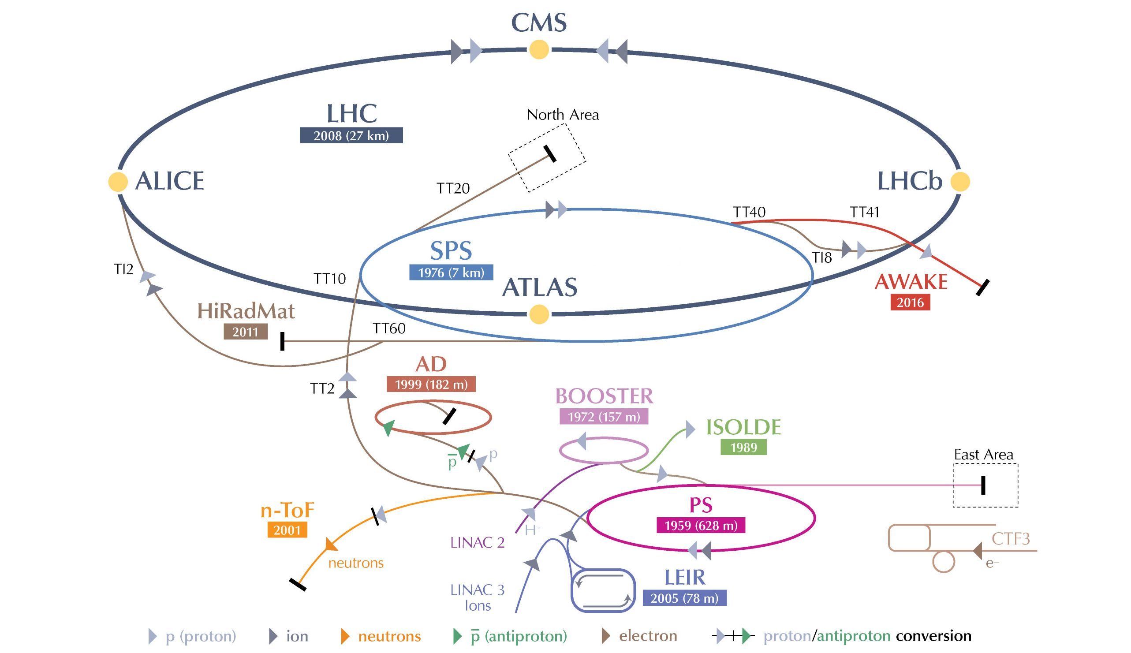
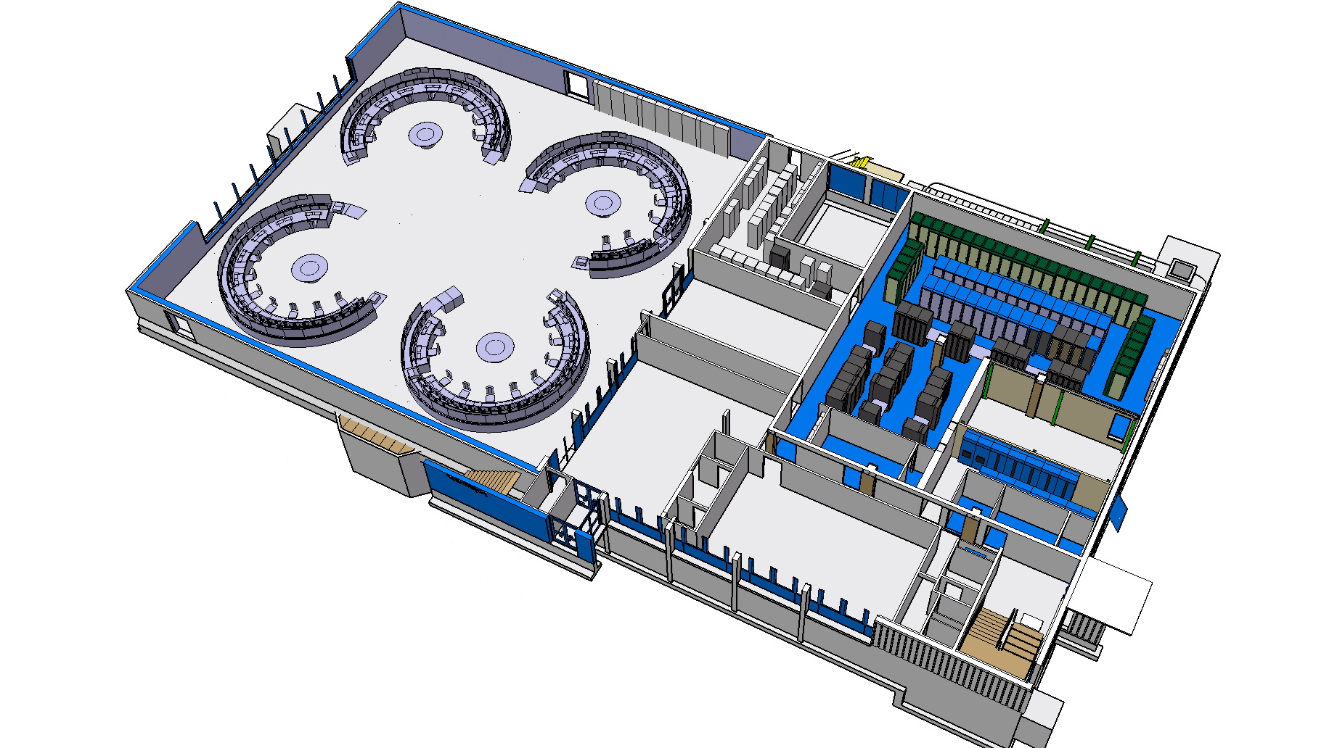
CERN’s
Accelerator
Complex
CERN Control Centre
(CCC)
Notes:
Although 80 of the Linux workstations are concentrated in the CCC, the other 320 are distributed around all the accelerators (except for AWAKE which is under construction) and many of the Experimental facilities shown.
The CCC is a 2006 extension of the control room built in 1975 on the French site for the SPS accelerator which runs underneath.

Slide 5
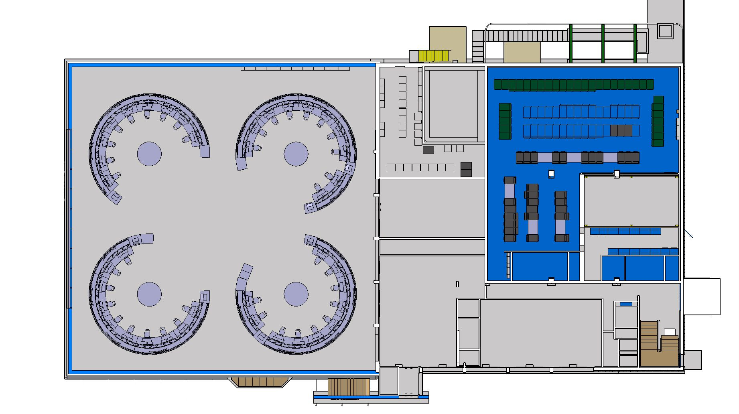
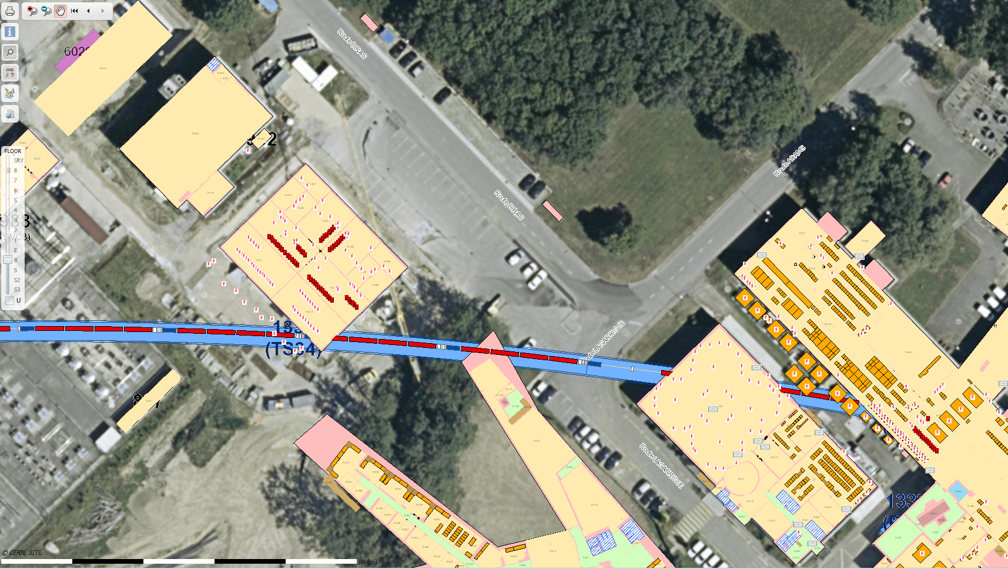
CERN Control Centre (CCC)
10 metres
Network
CCR (server room)
Technical
Infrastructure
& Cryo
LHC
CCC (operator room)
N N N
Booster & PS
LEIR & SPS
110 Linux and Windows workstations
300 Linux servers with 3 network racks (N)
Notes:
4 islands in CCC, each with around 10 operator positions and about two Linux workstations per position
Network room has routers, switches and Ethernet patch panels for CCC workstations and Front Ends at the top of CCR server room.
The lower part of the CCR server room contains 300 Linux servers, mostly HP blades. Server network connectivity is handled by a router in each of the 3 network racks.

Slide 6

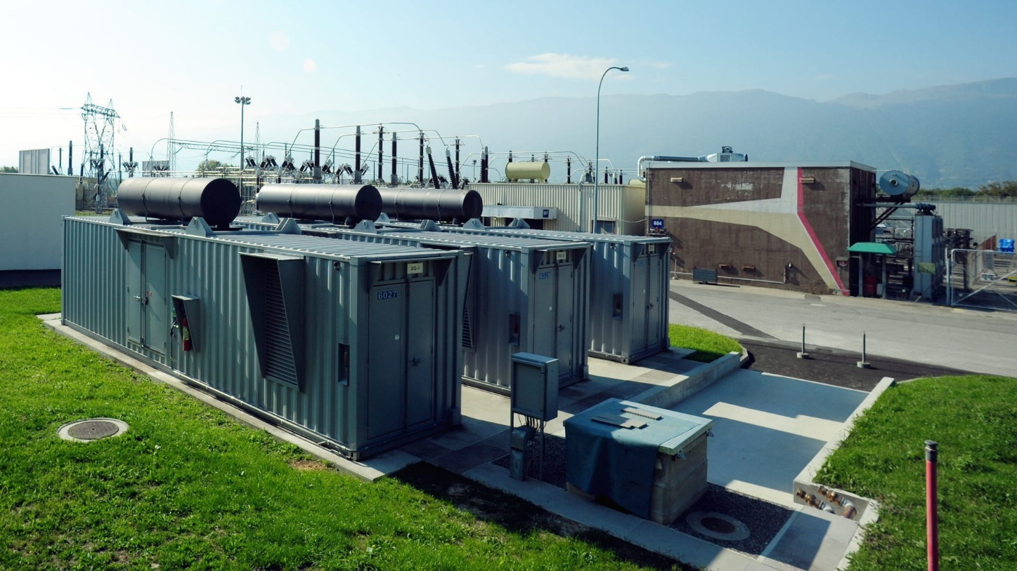
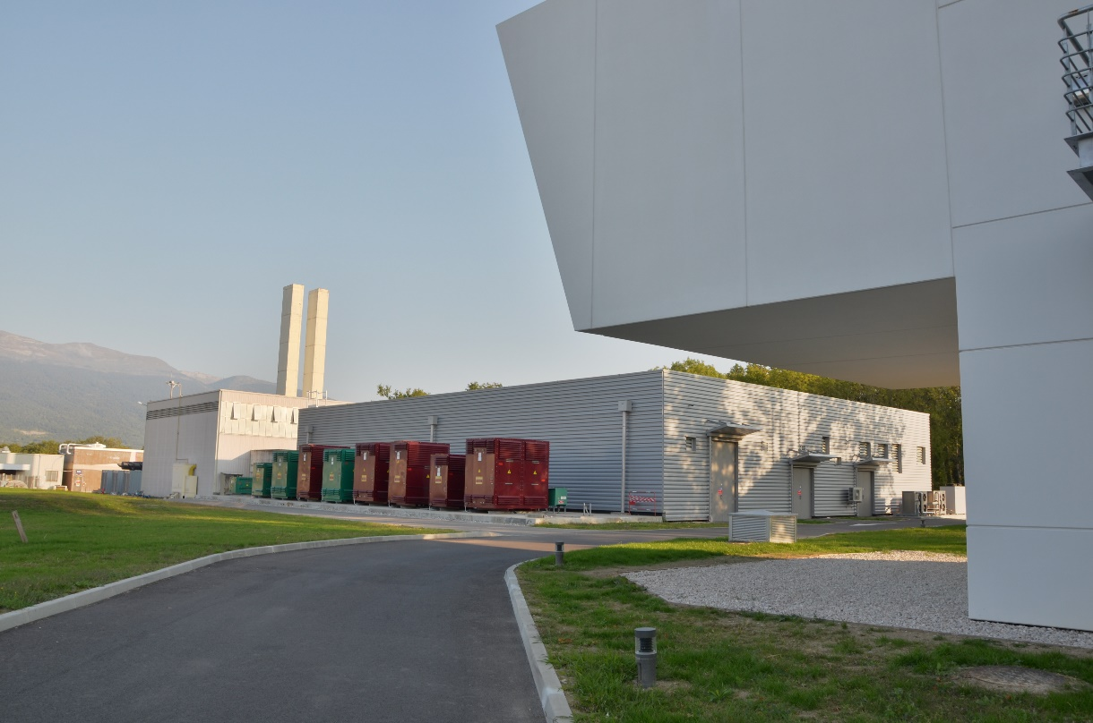
Powering
No cuts to servers during implementation
Maintenance does not stop service
Two separate power cable routes into CCC/CCR
All CCR racks can use both sources
Equipment that has only one power input can be connected to an auto transfer switch which seamlessly
switches over if one source fails – used for Technical Infrastructure and Cryogenics workstations in CCC
Firewall
Three diesel generators installed 150 m from CCC with N+1 redundancy
New electrical building with two sets of UPS (2N+1) and associated switch gear (2N), two-hour fire resistant concrete firewall divides the building
Notes:
Notes on redundancy
A ‘conventional’ system is presented on the basis of N equipment, where N is the number of units required to deliver normal service, with one source of electrical supply. Where an item of equipment is subject to maintenance, the service downstream must be turned off for the duration of this activity.
If continuous service is required then a 2N system (where two of each required item are provided in a redundant configuration) should be considered. Within a 2N system, concurrent maintenance and operation is possible, however active service provision is reduced to N during this time (i.e. if a failure occurs during a maintenance activity, all service is lost).
If continuous service and full redundancy is required then a 2N+1 system should be considered. In a 2N+1 configuration an additional item of equipment is provided over and above 2N, to allow for both service and redundancy to be maintained even in the event maintenance activity or a single equipment failure.
Official: UPS duration (10 minutes for each one) + diesels (3 days).
Currently: 1 hour + 7 days
Distance CCC -> diesels: 150 m
CCC -> electrical building: 60 m

Slide 7
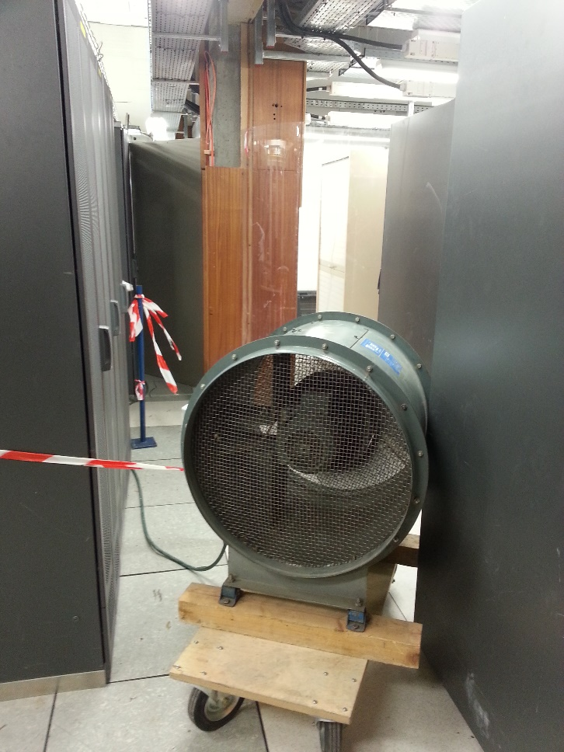
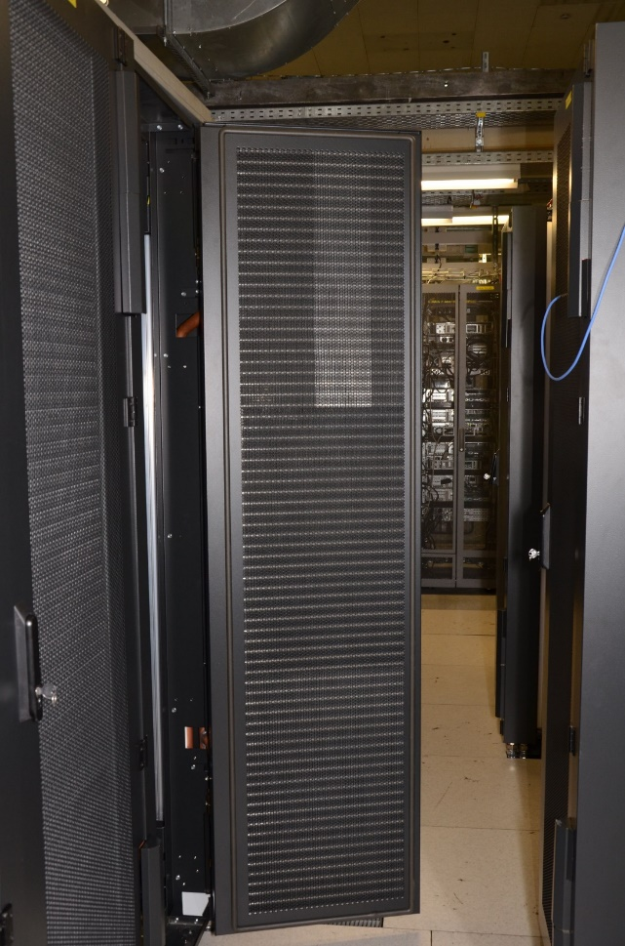
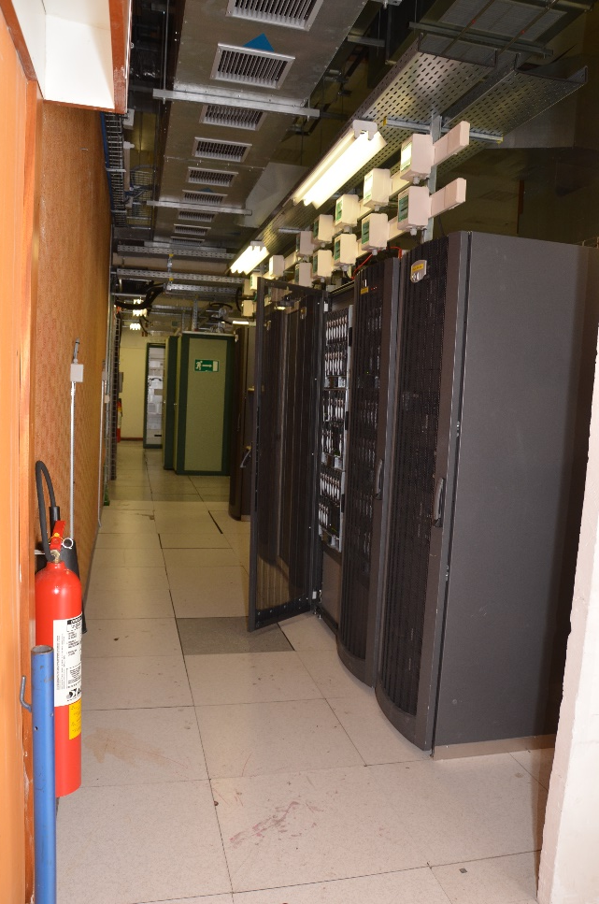
Cooling and Ventilation
Only 20 servers shutdown to reduce heat load during implementation
Maintenance does not stop service
Separated non-critical CCC and meeting rooms from critical CCR and network rooms
Can be powered by diesel or UPS
Portable
fan
retired
cold
hot
Water in
Water out
Two redundant cooling systems for CCR and network rooms
Water-cooled rack doors for server area
cold air corridor in front of servers and hot air removal corridor behind
Notes:
A fully enclosed corridor was not chosen because of the small size of the server area

Slide 8

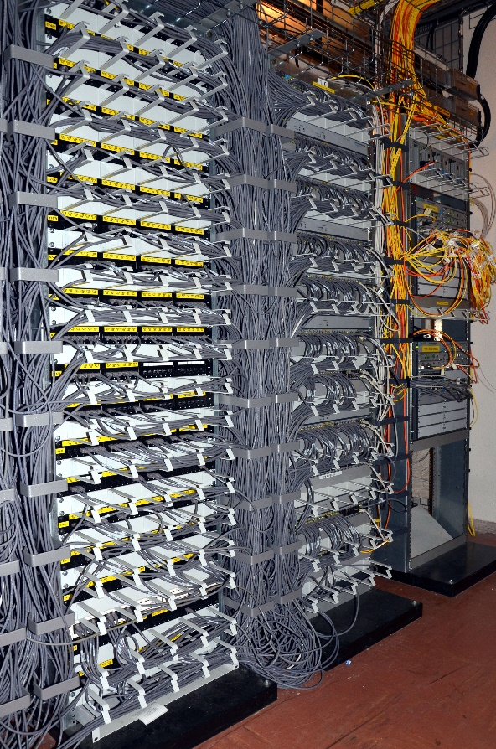
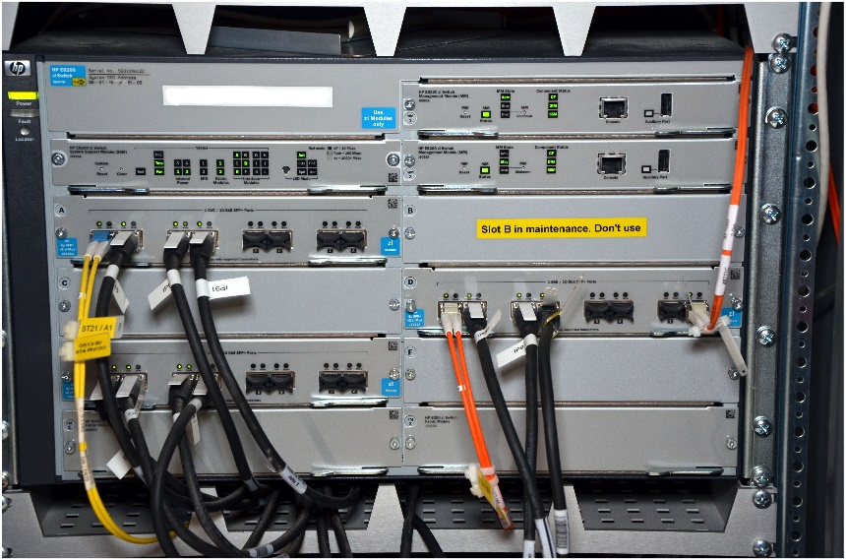
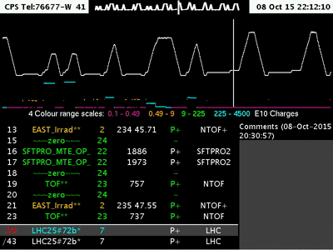
Network
10 second network loss for server 10 gigabit/s upgrade
90 second downtime for redundant router installation
Re-cabled and increased number of patch panels for 25% more Ethernet outlets in CCC and CCR
Upgraded switches for CCC to give option of 10 gigabit/s uplinks to routers
Redundant routers for CCC (and IT Computer Centre) allow maintenance with no cuts
3 new routers for servers have 10 gigabit/s downlinks to Blade switches
Pilot multicast service to CCC workstations
for efficient distribution of video streams
Notes:
The Technical Infrastructure operators moved to their backup location during the CCC re-cabling

Slide 9
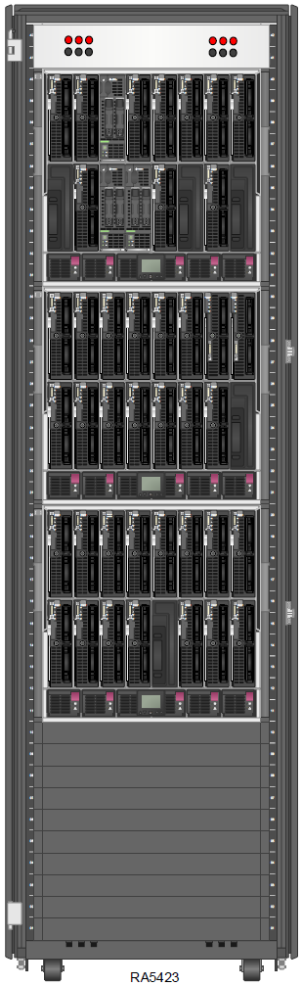
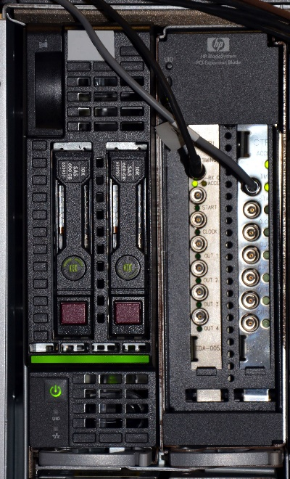
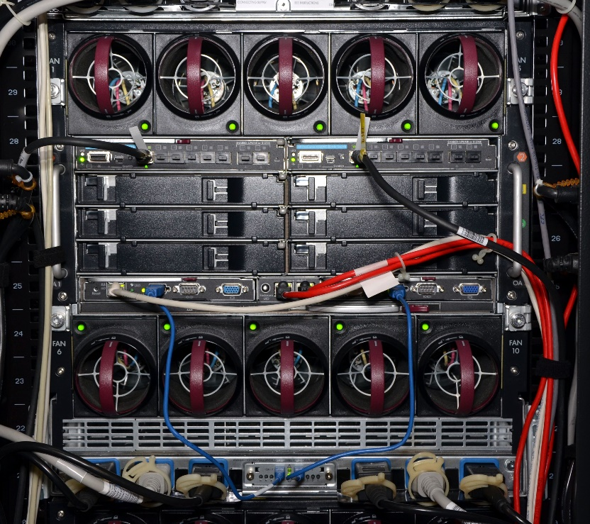
Servers in 2015
Rack view in Visio
Blade and Expansion
BE Beams Department
Rear enclosure view
Six redundant
power supplies
Blade in HP BladeSystem c7000 enclosure
3 enclosures in rack (4 possible)
Two ProCurve Blade Switches. Each with 10 gigabit/s uplink to router in the row of racks
Expansion Blade with CERN Timing Receiver PCI cards for software interlocks and LHC real-time orbit feedback
Ten redundant fans
Notes:
The 3 phases of the 2 power sources supply the 6 power supplies. The order of the phases is alternated as we go down the rack. On a light CPU load an enclosure can run with only one power supply.
An enclosure is still correctly cooled with 2 failed fans

Slide 10
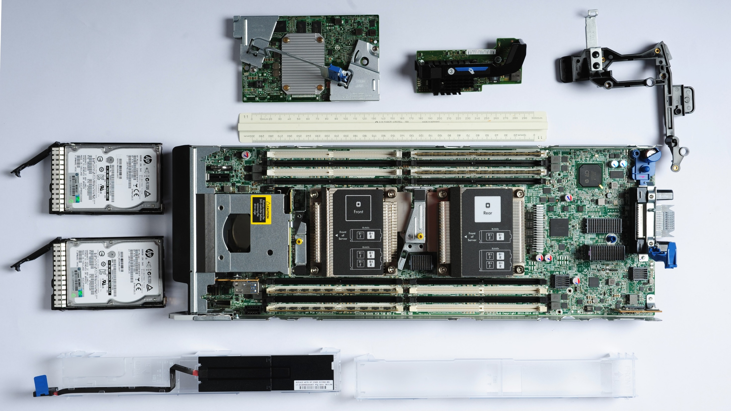
HP ProLiant BL460c Gen9 half-height blade server
Ethernet Mezzanine
RAID
controller
SAS 10k RPM 600 GB disks
64 GB ECC RAM in 4 slots out of 16
RAID cache battery
Two Intel Xeon E5-2630 v3 2.4 GHz CPUs, 32 cores + threads total
Notes:
Note: no fans!

Slide 11
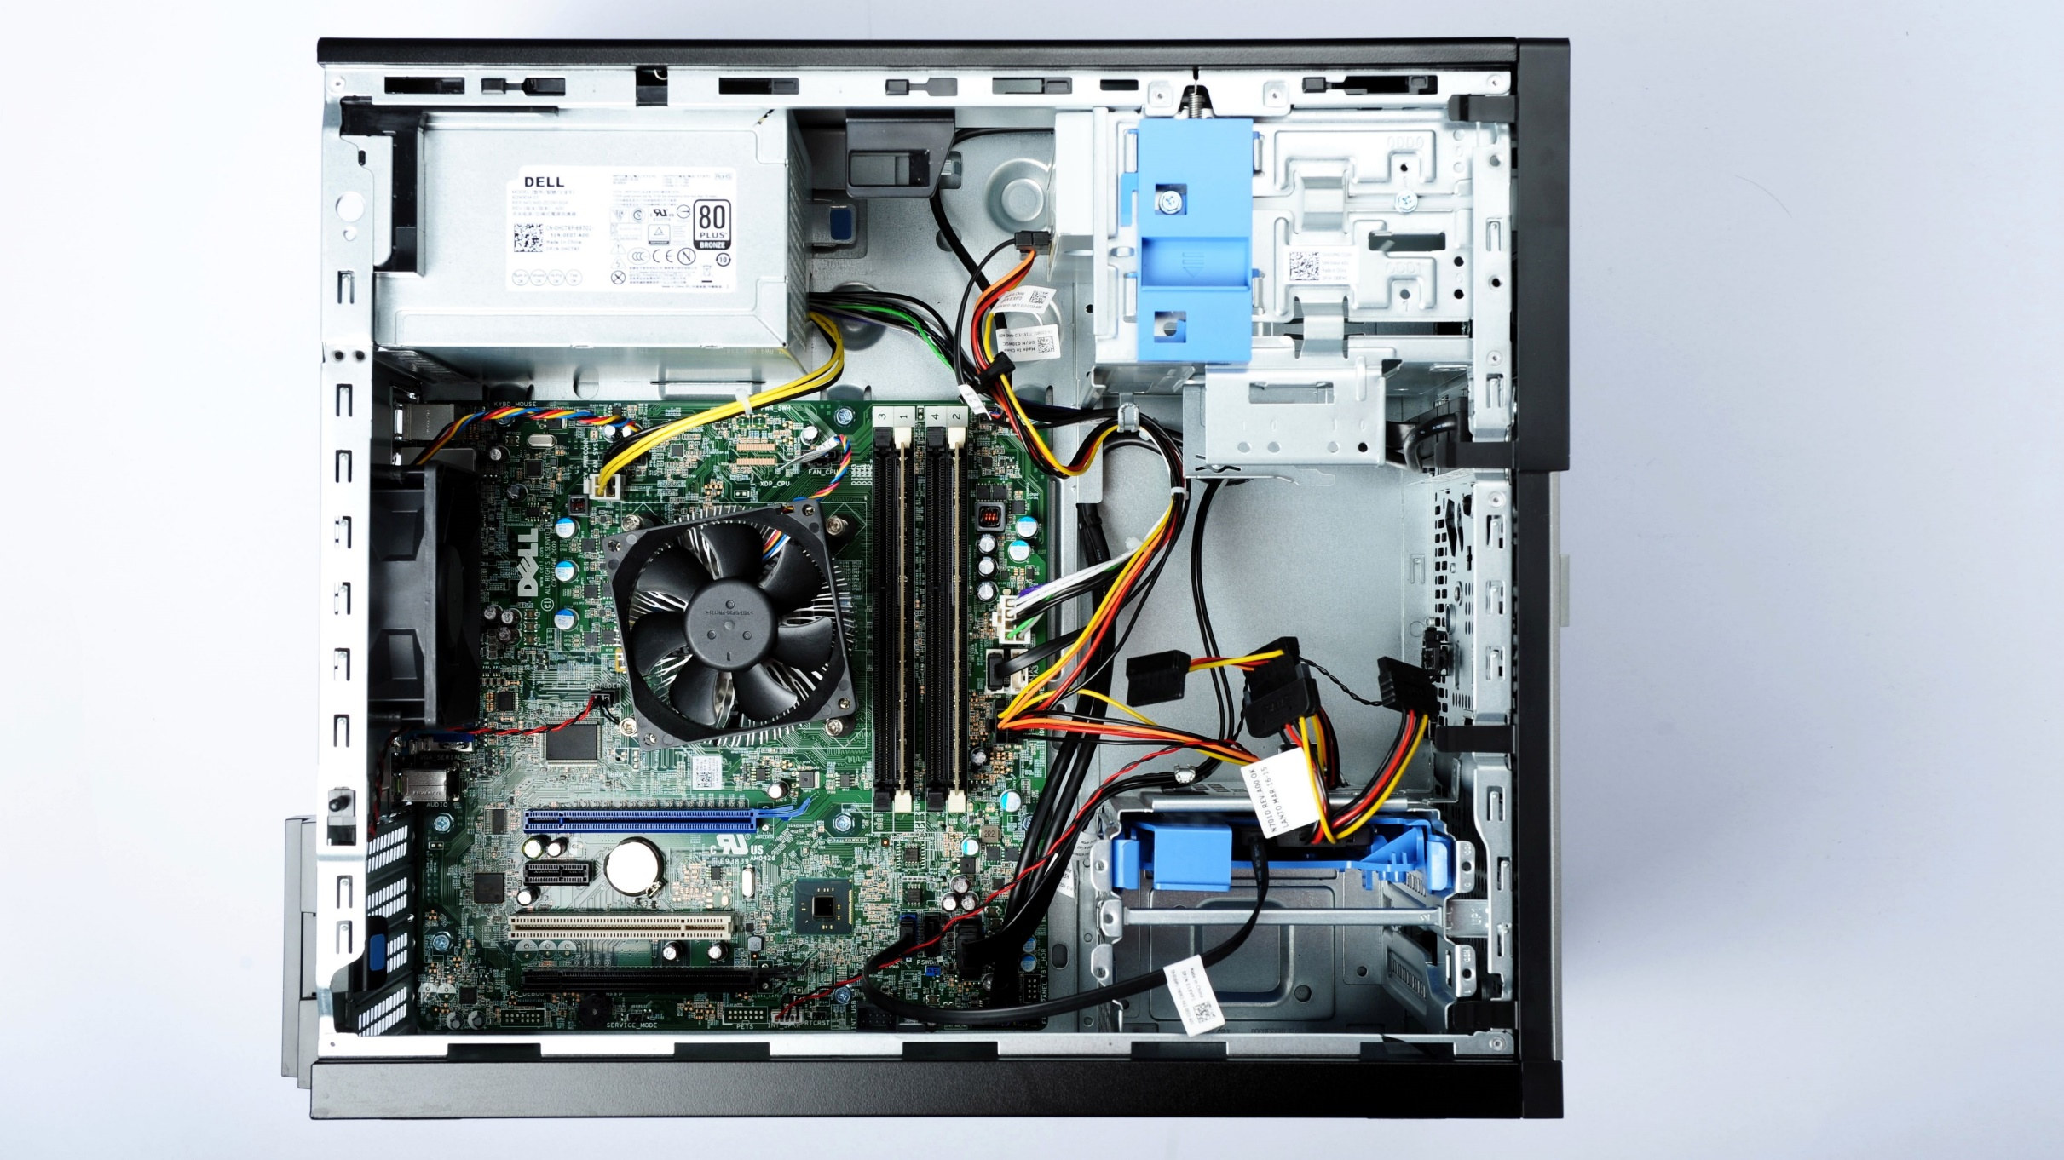
Dell business-class Optiplex 9020 Mini Tower
BE Beams Department
Workstations in 2015
All in CCC upgraded and old 2010 models re-used in technical buildings and LHC underground areas
285 CCC monitors renewed
90% of workstations need no PCIe graphics card as on-board Intel graphics can now drive up to three monitors
Intel Core i7-4790
3.6 GHz CPU
8 cores + threads
total
VGA
DisplayPort
DisplayPort
Q87 chipset with AMT for remote restart, BIOS control and KVM
16 GB RAM in 2 slots out of 4
256 GB SSD
Notes:
Power consumption:
idle 20 Watts (2010 model Elite 8100 with nvidia 53W, 2005 model DC 7600 with nvidia 106W)
full load 102 Watts (2010 model Elite 8100 with nvidia 155W, 2005 model DC 7600 with nvidia 163W)
Previous CCC workstations which already had Intel Active Management Technology (AMT) recycled to Technical Buildings and LHC underground areas to replace non-remote manageable 2006-era workstations
Saves two hour round-trip access to LHC to power on for updates

Slide 12

BE Beams Department
Ansible & Git Daily Workflow
Ansible is a configuration management system which we combine with the Git version control system in order to manage and track changes to our workstations and servers over time
Beam Control
Java servers
Daily Pull
New feature Git branch
Production Git branch
Merge
Pull
WinCC OA
servers
Daily Pull
SLC5
SLC6
Centos 7
Testbed
CCC
workstations
Notes:
The configuration of hosts in our infrastructure is described in Ansible and managed and distributed with the Git version control system.
Git allows changes to be developed in ‘feature’ branches, which can be applied to a group of test machines, generally virtual machines, for validation, independent of the production hosts.
After validation, a feature branch is merged into the production branch.
The production branch is then ‘pulled’ by all production hosts.

Slide 13
BE Beams Department
Ansible System Upgrade Workflow
Management host
Pre Playbook
Capture state
Update
Reboot
Post Playbook
Capture state
Compare state to pre-update state
100s of workstations and servers
~500 workstations and servers are updated each time
Hosts are split into 2 sets, with redundant servers divided between them
Each host takes around half-an-hour to update, but parallelism possible with Ansible allows all hosts to be updated within ~2 hours
Notes:
Example upgrade is SLC6.6 to SLC6.7 during the last Technical Stop
State: what is installed, is the monitoring system happy that all services are running

Slide 14


Conclusion
Upgrades have been made with a strong focus on redundancy, reliability and efficiency to eliminate potential points of failure
Powering, cooling & ventilation and network bandwidth upgrades permit considerable expansion of server numbers during Run 2
Modernized system administration based on Ansible and Git will scale to the needs
There has been an excellent symbiosis with the Electrical and Cooling & Ventilation Groups as their supervision systems run on servers managed by the Controls Group

Slide 15
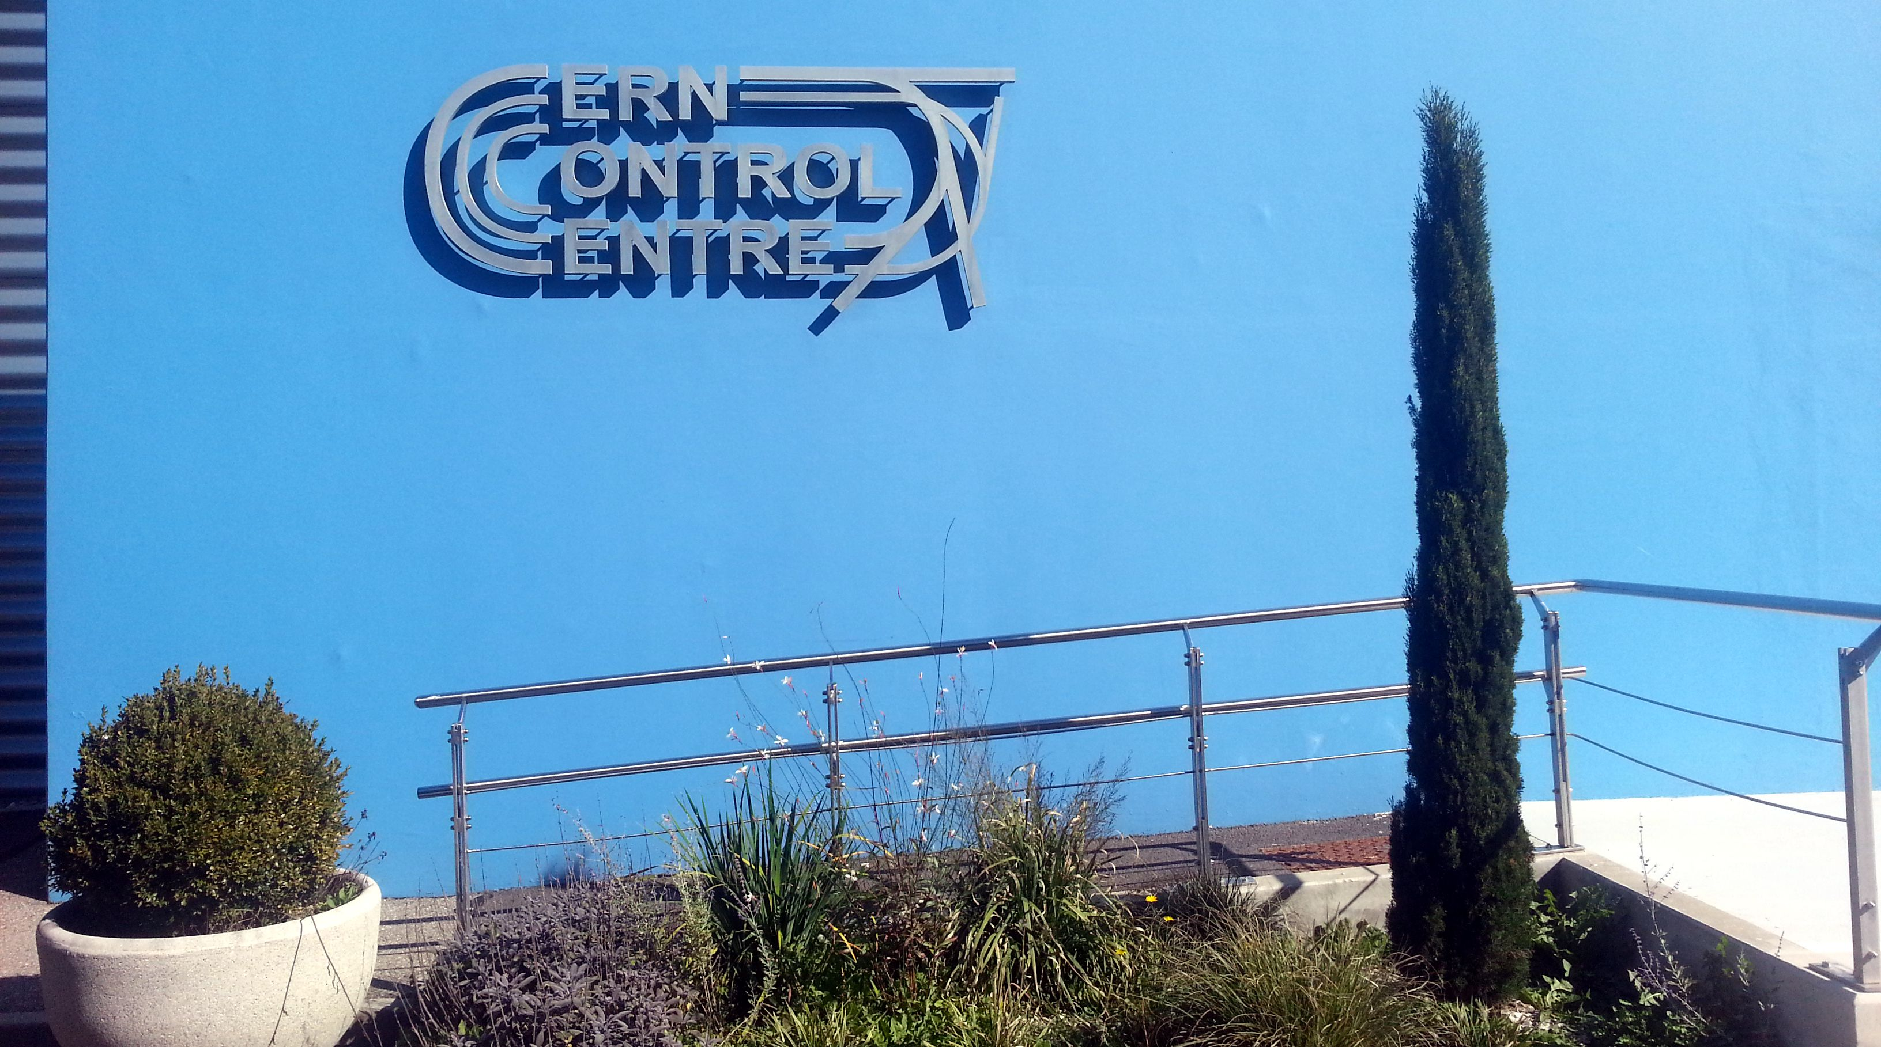
Questions?

