Slide 1


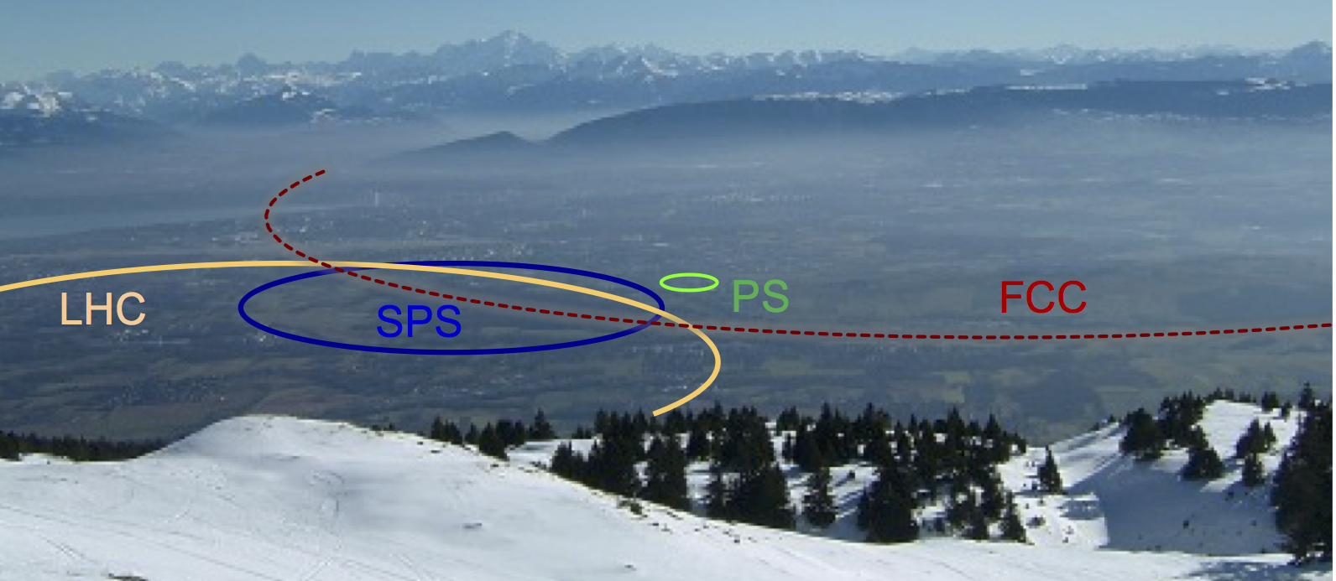
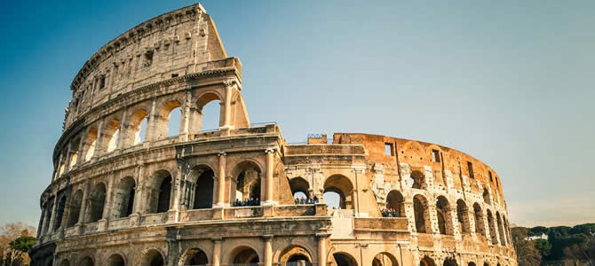
CERN roadmap and FCC
Fabiola Gianotti, FCC Workshop, Rome, 11 April 2016

Slide 2
CERN scientific roadmap
Full exploitation of the LHC:
Run 2 started last year → goal this year is L=10³⁴ at √s =13 TeV, ~25 fb⁻¹
building upgrade of injectors (LIU), collider (HL-LHC) and detectors (Phase-1 and Phase-2)
Diversity programme serving a broad community:
ongoing experiments and facilities at Booster, PS, SPS and their upgrades (ELENA, HIE-ISOLDE)
participation in accelerator-based neutrino projects outside Europe (presently mainly LBNF in
the US) through the CERN Neutrino Platform
Preparation of CERN’s future:
vibrant accelerator R&D programme exploiting CERN’s strengths and uniqueness
(including superconducting high-field magnets, AWAKE, etc.)
design studies for future accelerators: CLIC, FCC (includes HE-LHC)
future opportunities for scientific diversity programme (new)

Slide 3
CERN roadmap
Full exploitation of the LHC:
Run 2 started last year → goal this year is L=10³⁴ at √s =13 TeV, ~25 fb⁻¹
building upgrade of injectors (LIU), collider (HL-LHC) and detectors (Phase-1 and Phase-2)
Diversity programme serving a broad community:
ongoing experiments and facilities at Booster, PS, SPS and their upgrades (ELENA, HIE-ISOLDE)
participation in accelerator-based neutrino projects outside Europe (presently mainly LBNF in
the US) through the CERN Neutrino Platform
Preparation of CERN’s future:
vibrant accelerator R&D programme exploiting CERN’s strengths and uniqueness
(including superconducting high-field magnets, AWAKE, etc.)
design studies for future accelerators: CLIC, FCC (includes HE-LHC)
future opportunities for scientific diversity programme (new)
Important milestone: update of the European Strategy for Particle Physics (~ 2019-2020)

Slide 4
1) Full exploitation of the LHC

Slide 5
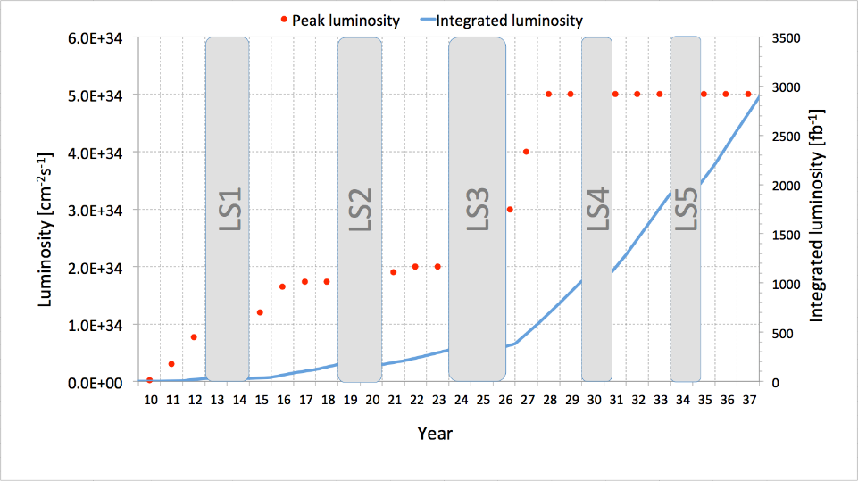
LHC and HL-LHC
7-8 TeV
13-14 TeV
HL-LHC
Run 1
Run 2
Run 3
~3000 fb⁻¹
Splices
fixed
Injectors
upgrade
New
low-β*
quads
~300 fb⁻¹
~100 fb⁻¹
LHC is today’s most powerful collider → full exploitation (√s ~ 14 TeV, 3000/fb) is mandatory:
If new physics discovered in Run 2-3:
→ first detailed exploration of new physics with well understood machine and experiments
while building next accelerator
If no new physics in Run 2-3:
→ extend direct discovery potential by ~ 20-30% (up to m ~ 10 TeV)
In either case: measure H couplings to few percent (including 2nd generation: Hμμ)

Slide 6
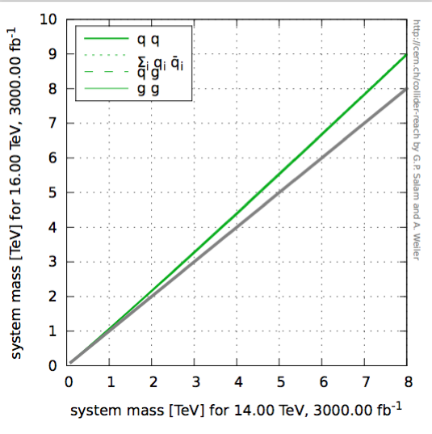
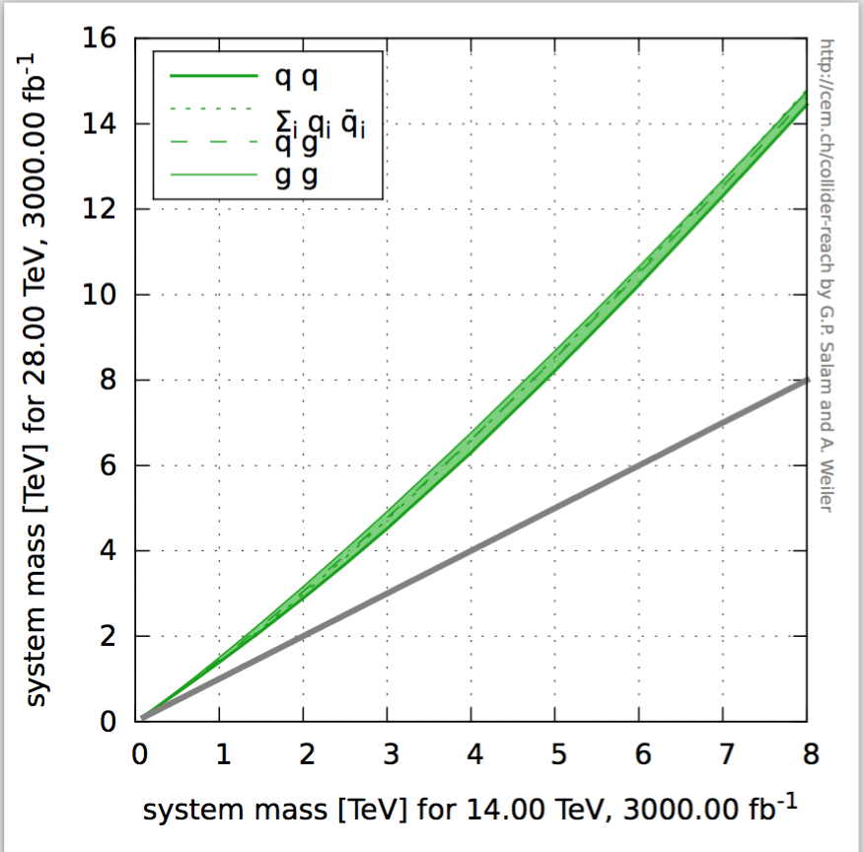
Higher √s in the LHC tunnel ?
16 TeV vs 14 TeV
28 TeV vs 14 TeV
WG set up to explore technical feasibility of pushing LHC energy to:
design value: 14 TeV
ultimate value: 15 TeV (corresponding to max dipole field of 9 T)
beyond (e.g. by replacing 1/3 of dipoles with 11 T Nb₃Sn magnets)
Identify open risks, needed tests and technical developments, trade-off
between energy and machine efficiency/availability
Report on 1) end 2016, 2) end 2017, 3) end 2018 (in time for ES)
Various options,
with increasing
amount of HW
changes, technical
challenges, cost,
and physics reach
HE-LHC (part of FCC study): ~16 T magnets in LHC tunnel (→ √s~ 30 TeV)
uses existing tunnel and infrastructure; can be built at fixed budget
strong physics case if new physics from LHC/HL-LHC
powerful demonstration of the FCC-hh magnet technology

Slide 7
2) Scientific diversity programme :

Slide 8
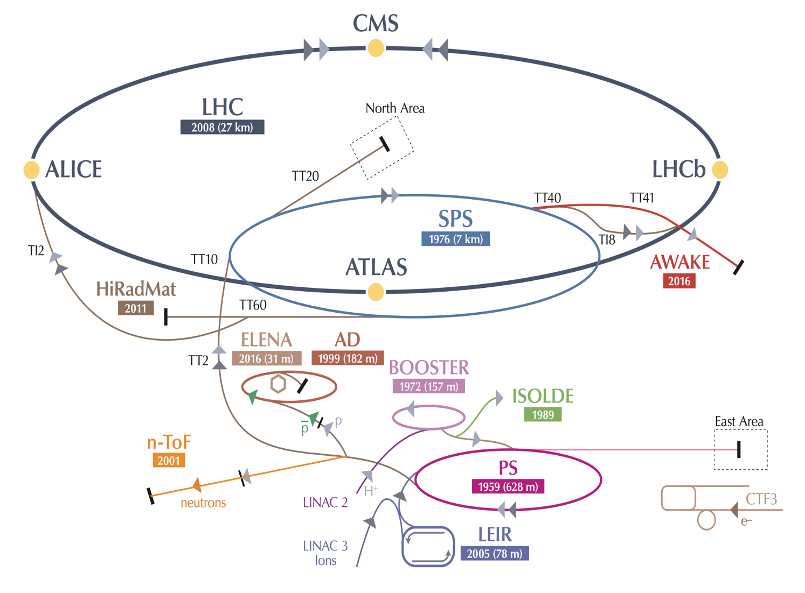
A compelling scientific programme beyond the LHC
AD: Antiproton Decelerator for antimatter studies
CAST, OSQAR: axions
CLOUD: impact of cosmic rays on aeorosols and clouds → implications on climate
COMPASS: hadron structure and spectroscopy
ISOLDE: radioactive nuclei facility
NA61/Shine: ions and neutrino targets
NA62: rare kaon decays
NA63: radiation processes in strong EM fields
n-TOF: n-induced cross-sections
UA9: crystal collimation
Neutrino Platform: collaborating with experiments in US and Japan → see later
~20 experiments > 1200 physicists
8

Slide 9
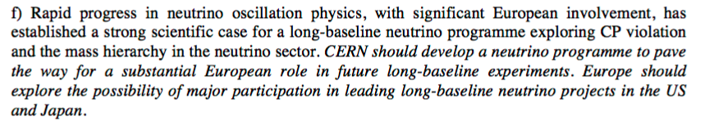
CERN neutrino activities
Neutrino oscillations (e.g. 𝜈_{μ}→ 𝜈_{e} ) established (since 1998) with solar, atmospheric, reactor and
accelerator neutrinos → imply neutrinos have masses and mix
Since then: great progress in understanding 𝜈 properties at various facilities all over the world
Nevertheless, several open questions:
Origin of 𝜈 masses (e.g. why so light compared to other fermions ?)
Mass hierarchy: normal (𝜈₃ is heaviest) or inverted (𝜈₃ is lightest) ?
Why mixing much larger than for quarks ?
CP violation (observed in quark sector): do 𝜈 and anti-𝜈 behave in the same way?
Are there additional (sterile) 𝜈 (hints from observed anomalies)?
Accelerator experiments can address some of above questions studying 𝜈_{μ}→ 𝜈_{e} oscillations
Need high-intensity p sources (> 1MW) and massive detectors, as 𝜈 are elusive particles
and the searched-for effects tiny → Next-generation facilities planned in US and Japan.
European Strategy 2013
9

Slide 10
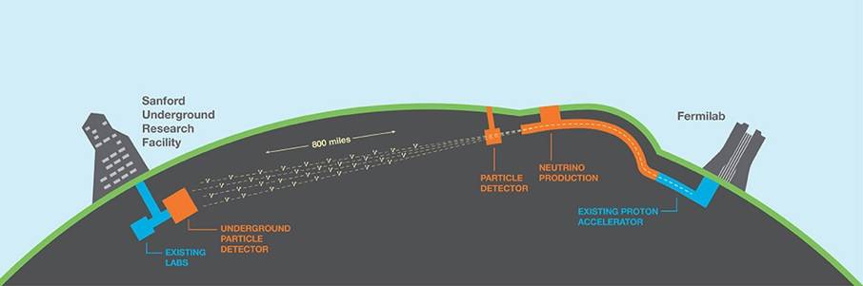
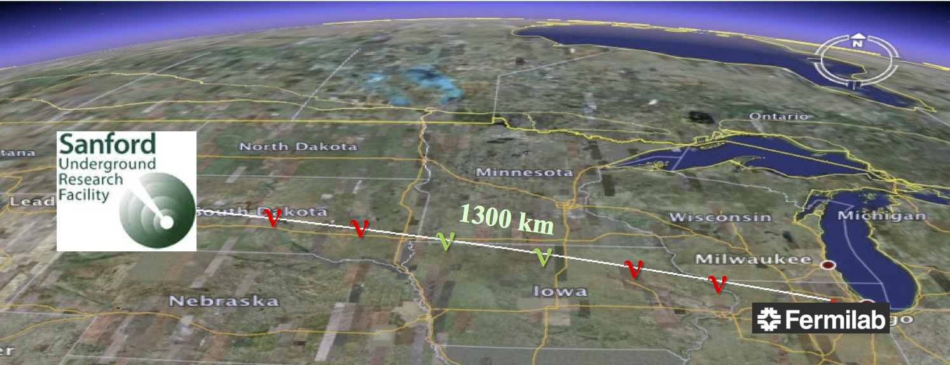
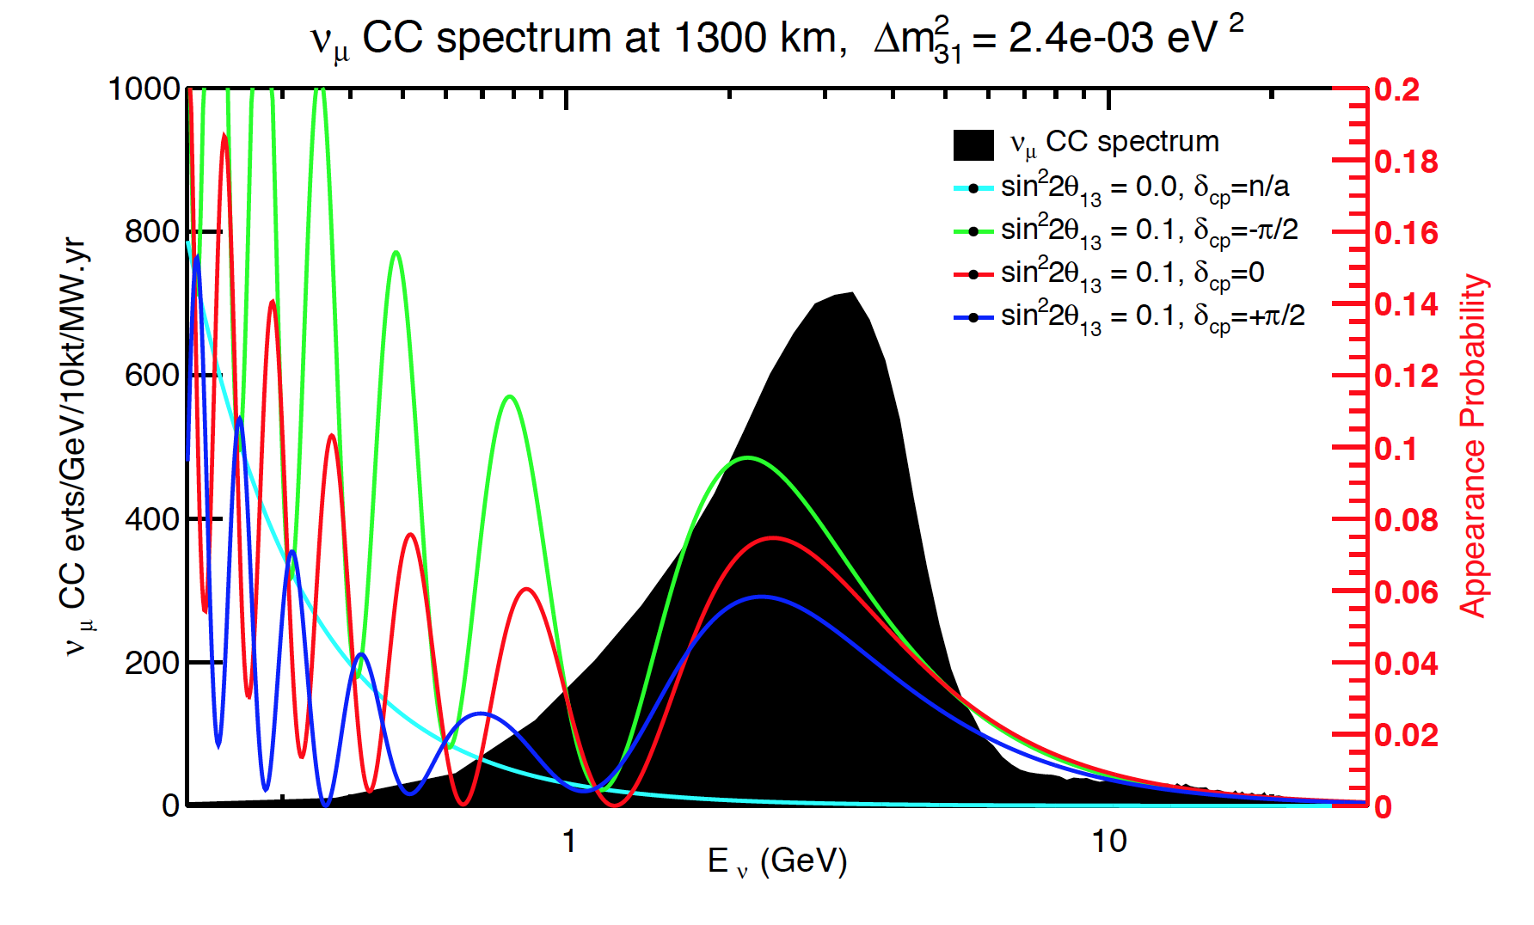
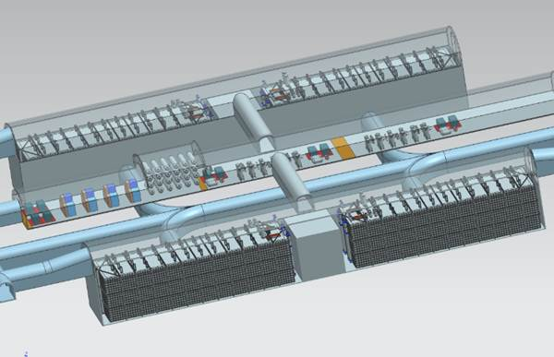
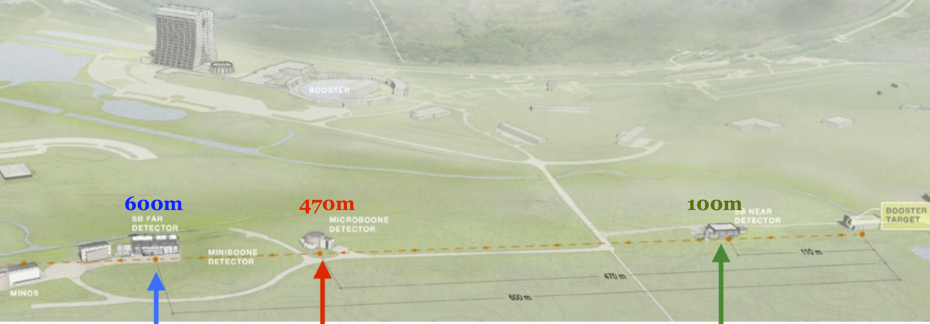
Long Baseline Neutrino Facility (LBNF) at FNAL
The CERN Neutrino Platform
South Dakota
1.2 MW p beam, 60-120 GeV (PIP-II)
Wide-band 𝜈 beam 0.5-2.5 GeV
DUNE experiment:
4x10 kt LAr detectors
~1.5 km underground
Far site construction starts ~2017, 1st detector installed ~2022, beam from FNAL ~ 2026
FNAL Short-Baseline Neutrino programme
Neutrino beam from Booster
Start ~2018
ICARUS T600
(476 t)
MicroBooNE (89 t)
SBND (112 t)

Slide 11
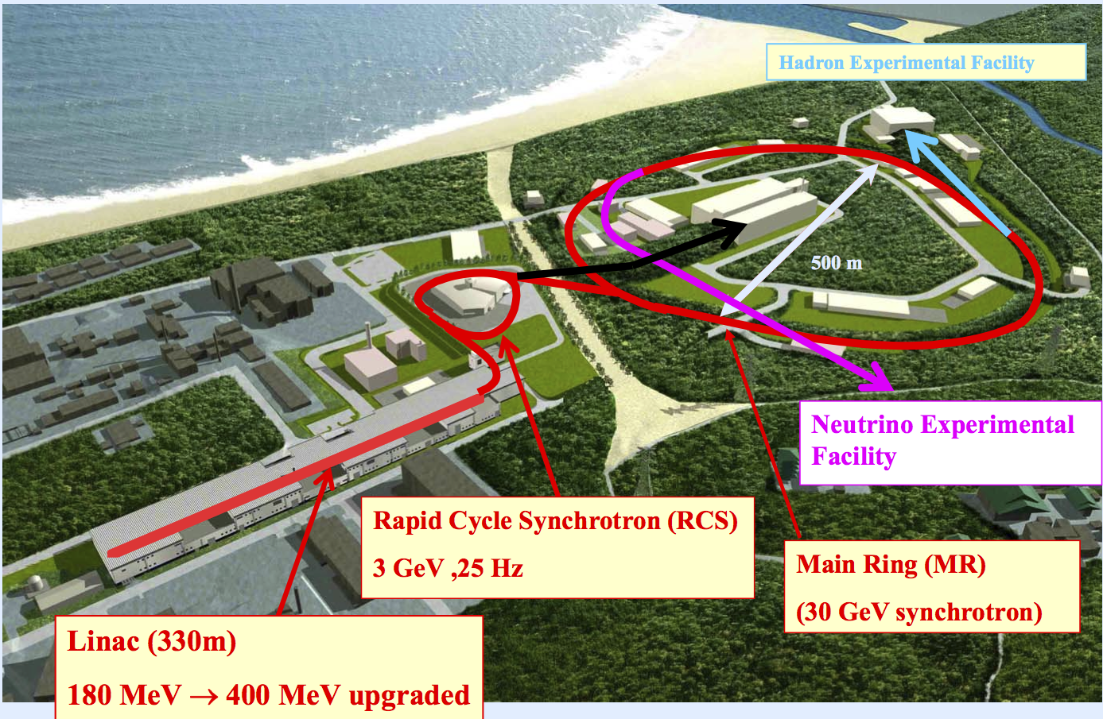
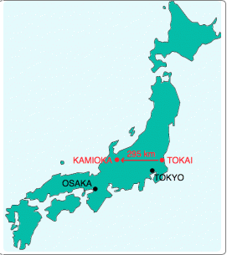
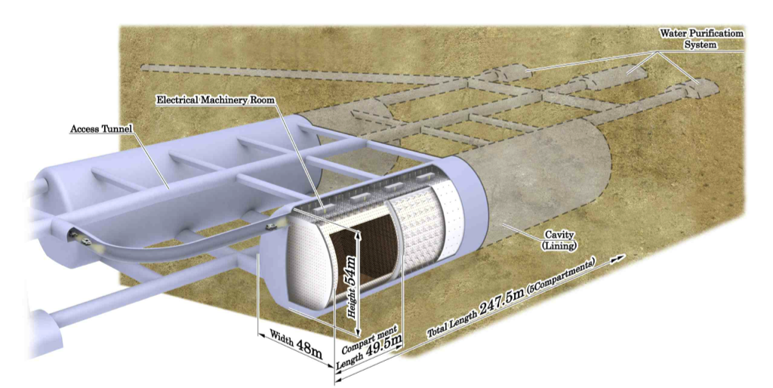
Hyper-Kamiokande, JPARC: construction could start ~2018
0.38 → 0.75 → > 1 MW p source
E_{p} = 30 GeV → E_{ν}~ 0.6 GeV
Narrow-band ν beam
→ high intensity at oscillation peak
300 km
HK
JPARC
Complementary to LBNE: different detector technology,
shorter baseline (→ less sensitive to mass hierarchy),
narrow-band beam (→ high statistics of ν/anti-ν at
oscillation peak but limited measurement of oscillation
spectrum)
~0.5 Mton Water Cerenkov detector
(~20 x Super-K)
~ 1 km underground
~ 2.5⁰ off-axis → narrow-band beam

Slide 12
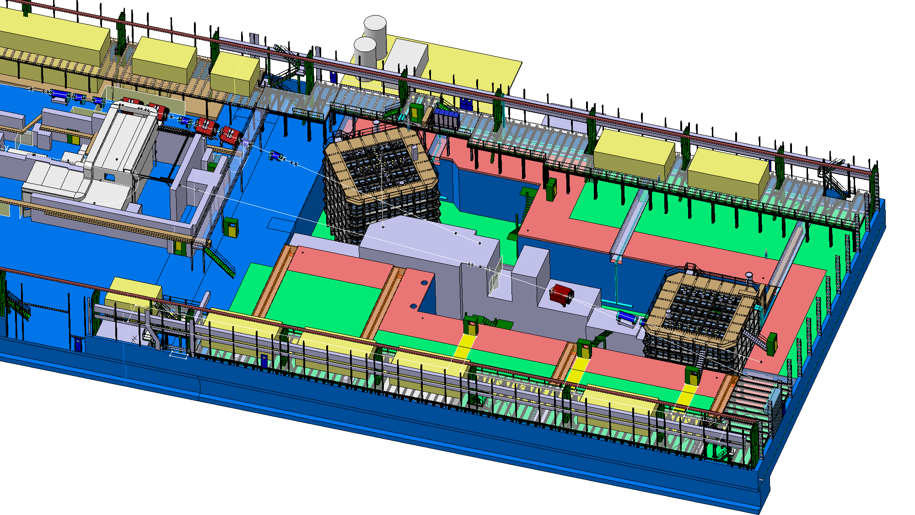
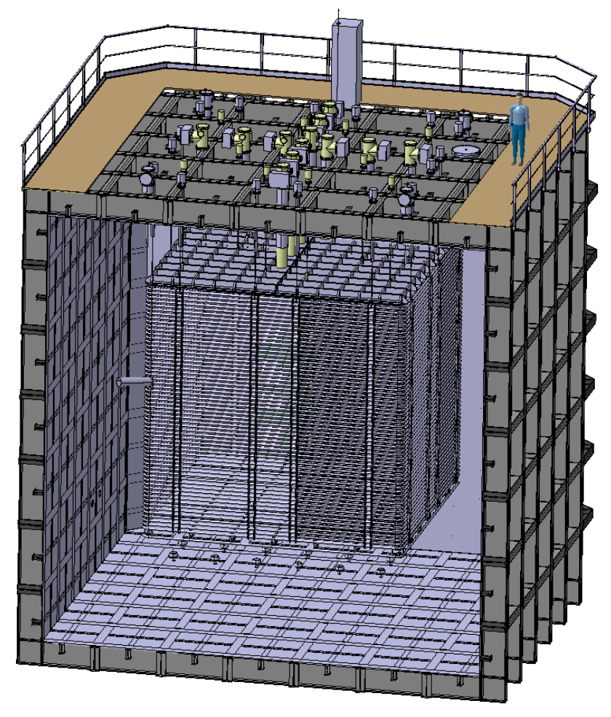
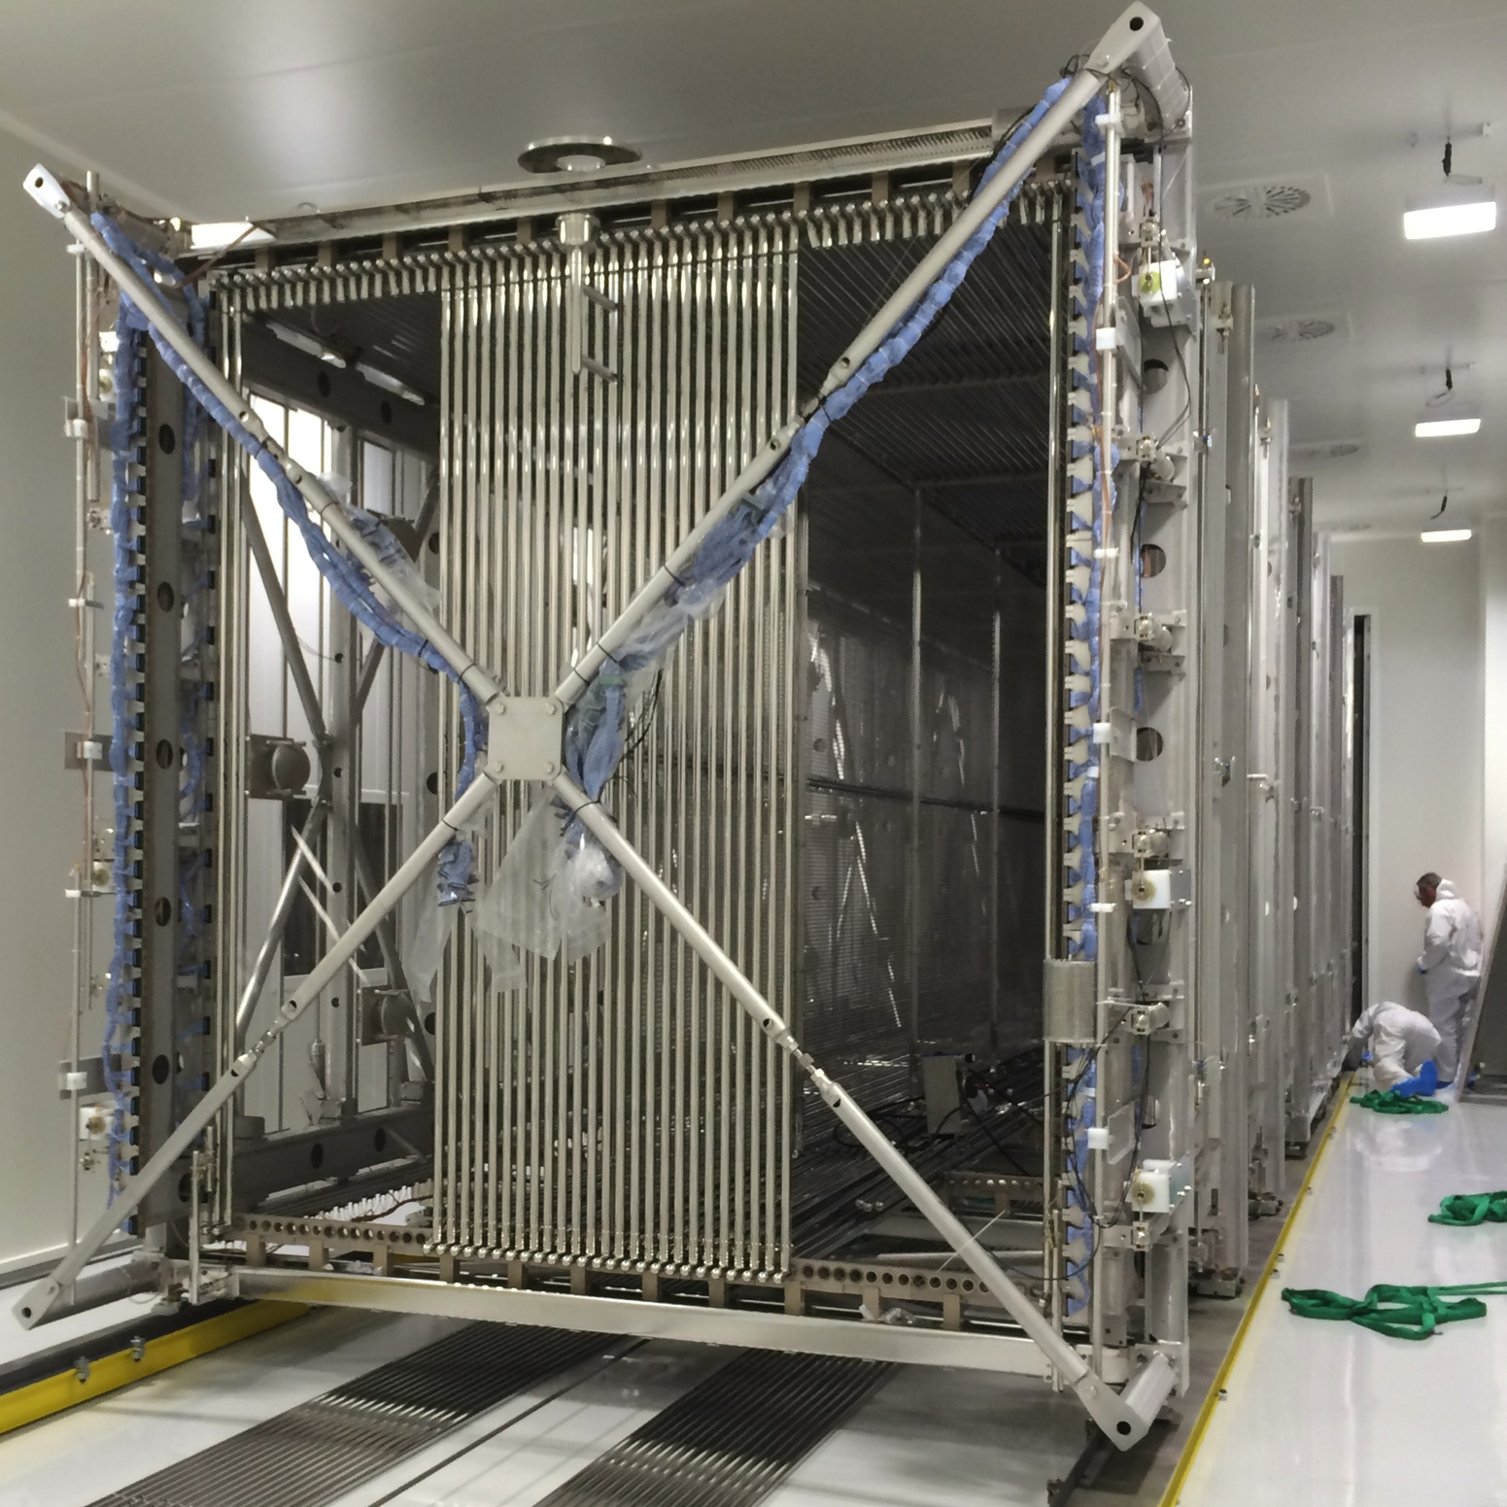
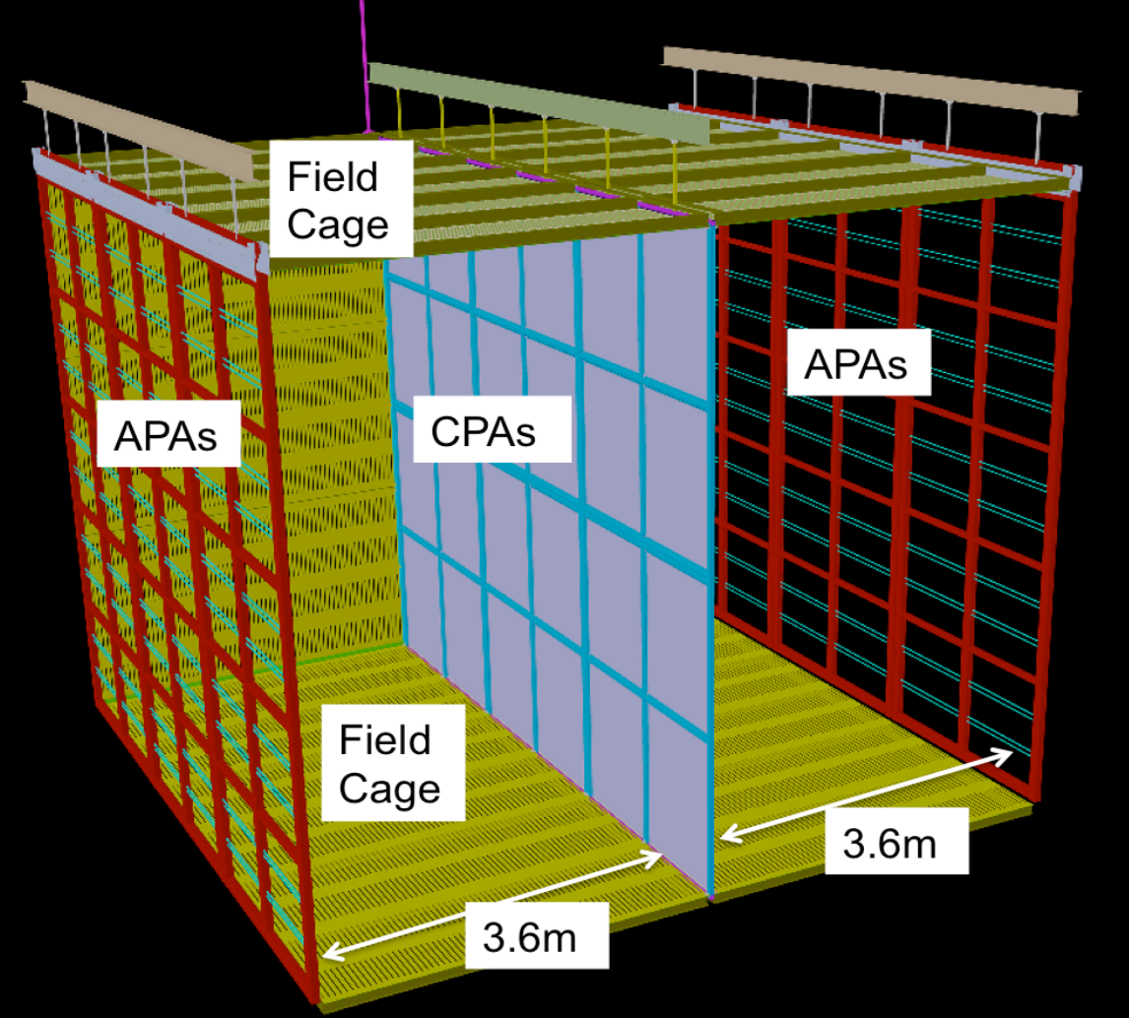
CERN Neutrino Platform
ready for beam
tests in 2018
(before LS2)
Mission:
Provide charged beams and test space to
neutrino community → North Area extension
Support European participation in accelerator
neutrino experiments in US and Japan:
R&D to demonstrate large-scale LAr technology
(cryostats, cryogenics, detectors)
Construction of one cryostat for DUNE detector modules
Construction of BabyMIND magnet: muon spectrometer for WAGASCI experiment at JPARC
Refurbishment of ICARUS T600
for short baseline programme
→ ship to FNAL beg 2017
Construction and test of “full-scale” prototypes of
DUNE drift cells: ~ 6x6x6 m³, ~ 700 tons
single-phase
double-phase

Slide 13
3) Preparation of CERN’s future

Slide 14

R&D on novel acceleration technologies
AWAKE = Advanced Proton Driven Plasma Wakefield Acceleration Experiment
Proof-of-concept demonstration of a novel acceleration technique: use SPS
protons to generate powerful wakefields in a 10m plasma cell → wakefields
accelerate externally injected electron beam.
Aim at electron acceleration of several GeV/m → compact accelerators
Experiment starts end 2016.
14

Slide 15
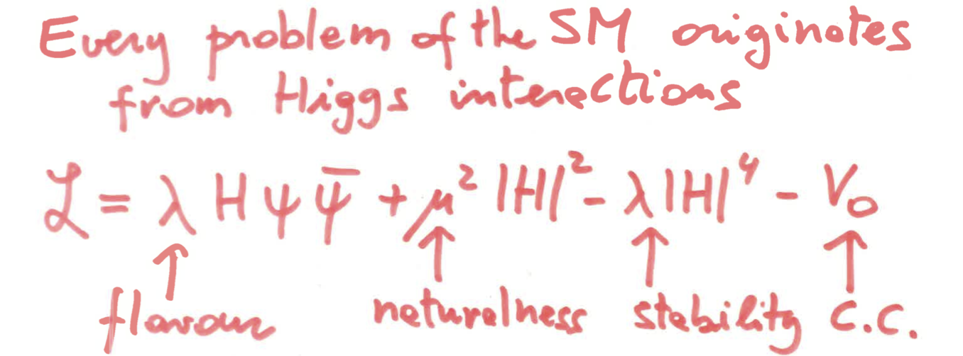

Two main goals of future high-energy/high-intensity colliders
1) Higgs boson studies
H boson is not just “yet another particle”:
Profoundly different from all elementary particles discovered so far
Related to the most obscure sector of SM
Linked to some of the deepest structural questions (flavour, naturalness, vacuum, ...)
Its discovery opens new paths of exploration, and a very broad and challenging experimental programme:
couplings, self-couplings, rare/exotic decays, searches for additional H, etc.
G.F. Giudice
2) Searches for new physics
the known unknown (e.g. dark matter)
the unknown unknown → exploration for uncharted territory
are we asking ourselves the right questions ?
Using direct observation (→ requires high energy) and indirect evidence through precision
measurements (→ requires mainly high intensity)

Slide 16
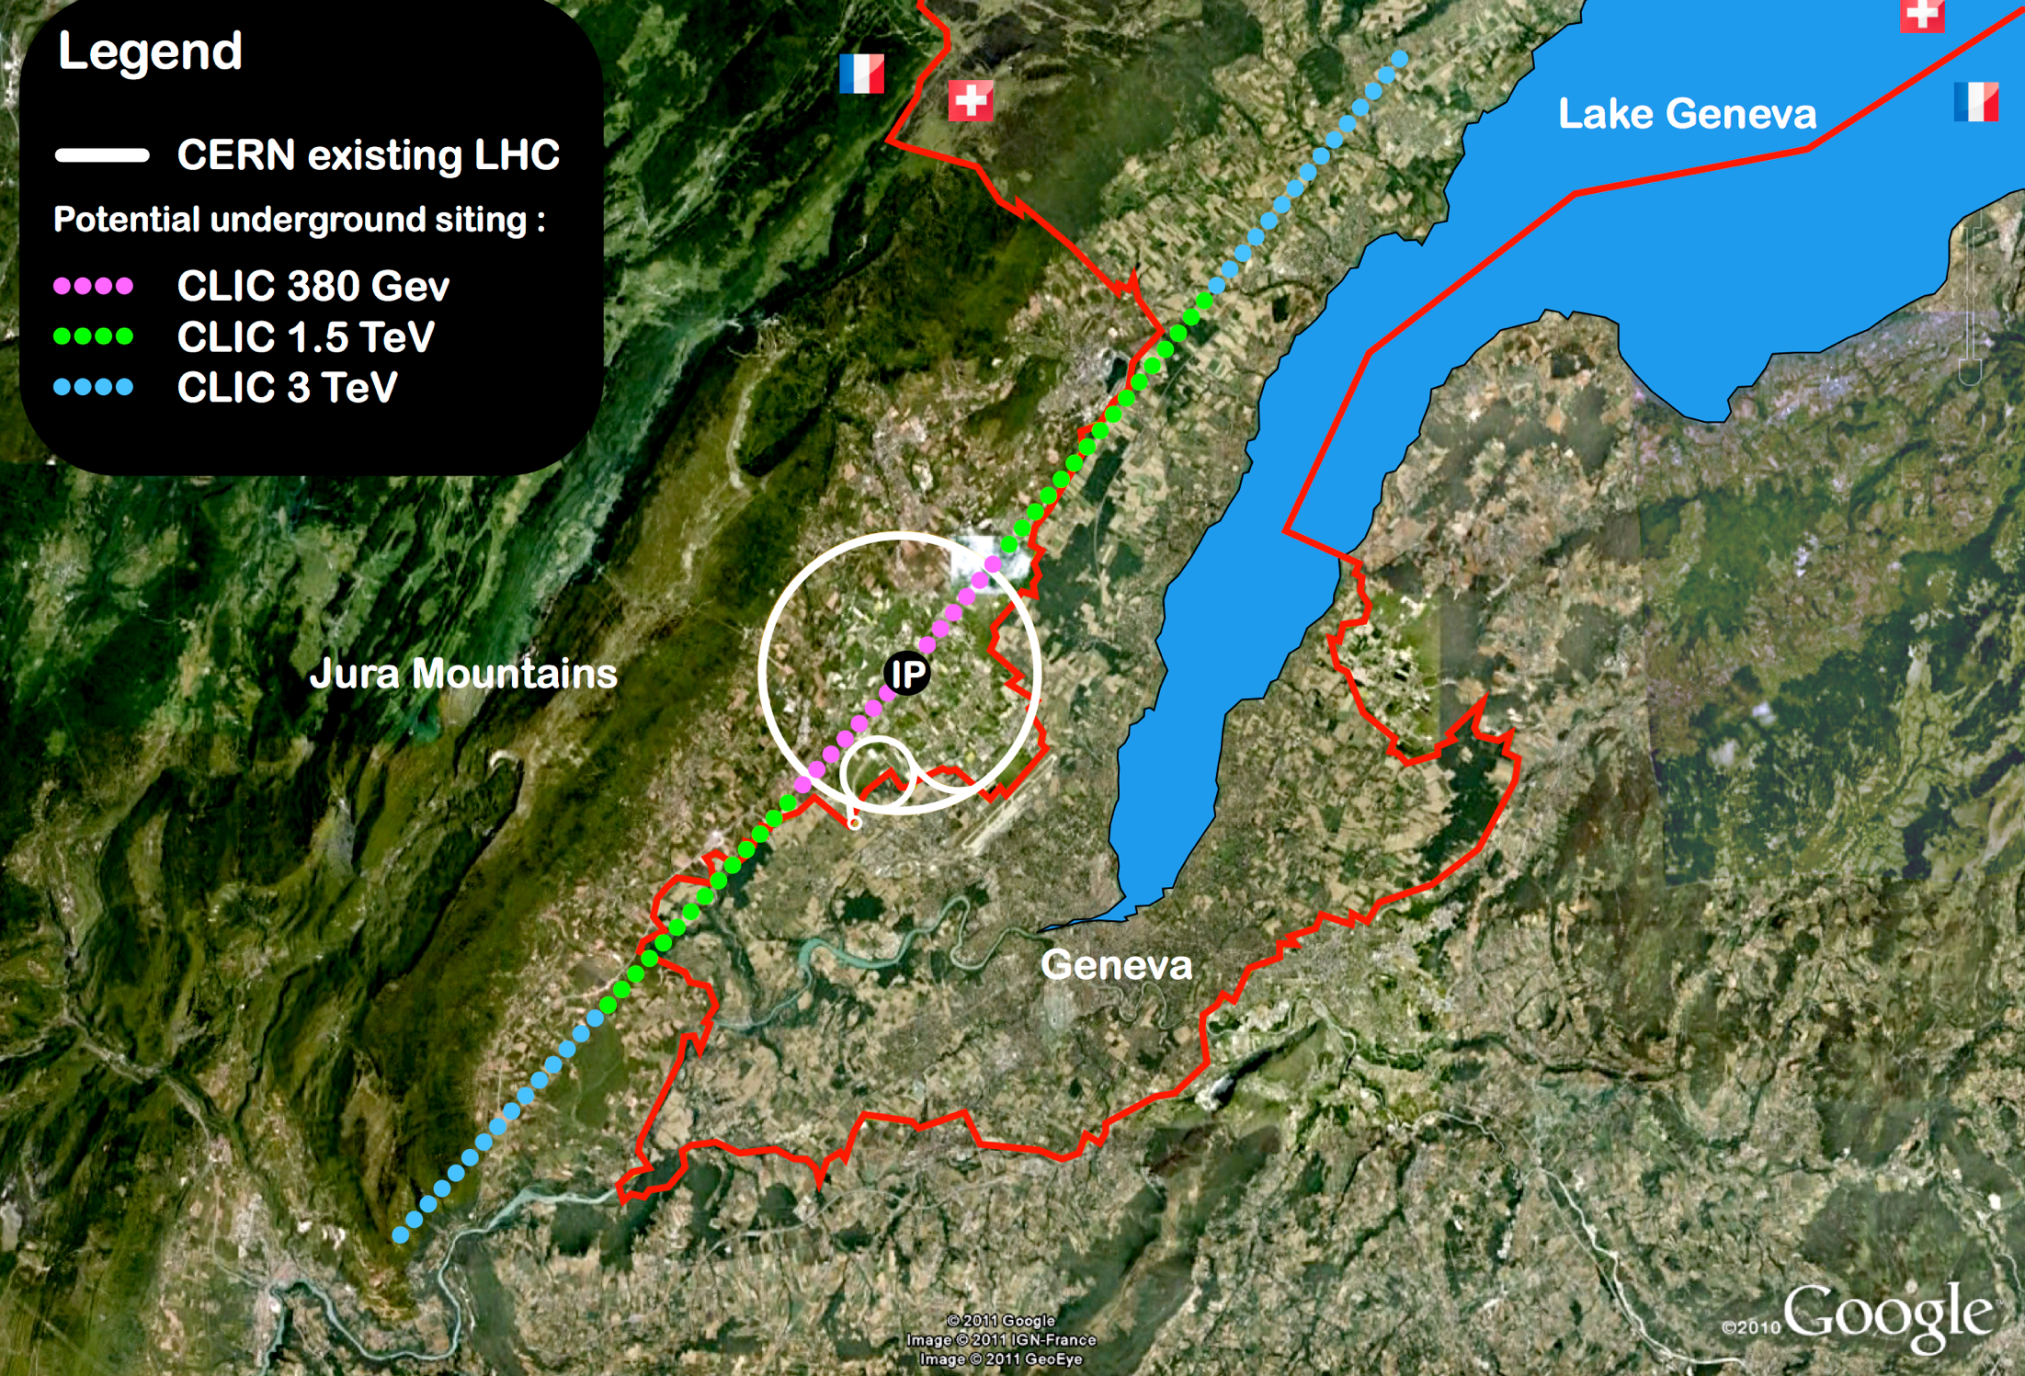
Compact Linear Collider (CLIC)
Linear e⁺e⁻ collider √s up to 3 TeV
100 MV/m accelerating gradient
needed for compact (~50 km) machine
based on normal-conducting
accelerating structures and a
two-beam acceleration scheme
Direct discovery potential and
precise measurements of new
particles (couplings to Z/γ*) up
to m~ 1.5 TeV
Indirect sensitivity to E scales
Λ ~ O(100) TeV
Measurements of “heavy” Higgs
couplings: ttH to ~ 4%, HH ~ 10%
Parameter | Unit | 380 GeV | 3 TeV
Centre-of-mass energy | TeV | 0.38 | 3
Total luminosity | 10³⁴cm⁻²s⁻¹ | 1.5 | 5.9
Luminosity above 99% of √s | 10³⁴cm⁻²s⁻¹ | 0.9 | 2.0
Repetition frequency | Hz | 50 | 50
Number of bunches per train |  | 352 | 312
Bunch separation | ns | 0.5 | 0.5
Acceleration gradient | MV/m | 72 | 100
Most recent operating scenario: start
at √s=380 GeV for H and top physics

Slide 17
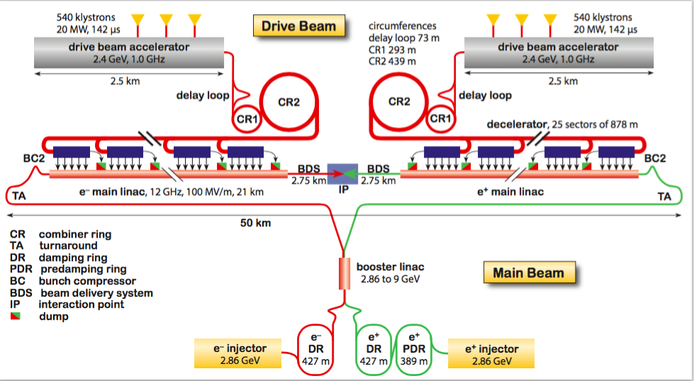
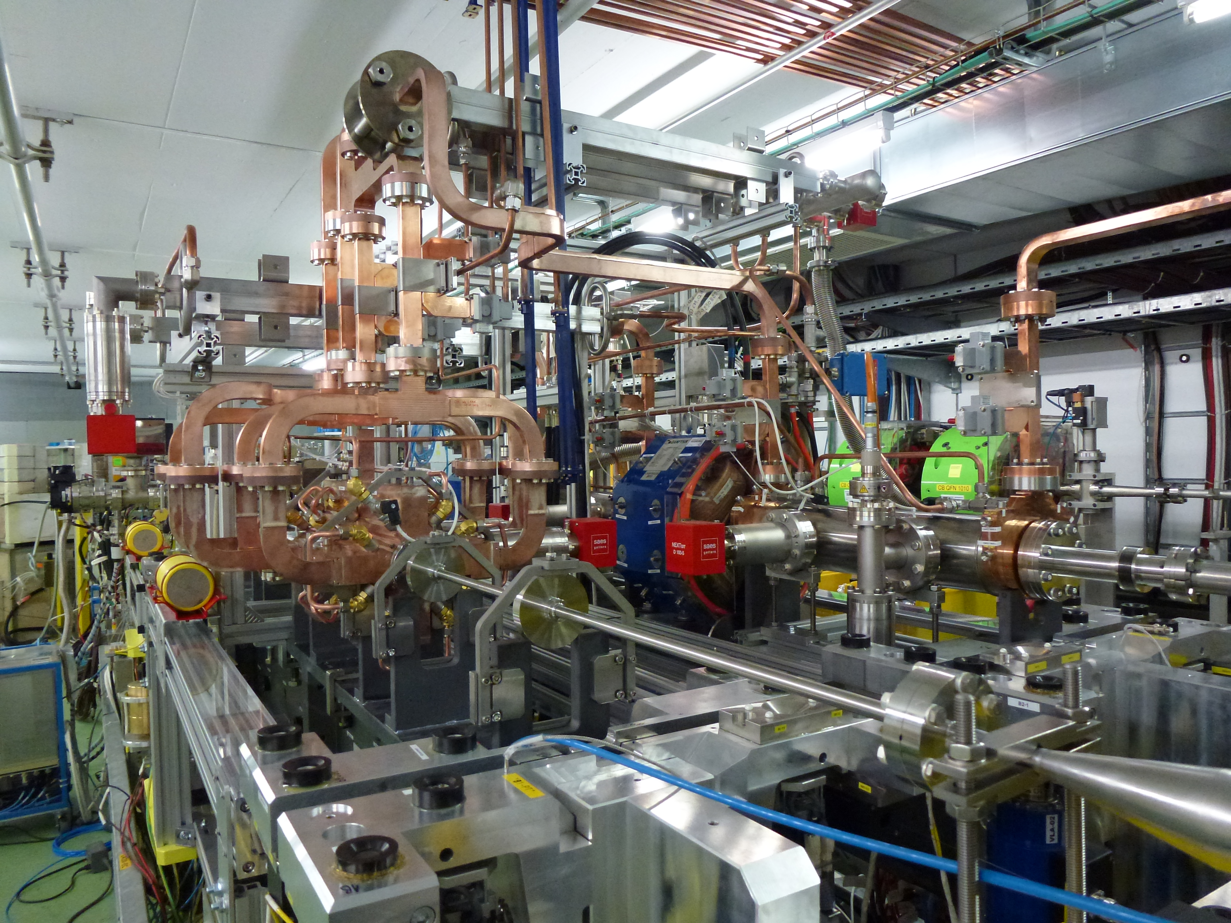
CLIC
International Collaboration: ~80 Institutions
CDR completed end 2012
→ Until ES update:
develop plan for staged implementation
complete key technical feasibility R&D
cost and schedule review
Challenges:
minimise RF breakdown rate in cavities
efficient RF power transfer from drive beam
to main beam
reduction of power consumption (600 MW at 3 TeV)
nm size beams, final focus
huge beamstrahlung in detectors
CTF3 facility: testing two-beam acceleration concept: efficient power transfer from
high-intensity low-E “drive” beam to the accelerating structure of the main (“probe”) beam.
→ to be completed in 2016
CLIC construction could technically start ~2025,
duration ~6 years for √s ~ 380 GeV (11 km Linac)
→ physics could start by ~2035
CLIC two-beam module under test in CTF3

Slide 18
FCC: physics reach in a nutshell
FCC-hh: 100 TeV
explore directly the 10-50 TeV E-scale
provide conclusive exploration of EWSB dynamics
study nature the Higgs potential and EW phase transition
say final word about heavy WIMP dark matter
etc.
FCC-ee: 90-350 GeV
indirect sensitivity to E scales up to O(100 TeV) by measuring most Higgs couplings to
O(0.1%), improving the precision of EW parameters measurements by ~20-200,
ΔM_{W} < 1 MeV, Δm_{top} ~ 10 MeV, etc.
sensitivity to very-weakly coupled physics (e.g. light, weakly-coupled dark matter)
etc.
FCC-ep: ~ 3.5 TeV
unprecedented measurements of PDF and α_{s}
new physics: leptoquarks, eeqq contact interactions, etc.
Higgs couplings (e.g. Hbb to ~ 1%)
etc.
Machines are complementary and synergetic, e.g. from measurement of ttH/ttZ ratio, and using ttZ coupling and H branching ratio from FCC-ee, FCC-hh can measure ttH to ~ 1%

Slide 19
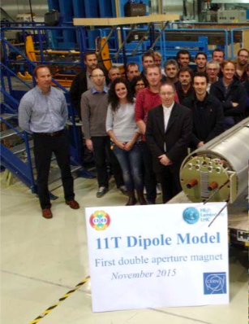
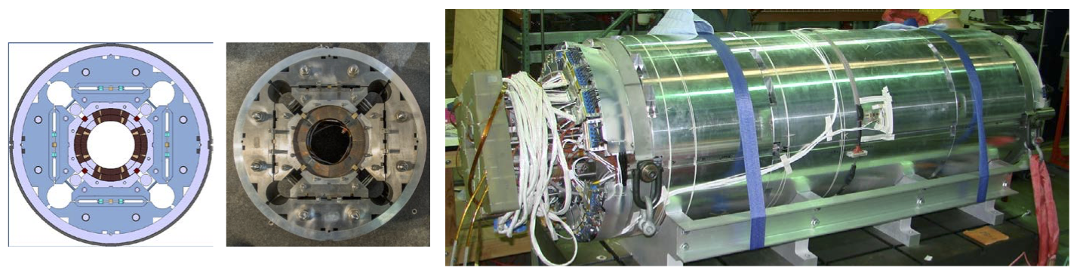

FCC magnet technology: learning from LHC/HL-LHC
“Natural” continuation of LHC and HL-LHC programmes.
Step-wise approach → each step deployed and operated
in a (big) accelerator:
LHC: 8.3 T → push to ultimate field of 9 T ?
HL-LHC: Nb₃Sn technology:
-- 11 T dipoles in dispersion suppression collimators
-- 12-13 T peak field low-𝛽 quads for ATLAS and CMS IR’s
December 2015: short (1.8 m)
Nb₃Sn two-in-one dipole reached
11.3 T (> nominal) without quenches
March 2016: short (1.5 m) Nb₃Sn quadrupole model (final aperture =150 mm) reached current 18 kA
(nominal: 16.5 kA). CERN-US LARP Collaboration (2 coils from CERN + 2 coils from US)

Slide 20
Future opportunities other than high-energy colliders
A “Physics Beyond Colliders" Study Group has been put in place
Mandate
Explore opportunities offered by CERN accelerator complex and infrastructure to address
outstanding questions in particle physics through projects:
complementary to future high-energy colliders (HE-LHC, CLIC, FCC)
exploiting unique capabilities of CERN accelerator complex and infrastructure
complementary to other efforts in the world → optimise resources of the discipline globally
Examples: searches for rare processes and very-weakly interacting particles, electric dipole moments, etc.
→ Enrich and diversify CERN’s future scientific programme
Will bring together accelerator scientists, experimental and theoretical physicists
Kick-off meeting in Summer 2016
Final report end 2018 → in time for European Strategy
One of the goals is to involve interested worldwide community, and to create synergies
with other laboratories and institutions in Europe (and beyond)
20

Slide 21
Conclusions
Today’s outstanding questions in fundamental physics can only be successfully addressed
through the variety of approaches the field has developed (thanks also to strong advances in accelerator and detector technologies): particle colliders, neutrino experiments, dark matter
direct and indirect detection, precision measurements of rare processes, dedicated searches
(e.g. axions, dark-sector particles), cosmic surveys, …
The full exploitation of the LHC, and more powerful future accelerators, are an essential
component of any future programme aiming at improving our knowledge of fundamental
physics. N.B. historically, accelerators have been our most powerful tool for exploration
in particle physics
New ideas, vigorous technological developments, perseverance, as well as worldwide
collaboration, will be needed to reach the highest energies and intensities and make future
accelerators financially and technically affordable.
The extraordinary success of the LHC demonstrates the strength of the community (accelerators, experiments, computing, theory) → a crucial asset in view of future,
even more ambitious, projects.

Slide 22

EXTRAS

Slide 23
Projected integrated luminosities of proposed future colliders for current operating scenarios
Integrated luminosities (ab⁻¹)
√s 90 ~240 350-380 500 1.4 3 70 100 Total # of # H events
at √s>240 GeV years at production
FCC-ee 90 10 3 13 ~ 15 2 M
CepC 5 5 ~10 1 M
ILC 2 0.2 4 6.2 ~20 1.6 M
CLIC 0.5 1.5 2 4 ~20 1.5 M
SppC 30 30 ~10 30 B
FCC-hh 40 40 ~25 40 B
GeV
TeV
2 experiments assumed for CepC, SppC and FCC-hh, 2 for FCC-ee
L upgrade assumed for ILC and crab waist option for FCC-ee
Note:
Different definitions of “year” across projects: assumed physics data-taking time varies over
0.5-1.6x10⁷ s/year. Note: LHC 2012: 0.6x10⁷ s machine operation in physics with stable beams
pp colliders: usable H events are ~ 10% of total cross-section due to large backgrounds
H studies are only one of several physics goals
Higgs couplings measurements:
Couplings to W, Z, g, c, b, τ: best measurements: 0.2-0.8% at FCC-ee (luminosity)
Couplings to top: best measurements: few % ILC, CLIC, FCC-hh (heavy final state → energy)
Self-couplings HH: best measurements: ~10 % at CLIC, FCC-hh (heavy final state → energy)

