Slide 1
Long Lived Machine Learning
G. Watts (UW/Seattle)
For the ATLAS Collaboration

Slide 2



ACAT 2017
21-25 August 2017
University of Washington, Seattle
Join us for talks, round tables, and discussions on
Machine Learning in Physics
New algorithms for Particle Physics
Advances in algorithms for theory computations
Tools and infrastructure for computing in physics
There is a fundamental shift occurring in how computing is used in research in general and data analysis in particular. The abundance of cheap, powerful, easy to use computing power in the form of CPUs, GPUs, FPGAs, etc., has changed the role of computing in physics research over the last decade. The rise of new techniques, like deep learning, means the changes promise to keep coming.
18th International Workshop on Advanced Computing and Analysis Techniques in Physics Research
acat2017@uw.edu
https://indico.cern.ch/event/acat2017

Slide 3
Longed Lived Particle Signatures
A Little Physics Context

Slide 4
The Standard Model
The Hidden Sector
Communication Mechanism
Hidden Sector does interact via Gravity
Notes:
In a search need a bench mark model
The ones we chose are a strong function of the people around us at the time
Also looking for similar but different decay signatures.
But there are things that all have in common.

Slide 5
Why haven’t we seen anything yet?
LHC (Run 2)
LHC Run 1
Tevatron
LEP
Us, daily life
Energy
Notes:
Obviously, the models needed to be inaccessible until now.

Slide 6
Why haven’t we seen anything yet?
Mixing
LHC (Run 2)
Physics of the Hidden Sector/Valley
Energy
SM
Tunneling/Mixing
Standard Model Particles
Notes:
And to have some sort of SM result – so they weren’t just a MET signature.

Slide 7

How long it lives
$$cτ$$
Energy
What it decays to, how many of them will you expect, kinematics, etc.
Notes:
Relevant parameters
Decay particles (SM)
Life time
kinematics

Slide 8





The mixing means the end result will be Standard Model Particles
$$f$$
Couples to leptons ($M_{X}$ small)
“lepton-jets” – jets of leptons
$$\overline{f}$$
$X$($π_{v}$)
$$Φ$$
Couples to heavy fermions (quarks)
Which means two (displaced) jets
Notes:
Add a display of decay
Mass of X particle
Many analyses looking for lepton jets
We focus on heavier fermions like quarks

Slide 9
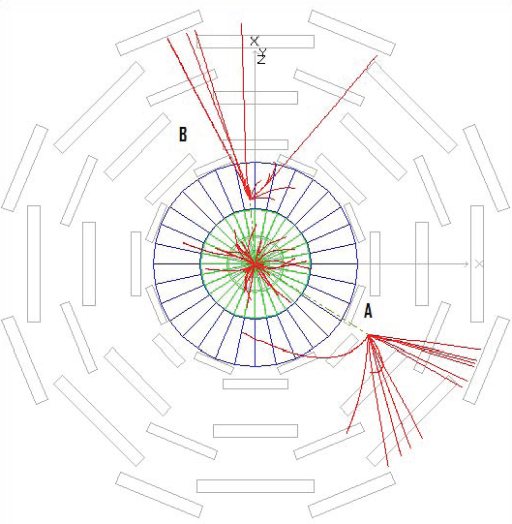
Detection strategy depends on where in the detector the decay happens
Prompt
Jet Appearing in the Calorimeter
Decay Product
[LJ or Hadronic Jets]
Displaced Vertex in a Tracker
Jet Appearing in the Muon Spectrometer
Distance from the Interaction Point
[Detector]
Lets concentrate on the calorimeter
Notes:
Normal signatures are not single detector
If the signature is all the way out of the detector, then you have missing ET only
This signal is rather stunning. We will be looking for selections put together that are equally stunning.
Ignore the prompt – mostly because the backgrounds from standard QCD are overwhelming to be searching for a rare decay! Especially from a Higgs or similar.

Slide 10
Identifying Displaced Jets in the ATLAS Calorimeter

Slide 11
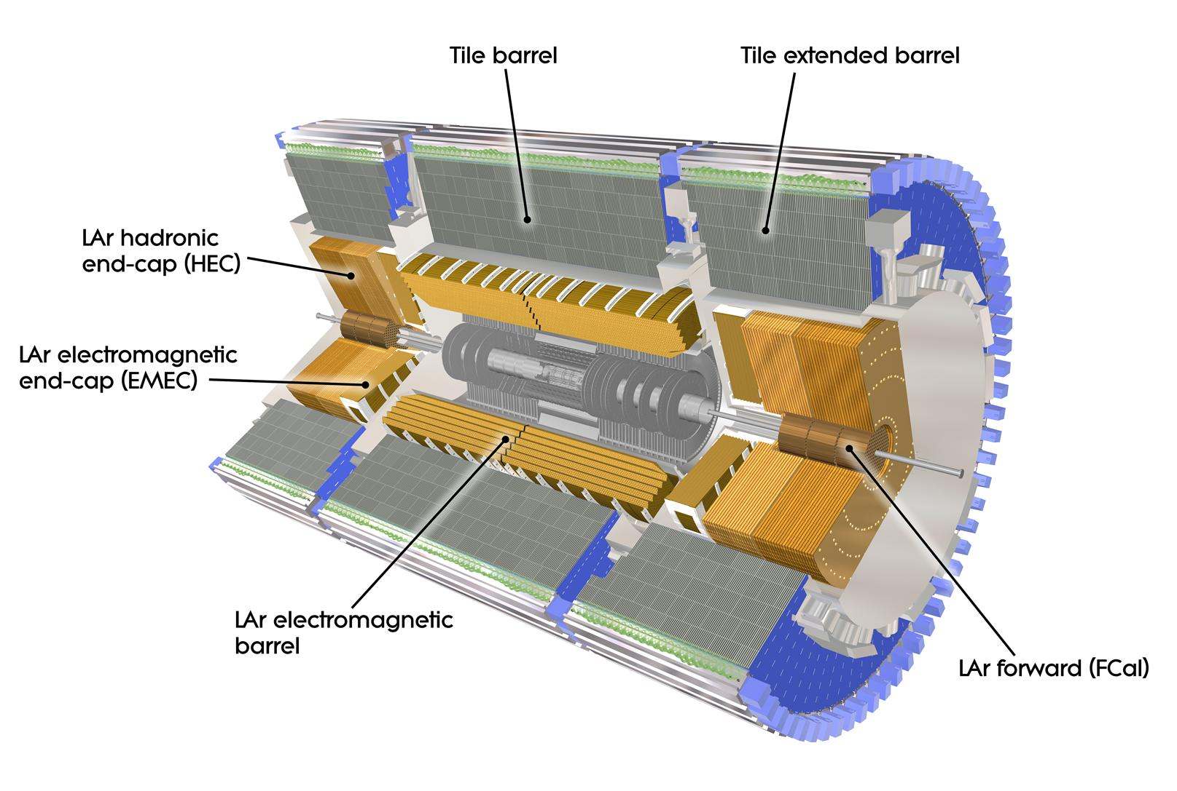
Decays in the Calorimeter
Look for the “appearance” of energy the Calorimeter
Little or no activity in the tracker

Slide 12
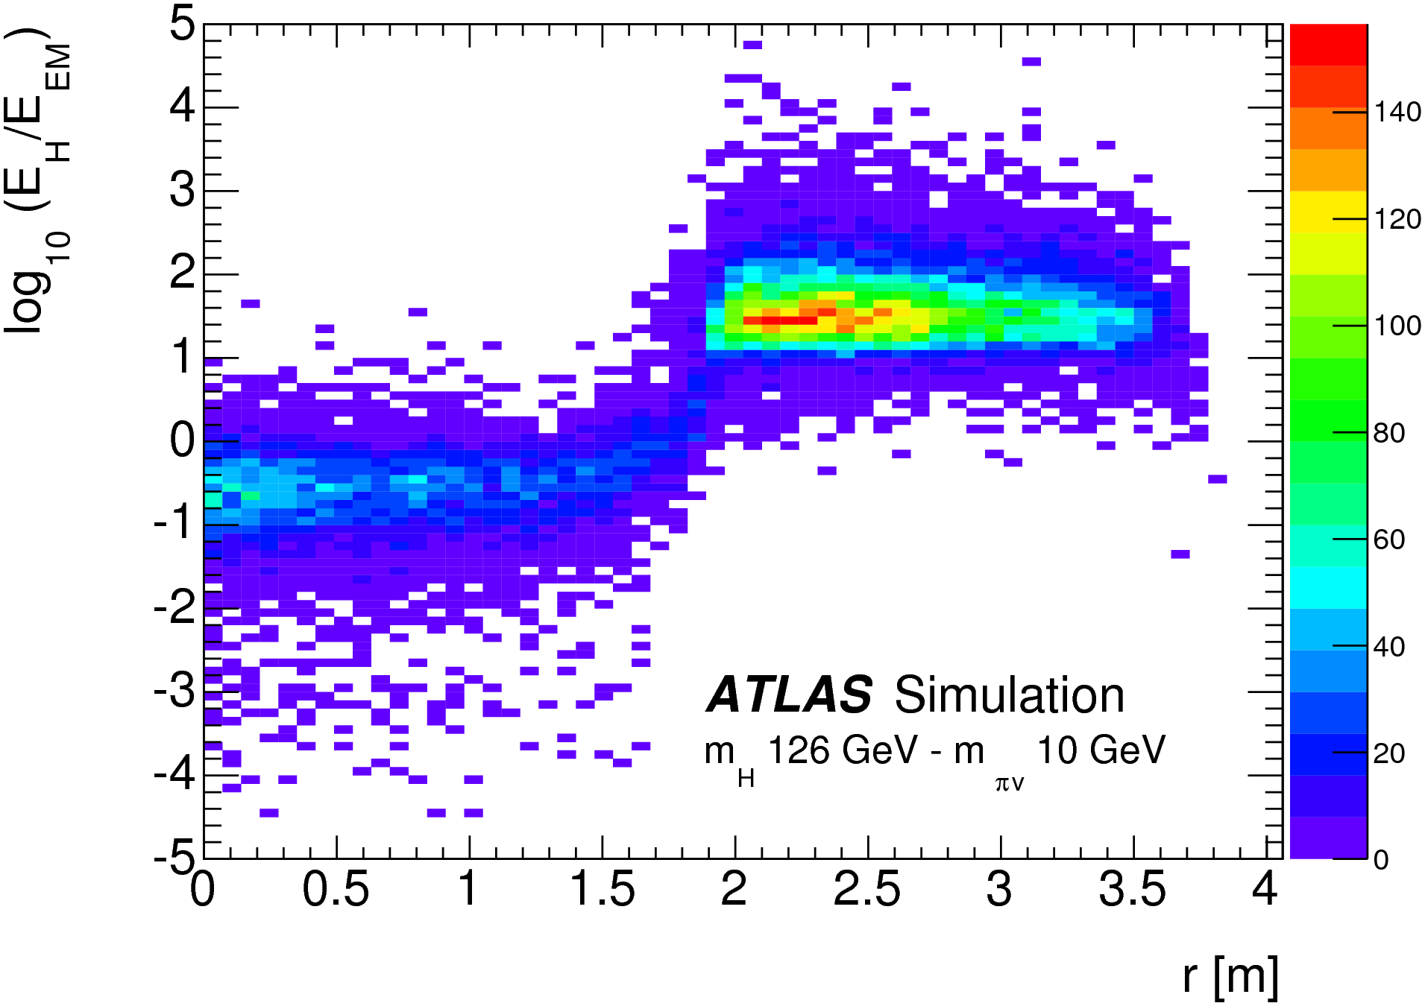
“CalRatio”
Signal Like
Background Like
Notes:
Keep in mind that these tails though they look small, are actually HUGE because this is QCD background we are talking about here!

Slide 13
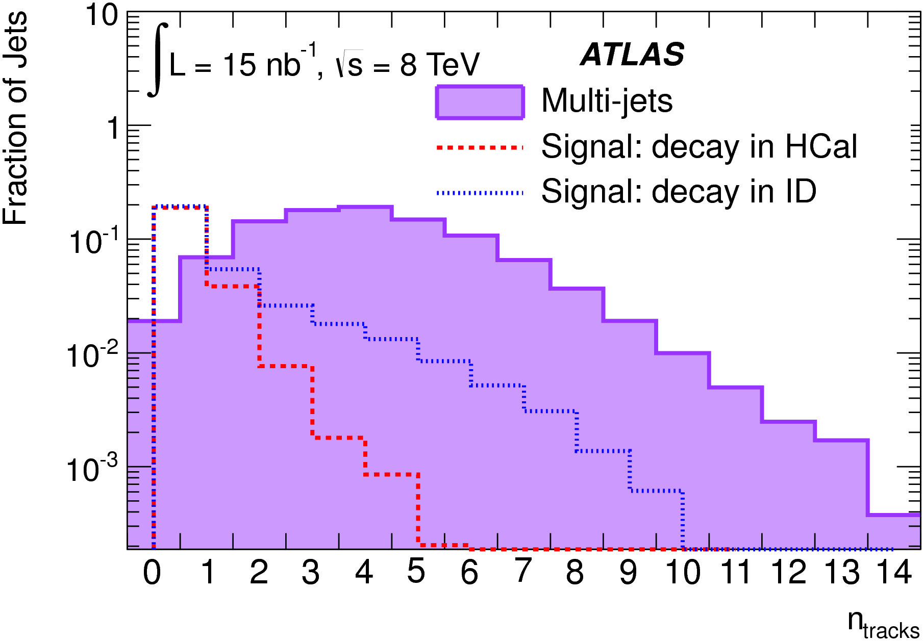
Notes:
Keep in mind that these tails though they look small, are actually HUGE because this is QCD background we are talking about here!

Slide 14
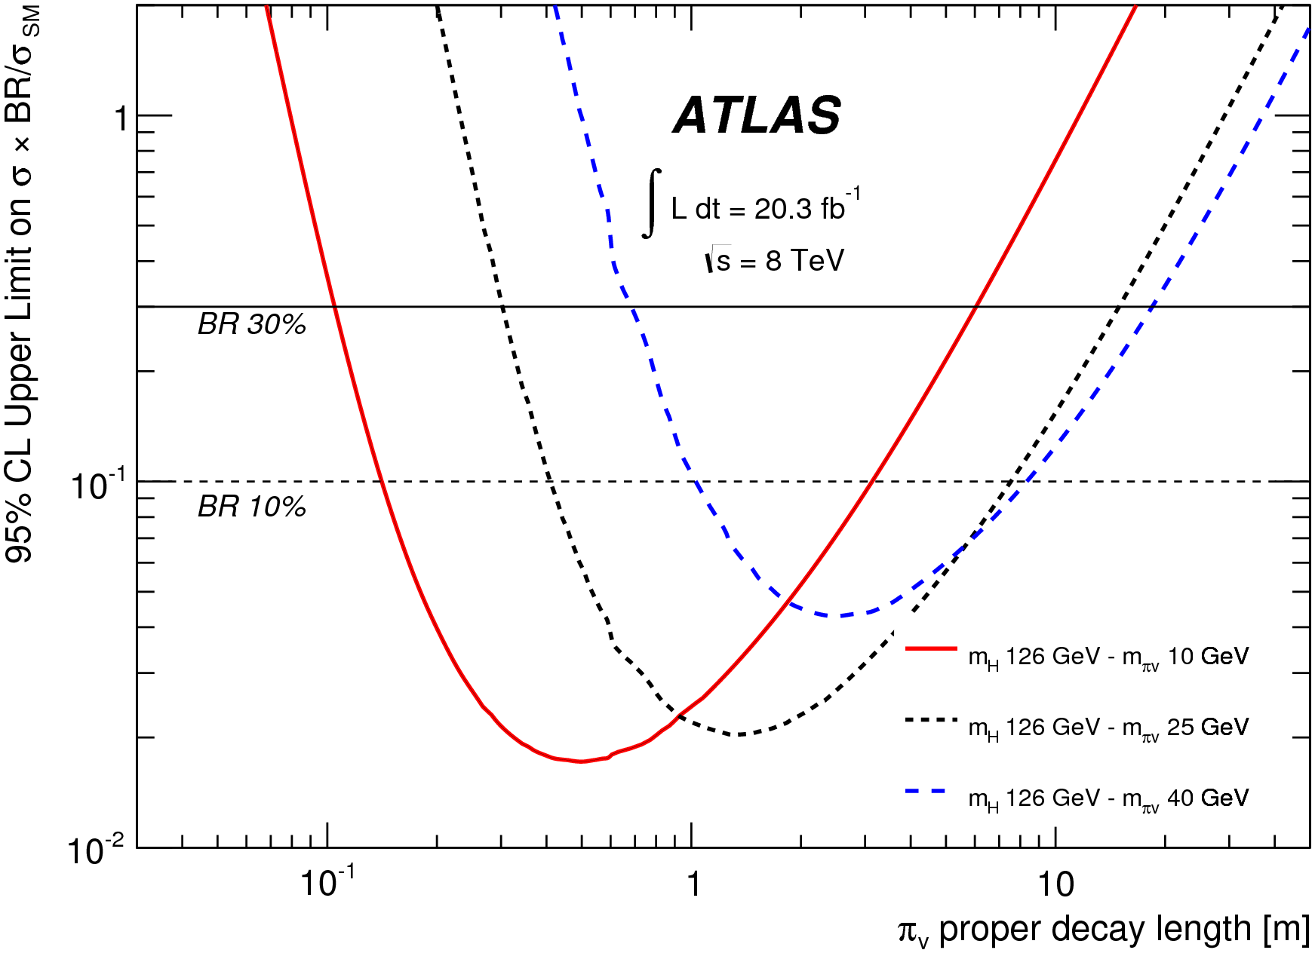
Can We Do Better?
There are lots more attributes connected with displaced jets

Slide 15
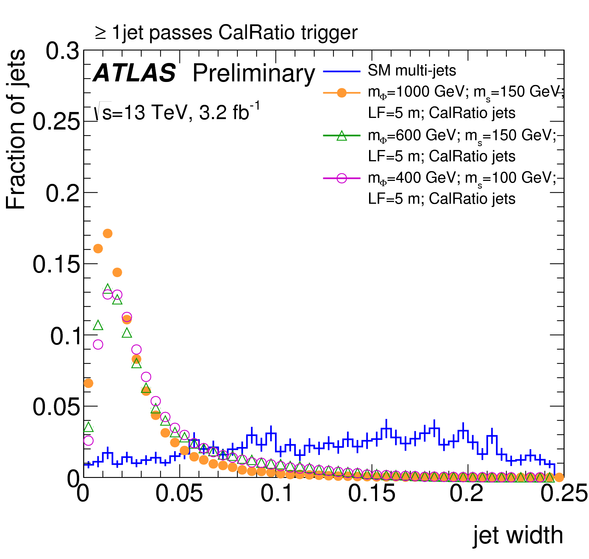
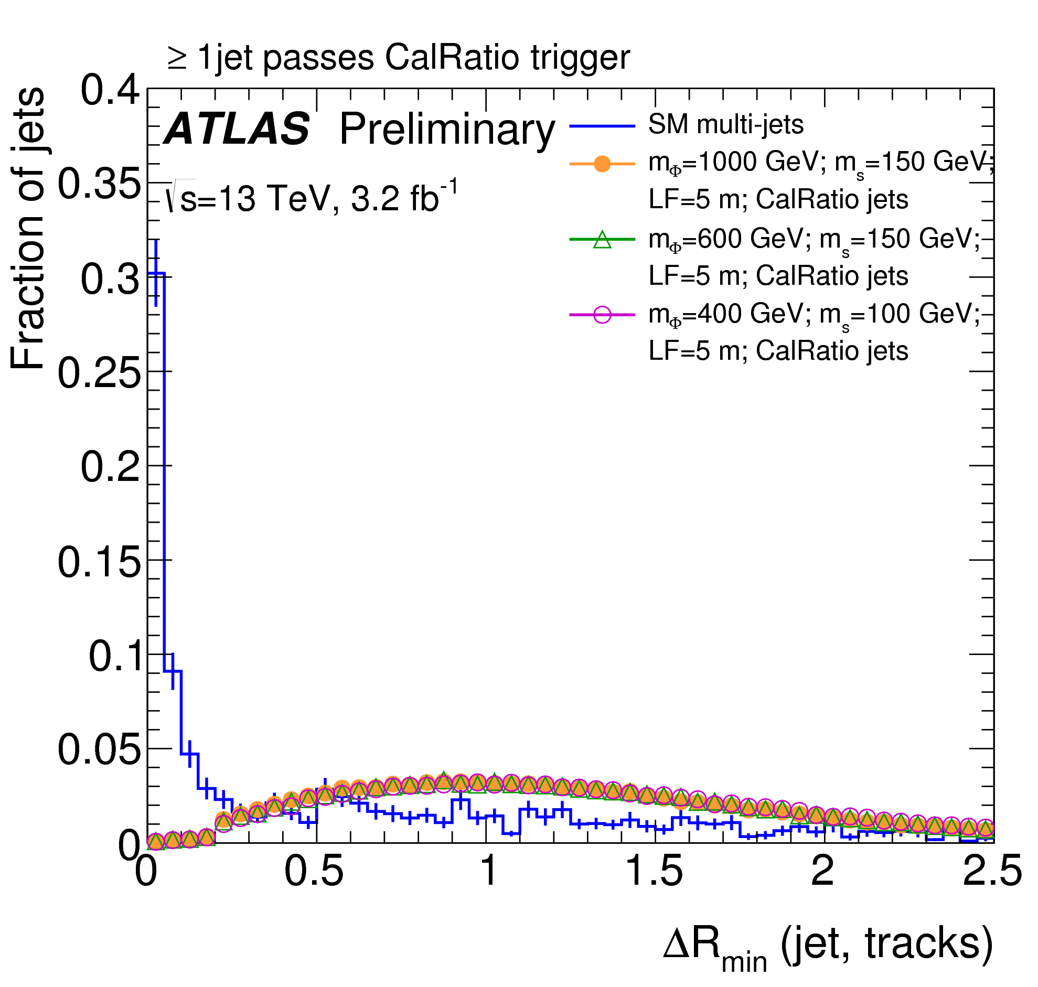
13 Jet Shape Variables

Slide 16
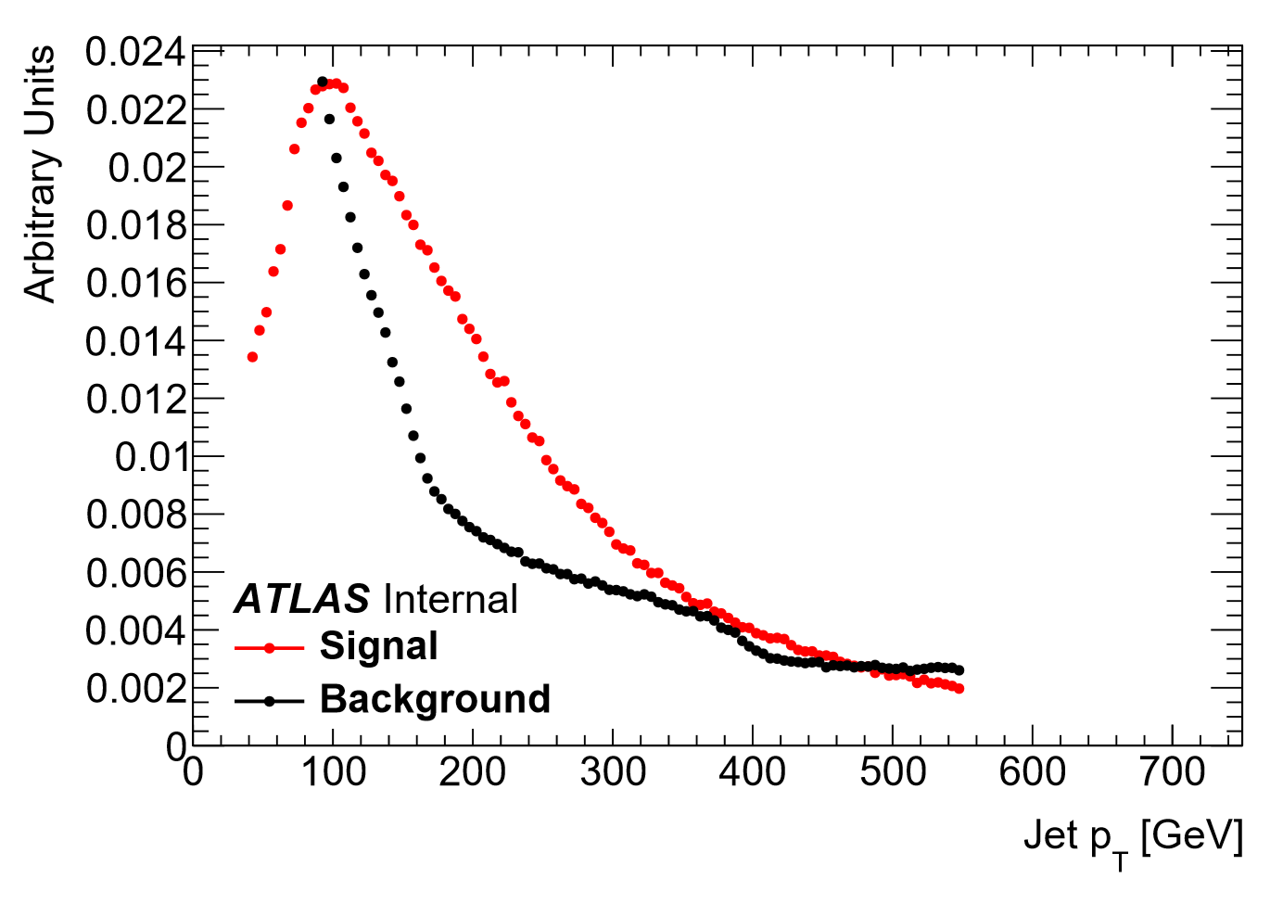


Boosted Decision Tree
We used TMVA, and an old version at that
Training:
Jets with $p_{T}>40$ GeV, $\left|η\right|<2.4$
Signal if $ΔR<0.2$ to a $π_{v}$
We are just finding out we are missing out here!
Reweight to flatten $p_{T}$ spectra to avoid model dependence

Slide 17
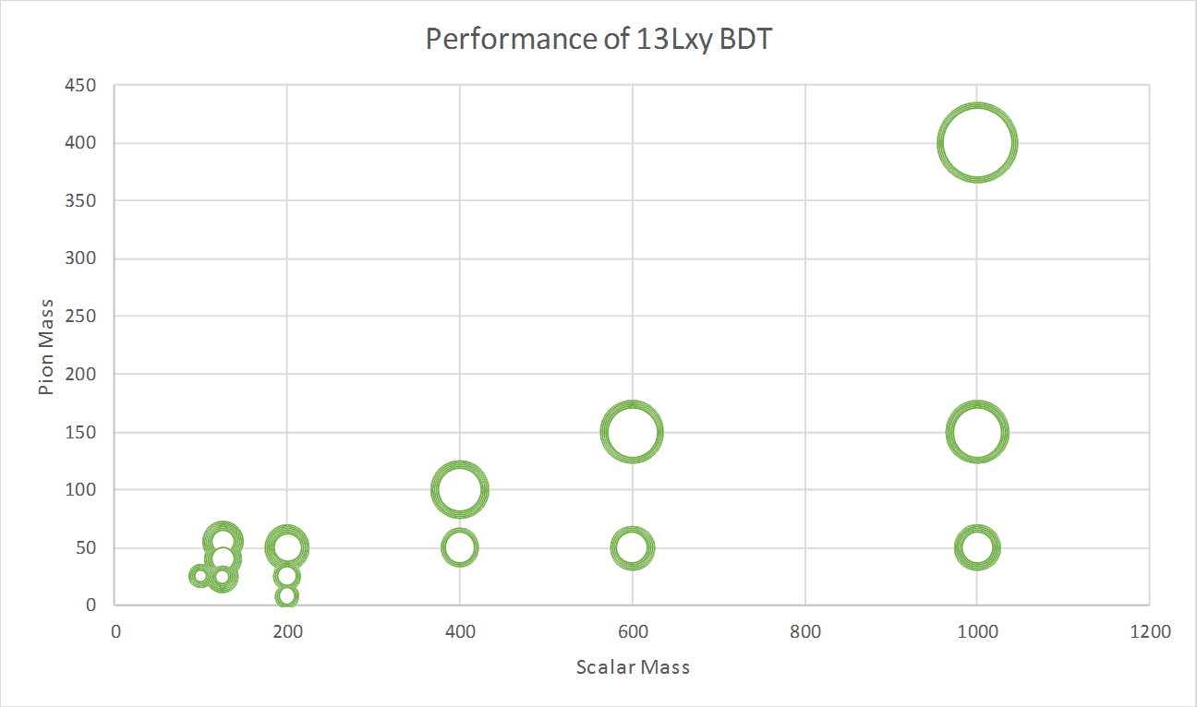
Training
A few parameter modifications from the defaults:
Minimum Leaf Size: 1%
Maximum Training Depth: 20
Signal Training: 944,638
Background Training: 1,499,996
Measuring performance:
What BDT cut gives you a straight-cut background rate?
Calculate the signal efficiency
Systematic Errors:
Many input variables depend on Jet Energy Scale
Required re-running on full sample many many times

Slide 18
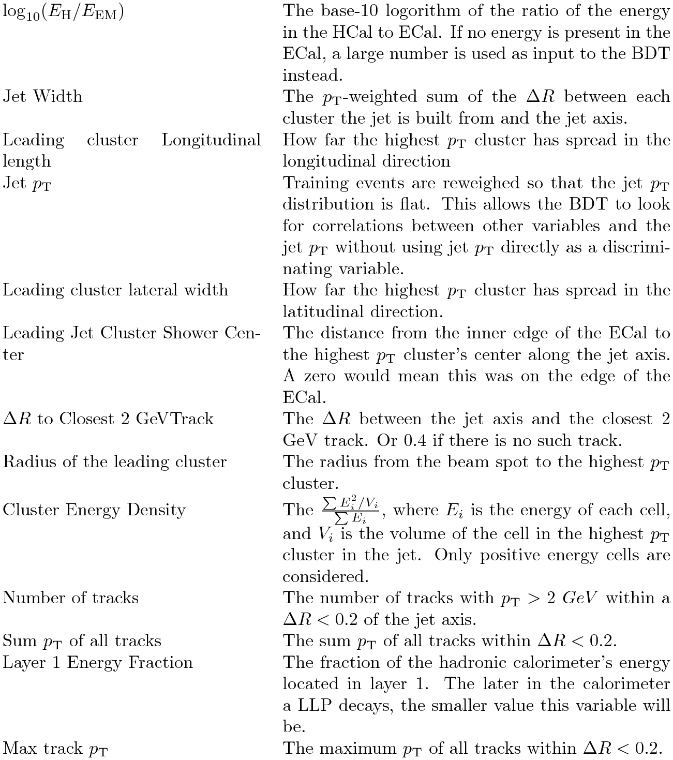

Ordered Variables
This result released as a conference note
Same sensitivity with 3.2 $fb^{−1}$ of data as the previous one with 20 $fb^{−1}$
  Note the $\sqrt{s}$ change!
Low mass sensitivity not as good in Run 2!

Slide 19
What is next?
We had to limit the sensitivity of the last BDT artificially.
Beam induced background is ugly and looks exactly like our signal.
Currently training a multi-class BDT to look for Multijet, signal, and Beam Induced Background
Per-Jet BDT
Signal Weight
Analysis BDT?
Multijet Weight
BIB Weight
Training separately… because we were unaware of the tools available
Further in the future:
The calorimeter is just a 3D CCD
These jets have particular shapes
Use Deep Learning to do image recognition.
Some work along these lines in other contexts has already been done

Slide 20

Peaches and Cream

Slide 21
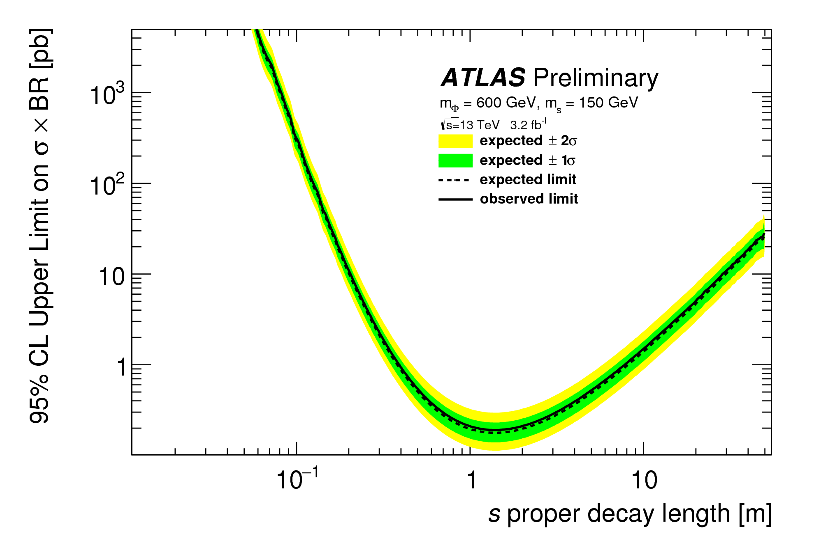
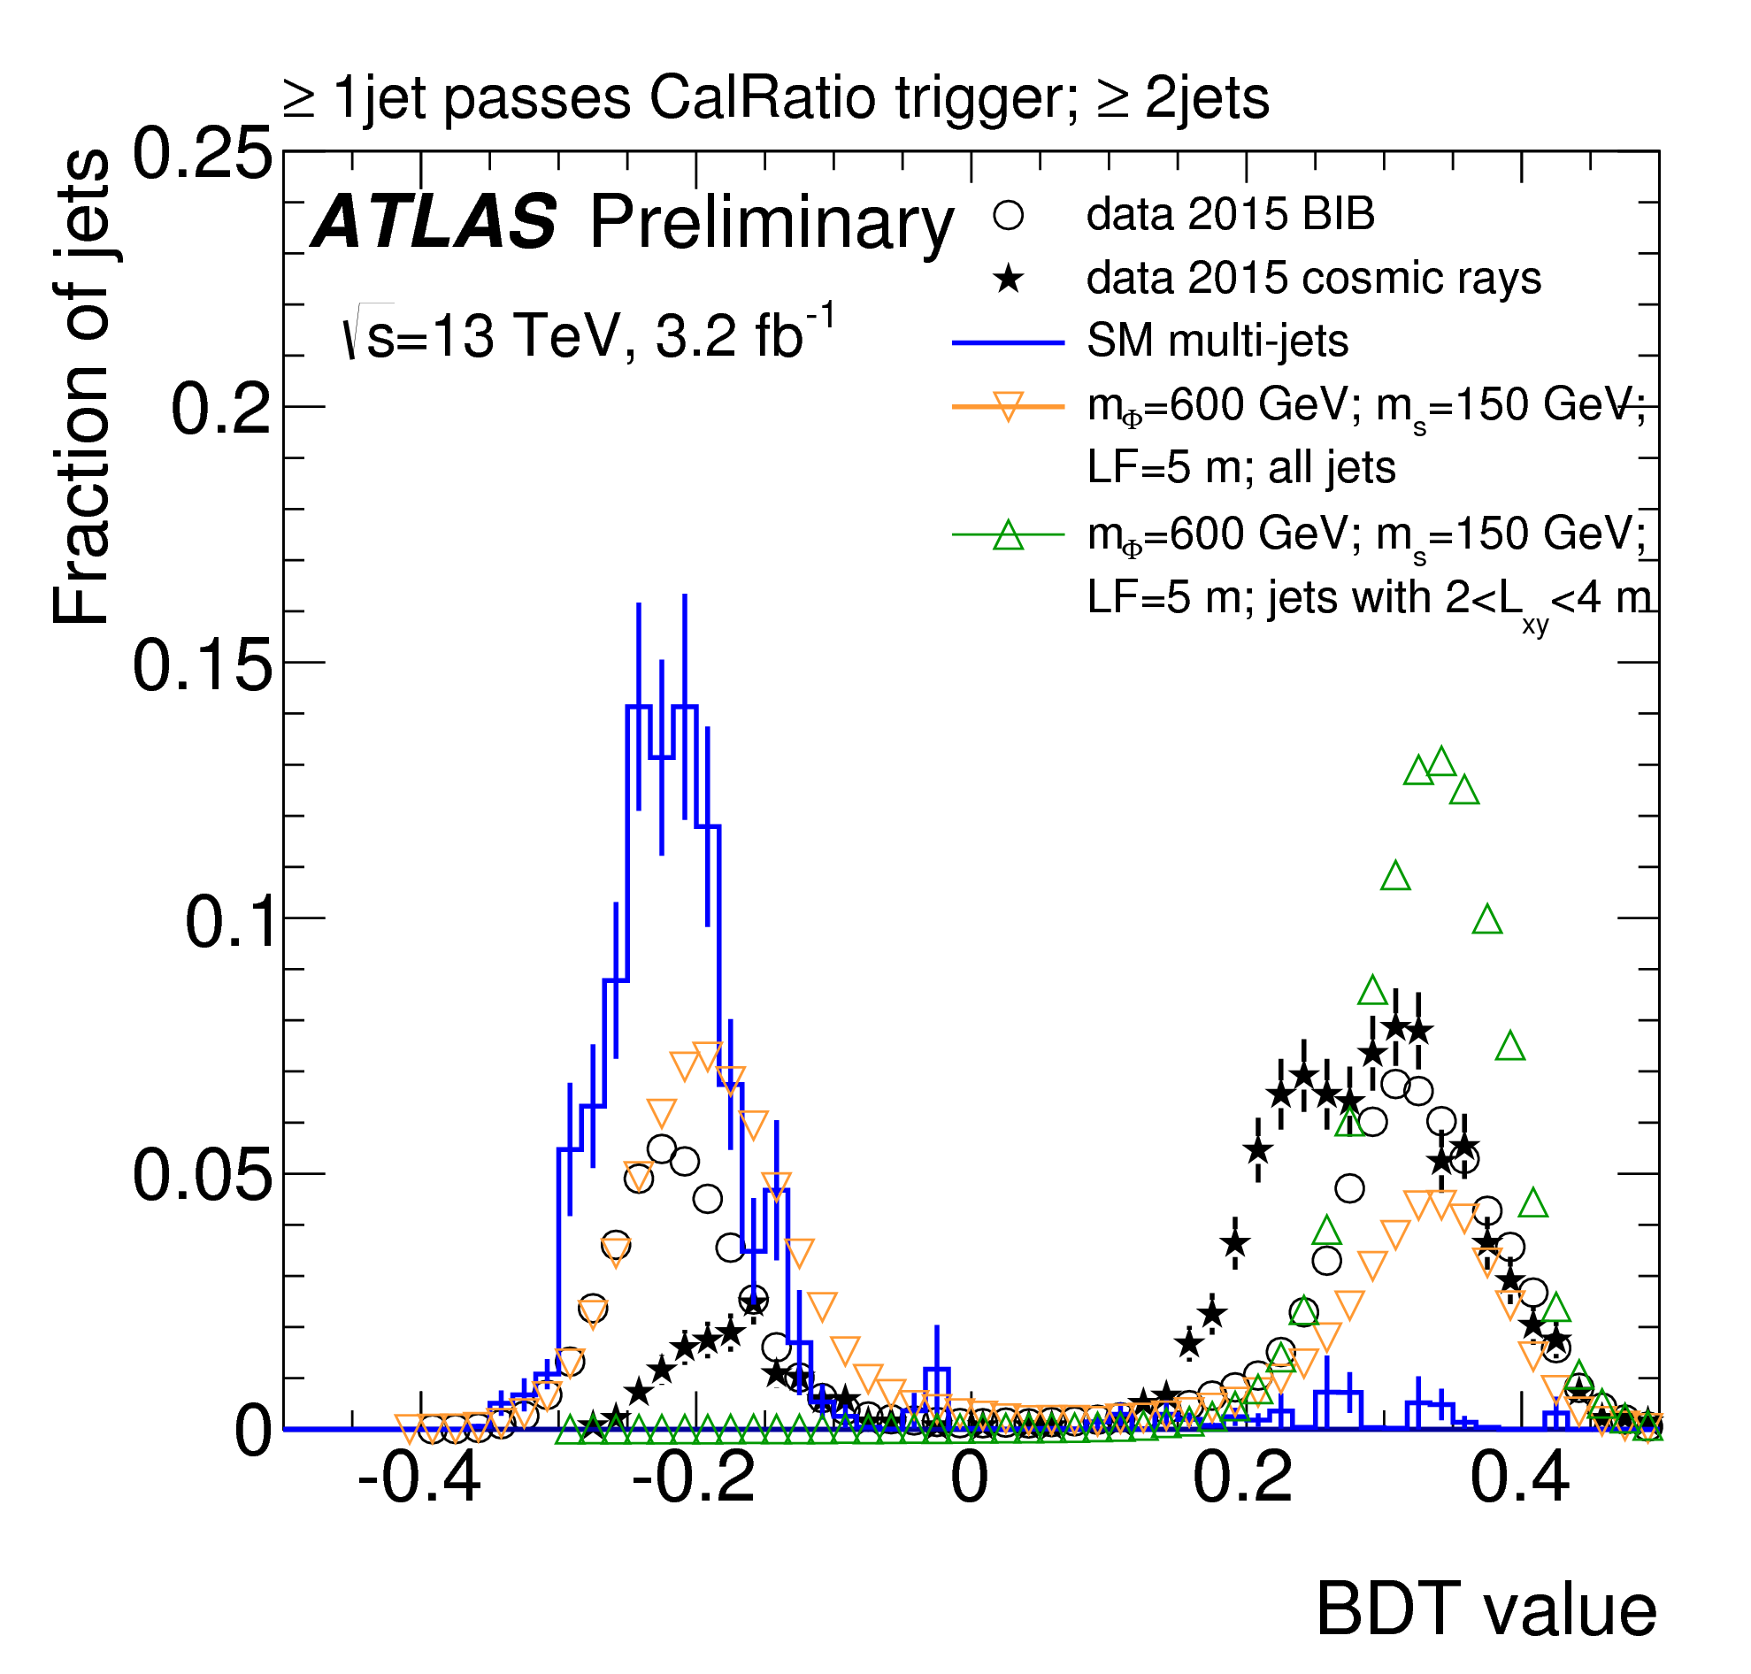
Pain…
GRID Samples
(xAOD)
Group Flat Ntuples
Training Ntuples
Training
I am a professor! How the heck can I tell the Internal Review Board what dataset I used on Tuesday, 6 months ago!?
Main Analysis Code
Training Evaluation
Partly ATLAS’ Fault
Partly the tools
Partly the analysis team

Slide 22
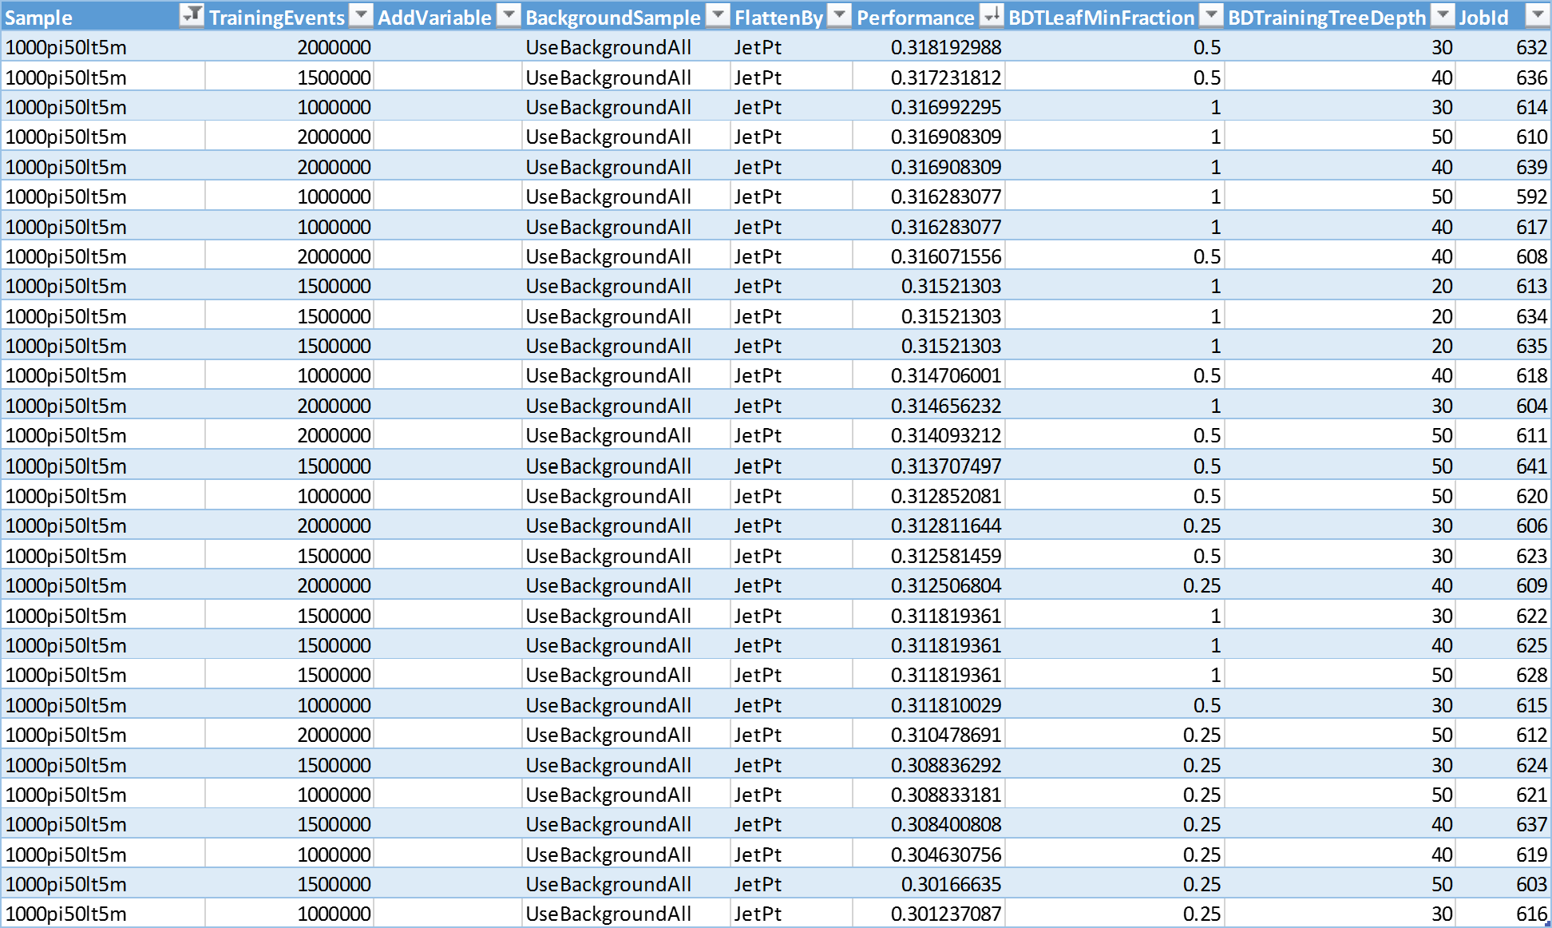
Testing the training required a huge amount of repeated runs.
Also a disaster to track.

Slide 23
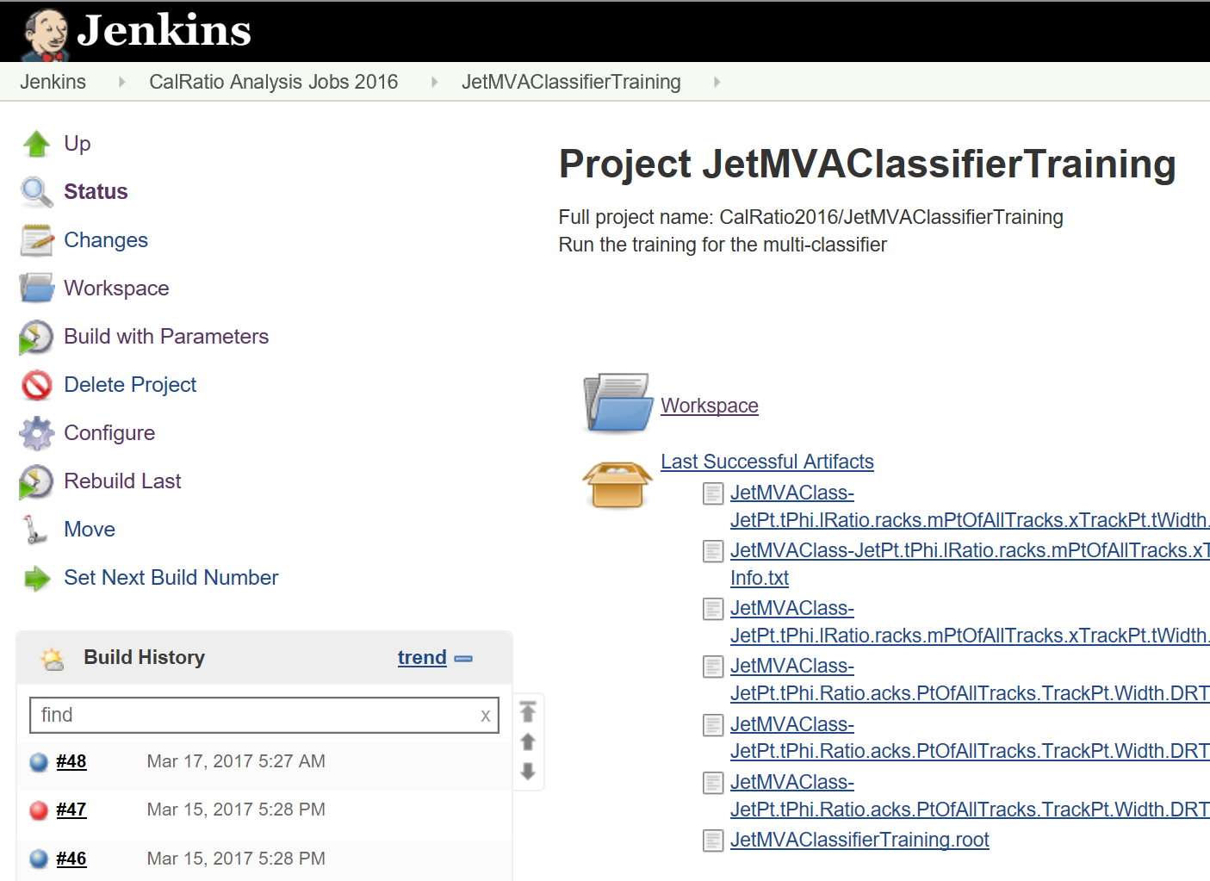
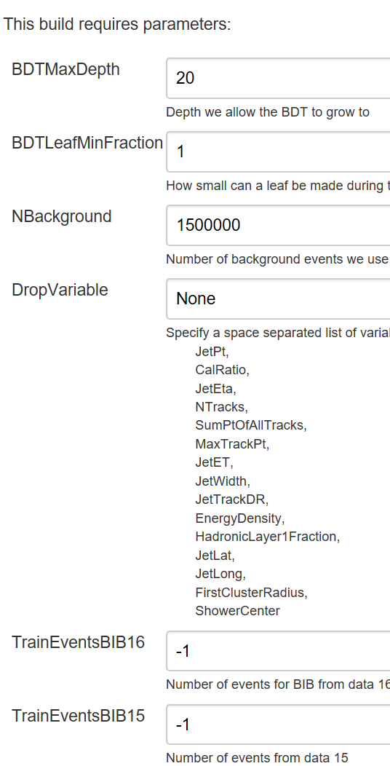
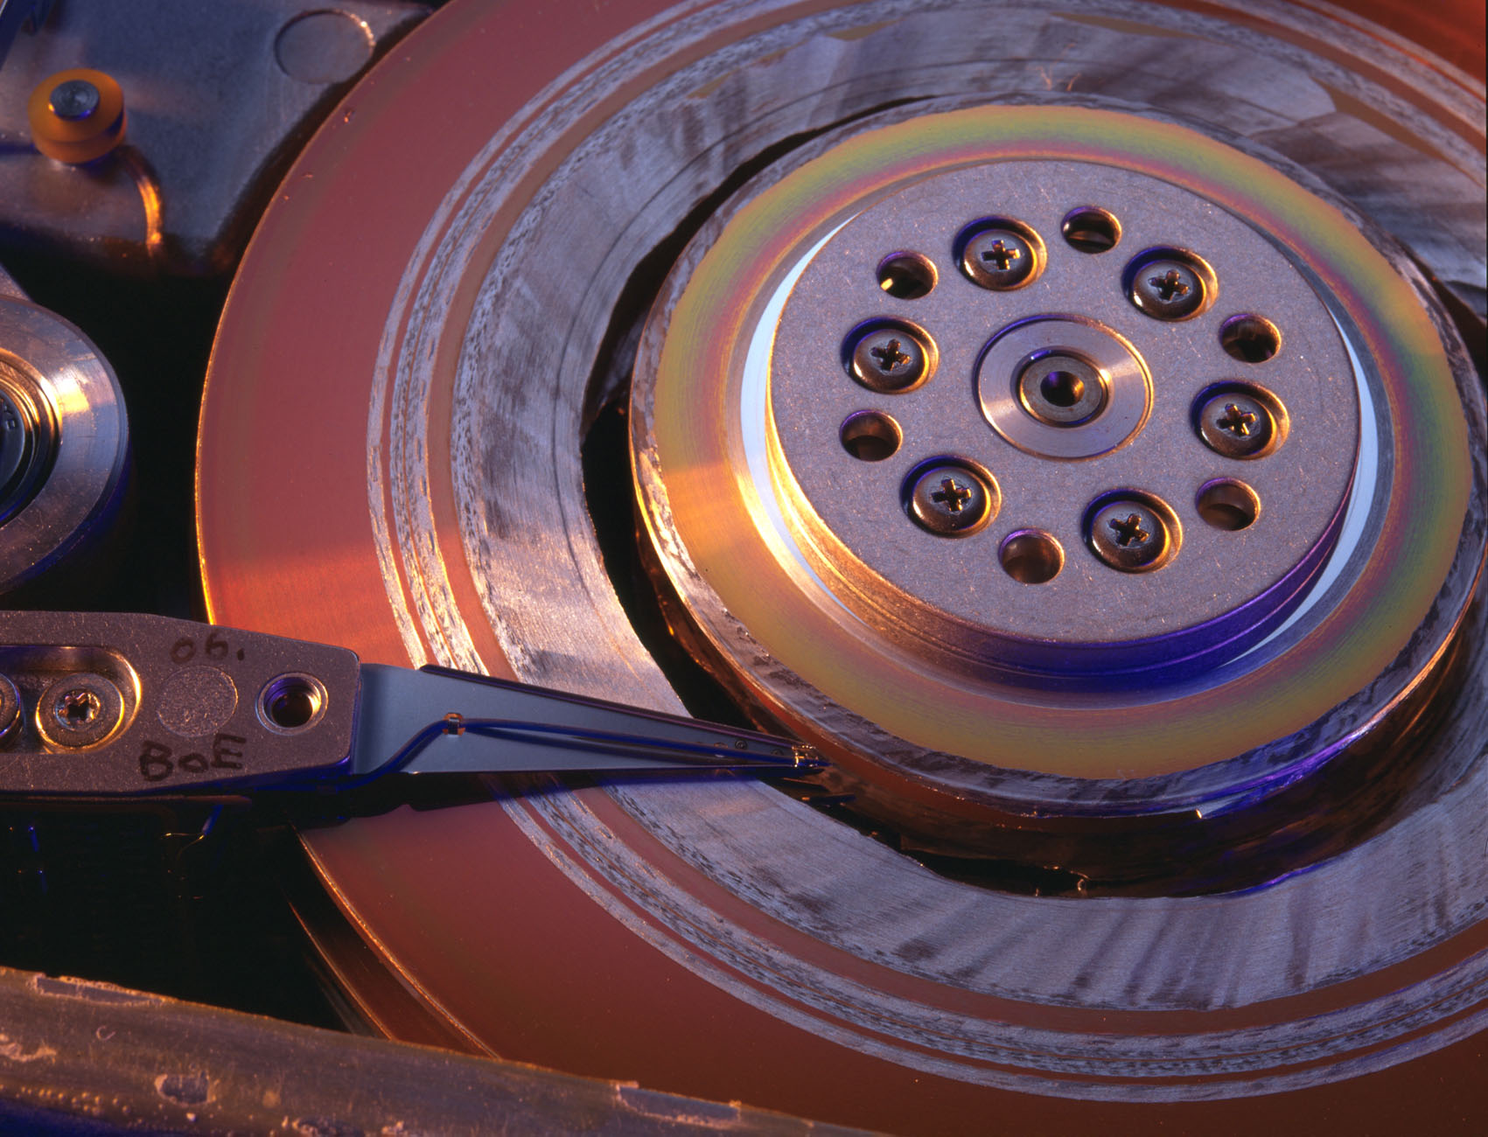
Automated Everything
Tracks from GRID to TMVA training XML
Scripts to download and scan log files automatically to generate performance tables
Command line configuration parameters

Slide 24
TMVA Training Simpler?
var training = flatSignalTrainingData
.AsSignal(isTrainingEvent: e => !(e.EventNumber % 3 == 1))
.Background(flatBackgroundTrainingData, isTrainingEvent: e => !(e.EventNumber % 3 == 1))
.UseVariables(varList);
// Build options (like what we might like to transform.
var m1 = training.AddMethod(ROOTNET.Interface.NTMVA.NTypes.EMVA.kBDT, "BDT")
.Option("MaxDepth", options.BDTMaxDepth.ToString())
.Option("MinNodeSize", options.BDTLeafMinFraction.ToString())
.Option("nCuts", "200")
;
// Do the training
var trainingResult = training.Train("JetMVATraining");
Does the required flexibility really require the existing TMVA complexity?
Obviously I should be exploring some of the tools mentioned here

Slide 25
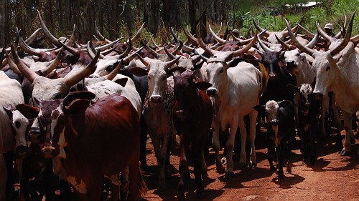
Conclusions
How to give theorists object efficiency plots for reinterpretation of the results
The Community White Paper processes
  The groups are not islands
  Analysis complexity is rising too fast
  For us: ML is too small a part of the overall experiment
Automate all tools
Make sure their use can easily be moved to the “cloud”
  Config files, network access required, keep to a minimum
I’ve been involved in ML for a long time
  Since DZERO single top discovery days
This is the first time I did it
  Rather than a student or post-doc of mine. ☺
I’m bullish in that given my limited analysis time I was able to contribute to an analysis
  Obvious measure of TMVA and ML’s success and accessibility
But, I am a “pet” analyzer

