Slide 1


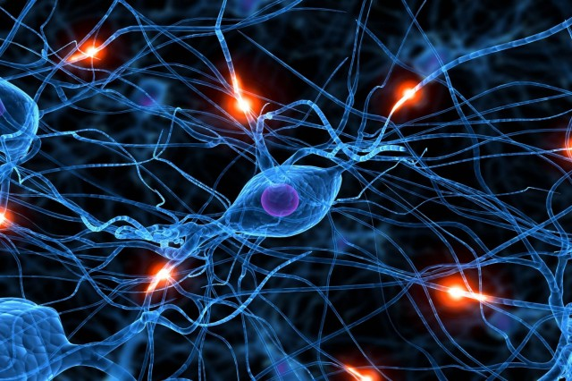
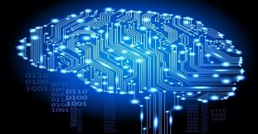
Machine Learning CWP
Sergei V. Gleyzer
IML Workshop
March 20, 2017

Slide 2
CWP
HSF CWP Webpage
HSF CWP-ML Google group
HSF CWP-ML Google doc

Slide 3
CWP-ML Timeline
Time-scale:
  three months
Part I:
  HSF San Diego Workshop
Part II:
  Today
Part III:
  DS@HEP
CWP Workshop in June

Slide 4
WG Charge
Scope: Machine Learning algorithms play an important role in many facets of today’s HEP data analysis, data-processing and detector applications. Machine-learning tools already form an important part of HEP software. To overcome the challenges related to data-processing and analysis of upcoming very large HEP data-sets, it is important to plan ahead for how HEP machine-learning software and tools develop. This group will work on both identifying the challenges related to machine-learning software in HEP and proposing possible solutions and a community roadmap towards better HEP-ML software.

Slide 5
Today
Look over questions
Discuss the roadmap towards possible answers
Edit individual sections

Slide 6
Groups
1. External and Internal ML Tools
2. New applications of ML and R&D
3. Bridges to other communities
4. Resources and related: Interactive, HPC, Cloud, GPUs, Storage
5. Training the community in ML

Slide 7
CWP-ML
Let’s begin!

Slide 8
CWP-ML Sections
1. Introduction
Motivation
Machine Learning and HEP

Slide 9
CWP-ML Sections
2. ML Software and Tools
Status
Software Methodology
Programming Languages
I/O
Parallelization
Interactivity
Interfaces to acceleration hardware
Sustainability

Slide 10
CWP-ML Sections
3. Computing Resources for ML
Data Storage
Training
Application
Data Availability

