Slide 1
CSCS-LCG2 Site report
HEPiX Spring 2017
Dino Conciatore - System Engineer - CSCS
Monday 24 April, 2017

Slide 2
Swiss National Supercomputing Centre

Slide 3


Swiss National Supercomputing Centre
Located in Lugano, Switzerland
Unit of the Swiss Federal Institute of Technology in Zurich (ETH Zurich)
  Flagship machine: Piz Daint
    Hybrid Cray XC50/XC40 system
    Intel E5-2690v3 - NVIDIA Tesla P100 / Intel E5-2695v4
Lugano Lake View
ETH Zürich View

Slide 4
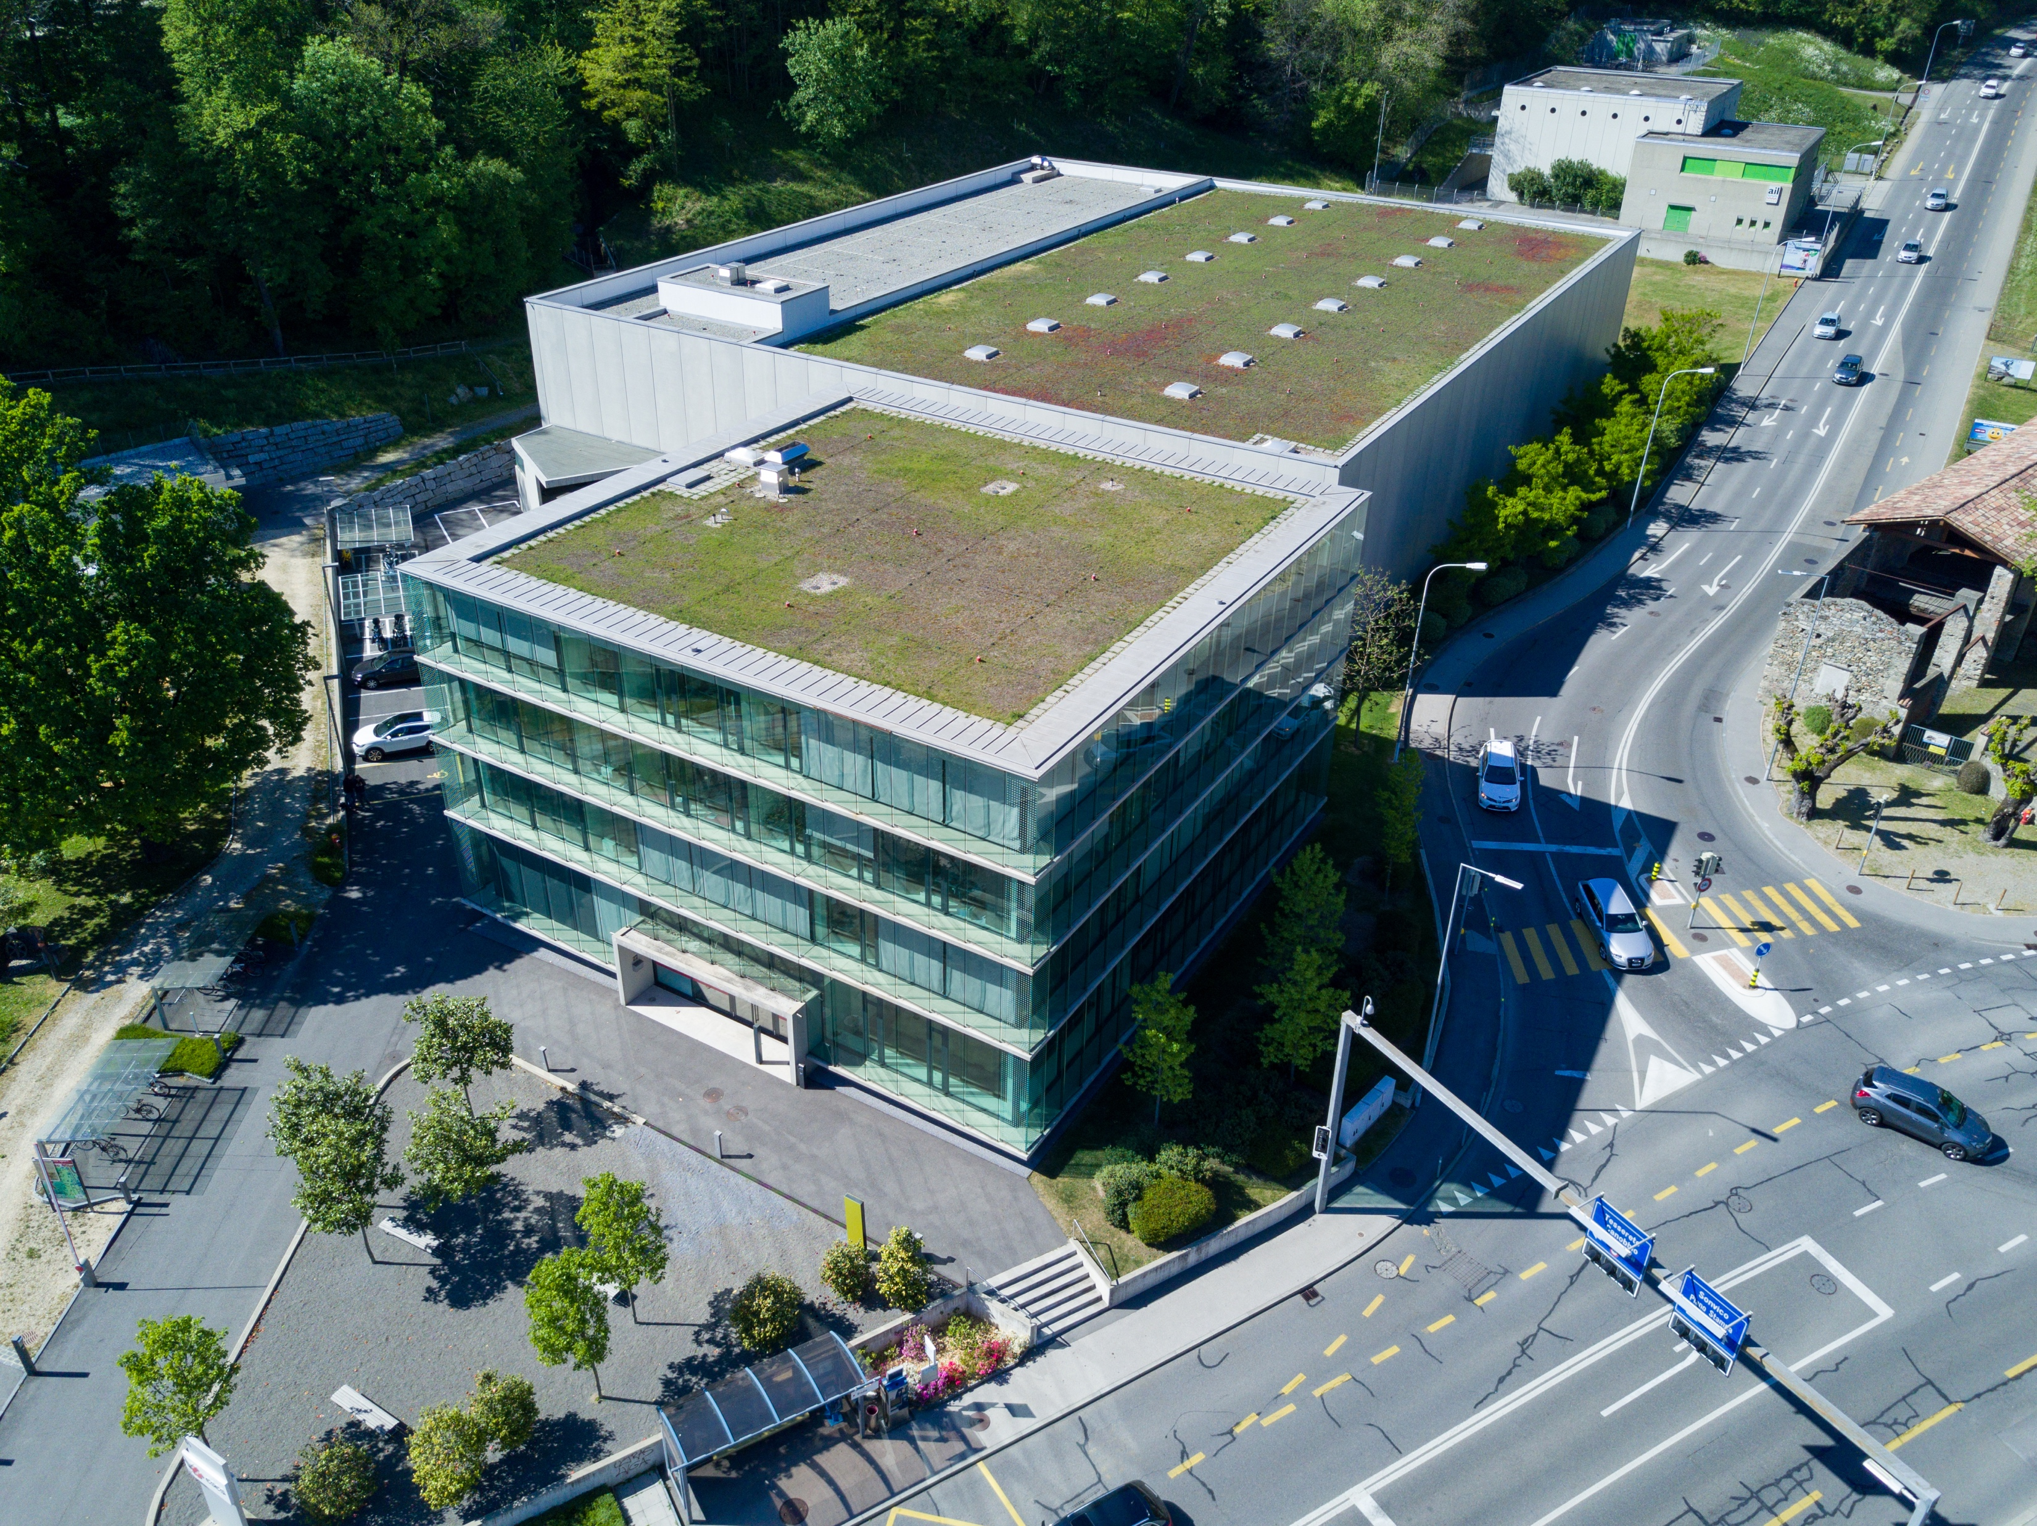
CSCS Facility - Offices and machine room

Slide 5
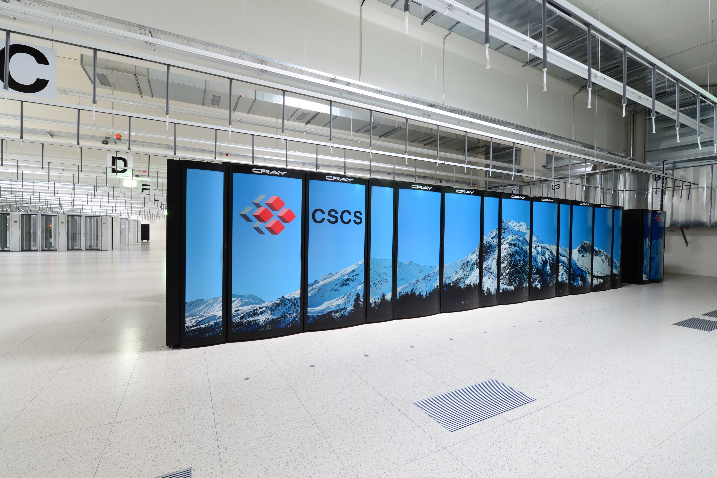
CSCS Facility – Machine room – Piz Daint

Slide 6
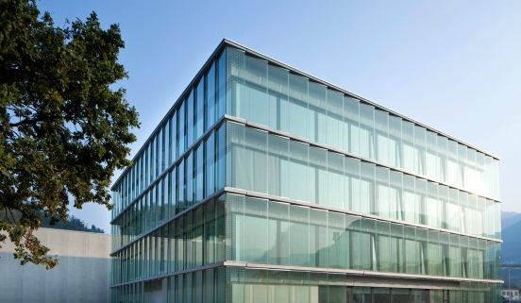
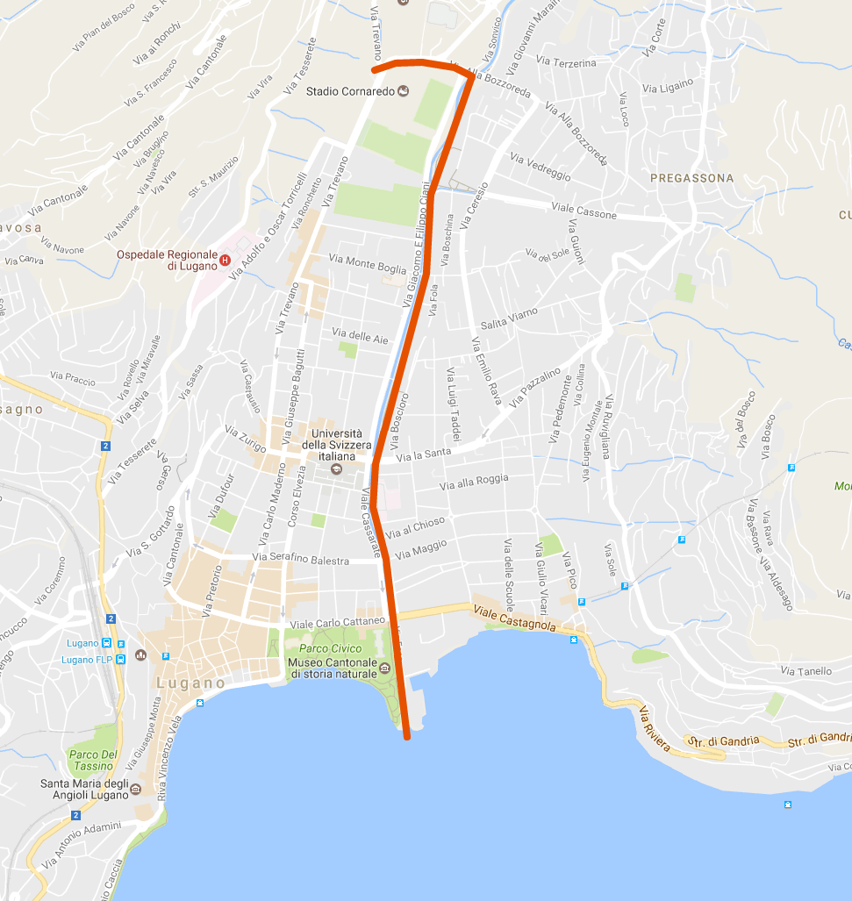
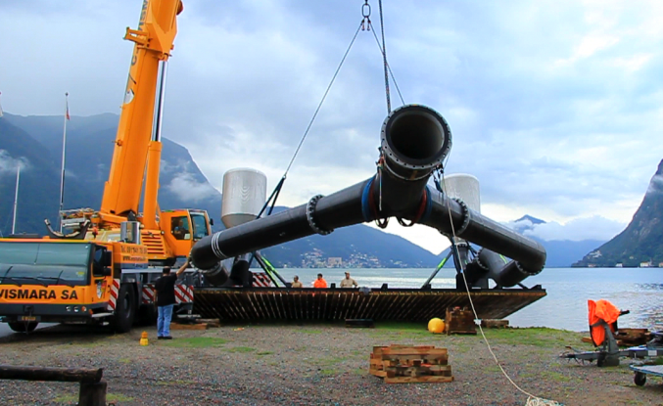
CSCS Facility – Free cooling (lake water)
Pipeline length: 2.8 km
High difference: 30 m
Max. flow rate: 760 l/s
Water taking depth: 45 m
Water temperature: 6 °C

Slide 7
CSCS-LCG2 Site report

Slide 8
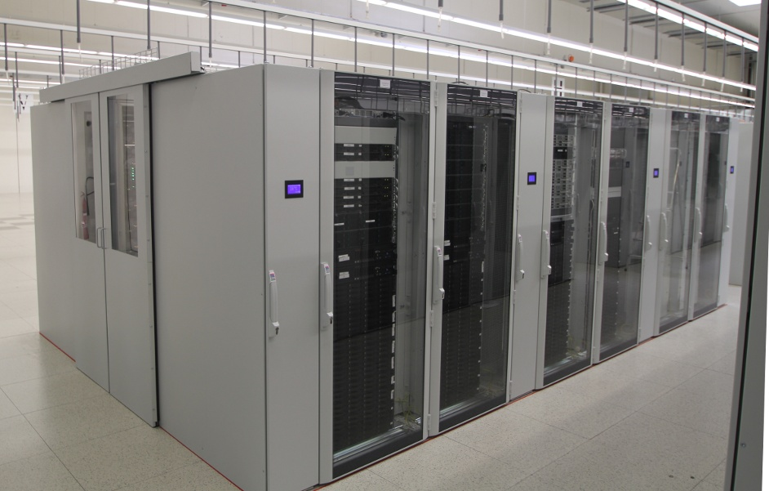
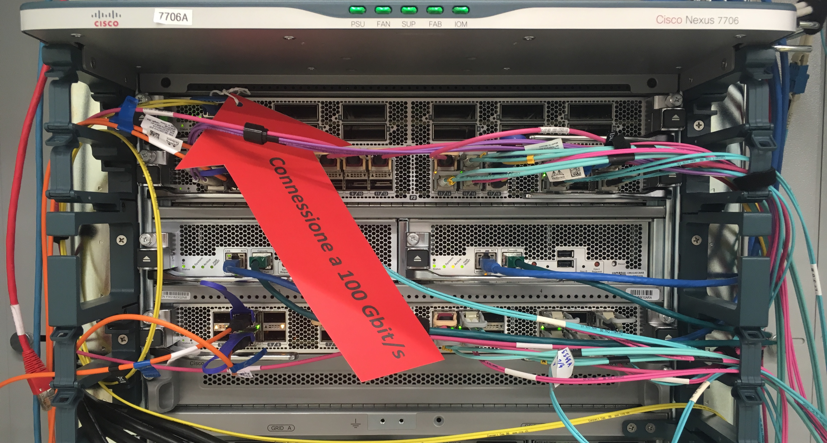
Dedicated T2 Cluster
3 VOs
  ATLAS – CMS - LHCb
  Shared resources
Compute
  6240 Job slots (SC and MC)
  3 CPU generations
  Total ~ 70 kHS06
  ARC middleware
  Fully puppetized
Network
  Infiniband (EDR / FDR)
  Ethernet
  Transparent IB to ETH Bridge @ 80Gbps
  100Gbps Internet (shared)

Slide 9
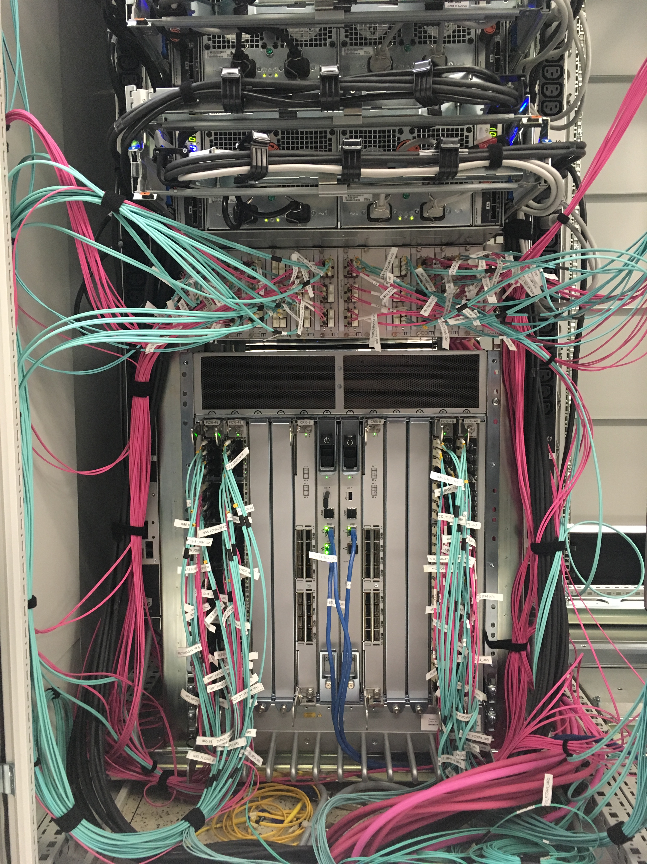
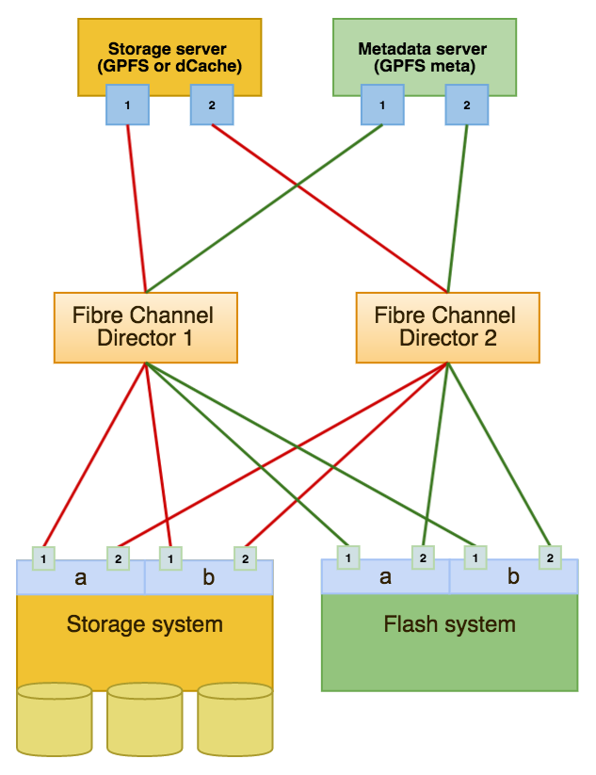
Dedicated T2 Cluster – SAN Storage
dCache (xrootd, dcap, gftp, srm)
  4.2 PB in total
/scratch – Spectrum Scale (formerly GPFS)
  DATA
    641 TB available
  META
    Flash Systems
    1TB available
    340M inodes

Slide 10
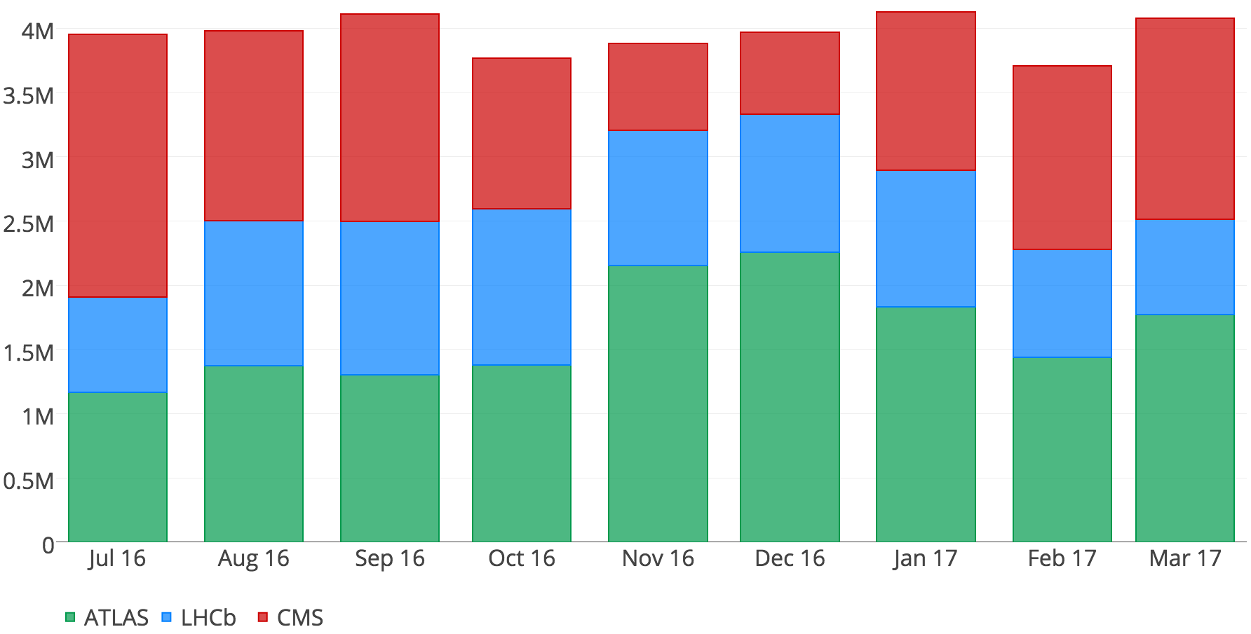
Cluster usage (walltime in hours)

Slide 11
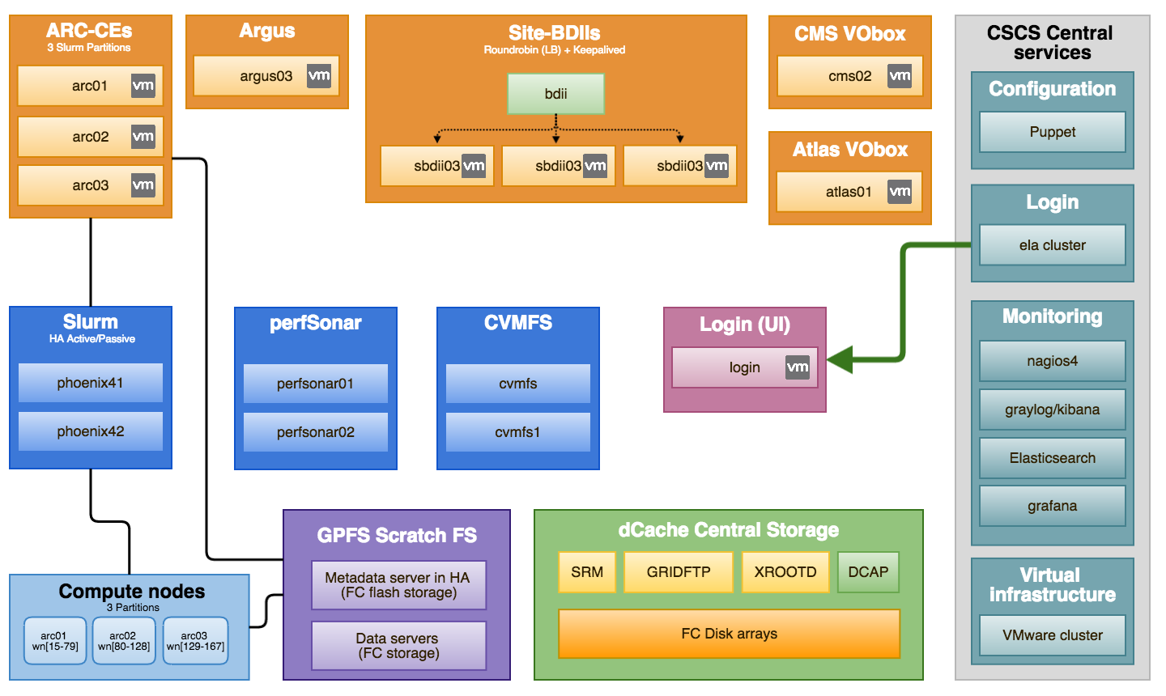
Services overview

Slide 12
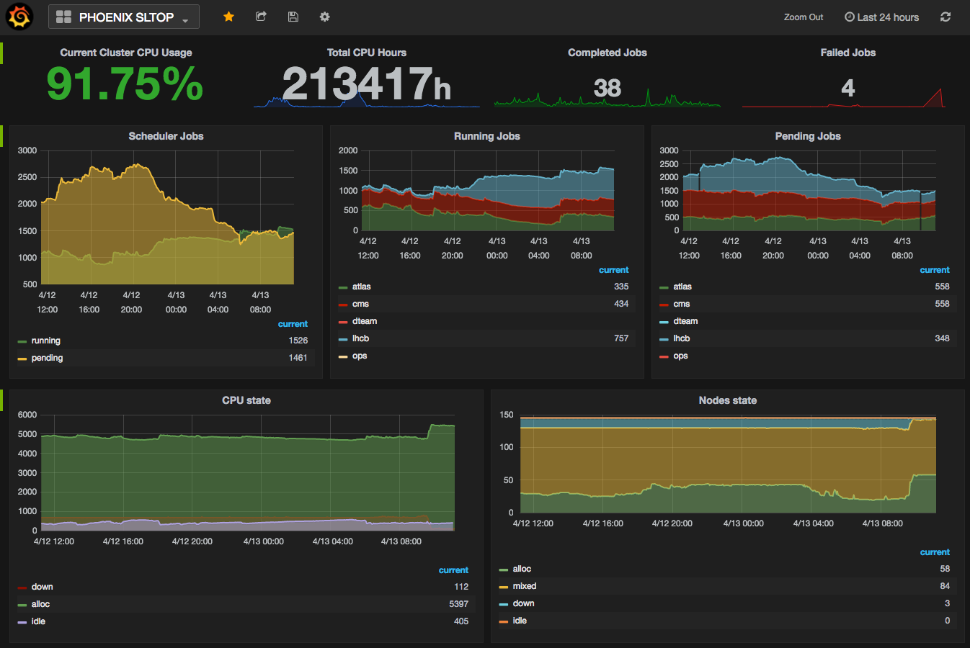
Cluster Status and Job Monitoring
  Python script collecting Slurm metrics (pyslurm lib)
  Slurm elasticsearch jobcomp plugin

Slide 13
LHConCray project

Slide 14
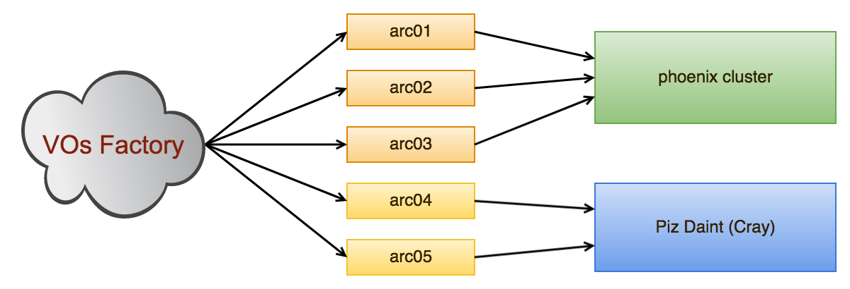
LHConCray project
Consolidation project to run LHC jobs on Piz Daint
  Started one year ago
  Recently started production
  The goal is to run production jobs without changes to the workflow
Normal workflow:
  Jobs submitted via ARC
  Running in containers (Shifter)
  CVMFS Native on cray nodes

Slide 15
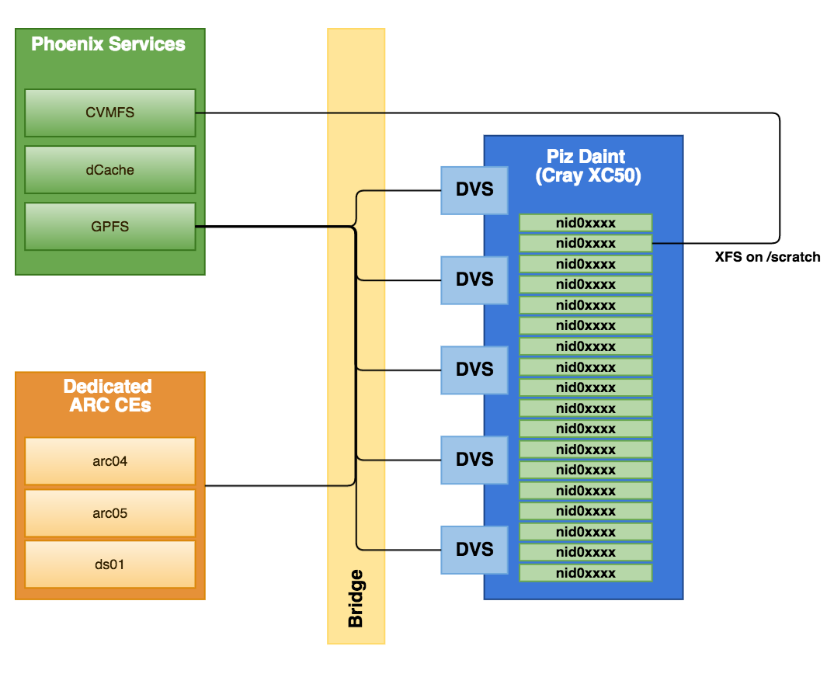
LHConCray project

Slide 16
Any Other Business

Slide 17
Challenges
Massive file creation (1M per minute, 250M in total)
  GPFS with Flash metadata and small files in metadata (feature)
  Quota per user/VO
3 VOs
  SLURM fairshare, 10k jobs in queue, cluster still full if one VO is not running for some reason
  Dealing with changes affecting all VOs
  dCache configuration complexity
  VOs are impacting each other in memory usage (swap)

Slide 18
Links
  CSCS
    http://www.cscs.ch/
  Pyslurm
    http://www.gingergeeks.co.uk/pyslurm/index.html
    https://github.com/Pyslurm/pyslurm/
  Jobcomp (SchedMD)
    https://github.com/SchedMD/slurm/tree/master/src/plugins/jobcomp/elasticsearch
  Shifter
    https://github.com/NERSC/shifter

Slide 19
Thank you for your attention.

