Slide 2
CERN IT-Storage
Strategy Outlook
Alberto Pace, Luca Mascetti, Julien Leduc

Slide 3
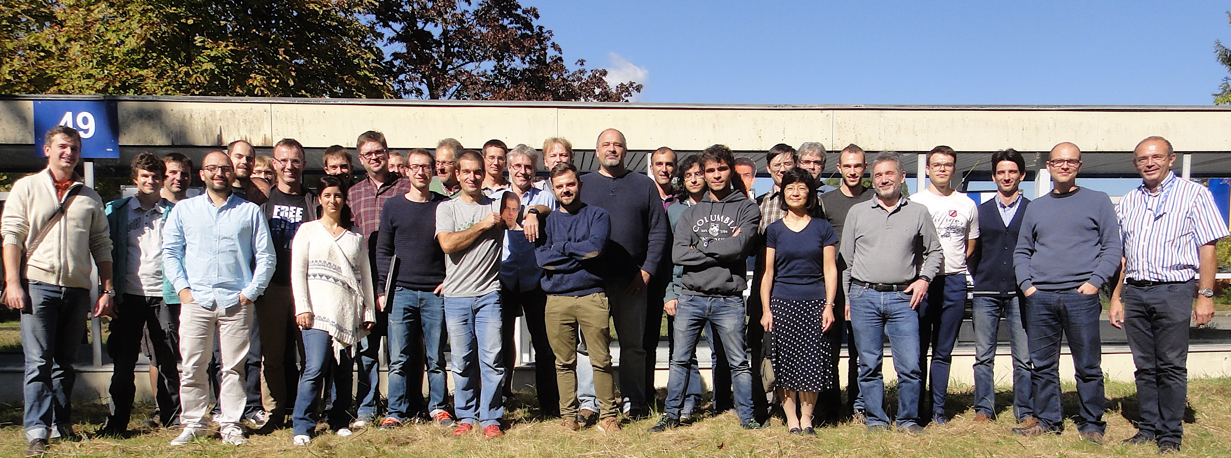

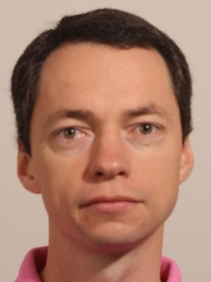
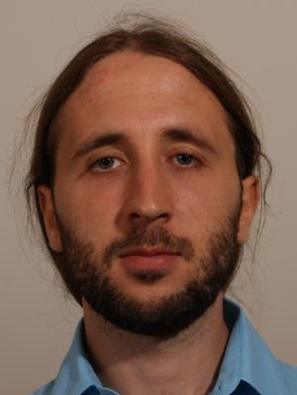
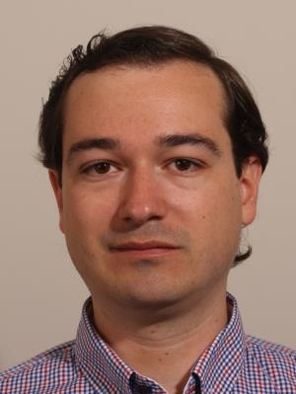
CERN IT-Storage Group

Slide 4
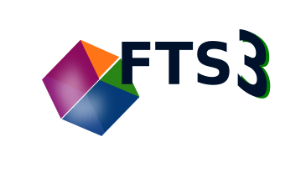






Storage Services
AFS
NFS
CVMFS
RBD
S3
TSM
ceph
CASTOR
SSD

Slide 5
Vision for CERN Storage
Build a flexible and uniform
infrastructure
Maintain and enhance (grid) data management tools

Slide 6
Vision for CERN Storage
  Unlimited storage for LHC experiments, at exabyte scale
    EOS Disk pools (on-demand reliability, on-demand performance)
      currently 165 PB deployed
    CERN Tape Archive (high reliability, low cost, data preservation)
      currently 190 PB stored
  A generic home directory service – currently 3 PB
    To cover all requirements of personal storage
    Shared among all clients and services
    Fuse mounts, NFS and SMB exports,
    Desktop Sync and Web/HTTP/DAV Access

Slide 7



EOS Development Strategy
Evolve flexible storage infrastructure as scale-out solution towards exabyte scale
  one storage – many views on data – analysis/analytics service integration
  suitable for LAN & WAN deployments
  enable cost optimized deployments
Evolve file-system interface /eos
  multi-platform access
  using standard protocol bridges CIFS, NFS, HTTP
Evolve namespace scalability
  scale-out implementation
Evolve scale-out storage back-end support
  object disks, object stores, public cloud, cold storage

Slide 8
EOS Challenges
Remote access APIs ⇒ filesystem API
Meta data scale-up ⇒ scale-out
  in-memory namespace ⇒ in-memory scale-up namespace cache + persistency in scale-out KV store
1st key project: EOS FUSE rewrite
2nd key project: EOS Citrine & QuarkDB

Slide 9
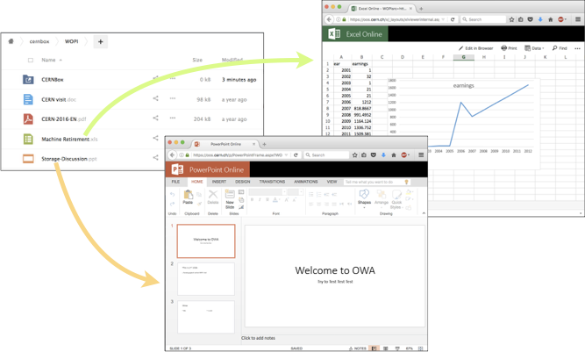
CERNBox
Strategic service to access EOS storage
  Unprecedented performances
    LHC experiments data workflows
  Access to all CERN physics (and accelerator) bulk data
  Disconnected / Offline Work
  Easy Sharing model
  Main Integration Access Point
    SWAN, Office Online, …
  Checksum and consistency

Slide 10
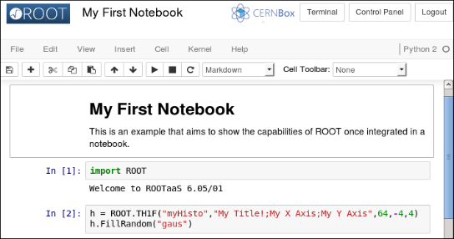
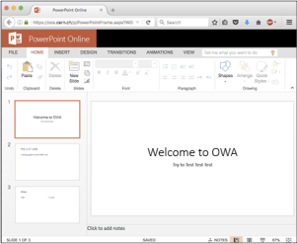
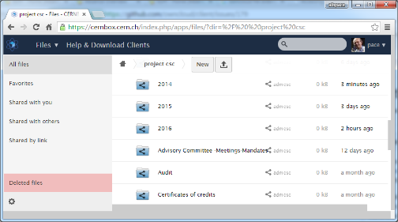
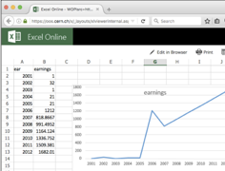


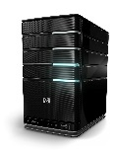

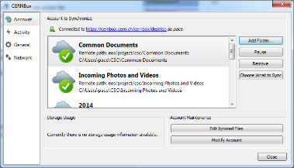
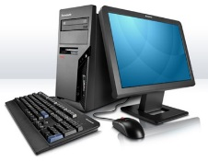
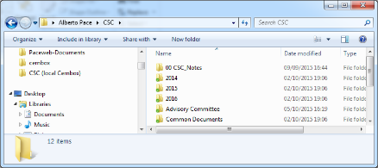

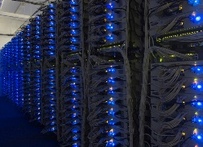
Architecture
Web browser access
(web access)
Sync client (CERNBox)
CERNBOX web interface
(offline access)
http sync protocol
Tape
Archive
Physicists
Engineers
Administrative staff
(online access)
http, fuse
Webdav, NFS,
SMB, xroot
Clusters (Batch, Plus, Analytics, …)
Disk Pools (EOS)
Applications
(Page 1, LHC Logging, …)

Slide 11
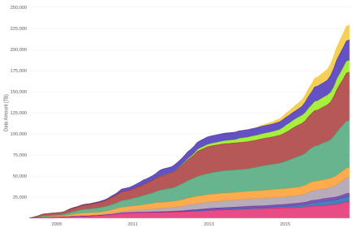

Data Archiving evolution
Preserving the past …
  Protect against bit rot (data corruption, bit flips, environmental elements, media wear out and breakage …)
  Migrate data across technology generations, avoiding obsolescence
    Some of our data is 40 years old
Data written to tape 2008-2016
… and anticipating the future
  2017-2018: 100PB/year
  2021++ : 150PB/year

Slide 12


Storage Services Evolution
NFS
CVMFS
RBD
S3
TSM
CTA
ceph
CASTOR
SSD

Slide 13

Data Archiving: Evolution
EOS + tape …
  EOS is the strategic storage platform
  Tape is the strategic long term archive medium
EOS + tape =
  Meet CTA : the CERN Tape Archive
  Streamline data paths, software and infrastructure
Notes:
CTA will provide optimise

Slide 14
What is CTA?
  CTA is
  A tape backend for EOS
  A preemptive tape drive scheduler
  A clean separation between disk and tape
One EOS instance
per experiment
Central CTA instance
EOS
namespace and redirector
Archive and
retrieve requests
CTA
front-end
Tape file catalogue,
archive / retrieve queues,
tape drive statuses,
archive routes and
mount policies
Archive and
retrieve requests
Tape files appear in EOS namespace as replicas.
EOS workflow engine glues EOS to CTA
CTA
metadata
Tape library
Scheduling information
and tape file locations
Tape drive
EOS
disk server
CTA
tape server
Tape drive
EOS
disk server
CTA
tape server
Tape drive
EOS
disk server
CTA
tape server
Files
Files
Tape drive

Slide 15
What is CTA?
    EOS plus CTA is a “drop in” replacement for CASTOR
    Same tape format as CASTOR – only need to migrate metadata
Current deployments with CASTOR
Future deployments with EOS plus CTA
EOS
EOS
Files
Files
Experiment
Files
Experiment
Files
Files
Tape
libraries
Files
Tape
libraries
CASTOR
Files
EOS + CTA
Files

Slide 16
When is CTA?
Mid 2018
End 2018
Ready for small experiments
Ready for LHC experiments
Mid 2017
First release for additional copy use cases

Slide 17
CTA outside CERN
CTA will be usable anywhere EOS is used
CTA could go behind another disk storage system but would require contributing some development:
  The disk storage system must manage the disk and tape lifecycle of each file
  The disk storage system needs to be able to transfer files from/to CTA (currently xroot - CTA can easily be extended to support other protocols)
CTA currently uses Oracle for the tape file catalogue
  CTA has a thin RDBMS layer that isolates Oracle specifics from the rest of CTA
  The RDMS layer means CTA could be extended to run with a different database technology

Slide 18
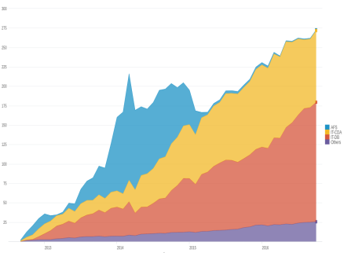

Backup Service
TSM cost is proportional to backed up volume
  Minimize backup volume in view of upcoming license retendering
Ongoing efforts to limit annual growth rate: 24% (50% in the past):
  Moved AFS backups to CASTOR
  Working with the two other large backup customers
Backup Service total data since 2012

Slide 19
Question?

