Slide 1



ALICE T2 Operations and Plans
at Hiroshima and Tsukuba
7th Annual ALICE T2/T2 Workshop
Institut Pluridisciplinaire Hubert Curien
Strasbourg, France
03 – 05 May 2017
Toru Sugitate of Hiroshima University
on behalf of ALICE-Japan-GRID Team
sugitate@hiroshima-u.ac.jp

Slide 2
Outline
Overview of Japan
Operation at Hiroshima T2
  Major upgrades in Feb. 2017
  Operation after the upgrade
Operation at Tsukuba T2
  Operation issues
  WN enforcement and SE readiness
Some issues in operation
Funding and Networking in Japan
Summary and plans

Slide 3
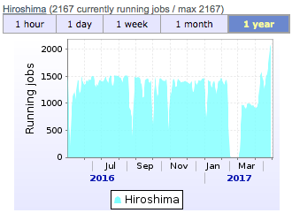
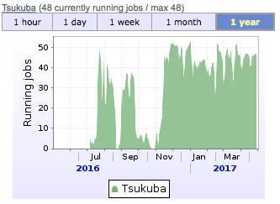
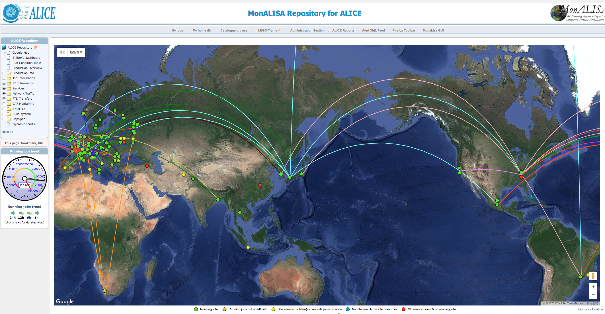

Overview in Japan
Note more Tiers in Japan;
ATLAS-T2 (x10) running and
Belle-II-T0 (x??) coming up.
Direct routing to GEANT @London
@10Gbps x2
Direct routing to Pacific Wave @LA
@100Gbps
&
Direct routing to ManLan @NY
@10Gbps
Full-mesh MPLS-TP
@200Gbps
Direct routing to TEIN @Singapore
@10Gbps

Slide 4
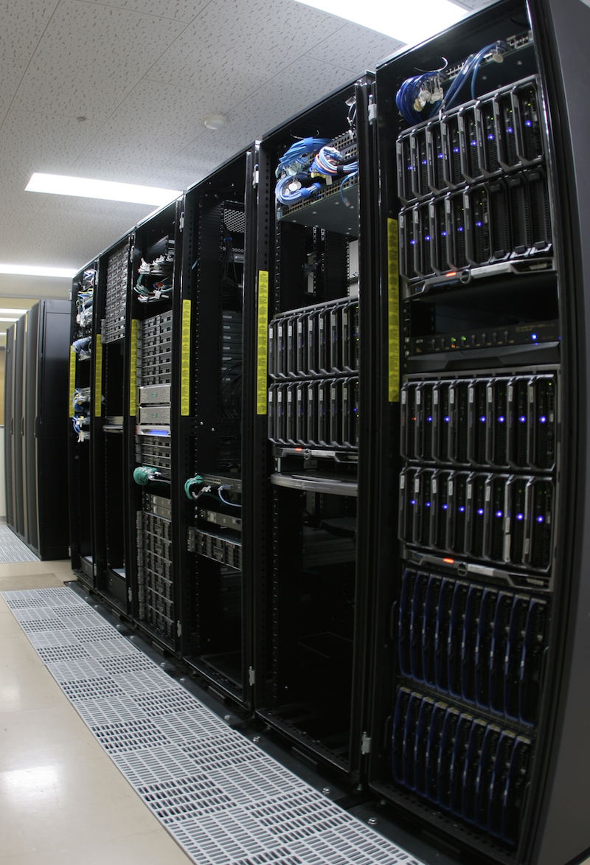
ALICE Tier-2 at Hiroshima
The ALICE T2 site “JP-HIROSHIMA-WLCG” with EMI-3 on SL6.8... as stable as possible.
GRID service; APEL, sBDII, CREAM-CE, CVMFS/Squid, EOS, VOBOX… as compact as possible.
WN resources; 1,284 Xeon-cores in total Xeon5365(4c@3.0GHz) x 2cpu x 20 blades Xeon5570(4c@2.9GHz) x 2cpu x 26 blades Xeon5670(6c@2.9GHz) x 2cpu x 3 blades E5-2470v2(10c@2.4GHz) x 2cpu x 16 blades E5-2640v4(10c@2.4GHz) x 2cpu x 28 mod’s
Storage; 1,032TB disks on 8 servers, but no MS
Around 3/4 resource deployed to ALICE GRID, and the rest for local commodity
Network: 10Gbps on 100Gbps-SINET5 in Japan
Housed in 9 racks
WLCG support by ASGC in Taiwan
Operated by TS and students under remote technical support by SOUM corp., Tokyo
Responsible by Prof. Toru Sugitate

Slide 5
Network Topology in Hiroshima
As of Mar. 2017;
10 Gbps opened.
Commodity moved out.
Perfsonar in operation.
PS
→3.5Gbps
←1.35Gbps
PS
→170Mbps
←410Mbps
SINET
Int. G/W
150.99.89.147
SINET
London
150.99.89.247
10Gx2
10,000km
500mile/h x 12h
Geant
PS
PS
SiNET5
Full-mesh MPLS
100 Gbps
KEK F/W
& G/W
130.87.4.201
→2.9Gbps
←2.1Gbps
→67Mbps
←740Mbps
Hiroshima
University
Campus
LAN G/W
133.41.0.0
Projects’
LAN G/W
Projects’ LAN SW
20G/L3
10G/L2
10G x 3
30km
PS
10G 500m
GRID nodes
202.13.220.0
172.16.0.0
GRID
Grid00
202.13.220.40
Grid00
202.13.220.40
Grid00
202.13.220.40
10G
HP5700/L3
10G
Fortigate 1500D/L3
10G
KEK Router
Cat.3560
202.13.220.250
HP5700/L3
WN’s
172.16.10.0
SW/L2
Grid00
202.13.220.40
SW/L2
Grid00
202.13.220.40
Grid00
202.13.220.40
DMZ 10G/1G
PS
→4.8Gbps
←2.6Gbps

Slide 6
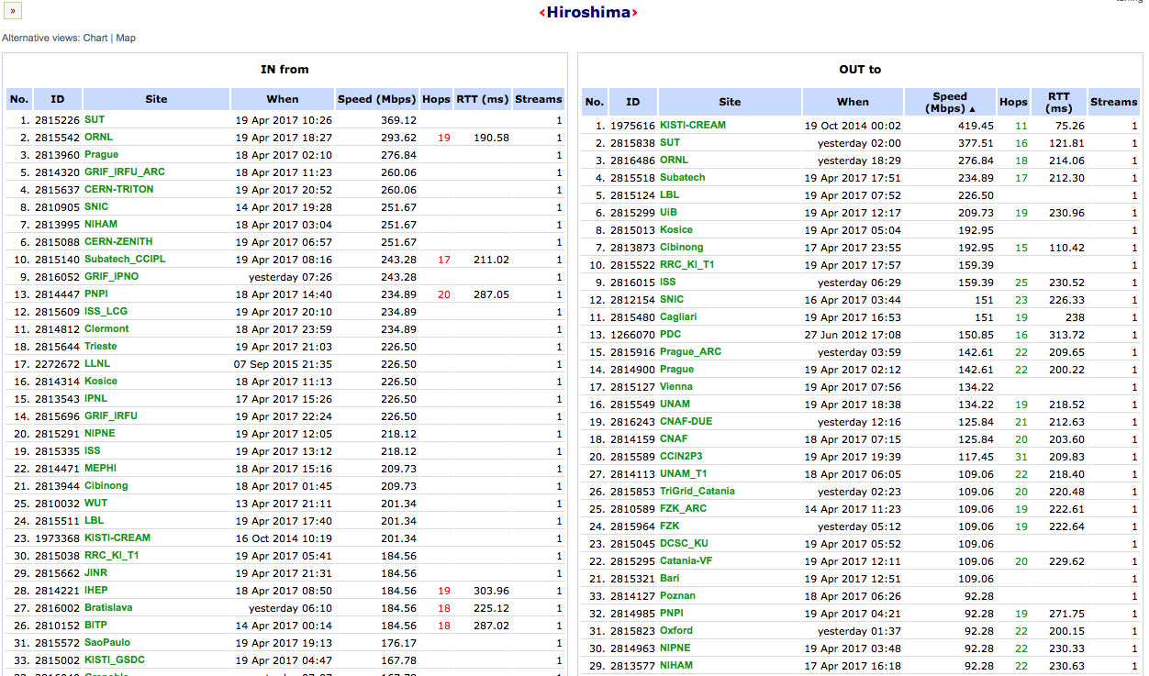
Network Connection in ALICE
as of 21 Apr. 2017
Up to 250 Mbps to/from EU and US, and
more to an Asian Tier SUT, but
particularly slow to Tsukuba and KISTI.

Slide 7
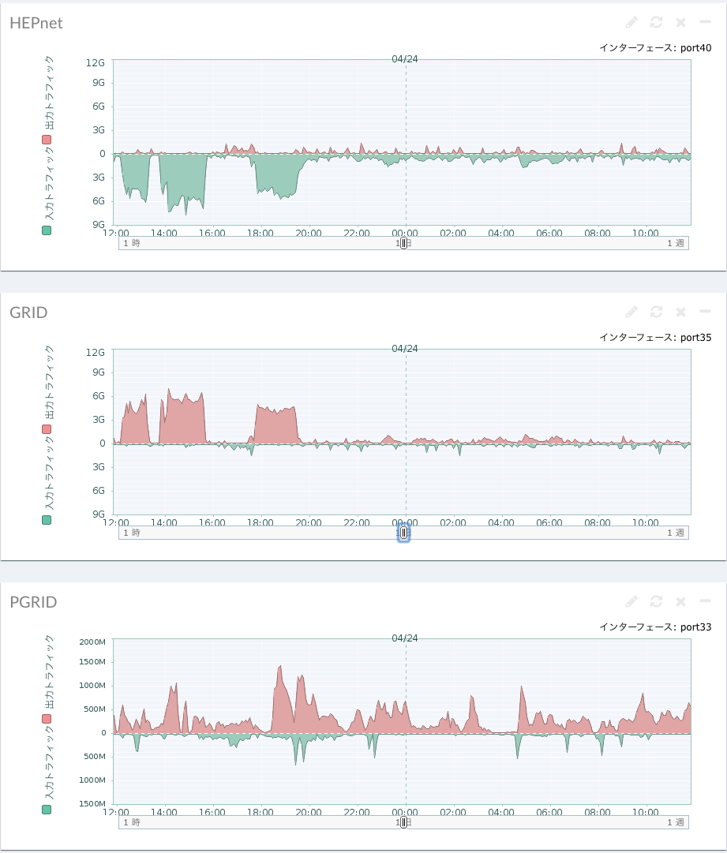
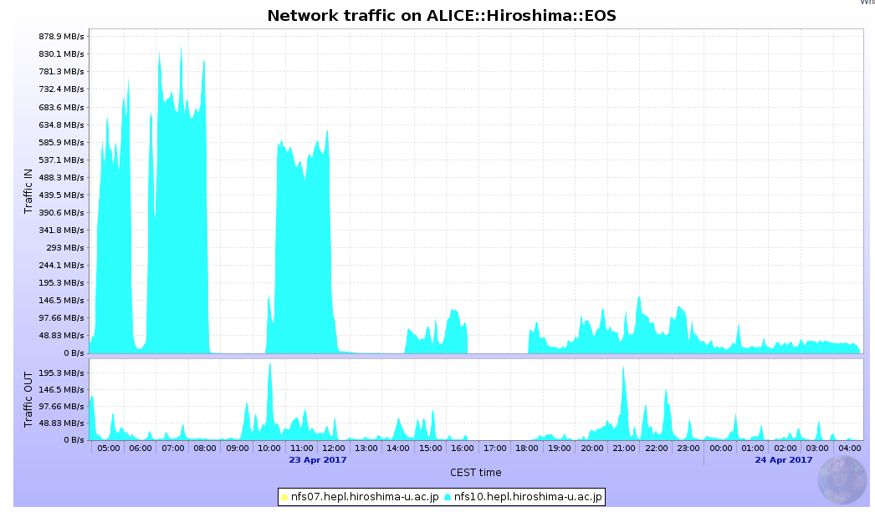
Daily LAN Traffic by Hiroshima
Outer port at F/W
Traffic on
ALICE:Hiroshima:EOS
under the GRID port
outbound
6Gbps
inbound
GRID port at F/W
MC job traffic load is around 1Gbps.
File transfer fills traffic up to 6-9Gbps.
Private port at F/W

Slide 8
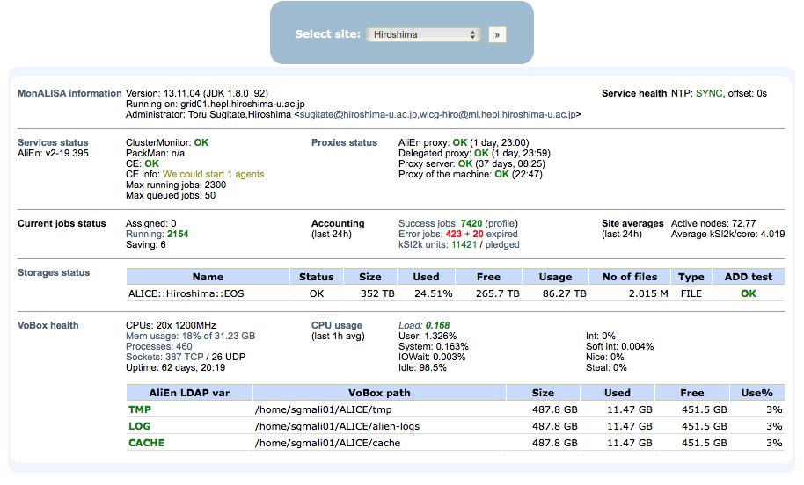
Daily Score at Hiroshima
→wlcg-hiro@ml.hiroshima-u.ac.jp
X5570@2.93 = 8.33 HS06/HTcore
X5670@2.93 = 8.79 HS06/HTcore
E5-2470v2@2.4 = 7.38 HS06/HTcore
E5-2640v4@2.4 = 7.38 HS06/HTcore
→16.7 kHS06 (due 12.2k)
→700 TB (due 1.11P)

Slide 9
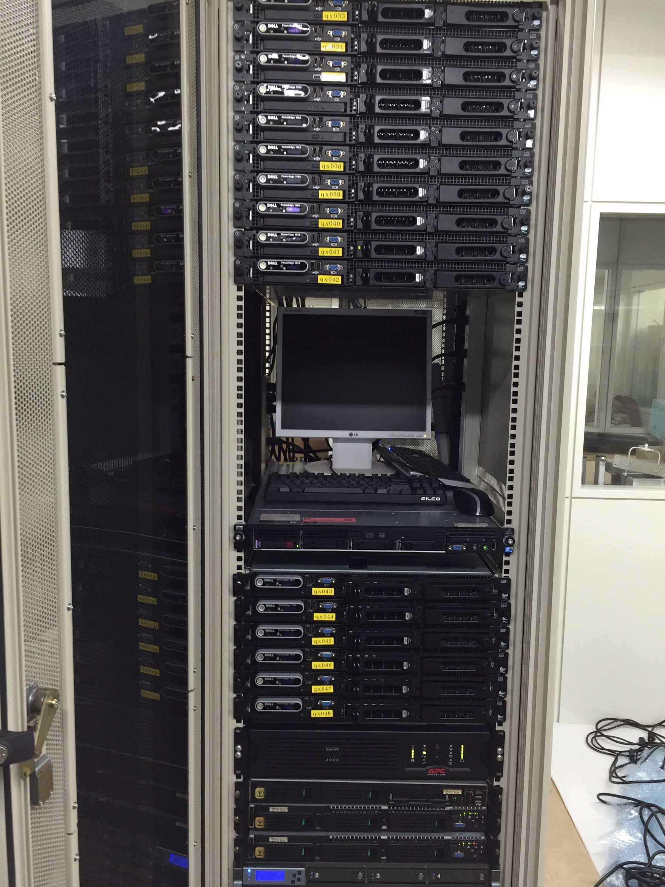
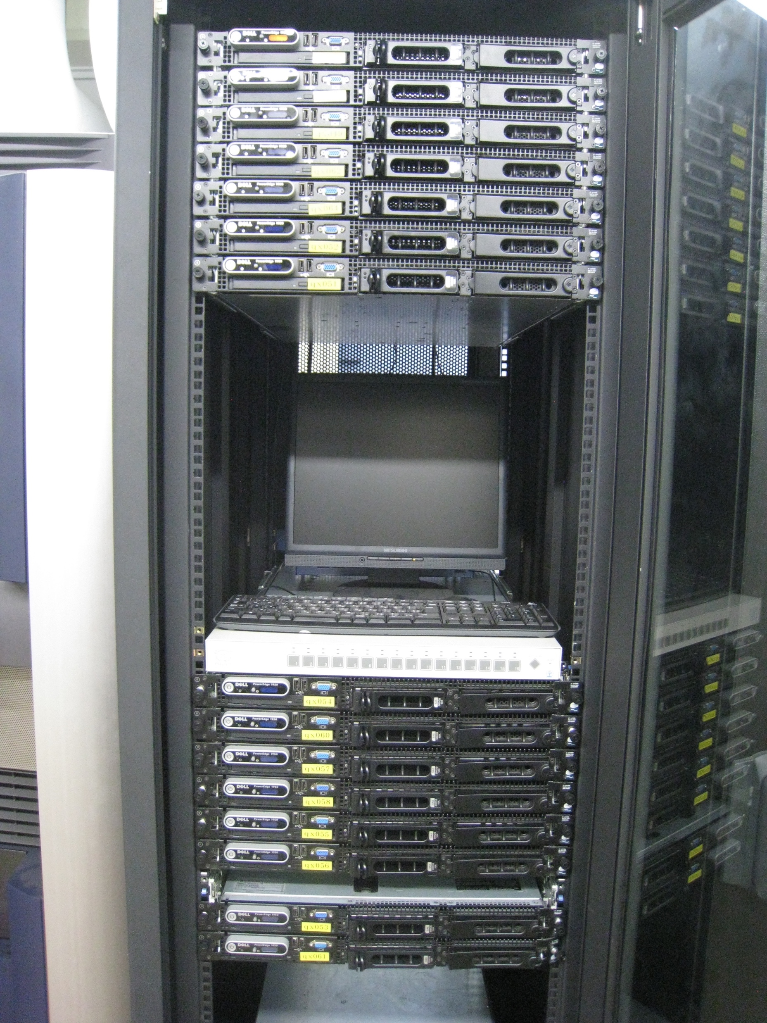

Tsukuba Tier2 status (as of May 1, 2017)
Member:
T. Chujo (responsible)
S. Kato (technical staff)
Status:
OS: SL6
MW: EMI 3.1
Configuration:
  6 service nodes (X5355; 4 cores x 2 cpu,@2.6GHz)
  6 worker nodes (X5355; 4 cores x 2 cpu,@2.6GHz)
On July 4th, 2016, Tsukuba T2 started the operation as a production site.
50 jobs running on average.
Network: connected to SINET-5 via HepNet-J network.
On Nov. 11, Latchezar and Costin visited Tsukuba, and discussed the operation and setup of Tsukuba T2.
Plan:
We received another 16 WNs from Toru (Hiroshima), to be powered up on May.
To be purchased and installed ~50 TB disk in 2017.
We also started to work on O² w/ JAEA, Tokyo, Nagasaki Groups
Prepare for LHC-one (using campus network?)
16 WNs from Hiroshima U
(running at Tsukuba)
Another 16 WNs from Hiroshima (Dec. 2016)

Slide 10
Daily Score at Tsukuba
Running jobs
~50 jobs
Latchezar, Costin visited Tsukuba
fixing CVMFS, SQUID setups
(Nov. 11, 2016)
Done jobs in Tsukuba
→+128
Slide by N. Nakamura (NII) @ AFAD2015
→+50TB

Slide 11
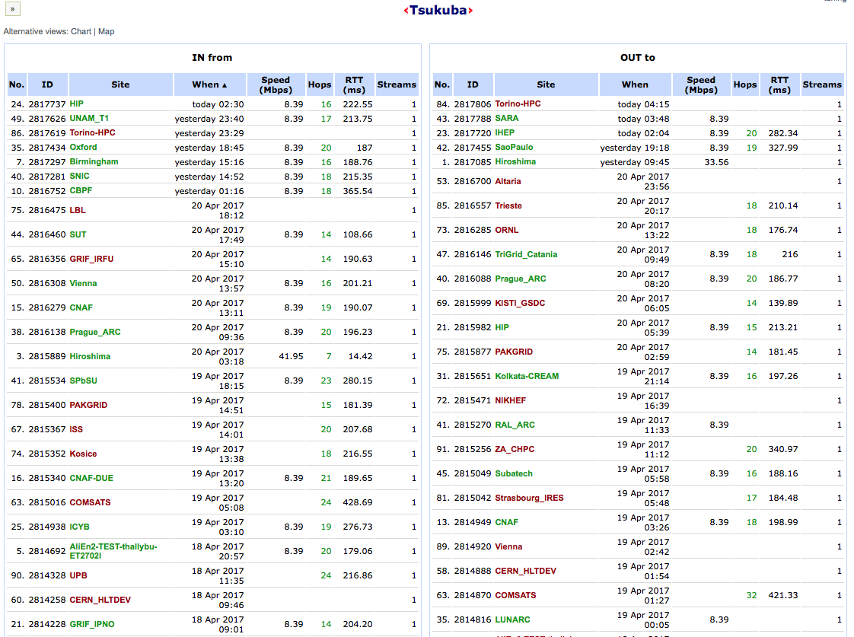
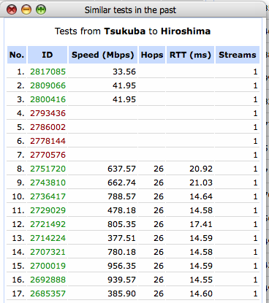
Network Connection in ALICE
B/W has dropped drastically on around 20th of March to/from all sites. Investigation underway.

Slide 12
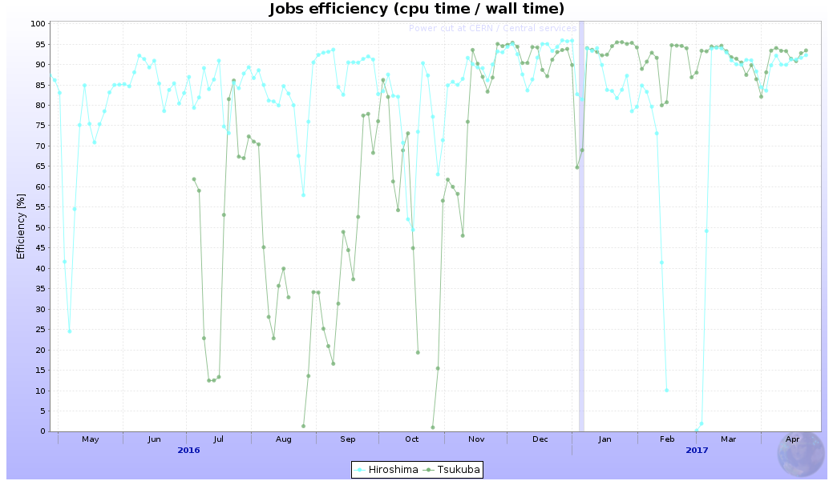
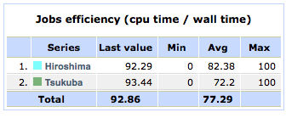
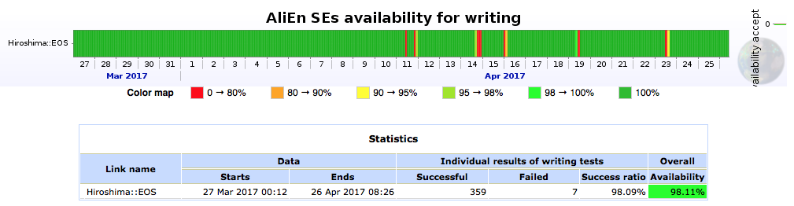
CPU/SE Efficiencies in Japan
Setup time at Tsukuba
Upgrade at Hiroshima

Slide 13
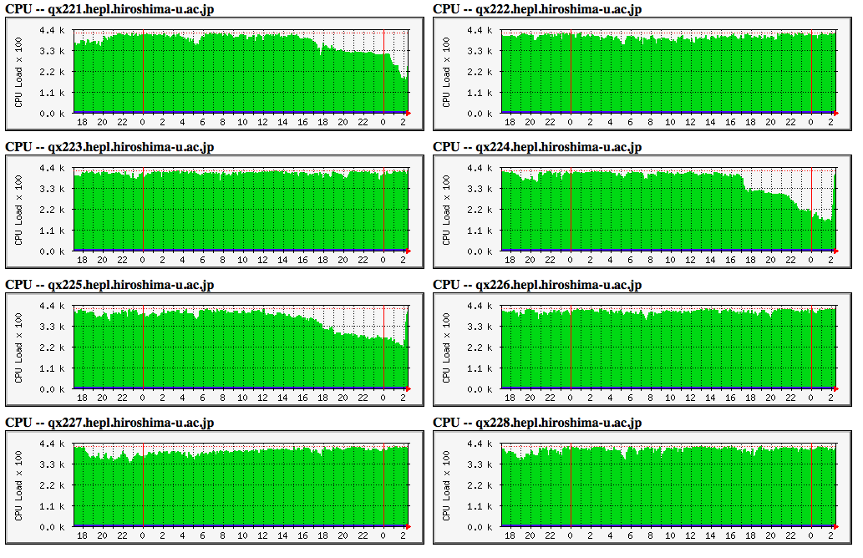
Strange Behavior of Torque/Maui at Hiroshima
One day, 6 WN’s stopped accepting new jobs at almost same time.
PBS status of the WN’s became BUSY, but others job-exclusive.
PBS restart on the CREAM-CE server does not change the WN’s status.
Pbs_mom restart on each WN removed the BUSY flag, then resume accepting.
Any hints/suggestions?

Slide 14
Funding and Networking in Japan
Funding of T2’s
  No T2 operation or equipment budgets either in Hiroshima or Tsukuba, then grabbing from individual/group research grant/budget from time to time.
  Hiroshima T2 is parasitized in a high-energy physics computing facility which provides us a latest networking environment and basic rental servers, but quite unknown for future. Massive WN’s and disks were provided with Toru’s grants.
Network status
  SINET-5 in operation and NII is looking for heavy users.
  SINET though-put achieves beyond 9Gbps from CERN to Hiroshima, but
  Daily MC@T2 load needs more or less 1Gbps.
IPv6 readiness
  Let’s learn pros and cons, and discuss with network experts.
LHCONE adoption
  May move in 2 sites together or individuals. Which preferred?
  Let’s learn pros and cons for T2 sites, considering to remove/bypass F/W.
  Shall discuss with network experts. I guess KEK will/has joined LHCONE.
  Should negotiate with the security authorities, since they are quite quite sensitive to any incidents.

Slide 15
Summary and Plans
  Status at Hiroshima
    Major network equipment replaced. 10 Gbps connection opened in March.
    T2 operation resumed in April, accepting around 2200 jobs.
    EOS in operation, increasing cap. up to 700TB in months.
  Status at Tsukuba
    Stably accepting 50 jobs, increasing the payload +128.
    50TB of SE pledged at Bergen will be provided in this year.
    A sudden drop of B/W observed in March needs investigation.
  Perspective view of Tier operation in Japan
    16.7kHS06 meets the resource required 12.20k (Yves’ talk today for 2017), but 0.75 PB fails that of 1.11PB (ibid.).
    SINET-5 in operation. They looks for heavy users to upgrade the London route.
    Ready to discuss/negotiate about IPv6 and LHCONE.
    No optimistic views on funding issues anywhere.
  Some efforts toward RUN-3 and beyond
    Individual O2 efforts exit in Japan, but some do not pay any attention.
    Should form a body including all efforts/potential, collaborating with JPARC.
    Design a new computing farm, including JPARC activities, in Japan.

Slide 16
Thanks for your attention

Slide 17
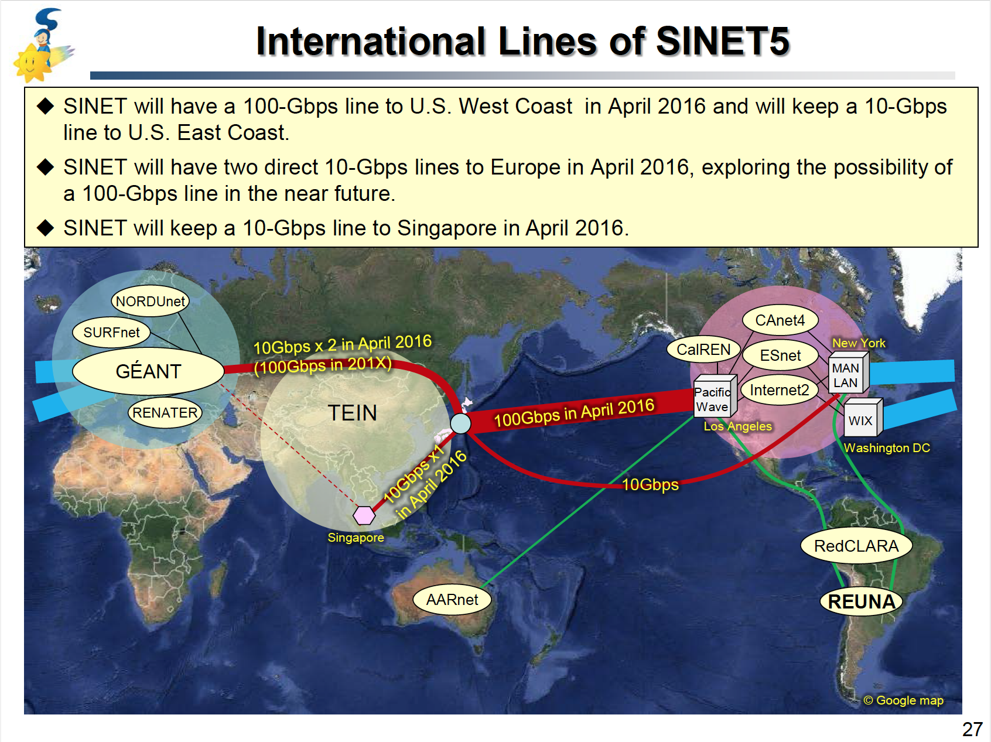
SINET-5
by M. Nakamura of NII, Japan on Jan. 27, 2015 at AFAD, Hsinchu, Taiwan

