Slide 1


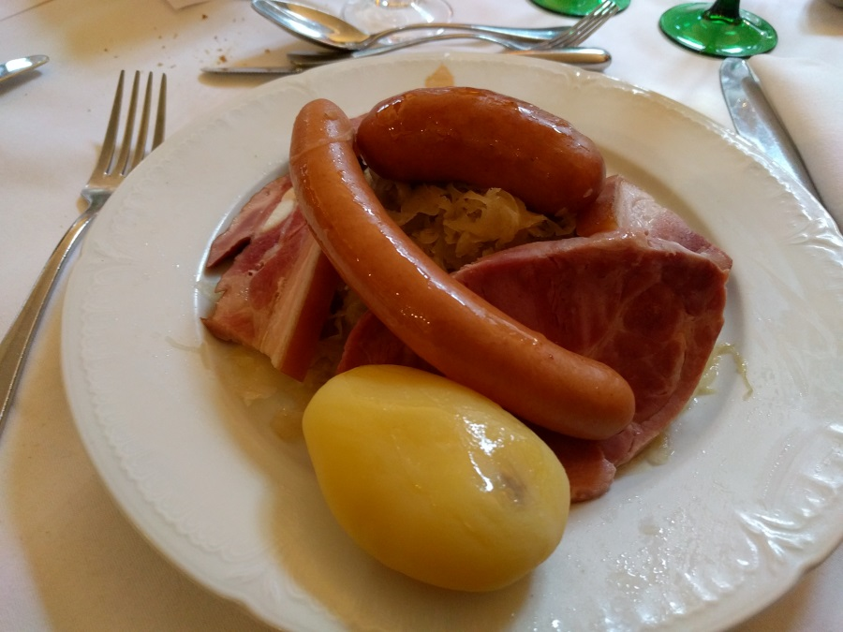
T1/T2 workshop summary
T1/T2 workshop - Strasbourg
5 May2017
Latchezar Betev

Slide 2
Stats
53 participants
34 presentations
  16 regional/site reports
  16 Middleware/general operations/future/research

Slide 3
General
Year 3 of Run 2 is starting tomorrow
Computing model remains unchanged
  … but we have some worries with resources
  With your help and some hard work, hopefully surmountable
Should not dampen the good atmosphere and positive outcome of this workshop

Slide 4
Grid
Operations are smooth in all aspects
Stability and efficiency still has some room for improvement
  Goal for the storage is >95%
  New goodies in EOS can help!
New tools to make the site administration more elegant and easy
  Improvement over existing system, some being aggressively adopted in entire regions
  VCycle/VAC, HTCondor, ARC, Containers

Slide 5
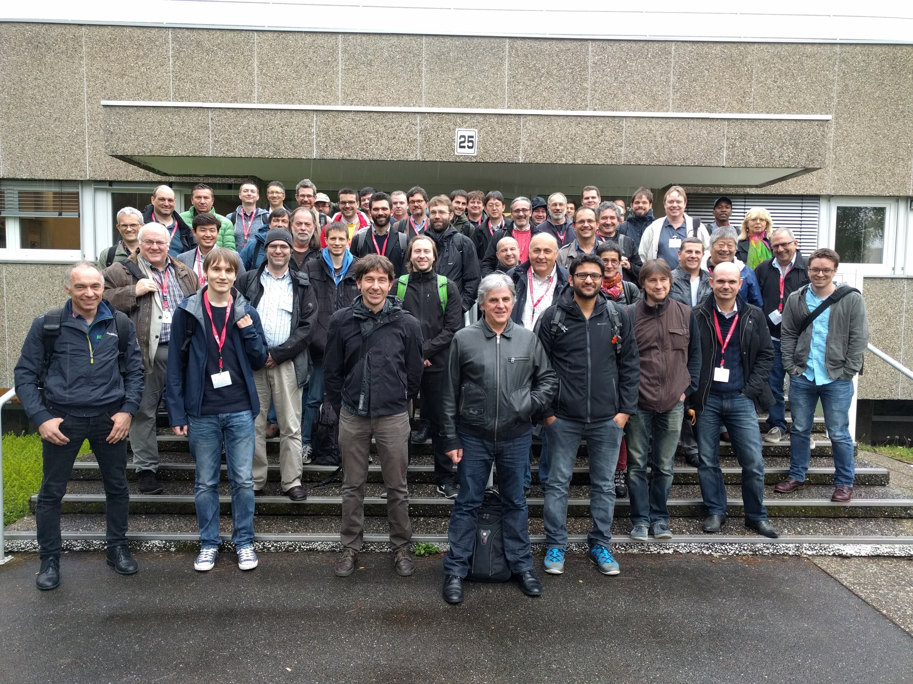

Slide 6
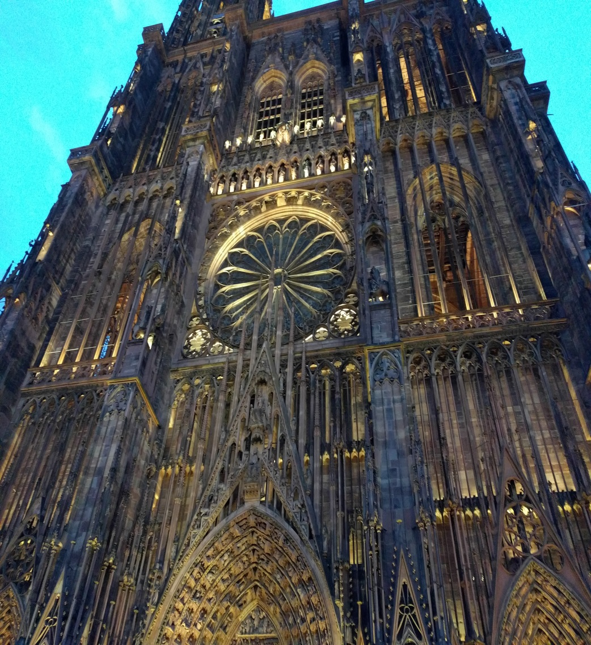
Social
A pleasure to be in the beautiful city of Strasbourg and be hosted by IPHC
City with incredible history, proudly presented and visible from everywhere

Slide 7
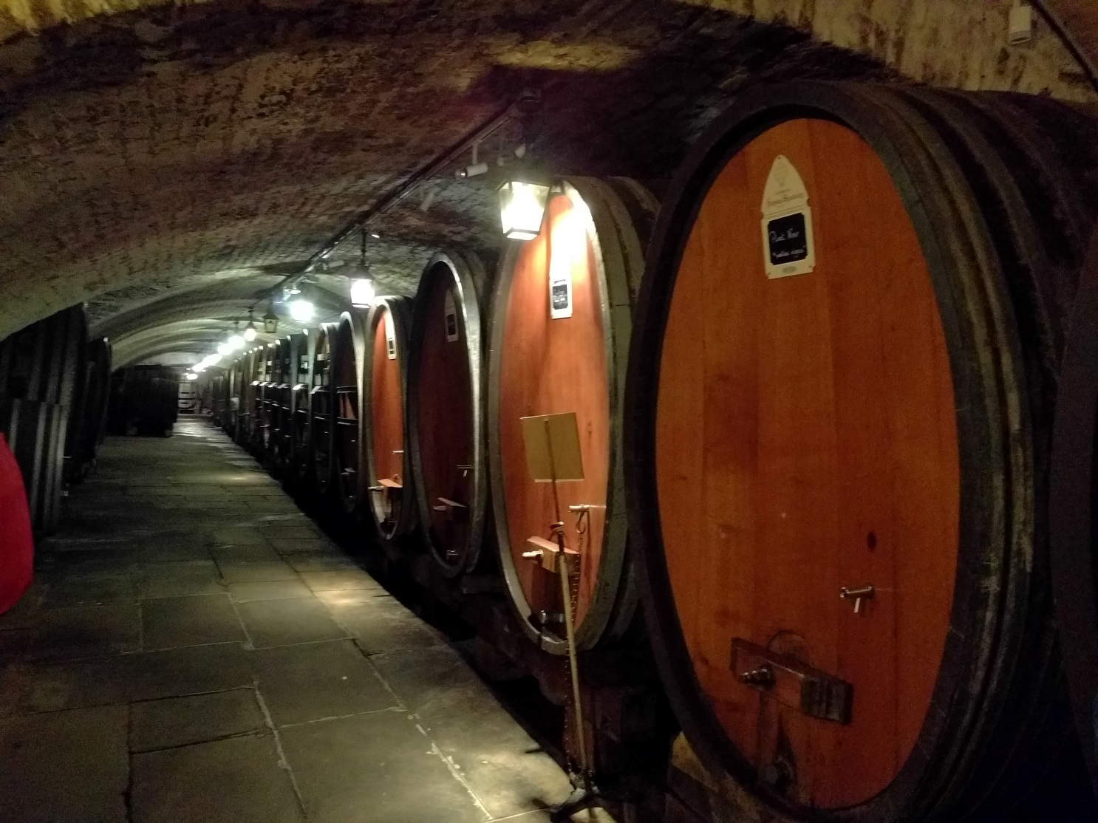
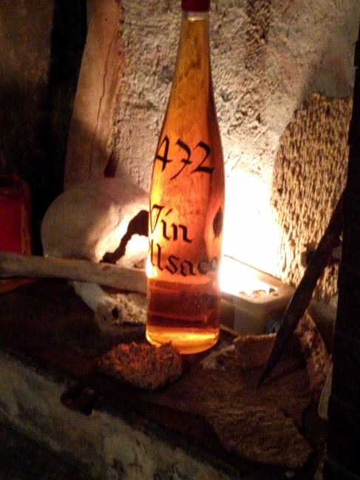
Underground

Slide 8
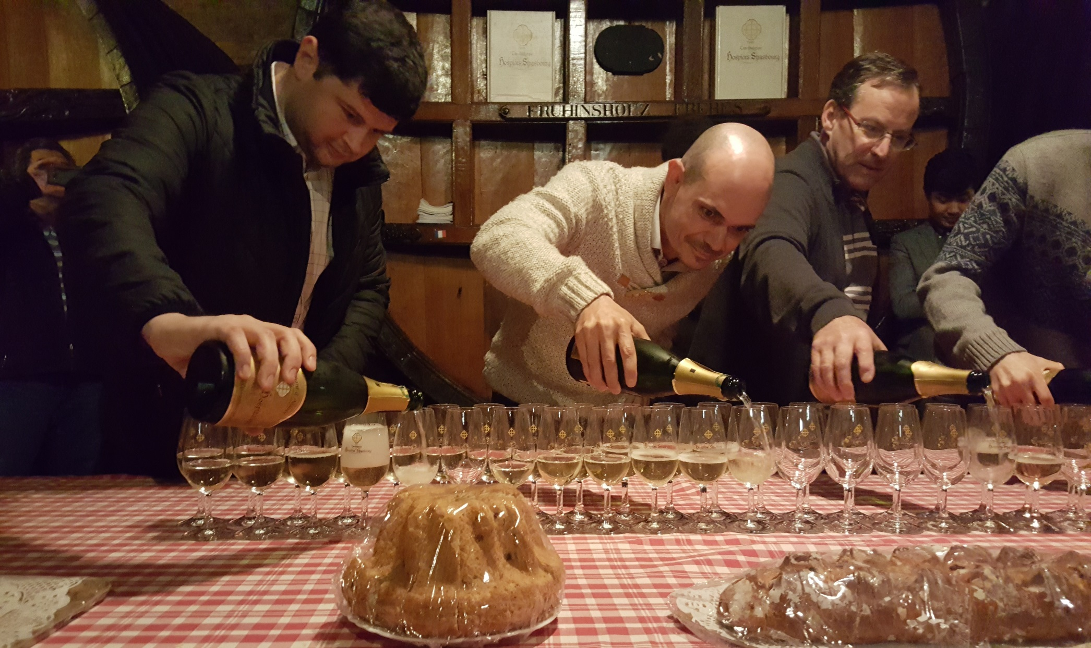
The traditional bowling
pouring
…and as usual, some serious skills

Slide 9
Thank you all for coming
Thanks to all contributors
Many thanks to our hosts
Antonin Maire
Jerome Pansanel, Yannick Patois
Yves Schutz
Special thanks to IPHC

