Slide 1
The O2 project and future of ALICE computing
ALICE T1/T2 Workshop
Predrag Buncic

Slide 2

PHASE I Upgrade
ALICE, LHCb major upgrade
ATLAS, CMS ‚minor‘ upgrade
Heavy Ion Luminosity from 10²⁷ to 7 x10²⁷
PHASE II Upgrade
ATLAS, CMS major upgrade
HL-LHC, pp luminosity
from 10³⁴ (peak) to 5 x10³⁴ (levelled)

Slide 3
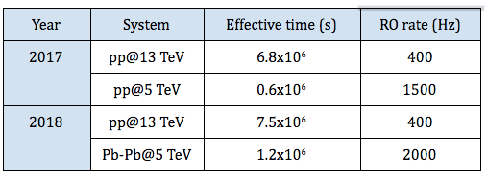
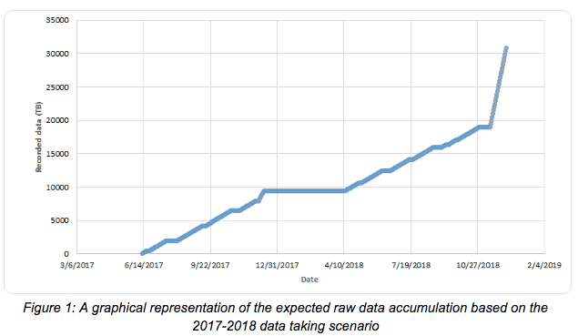
Data taking plans 2017-2019

Slide 4
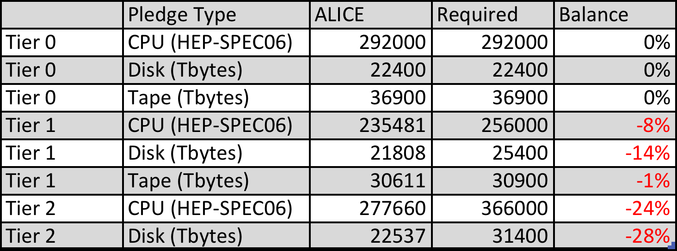
C-RSG Exercise and “flat budget”
“The requirements for 2018, specifically: T1-disk (47% increase), T2-disk (82%) and T2-cpu (58%) are well beyond "flat budget" and we noticed that T2 pledges are about 20% less than the request. CRSG is not in a position to accept these requests and asks the experiment and the LHCC to take the actions necessary to reduce the resource needs in order to be scrutinized in October. CRSG is willing to follow and to help in this process if asked.”

Slide 5
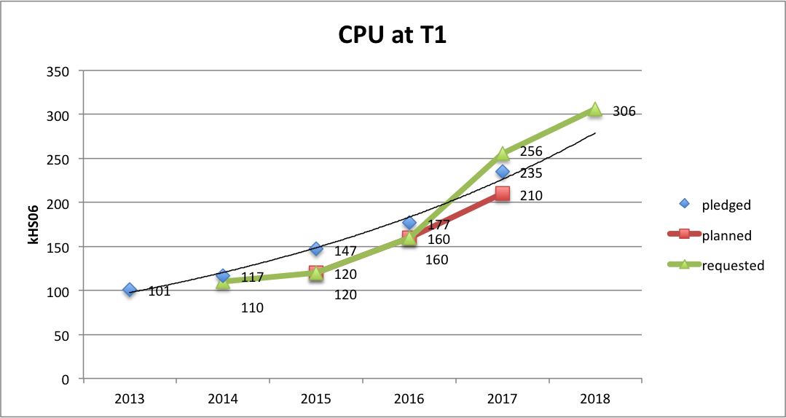
ALICE: Plans, requests and pledges

Slide 6
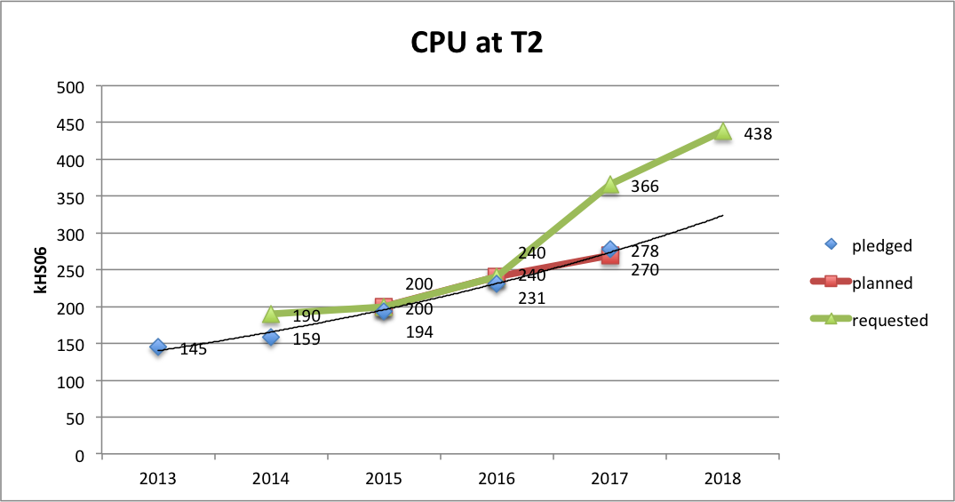
ALICE: Plans, requests and pledges

Slide 7
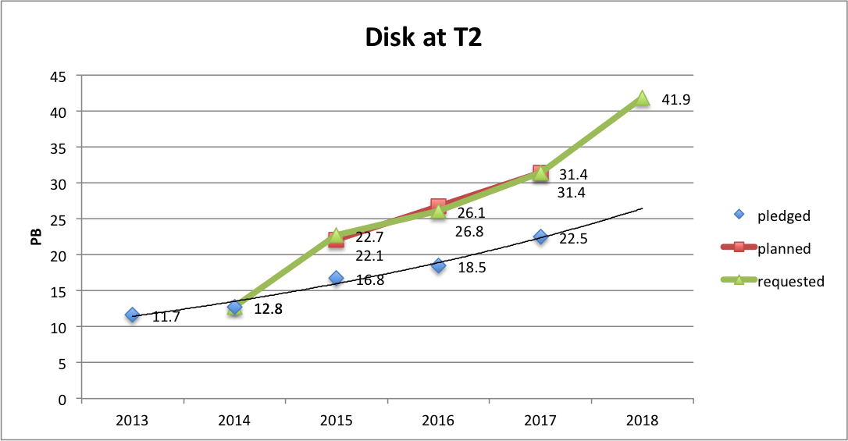
ALICE: Plans, requests and pledges

Slide 8
Projection 2017-2020 assuming 20% growth
 |  | CPU |  |  | Disk |  |  | Tape
 | Tier | requested | pledged | difference | requested | pledged | difference | requested | pledged | difference
2017 | 0 | 292.00 | 292.00 | 0.00% | 20.60 | 22.40 | 8.04% | 34.5 | 36.9 | 6.50%
 | 1 | 256.00 | 235.48 | -8.71% | 24.40 | 21.81 | -11.90% | 26.60 | 30.60 | 13.07%
 | 2 | 366.00 | 318.62 | -14.87% | 31.20 | 26.01 | -19.95%
 | Total | 914.00 | 846.10 | -8.03% | 76.20 | 70.22 | -8.52% | 61.10 | 67.50 | 9.48%
2018 | 0 | 350.00 | 350.40 | 0.11% | 27.00 | 26.88 | -0.45% | 55 | 55
 | 1 | 306.00 | 282.58 | -8.29% | 32.00 | 26.17 | -22.30% | 41.00 | 41.00
 | 2 | 438.00 | 382.34 | -14.56% | 41.00 | 31.21 | -31.35%
 | Total | 1094.00 | 1015.32 | -7.75% | 100.00 | 84.26 | -18.68% | 96.00 | 96.00 | 0.00%
2019 | 0 | 534.00 | 420.48 | -27.00% | 33.60 | 32.26 | -4.17% | 55 | 55
 | 1 | 501.00 | 339.09 | -47.75% | 39.90 | 31.40 | -27.07% | 49.50 | 49.50
 | 2 | 635.00 | 458.81 | -38.40% | 51.10 | 37.46 | -36.42%
 | Total | 1670.00 | 1218.38 | -37.07% | 124.60 | 101.11 | -23.23% | 104.50 | 104.50 | 0.00%
2020 | 0 | 534.00 | 504.58 | -5.83% | 33.60 | 38.71 | 13.19% | 55 | 55
 | 1 | 501.00 | 406.91 | -23.12% | 39.90 | 37.68 | -5.89% | 49.50 | 49.50
 | 2 | 635.00 | 550.57 | -15.34% | 51.10 | 44.95 | -13.69%
 | Total | 1670.00 | 1462.05 | -14.22% | 124.60 | 121.33 | -2.69% | 104.50 | 104.50 | 0.00%

Slide 9
What next?
To restore the expected resource growth, we must insist and follow-up on the installation of the pledged resources:
  The deficit of disk in the T2 centres, to the approved levels for 2016 must be installed;
  T1 and T2 pledges correspond to the required and approved resources levels in 2017. Presently, there is a pledges deficit of 8% and 24% (CPU) and 14% and 28% (disk) at the T1s and T2s respectively;
  The computing resource sharing between countries and FAs should be respected and enforced
We will calculate 2018 shares between the countries participating in ALICE based on our actual request and not on C-RSG approved resources.
The additional resources would have to be over-pledged or provided as unpledged contribution, which however will be accounted by ALICE.

Slide 10
Flat budget?
+38.6%
+30.2%
+32.0%

Slide 11
Flat budget?
+27.2%
+41.7%
+20.3%

Slide 12
Flat budget?
+21.2%
+14.9%

Slide 13
It is totally unclear what flat budget means on different tiers
However, we are forced to make our plans for Run 3 assuming that flat budget means
  maximim 20% year on year growth
  applied equally on all resources categories
  applied equally to all Tiers

Slide 14
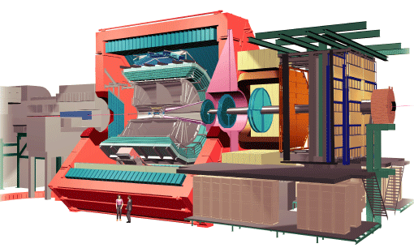


Run 3 data taking objectives
For Pb-Pb collisions:
  Reach the target of 1 13 nb⁻¹ integrated luminosity in Pb-Pb for rare triggers.
The resulting data throughput from the detector has been estimated to be greater than 1TB/s for Pb–Pb events, roughly two orders of magnitude more than in Run 1
10 GB/s
90 GB/s
3 TB/s
500 Hz
50 kHz
Factor 90 in terms of Pb-Pb events (x 30 for pp)

Slide 15

ALICE O² Technical Design Report
https://cds.cern.ch/record/2011297/files/ALICE-TDR-019.pdf

Slide 16
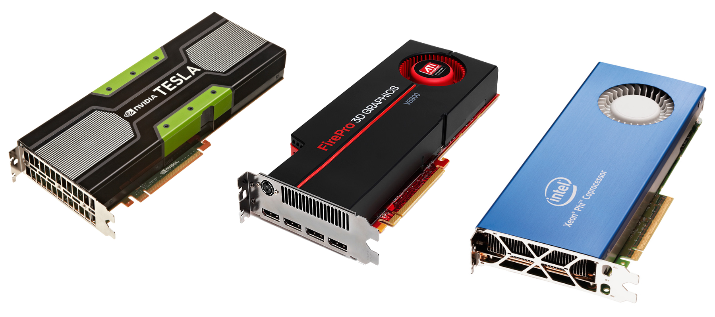
O2 Facility
463 FPGAs
  Detector readout and fast cluster finder
100’000 CPU cores
  To compress 1.1 TB/s data stream by overall factor 14
3000 GPUs
  To speed up the reconstruction
  3 CPU¹⁾ + 1 GPU²⁾ = 28 CPUs
60 PB of disk
  To buy us an extra time and allow more precise calibration
----------------------------------------------------------------
Considerable (but heterogeneous) computing capacity that will be used for Online and Offline tasks
  Identical s/w should work in Online and Offline environments

Slide 17
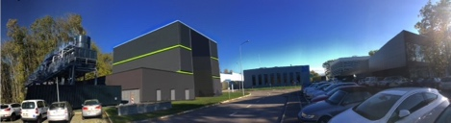
Containter@P2 or Prevessin Computing Centre (PCC)?
  Original plan: Commercial Container Data Center
    2015-16 Market Survey → Invitation Tender → Purchase lab (20-30 % of the total capacity)
    2018 Move lab to P2 and implement first slice of CR0 (10% EPN and DS)
    2020 Purchase CR0 addition (70-80 %) and full deployment
We will know the answer in June…

Slide 18
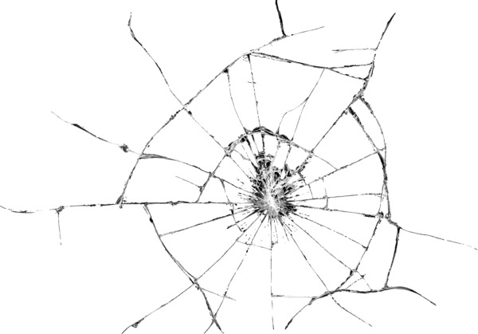
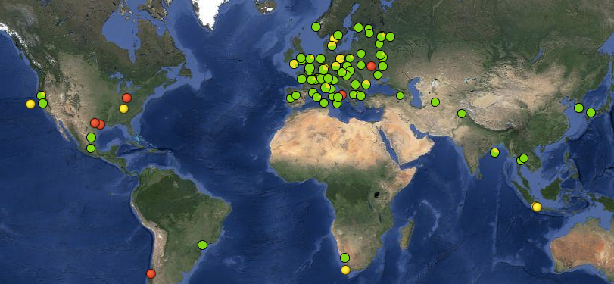
Computing Model in Run 1&2
Computing model built on top of WLCG services
  Any job can run anywhere and access data from any place
  Scheduling takes care of optimizations and brings “computing to data”
  Every file and its replicas are accounted in the file catalogue
Worked (surprisingly) well during Run 2 and Run 2

Slide 19
Run 2 vs Run 3: Data volume and # of events
# of events
Raw data volume
x 4.2
x 88
x 30
While event statistics will increase by factor 30in Pb-Pb (x88 in pp), data volume will increase by factor 4.2
  Thanks to data reduction in O2 facility
    Online tracking that allows rejection of clusters not associated with tracks
    Large effect in case of pileup (pp)

Slide 20

Data management
Only one instance of each raw data file (CTF) stored on disk with a backup on tape
  In case of data loss, we will restore lost files form the tape
  O2 disk buffer should be sufficient accommodate CTF data from the entire period.
  As soon as it is available, the CTF data will be archived to the Tier 0 tape buffer or moved to the Tier 1s
All other intermediate data created at various processing stages is transient (removed after a given processing step) or temporary (with limited lifetime)
  Only CTF and AODs are archived kept on disk to tape
Given the limited size of the disk buffers in O2 and Tier 1s, all CTF data collected in the previous year, will have to be removed before new data taking period starts.
Reconstruct
Calibrate
Re-Reconstruct
Archive

Slide 21

Complexity management
We need to transform (logically) 100s of individual sites to 10s of clouds/regions
Each cloud/region should provide reliable data management and sufficient processing capability to simplify scheduling and high level data management

Slide 22
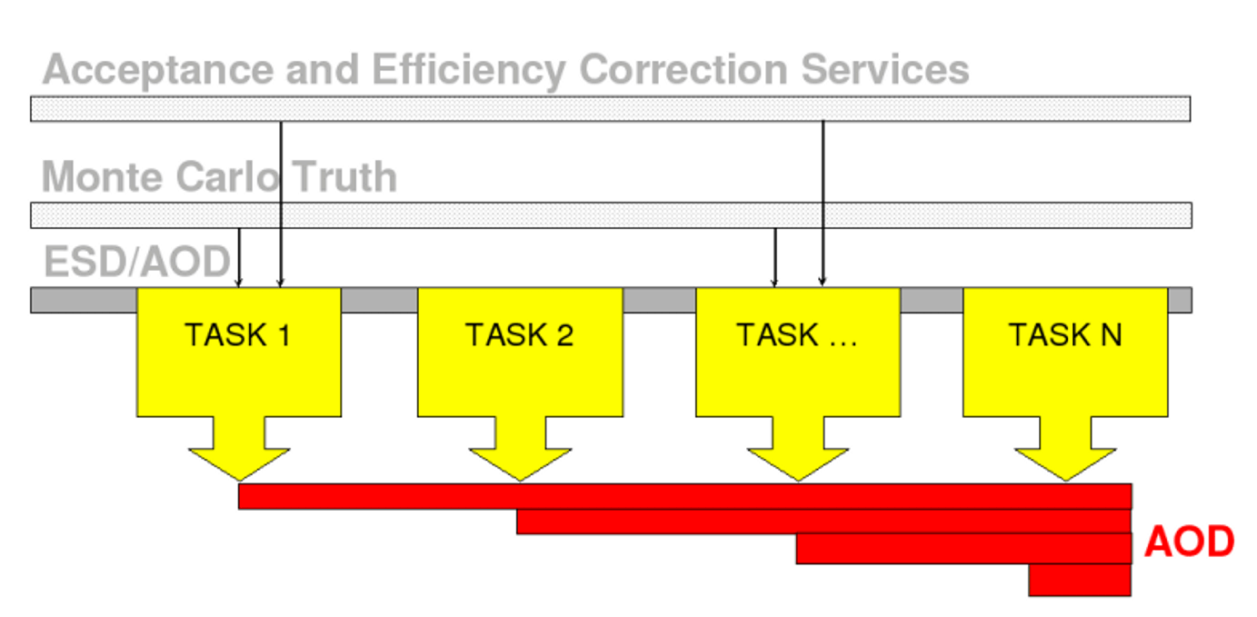

Analysis Facilities
T 1
T 5
Input File(s)
T 2
T 4
T 6
Output File
T 3
Motivation
  Analysis remains /O bound in spite of attempts to make it more efficient by using the train approach
Solution
  Collect AODs on a dedicated sites that are optimized for fast processing of a large local datasets
  Run organized analysis on local data like we do today on the Grid
  Requires 20-30’000 cores and 5-10 PB of disk on very performant file system
  Such sites can be elected between the existing T1s (or even T2s) but ideally this would be a purpose build facility optimized for such workflow

Slide 23
Run 3 Computing Model
T0/T1
CTF -> ESD -> AOD
1..n
O²
RAW -> CTF -> ESD
-> AOD
1
CTF
AOD
AOD
AOD
T2/HPC
MC -> CTF -> ESD
-> AOD
1..n
AF
AOD -> HISTO, TREE
1..3
  Grid Tiers mostly specialized for given role
    O2 facility (2/3 of reconstruction and calibration), T1s (1/3 of reconstruction and calibration, archiving to tape), T2s (simulation)
    All AODs will be collected on the specialized Analysis Facilities (AF) capable of processing ~5 PB of data within ½ day timescale
  The goal is to minimize data movement and optimize processing efficiency

Slide 24
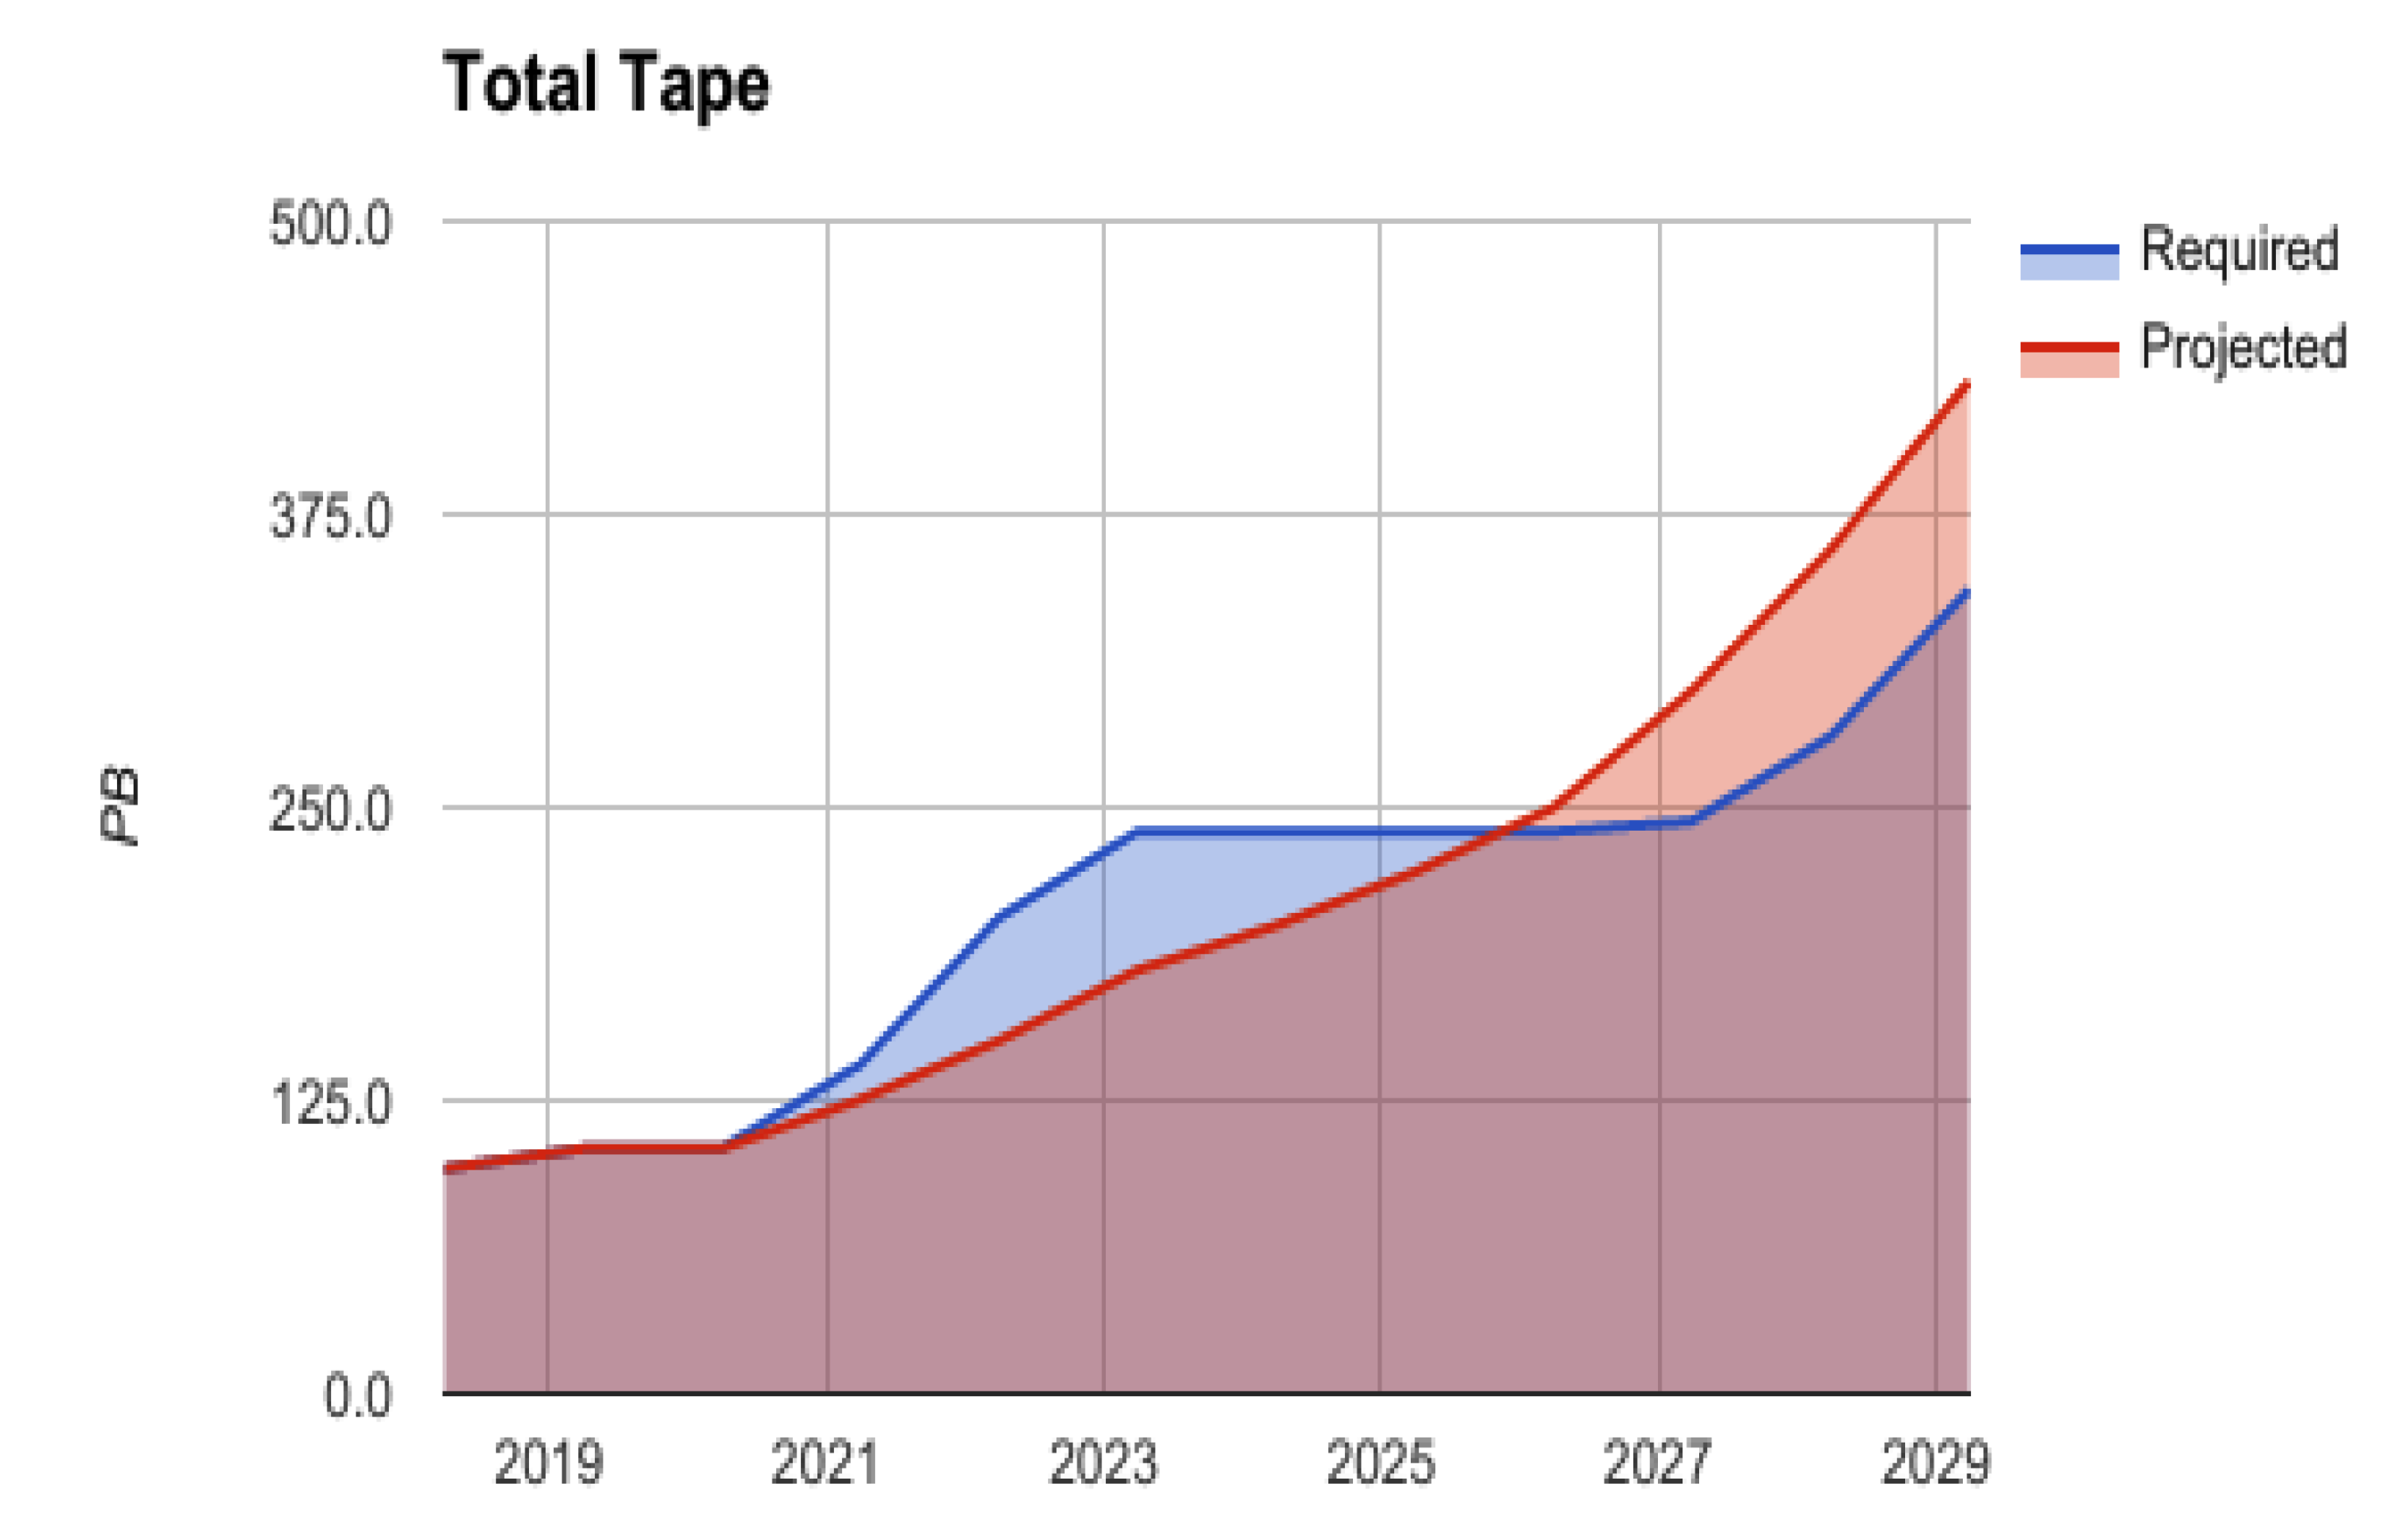
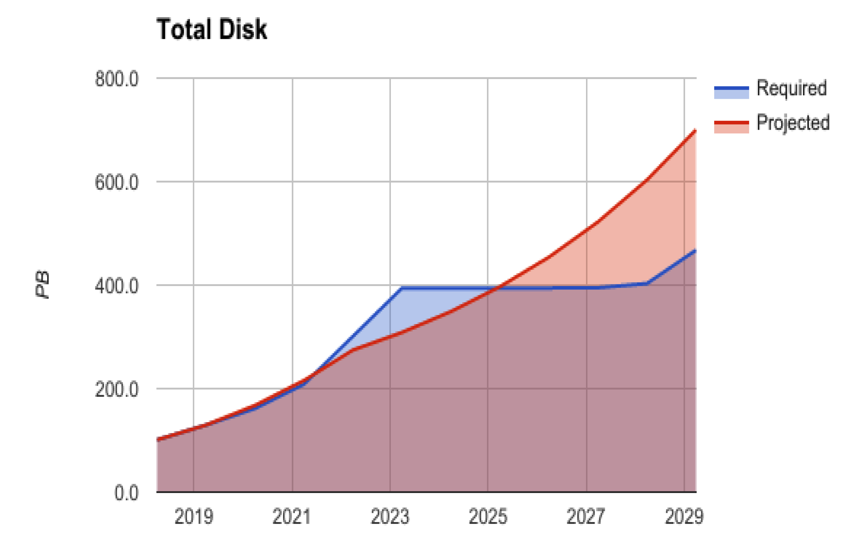
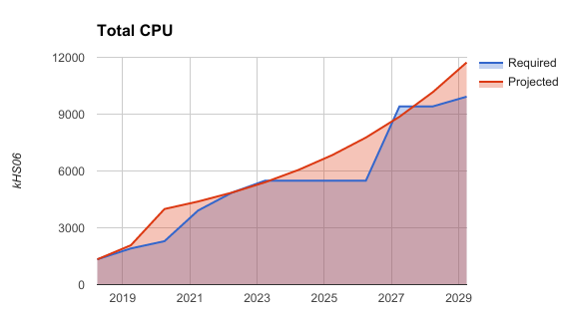
“Flat budget” scenario
Overall, we seem to fit under projected resource growth curves
  Still doable under the flat budget scenario (+20%)

Slide 25
Summary (and caveats)
If everything works as expected, ALICE will fit under flat budget envelope in Run 3
Still large uncertainties
  Run 2 resource evolution
  Compression efficiency (assumed to be x14)
  CPU and AOD size estimates (assumed to scale with raw data as in Run 2)
Availability of Analysis Facilities and ability to grow
  Depending on AOD size, AFs needs could grow faster than expected under flat budget
Software readiness
  We are already accumulating delays
All this can distort our elegant Run 3 computing model
  Force us to run analysis on T1s
  Run simulation of all Tiers as a backfill

