Slide 1


Monitoring system for large and federated datacenters
Gioacchino Vino

Slide 2

Monitoring system for large and distributed datacenters
OUTLINE
Initial development: Dashboard for ALICE computing in Italy
Evolution: Monitoring for large and distributed centers
Application for O2: Contribution to WP8 (modular stack)
Outlook

Slide 3
Monitoring system for large and distributed datacenters
DASHBOARD FOR THE ALICE COMPUTING IN ITALY
Motivation:
Concentrate in a single graphical interface all the information concerning the ALICE activity in each site (MonALISA, local Batch system, local Monitoring system metrics)
Concentrate in a custom graphical interface all the needed information concerning the ALICE activity in Italy
Provide a better debug tool using real-time value coming from multiple sources

Slide 4
Monitoring system for large and distributed datacenters
DASHBOARD FOR THE ALICE COMPUTING IN ITALY
The Bari site was used as testbed and the Dashboard is active and running from Oct 2014
Currently it is running in all ALICE T2 and WLCG sites in Italy from Nov 2016
Presented to CHEP’ 16

Slide 5


Monitoring system for large and distributed datacenters
DASHBOARD FOR THE ALICE COMPUTING IN ITALY
The Dashboard system consists of :
InfluxDB, an open source time-series database
Grafana, dashboard builder with powerful visualization features for time series data
Sensors, python scripts able to gather data from datasources and send them to the database
MonALISA
Sensor
Local monitoring system
Sensor
Local batch system
Sensor

Slide 6
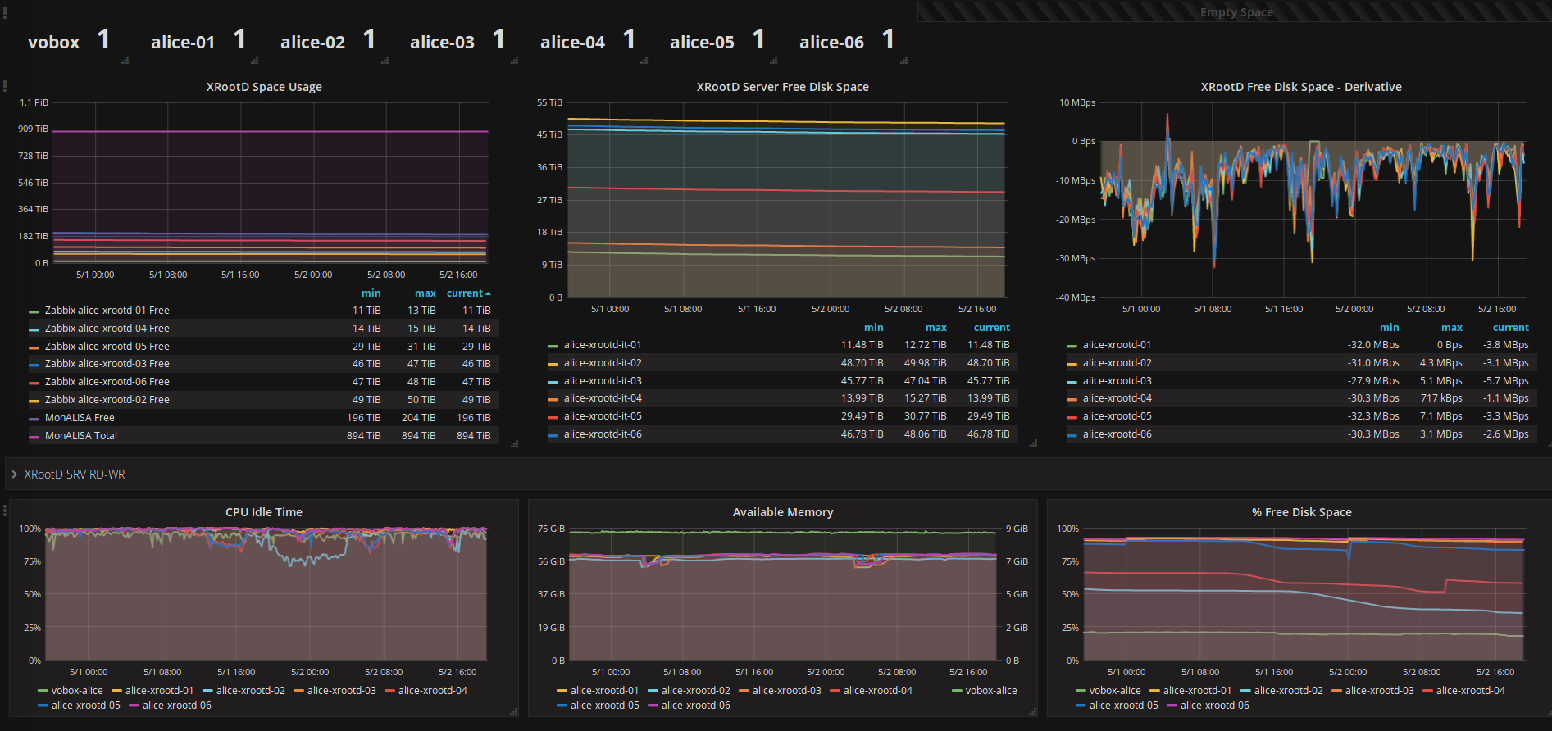
Monitoring system for large and distributed datacenters
DASHBOARD FOR THE ALICE COMPUTING IN ITALY
Bari Storage activity

Slide 7
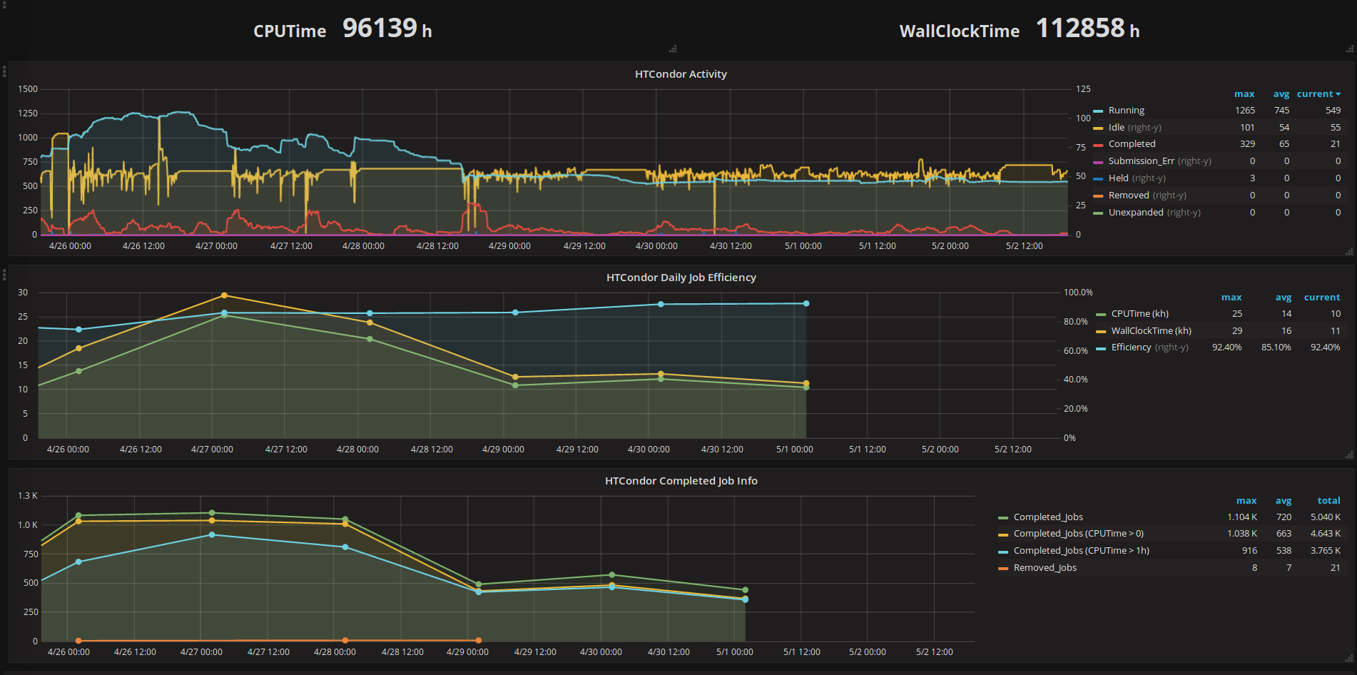
Monitoring system for large and distributed datacenters
DASHBOARD FOR THE ALICE COMPUTING IN ITALY
Bari Batch system activity

Slide 8
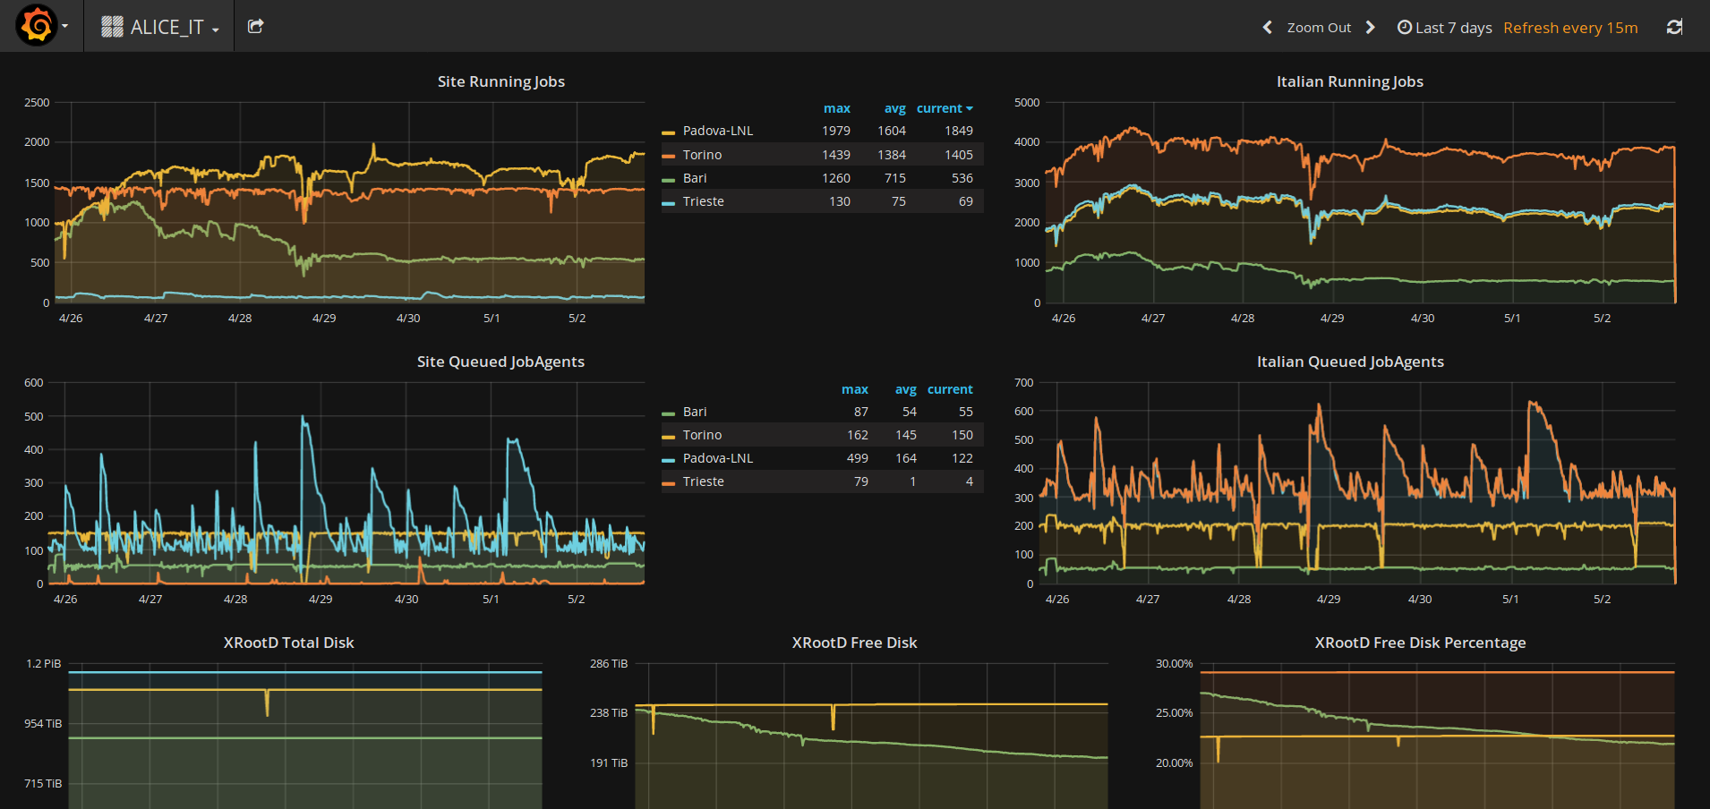
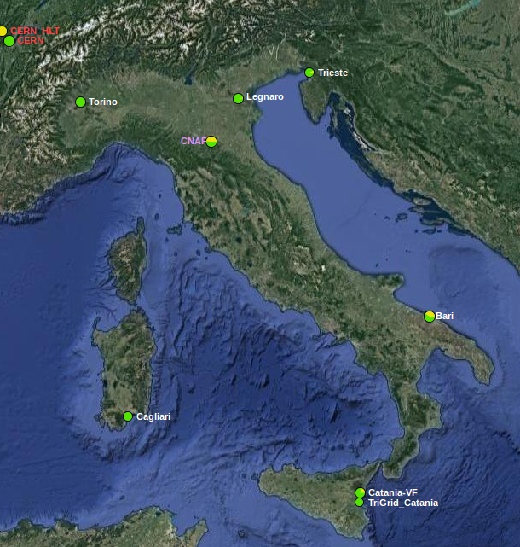
Monitoring system for large and distributed datacenters
DASHBOARD FOR THE ALICE COMPUTING IN ITALY
Italian computing activity

Slide 9
Monitoring system for large and distributed datacenters
MONITORING FOR LARGE AND DISTRIBUTED CENTERS
Designing of a monitoring system able to support the management of large and distributed datacenters
Key features:
Collecting heterogenous data from different data sources:
  Services
  Cloud platform (OpenStack)
  Hardware Devices
Analysis on the gathered data:
  Anomaly Detector
  Root Cause Analysis

Slide 10
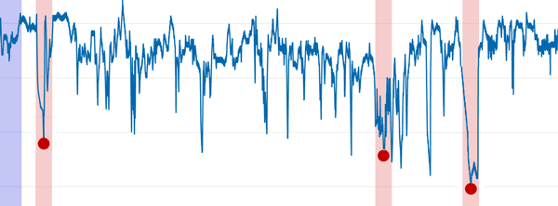
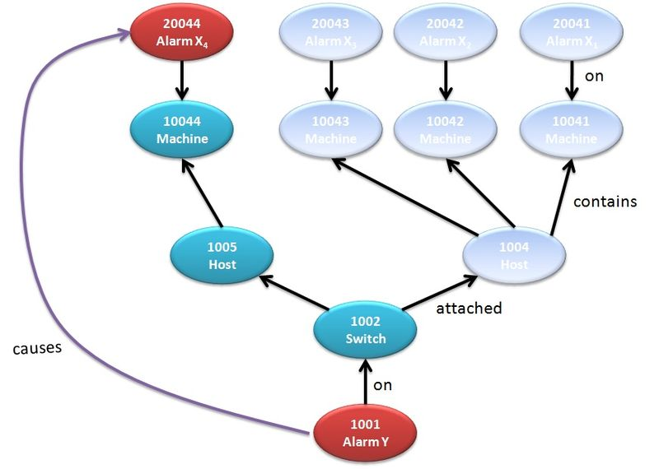
Monitoring system for large and distributed datacenters
MONITORING FOR LARGE AND DISTRIBUTED CENTERS
Anomaly Detector
Root Cause Analysis

Slide 11
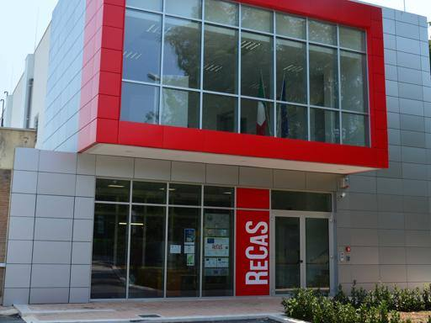
Monitoring system for large and distributed datacenters
MONITORING FOR LARGE AND DISTRIBUTED CENTERS
Testbed: Datacenter ReCaS in Bari
128 server with 8192 cores
Disk space: 3.5 PB
Tape: 2.5 PB
Cloud platform: OpenStack
Cluster HPC composed of 20 servers with 800 cores

Slide 12








Monitoring system for large and distributed datacenters
MONITORING FOR LARGE AND DISTRIBUTED
Kafka
Flume Syslog
Flume
InfluxDB
Syslog
Zabbix
HTCondor
Flume
ElasticSearch
ElasticSearch
Flume HTTP
Ceilometer
OpenStack
Flume HDFS
Zeppelin
Spark Streaming / Spark
HBase

Slide 13
Monitoring system for large and distributed datacenters
MONITORING FOR LARGE AND DISTRIBUTED CENTERS
Data sources:
Syslog:
  Information on system processes
  5 - 6 million of logs per day
  Stored more than 70 GB starting from 18 November 2016

Slide 14
Monitoring system for large and distributed datacenters
MONITORING FOR LARGE AND DISTRIBUTED CENTERS
Data sources:
Syslog
Zabbix:
  Resource usage of nodes, information on OpenStack components and services
  Sensor written in Python
  Sampled 42000 values every 10 minutes
  Collected 3 GB starting from 19 July 2016

Slide 15
Monitoring system for large and distributed datacenters
MONITORING FOR LARGE AND DISTRIBUTED CENTERS
Data sources:
Syslog
Zabbix
HTCondor:
  Scheduler states, completed and running job information
  Sensor written in Python
  Sampled 750000 values every 5 minutes
  Collected 11 GB starting from 18 July 2016

Slide 16
Monitoring system for large and distributed datacenters
MONITORING FOR LARGE AND DISTRIBUTED CENTERS
Data sources:
Syslog
Zabbix
HTCondor
Openstack + Ceilometer:
  Resource usage and services information
  Sensor being written in Python

Slide 17

Monitoring system for large and distributed datacenters
Kafka
Flume
InfluxDB
MONITORING FOR …
Transport layer:
Apache Flume
  Distributed, reliable, and available service for efficiently collecting, aggregating and moving large amounts of log data.
  Robust, fault tolerant and provides ready-to-use interfaces
Apache Kafka
  Distribuited streaming platform, reliable and allows data replication on multiple nodes
Apache Flume + Kafka (aka Flafka)
  Take advantage of both
Flume Syslog
Flume
ElasticSearch
Flume HTTP
Flume HDFS

Slide 18

Monitoring system for large and distributed datacenters
MONITORING FOR LARGE AND DISTRIBUTED CENTERS
Storage:
HDFS (Hadoop Distributed File System)
  Used as long term storage of batch jobs
HBase
  Very fast key-value database on top of HDFS
  Serve real-time requests
InfluxDB
  With Grafana, used to visualize time-series data
ElasticSearch
  With Kibana, used to plot information about log data

Slide 19
Monitoring system for large and distributed datacenters
MONITORING FOR LARGE AND DISTRIBUTED CENTERS
Processing Components:
Apache Spark:
  Execute batch jobs on data stored in HDFS
Apache Spark Streaming:
  Execute real-time analysis on acquired data
Support Components:
Spark SQL, Spark GraphX, Spark MLlib, Apache Zeppelin

Slide 20
Monitoring system for large and distributed datacenters
O2 WP8 CONTRIBUTION - MISSION
Data Collection of system monitoring, infracstructure monitoring and application monitoring (~600 kHz)
Processing like Data suppression, Data enrichment, Data aggregation and Data correlation.
Storage
Graphical display
Three main alternative options currently under evaluation:
MonALISA, Modular Stack, Zabbix

Slide 21
Monitoring system for large and distributed datacenters
O2 WP8 CONTRIBUTION – MODULAR STACK
Different tools used to accomplish the goal:
  CollectD, used to collect host information
  Apache Flume, used as transport layer
  InfluxDB, used as TimeSeries Database
  Grafana, used as Dashboard for Timeseries data
Sensors
Flume Source
Flume InfluxDB Sink
.
.
.
.
.
.
Sensors
Flume Source
Flume InfluxDB Sink

Slide 22
Monitoring system for large and distributed datacenters
OUTLOOK
Implement algorithms for Anomaly Detector and Root Cause Analysis
Use Apache Mesos or DC/OS as resource manager
Design and implement bottleneck analysis
Test the project on multiple datacenters
Finalize system choice for O2 monitoring
Upgrade of the Dashboard of ALICE activity in Italy using the knowledge acquired on Apache components

Slide 23
THANKS
FOR YOUR
ATTENTION

