Slide 1
GRID OPERATIONS IN ROMANIA
ALICE T1-T2 workshop 2017
Strasbourg, France
Ionel STAN – ISS
Mihai CIUBANCAN – IFIN-HH (NIPNE)
Mihai CARABAS - UPB
Claudiu Schiaua – IFIN-HH (NIHAM)

Slide 2
Table of contents
Overview
Sites capabilities
Sites status
Status of Networking - IPv6 readiness
EOS
Sites planning

Slide 3
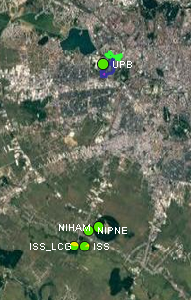
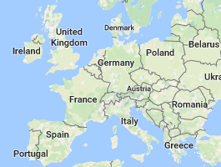
Overview
UPB - University Politehnica of Bucharest (UPB)
NIHAM, NIPNE - Horia Hulubei National Institute for R&D in Physics and Nuclear Engineering (IFIN-HH)
ISS, ISS_LCG – Institute Of Space Science (ISS)

Slide 4
Table of contents
Overview
Sites capabilities
Sites status
Status of Networking - IPv6 readiness
EOS
Sites planning

Slide 5
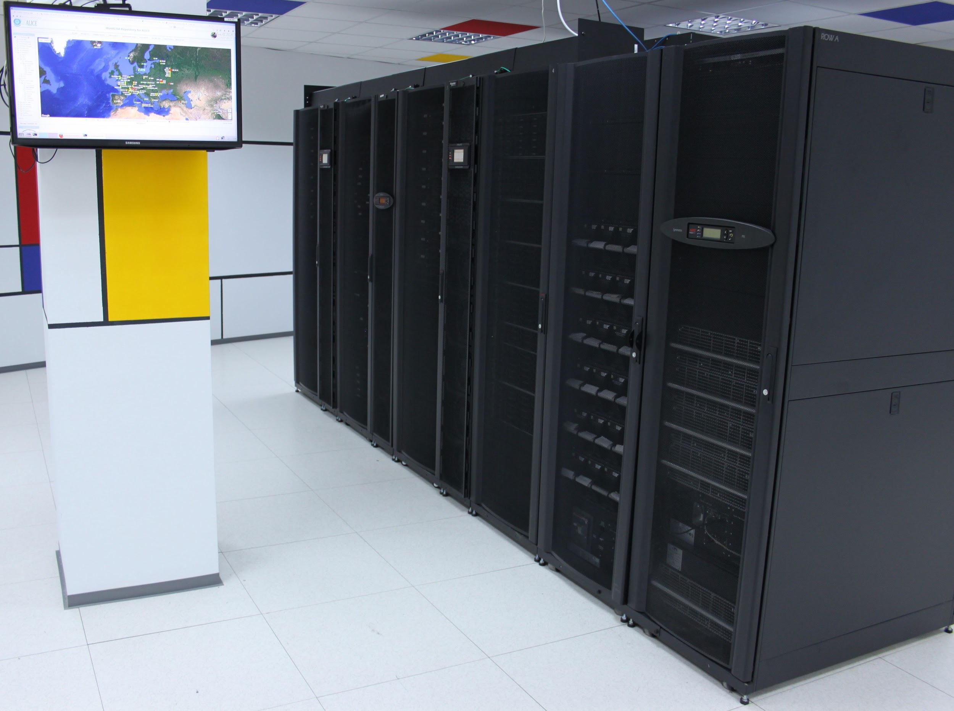
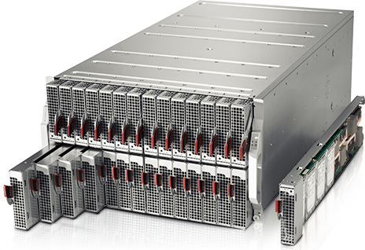
New ISS Computing Infrastructure
Sites capabilities - ISS
Designed for high density computing (Hot Aisle, InRow cooling)
Scalable solution for future investments
UPS Power : 48 kVA (with N+1 redundancy power units)
Cooling capacity : 80 kW installed (2N capacity redundancy)
new computing resources purchased at the end of 2016
192 cores (Broadwell, 14 nm, 2.2 GHz base freq) - 8 nodes
memory 5.3 GB/core - DDR4 2400 MHz ECC
2 x 10 Gb network/server; 4x40 QSFP uplinks
enclosure expandable to 28 nodes
storage capacity upgraded from 220 to 460 TB

Slide 6
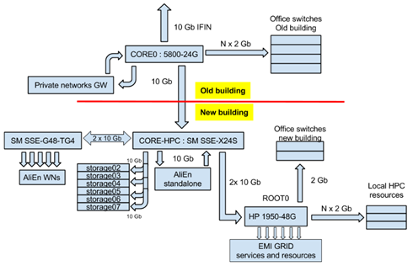
Sites capabilities - ISS
HARDWARE AND TOPOLOGY OF COMPUTING FACILITY
Our hardware is mainly comprised of SuperMicro machines that were chosen for the great resource density/price ratio. For computing nodes we use Twin servers, Blade servers which give us very good densities and for the storage we use servers with 24, 36 drives and JBOD cases with 45 drives in 4U of rack space.
In present we have 550 cores and 460 TB
Generic schematic of ISS computing facility :

Slide 7
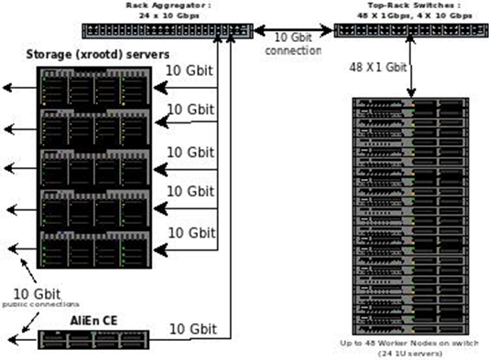
Sites capabilities - ISS
HARDWARE AND TOPOLOGY OF COMPUTING FACILITY
The AliEn cluster has at his core a 10 Gbps aggregating switch which is connected to the top-of-rack switch of the computing nodes. In the aggregating switch are connected the interfaces of the storage node, a topology which give a high bandwidth connection between worker nodes and storage with very little oversubscribing.

Slide 8
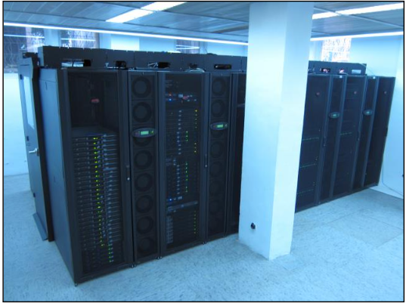
Sites capabilities – RO-07-NIPNE
Computing infrastructure
APC InRow Chilled Water Cooling
160KVA UPS
More then 3100 CPU(~230 nodes)
8, 16, 20, 32 cores/server
Computing and storage resources dedicated
to 3 LHC VOs: Alice, ATLAS, LHCb
2 different resource managers:
PBS/Torque+Maui, SLURM
4 subclusters , 6 queues ,2 multicore queues
Storage access for romanian ATLAS diskless sites
Member in FAX(Federated ATLAS storage systems using XRootD)
Part of LHCONE network (10Gbps connectivity)

Slide 9
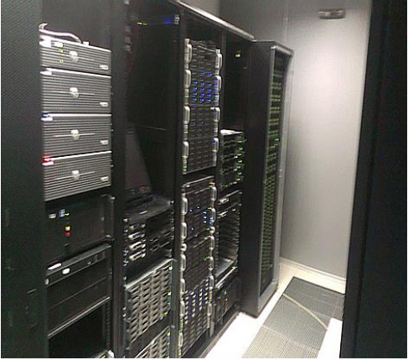
Sites capabilities – RO-07-NIPNE
Storage infrastructure
4x80KVA UPS Emerson
10 servers
~1,5PB total capacity
>1PB used capacity
Network infrastructure:
120Gbps connectivity between DC1 and DC2
2x40Gbps, 4x10Gbps
RO-07-NIPNE Software:
Scientific Linux 6, UMD3 middleware
3 CREAM + 1 ARC-CE as job management service
12 queues (PBS/Torque + MAUI, SLURM)
Disk Pool Manager(DPM – for ATLAS, LHCb) with 9 disk storage
EOS (Alice) – 1 FST server
Top BDII, Site BDII, VOBOX, CVMFS for all VOs
Alice VO: VOBOX, Dedicated CREAM, 688 cores, 30 nodes;

Slide 10
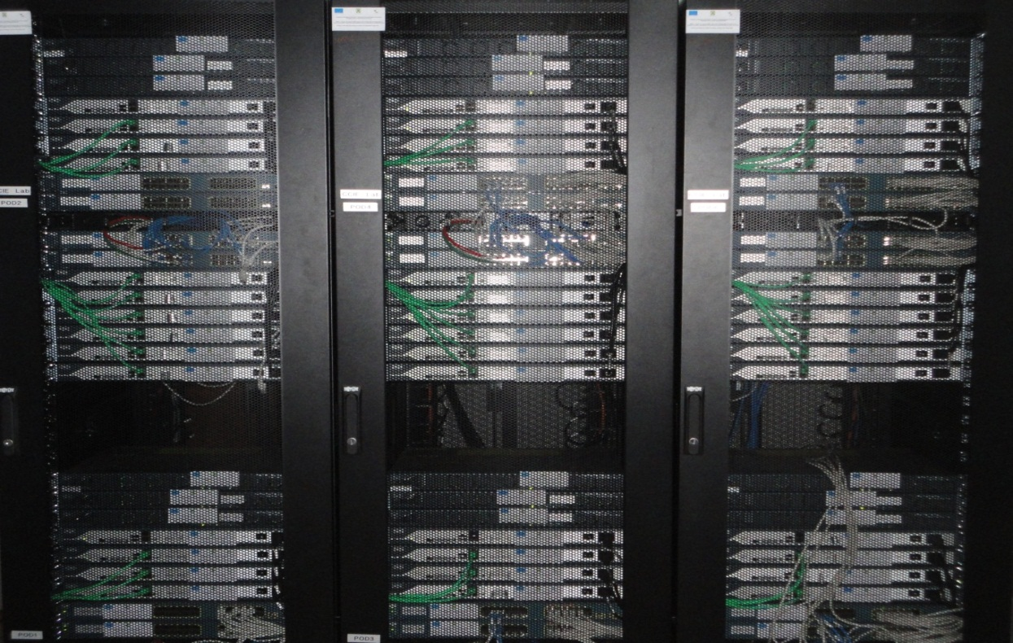
HW Computing Infrastructure
Sites capabilities - UPB
32 dual quad-core Xeon
20 dual hex-core Opteron
28 dual quad-core Nehalem
4 dual PowerXCell 8i
8 dual octo-core Power7
4 dual Xeon – 2 x NVidia Tesla M2070
60 dual octo-core Haswell
3 dual octo-core Haswell – 2 x NVidia Tesla K40m
1Gb-10Gb Ethernet / 40Gb-56Gb Infiniband Interconnect
Total storage of 120TB (small capacity disks SAS/Fibre Channel)

Slide 11
Grid Nodes as OpenStack VMs
Sites capabilities - UPB
Worker Grid Nodes running on top of OpenStack
Prepared Cloud Image with all the necesarry packages
Able to Run Scripts after VM creation
Provide elasticity
easily increase or decrease the capacity of the Grid
No performance issues
jobs are running with no cost of performance in terms of CPU
performant virtualized I/O operations using Virt I/O
RO-03-UPB in Alice
Started from November 2016
Pilot Test with168 cores
From January 2017 increased at 448 cores on top of OpenStack
At any time we can scale-up up very fast
E.g.: during the summer the resources aren’t used by students and can be shared
in the Grid

Slide 12
Table of contents
Overview
Sites capabilities
Sites status
Status of Networking - IPv6 readiness
EOS
Sites planning

Slide 13
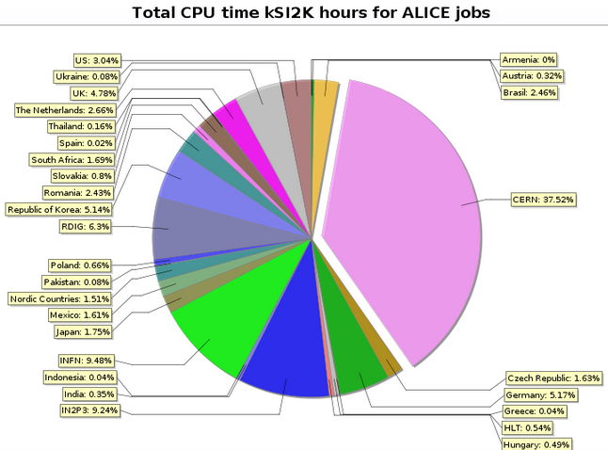
Sites status – Romanian computing contribution
- 4.56M jobs (2.46%)
- 22.9 M CPU hours (3.99%)
- 49.9 M kSI2k hous (2.42%)

Slide 14
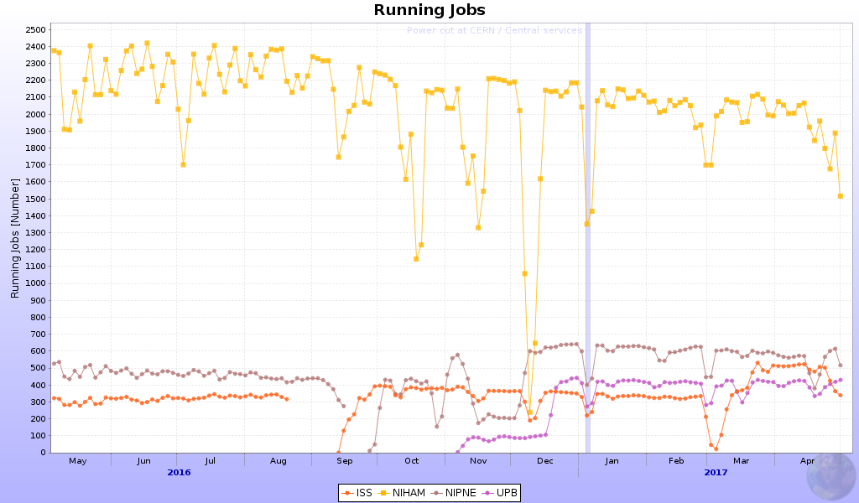
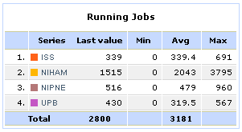
Sites status – running jobs profile

Slide 15
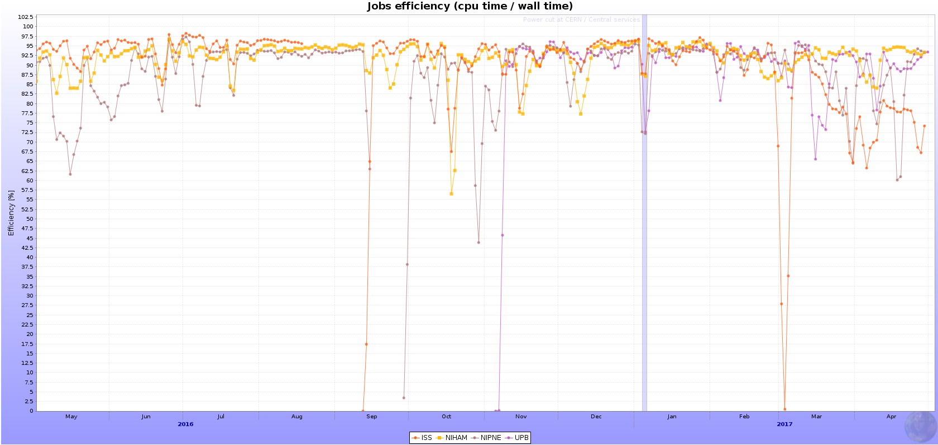
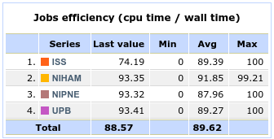
Sites status - Job Efficiency

Slide 16
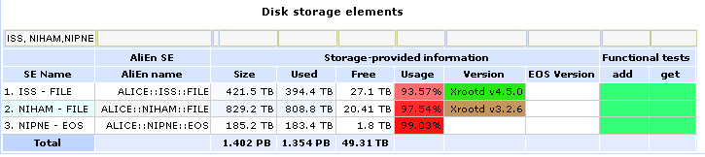
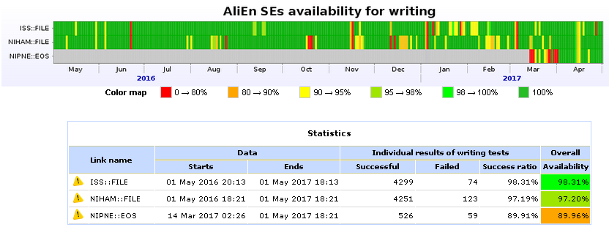
Sites status – SE Availability

Slide 17
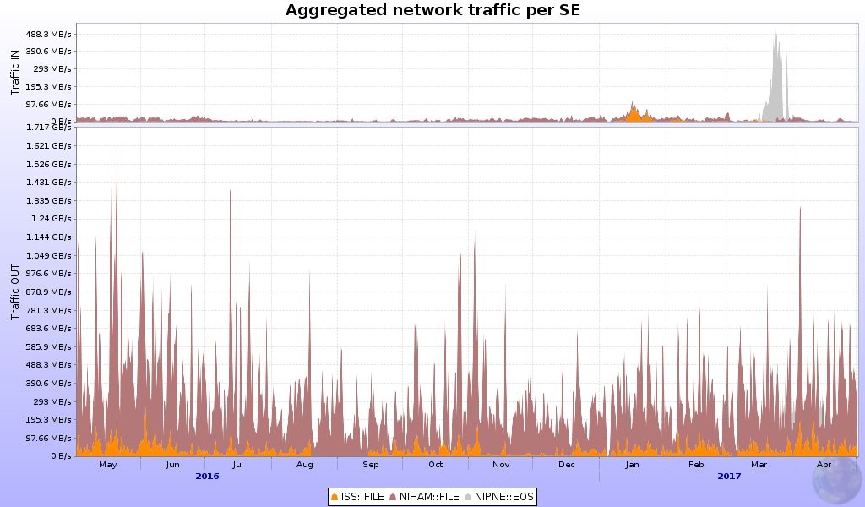
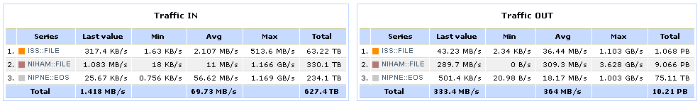
Sites status - Aggregated network traffic pe SE

Slide 18
Table of contents
Overview
Sites capabilities
Sites status
Status of Networking - IPv6 readiness
EOS
Sites planning

Slide 19
Status of Networking - IPv6 readiness
NIHAM, NIPNE
- infrastructure is IPv6 ready
- servers not dual stacked yet
ISS
- work in progress: IPv6 class already assigned, next step basic implementation in central routers (ISS + upstream RoEduNet)
UPB
- infrastructure is IPv6 ready
- at any time we can switch grid services to IPv6

Slide 20
Table of contents
Overview
Sites capabilities
Sites status
Status of Networking - IPv6 readiness
EOS
Sites planning

Slide 21
EOS
NIHAM
- no plan to migrate to EOS
NIPNE
- already use EOS
ISS
- no plan to migrate to EOS
- high initial effort for new storage cluster (upgrading hdds brings more space than purchasing a single server or at most two)
UPB
- no storage at the moment

Slide 22
Table of contents
Overview
Sites capabilities
Sites status
Status of Networking - IPv6 readiness
EOS
Sites planning

Slide 23
Sites planning
ISS
- ~ 55000 Euro (from RO-CERN 2 projects : physics + GRID)
- purchase new hard drives (+320 TB net gain) to replace the obsolete ones
- purchase new worker nodes (+96 Broadwell 2.2 Ghz cores)
NIHAM
- no funding info
- present efforts are concentrated into replacing hardware while preserving the overall capacity. From Claudiu email: “We have new workers to replace the oldest ones. By the end of this year we will also buy new storage machines, so next year we will replace the present storage hardware. Increased storage capacity is desirable, as the storage is now full, but I cannot say now if we will have it.”

Slide 24
Sites planning
NIPNE
- no funding info
- double the storage(EOS) capacity for Alice
- upgrade the network bandwidth for RO-07-NIPNE from 10Gbps to 20Gbps
- keep the amount of dedicated computing resources for Alice
UPB
- no funding dedicated for Alice
- add storage capacity from internal funding (initial 72TB with potential increase to 200TB)

Slide 25
Thank you for your attention!
Contacts for site admins:
ISS: ionel.stan@cern.ch, adrian.sevcenco@cern.ch
NIHAM: claudiu.schiaua@cern.ch
NIPNE: mihai.ciubancan@cern.ch
UPB: mihai.carabas@cs.pub.ro

