Slide 1
BIF Measurement update

Slide 2
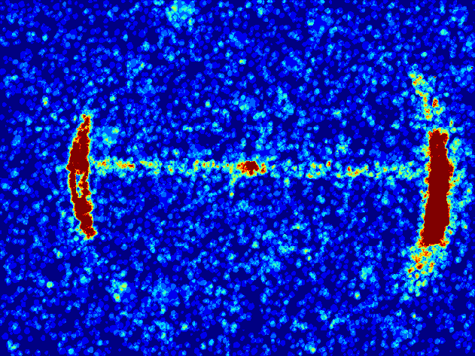
Data analysis
Medfilter2
Twice
Threshold
Sum all pictures
Normalize and show
Hot spot in MCP might affect the resolution.
Distribution around the photon in each picture might not be real.
Not dealing with non-linear amplification in MCP

Slide 3
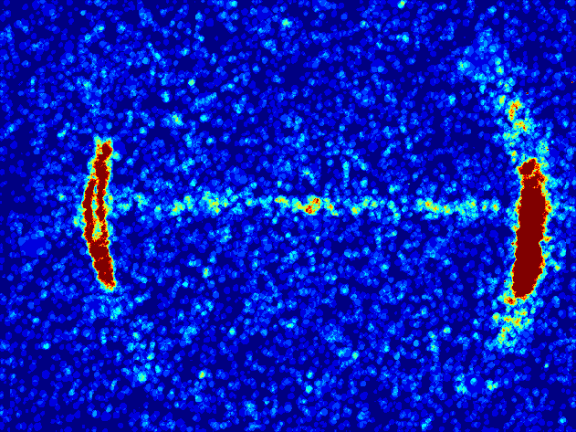
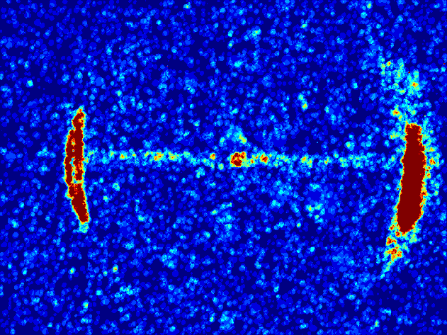
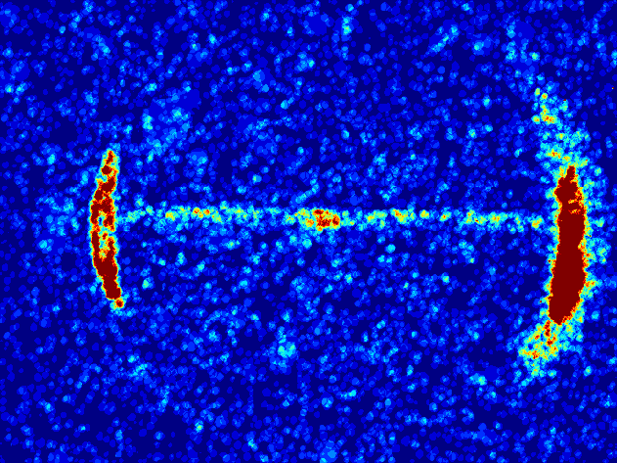
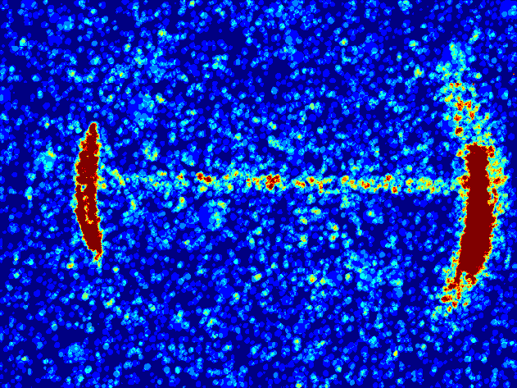
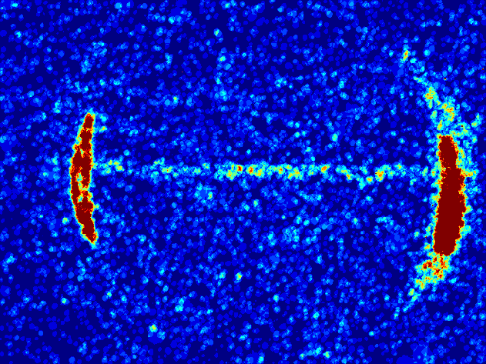
Y scan (1000s)
5.6
6.0
6.4
108 mm
6.8
7.2
7.6
Jet direction
E-Beam direction

Slide 4
Analysis
1 pixel ~= 0.22mm

Slide 5
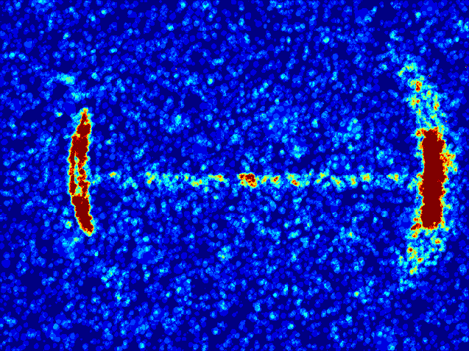
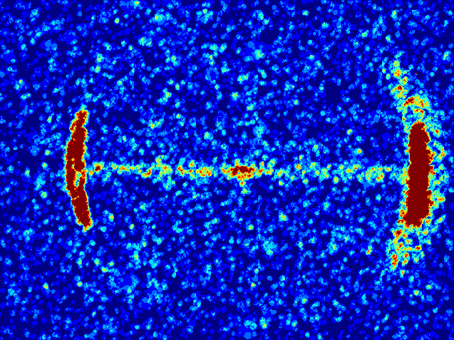
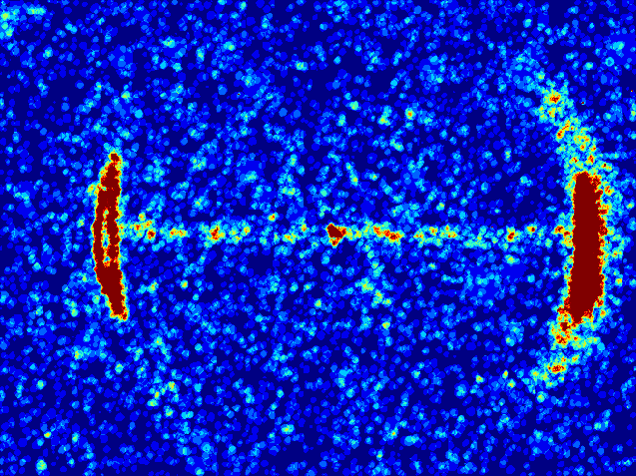
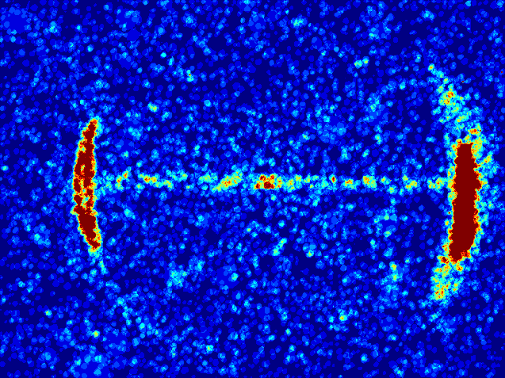
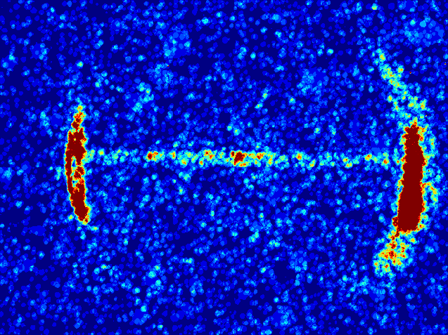
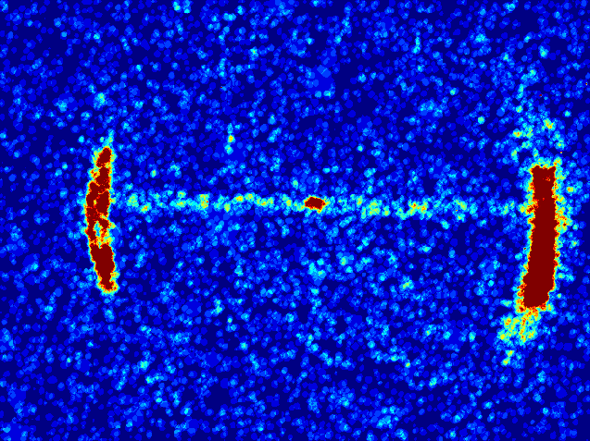
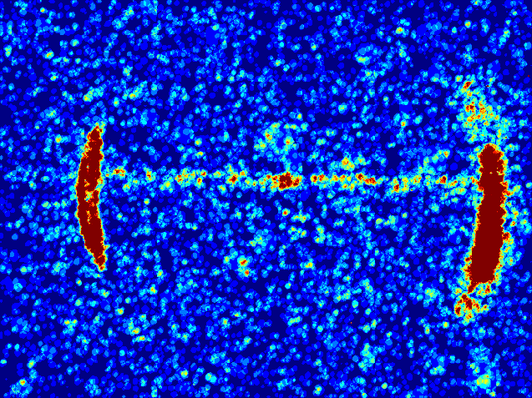
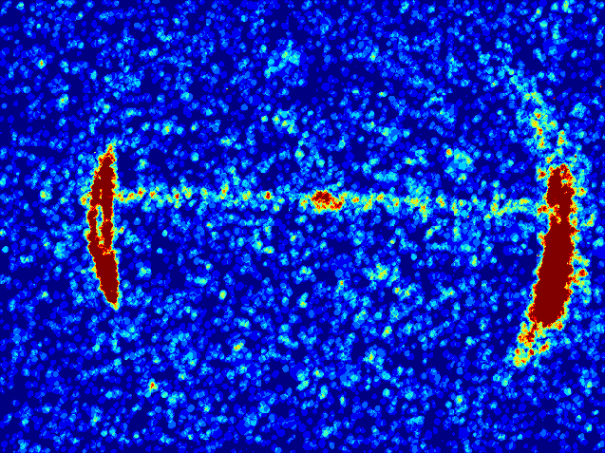
X scan (1000s)
5.9
6.3
6.7
7.1
7.5
7.9
8.3
8.7

Slide 6
Analysis
1 pixel ~= 0.22mm

Slide 7
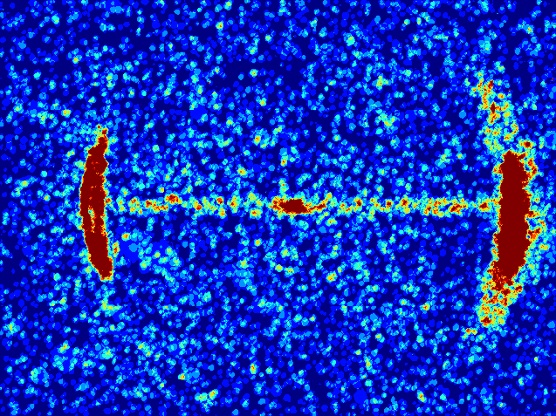
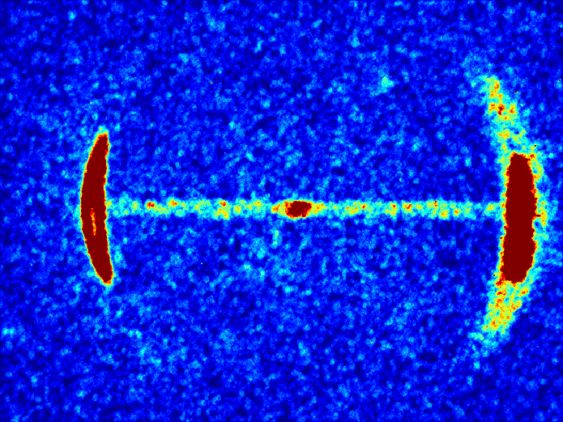
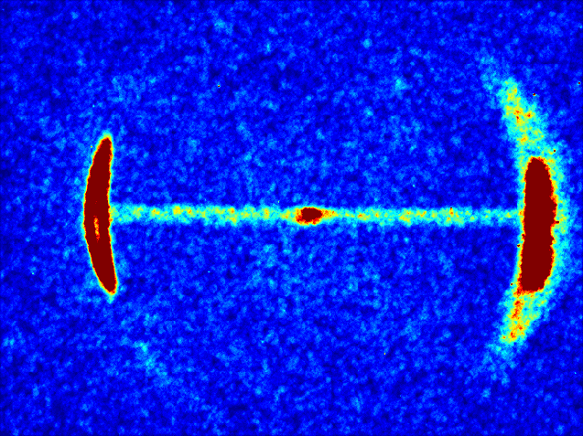
Integration time
1000s
4000s
8000s

Slide 8

Fitting
time | 1000s | 2000s | 3000s | 4000s | 5000s | 6000s | 7000s | 8000s
a | 188.8 | 331 | 480 | 592.8 | 706.8 | 829.7 | 917.2 | 1032
b | 347.3 | 348.4 | 348.7 | 348.6 | 350.1 | 349.9 | 349.6 | 349.5
c | 9.834 | 8.824 | 7.926 | 8.662 | 8.979 | 9.529 | 8.842 | 9.138
d | 190.7 | 389.1 | 586.6 | 778.6 | 945.1 | 1127 | 1327 | 1513
R2 | 0.7358 | 0.8193 | 0.7988 | 0.8235 | 0.8475 | 0.8513 | 0.8718 | 0.8695
Size ?? | 2.15 | 1.93 | 1.73 | 1.89 | 1.96 | 2.08 | 1.93 | 1.99
$$y=a∗e^{− \frac{{(x−b)}^{2}}{2c^{2}}}+d$$

Slide 9
Y fitting
 | case1 | csae2
a | 3438 | 9121
b | 244.1 | 244.1
c | 6.217 | 6.63
d | 881.5 | 3191
R2 | 0.9755 | 0.9837

Slide 10
Y line scan
a | 82.42
b | 244.1
c | 6.45
d | 8.084
R2 | 0.9321
1.41 mm

Slide 11
108 mm == 494.7 pixel

