Slide 1
Eyets 16/17
BI activities

Slide 2
General information
Technical stop duration:
LINAC2: from 5/01/2017 to 10/03/207
LINAC3: from 12/12/2016 to 24/02/2017
LEIR: from 12/12/2016 to 8/05/2017
PS & TT2: from 15/12/16 @ 6:00 to 31/03/2017 @ 12:00
PSB: from 15/12/2016 to 6/01/2017 and from 30/01/2017 to 17/03/2017

Slide 3
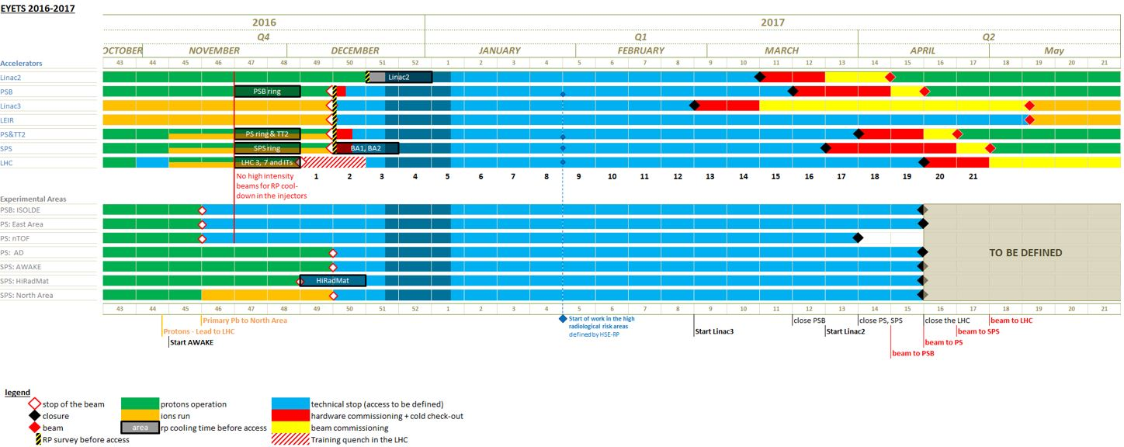
Official schedule: ATS-PM-MS-0001 EDMS 1470895

Slide 4
The following shows what I’ve been informed of and what I could dig out from IMPACT
Inform me about any other activity not listed
For interventions that concerns vacuum the proposed date are the ones suggested by TE/VSC. Each activity responsible has to contact directly Jose Somoza to organize the intervention and/or re negotiate the date if not ok.
Contact Tobias Dobers(EN-ACE-SU) in case you need survey to schedule the intervention

Slide 5
LINAC2-LINAC3-LEIR

Slide 6
PS

Slide 7
TT2

Slide 8
PSB

