Slide 1
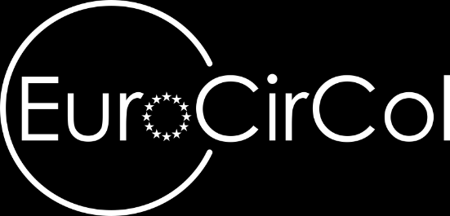

US-EuroCirCol coordination meeting 02
January 17th, 2017
Cable parameters for EuroCirCol dipoles
Davide Tommasini

Slide 2
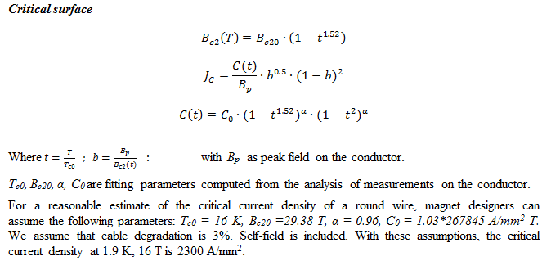
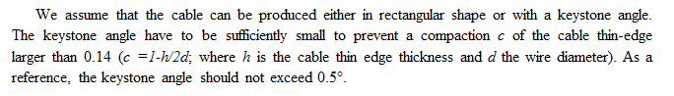
Cable parameters
Critical current density @ 1.9 K, 16T (total) 2300 A/mm²
Degradation due to cabling 3%
Minimum Cu/nonCu 0.8 also check 0.9-1.0
Maximum strand diameter 1.2 mm also check 1.1 mm
Maximum (any) stress on conductor 200 MPa
Maximum number of strands in a cable 40 check up to 60

Slide 3
Thank you for your attention

