Slide 1
Experimental Tests and Simulations of 3D Trench Detectors
Shahab Kohani, Allen Mincer and Christopher Musso, NYU for an NYU, BNL (David Lynn et. al), CNM, SUNY SB Collaboration

Slide 2
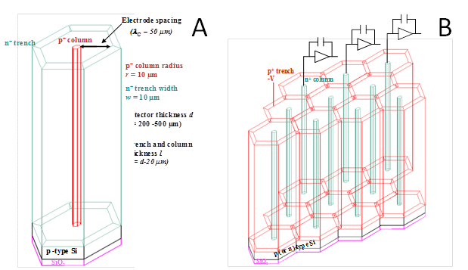
Introduction
“Trench” Electrode
Why silicon detectors?
Why 3D trench design?
The small bandgap leads to a large number of charge carriers per unit energy loss of the ionizing particle. The average energy to create an electron-hole pair in Silicon (3.6eV) is much smaller than the ionization energy of gasses (~10-30eV).
Due to high density compared to gas, it is possible to build thin detectors that produce large measurable signals.
They are also rigid and self supporting, when combined with previous points, allows us to minimize any possible change of direction of the tracked particle.
Despite high density, electrons and holes can move almost freely to allow for rapid collection of charge (~10ns). This is due to high mobility of electrons and holes.
Cheaper and easier to manufacture compared to other semiconductors.
Long term radiation damage slows down the charge collection and limits the maximum collection distance in the bulk to ~100 microns.
In the trench design, thickness and maximum collection distance are independent. The drift distance can be kept small while the detector can be made thick enough for rigidity and sufficient charge production.
Radiation damage slows down the charge collection. The ability to make the collection distance arbitrarily small without compromising the amount of charge deposited in the detector is useful.
Near full depletion necessary for the detector to function properly does not depend on the depth, which results in smaller minimum necessary bias voltages, in turn lowering the power requirements for the system.
Non uniform response in the active region of the detector makes these detectors unsuitable for direct energy measurement. They are still effective for tracking.
Initial designs only included alternating columns of highly doped n and p silicon. These designs fail due to existence of potential saddle points and lack of sufficient charge collection. Trench detectors are designed to address these shortcomings.

Slide 3
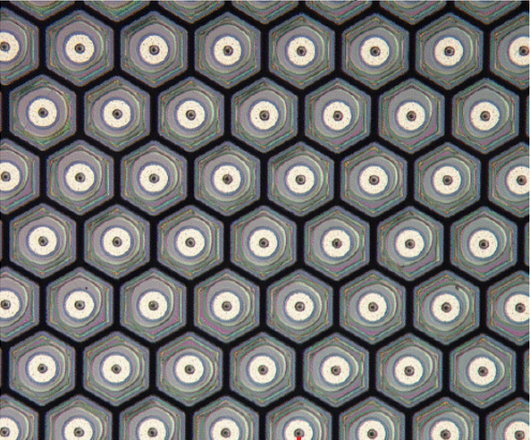
Trench 3D detectors
Wafer Cross section which include a variety of detectors
Detector Array for High Energy Experiments
85 um

Slide 4
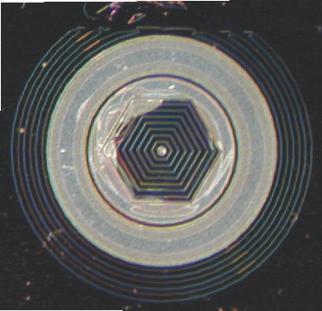
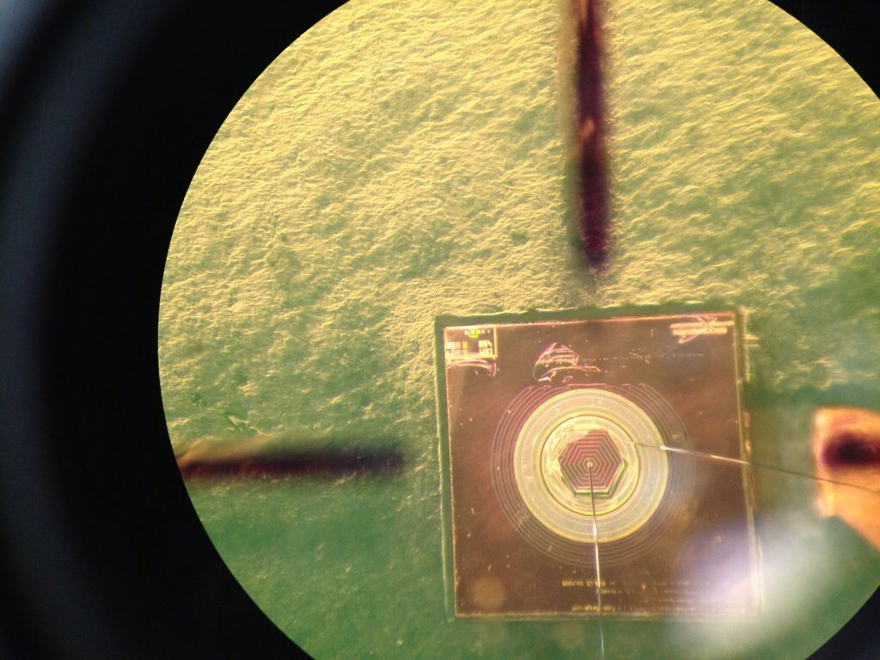
Hexagonal Test Detectors
1 mm
Charge Collection

Slide 5
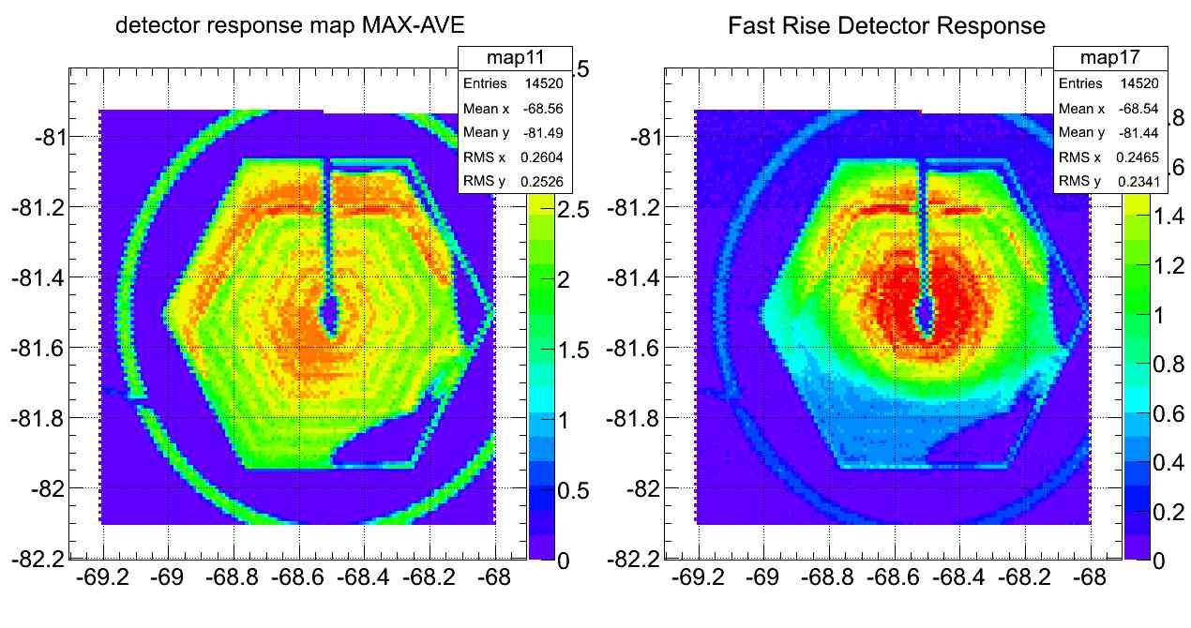
Why Laser Response Map?
By moving the laser over the surface of the detectors we can map their response.
Laser going through the detector creates electron-hole pairs. We collect the electrons and generate a signal. By creating a response map for the detector, we investigate the response to ionization as a result of the particles going through the detector and investigate the shape of the active region of the detector.
Length is marked in mm on all response maps.

Slide 6
Measurement Electronics
Detector
Cremat
Shaper
Amplifier
Final Stage Low Pass Filter
Induced charge is collected here.
A charge sensitive preamplifier generates the initial voltage signal from the charge coming from detector.
Signal is shaped to reduce the noise.
Signal is amplified
Optional to further
reduce the noise or remove the slow rise part of the signal and the ringing on the fast rise.

Slide 7
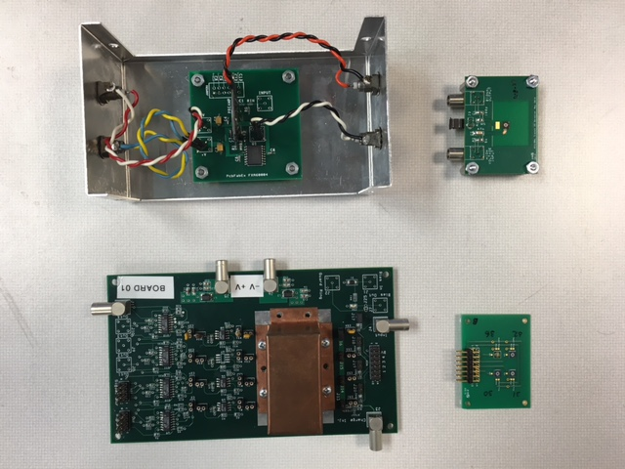
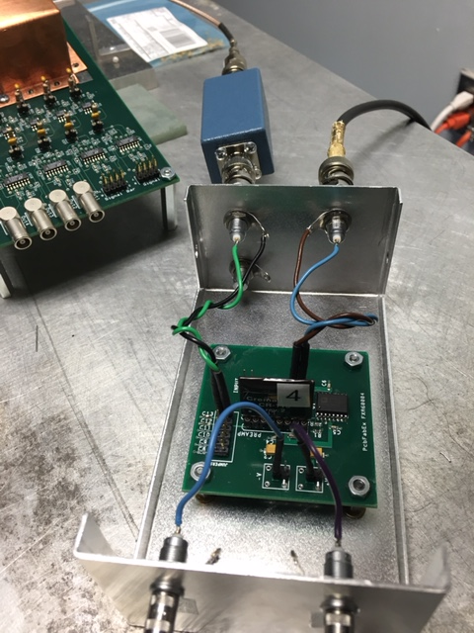
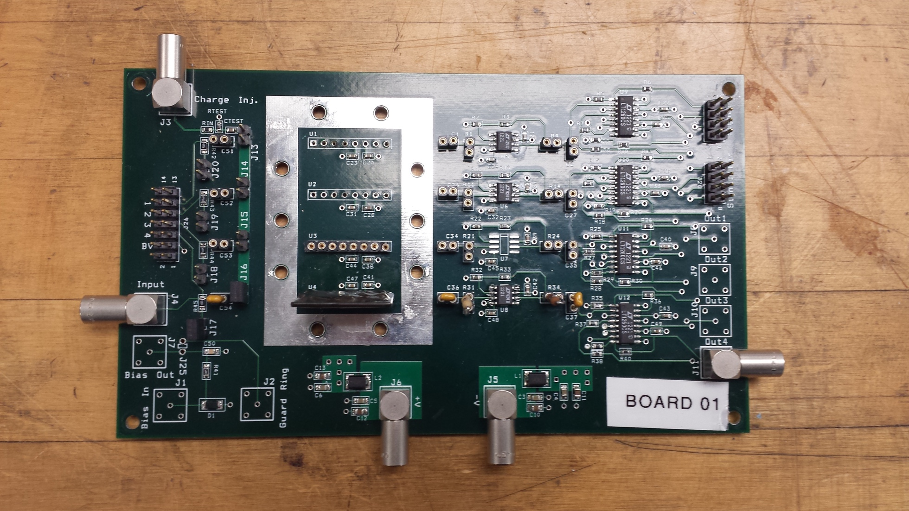
Single Channel Board Electronics

Slide 8
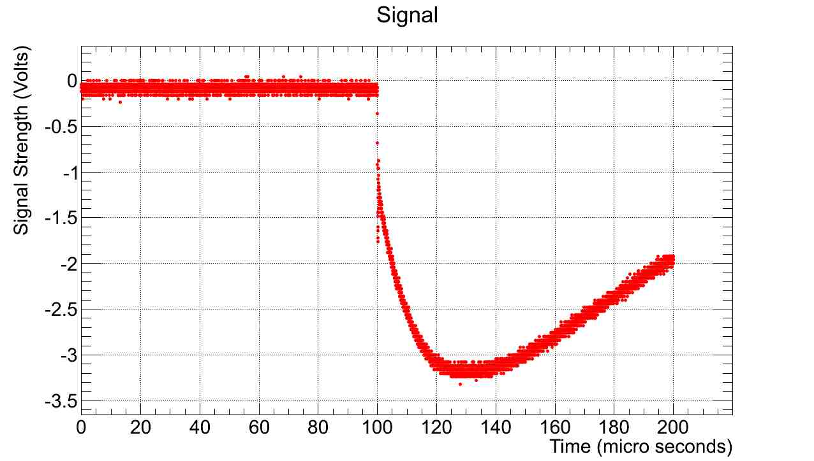
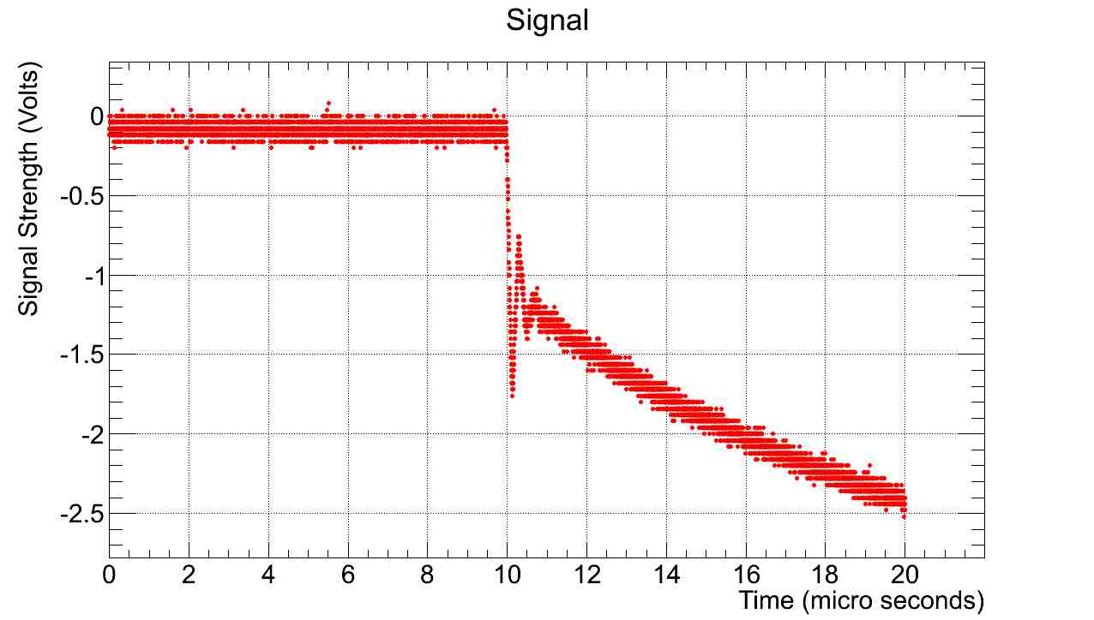
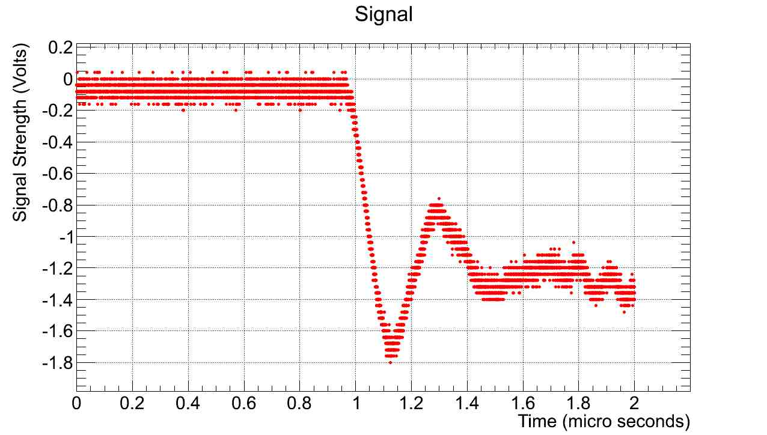
Components of an output laser response signal under different time scales
To measure the size of the total signal we calculate the difference between the minimum and the average of the first few thousand points.
Due to ringing in the signal we have to use a low pass filter to remove its effect or fit a line on the total signal close to the end of the fast rise.
Other than the ringing we can minimize all the other types of noise by using the oscilloscope to average multiple signals at each point.
Better to fit a line and use intersection shown above for fast signal pulse.

Slide 9
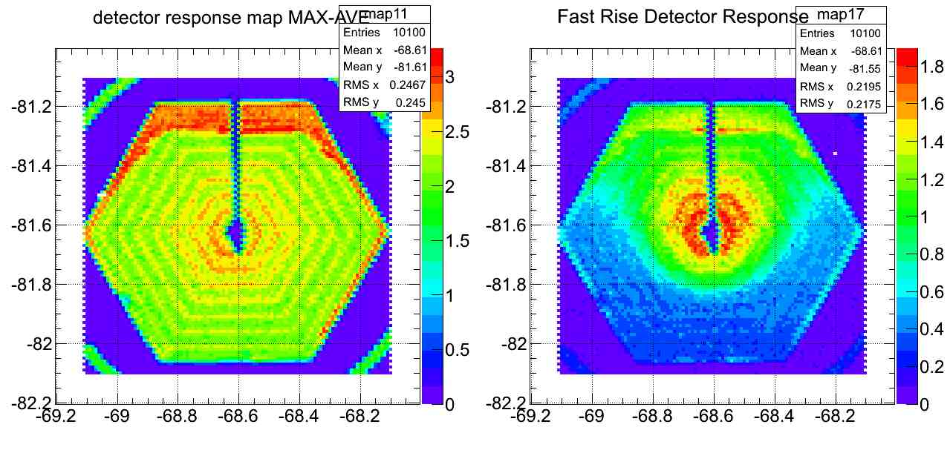
Laser Response Map for Hexagonal Detectors
These maps are made by laser hitting the detector from the top.
Using 100V bias, there is clearly an asymmetry in the response maps of these Hexagonal Detectors.
Metal surfaces like the Aluminum in guard ring and over the trench and also the central wire connection block the laser and result in a zero response.
The fast response signal is larger closer to the center.
Detector 01
Detector 02
*Color scales are different for different graphs

Slide 10
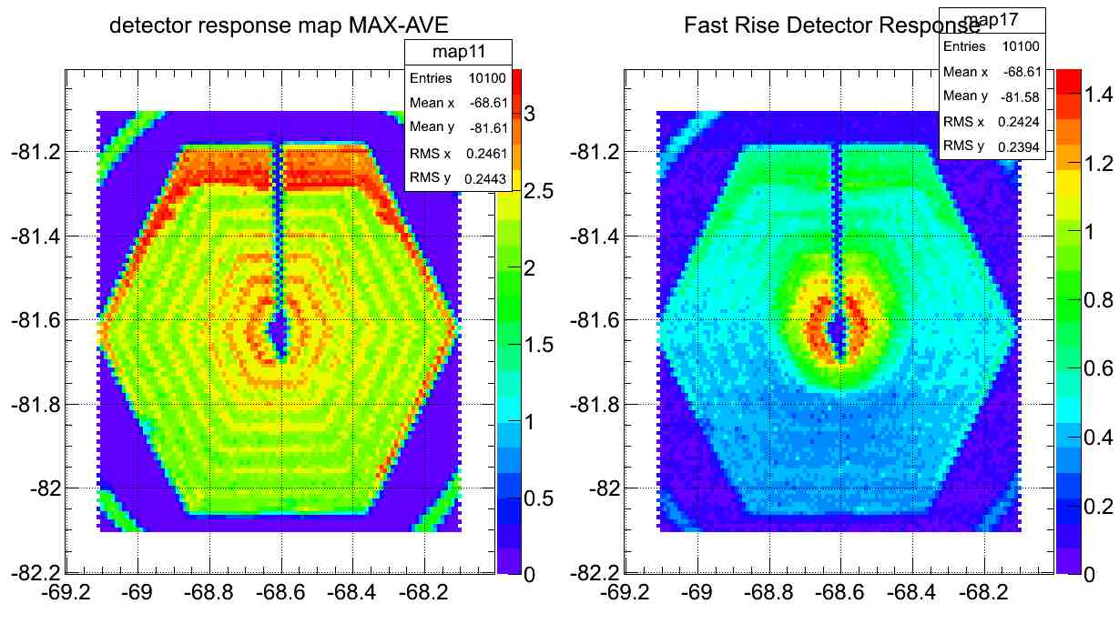
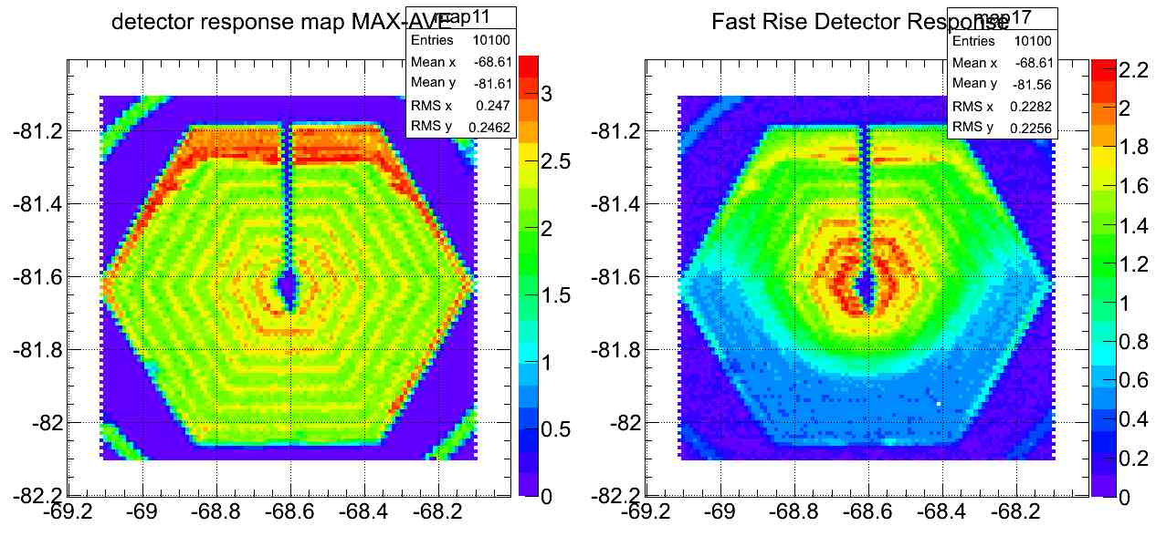
Bias Voltage Effects
V_{bias}=60V
Response maps of a hexagonal detector with three different bias voltages
As we can see here the total response remains nearly unchanged.
The fast signal clearly grows with increasing the bias voltage. This was originally interpreted as an indication that detector is not fully depleted but simulations suggest that may not be the case.
The asymmetry along the bond wire can be observed in any bias voltage.
V_{bias}=100V
V_{bias}=140V
*Color scales are different for different graphs

Slide 11
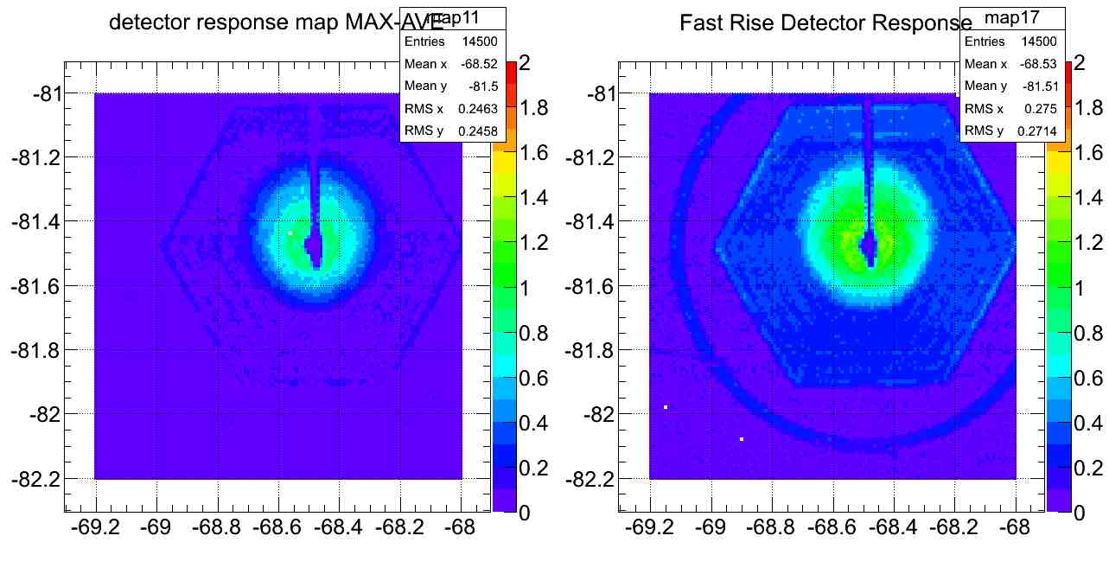
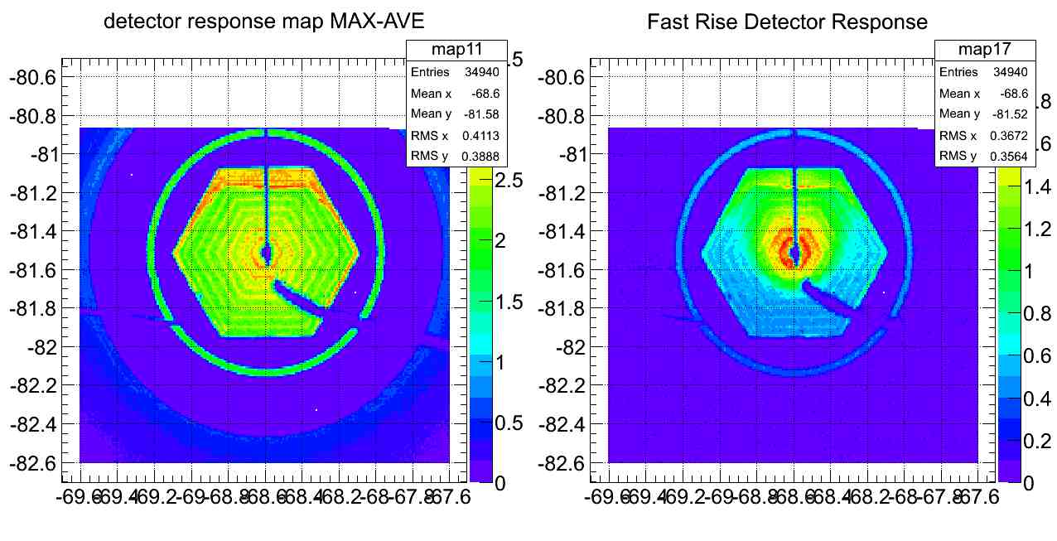
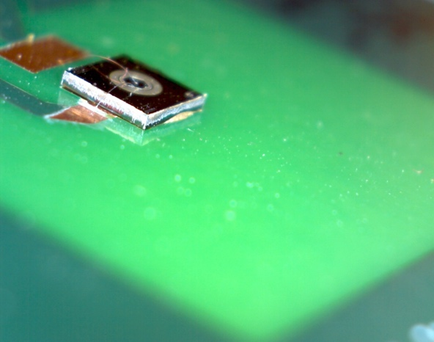
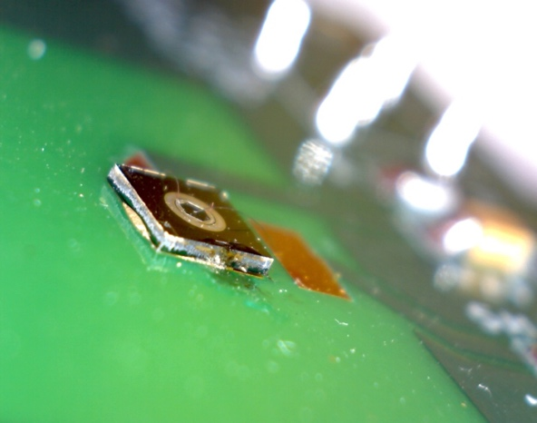
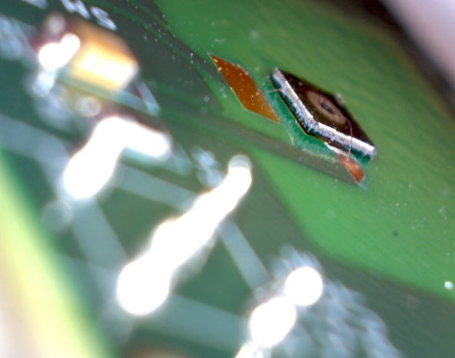
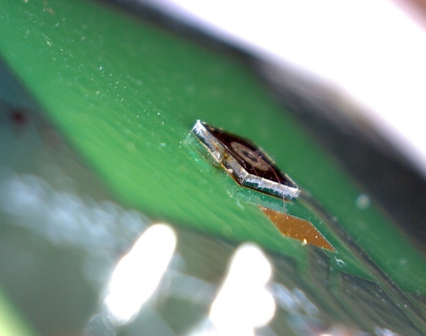
Laser Response to grounding the conducting back-side
The original detector batch (2012) had their backside glued using a conductive glue.
As can be seen here grounding the back side of the original detector batch kills the signal.
*Color scales are different for different graphs

Slide 12
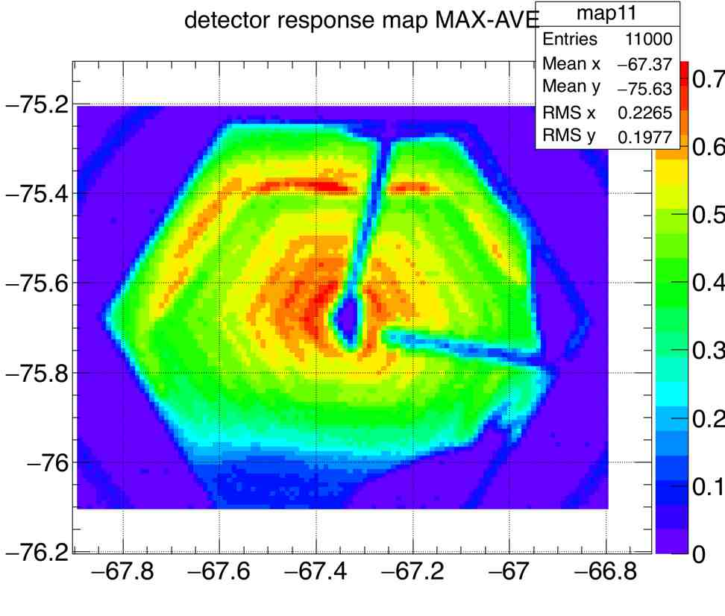
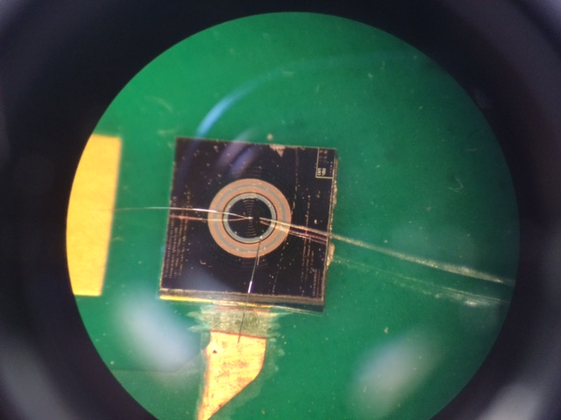
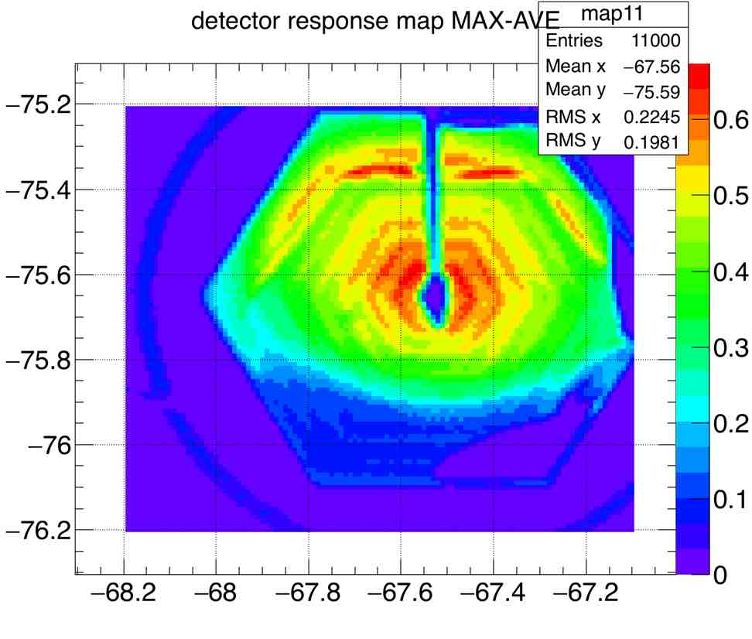
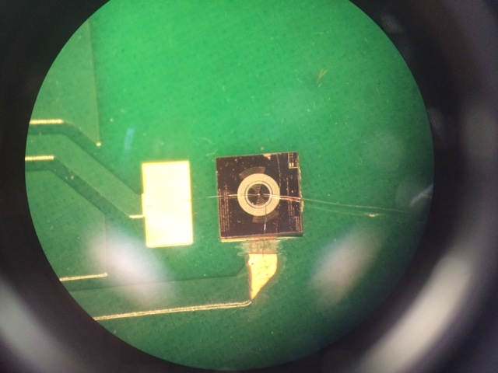
Effects of Bond Wire Rotation and Additional Grounded Wire
To investigate the possible relation between the asymmetry of the original detector response maps and the virtually grounded bond wire, we add an additional grounded wire and turned the ground wire.
As can be seen here, the only effect is coming from the shadows cast by the the metal wires blocking the laser.
As a result of this experiment, we claim that the observed asymmetry is an artifact of manufacturing process.
*Color scales are different for different graphs

Slide 13
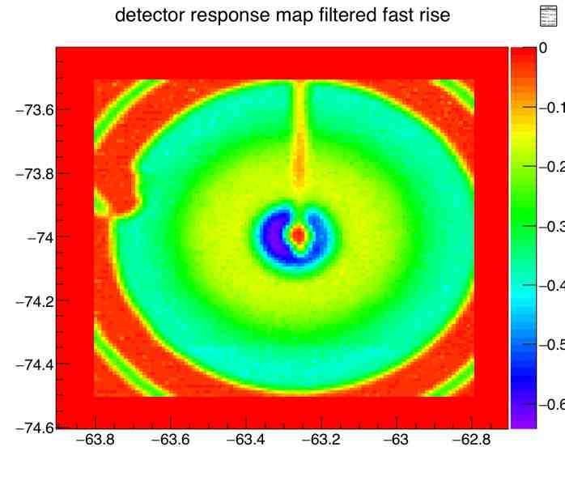
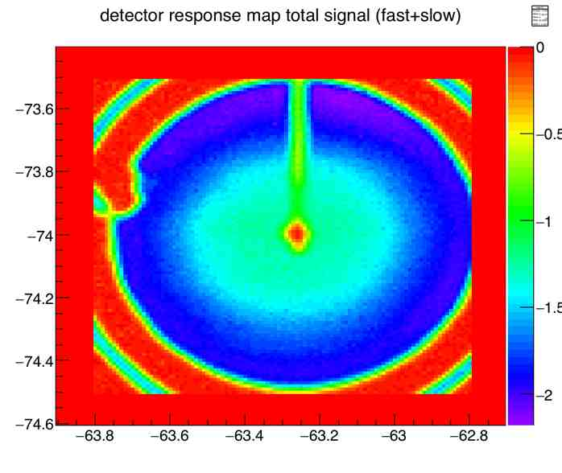
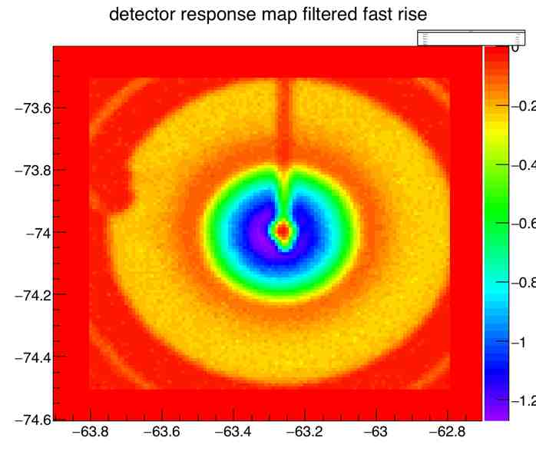
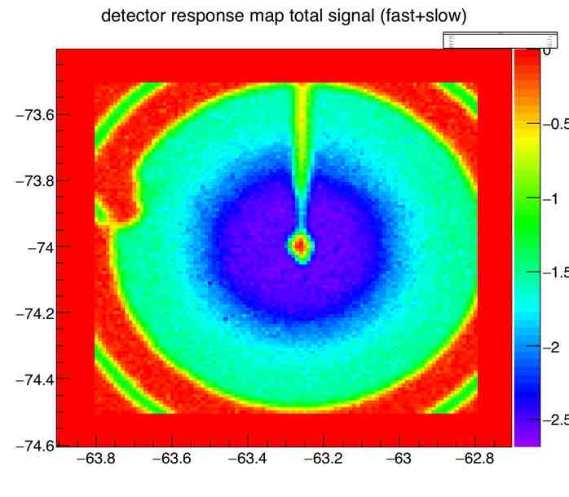
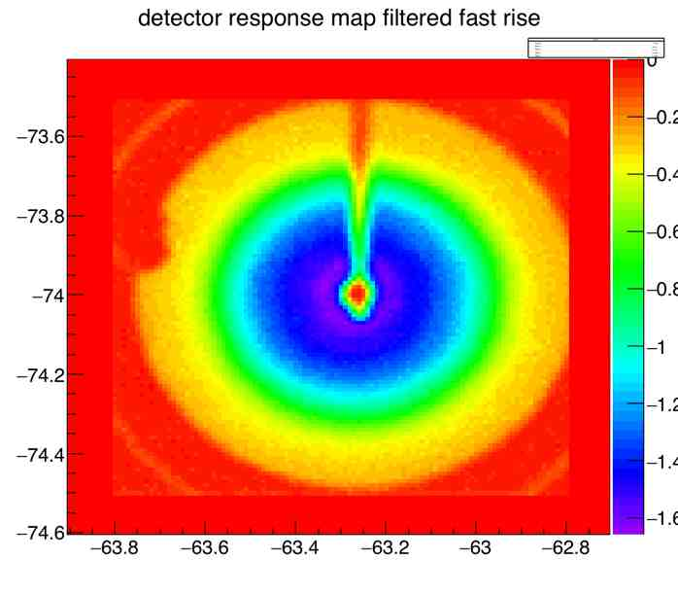
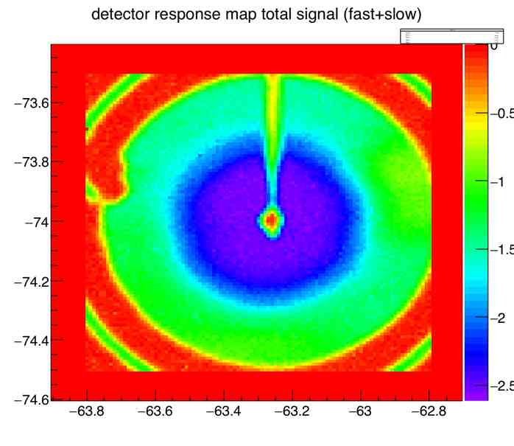
Circular Detector Response
V_{bias}=20V
Voltage is applied to both trench and guard ring.
At 20V total signal drops massively around the center. This is likely due to lack of depletion and a large part of charge being collected late.
Fast Rise signal being larger close to the center is likely simply due to smaller physical distance.
V_{bias}=50V
V_{bias}=100V
*Color scales are different for different graphs

Slide 14
Multi-Cell Array Laser Response
Hexagonal pattern allows full tiling of a detection plane.
Cell-to-cell variation and non-uniformity of response within cells is visible.
Currently testing response from detector underside, to avoid shadowing by stray conductive material.
Crosstalk tests such as the graph below show no observable signal larger than noise in cells neighboring an irradiated cell, which generates signals larger than a volt.
V_{bias}=100V
V_{bias}=100V
- Total Detector Response with laser hitting the active region of a neighboring cell
- Pure noise, total signal results when laser is off
*Color scales are different for different graphs

Slide 15
Radioactive Response Test System
Am 241, ~10μCi, 60keV
Cremat
−>
x10
High-pass
filter
Amplifier
Trench Detector
-60 to -140V
±6V
Gate generator Start
Discriminator
threshold 0−255 mV
Fan
In/out
Splitter
Gate generator Stop (>500ns)
VETO (microseconds)
Inverter
Fan
In/out
Gate = Start AND ~Stop OR ~VETO
Cable delay
~300ns
Gate Input
Peak-sensing ADC

Slide 16
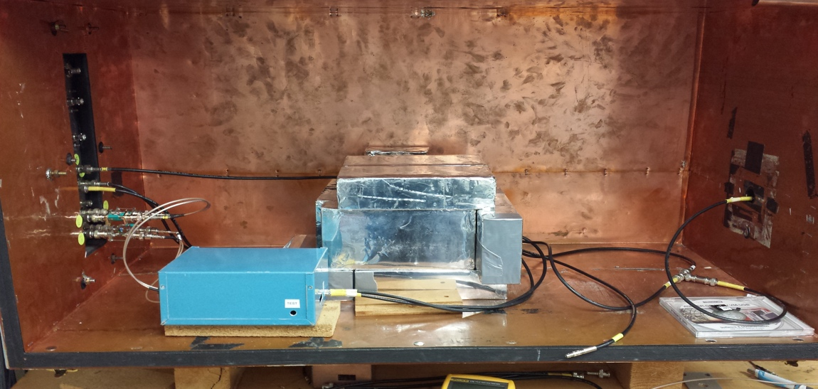
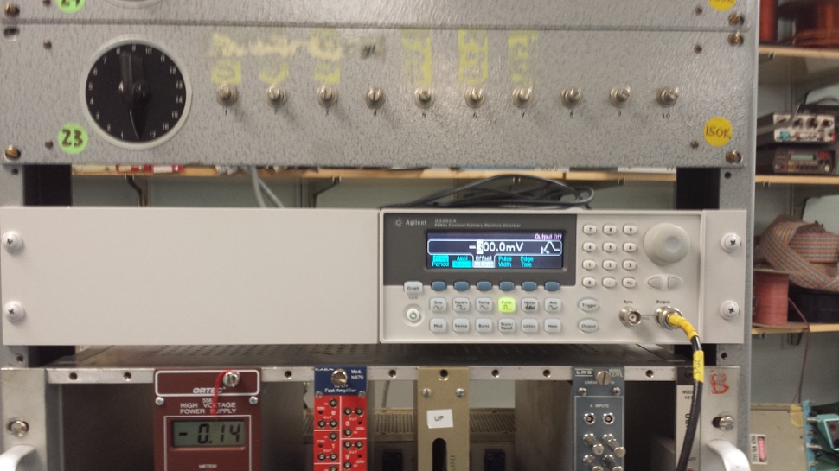
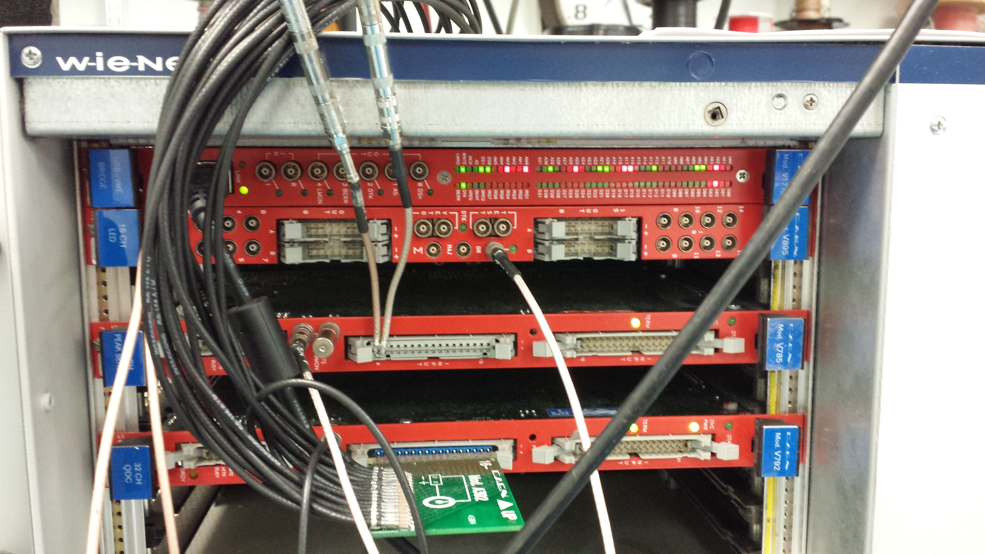
Radioactive Response Measurement System
Only Limo Inputs on Discriminator
Ribbon Input

Slide 17
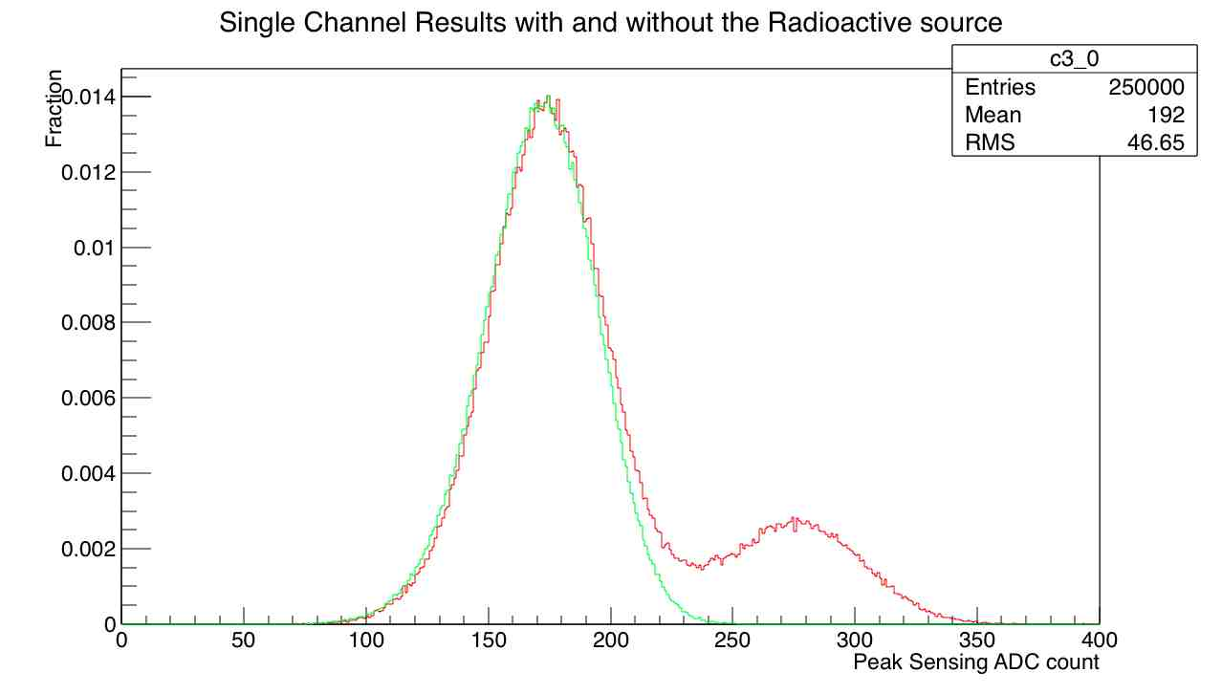
Single Channel Results with and without the Radioactive source
²⁴¹Am source generates ~60KeV gammas. Though detector response is not uniform (as seen in IR laser maps) there is clear separation of signal and noise distributions.
Measurements are done using the single channel board and channel 00 on both the discriminator and PADC.
Normalized graphs for effect with 250000 measurements in each set of data
Discriminator set to 60mV
Red Graph is with radioactive source. Green is just noise as there is no source in this measurement.
As expected second red bump is the signal value.

Slide 18
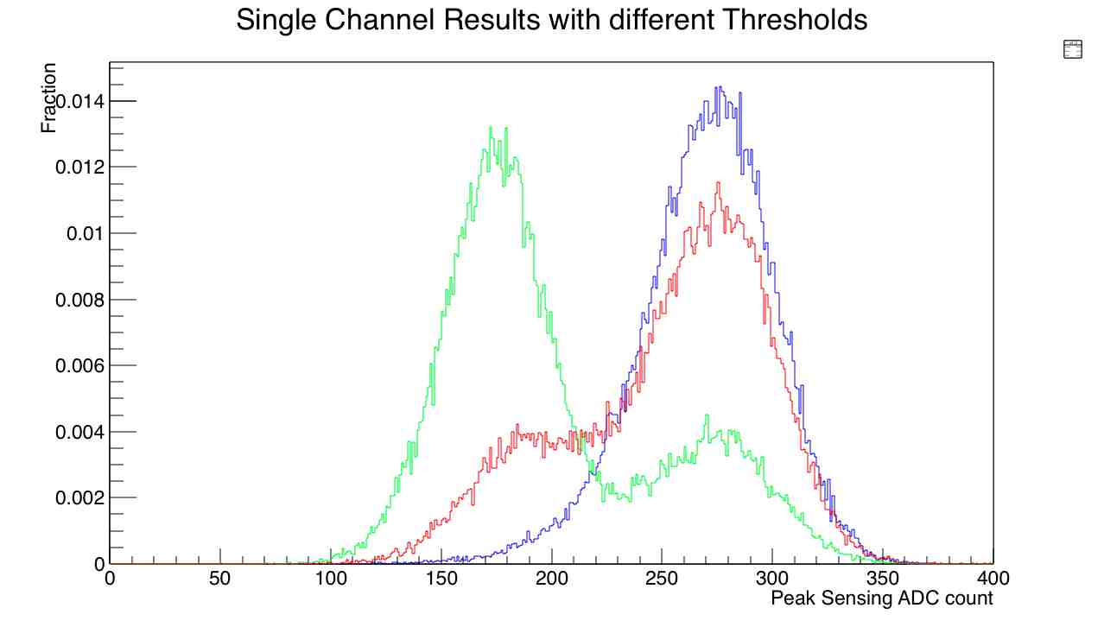
Single Channel Results with different Thresholds
Raising the discriminator threshold filters out most noise triggers, while preserving the large-amplitude gamma generated trigger signal.
As expected second bump is the signal value which remains unchanged.
Measurements are done using the single channel board and channel 00 on both the discriminator and PADC.
Normalized Graph with 50000 measurements in each set of data
X axis is Peak ADC counts
Discriminator set to 60mV for Blue, 65mV for Red and 70mV for Green
Signal maximum is ~270 counts which corresponds to ~100mV.

Slide 19
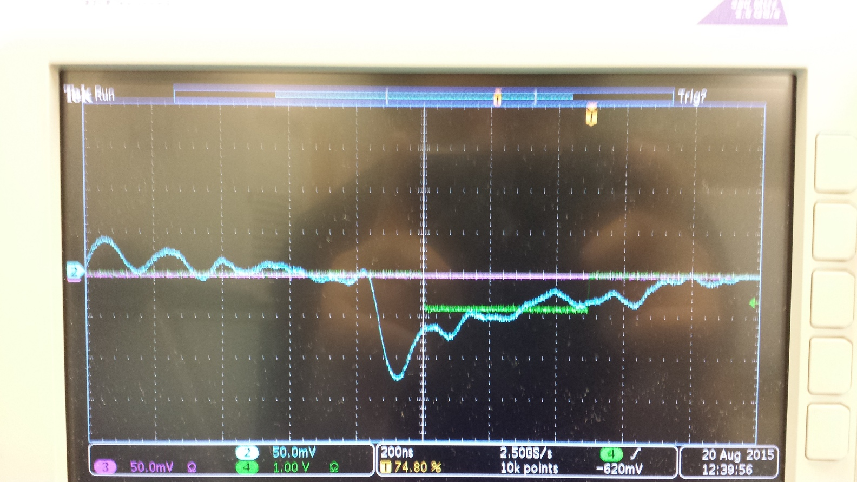
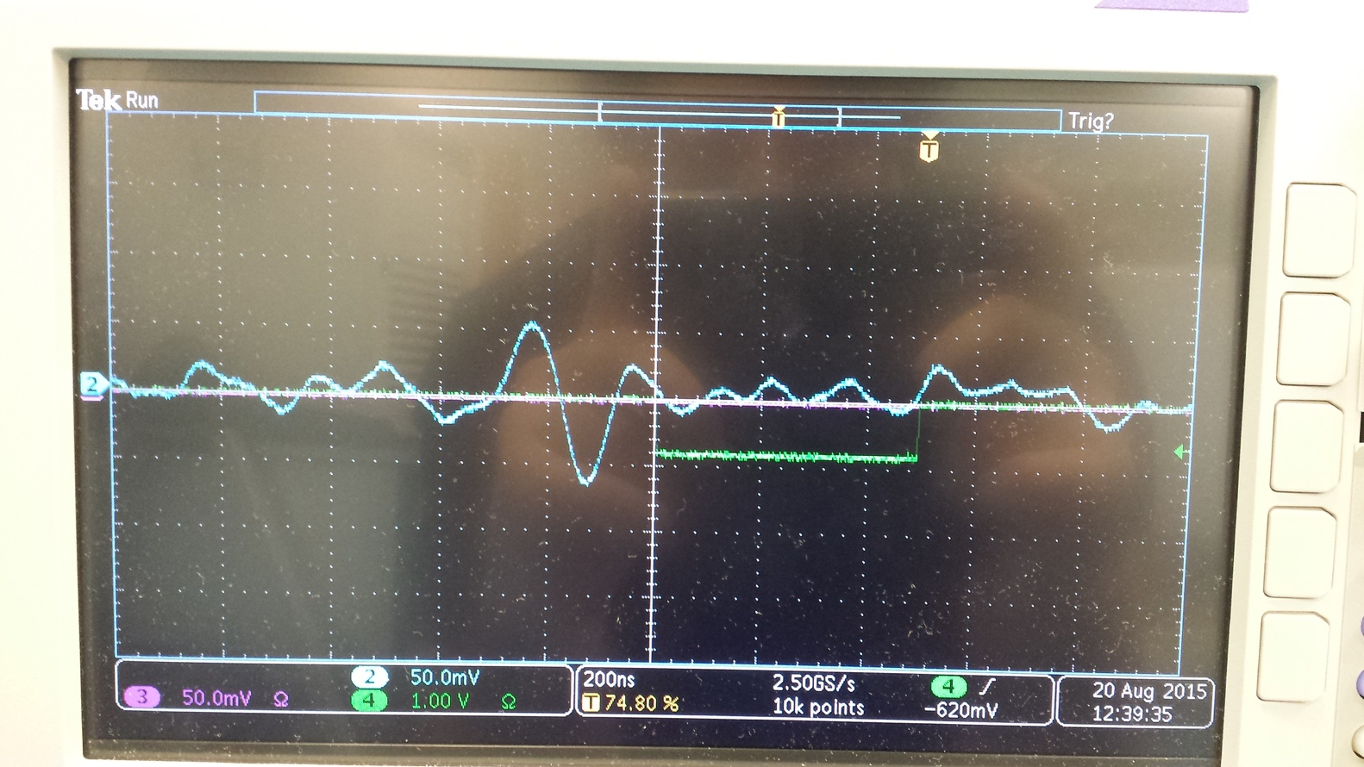
Noise
Noise is dominated by electronics and cable pickup.
System is extremely sensitive to the connectors and cable the carrying signal from detector to the boards. We could only get manageable noise by using Limo connectors and a Single short cable.
Signal from radioactive source (²⁴¹Am) is not symmetric. Slow rise mostly filtered out.
Noise is almost symmetric

Slide 20
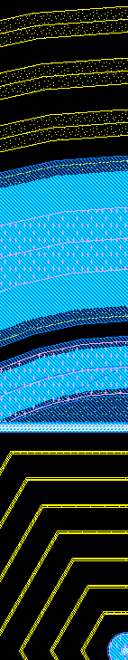



Passivation layer
Aluminium contact
Width =320 µm
Aluminium contact
Width =115 µm
Aluminium contact
R =35 µm
Polysilicon
R=13µm
Polysilicon
width=18µm
dioxide layer
39µm
120µm
29µm
100µm
388µm
P-type implant
Width = 300µm
50µm
P-type implant
Width= 50µm
Width =
174 µm
36µm
Distance
between
implants=49µm
Distance between
implants = 47µm
65µm
P-type implants
Width=5µm
P-type Trench
Width =10 µm
Depth= 250µm
N-type Column
R=5µm
Depth=250µm
Si bulk n-type 400µm thick
Mask design
Real device

Slide 21
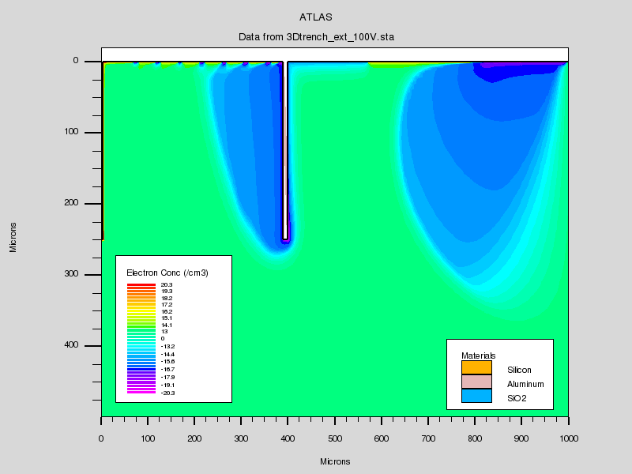
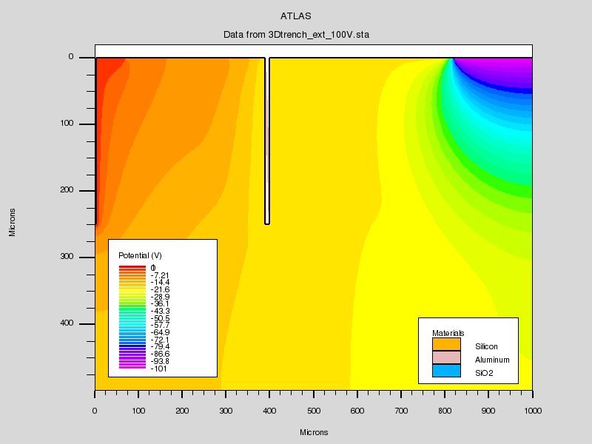
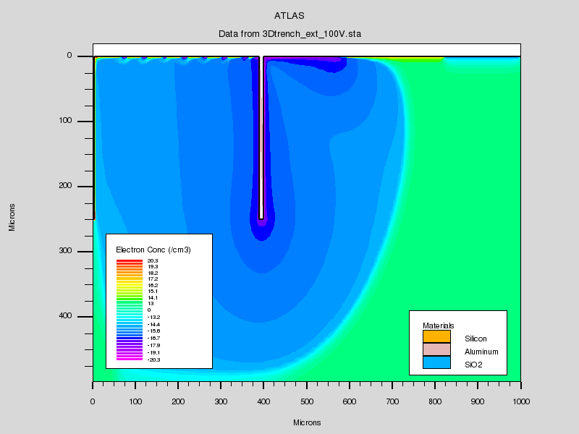
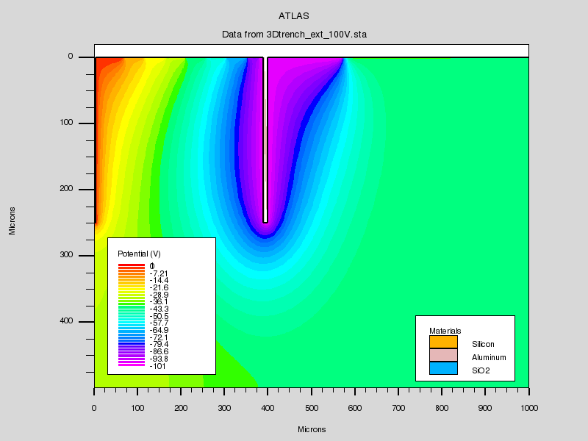
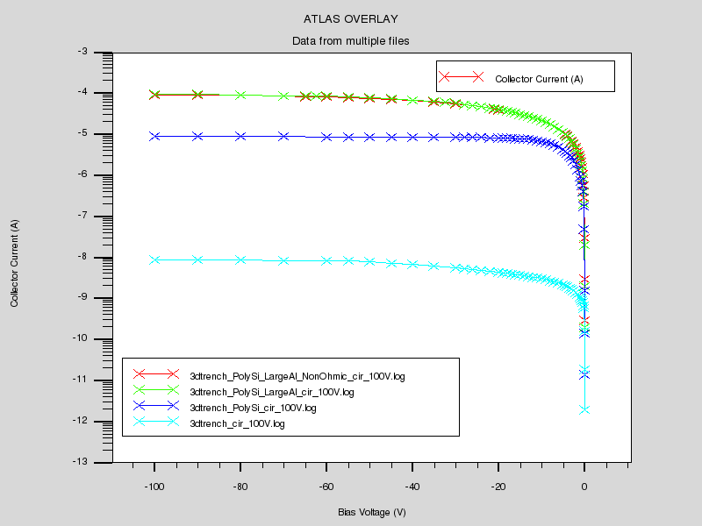
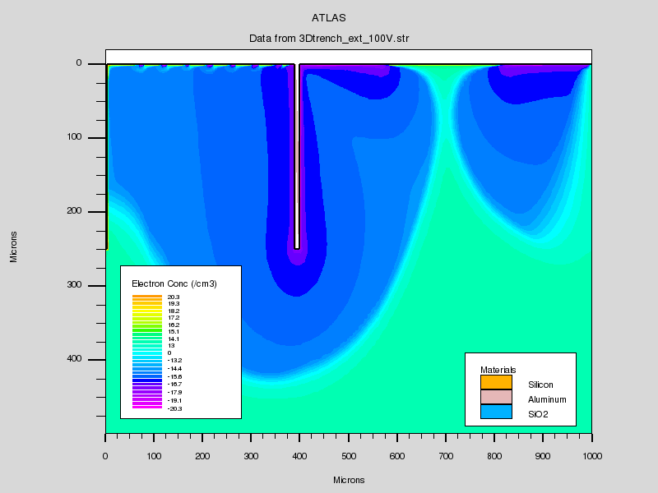
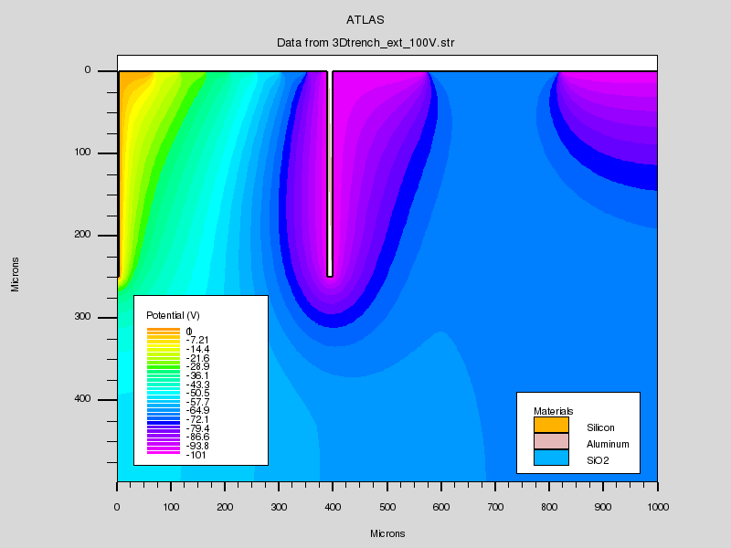
Silvaco 2D Simulations
Silvaco TCAD software suite is used for simulations.
Simulations are made by using a 2D cut and cylindrical symmetry. This means that these are only approximations for the hexagonal detectors.
As can be seen in the pictures in cases of voltage being applied to both the trench and guard ring and only the trench are similar in their active region.
The bottom graph shows the bias current as function of bias voltage of detector in various surface arrangements. Surface effects can massively change the bias current.

Slide 22
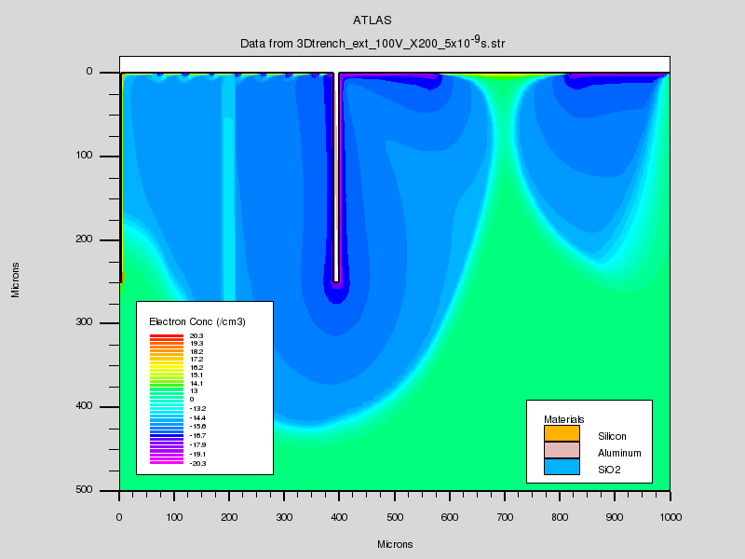


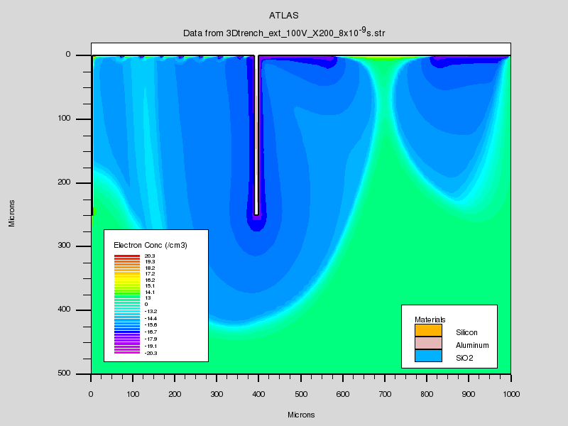




2D Simulation of charge density of the detector with 100V bias on both trench and guard ring after laser hitting the detector 200 microns from central column
t=0ns
t=1ns
t=2ns
t=3ns
t=4ns
t=5ns
t=10ns
t=20ns

Slide 23
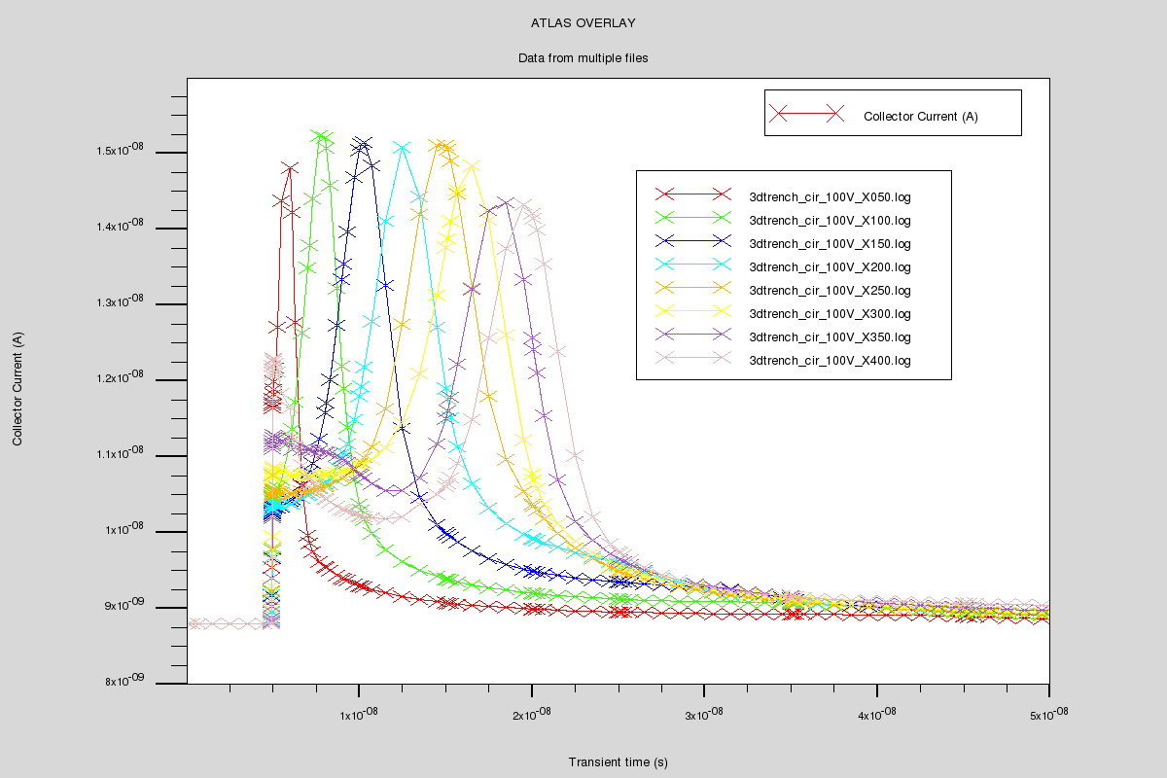
Current vs Time for after Laser Hit
This graph shows the collector current as function of time after 100V biased detector is hit with laser at various distances from the collector column and t=5ns.
As can be seen here charge collection continues well after 15ns point. Since the rise time of the Cremat output is around 10ns, this can explain the existence of the fast and slow rise signal in the experimental results.
The near instantaneous jump in current at the beginning is likely due to induction and explained by Ramo’s theorem.

Slide 24
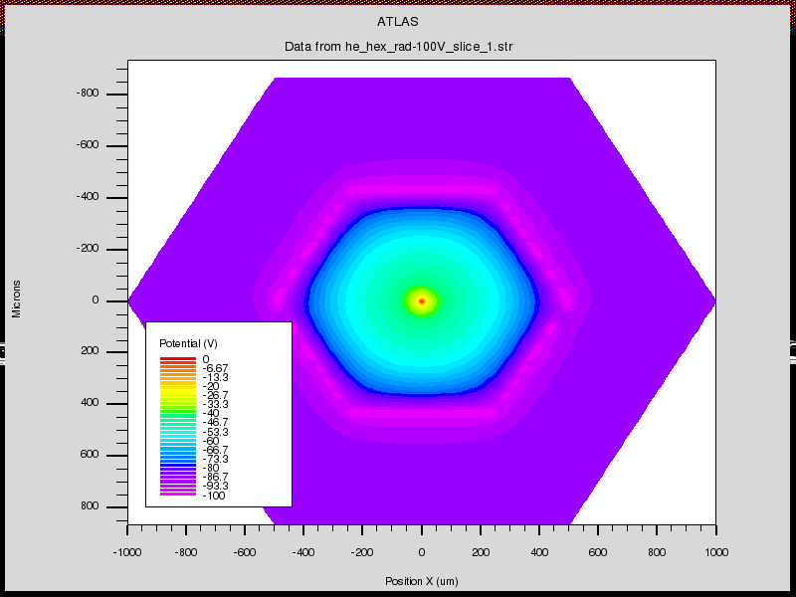
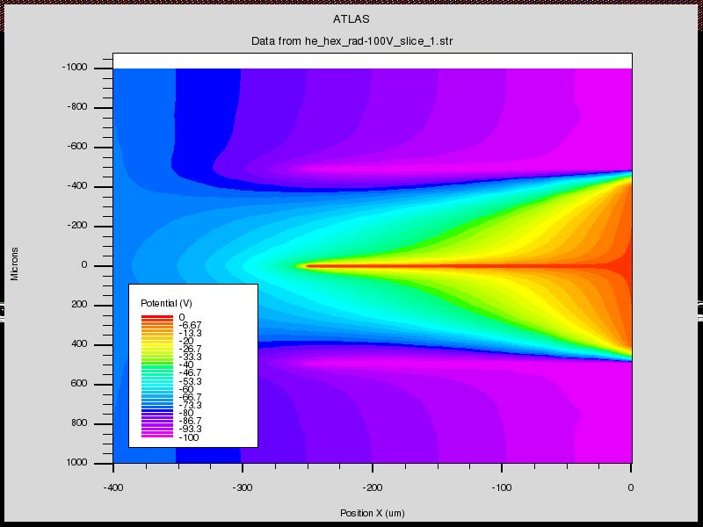

Silvaco 3D Simulations
In full 3D simulations, granularity is limited by computation time needed for the large number of points and limitations of Silvaco software suite. Some fine structural details near the surface of the detectors are thus lost These simulations are incomplete. As can be seen the trench is not fully formed in the simulation. This is due to low density of mesh near the trench on the top and bottom in the xy plane.
Electric Potential distribution in XY cut, , Z=100 μm, V_{bias}=100V
Electric Potential distribution in XZ cut, V_{bias}=100V
Electric Potential distribution in YZ cut, V_{bias}=100V

Slide 25
Future Measurements and Conclusion
Migrate the radioactive test system to a full digital oscilloscope.
Wire bonding and laser mapping of select detectors in the HE array.
Radiation damage effects measurement.
The 3D trench detectors generally work as expected, but there are many unique manufacturing defects to be found in each batch.
We have to know more about the exact issues of manufacturing process between different batches. This is especially need to increase the accuracy of simulation results.

Slide 26
NYU Resources
Experimental Setups
Funding challenges
Infrared laser focused to ~7microns driven with a 1 micron precision stage.
Radioactive source test setup that currently allows measuring 4 channels simultaneously.
Currently we have one faculty member, a full time technician and a full time graduate student working on this project.
We are NSF funded, and to the extent this work is ATLAS related it falls under DOE rather than NSF.
How to fund if it grows beyond ATLAS.

