Slide 1


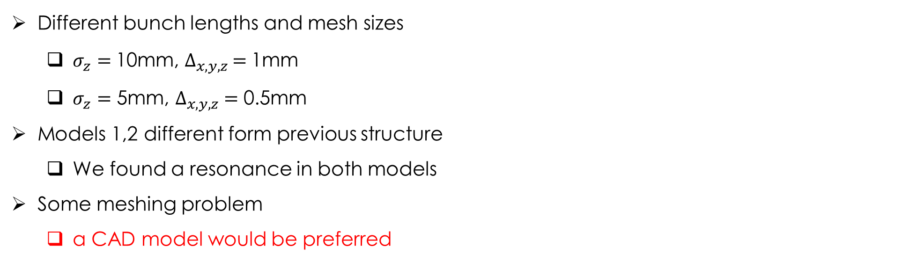
Trapped modes analysis update
Different bunch lengths and mesh sizes
  $σ_{z}=$10mm, $∆_{x,y,z }=$1mm
  $σ_{z}=$ 5mm, $∆_{x,y,z} =$ 0.5mm
Models 1,2 different form previous structure
  We found a resonance in both models
Some meshing problem
  a CAD model would be preferred
E. Belli
25/01/2017 – FCCee MDI Workshop

Slide 2
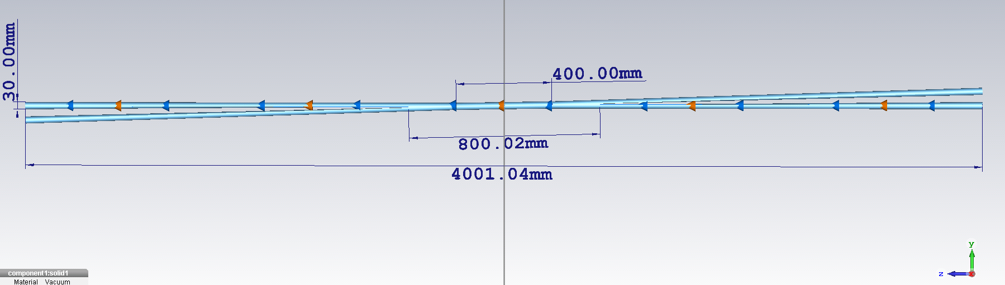
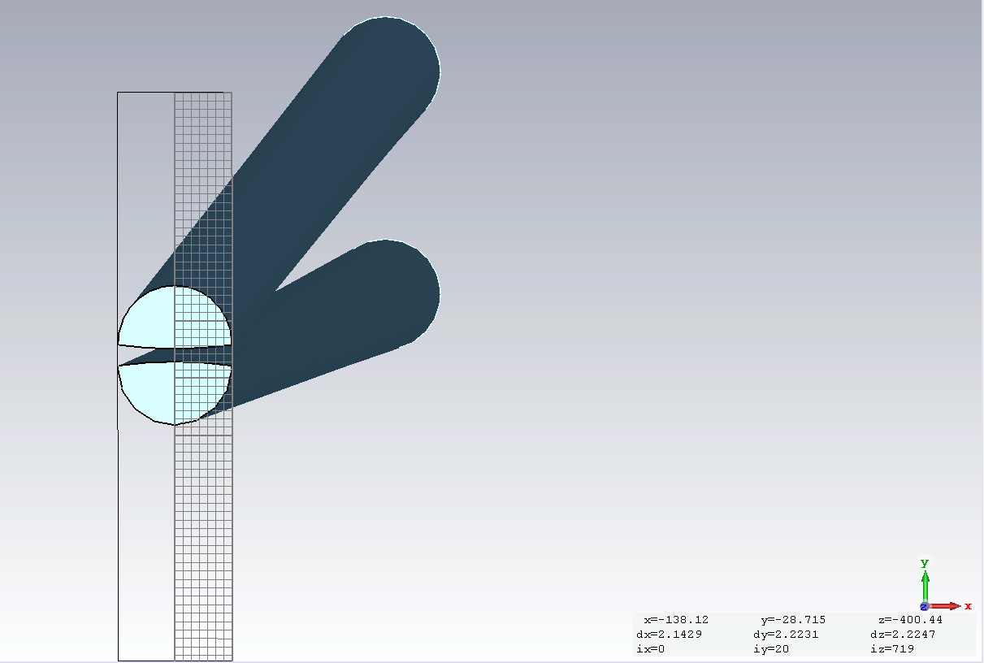
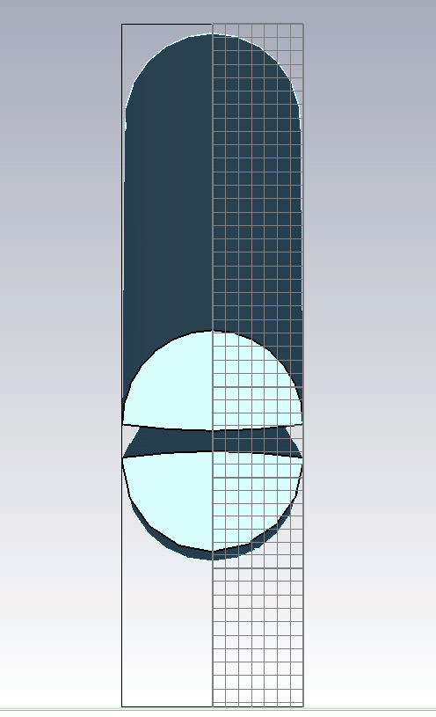
Model 1
Pipes circular at the end (15mm radius)
E. Belli
25/01/2017 – FCCee MDI Workshop

Slide 3
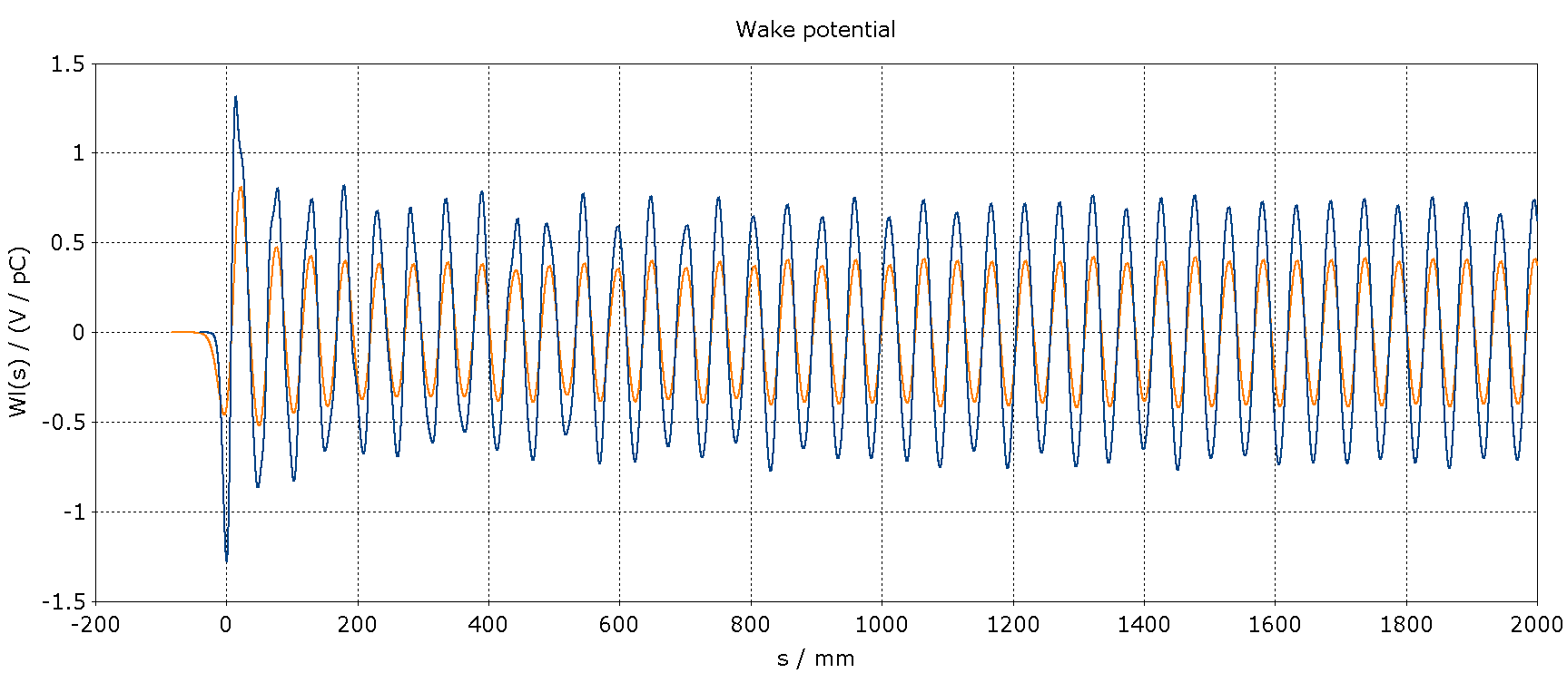
Wake potential
10 mm
5 mm
E. Belli
25/01/2017 – FCCee MDI Workshop

Slide 4
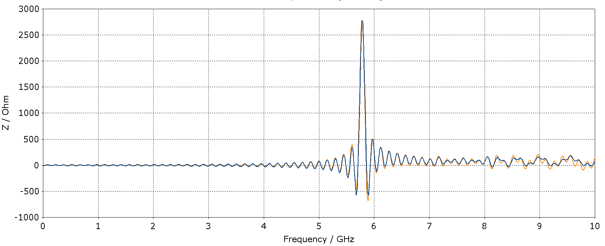
Impedance
10 mm
5.78 GHz
5 mm
E. Belli
25/01/2017 – FCCee MDI Workshop

Slide 5
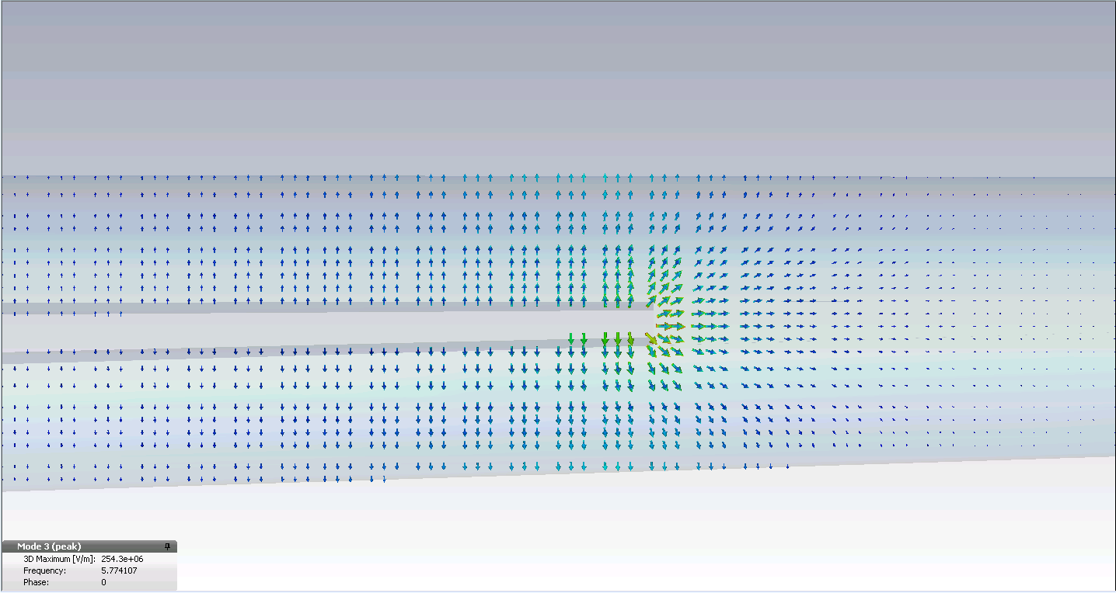
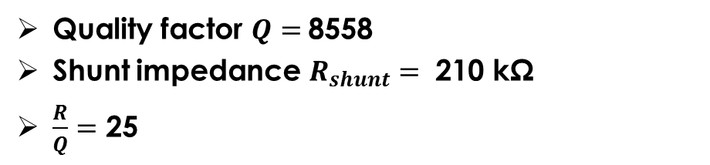
Eigenmode simulations
Quality factor $Q=$8558
Shunt impedance $R_{shunt}=$ 210 kΩ
$\frac{R}{Q}=$ 25
E. Belli
25/01/2017 – FCCee MDI Workshop

Slide 6
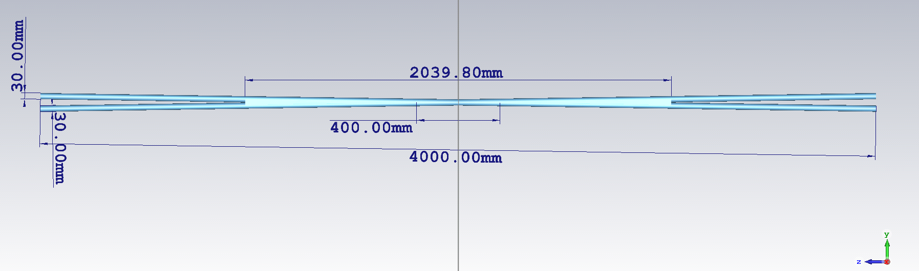
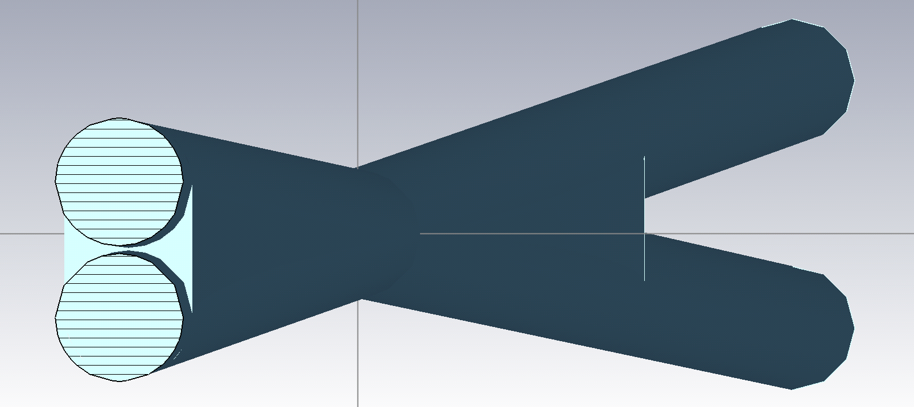
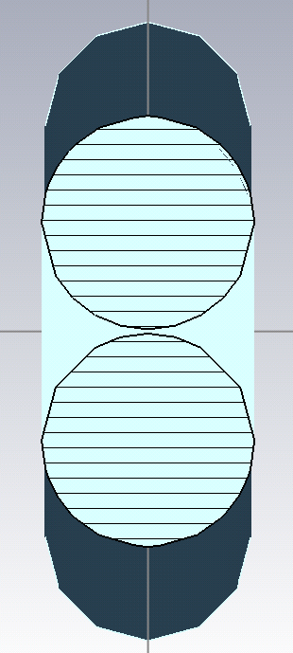
Model 2
E. Belli
25/01/2017 – FCCee MDI Workshop

Slide 7
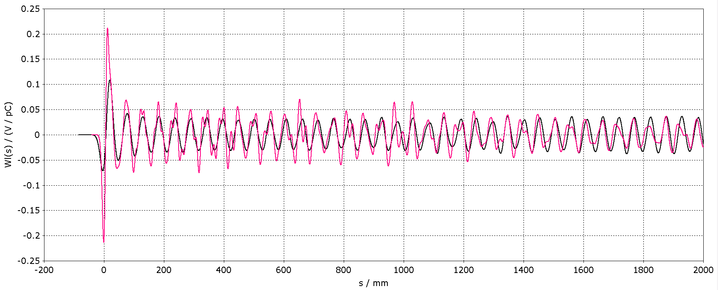
Wake potential
10 mm
5 mm
E. Belli
25/01/2017 – FCCee MDI Workshop

Slide 8
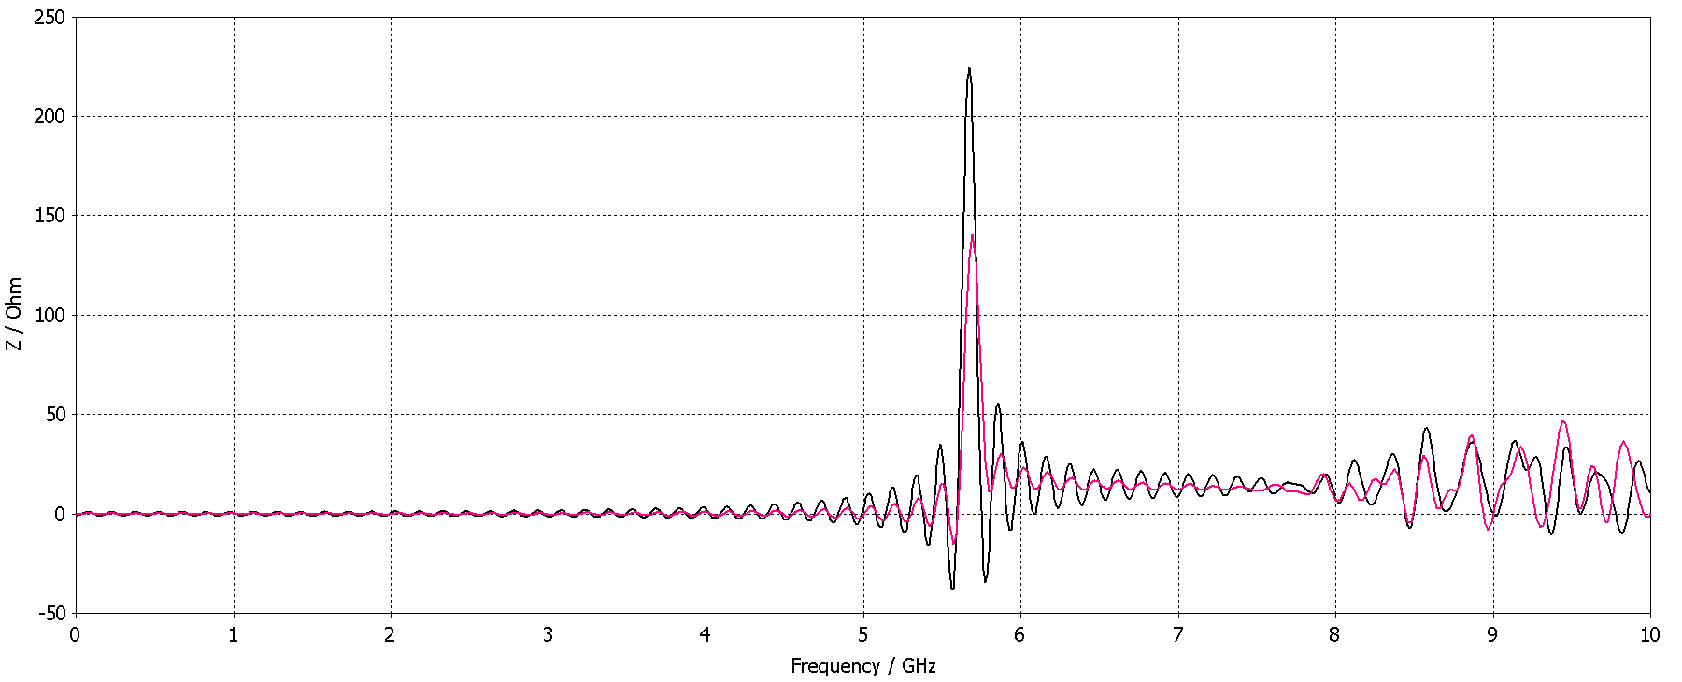
Impedance
10 mm
5.67 GHz
5 mm
E. Belli
25/01/2017 – FCCee MDI Workshop

