Slide 1
Lumi-monitor update and IR geometry
M. Sullivan
Jan 27, 2017

Slide 2
Outline
IR layout at start of workshop
Some evolution
Current layout
  How Lumi-monitor fits in
Next steps
Summary

Slide 3
Detector geometry view
c
d
b
a

Slide 4
Central chamber now 30 mm diameter but…
  Lumi-monitor not shown
  Tagging angles for LumiCal incorrect
  Beam pipe not optimized for LumiCal
After Mogens presented the LumiCal and Mike Koratzinos presented the latest on the solenoid compensation
  Settled on putting the LumiCal at 1.0-1.2 m from the IP
We also settled on making the beam pipe warm and 30 mm diameter inside the QC1
The diameter of the beam pipe in QC2 (second FF magnet) is probably even larger (~40 mm)

Slide 5
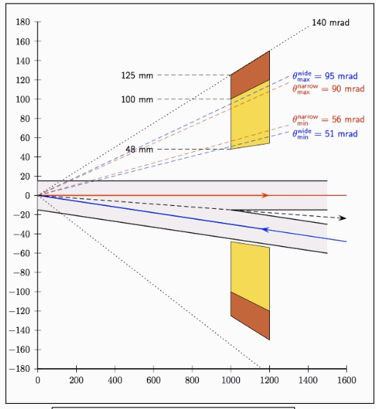
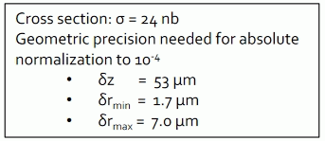
LumiCal at 1-1.2 m (Mogens case ‘b’)
Services are squeezed into 100-140 mrad cone to maximize SA acceptance
Note minimum angle of 50 mrad
Courtesy Mogens

Slide 6
Mogens was asked how much radiation length of material can he stand in front of his detector and it can still function
  10% of RL
Armed with this information went back to the drawing board

Slide 7
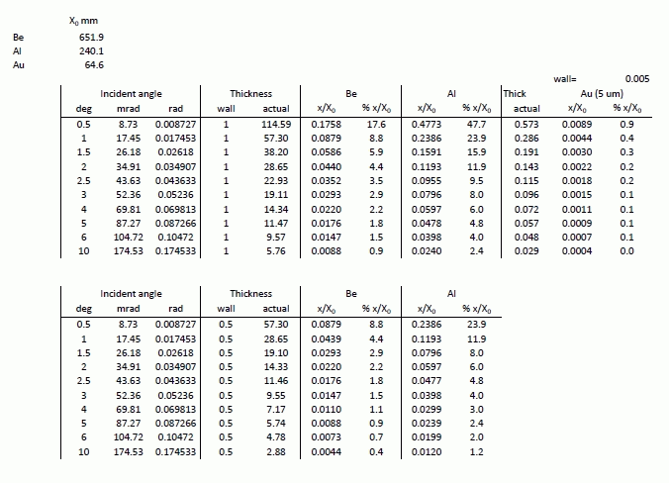
And first made a table of RL vs angle of incidence
Which led to …..
Tried this first

Slide 8
An Al chamber could work with this design

Slide 9
HOMs
Attempt to make minimum angle of incidence 3 deg (50 mrad)
  Then chamber could be Al
Showed this to Sasha and it was not well received
  This makes the cavity larger and adds more HOM power to the region
  Also the beam pipe bulge is only needed at the part of phi that is close to the other beam pipe

Slide 11
How about Be?
So went back to RL table and decided to be more aggressive and ask for Be
  Then we can go down to 1 deg of incident angle and still be below 9% of a RL. This is for a 1 mm thick beam pipe wall
  Perhaps we can use a thinner wall?
Using Be then gets us to this design

Slide 13
Shielding
The question now arises about shielding the central detector from SR from the last bend magnet
The LumiCal needs a window in the beam pipe where we can no longer put shielding
For the Z running this may not be a big issue
  The photon energies are lower (Ave scattered=1.3 keV)
But for the Top running this becomes an issue
  Ave scattered is 390 keV
  Effectively the central part of the beam pipe increases from +/-12.5 cm to +/-50 cm
  This will increase the number of photons going into the central chamber (factor of 10? More?)
  Simulation comparison will tell us the answer

Slide 14
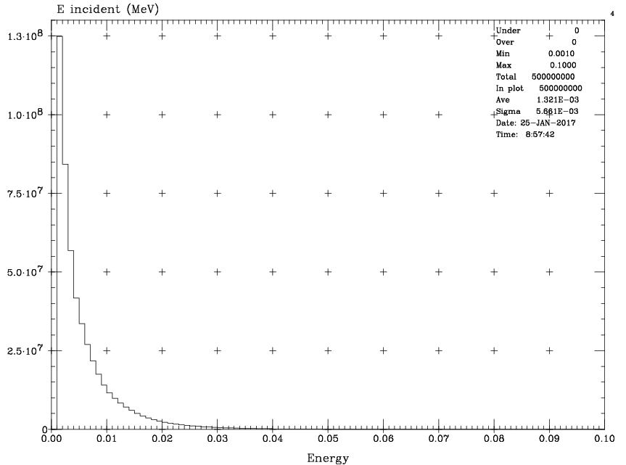
Z scattered photon energy spectrum

Slide 15
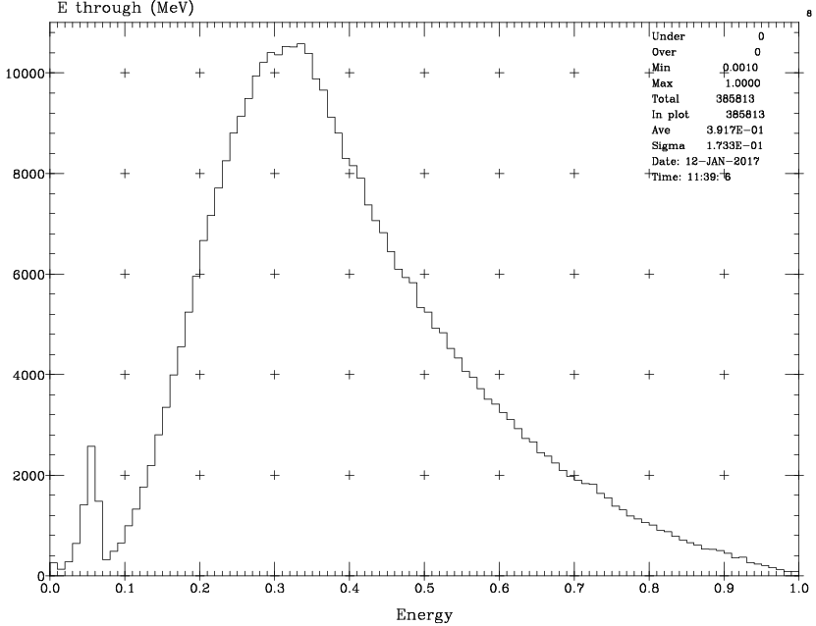
Top scattered photon energy spectrum
Note change in X scale
from the Z plot
The photons that cause trouble are coming from the high energy tail

Slide 17
For the Top running
1.9×10⁹ photons incident on the mask tip every beam bunch
3.87% scatter through the mask tip
About 1% can scatter through 2 cm of Ta
This means about 700,000 photons go into the central detector region every beam crossing – too many
We will need to add as much shielding as we can in order to cut this rate down

Slide 18
What about the Higgs?
Scattered SR photon energies will increase
  The critical energy of the last soft bend magnet
  For the Top – 100 keV
  For the Higgs – 40 keV
  For the Z – 1.7 keV
Needs to be looked at as a separate case
More simulation runs with the GEANT4 model of the beam pipe
Do we want/need the LumiCal for the Higgs?
Stay tuned……

Slide 19
Summary
The LumiCal looks OK at the Z running
We need a Be beam pipe for the LumiCal window in order to minimize the RL to the LumiCal and to minimize the HOM power in this region
The LumiCal window will cause central detector SR backgrounds to increase at the Top running because of the high energy of the scattered photons

Slide 20
Conclusions
A great deal of progress has been made in deciding on baseline parameters and general layout of the IR
SR at the Z does not seem to be a big concern due to the very low photon energies
SR backgrounds at the Higgs and Top will be more of an issue. The photon energies will significantly increase.

