Slide 1
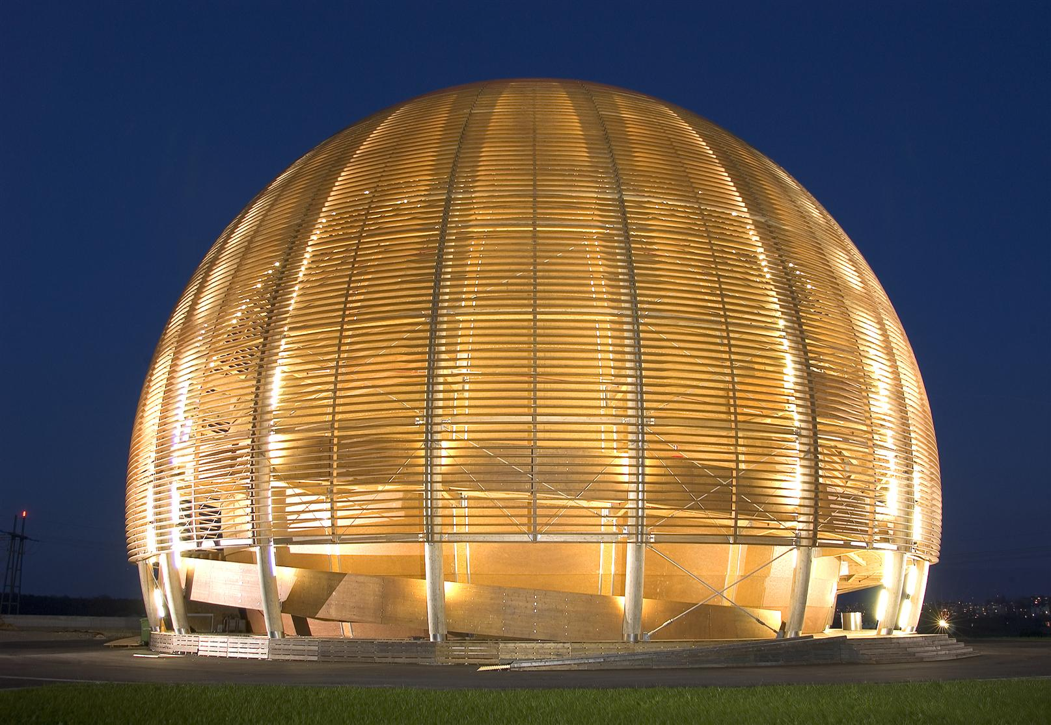

Daniel Schörling, 22. März 2017
Einführung CERN und FCC

Slide 2
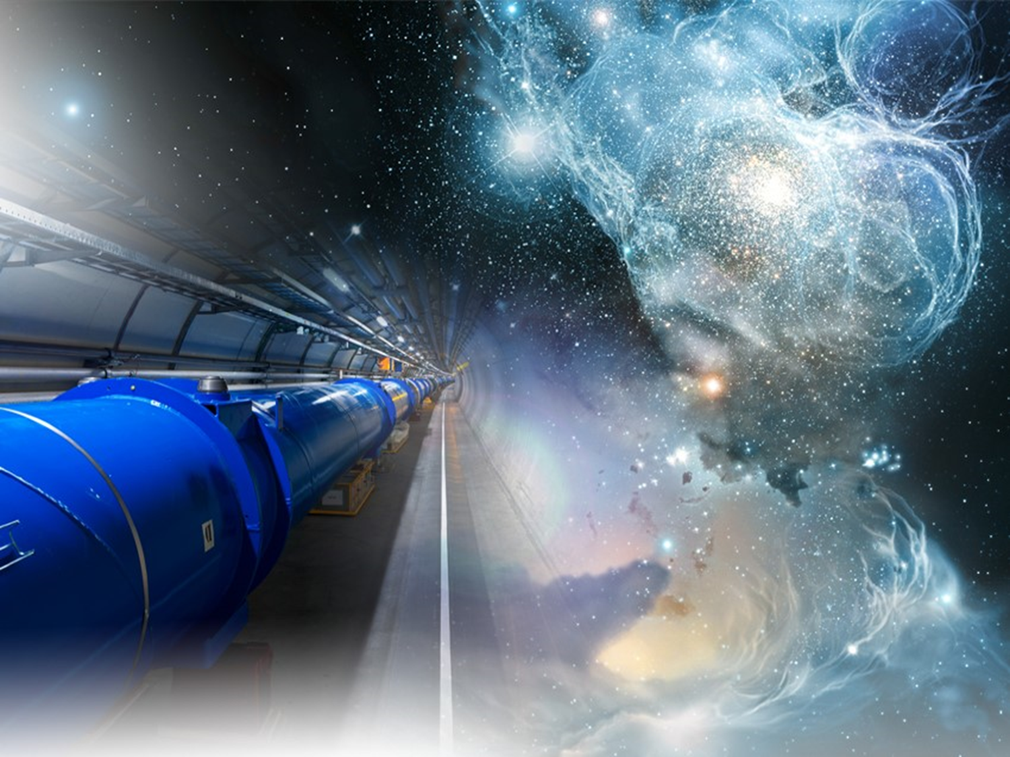
Outline
Introduction to CERN
General introduction to accelerators
The Future Circular Colider (FCC) study
The dipole magnets for FCC
Conclusion

Slide 3
Introduction
to CERN

Slide 4
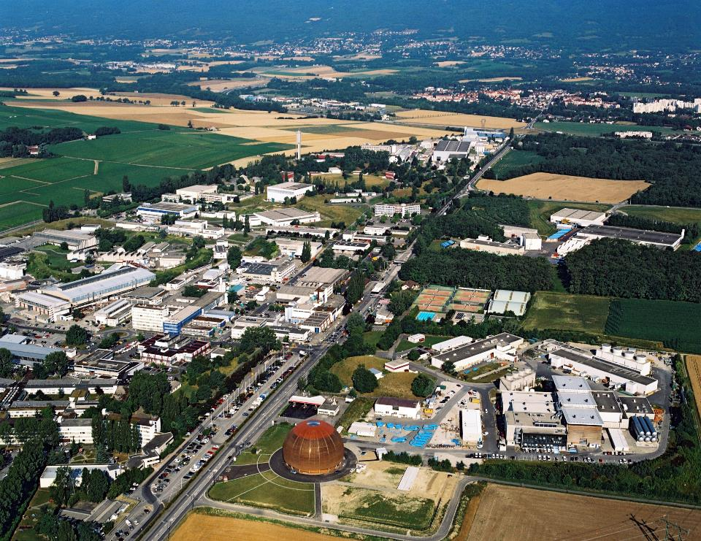


Daniel Schoerling TE-MSC-MNC

Slide 5
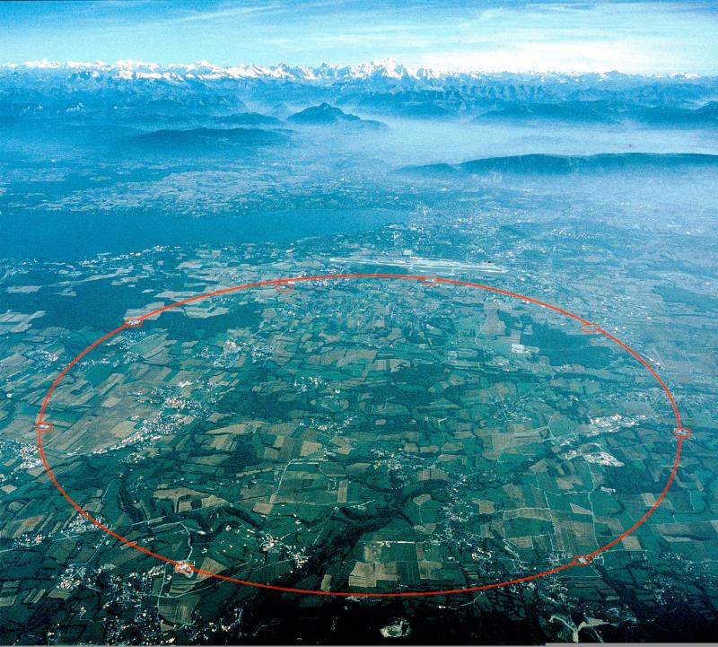

Slide 6
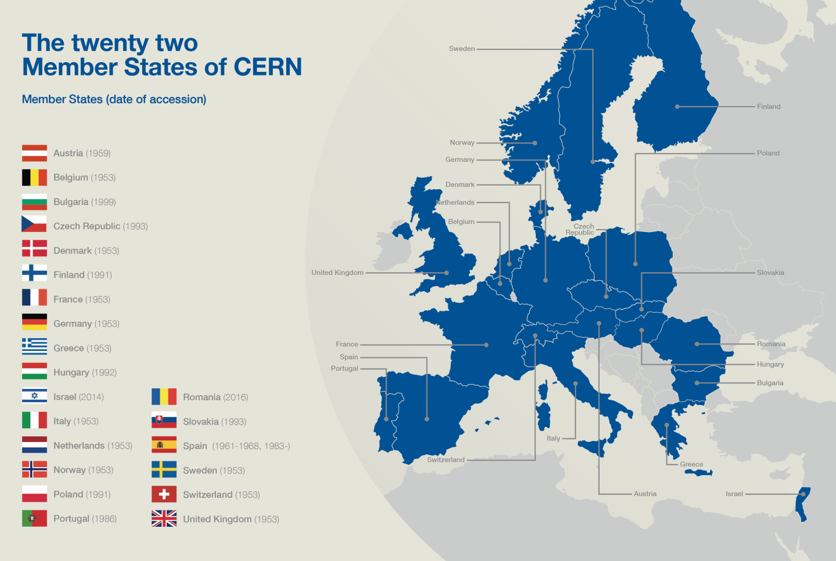
CERN member states
Freiberg
CERN
Notes:
6
6

Slide 7
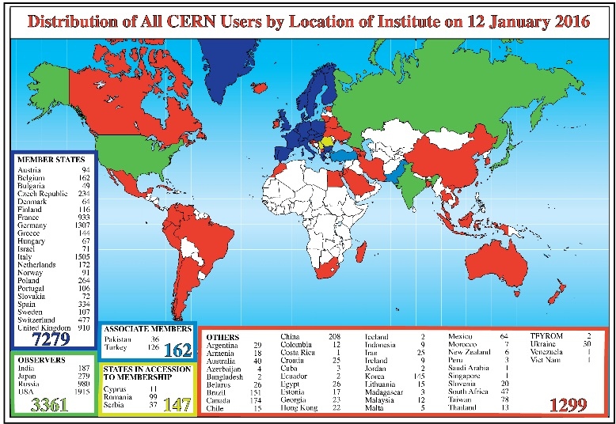
CERN facts
~ 2300 staff
~ 1600 other paid personnel
~ 12000 users
Budget ~1000 MCHF/year
~ 1600 young people trained at CERN every year
Dedicated PhD program for students from German universities (Wolfgang-Gentner-Stipendien)
Notes:
7
7

Slide 8
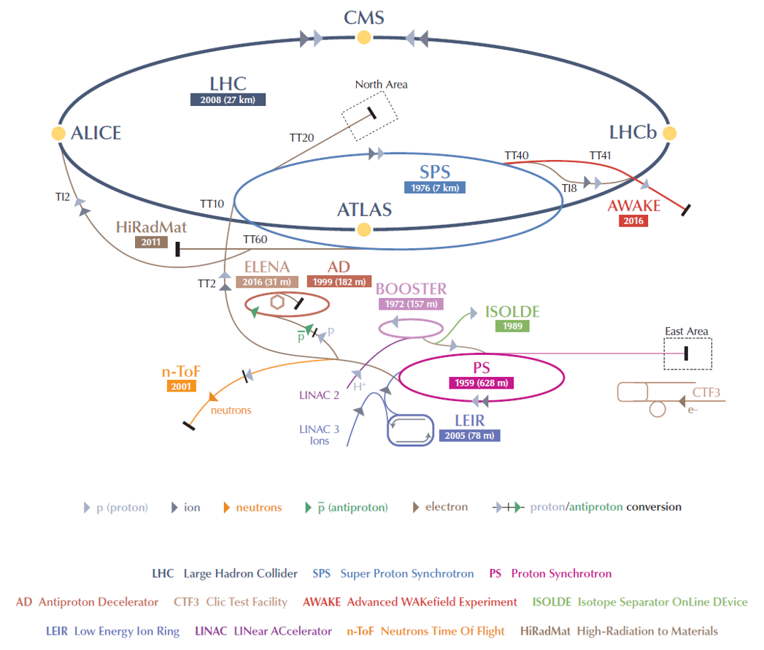
The CERN accelerator chain
50 000 tons of normal conducting magnets & 50 000 tons of superconducting magnets

Slide 9
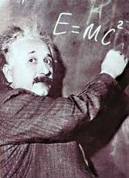



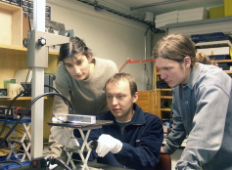
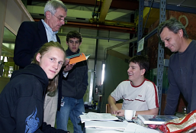
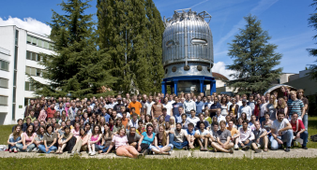
CERN’s mission
Innovation
Education
CERN
uniting people
Research
Push back the frontiers of knowledge
Develop new technologies for accelerators and detectors
Train scientists and engineers of tomorrow
Unite people from different countries and cultures

Slide 10
General Introduction
to accelerators

Slide 11
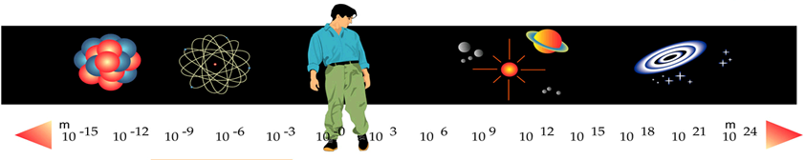
Why accelerators?
Accelerators
Microscopes
Binoculars
Optical, radio télescopes
Accelerators are the finest microscopes: atto-scope or zepto-scope
λ = h/p ; @LHC: T = 1 TeV ⇒ λ ≅ 10⁻¹⁸ m

Slide 12
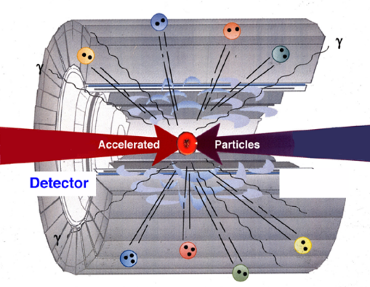
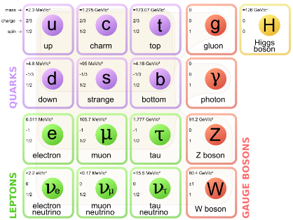
How to probe matter

Slide 13
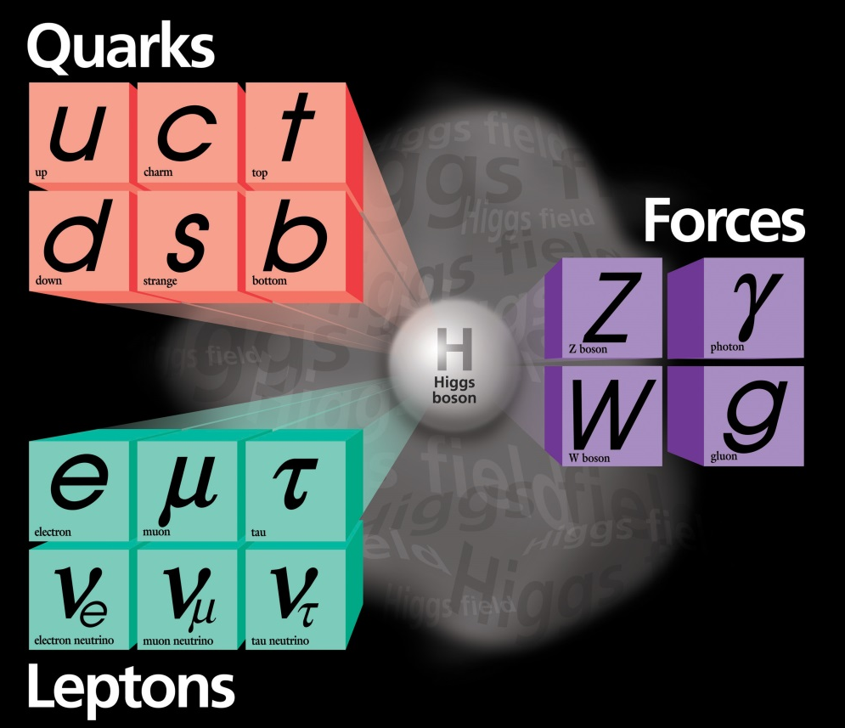
Discoveries by colliders
Standard Model
Particles and forces
LHC:
Higgs-boson
SppS:
Z-boson
W-boson
PETRA:
gluon
Tevatron:
top-quark
SPEAR:
charm quark
tau lepton
Colliders are powerful instruments in High Energy physics
for particle discoveries and precision measurements
Notes:
New slide from Davide.
Showing that conductor development is launched at international level, Russia, Japan, (Korea and Europe in preparation)
Underline importance of that development as main cost driver for the hadron collider machine.

Slide 14
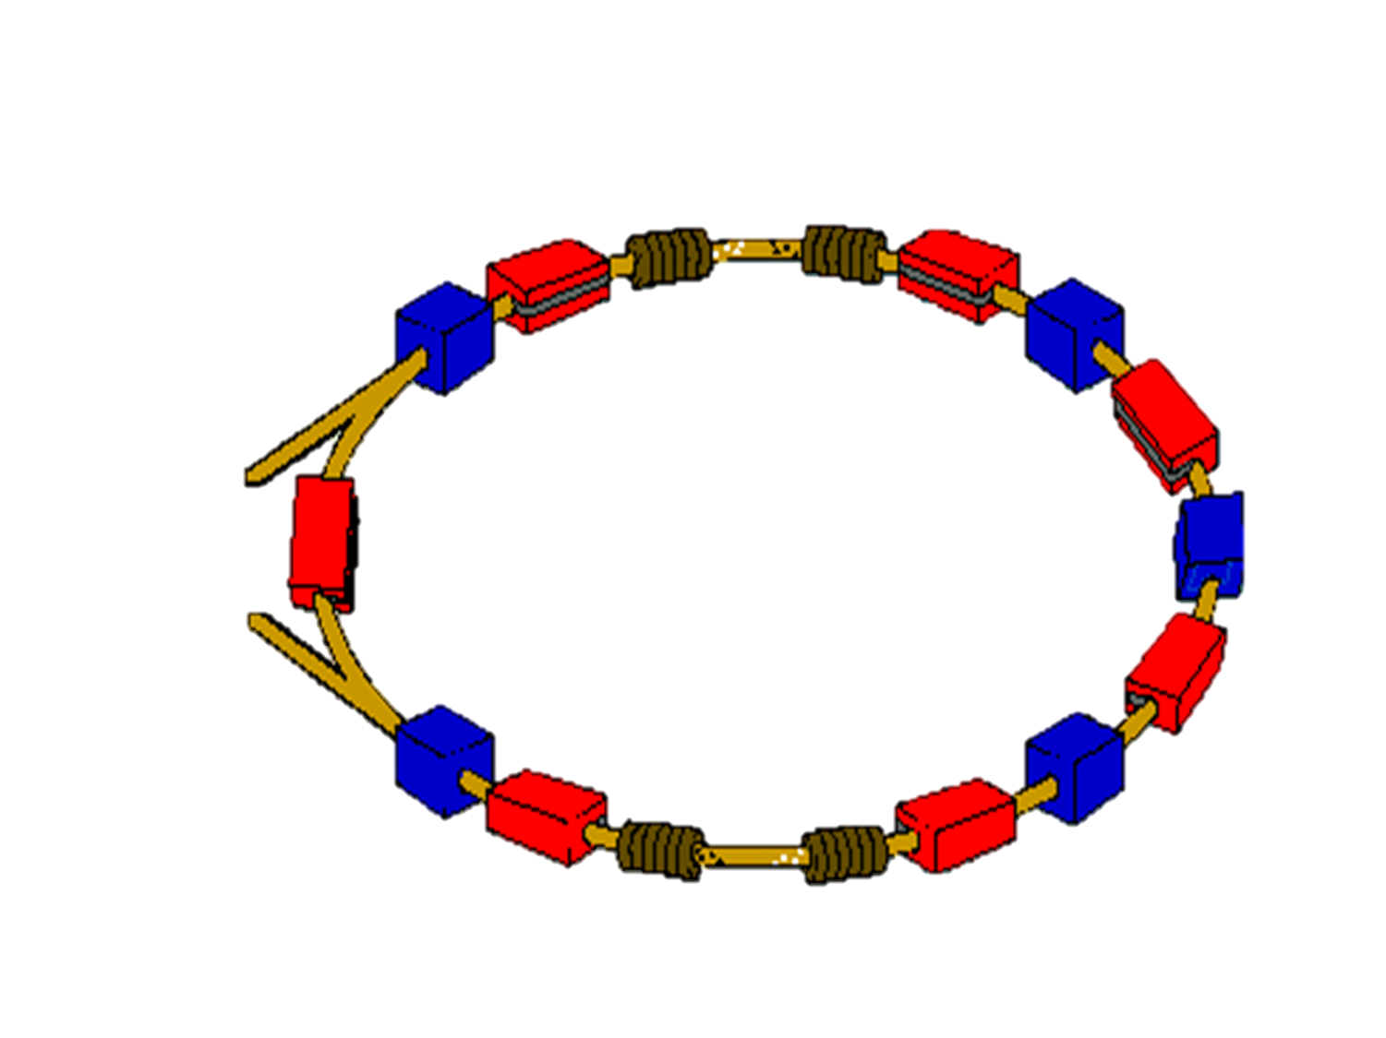
Collider
Accelerating cavity
Vacuum chamber
Injection of particles
Collisions
Focusing magnets
Dipoles

Slide 15
The Future Circular Colider
(FCC) Study

Slide 16
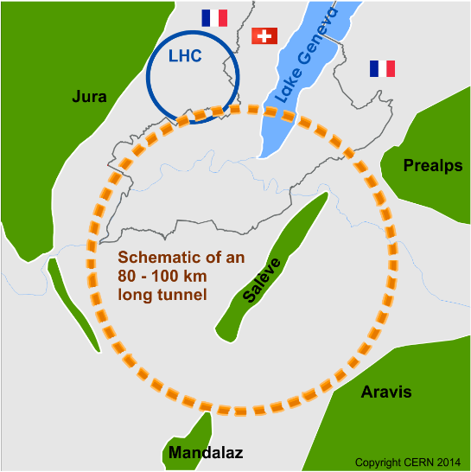
LHC, what next?
International FCC collaboration (CERN as host lab) to study:
80-100 km tunnel infrastructure
pp-collider (FCC-hh)
e⁺e⁻ collider (FCC-ee) as potential first step
p-e (FCC-he) option
HE-LHC with FCC-hh technology
Notes:
16
16

Slide 17
CERN Circular Colliders & FCC
1980
1985
1990
1995
2000
2005
2010
2015
2020
2025
2030
2035
Constr.
Physics
LEP
Design
Proto
Construction
Physics
LHC
Design
Construction
Physics
HL-LHC
20 years
FCC
Design
Proto
Construction
Physics
Now is the time to plan for the period 2035 – 2040
Notes:
17
17

Slide 18
Open Questions
Standard model describes known matter, i.e. 5% of the universe!
what is dark matter?
what is dark energy?
why is there more matter than antimatter?
why do the masses differ by more than 13 orders of magnitude?
do fundamental forces unify in single field theory?
what about gravity?
Is there a “world equation – theory of everything”? …
Known Matter 4.9%
Dark Matter 26.8%
Dark Energy 68.3%
galaxy rotation curves, 1933 - Zwicky
K. Borras
Notes:
New slide from Davide.
Showing that conductor development is launched at international level, Russia, Japan, (Korea and Europe in preparation)
Underline importance of that development as main cost driver for the hadron collider machine.

Slide 19
State-of-the-art: LHC
Superconductor: Nb-Ti
Nominal field: 8.33 T
Operating temperature: 1.9 K
1232 dipoles

Slide 20
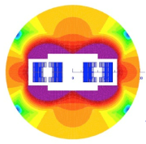
FCC vs. LHC dipole
Twice the magnetic field →
2 x more Ampere turns
4 x higher forces/m
~6 x more stored energy/m
4 x more magnets

Slide 21
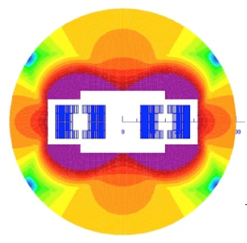
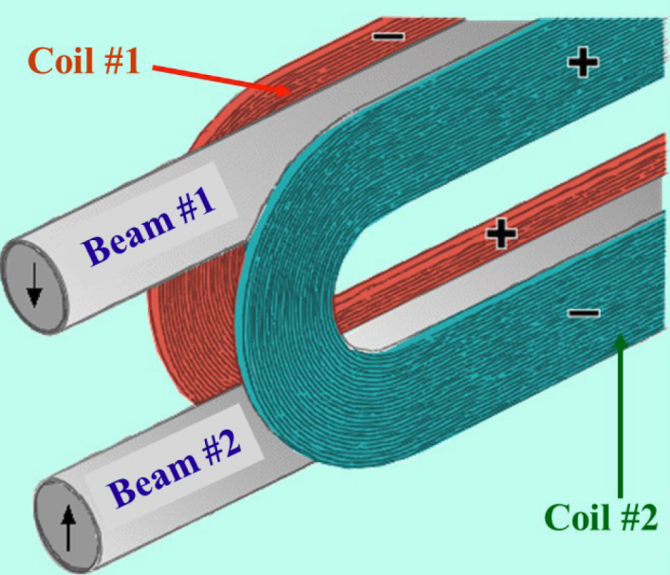
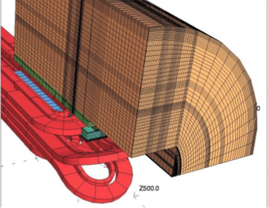
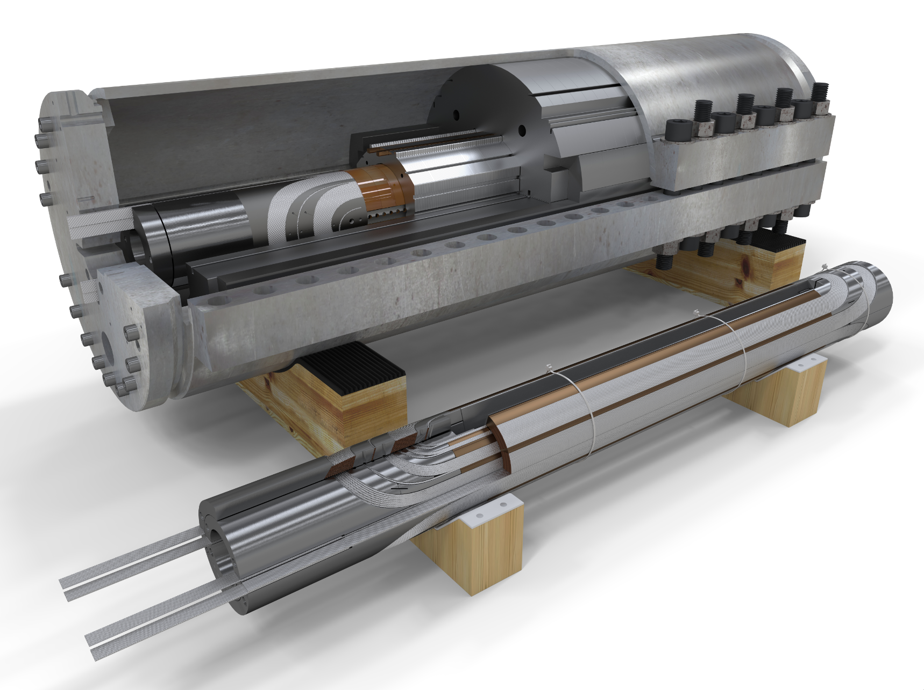
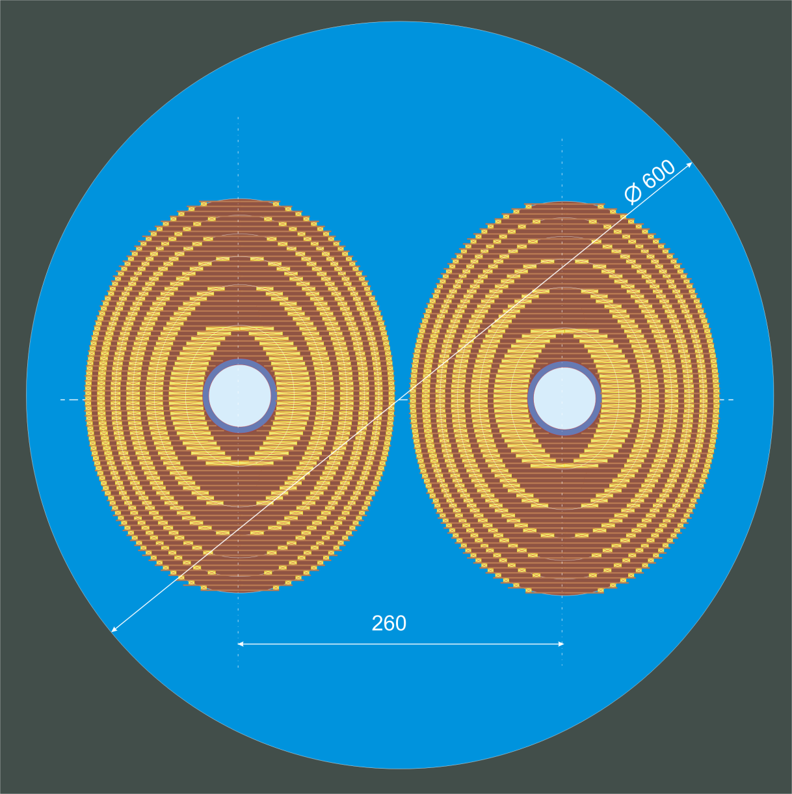
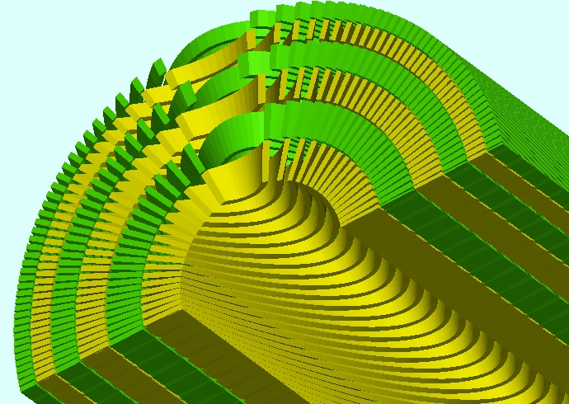
Magnet design for 16 T
Blocks
Cos-θ
Common-Coil
Laminar Elliptical
Canted Cos-θ

Slide 22
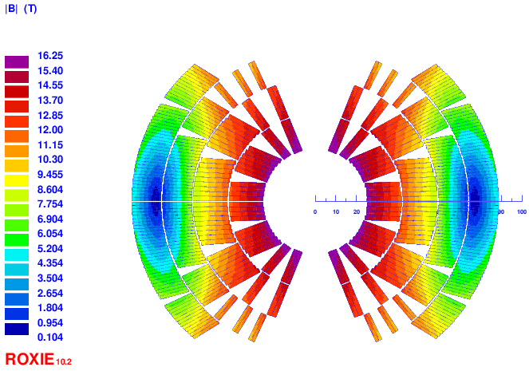
Magnet design for 16 T (cos-θ)
B peak
16.3 T (with strand ’’self-field’’)
Main characteristics:
2 double-pancakes
2 conductor size
Splitting of pole blocks to decrease peak-field
Turn number:
Layer 1: 14
Layer 2: 21
Layer 3: 37
Layer 4: 43
Tot: 230/ap.
high-field
low-field cond.

Slide 23
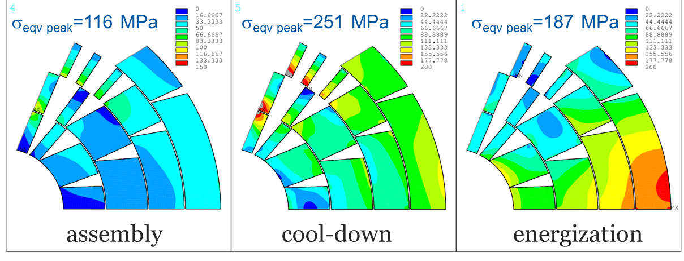
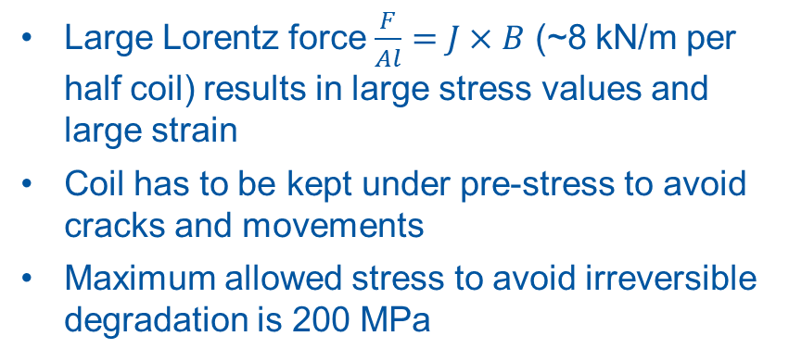
Structural design
 | σ_{θ –layer} (MPa) | σ_{θ –winding} (MPa)
layer 1 | 110 | 135
layer 2 | 140
layer 3 | 200
layer 4 | 90
Large Lorentz force $\frac{F}{Al}=J×B$ (~8 kN/m per half coil) results in large stress values and large strain
Coil has to be kept under pre-stress to avoid cracks and movements
Maximum allowed stress to avoid irreversible degradation is 200 MPa
Al alloy
iron
Ti
SS

Slide 24
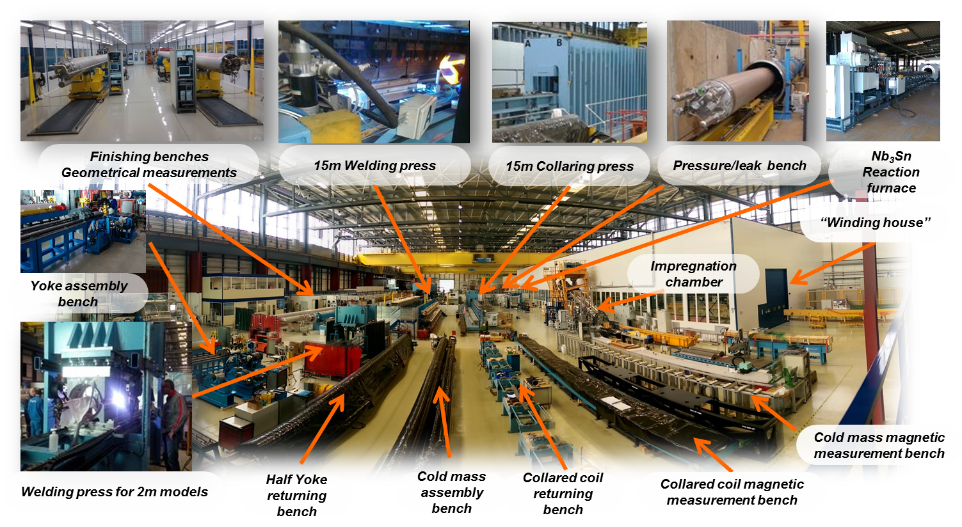
The Large Magnet Facility

Slide 25
Conclusion
At CERN more than 10000 physicists and engineers from over 100 countries are probing the fundamental structure of the universe
FCC is an international collaboration to explore concepts for the most powerful particle collider and develop enabling technologies
Superconducting high-field accelerator magnet are currently designed and constructed in an international and multi-disciplinary team

