Slide 1
  CFP
Critical Function Prototype

Slide 2
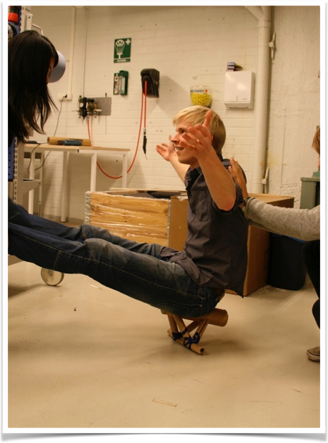
WHAT DO WE EXPECT FROM YOU
Design, build, test and demonstrate a component or subsystem that is “critical” to the success of your Ö2Bot
Present your prototype, your tests and results
Explain how this new information has influenced your thinking
NO powerpoints!
Handout might be good (or a laptop) - show us the pictures!

Slide 3

The anatomy of CFP
Critical
  Something fundamental and necessary to the success of the design.
  If this component were to fail, another approach would be needed.

Slide 4
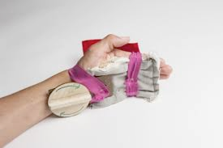
The anatomy of CFP
Function
  What the element, piece or subsystem must do (not what it is
  or what it should be).
  Identify the function and the parameters for success

Slide 5


The anatomy of CFP
Prototype
  Something physical that you have made (not a calculation, research or user tests).
  It allows you to perform real tests and obtain useful results.

Slide 6
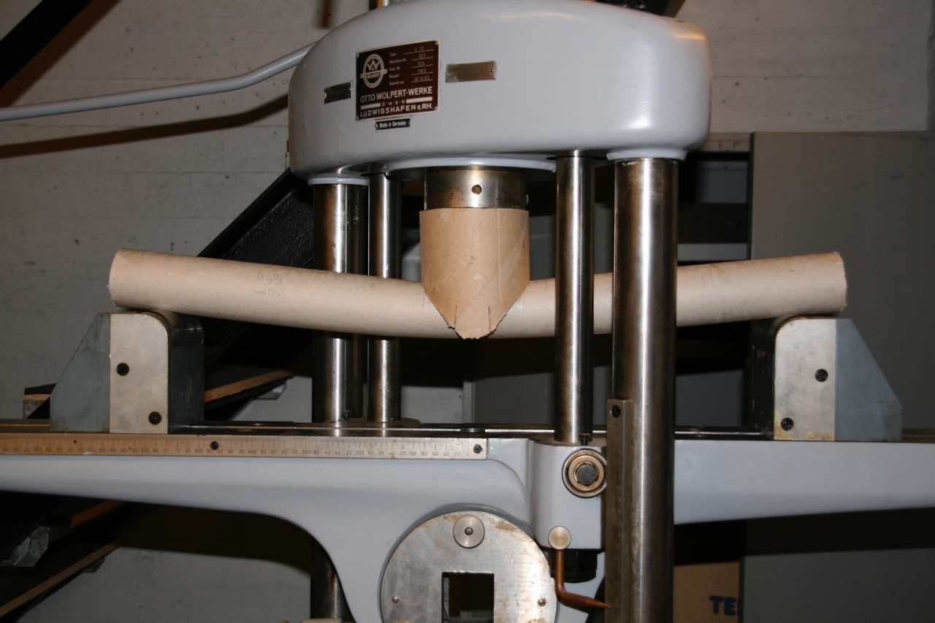
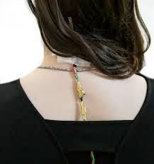
Deadline I 18:00 in the plaza
5minutes presentation
No slides
Be prepared to comment other teams work.
Report your selected function, testing parameters and TEST RESULTS (=Numeric data) and your conclusions

Slide 7

Deadline II
19:30 —> At your spot.
Present your vision for the future and plan for next steps
Be prepared to present different approaches for you development

