Slide 1

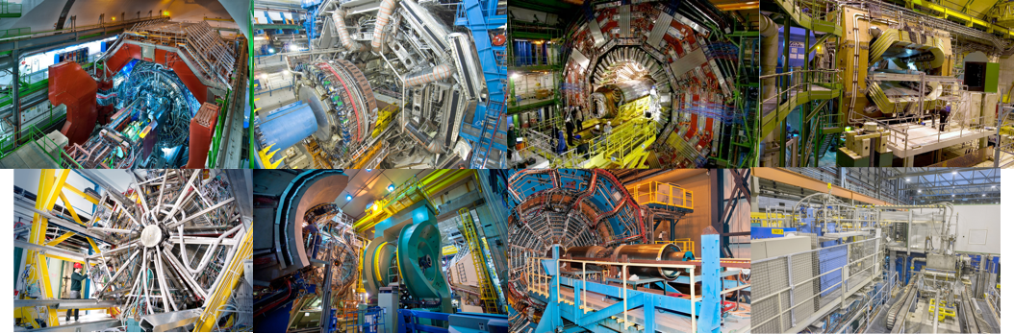
The physics of heavy-ion collisions
Alexander Kalweit, CERN

Slide 2
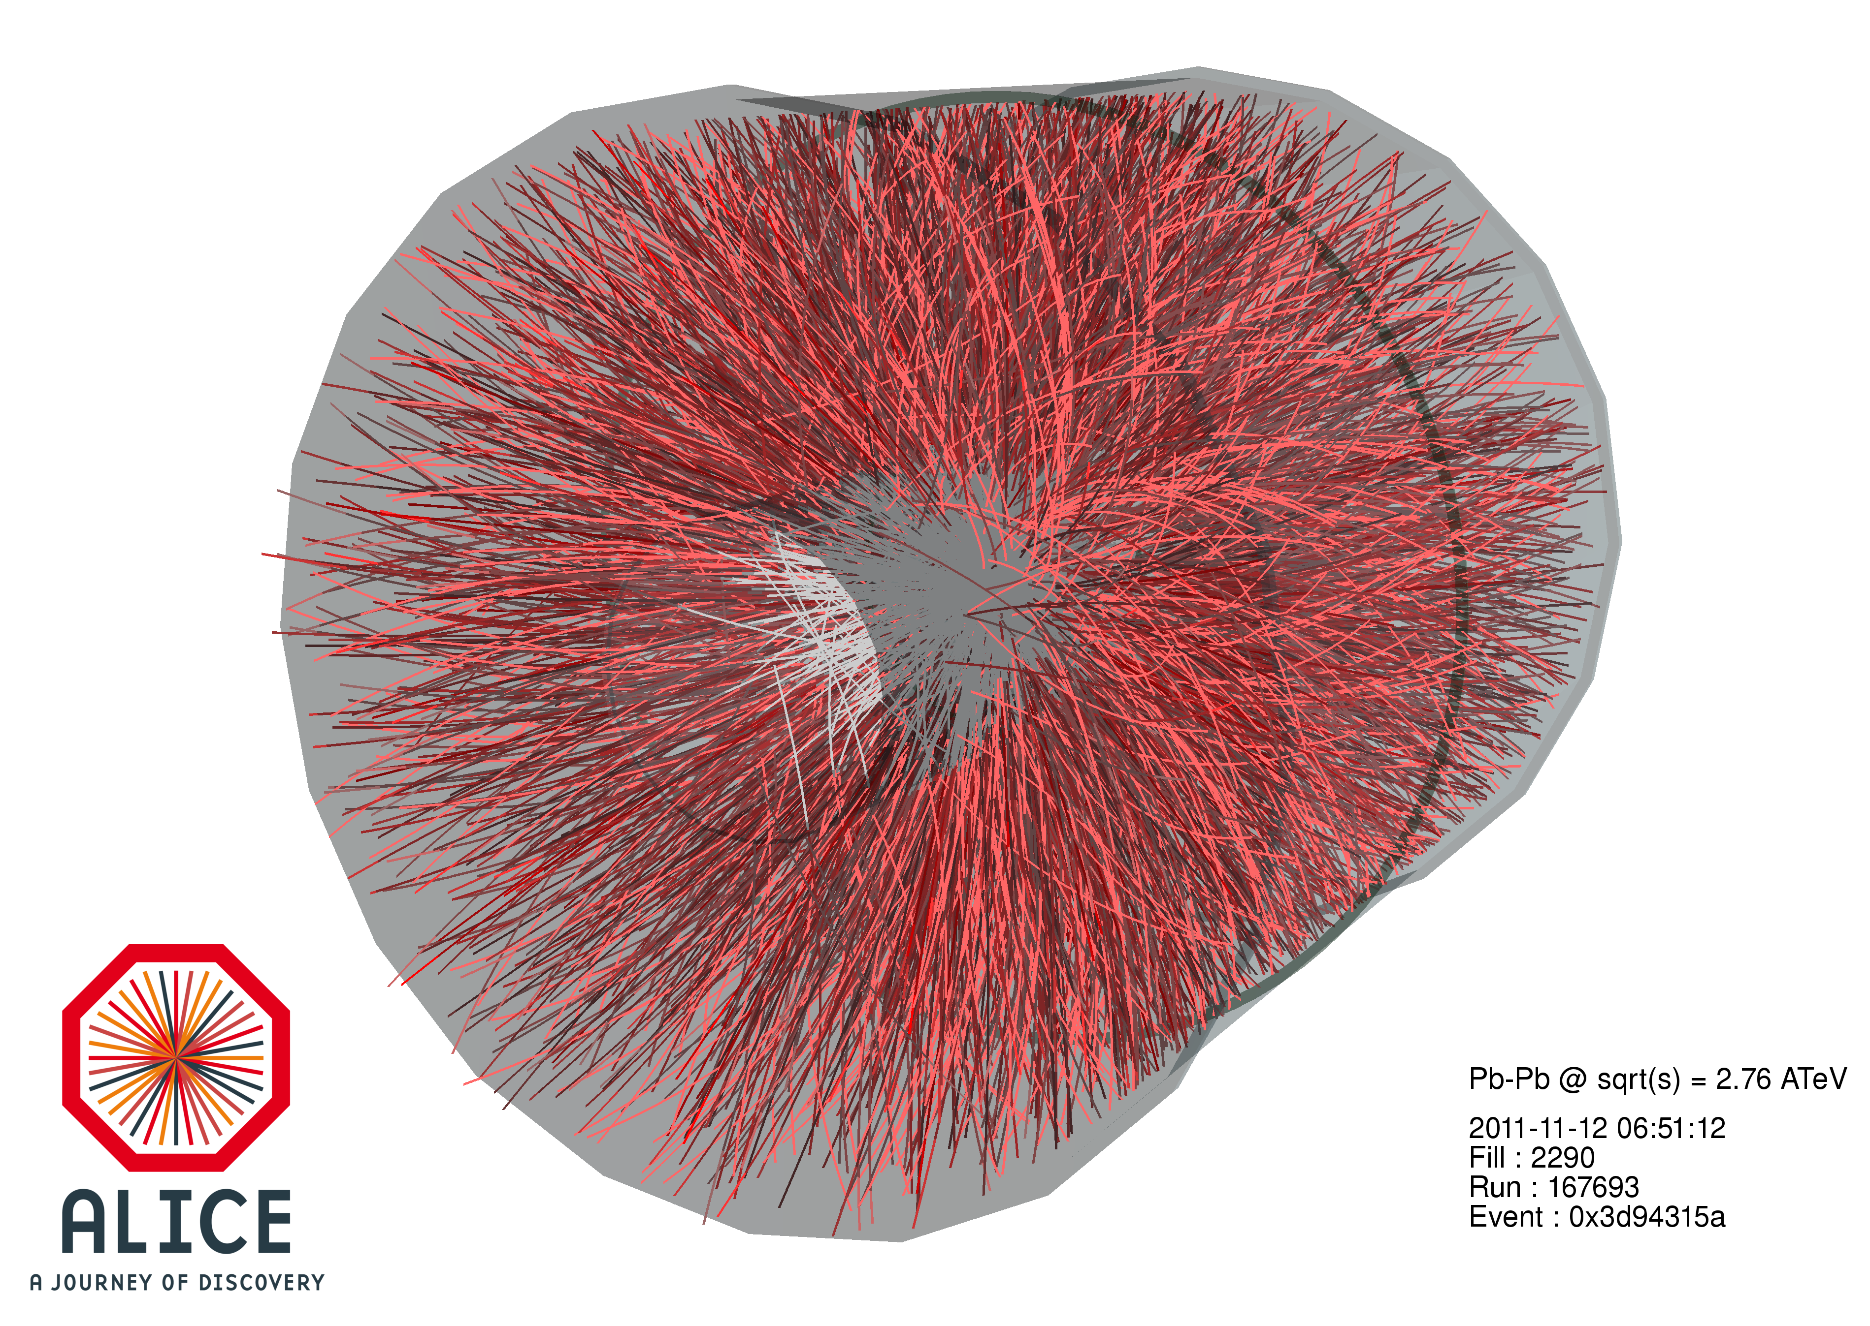
Overview
Three lectures (one hour each):
  Friday, 10:30h-11:30h (Prevessin)
  Saturday, 11:30h-12:30h (Meyrin)
  Monday, 10:30h-11:30h (Prevessin)
Specialized discussion sessions with heavy-ion experts in the afternoons on Friday and Monday.
Feel free to contact me for any questions regarding the lecture:
Alexander.Philipp.Kalweit@cern.ch
Many slides, figures, and input taken from:
  Jan Fiete Grosse-Oetringhaus, Constantin Loizides, Federico Antinori, Roman Lietava

Slide 3



Outline and discussion leaders
→ Heavy-ion physics is a huge field with many observables and experiments: impossible to cover all topics! I will present a personally biased selection of topics.
Introduction
The QCD phase transition
QGP thermodynamics and soft probes (Francesca)
  Particle chemistry
  QCD critical point and onset of de-confinement
  (anti-)(hyper-)nuclei
  Radial and elliptic flow
  Small systems
Hard scatterings (Leticia, Marta)
  Nuclear modification factor
  Jets
Heavy flavor in heavy-ions
  Open charm and beauty
  Quarkonia
Di-leptons
Francesca
Bellini
Leticia
Cunqueiro
Marta
Verweij

Slide 4
Introduction

Slide 5
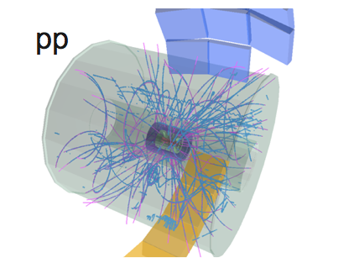
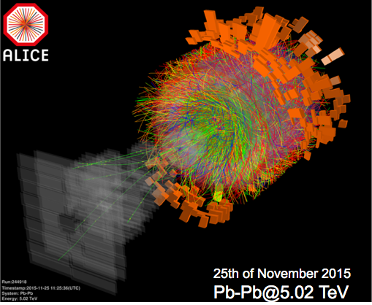
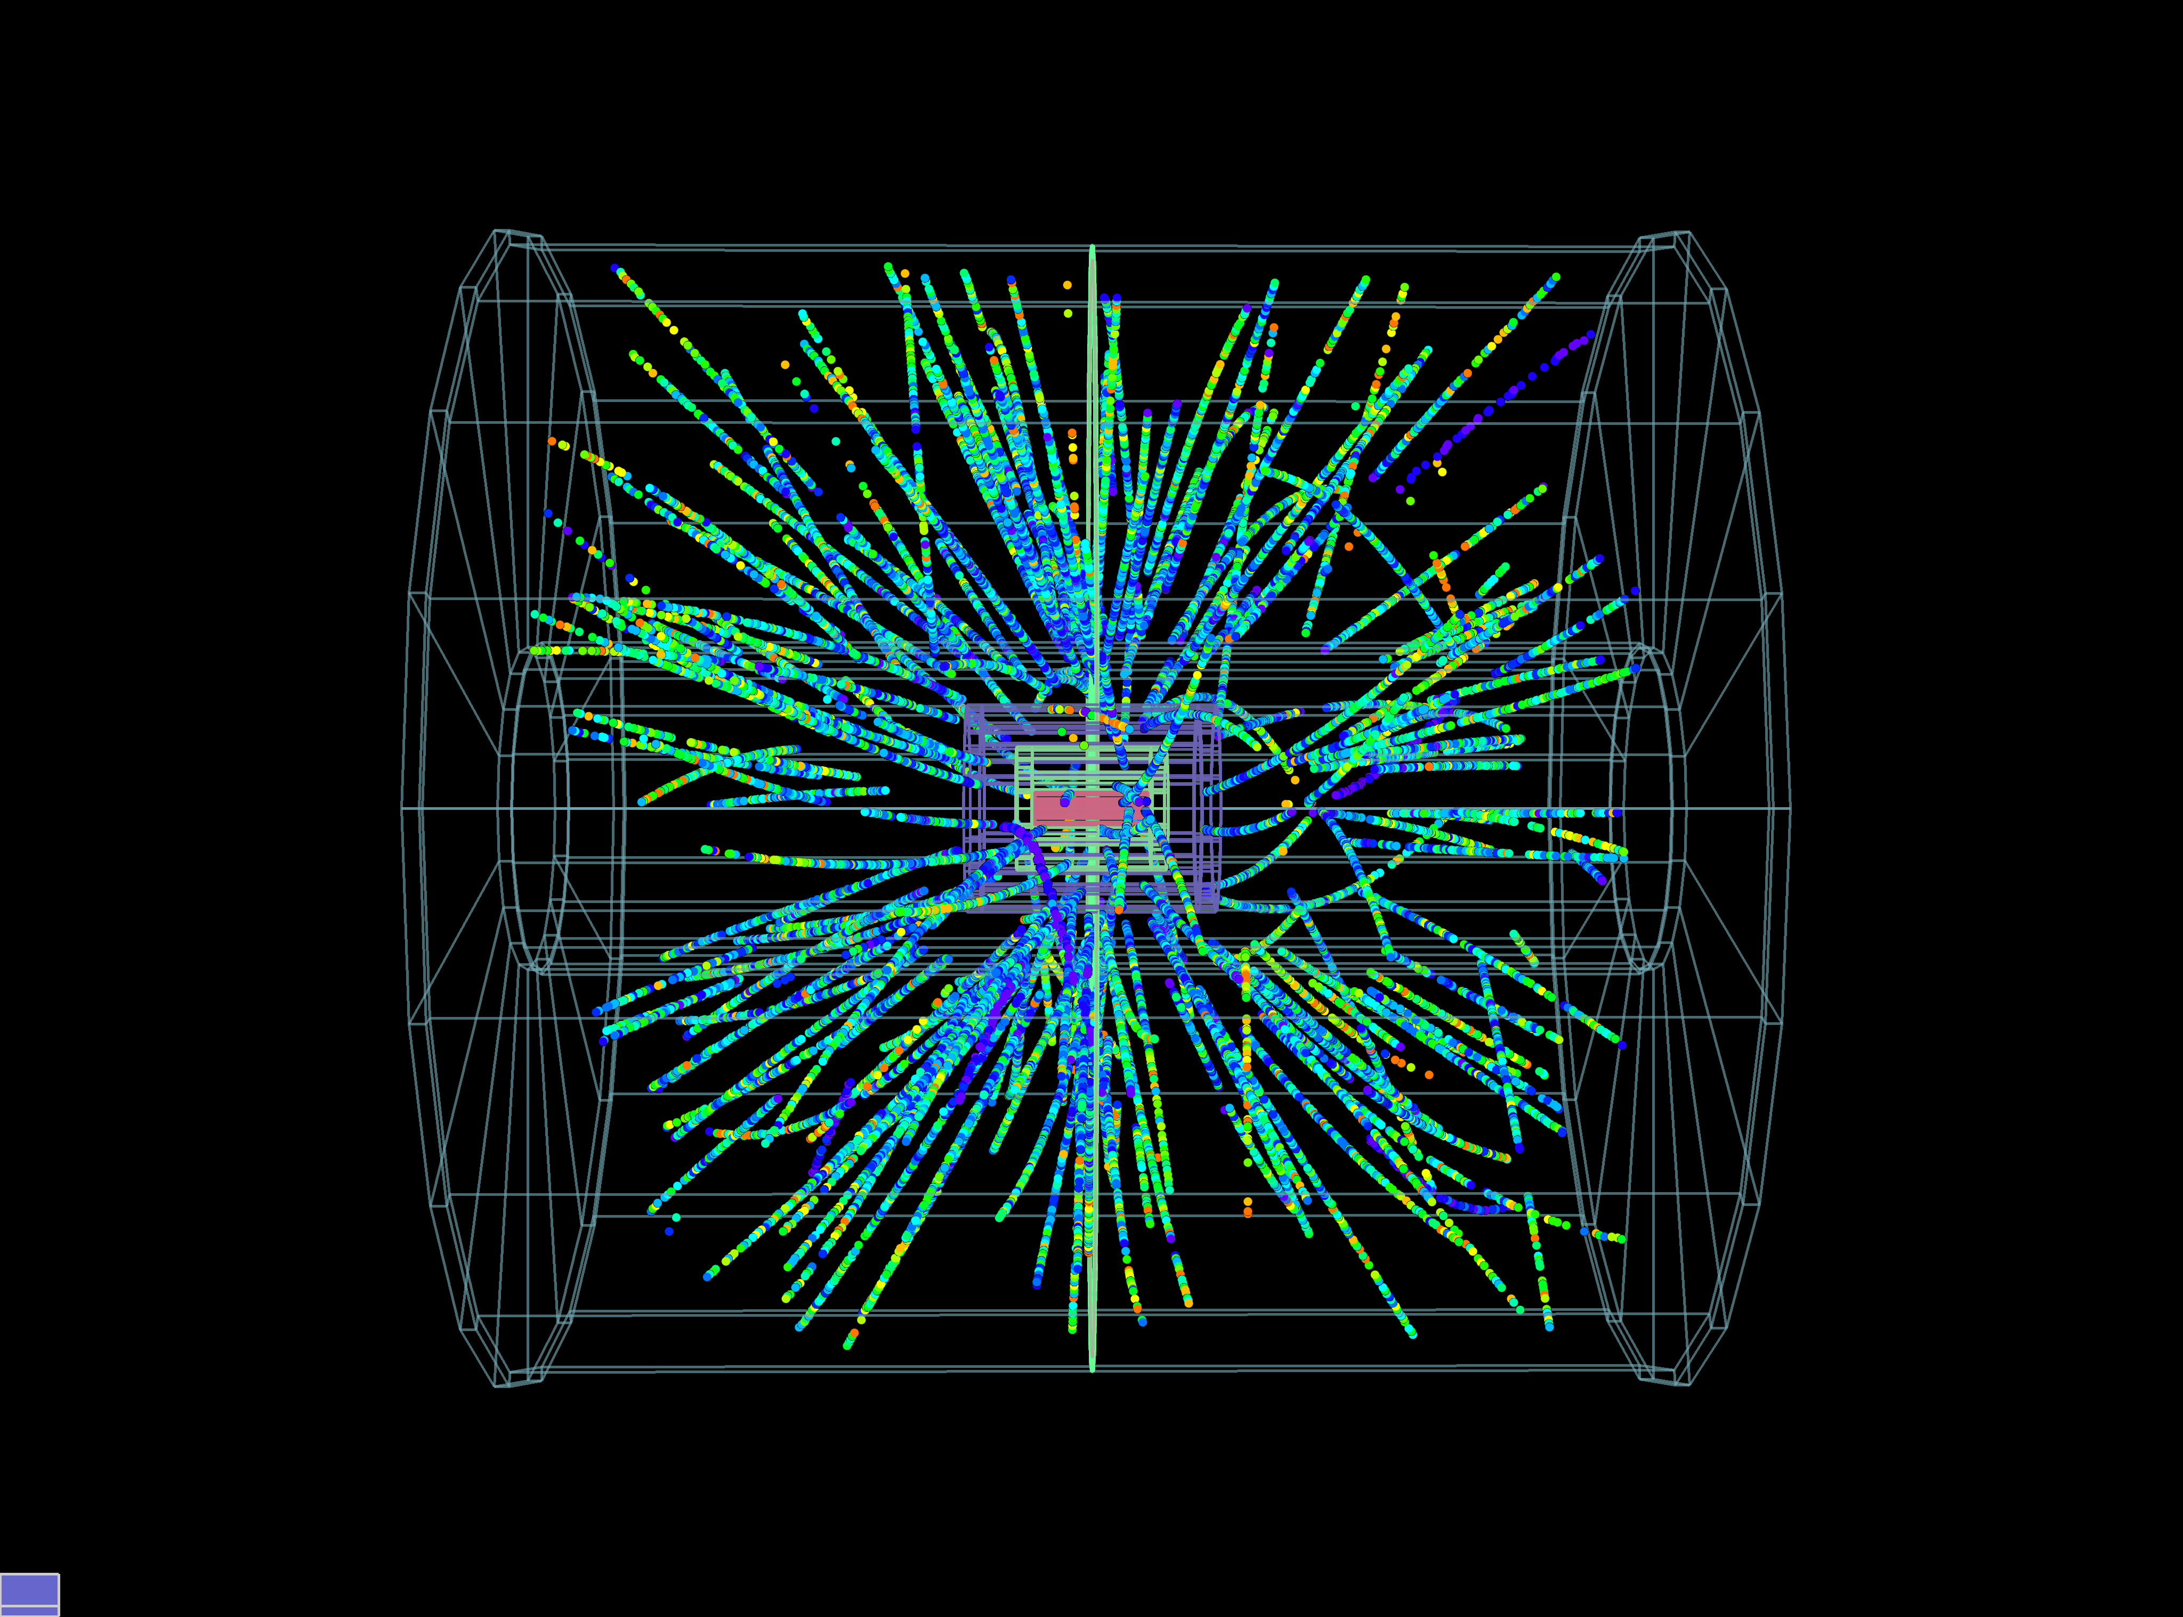
pp / p-Pb / Pb-Pb collisions
The LHC can not only collide protons on protons, but also heavier ions.
Approximately one month of running time is dedicated to heavy-ions each year.
Pb-Pb
p-Pb

Slide 6
Heavy-ions at the LHC
→What can we learn from these massive interactions?
Energy per nucleon in a ²⁰⁸₈₂Pb-Pb collision at the LHC (Run 1):
  pp collision energy √s = 7 TeV
  beam energy in pp E_{beam} = 3.5 TeV
  Beam energy per nucleon in a Pb-Pb nucleus:
  E_{beam,PbPb} = 82/208* 3.5 = 1.38 TeV
  Collision energy per nucleon in
  Pb-Pb: √s_{NN} = 2.76 TeV
  Total collision energy in Pb-Pb:
  √s = 574 TeV
  Run 2: √s_{NN} = 5.02 TeV and thus
  √s = 1.04 PeV

Slide 7
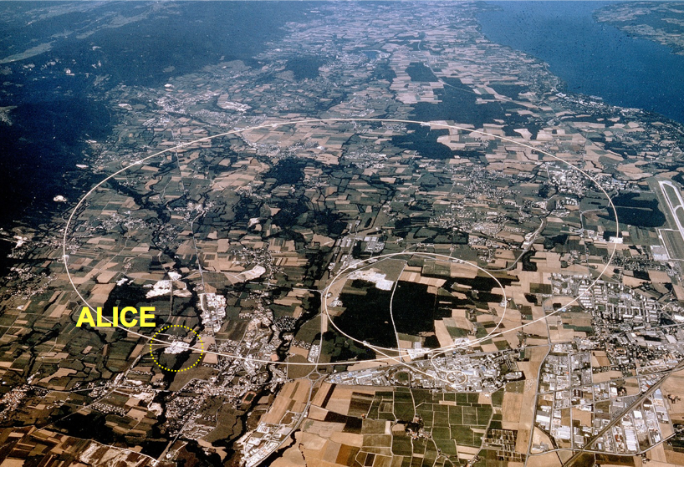
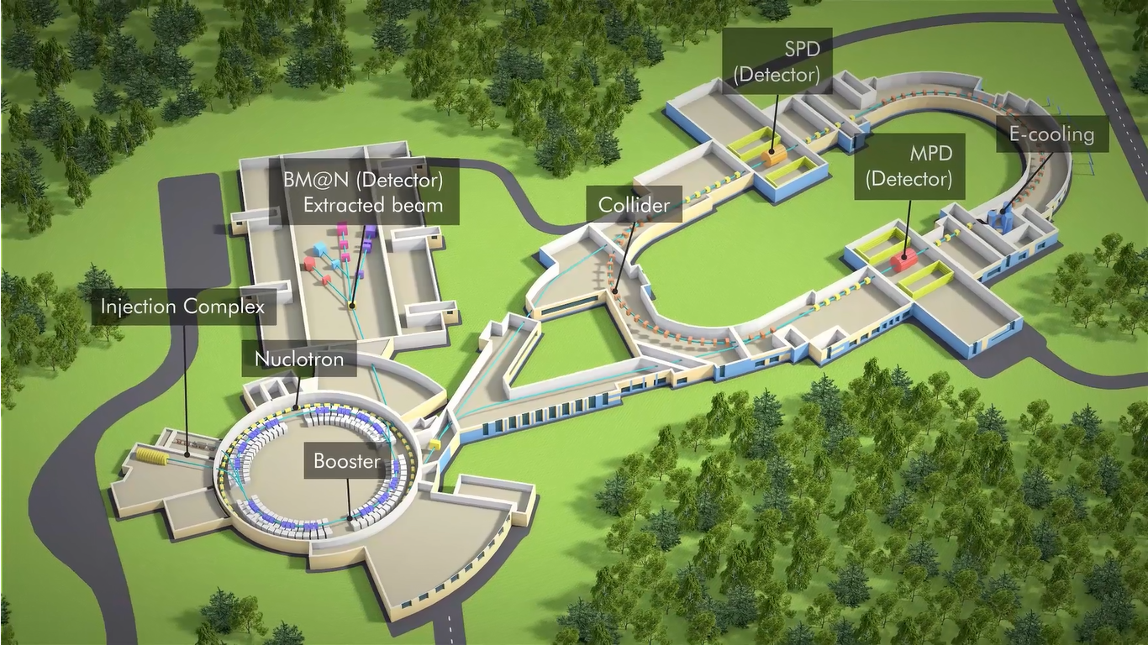
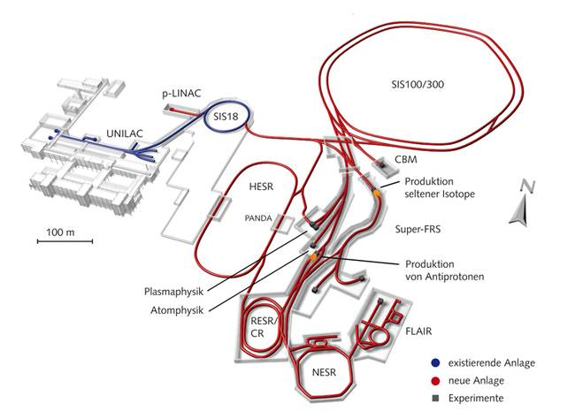

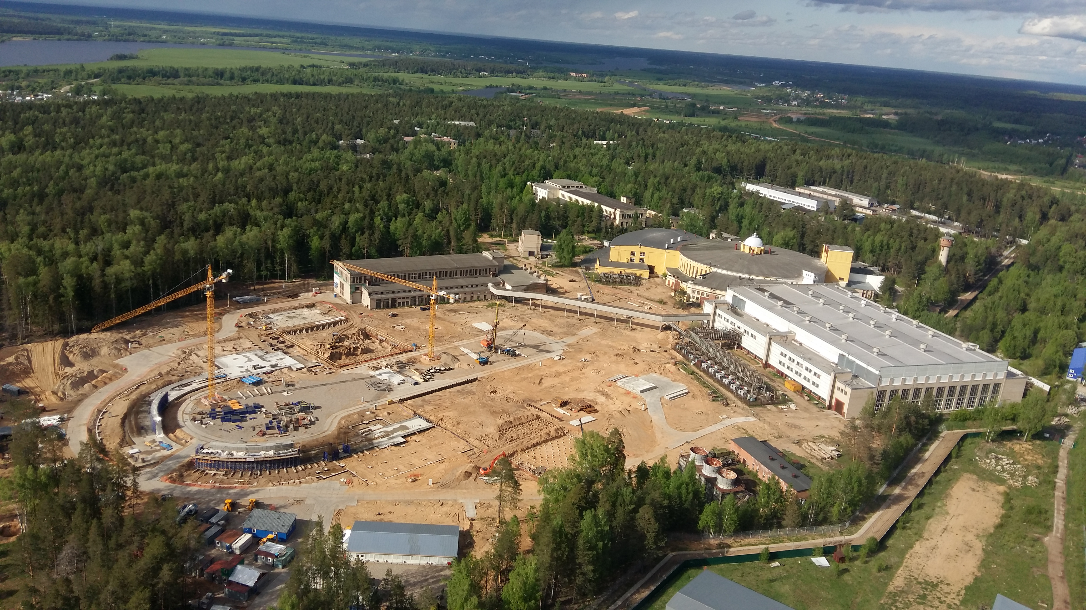
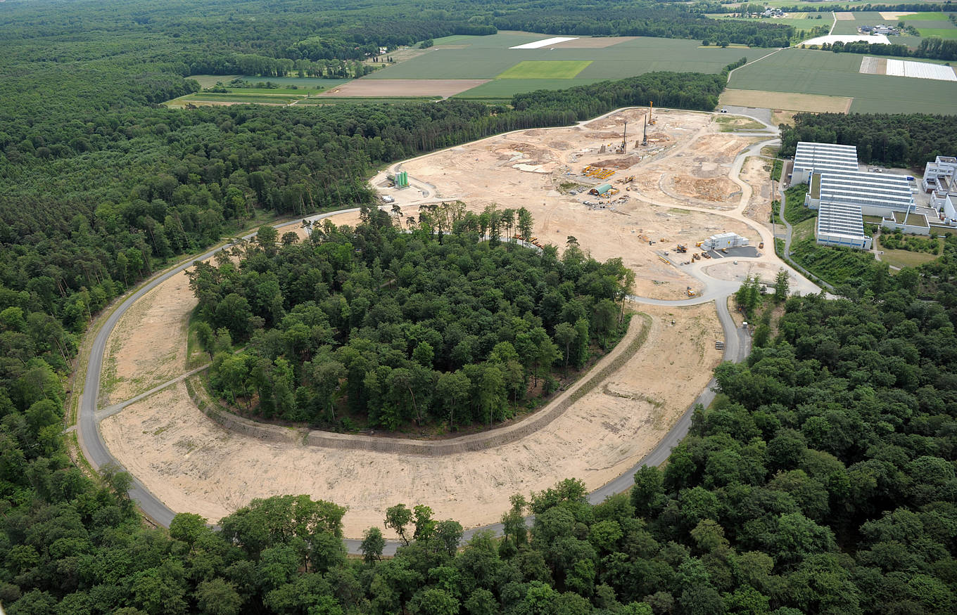
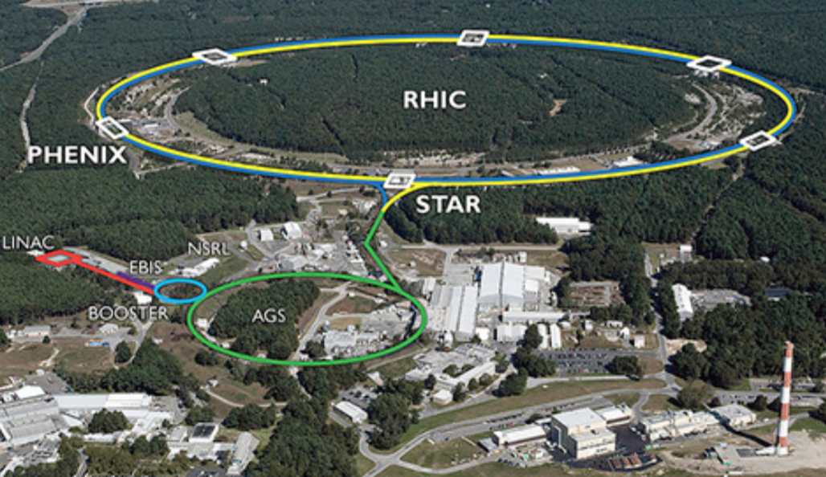
Heavy-ion experiments
Low energy frontier: RHIC (BES), SPS
→ future facilities: FAIR (GSI), NICA
High energy frontier: LHC
CMS
NA-61
LHCb
FAIR
ATLAS
→ By now all major LHC experiments have a heavy-ion program: LHCb took Pb-Pb data for the first time in November 2015.
RHIC

Slide 8
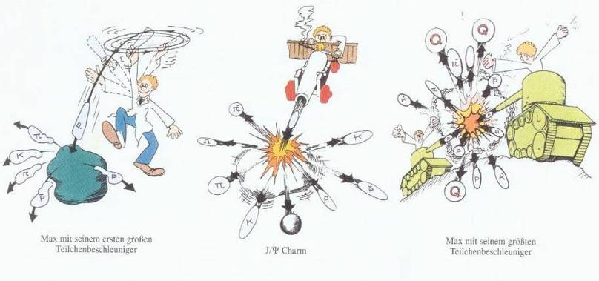
Increasing the beam energy over the last decades…
..from early fixed target experiments at GSI/Bevalac and SPS to collider experiments at RHIC and LHC.
SIS
RHIC/LHC
SPS
GSI Darmstadt,√s_{NN}~2.4 GeV
CERN,√s_{NN}~6-20 GeV
Brookhaven → RHIC √s_{NN}~8-200 GeV (BES)
CERN → LHC √s_{NN} = 5.02 TeV

Slide 9
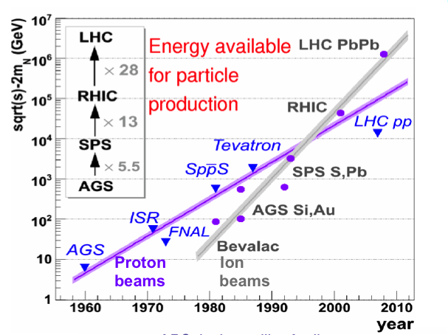

Slide 10
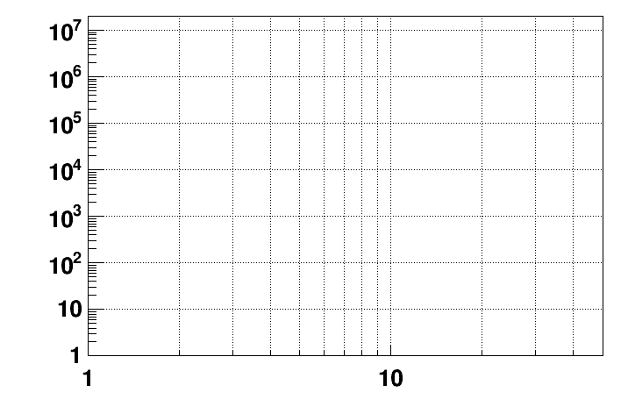
Energy ranges covered by different non-LHC accelerators
energy region of max.
baryonic density
CBM
2022 – 2025: SIS-100 FAIR
NICA/BM@N II
→ Collider experiments allow for very high √s_{NN} and fixed target experiments allow for very high interaction rates at lower √s_{NN} .
HADES
NICA/MPD
Interaction rate [Hz]
STAR F.T.
STAR BES II
NA-61/SHINE
[V. Kekelidze, SQM2017 talk]
Collision energy √S [GeV]
NN

Slide 11
LHC Run 2
LHC Run 2 data taking and analysis is now in full swing.
Significant increase in integrated luminosity (approx. 4 times in Pb-Pb) allow more precise investigation of rare probes.
Various collision systems at different center-of-mass energies are ideally suited for systematic studies of particle production.
Run 1(2009-2013) | Run 2 (2015-now)
Pb-Pb 2.76 TeV | Pb-Pb 5.02 TeV
p-Pb 5.02 TeV | p-Pb 5.02 TeV, 8.16 TeV
pp 0.9, 2.76, 7, 8 TeV | pp 5.02, 13 TeV

Slide 12
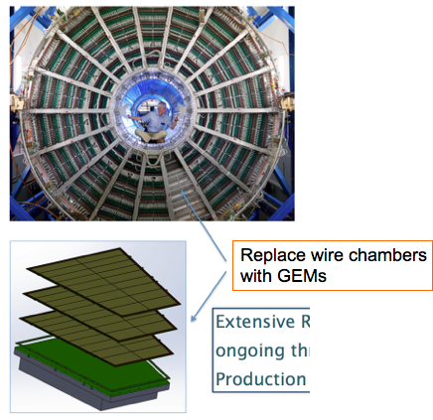
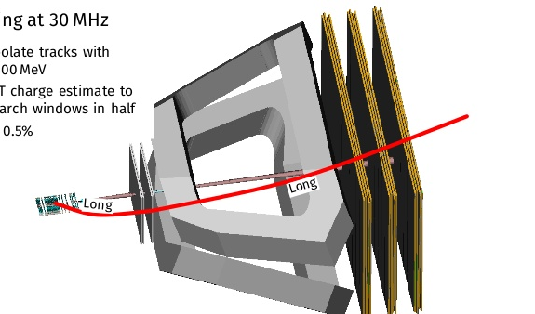
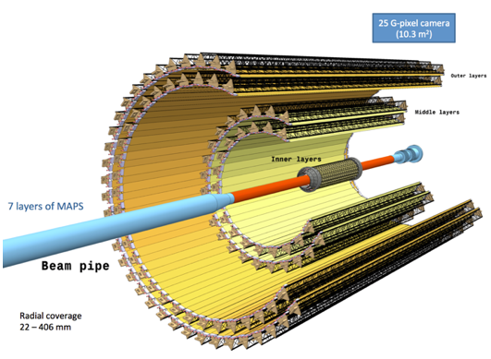
LHC Run 3 and 4
Major detector upgrades in long shutdown 2 (2019-2020) will open a new era for heavy-ion physics:
  New pixel Inner Tracker System (ITS) for ALICE
  GEM readout for ALICE TPC => continuous readout
  SciFi tracker for LHCb
  50 kHz Pb-Pb interaction rate

Slide 13
The QCD phase transition

Slide 14
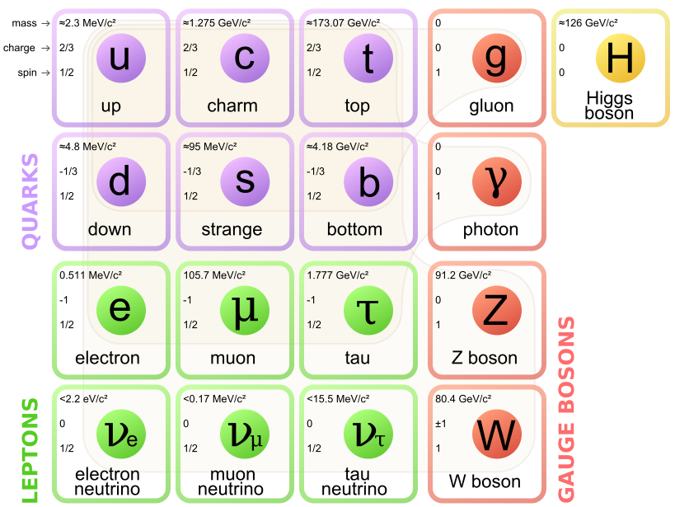
The standard model
The standard model describes the fundamental building blocks of matter (Quarks and Leptons) and their Interactions:
Elektromagnetic: γ
Weak interaction: W&Z
Strong interaction: Gluons
Gravitation: Graviton?
Dramatic confirmation of the standard model in the last years at the LHC: discovery and further investigation of the Higgs-Boson.
However, no signs of physics beyond the standard model were found so far (SUSY, dark matter..).
→ In heavy-ion physics, we investigate physics within the standard model and not beyond it.
→ Discovery potential in many body phenomena of the strong interaction (as in QED and solid state physics: magnetism, electric conductivity, viscosity,..)!
[https://commons.wikimedia.org/wiki/File:Standard_Model_of_Elementary_Particles.svg]

Slide 15
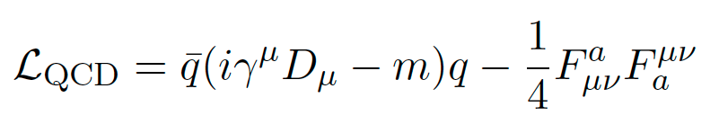


Heavy-ions and Quantum Chromodynamics
Heavy-ion physics is the physics of high energy density Quantum Chromodynamics (QCD):
Quark-field
Quark-mass
Gluon field
strength tensor
Properties of QCD relevant for heavy-ions:
(a.) Confinement: Quarks and gluons are bound in color neutral mesons ( ) or baryons ( ).
(b.) Asymptotic freedom: Interaction strength decreases with increasing momentum transfer (α_{S}➞0 for Q² ➞∞).
(c.) Chiral symmetry: Interaction between left- and right handed quarks disappears for massless quarks.
[Prog.Part.Nucl.Phys. 58 (2007) 351-386]
→ See also QCD lecture by Bryan Webber.

Slide 16
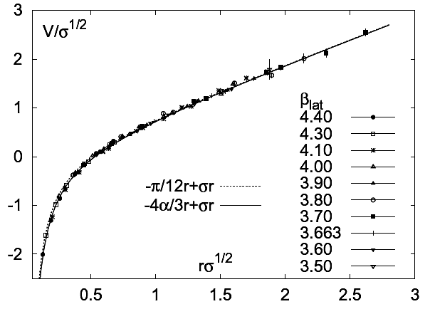
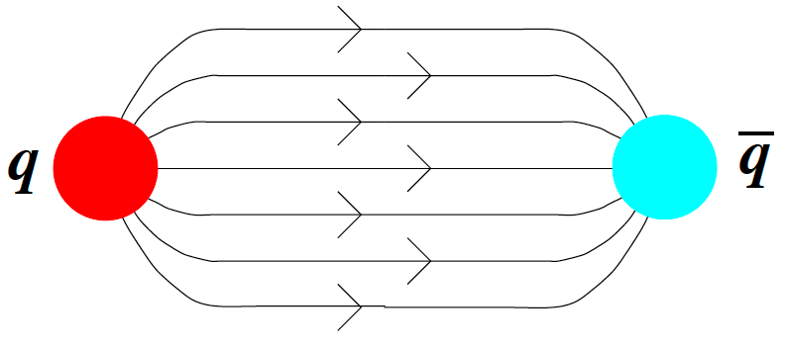
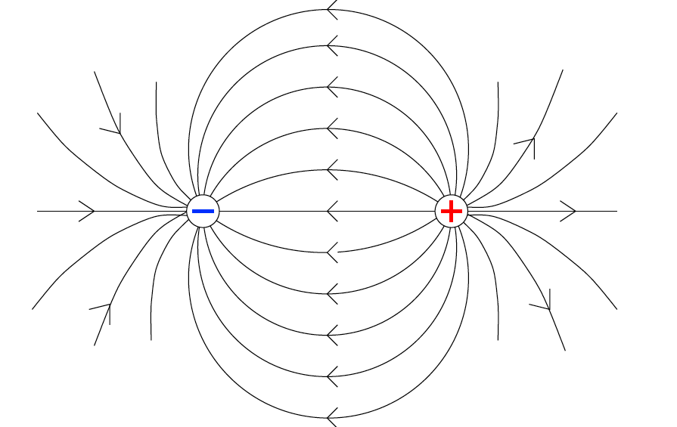

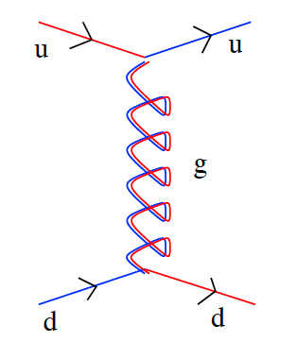
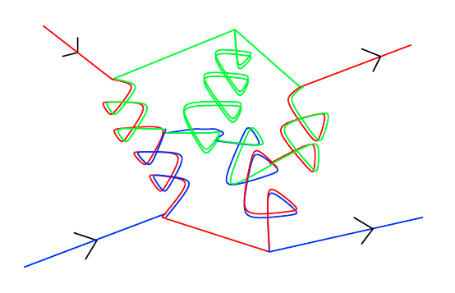
(De-)confinement (1)
QCD vacuum:
  Gluon-gluon self-interaction (non abelian) → in contrast to QED
  QCD field lines are compressed in a flux tube
Potential grows linearly with distance
→ Cornell potential:
“String tension” is huge:
K ~ 880 MeV/fm
QCD
QED

Slide 17
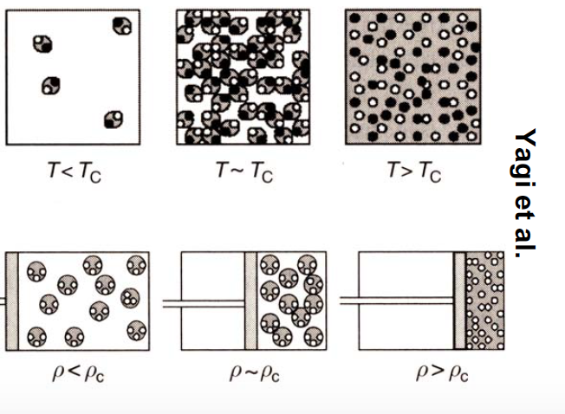
(De-)confinement (2)
Pulled apart, the energy in the string increases.
New q-qbar is created once the energy is above the production threshold as it is energetically more favorable than increasing the distance further.
No free quark can be obtained → confinement.
Percolation picture: at high densities / temperatures, quarks and gluons behave quasi-free and color conductivity can be achieved:
Quark-Gluon-Plasma (QGP).

Slide 18
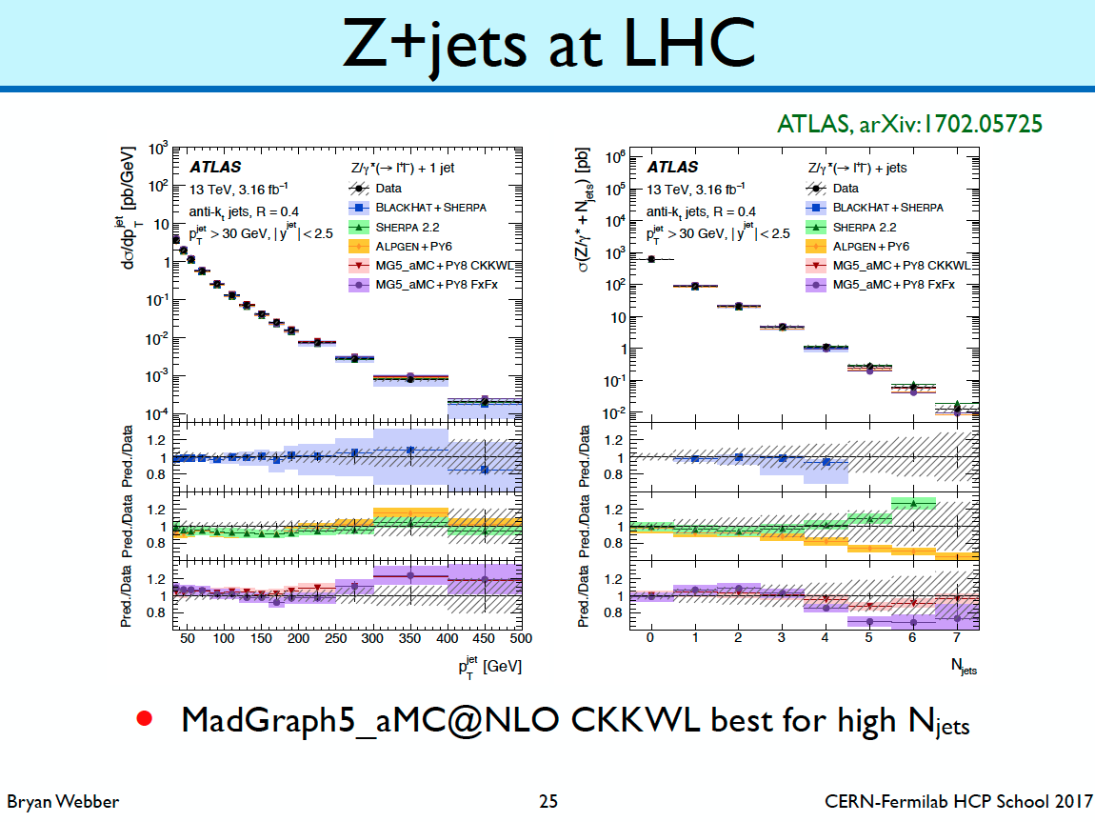
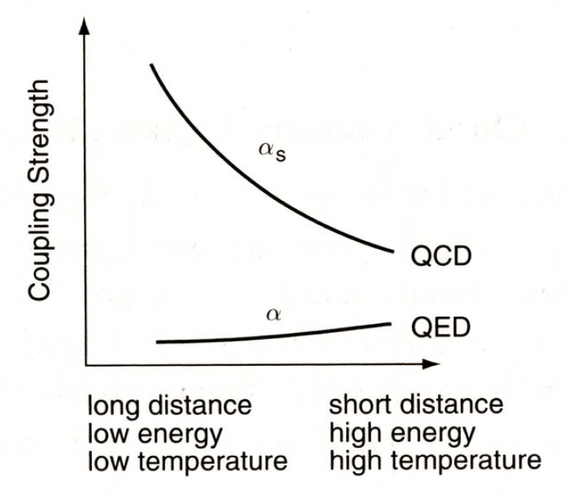
Ab-initio QCD calculations
Ab-initio: a calculation without modeling (and model parameters), but directly derived from the basic theory and only based on fundamental parameters.
In QCD, there are two ab-initio approaches relevant for heavy-ion physics:
  Perturbation theory: pQCD
  Lattice QCD: LQCD
Perturbation theory is only applicable for small values of α_{S}:
→ only possible for large momentum transfers as in jets.
(De-)confinement cannot be described by pQCD, but with LQCD!

Slide 19
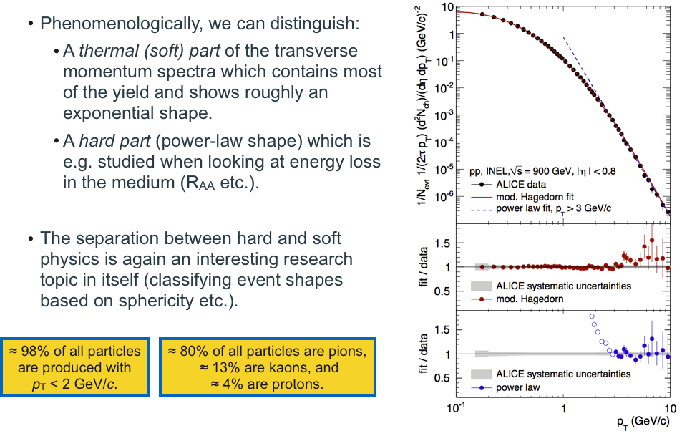
Soft and hard probes
Phenomenologically, we can distinguish:
  A thermal (soft QCD) part of the transverse momentum spectrum which contains most of the yield and shows roughly an exponential shape (thermal-statistical particle chemistry and flow).
  A hard part (power-law shape, pQCD) which is studied in jet physics (energy loss mechanisms etc., R_{AA} in heavy-ion physics)
Even at LHC energies ~98% of all particles are produced at p_{T} < 2 GeV/c.
~80% are pions, ~13% are kaons, ~4% are protons.
The bulk of the produced particles is not accessible with pQCD methods.

Slide 20
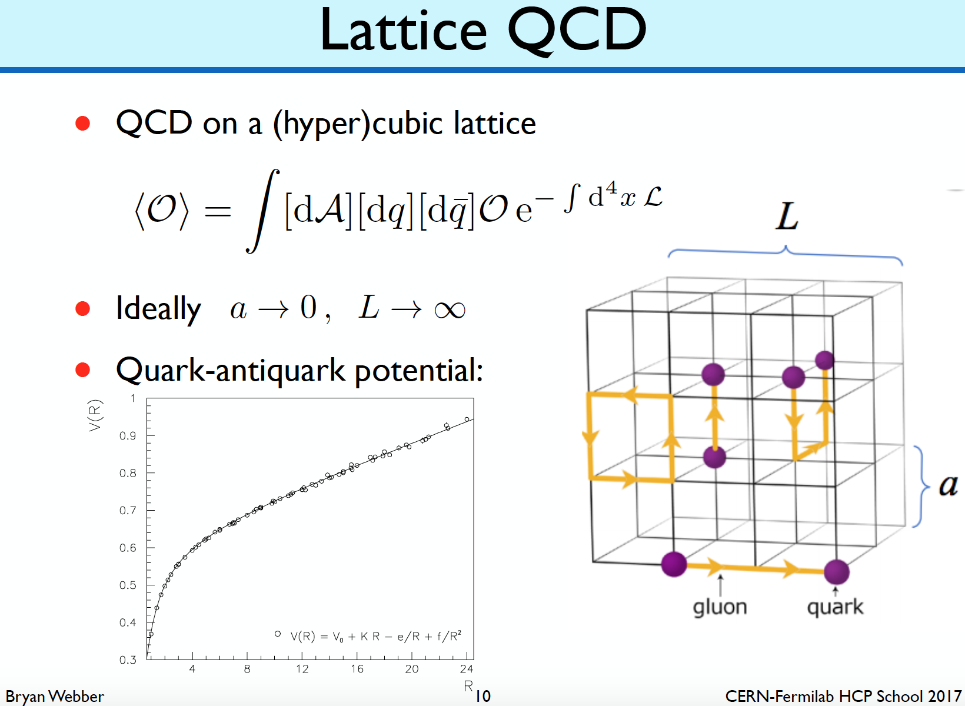
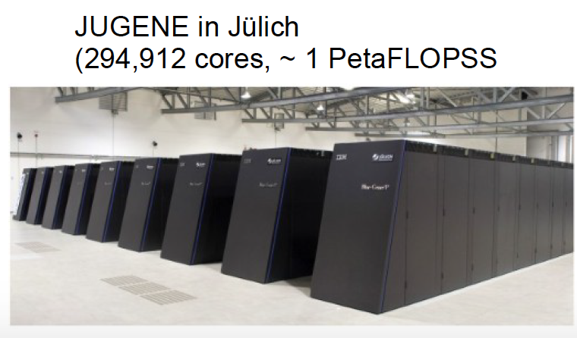
Lattice QCD (LQCD)
Solve QCD numerically by discretizing Lagrangian on a space-time grid.
Static theory, no dynamical calculations possible as computations are done in imaginary time (τ → ιτ).
Only directly applicable (extrapolation methods exist) to systems with no net-baryon content:
number of baryons = number of anti-baryons
(early universe, midrapidity LHC
→ μ_{B} ≈ 0 MeV)
Computationally very demanding
→ dedicated supercomputers.

Slide 21
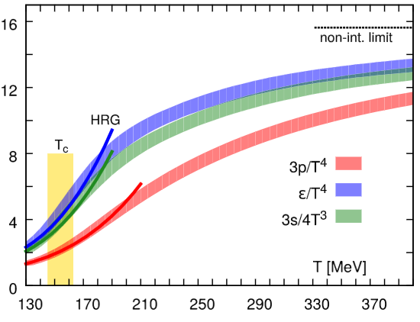
QGP as the asymptotic state of QCD
Quark-Gluon-Plasma (QGP): at extreme temperatures and densities quarks and gluons behave quasi-free and are not localized to individual hadrons anymore.
bound quarks & gluons
Where is the phase transition?
→ Lattice QCD
Asymptotic freedom: free quarks & gluons
Critical temperature
T_{c} ≈ 156 MeV
T → ∞
Temperature T
T₀ ≈ 1/40 eV
[PRD 90 094503 (2014)]
Are such extreme temperatures reached in the experiment?
Yes..
Is it for all quark flavors the same?
Not clear yet..
…

Slide 22
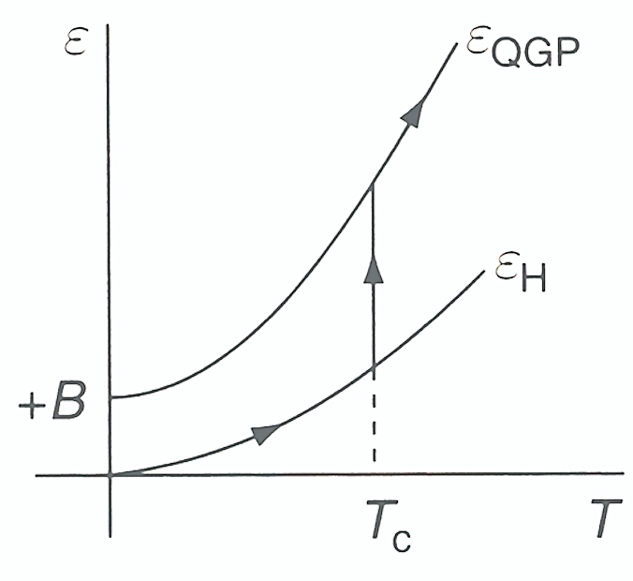
Phase transition in Lattice QCD
Steep rise in thermodynamic quantities due to change in number of degrees of freedom → phase transition from hadronic to partonic degrees of freedom.
Critical temperature
T_{c} ≈ 156 +/- 9 MeV
[PRD 90 094503 (2014)]
Energy density ε
Pressure p
Entropy density s
Smooth crossover for a system with net-baryon content equal 0. For a first order phase transition, the behavior would be not continuous.
For comparison:
T=156 MeV ≙ 1.8∙10¹² K
Sun core: 1.5 ∙ 10⁷ K
Sun surface: 5778 K

Slide 23
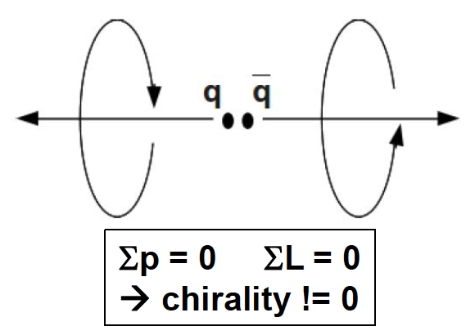
Chiral symmetry
QCD Lagrangian is symmetric under SU(2)_{L} x SU(2)_{R}
→ In the dynamics of QCD, the interaction between right handed (spin parallel to momentum vector) and left handed (spin anti-parallel to momentum vector) quarks vanishes in the case of massless quarks.
Light quarks have a finite small bare (current) mass
→ explicit breaking of chiral symmetry.
Creation of coherent q-qbar pairs in QCD vacuum
(as in cooper pairs in superconductivity).
  Has a non-zero chiral charge
  Not symmetric under SU(2)_{L} x SU(2)_{R}
  → spontaneous symmetry breaking in the QCD ground state (pseudo-goldstone boson: pions)
Quarks acquire ~350MeV additional (constituent) mass
  Only relevant for the light u,d,s quarks.

Slide 24
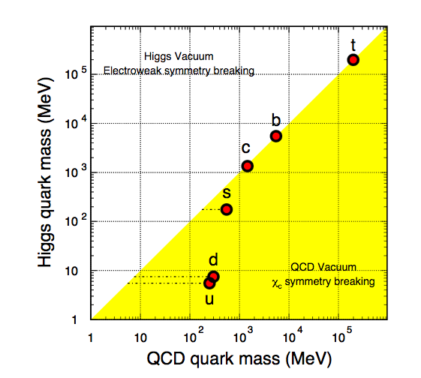
Spontaneous breaking of chiral symmetry
Consequences:
  Isospin symmetry: constituent quark masses m_{u} ≈ m_{d} → isospin symmetry
  Isospin symmetry is not based on a fundamental relation, but due to the fact that the acquired masses are much larger than the bare masses
  m(nucleon) >> m(bare u+u+d)
  938 MeV >> ~10 MeV
In the QGP, chiral symmetry is expected to be restored!
arXiv:nucl-ex/0610043
LF

Slide 25
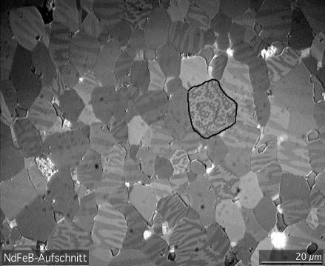
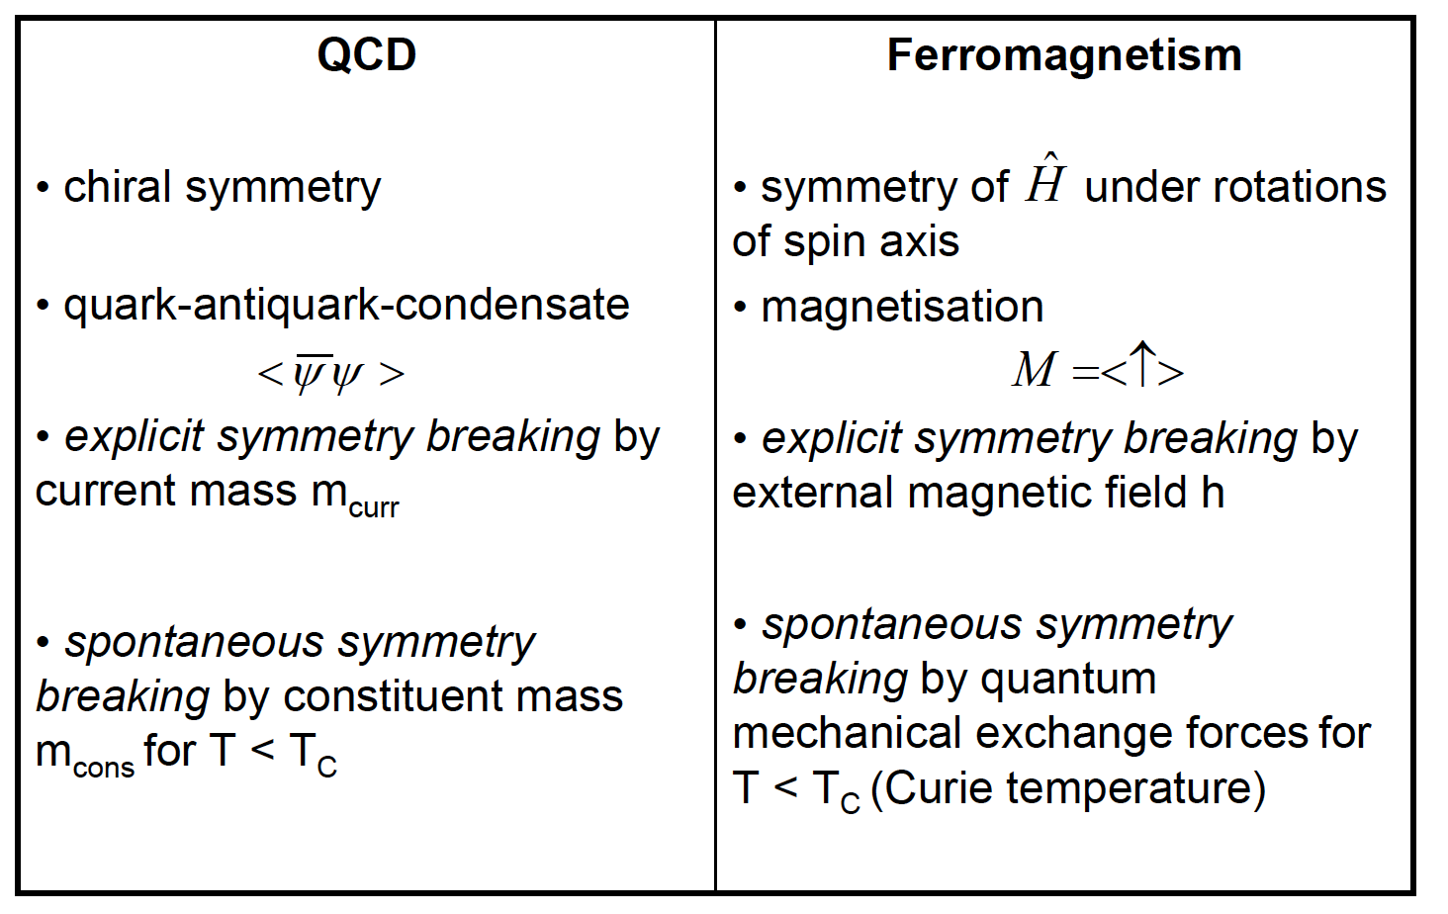
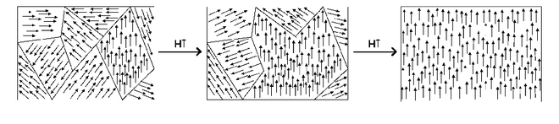
Spontaneous and explicit symmetry breaking
→ Best explained in an analogy to ferromagnetism:
Magnetic domains

Slide 26
Chiral and de-confinement transition
[PLB 723 (2013) 360]
Both phase transitions take place at the same temperature in Lattice QCD (de-confined ⬌ confined and chiral symmetry restored ⬌ chiral symmetry broken).
The fact that both phase transitions occur at the same temperature is not linked from first principles QCD!
→ Experimental verification: di-leptons and net-charge fluctuations (see later).
Lattice QCD

Slide 27
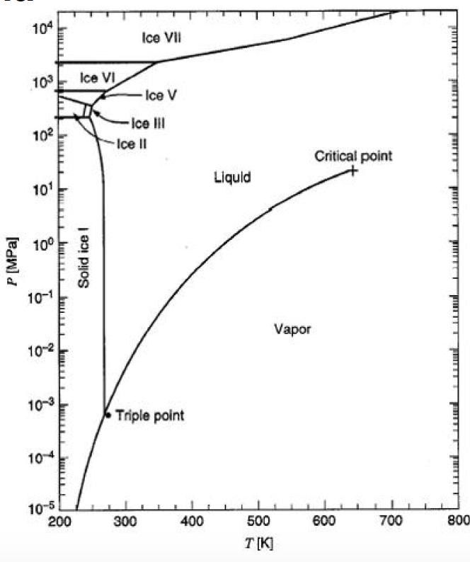
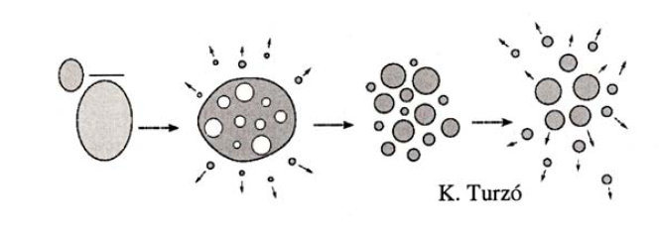
Summary: phase transitions from 0 to 10¹³ K
Even in our everyday life we realise that matter comes in various forms:
Solid → liquid → gas → plasma (de-localisation)
~0 K → ~ 273 K → ~ 373 K → ~2000K
In our life as heavy-ion physicist, we continue further:
  First, around T=10 MeV (1.1∙10¹¹K), the nucleons are not bound to nuclei anymore (low energy heavy-ion experiments at a few 100 MeV beam energy).
  Then, at around T=156MeV (1.8∙10¹²K) the (de-)confinement
  and chiral symmetry phase transition.
Phase transition: A phase transition is of n^{th} order if discontinuities in variations transverse to the coexistence curve occur for the first time in the n^{th} derivatives of the chemical potential (Ehrenfest defintion).

Slide 28
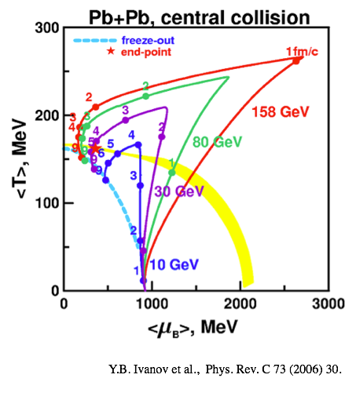
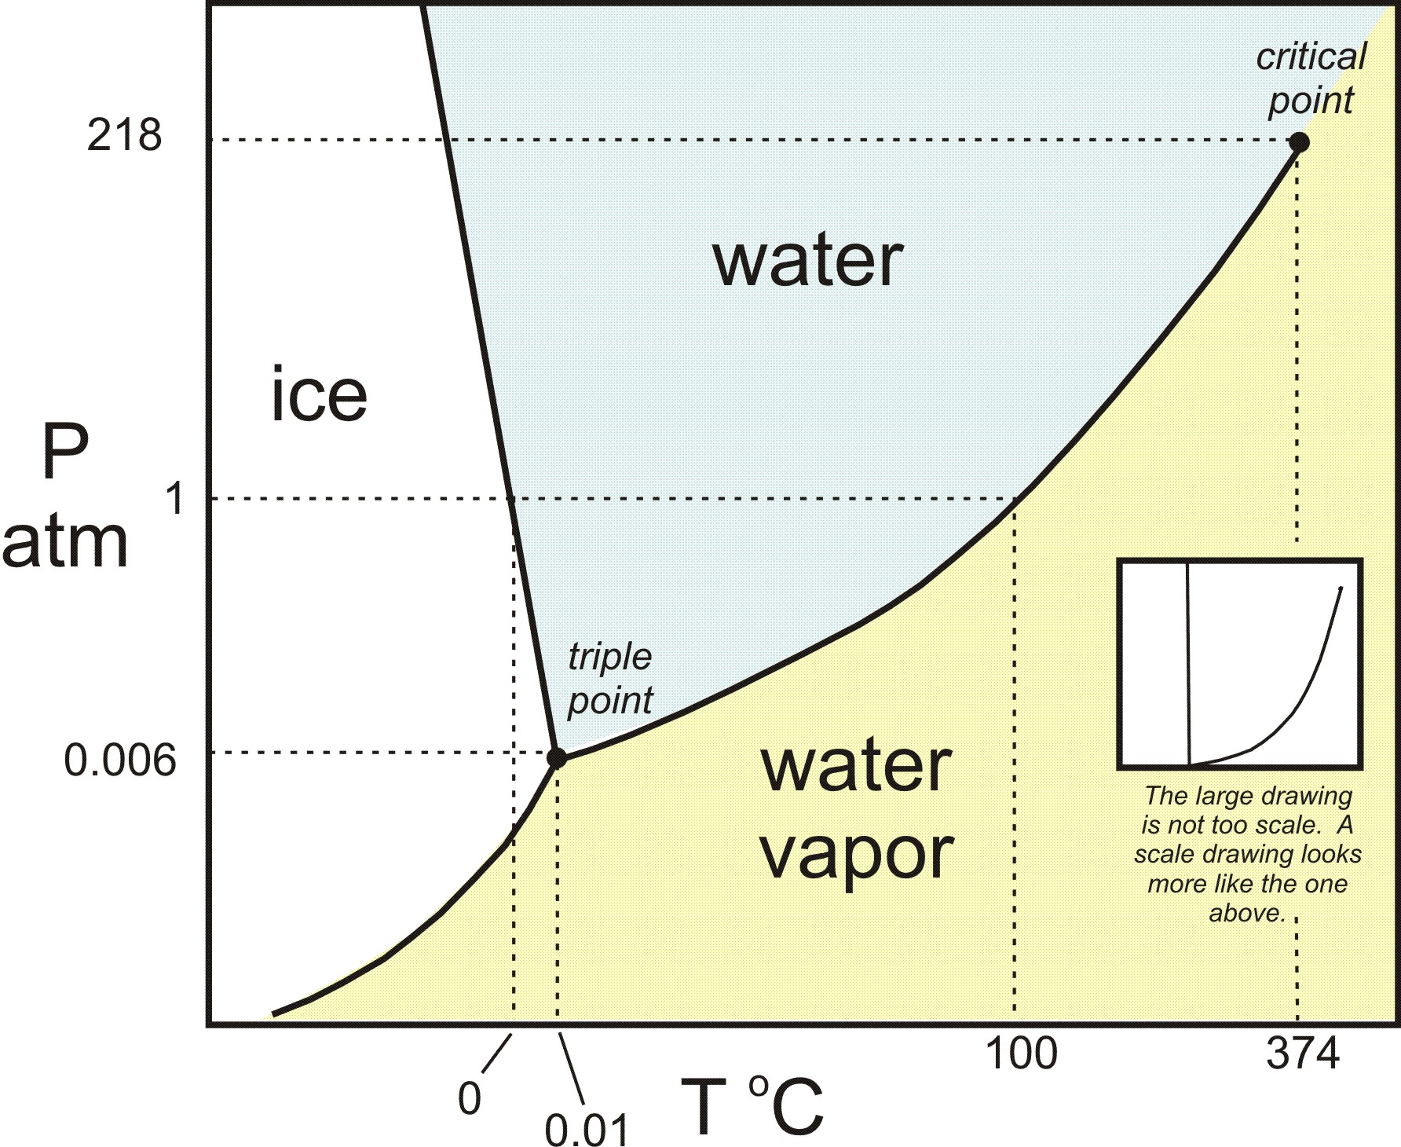
The phase diagram of QCD (1)
→ Different regions of the phase diagram are probed with different √s_{NN}.
=> beam energy scan (BES) at RHIC.
The thermodynamics of QCD can be summarized in the following (schematic) phase diagram.
Control parameters: temperature T and baryo-chemical potential µ_{B}.
At LHC-energies (√s = 5.02 TeV): µ_{B} ≈ 0 MeV << T_{ch}
At SIS18: (√s = 2.4 GeV): µ_{B} ≈ 883 MeV >> T_{ch}
Early universe
LHC
critical
point
[http://serc.carleton.edu/research_education/equilibria/phaserule.html]
[Ann. Rev. Nucl. Part. Sci. 62 (2012) 265]

Slide 29
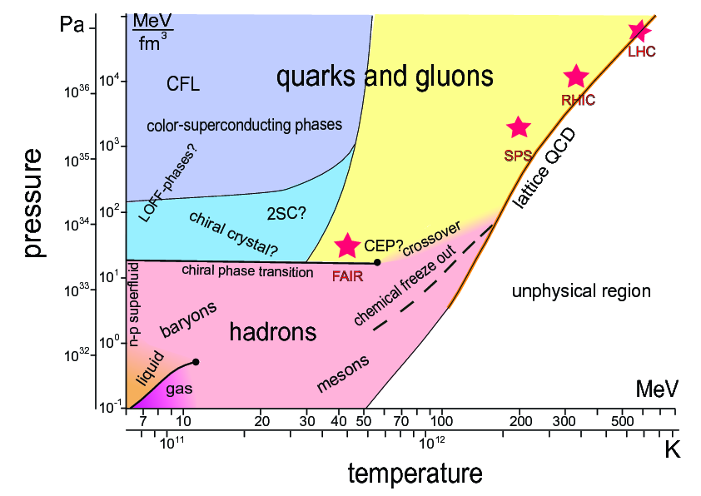
The phase diagram of QCD (2)
→ Alternative representation which is not used in practice, but to emphasize more the similarity to the phase diagram of water.

Slide 30
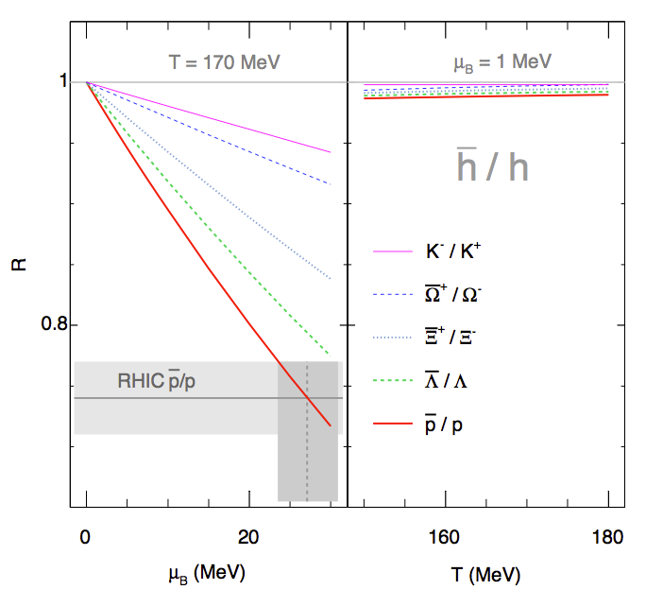

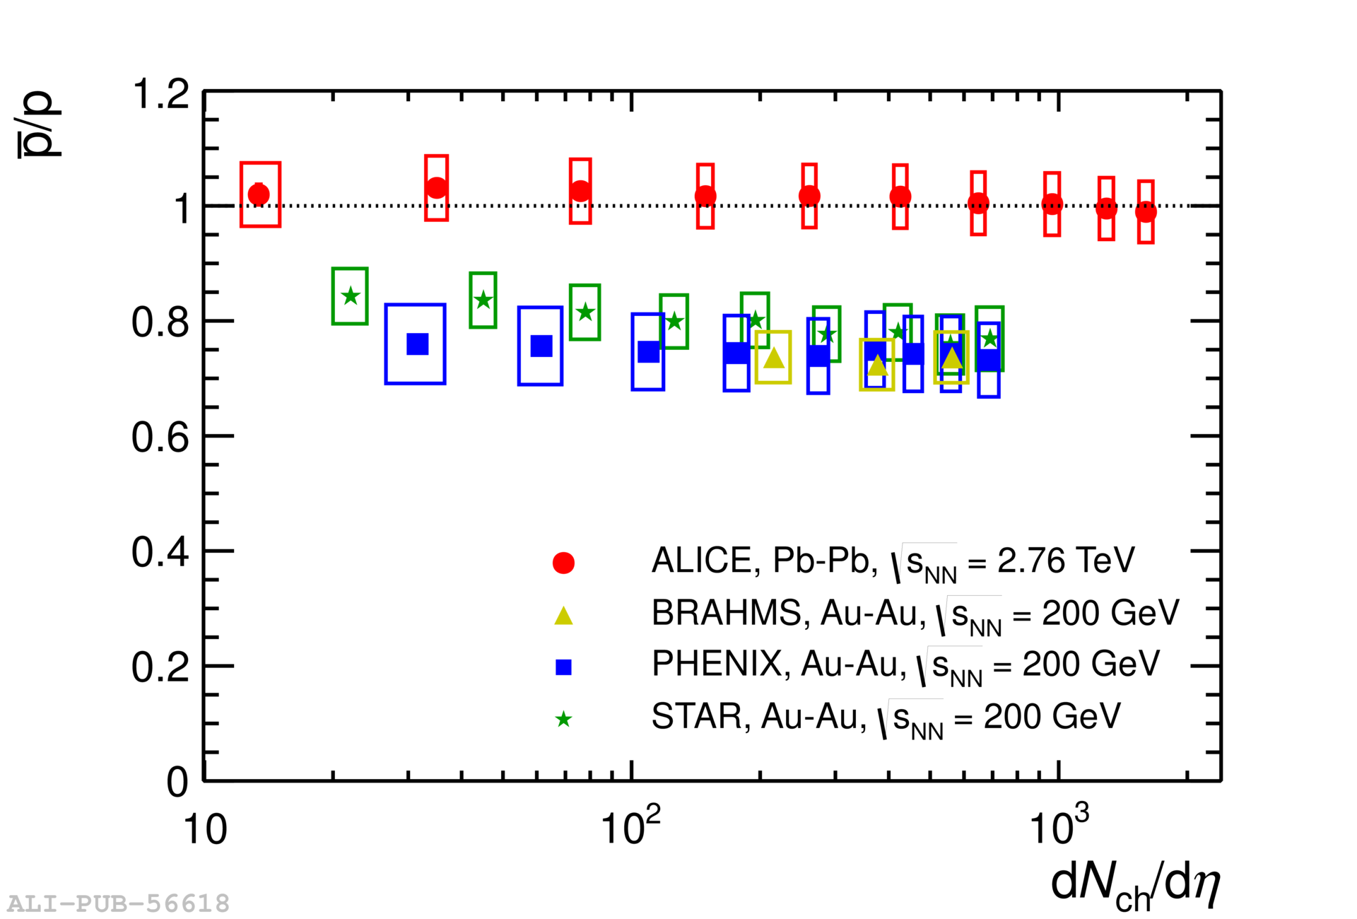
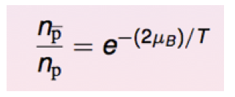
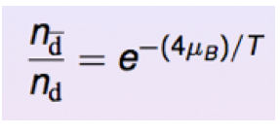
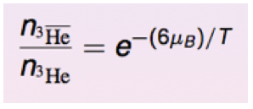
The baryochemical potential µB
In contrast to the (chemical freeze-out) temperature T, the baryochemical potential is a less intuitive quantity…
It quantifies the net-baryon content of the system (baryon number transport to midrapidity).
fundamental
thermodynamic relation
However, (anti-)nuclei are more sensitive:
arXiv:1303.0737
(I. Kraus)

Slide 31
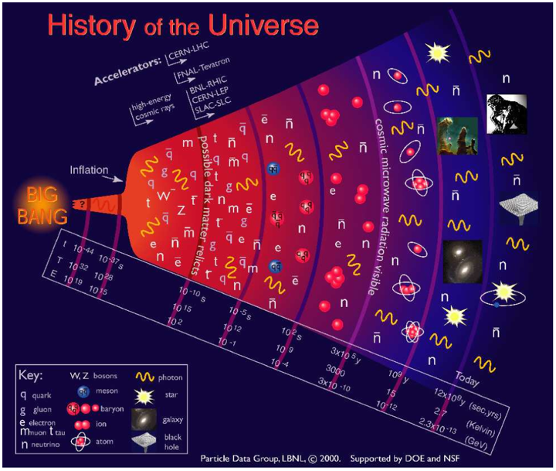
QGP and the early universe (1)
Big bang in the early universe and little bang in the laboratory.
The Universe went through a QGP phase about 10ps after its creation and froze out into hadrons after about 10µs which later formed nuclei.
In addition, there are similarities between the big bang (universe QGP) and the little bang (heavy-ions) concerning the decoupling.

Slide 32
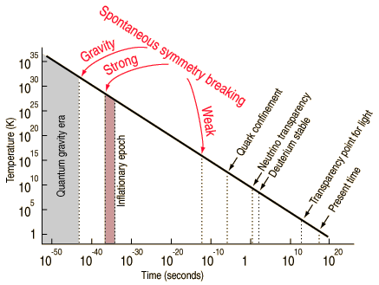
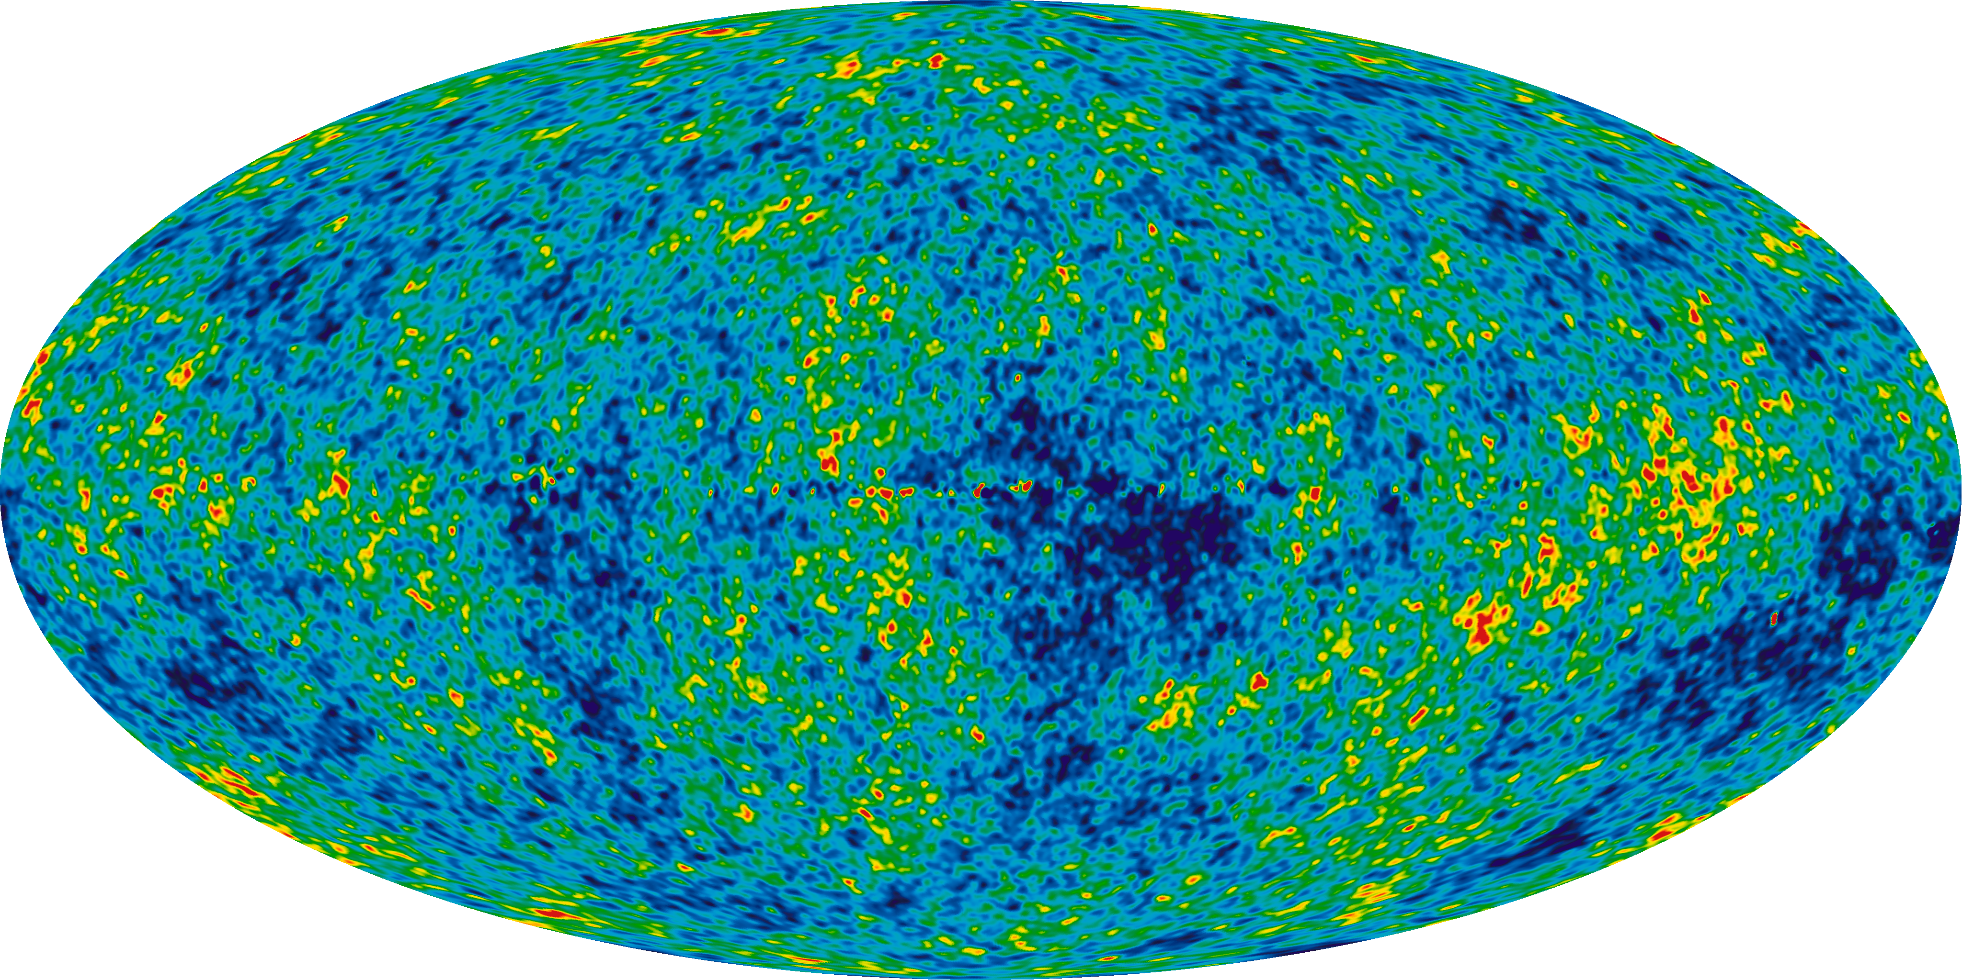
QGP and the early universe (2)
Decoupling: different type of particles fall out of thermal equilibrium with each other and freeze out when the mean free path for interaction is comparable to the size of the expanding system.
Examples of this analogy:
  Early Universe: neutrinos decouple early as their interaction is weak.
  Heavy-ions:
    chemical freeze-out (inelastic interactions changing particle type) happens before kinetic freeze-out (elastic interactions changing only momenta)
    Kinetic freeze-out of strange particles might happen before the kinetic freeze-out of non-strange particles
Decoupled photons (WMAP)

Slide 33

Can we reach such temperatures in the experiment?
→ We would need initial temperatures of more than 200 MeV.
→ Let’s look first at a schematic evolution of a heavy-ion collision:
What is the temperature reached in a heavy-ion collision? Let’s measure it..
[arXiv:1207.702]

Slide 34



Heavy ion collision
Colliding nuclei

Slide 35


Heavy ion collision
Production of colour medium and equilibration
PreEquilibrium

Slide 36


Heavy ion collision
QGP and expansion
QGP expansion
PreEquilibrium

Slide 37


Heavy ion collision
Hadronisation and Chemical freeze-out
Chemical freeze-out
Hadronisation
QGP expansion
PreEquilibrium

Slide 38


Heavy ion collision
Kinetic freeze-out
Kinetic freeze-out
T ~ 90 MeV
System cools down by (isentropic)
expansion
T > 300 MeV
Chemical freeze-out
Hadronisation
QGP expansion
PreEquilibrium

Slide 39

Direct photons – black body radiation from the QGP
The challenging measurement of direct (subtract decay such as π⁰→γγ) photons gives access to the initial temperature of the system created in heavy-ion collisions. However, model comparisons are needed as direct photons are also emitted at later stages of the collision.
Teff = 304 ± 11 ± 40 MeV
→ Effective temperature of approx. 300 MeV is observed as a result of a high initial temperature and the blue-shift due to the radial expansion of the system.
[Phys. Lett. B 754 (2016) 235-248]

Slide 40
QGP thermodynamics and soft probes

Slide 41
Thermodynamics
It is important to distinguish between:
  a system of individual particles
  a medium in which individual degrees of freedom do not matter anymore and thermodynamic (hydrodynamic) concepts (many body theories) can be applied.
Thermodynamic (hydrodynamic) are typically used for systems with 10⁵-10²³ particles in local thermodynamic equilibrium.
  Average (minimum bias) pp collision at the LHC: dN_{ch}/dη ≈ 6
Lifetime of the system must be long enough so that equilibrium can be established by several (simulations indicate 5-6) interactions between its constituents.
With only 6 particles, it sounds hopeless.. But how many particles are created in a massive heavy-ion collision? Let’s measure it..

Slide 42

Geometry of heavy ion collisions
Centrality Variables:
N_{coll}: Number of
nucleon-nucleon collisions
N_{part}: Number of
participating nucleons
Percentile of hadronic
cross-section:
0-5% => central (“many particles”)
80-90% => peripheral (“few particles”)
Peripheral
→ We can determine (a posteriori) the geometry of heavy ion collisions. More details on the Glauber model when discuss hard probes..
~ # charged particles
Participants
NN Collisions

Slide 43



How many particles are created in such a collision?

Slide 44

dN_{ch}/dη in 5.02 TeV Pb-Pb collisions at the LHC
dN_{ch}/dη ≈ 1943 ± 54 at midrapidity.
→ Even at LHC energies, 95% of all particles are produced with p_{T} < 2 GeV/c in pp and Pb-Pb collisions.
→ Bulk particle production and the study of collective phenomena are associated with “soft” physics in the non-perturbative regime of QCD.
[arXiv:1612.08966]

Slide 45



Instrumentation for heavy-ion experiments: granularity
In order to cope with the high density of particles, heavy-ion detectors have to be very granular (e.g. large TPC with small read-out pads).
Track seeding typically in outer detectors (where track density is lower) and then Kalman filter propagation to the primary vertex.

Slide 46



Short reminder: (Pseudo-)rapidity
→ Always keep in mind: Rapidity and pseudo-rapidity are not the same, especially at low transverse momenta!
From: K. Reygers

Slide 47

Total number of charged hadrons in Pb-Pb collisions
→ Collisions of heavy-ions at high energy accelerators allow the creation of several tens of thousands of hadrons (1 << N << 1mol) in local thermodynamic equilibrium in the laboratory.
So, we have enough particles, but are they in local thermodynamic equilibrium? How can we test that?
[arXiv:1612.08966]

Slide 48
Total number of charged hadrons in Pb-Pb collisions
→ Collisions of heavy-ions at high energy accelerators allow the creation of several tens of thousands of hadrons (1 << N << 1mol) in local thermodynamic equilibrium in the laboratory.
Success of hydro models describing spectral shapes and azimuthal anisotropies supports idea of matter in local thermal equilibrium (kinetic).
Success of thermal models describing yields of hadrons composed of up, down, and strange quarks supports idea of matter in local thermal equilibrium (chemical).
[arXiv:1612.08966]
Equilibrium models such as hydro typically need 5-6 interactions to work. Where does this picture break down? Does it work in pp and pPb? → What is the smallest possible QGP droplet?

Slide 49

A short introduction to statistical thermodynamics (1)
The maximum entropy principle leads to the thermal most likely distribution of particle species.
Entropy: the number of possible micro-states Ω being compatible with a macro-state for a given set of macroscopic variables (E, V, N):
Compatibility to a given macroscopic state can be realized exactly or only in the statistical mean.

Slide 50

A short introduction to statistical thermodynamics (2)
We therefore distinguish three different statistical ensembles:
(i) micro-canonical: E, V, N fix
(ii) canonical: T, V, N fix
➔ given volume element is coupled to
a heat bath
(iii) grand-canonical: T, V, µ fix
➔ given volume element can also exchange particles with its surrounding (heat bath
and particle reservoir)

Slide 51
A short introduction to statistical thermodynamics (3)
A small example: barometric formula (density of the atmosphere at a fixed temperature as a function of the altitude h).
Probability to find a particle on a given energy level j:
Energy on a given level is simply the potential energy: Epot = mgh. This implies for the density n (pressure p):
Boltzmann factor
Partition function Z
(Zustandssumme = “sum over states”)

Slide 52
QGP thermodynamics and soft probes
Particle chemistry

Slide 53




Statistical-thermal model for heavy-ion collisions
Starting point: grand-canonical partition function for an relativistic ideal quantum gas of hadrons of particle type i (i = pion, proton,… → full PDG!):
Once the partition function is known, we can calculate all other thermodynamic quantities:
dispersion relation
(relativistic)
(-) for bosons, (+) for fermions (quantum gas)
Only two free parameters are needed: (T,µB). Volume cancels if particle ratios
ni /nj are calculated. If yields are fitted, it acts as the third free parameter.
spin
degeneracy
chemical potential representing each conserved quantity
Partition function shown here is only valid in the resonance gas limit (HRG), i.e. relevant interactions are mediated via resonances, and thus the non-interacting hadron resonance gas can be used as a good approximation for an interacting hadron gas.

Slide 54



p_{T}-spectra of identified particles
Identify particle in the detector (pion, kaon, proton, Lambda, Xi, Omega, anti-deuteron…)
Fill p_{T}-spectrum
Interpolate unmeasured region at low p_{T} (at high p_{T} negligible)
Integrate:
$$\frac{dN}{dy}=\int{\frac{d^{3}N}{dp_{T}dydφ} }dφ{dp}_{T}$$

Slide 55

Instrumentation for heavy-ion experiments: PID
→ In order to measure as many different particle species directly, heavy-ion experiments typically have a lot of particle identification (PID) detectors.

Slide 56

Chemical equilibrium at the LHC (1)
Production yields of light flavour hadrons from a chemically equilibrated fireball can be calculated by statistical-thermal models
(roughly dN/dy ~ exp{-m/T_{ch}}, in detail derived from partition function)
→ In Pb-Pb collisions, particle yields of light flavor hadrons are described over 7 orders of magnitude with a common chemical freeze-out temperature of T_{ch} ≈ 156 MeV.
→ This includes strange hadrons which are rarer than u,d quarks. Approx. every fourth to fifth quark (every tenth) is a strange quark in Pb-Pb collisions (in pp collisions).
→ Light (anti-)nuclei are also well described despite their low binding energy (E_{b} << T_{ch}).
[A. Andronic et al., arXiv:1407.5003]

Slide 57
Chemical equilibrium at the LHC (2)
Particle yields of light flavor hadrons are described over 7 orders of magnitude within 20% (except K*0) with a common chemical freeze-out temperature of Tch ≈ 156 MeV (prediction from RHIC extrapolation was ≈ 164 MeV).
Hadrons are produced in apparent chemical equilibrium in Pb-Pb collisions at LHC energies.
Largest deviations observed for protons (incomplete hadron spectrum, baryon annihilation in hadronic phase,..?) and for K*0.
Three different versions of thermal model implementations give similar results.
[Wheaton et al, Comput.Phys.Commun, 18084]
[Petran et al, arXiv:1310.5108]
[Andronic et al, PLB 673 142]

Slide 58


Chemical equilibrium vs collision energy
[A. Andronic et al., NPA 834 (2010) 237]
Hadron yields from SIS up to RHIC and LHC can be described in a hadro-chemical model applying thermal fits.
Effective parameterization of (T, µB) as a function of collision energy:
Particle ratios can be calculated (or predicted) at any collision energy….
→ One observes a limiting temperature of hadron production around T≈160MeV.

Slide 59

Chemical equilibrium vs collision energy
Hadron yields from SIS up to RHIC and LHC can be described in a hadro-chemical model applying thermal fits.
Effective parameterization of (T, µB) as a function of collision energy:
Particle ratios can be calculated (or predicted) at any collision energy….
→ One observes a limiting temperature of hadron production around T≈160MeV.

Slide 60

Chemical freeze-out line
Early universe
By colliding nuclei with different center of mass energies, different regions of the phase diagram are explored.
Thermal model fits to the experimental data define the chemical freeze-out line in the QCD phase diagram.
The previously schematic phase diagram becomes one which is actually measured.
LHC
critical
point
Y.B. Ivanov et al., Phys. Rev. C 73 (2006) 30.

Slide 61
Chemical freeze-out line
By colliding nuclei with different center of mass energies, different regions of the phase diagram are explored.
Thermal model fits to the experimental data define the chemical freeze-out line in the QCD phase diagram.
The previously schematic phase diagram becomes one which is actually measured.
Y.B. Ivanov et al., Phys. Rev. C 73 (2006) 30.

Slide 62
Chemical freeze-out line
By colliding nuclei with different center of mass energies, different regions of the phase diagram are explored.
Thermal model fits to the experimental data define the chemical freeze-out line in the QCD phase diagram.
The previously schematic phase diagram becomes one which is actually measured.
P. Braun-Munzinger and J. Stachel, arXiv:1101.3167

Slide 63

Chemical freeze-out as a proof of QGP existence?
A priori, a thermal model description is not related to the QGP itself. It describes a hadron gas and not a parton gas.
However, the chemical freeze-out line determined by thermal fits coincides with the phase boundary calculated by lattice QCD above top SPS energies!
However, a detailed study of collision rates and timescales of fireball expansion imply that equilibrium cannot be reached in the hadronic phase…
Do multi-particle collisions near TC equilibrate the system? A rapid change in density near the phase transition can explain this [1].
Alternatively, the system is ‘born into equilibrium’ by the filling of phase space during hadronization [2].
P. Braun-Munzinger and J. Stachel, arXiv:1101.3167
[1] Braun-Munzinger, P., Stachel, J. & Wetterich, C.,
Phys. Lett. B. 596, 61–69 (2004).
[2] Stock, R. Phys. Lett. B 456, 277–282 (1999).

Slide 64
QGP thermodynamics and soft probes
Search for QCD critical point and onset of de-confinement

Slide 65
The QCD critical point
By a variation of beam energies, one might hit the critical point in the QCD phase diagram => critical chiral dynamics.
Early universe
LHC
→ Different regions of the phase diagram are probed with different √s_{NN}.
=> Beam energy scan (BES) at RHIC.
critical
point

Slide 66

Critical fluctuations – in ordinary matter
Phase transitions are often connected to critical phenomena.
Example: Opalescence of Ethene at the critical point (divergence of correlation lengths).
[S. Horstmann, Ph.D. Thesis University Oldenburg]

Slide 67

Critical fluctuations – in quark matter
In the QCD case, event-by-event fluctuations in the conserved charges of QCD (Baryon number B, Strangeness S, electric charge Q).
Key observable: baryon number fluctuations quantified as the higher moments χ_{B} of the net-proton (N_{p}-N_{anti-p})
distribution => fixed at chemical freeze-out
→ Hint for deviation from Poisson baseline in kurtosis around √s_{NN} ≈ 20 GeV?
[PRL 112 (2014) 032302]

Slide 68
End of Lecture 1..

