Slide 2
PSB Recombination kickers rise time
(Update January 2017)
L. Sermeus TE/ABT/FPS

Slide 3
Contents
Installed BT.KFAs systems and measured kick (quick reminder).
Tests performed in the laboratory up to now.
PSB LIU kickers roadmap (update).

Slide 4
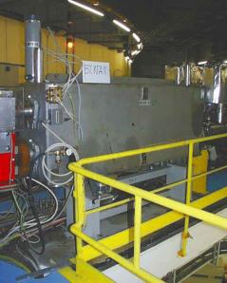
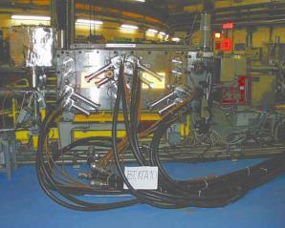
BT.KFA10 as installed
Layout for 1 transfer line
1 vacuum tank installed in ~1970.
4 magnets (2 per transfer line, 2 types) designed for 800 MeV beam deflection.
Glued ferrite C cores of 4L1 type (not optimum for fast kickers and vacuum performance).
No spare.
1 pulse generator per line supplying 2 magnets in parallel.
PFL voltage for 1.4GeV: ~43kV (at 2GeV: ~56kV)

Slide 5
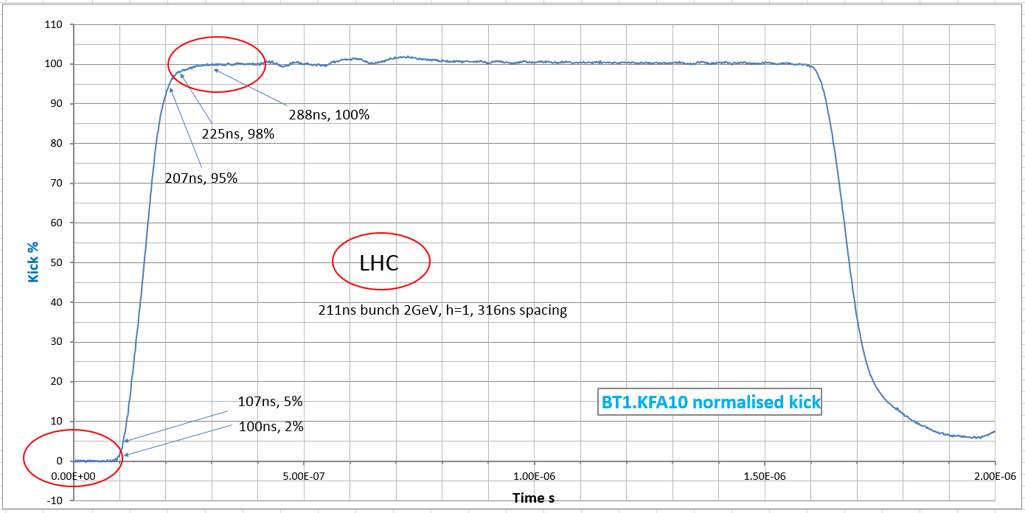
BT1.KFA10 kick (measured waveform at 50 kV)
Kick measurement in the PSB with a small inductive loop hidden in magnet ground conductor (unknown frequency response , probably not very good)
Kick rise time: |  |  | (5-95)% | 100ns
 |  |  | (2-98)% | 125ns
Scope: 100MHz BW, 13 bits vertical resolution
LIU:105ns
for LHC

Slide 6
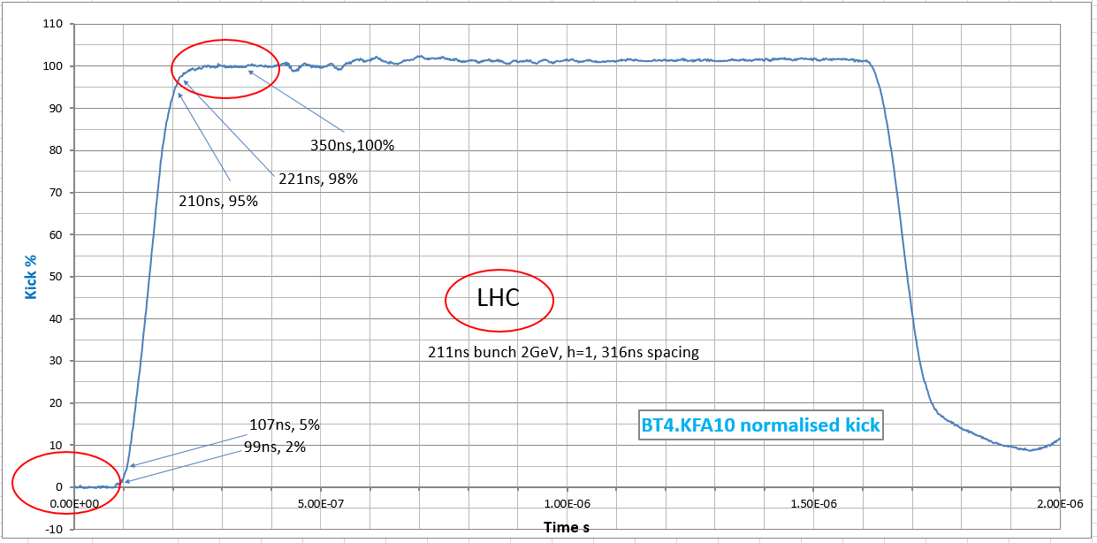
BT4.KFA10 kick (measured waveform at 50 kV)
Kick measurement in the PSB with a small inductive loop hidden in magnet ground conductor (unknown frequency response , probably not very good)
Kick rise time: |  |  | (5-95)% | 103ns
 |  |  | (2-98)% | 122ns
Scope: 100MHz BW, 13 bits vertical resolution
LIU:105ns
for LHC

Slide 7
BT2.KFA20 present system layout
One generator supplying two magnets in parallel.
Magnets equipped with CMD5005 ferrite blocks.
Magnets are charged with the PFLs up to 36.5 kV (breakdown limit is 37 kV)
LIU 2GeV requires 36.5kV.

Slide 8
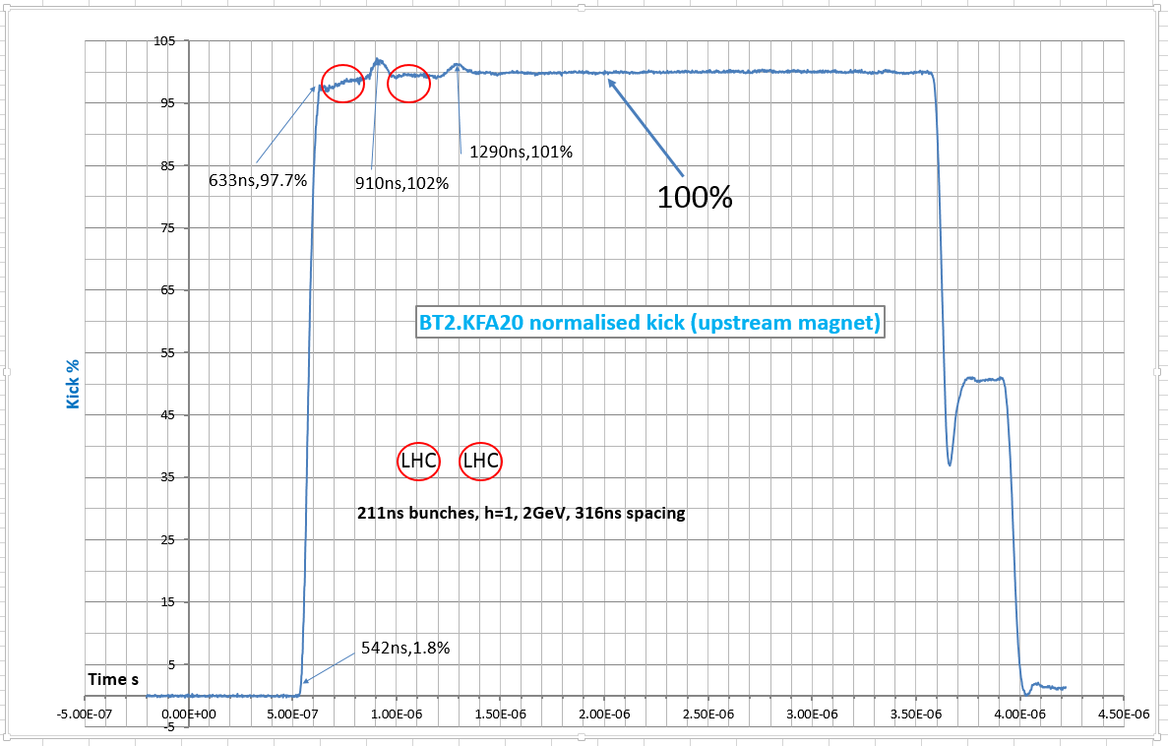
BT2.KFA20 kick (measured waveform at 27 kV)
Kick measurement in the PSB with a matched strip-line (Scope: 100MHz BW, 13 bits)
Kick rise time: |  |  | (5-95)% | 78ns
 |  |  | (2-98)% | ~94ns (LIU 105ns for LHC)
 |  |  | (1-99)% | 270ns

Slide 9
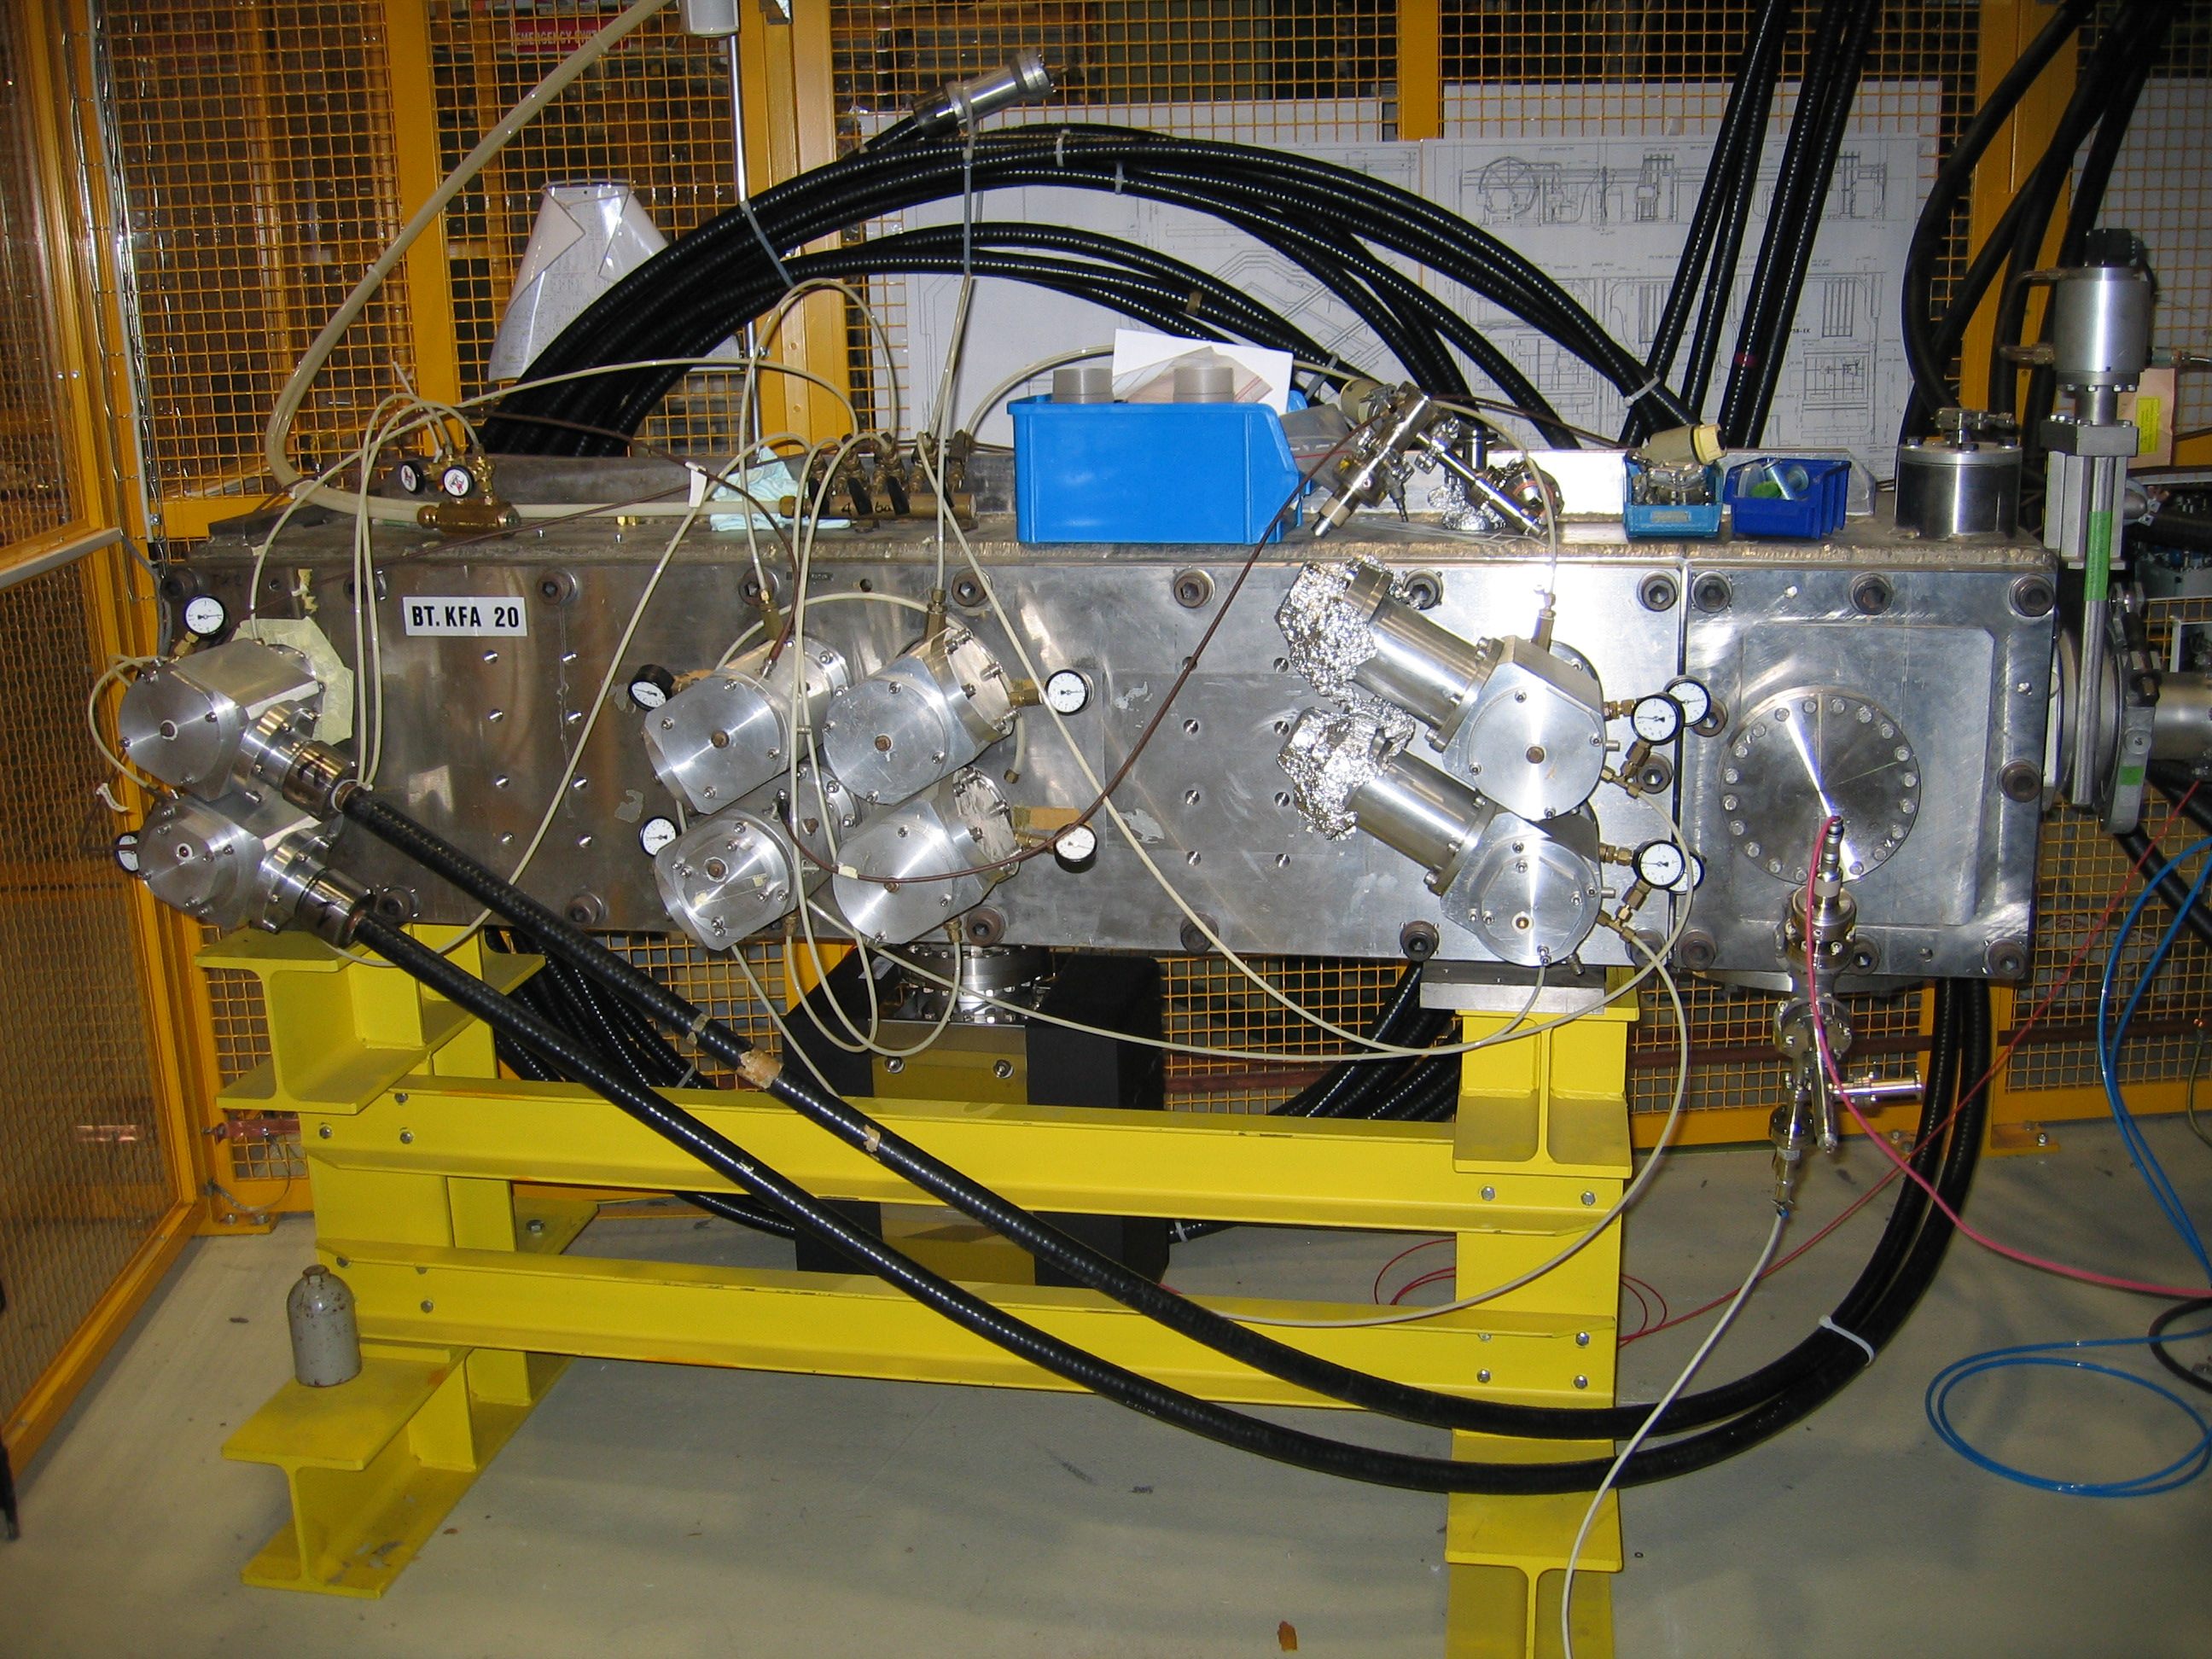
BT2.KFA20 spare tank in B867 SAL5 test cage.
BT.KFA10 test 1 system layout
First simple layout tested to check PSPICE model
Disconnected
One generator supplying only one magnet connected the same way as KFA10.
Two cables connected for 12.5Ω impedance.
Magnets equipped with CMD5005 ferrite type.
Filters disconnected.
PFL voltage: 56kV (required for 2GeV beam)
Magnet current: ~4500A (=thyratron current)

Slide 10
BT.KFA10 test 1 in B867: kick
Kick measurement with a matched strip-line (large bandwidth)
First peak 96.2%
100%
Pre-pulse ripple due to 2-gap thyratron switching
Normalised kick of 1 magnet. Measured with strip-line probe – Simulated with PSPICE (~1000 components). Discrepancy in the rise due (I think) to magnet conductor skin effect not modelled in PSPICE due to convergence problems.
Rise (2-96.2)%
Measured
~95ns
Calculated
~95ns

Slide 11
BT.KFA10 test 2 in B867: kick
First layout with added saturating inductor (July 2016)
Disconnected
One generator supplying only one magnet connected the same way as KFA10.
Two cables connected for 12.5Ω impedance.
Magnets equipped with CMD5005 ferrite type.
Filters disconnected. Saturating inductor at magnet input.
PFL voltage: 56kV (required for 2GeV beam)
Magnet current: ~4500A (=thyratron current)

Slide 12
BT.KFA10 test 2 in B867: kick
First peak 95.6%
100%
First peak 96.6%
Undershoot
92.3%
Pre-pulse ripple cancelled
Normalised kick of 1 magnet. Measured with strip-line probe – Simulated with PSPICE
Discrepancy in the rise due (I think) to magnet conductor skin effect not modelled in PSPICE + saturating inductor behaviour.
Rise (2-96.6)% (2-95.6)%
Calculated
97.6ns
Measured
~91ns

Slide 13
BT.KFA10 test 4 in B867: kick
First layout with added saturating inductor, magnet filters and MS cathode filter
Disconnected
One generator supplying only one magnet connected the same way as KFA10.
Two cables connected for 12.5Ω impedance.
Magnets equipped with CMD5005 ferrite type.
Filters added. Saturating inductor at magnet input.
PFL voltage: 56kV (required for 2GeV beam)
Magnet current: ~4500A (=thyratron current)

Slide 14
BT.KFA10 test 4 in B867: kick
First peak 102.5%
First peak 102.3%
100%
Undershoot
99.2%
Pre-pulse ripple cancelled
Normalised kick of 1 magnet. Measured with strip-line probe – Simulated with PSPICE
This is the best rise time we could achieve with a reasonable overshoot.
Rise (2-98)%
Calculated
90ns
Measured
~89ns

Slide 15
BT.KFA10 test 8 in B867: kick
Two magnets connected with saturating inductor and filters, MS cathode filter.
Disconnected
One generator supplying two magnets connected the same way as KFA10.
Four cables connected for 6.25Ω impedance.
Magnets equipped with CMD5005 ferrite type.
Filters added. Saturating inductor at magnet input.
PFL voltage: 56kV (required for 2GeV beam)
Magnet current: ~4500A (thyratron current: 9000A)

Slide 16
BT.KFA10 test 8 in B867: kick of upstream magnet
First peak 100%
Hole 91.5% due to thyratron inductance
First peak 98.4%
100%
Undershoot
97.8%
Pre-pulse ripple cancelled
Normalised kick of upstream magnet. Measured with strip-line probe – Simulated with PSPICE
The low system impedance increases the influence of the parasitic inductances, mainly the switch inductance.
Rise (2-98)%
Calculated
117ns
Measured
~107ns

Slide 17
BT.KFA10 test 7 in B867: kick
Two magnets connected with saturating inductor and filters, MS cathode&anode filters.
Disconnected
One generator supplying two magnets connected the same way as KFA10.
Four cables connected for 6.25Ω impedance.
Magnets equipped with CMD5005 ferrite type.
Filters added. Saturating inductor at magnet input.
PFL voltage: 56kV (required for 2GeV beam)
Magnet current: ~4500A (thyratron current: 9000A)

Slide 18
BT.KFA10 test 7 in B867: kick of upstream magnet
First peak 100%
Hole 94%
First peak 98.4%
100%
Pre-pulse ripple cancelled
Normalised kick of upstream magnet. Measured with strip-line probe – Simulated with PSPICE
Rise (2-98)%
Calculated
112ns
Measured
~111ns

Slide 19
BT.KFA10 test in B867: work to be continued
Present status:
Optimisation of kick rise time and flat-top not finished but it appears that the 105ns figure will not be met. 120ns seems to be more realistic to limit the ripple to ±2%. This value will confirm the BT.KFA10 measurements in the PSB.
Next step: add two filters to the main switch output.
Possible solution: add a second main switch to the generator in order to half the switch current and double the impedance of each branch.
The estimated cost is about 160kCHF per generator.
Another option: add a saturating inductor at the main switch output to help the thyratron switching. To be tested without guarantee. A gain of 5 to 10ns is expected but the ripple might increase.
Estimated cost: ~15kCHF per generator.

Slide 20
BT.KFA10 test in B867: work to be continued
Dual main switch configuration. This is also valid for BT2.KFA20.
Total additional cost would be ~480kCHF for the BT.KFAs.

Slide 21
PSB-LIU kicker roadmap update
The updated plans for PSB-LIU kickers are:
Measurements in the lab to be continued.
Quick decision to be taken to allow or not ~480kCHF to produce 3 new main switches.
- Production of a spare BT.KFA10 with CMD5005 ferrite blocks. Expected to be ready end 2017. Installation in the ring during LS2.
- Re-cabling of BT2.KFA20 in BT.KFA10 configuration to reduce the risk of magnet breakdown. This was not in the LIU PSB kickers initial plan (only an option).
(- Production of a spare BE.KFA14L1. Expected to be ready end 2017)

