Slide 1
CLIC module instrumentation
Module beam instrumentation
    BPM’s
    Wakefield monitors
    BLMs
    Acquisition system
Sector beam instrumentation
    Transverse profile monitors
    Current measurement
    Bunch form / length
    Beam phase

Slide 2
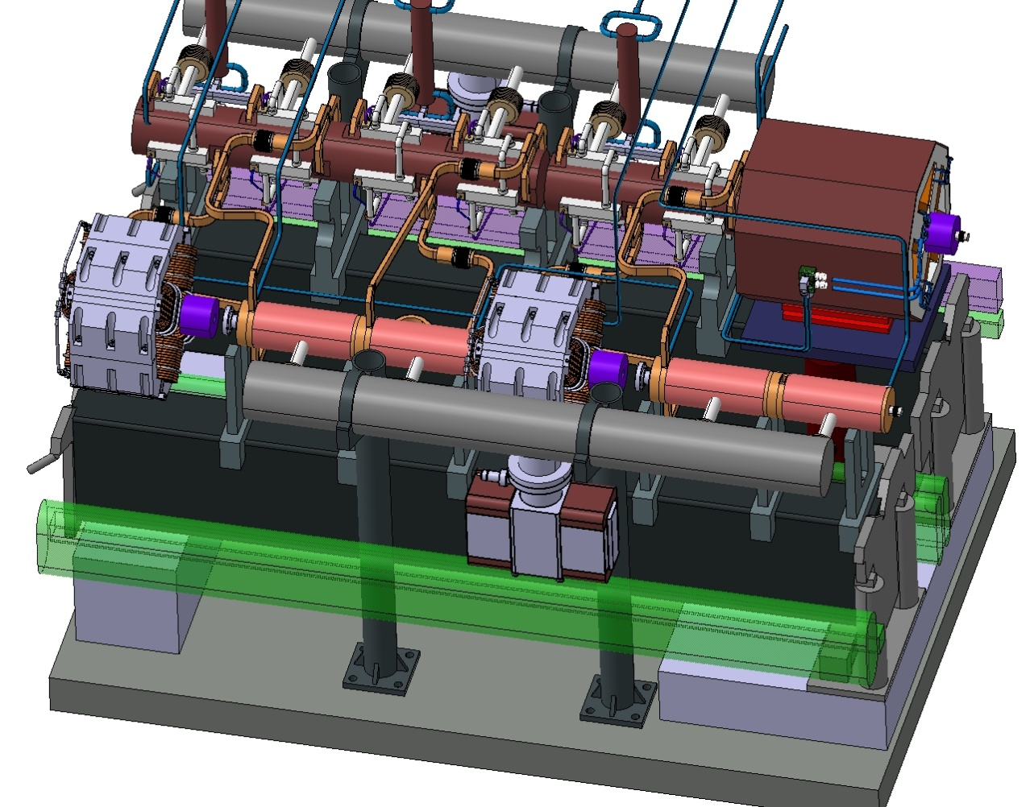
CLIC module, Type 1
Wake Field Monitors
MB-BPM
Main Beam
Beams
DB-BPM
Drive Beam
Hybrid
Other electronics
BLM
DB-BPM

Slide 3
BPM collaborations
 | Main beam BPM | Main beam BPM | Drive beam BPM | WFM | FE electronics
Institute | FNAL | RHUL | SLAC | CEA | LAPP
Contact | M. Wendt | G. Blair | S. Smith | F. Peauger | S. Vilalte
Deliverable | 3D design Cavity BPM Acq. system | 3D design Choke BPM, Lab tests Beam tests? | 1year at CERN. 3D design. Lab tests | Design, build and test in CTF3 | Design and test of standard acquisition module.
CERN | Mechanical design. Build 3 (4) proto types Lab tests | Mechanical design. Build proto type. | Mechanical design. Build 1 (3) proto types | ? | Write specifications Test in CTF3
MOU | Unofficial | Not yet | Yes | Yes | Not yet

Slide 4
BPM and WFM specifications
Main beam
Nominal beam parameters: Charges/bunch :3.7*10^{9 ,} Nb of Bunches: 312, Bunch length: 45µm-70µm, Train length: 156ns
 | Accuracy | Resolution | Stability | Range | Bandwidth | Beam tube aperture | Available length | Intercepting device? | How many? | Used in RT Feedback? | Machine protection Item? | Comments | Ref
BPM | 5µm | 50nm | 100nm |  | 35MHz | 8.0mm | 95/65mm | No | 4176 | Yes | Yes | Choke BPM? Inductive BPM | CLIC note 764
WFM | 5µm | <5µm | ? |  | 35MHz | 8.0mm? | "-" | No | 142812 | Yes | No | TM01~16GHz | CLIC note 764
Drive beam
Nominal beam parameters: Charges/bunch :5.2*10^{10 ,} Nb of Bunches: 2922, Bunch length: 1mm, Train length: 243.7ns
Accuracy | Resolution | Stability | Range | Bandwidth | Beam tube aperture | Available length | Intercepting device? | How many? | Used in RT Feedback? | Machine protection Item? | Comments | Ref
BPM | 20µm | 2µm | ? | <5mm | 35MHz | 23mm | 104/74mm | No | 41480 | Yes | Yes | Inductive ? Strip line ? | CLIC note 764

Slide 5
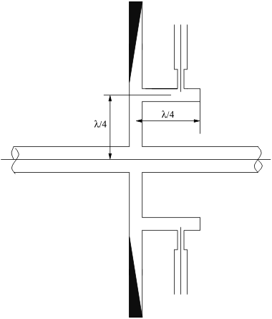
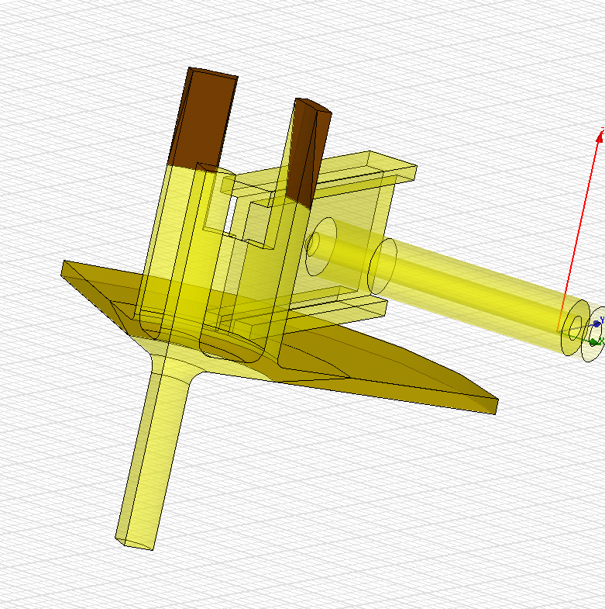
Main beam choke BPM
Developed by R. Fandos and I. Syrachev’s
Coaxial antenna pickup
Beam
Choke where the TM11 mode is trapped
RF design is made, but mechanical design still needs to be done. RHUL?.
Better than 50nm resolution with time resolution of 10ns.
Low wake field impedances.
Damping material, TM01
CLIC workshop 15-16 September 2009

Slide 6
Main beam BPM: FNAL
1
1
General idea:
- low Q-factors
- monopole modes decoupling
Cavity spectrum calculations:
- Frequency
- R/Q, Q
- TM11 output voltage
Cavity BPM design steps
1
BPM parameters:
- Cavity length
- Waveguide dimensions
- Coupling slot
- Coaxial transition
1
3. Parasitic signals:
- monopole modes
- quadruple modes
4. Cross coupling:
- waveguide tuning
- 2 ports vs 4 ports
loop
loop
5. Tolerances calculation:
- coupling slots
  waveguide to cavity
- cavity to pipe
1
Courtesy A. Lunin
CLIC workshop 15-16 September 2009

Slide 7
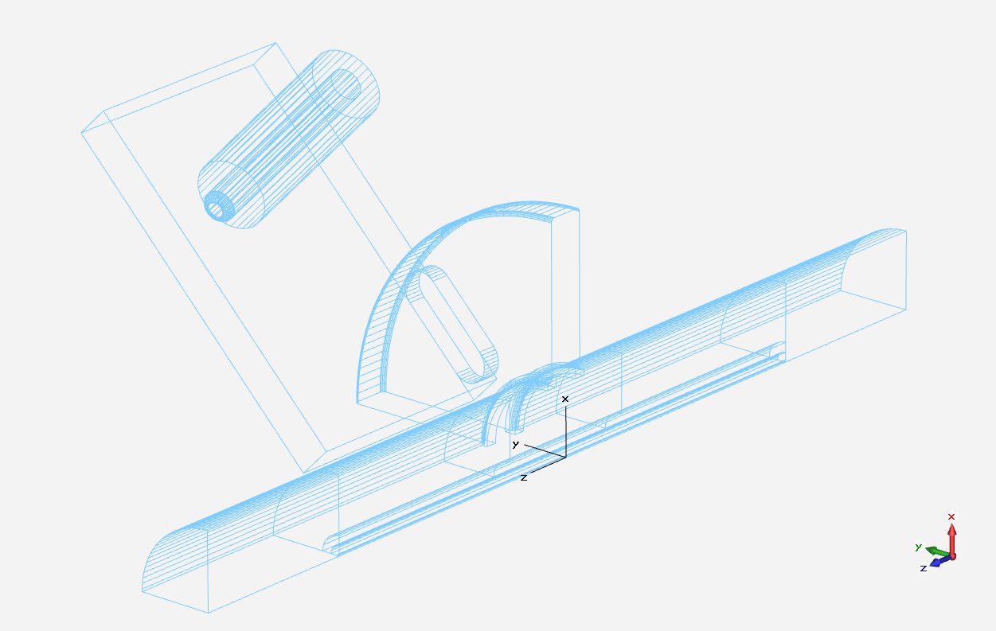
Main beam BPM: FNAL
2
14
BPM Geometrical Dimensions
2
R12.05
R4
7
1
20
25
Courtesy A. Lunin
CLIC workshop 15-16 September 2009

Slide 8
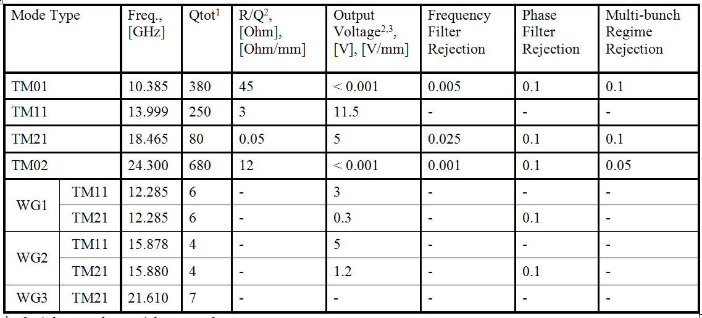
Main beam BPM: FNAL
Cavity BPM spectrum calculation
¹ - Stainless steel material was used
² - Dipole and quadruple modes values were normalized to 1mm off axis shift
³ - Signals are from a single coaxial output at resonance frequency.
Courtesy A. Lunin
CLIC workshop 15-16 September 2009

Slide 9
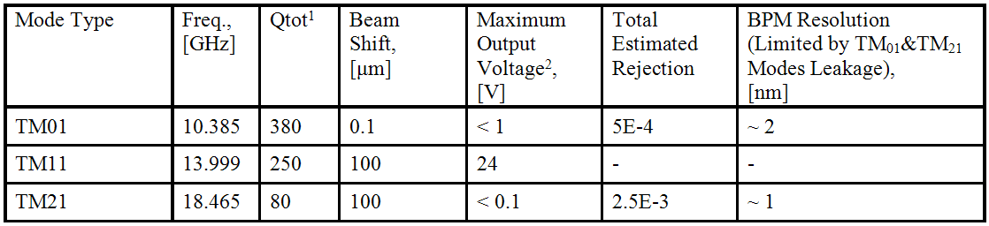
Main beam BPM: FNAL
The sum of TM₁₁, TM₀₁, TM₂₁ output voltages
100 μm off-axis
beam shift
Vout, [V]
Multi-bunch Regime
Multi-bunch Regime
0.1 μm off-axis
beam shift
Vout, [V]
Time, [s]
¹ - Stainless steel material was used
² - Sum of the signals from two opposite coaxial outputs at resonance frequency.
Courtesy A. Lunin
CLIC workshop 15-16 September 2009

Slide 10
FNAL Low-Q cavity BPM
Main beam BPM
Developed by A Lunin
Wake field calculations coming within a few weeks
M. Wendt and A. Lunin will come to CERN beginning of November
FNAL will also develop acquisition system
Beam tests to be discussed in November
Fabrication drawing costs and production to be covered by CERN.
Four proto types to be build
Choke BPM
Developed by Raquel and Igor
Possible collaboration with RHUL to build proto type

Slide 11
Main beam BPM
The main beam BPMs are mounted before the quadrupoles and on the same vibration damped support as the quadrupoles. They are fixed to the quadrupole and cannot be aligned separately, and must be connected to the Wire Position System. The BPM should include a connection to the quadrupole chamber (different length according to module type), and a bellow at the other end, for inter module connection.
WPS
Is WPS necessary on BPM?
Rigid connection. Study vibration resonances, < 50nm.
Beam in BPM center. Offset varying (50Hz) and must be read back and corrected for. Study vibration resonances, bellow.
Quad
BPM
Beam
Base line scenario
Bellow
Stabilization
Displacement
WPS
Quad
Beam in BPM center?. If NO, real beam position and NO BPM displacement.
Space on girder?
BPM
Beam
Alternative scenario
Bellow
Stab.
Displ.??
Stabilization
Displacement

Slide 12
Drive beam BPM
The drive beam quadrupole and BPM are mounted on the drive beam girders. BPMs cannot be moved independently of the PETS, the quadrupoles will either be on movers, or equipped with dipole corrector coils. The BPMs are mounted before quadrupoles. The acceptable level of wake field needs to be determined.
WPS
Quad
Base line scenario
BPM
Drive beam BPM studies will start January 2010!
CLIC workshop 15-16 September 2009

Slide 13
Wakefield Monitors (1/2)
One WFM per accelerating structure needed (up to 8 per girder), the mean of the WFM’s on one girder computed
Main specifications:
- Accuracy : 5µm
- Resolution: 5 µm
- Single bunch to long train operation
- No available length WFM integrated in the structure
Courtesy F. Peauger
The four damping waveguides of the middle cell are used to measure the beam position inside the accelerating structures
R&D phase development plan:
1) Detailed design of WFM and procurement of a prototype for integration in a CERN accelerating structure and test on the Two Beam Test Stand with CALIFES probe beam (2009 – 2010)
2) Design and procurement of complete accelerating structures including WFM (2010)
CLIC workshop 15-16 September 2009

Slide 14
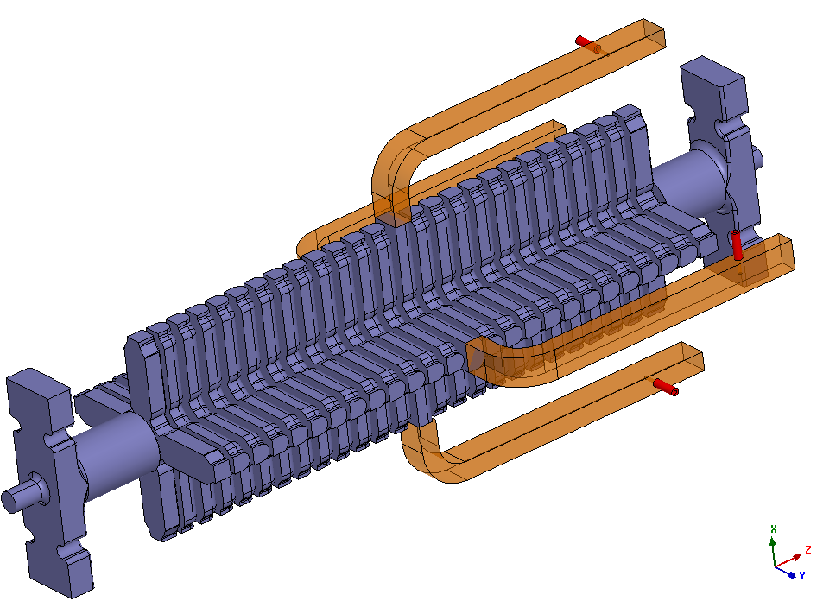
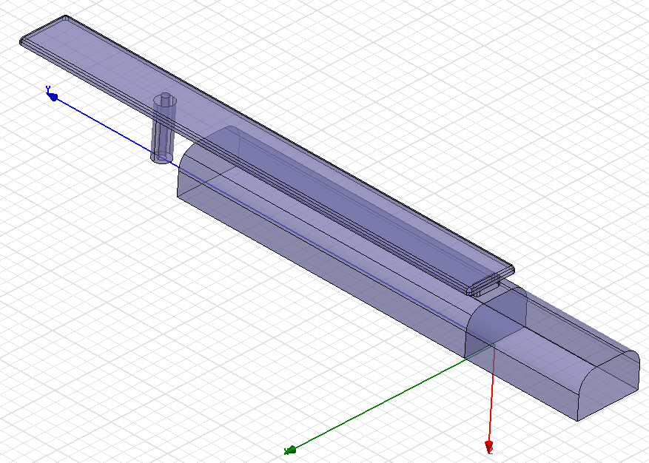
Wakefield Monitors (2/2)
Design:
Mode: Baseline = TM11 at ~18 GHz, alternative = TE11 at 23 GHz
Transition: several design under study, must attenuate fundamental to ~160 dB
RESONATING WFM
LONG DAMPING WAVEGUIDE
compact
tuneable
parasitic modes reflected to the cell
- no additionnal machining of the disks
wideband
may be difficult to integrate in the module
!! needs support and additional time to converge to a solution
Opposite port recombination by external 180° hybrid coupler (only if TM11 used)
Electronic not studied -> needs maybe additional ressources
Courtesy F. Peauger
CLIC workshop 15-16 September 2009

Slide 15
BLM schedule
1
Loss locations in standard operation
  MPWG; Jean Bernard Jeanneret ? + Barbara Holzer ?
Nov ’09
2a
  List ‘all’ failure scenarios and identify most critical ones
  MPWG; Jean Bernard Jeanneret + Michel Jonker
Nov ‘09
2b
Simulation of the 2-3 most critical ones
  MPWG; Daniel Schulte (team)‏
Q2 ‘10
3a
Limiting equipment for loss (standard and failure)‏
  MPWG (determine limiting condition); Daniel Schulte (team), equipments experts
Q4 ‘09
3b
Limits for steady state beam loss (radiation)‏
  MPWG; Thomas Otto
Q2 ‘10
3c
  Simplified (geometry) model simulations (particle showers) of the 2-3 most critical failure scenarios
  BLM; Mariusz Sapinski
(SCR: Sophie Mallows -FLUKA)‏
Q3 ‘10
4a
  Choice of measurable (BLM, BPM, etc); establish required SIL (damage protection and availability) levels, estimate SIL levels of various protection systems, determine redundant systems when needed.
  MPWG; ??
  for BLM: Mariusz Sapinski
Q1 ‘10
4b, 4c
Choice of BLM system; simulations for the most critical loss scenarios and estimation of monitor response (accuracy ~ factor 10)‏
  BLM; Mariusz Sapinski
Q3 ‘10
Courtesy B. Holzer
CLIC workshop 15-16 September 2009

Slide 16
Additional CLIC BLM tasks
BLM system specs for fiber studies (Liverpool collaborators)‏
Nov‘09
Investigate existing solutions for the CLIC components; document cost and number of monitors; identify costly and tech. difficult parts
Jan ‘10
Investigate and document the radiation sources in tunnel (other than beam loss)‏
Nov‘09
Investigate and document loss locations in standard operation (item 1)‏
Nov09
Prepare list of questions for failure scenarios (item 2)‏
Oct ‘09
Investigate and document limiting equipment for loss (item 3a)‏
Nov‘09
Collection of requirements for BLM system from BD group
Q1 ‘10
Functional specs
Q4 ‘10
Cost estimate
Q4 ‘10
Courtesy B. Holzer
CLIC workshop 15-16 September 2009

Slide 17
Module acquisition systems
BLM
WFM* 8
BPM
Main Beam
Drive Beam
BPM
BPM
BLM
Very close < 1m
Hybrid
Hybrid
Hybrid
Hybrid’s
Very radiation hard
Tunnel
Below girder, shielded
radiation hard electronics,
Analogue FE
Analogue FE
Analogue FE
Analogue FE
< 35G/Y
Digital FE
Data link
HV
Digital FE
220V or DC
Power
High Voltage
UTR
400m max.
Data treatment
RF reference
Analogue FE
= Down converters, Signal conditioning, Calibration units
OBS: Only 4 cables per module
But could be further reduced!
Digital FE
= Digitizers and control

Slide 18
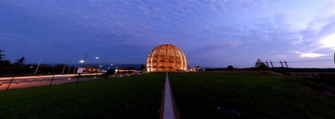



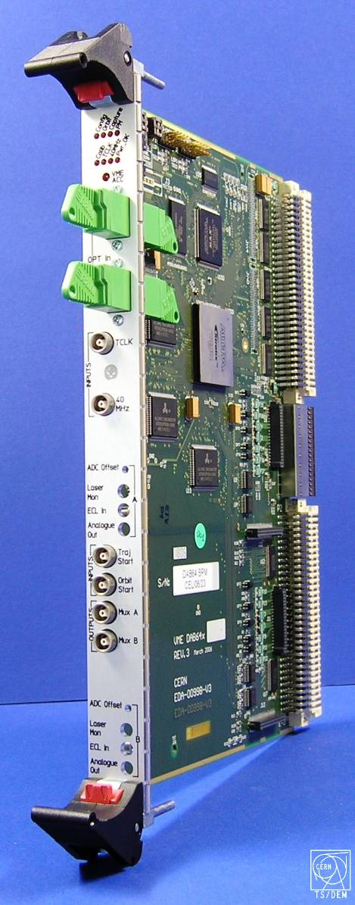
Numbers of devices
CLIC
Electronic Standardisation
  Single type of digital electronics acquisition card used for the majority of LHC instruments
    Disadvantages
      Needs from many users have to be assimilated
      Design more complicated
      Small changes affect many systems
    Advantages
      More efficient & cheaper production runs
      Faults easier to find as many users test a single product
      Software development much faster
R. Jones

Slide 19
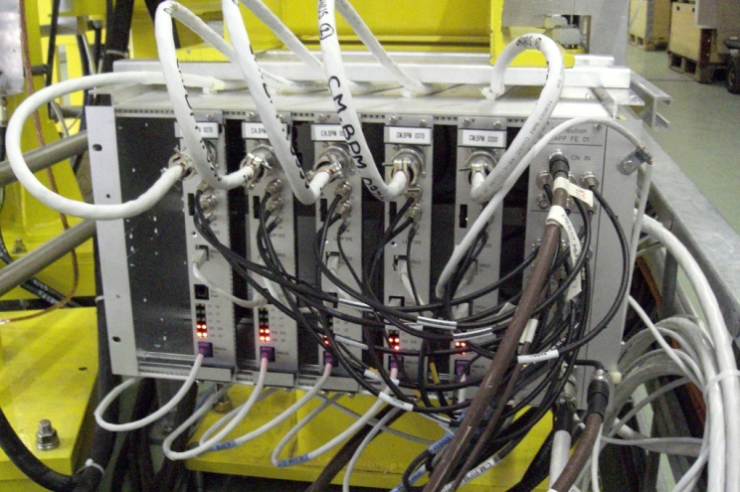

LAPP BPM Read-out electronics
CLIC
From CTF3 – to the development of a larger infrastructure as for CLIC
Rare acces from surface, high number of channels, rad-hard, low-cost, low consumption, Standartisation…
Most important points to develop: elimination of cables
  Power supplies: autonomous (220V sector, DC-DC converters…).
  Local calibration
  Network : flexible data collection, repetition crates…
  Acquisition architecture: faster ADC, direct bpm read-out, continuous sampling…
  FPGA processing: raw data, processed data…
  Radiation hardness ?
  Timing/clock and connection via synchronous ethernet (White Rabbit)
Prototype in 2010 to be tested in CTF3 for radiation hardness
Specifications to be written by CERN
(channel per girder, ADC’s Bandwidth,…)
S. Vilalte, J. Jacquemier, Y. Karyotakis, J. Nappa, P. Poulier, J. Tassan

Slide 20
Specifications of sector instruments
Main beam
 | Accuracy | Resolution | Bandwidth | Beam tube aperture | Stability | Non-intercepting device? | How many? | Used in RT Feedback? | Machine protection Item ? | Comments | Ref
Intensity | 0.1% |  |  |  |  |  | 48 | No | Yes
Beam Size / Emittance | 10% | 2% |  |  |  | yes | 48 | No | No
Energy | 0.10% |  |  |  |  | yes | 48 | Yes
Energy Spread |  |  |  |  |  |  |  | ?
Bunch Length |  |  |  |  |  |  | 48 |  |  | single shot
Beam Phase |  | 0.1° |  |  |  |  | 48 | Yes | No
Drive beam
 | Accuracy | Resolution | Range | Bandwidth | Beam tube aperture | Stability | Non-intercepting device? | How many? | Used in RT Feedback? | Machine protection Item ? | Comments | Ref
Intensity | 0.1% |  |  | 20MHz | 23mm |  | Yes | 48 | No | Yes
Intensity | 1% |  |  | 20MHZ | 23mm |  | Yes | ~864 | No | Yes | Still Valid?
Beam Size / Emittance | 50um |  |  |  | 23mm |  | No | 288 | No | No
Energy | 10um |  | 10mm | 12GHz | ? |  |  | 48 | No | No
Energy Spread |  |  |  |  | ?
Bunch Length | 1% |  |  |  | 23mm |  |  | 24 | No | No | single shot
Beam Phase |  |  |  |  | 23mm |  |  | 96

Slide 21
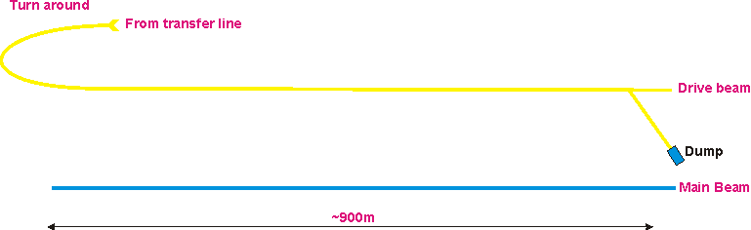
Sector instrumentation
8m
Transverse profile monitors, L~300mm
Fast (12GHz) BPM, L~100mm, Energy
Form factor, Fast bunch shape measurement,L~500mm
Slow current measurement, L~150mm, 1%
Slow current measurement, L~150mm, 0.1%
Beam Phase
Segmented dump, Energy

Slide 22
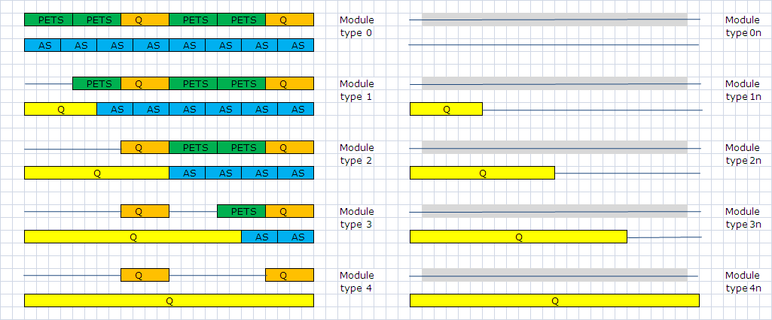
Module types
8374
154
634
477
731
78
0?
4
5
5
298mm
Use “empty” space for “sector” beam instrumentation
~4 type “xn” per sector at extraction
Module length: 2.010 m

Slide 23
Summery
Dedicated studies and designs of main beam BPM’s and WFM ‘s are well advanced.
Drive beam BPM studies will start as from 1st of January.
BLM design schedule well established
A digital standard FE will be developed by LAPP and will significantly reduce the cable costs.
Space must be foreseen for electronics on the module and in a radiation shielded location within a few meters, i.e. in the floor.
Dive beam SECTOR instruments should be designed for type 1-4 modules.
Main beam SECTOR instruments can only be foreseen close to extraction region on module types 0n-3n.

