Slide 1
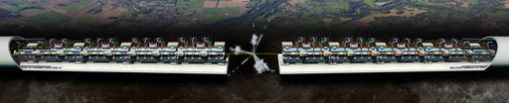
CLIC Module &
IMPACT of PACMAN on its alignment
CLIC module introduction
Status and results
Possible PACMAN impact

Slide 2
CLIC Layout at 3 TeV
Drive Beam Generation Complex
Main Beam Generation Complex

Slide 3
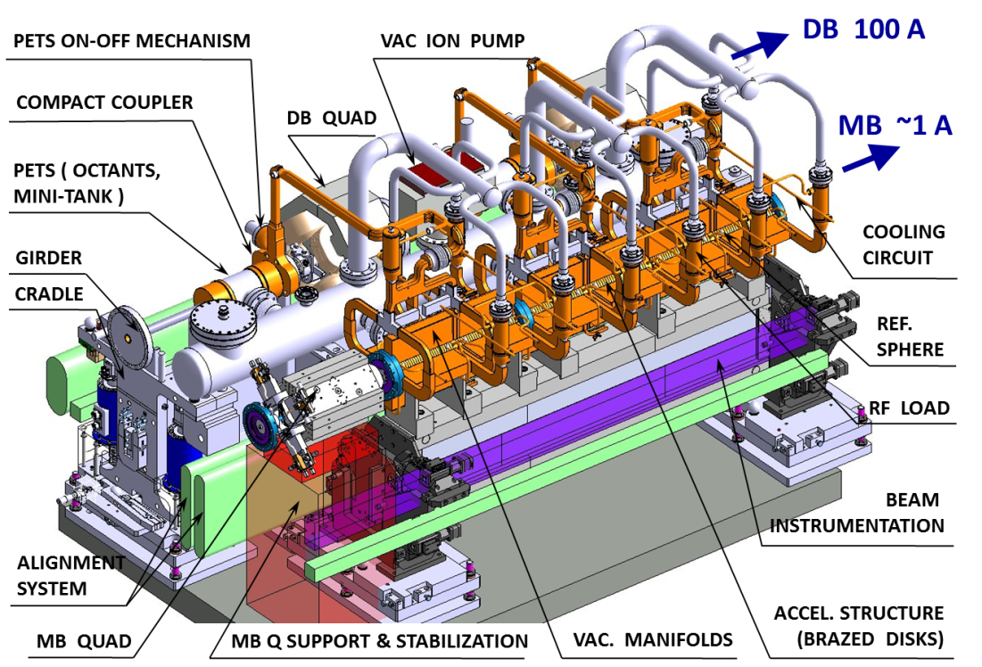
Two-beam module layout
CLIC at 500 GeV (4232 modules)
26920 Accelerating structures
13460 PETS
~ 70000 RF components
CLIC at 3 TeV (21460 modules)
142760 Accelerating structures
71380 PETS
~ 400000 RF components

Slide 4
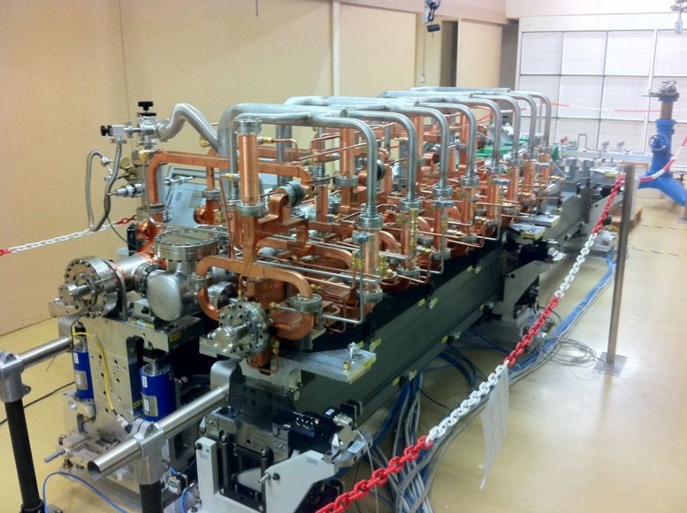
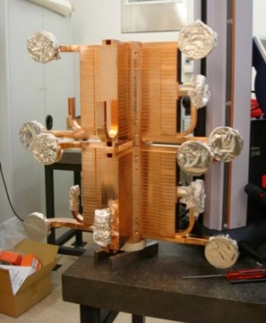
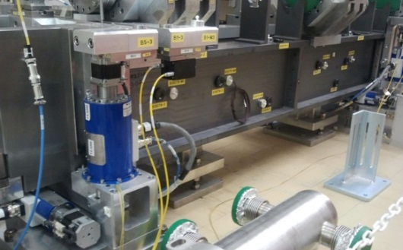
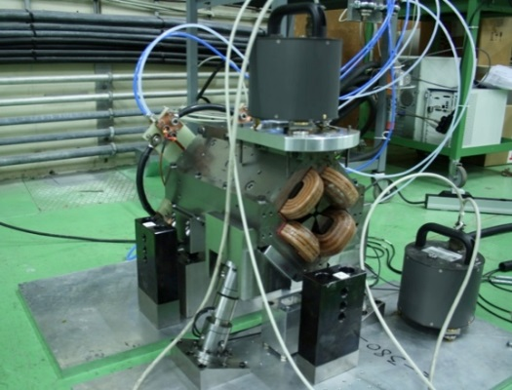
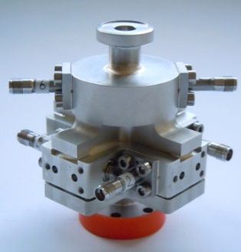
Two-Beam Modules

Slide 5
Main Module Requirements
SYSTEM | REQUIREMENTS
RF | AS/PETS shape tolerance ± 2.5/ ±7.5 µm AS/PETS Assembly ± 15/ ± 25 µm RF phase stability, HOM damping, Wakefield monitors
INSTRUMENTATION | BPM resolution: MB - 50 nm, DB – 2 µm
SUPPORTING | Max. vertical & lateral deformation of the girders is ~ 10 μm Capability for beam based alignment corrections
COOLING | ~400 W per AS, ~ 7.5 kW per modules, max ΔT= 10 deg per SAS
MAGNET & POWERING | DB: 81.2-8.12 T/m, current density: 4.8 A/mm2, MB: 200 T/m
PRE-ALIGNMENT & STABILIZATION | active pre-alignment ± 14 µm at 1σ, beam axis included in a cylinder of radius 10 µm MB Q stabilization 1 nm > 1 Hz (vertical)
VACUUM | 10⁻⁹ mbar to avoid stabilities
ASSEMBLY, TRANSPORT, INSTALLATION | Preserve alignment and tolerances
Module design and integration coping with challenging requirements
from different technical systems.

Slide 6
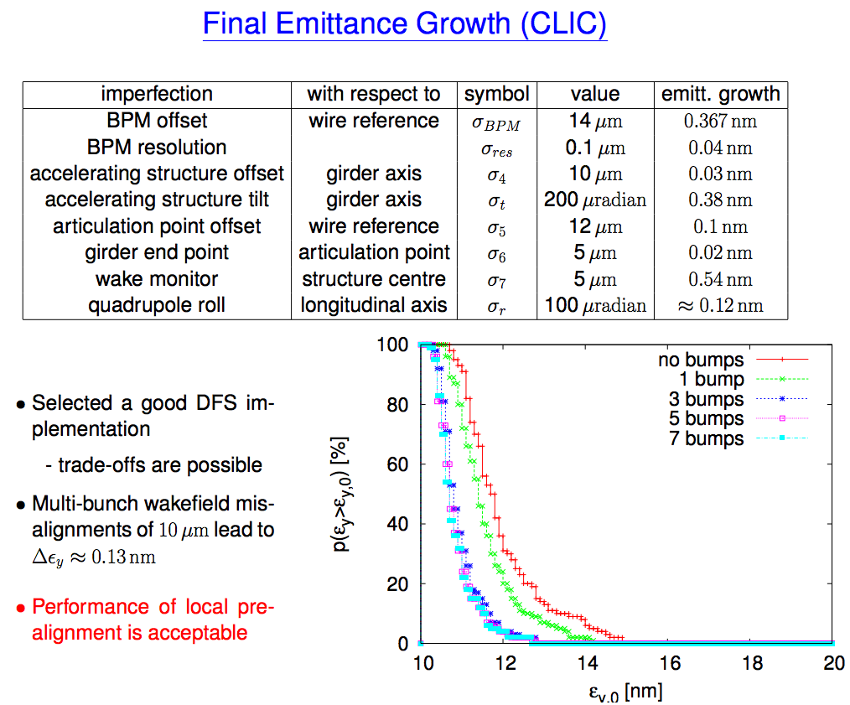

Slide 7
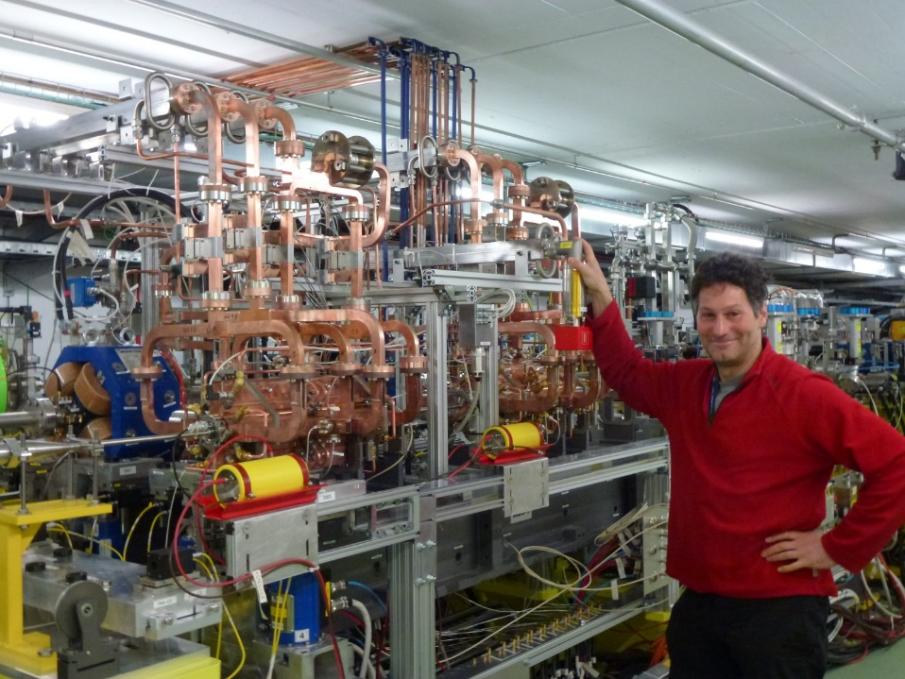
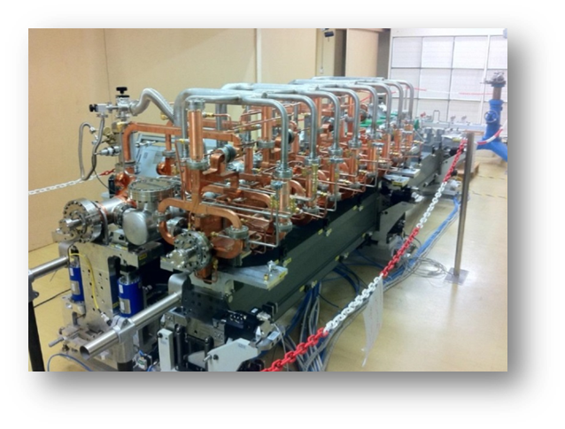
CLIC Module R&D
CLIC mechanical test modules with mock up components in a dedicated Lab for thermo-mechanical, alignment and integration testing.
CLIC prototype Module with real RF components installed in CTF3 and tested with drive and probe beam
A
B

Slide 8
CLIC project: alignment strategy
Beam off
Mechanical pre-alignment
~0.2 - 0.3 mm over 200 m
Active pre-alignment
14 - 17 µm over 200 m
Beam on
Beam based Alignment & Beam based feedbacks
One to one
steering
Dispersion Free
Steering
Minimization of
AS offsets
Make the beam
pass through
Optimize the position of
BPM & quads by varying
the beam energy
Using wakefield
monitors &
girders actuators
Minimization of the emittance growth

Slide 9
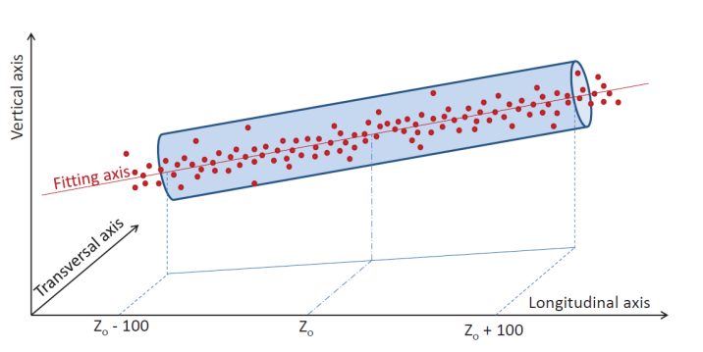
Pre-alignment strategy
The zero of each component will be included in a cylinder with a radius of a few microns:
  14 µm (RF structures & MB quad BPM)
  17 µm (MB quad)
  20 µm (DB quad)
Budget of alignment errors
Steps | AS | MB quad | Achieved
Zero of components to fiducials | 5 µm | 10 µm | ????
Fiducials to sensor interface on support | 5 µm | 5 µm | Yes
Sensor interface on support | 5 µm | 5 µm | Yes
Sensor measurement w.r.t straight reference | 5 µm | 5 µm | Yes
Stability knowledge of the straight reference | 10 µm | 10 µm | Yes, on short range
Total error budget | 14 µm | 17 µm
The combination of the 3 first steps is the object of PACMAN

Slide 10
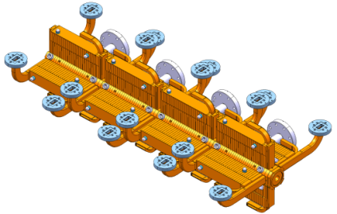
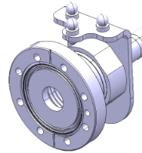
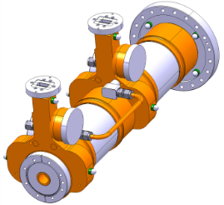
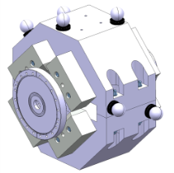
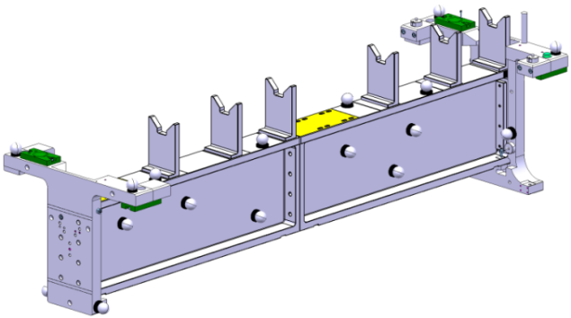
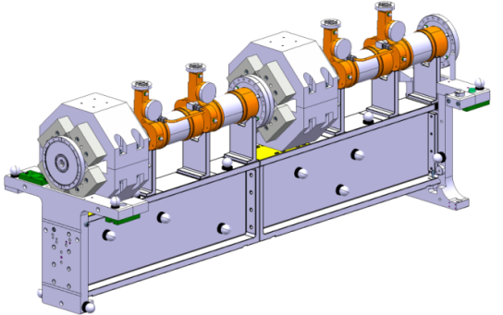
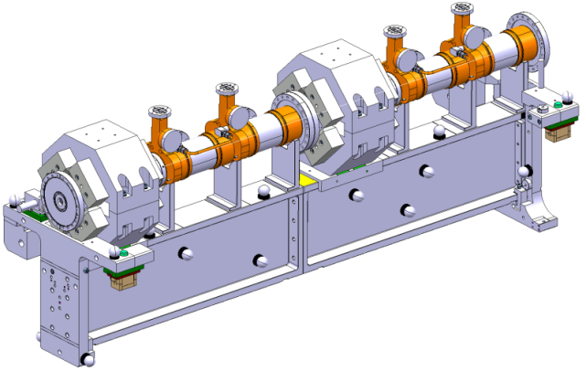
Pre-alignment strategy
Fiducialisation of components
Fiducialisation of their common support
Alignment on a common support
Whole assembly ready to be aligned

Slide 11
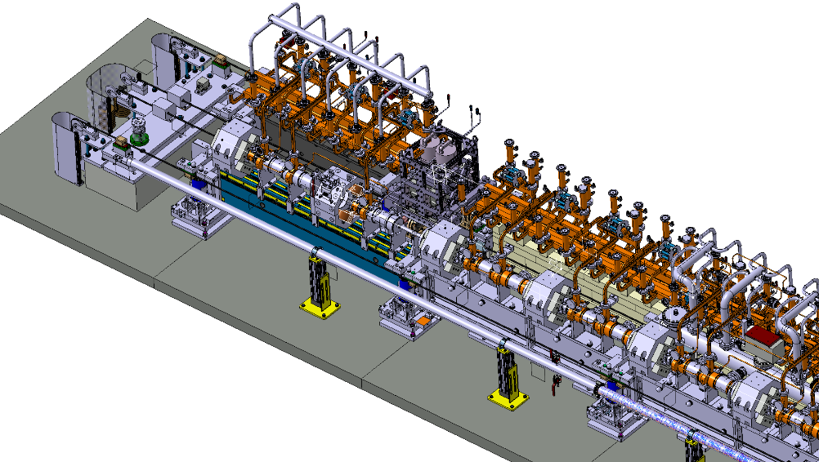

Pre-alignment in the tunnel
Active alignment
Articulation point
Link girder/cradle
Independent linacs
Actuators
Sensors
Pre-align/inverse-align

Slide 12
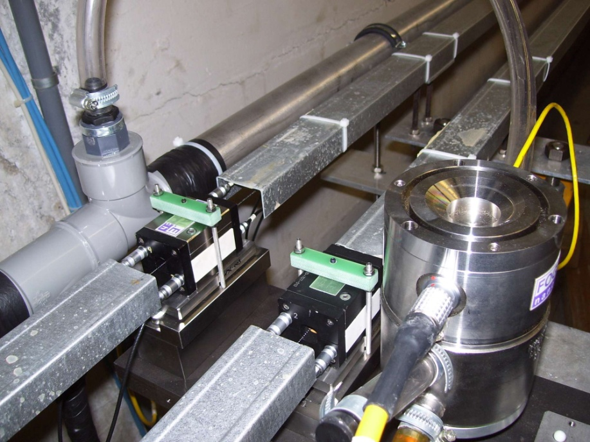

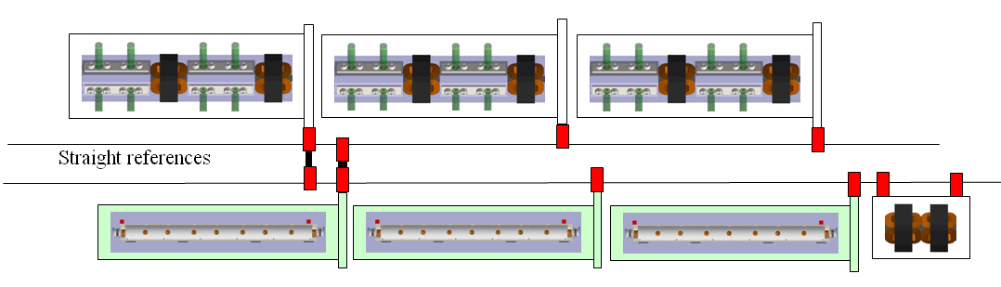
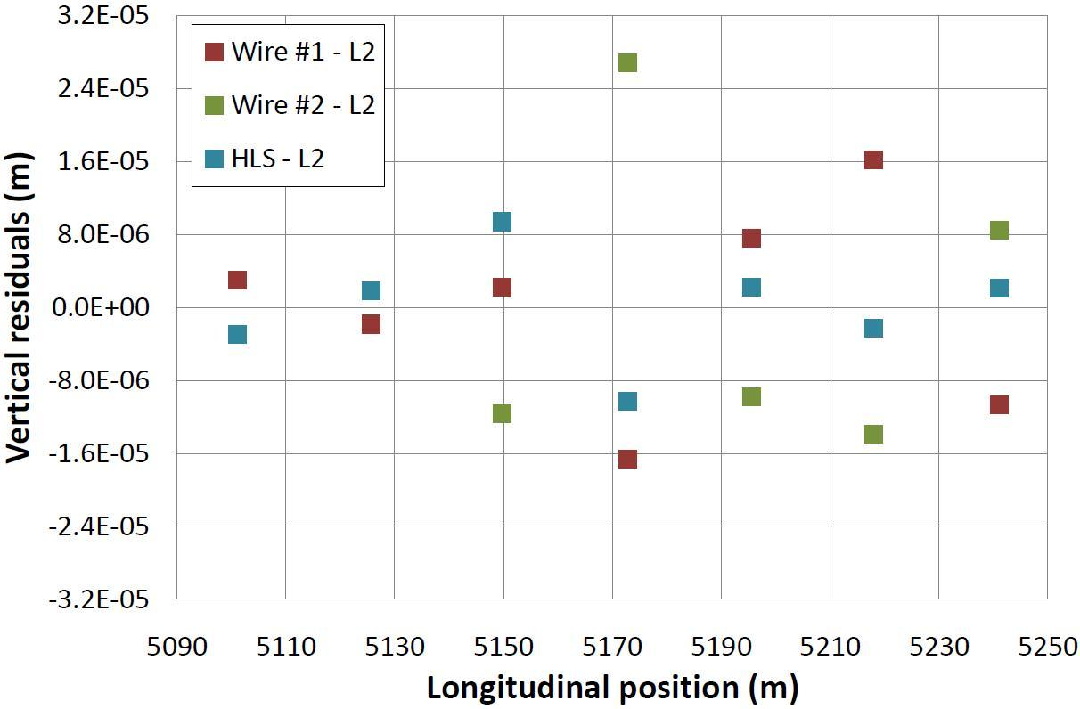
CLIC Pre-alignment System
Required accuracy of reference points is 10μm
Test of prototype shows
  vertical RMS error of 11μm
  i.e. accuracy is approx.13.5μm
Improvement path identified
PACMAN Project - H. Durand

Slide 13
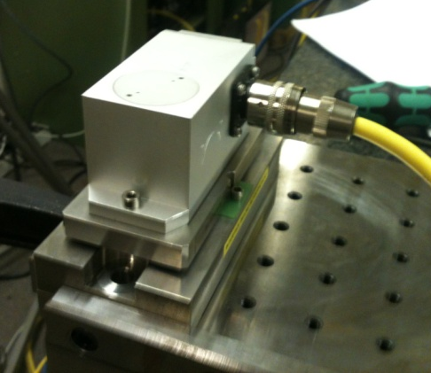
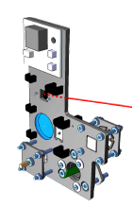
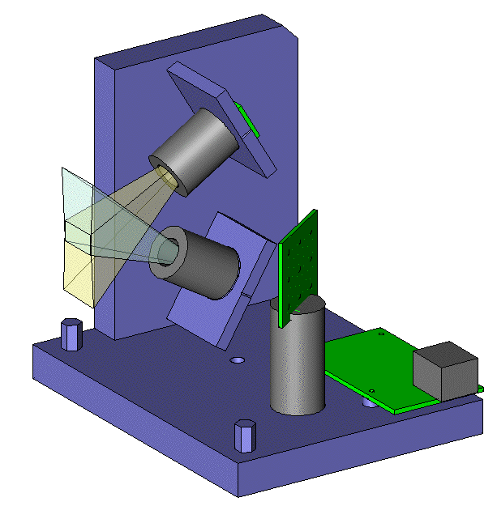
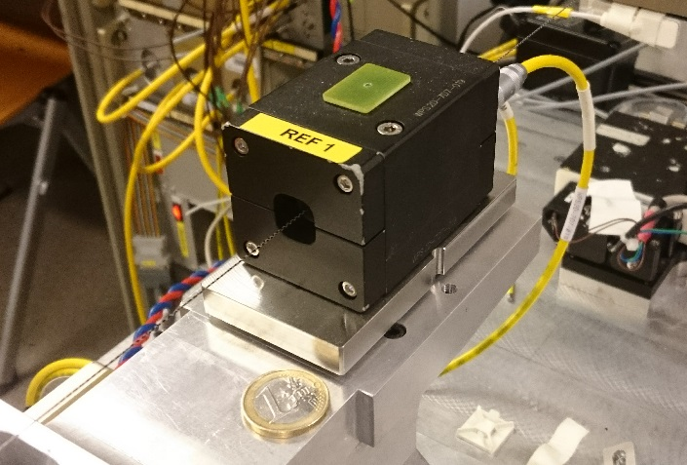
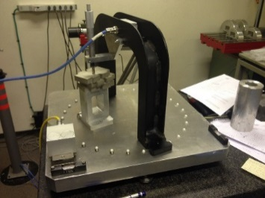
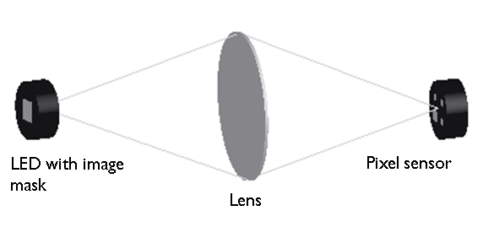
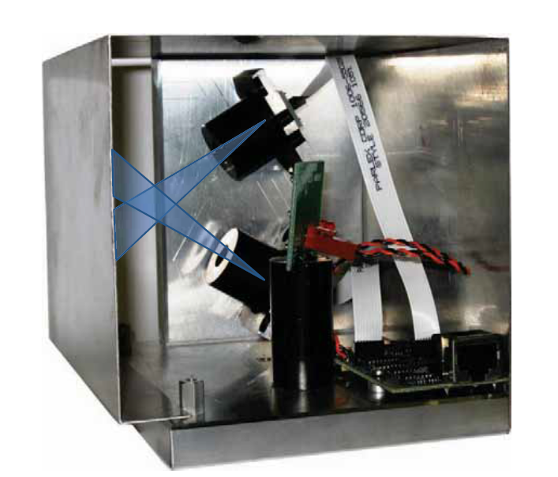
Pre-alignment in the tunnel
Sensors
Study of different configurations
Inter-comparison between sensors
Tilt-meter
RasChain
Study of the supporting solutions
Range : +/- 15 mrad
Repeatability system: +/- 5 μrad
Linearity : ~ 2 μrad / mrad
Resolution : < 1 μrad
System 3 points
Range : +/- 10 mm
Repeatability: under tests
Resolution : under tests
cWPS
(capacitve Wire Positioning System)
oWPS
(optical Wire Positioning System)
Range : +/- 5 mm
Repeatability: +/- 1 μm
Linearity : ~ 2 μm/mm
Accuracy : 5 μm
Resolution : < 1 μm
RAD-HARD
Range : +/- 15 mm
Repeatability: +/- 1 μm
Linearity : ~ 3 μm/mm
Accuracy : ~ 10 μm
Resolution : < 1 μm
Absolute Tilt-meter
Fil
Beam OFF
Beam ON
LAB (2011 – 2013) : 2 cWPS + 2oWPS + 1 Relative Tilt meter (without beam)
LAB (2013 – 2014) : 2 cWPS + 2 Nikhef sensors + 1 Relative Tilt meter (without beam)
CLEX (2014-2015) : 4 cWPS (With Beam)
LAB (2015) : 2 cWPS + 2oWPS + 1 Absolute Tilt meter (without beam) FUTURE

Slide 14
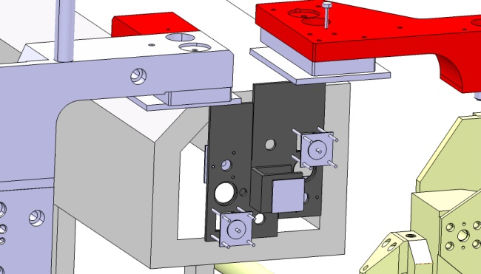
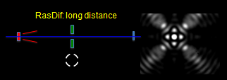
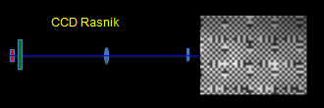
Alternative alignment sensor development
  2 main systems developed by NIKHEF
RasDif
RasNik
Development of sensors
Qualification (@ NIKHEF)
Integration in 3D models
Installation & analysis of data
Length between girders not the same
Use of oWPS interface
Choice of the components
Software, preparation of database
Influence of T°
Necessity of thermal shielding
Exchange of 3D models
Longitudinal position of cradles not good
Interferences with other systems
One cradle with problem

Slide 15
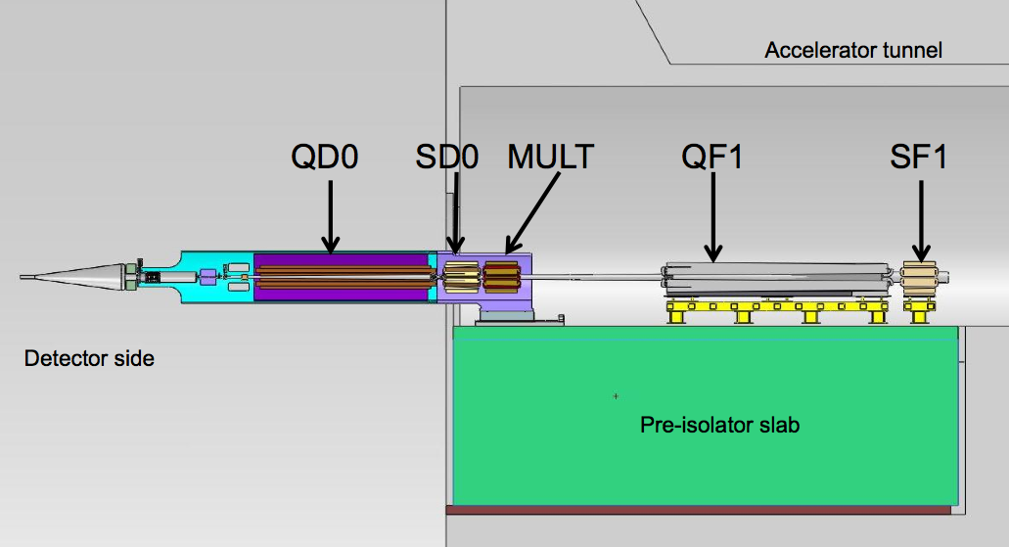
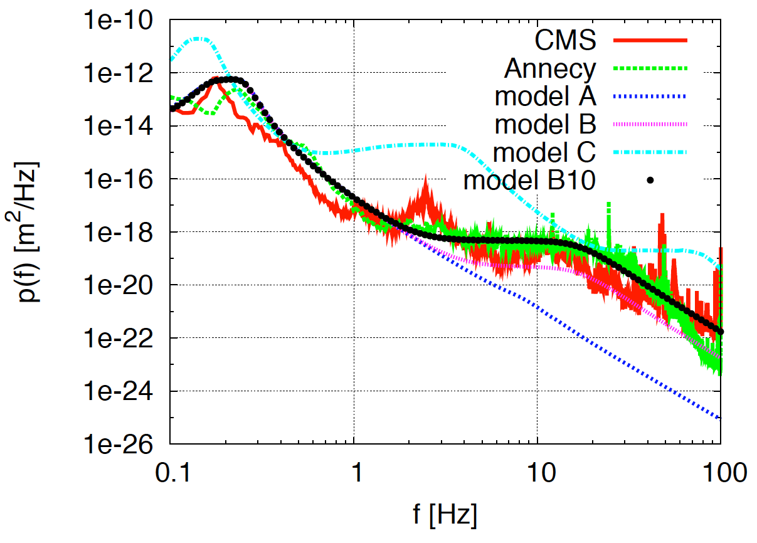
Ground Motion and its Mitigation
Natural ground motion can impact the luminosity
typical quadrupole jitter tolerance O(1nm) in main linac and O(0.1nm) in final doublet

Slide 16
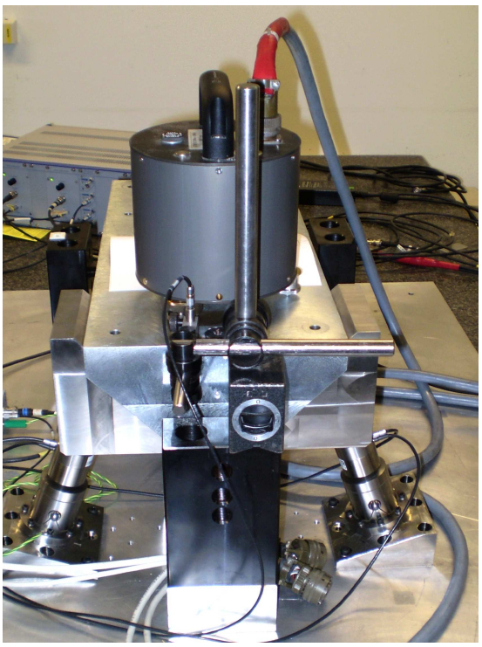
Active Stabilization Results
Luminosity achieved/lost [%]
 | B10
No stab. | 53%/68%
Current stab. | 108%/13%
Future stab. | 118%/3%
Code
Machine model
Beam-based feedback

Slide 17

First CLIC prototype module completely installed in CLEX
Fully equipped module including superstructures with SiC damping,
rf distribution, active alignment system, BPM’s and Quads

Slide 18
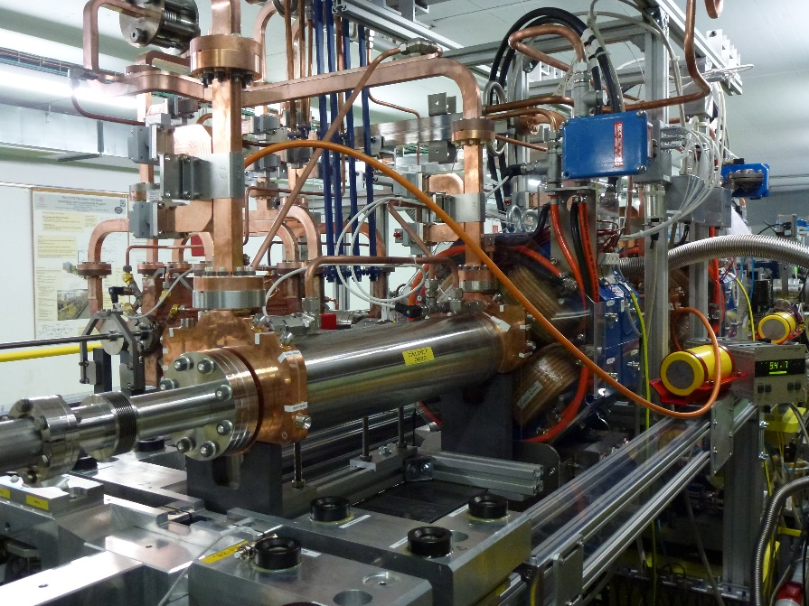
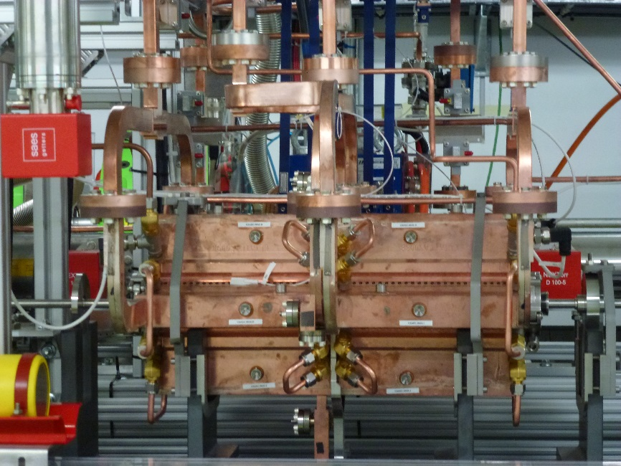
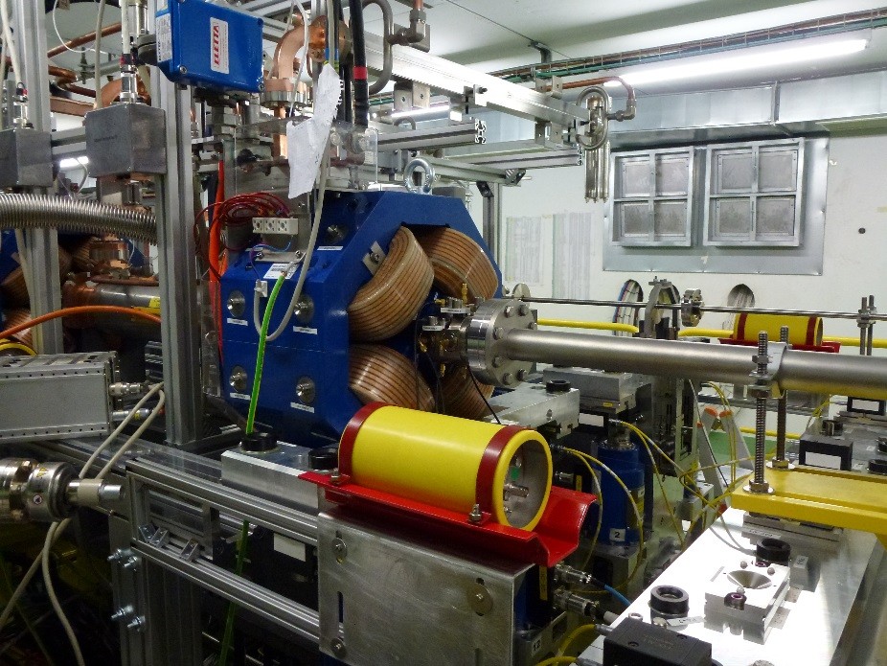
First CLIC prototype module completely installed in CLEX
CLIC superstructure
Power Extraction Structure (PETS)
Dive Beam Quad + BPM

Slide 19
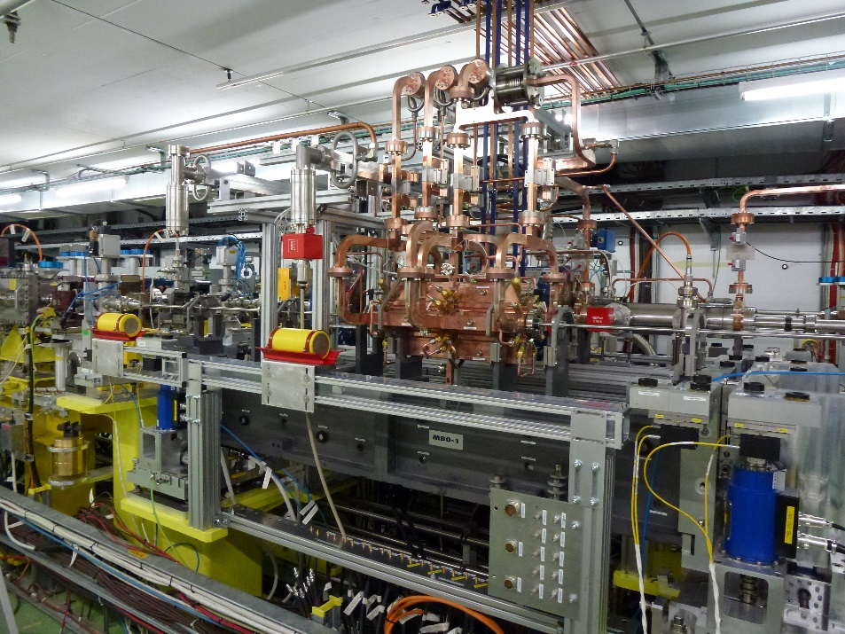
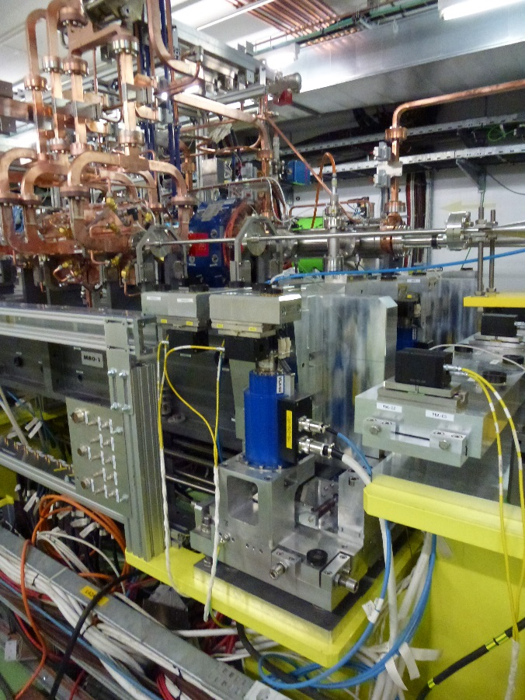
First CLIC prototype module completely installed in CLEX
Module support out of SiC
Actuators of the alignment system

Slide 20

Wakefield monitors
TM-like at 18 GHz and TE-like at 24 GHz HOM pick-ups
5 um resolution required for CLIC Beam Based Alignment scheme

Slide 21
Wakefield monitors
Required 5 um resolution demonstrated in the two beam test stand, ongoing with the prototype module

Slide 22
CLEX
Alignement
Component Main Beam |  | Radial (μm) | Vertical (μm) | Error budget (μm)
AS1 | Enter | -51 | -59 | 10
 | Exit | -161 | -16 | 10
AS2 | Enter | -68 | -85 | 10
 | Exit | -139 | -103 | 10
Component Drive Beam |  | Radial (μm) | Vertical (μm) | Error budget (μm)
PETS1 | Enter | 65 | 37 | 100
 | Exit | -27 | 15 | 100
DBQ1 | Enter | -9 | -4 | 20
 | Exit | -2 | 19 | 20
PETS2 | Enter | 28 | 78 | 100
 | Exit | -51 | 58 | 100
DBQ2 | Enter | 8 | 11 | 20
 | Exit | -3 | -14 | 20
Component Main Beam |  | Radial (μm) | Vertical (μm) | Error budget (μm)
AS1 | Enter | 29 | -24 | 10
 | Exit | -65 | 39 | 10
AS2 | Enter | 46 | -8 | 10
 | Exit | -10 | -7 | 10
Vivien Rude

Slide 23
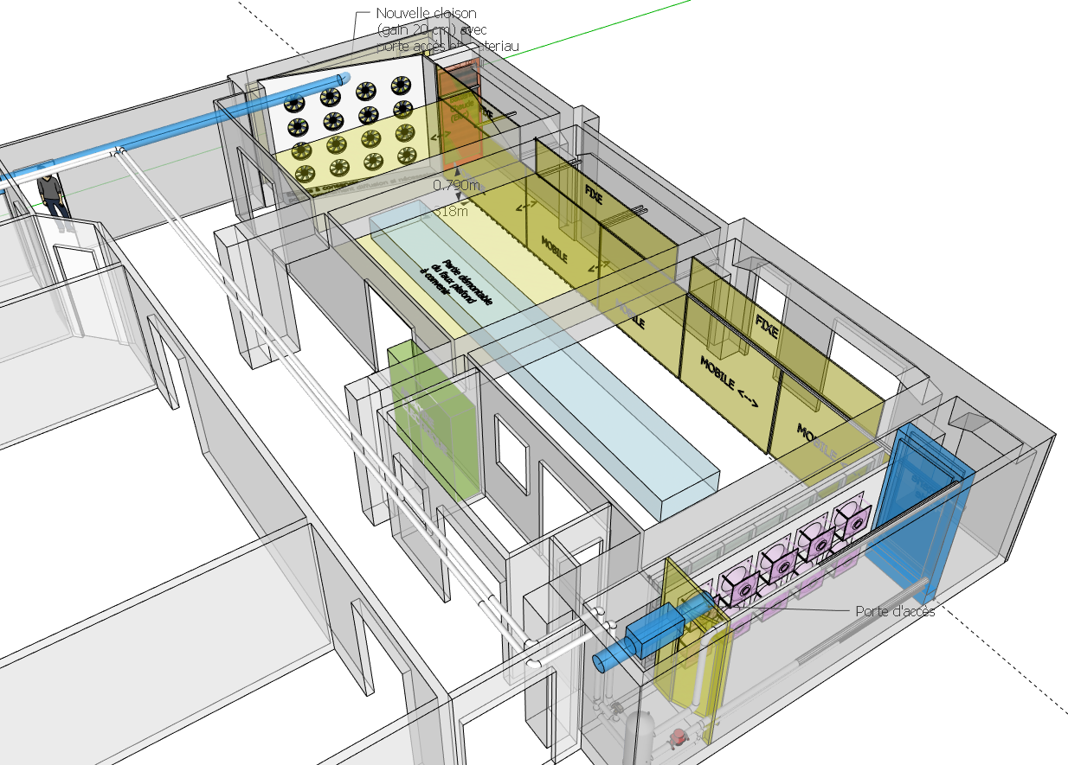
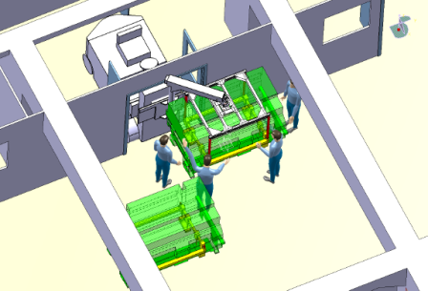
Lab-Module test stand
Range for air temperature and speed:
  T_{air} = 20 - 40 °C
  v_{air} = 0.2 - 0.8 m/s
Heating coils
Air speed sensors installed in the middle of the room
The ceiling is movable for the transport test
AIR FLOW
AIR CIRCULATION
Air speed sensors
Cooling coils
transport test

Slide 24
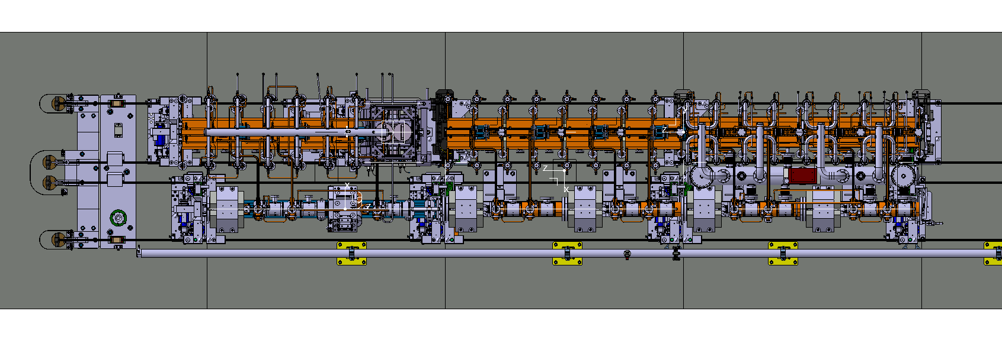
Module configuration in the Lab
T1-T0-T0
Thermo-mechanical measurements under vacuum
Alignment and temperature response measurements
Thermal and mechanical coupling between girders and modules
Thermo-mechanical comparison of T0 and T1
Failure modes: Control of time constants through water flow
Outgassing of structures with SiC
Module interconnects T0-T0-T1 (snake system)
Alignment of mini module string

Slide 25
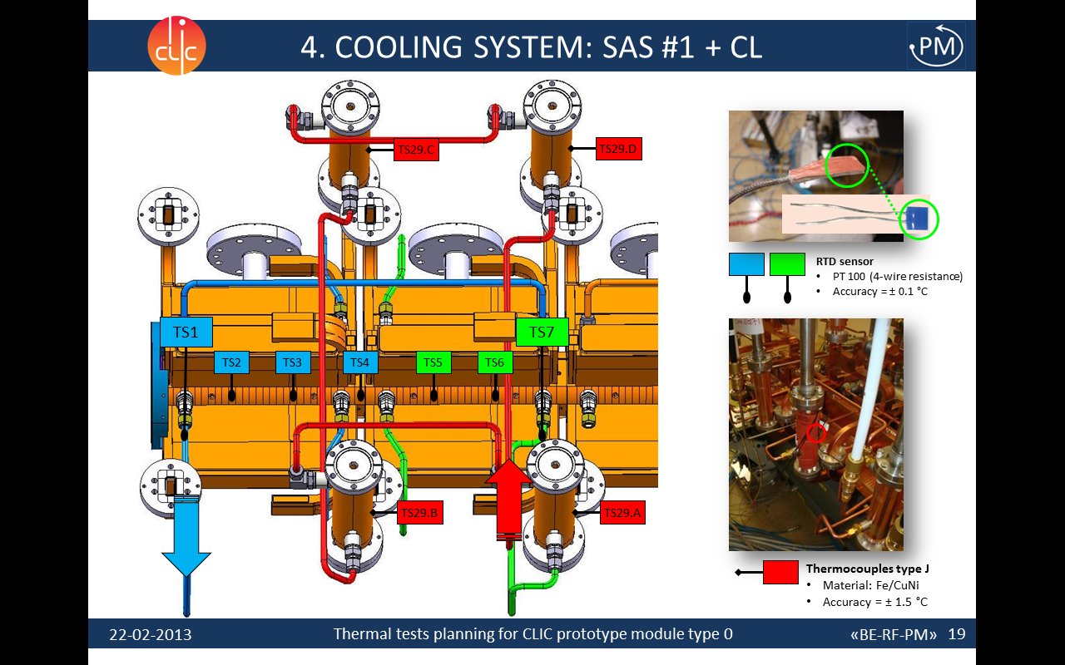
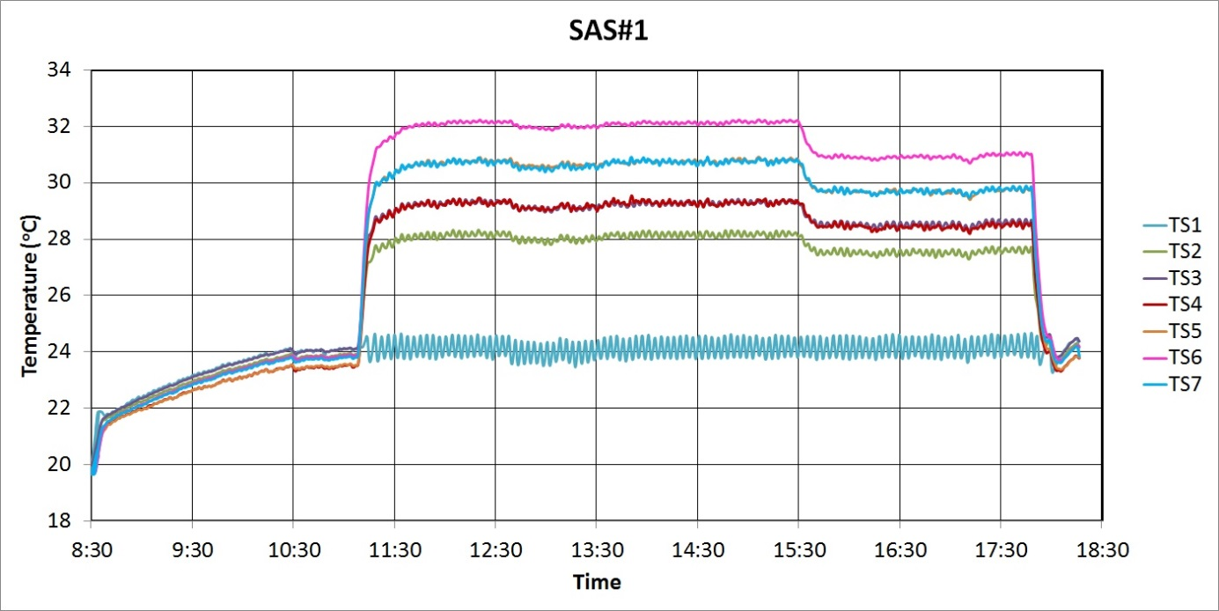
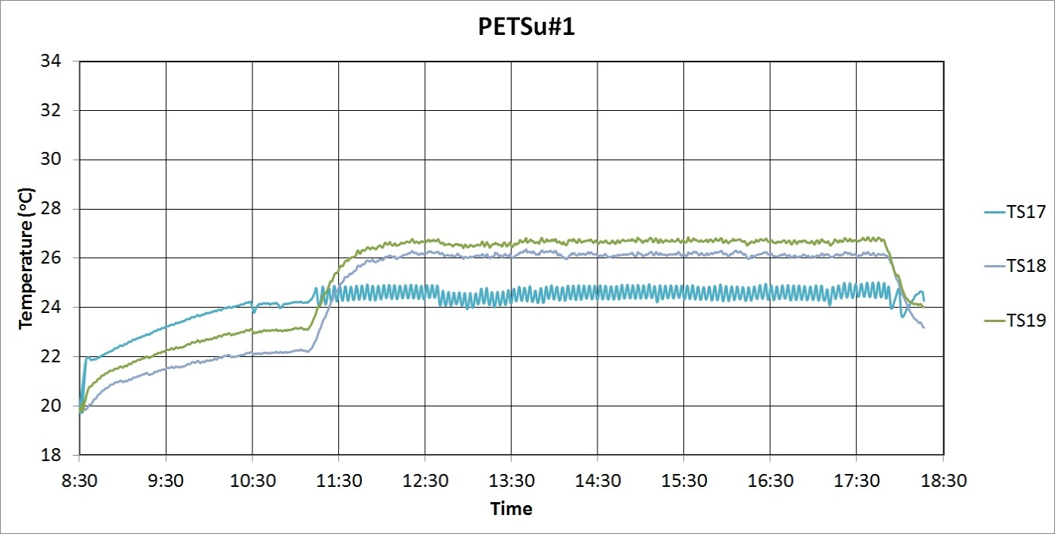
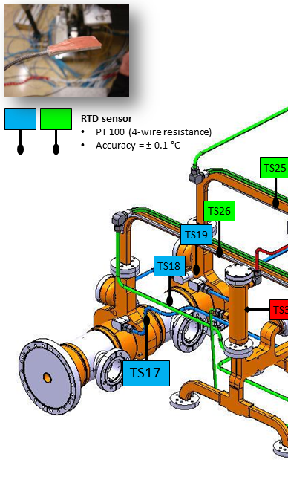
Thermal test data example
Water only
Unloaded
Loaded
Temperature fluctuation: ± 0.2 ºC
Elena Daskalaki, Alex Vamvakas,
Anastasia Xydou
Temperature evolution (Zero - Unloaded - Loaded conditions)

Slide 26
Results: One point of AS
Displacement
measurements
Time constants (min)
 | Δx | ΔΤ
Rise | 7.28 | 7.52
Fall | 7.87 | 7.33
Vertical displacement of AS axis
No radial displacement was detected
Movement and temperature dynamics are the same
Time constants can be calculated as in the case of temperature
Mathieu Duquenne , Eleni Daskalaki
Notes:
The graph demonstrates the movement of the followed point where the blue points are the measurement values, and the orange line is the best fitting line. The green line is the corresponding temperature response of the AS. We can see that the temperature and movement dynamics of the point are the same

Slide 27
Experimental result: displacements, example
DRIVE BEAM
Radial (mm)
MAIN BEAM
Loaded
AS1
AS1
AS1
AS1
AS1
AS1
AS1
AS1
Radial (mm)
Longitudinal (mm)

Slide 28

Production flow when to we do the alignment
Production of components
Assembly on girder
Fiducialisation
Pre-alignment
Transport
Final position
Commissioning
Many permutation possible
PACMAN suggest to do the assembly, fiducialisation and pre-alignment in one step (at CERN ?)
Can industry do that at a reasonable cost
Can this be automatized ?
Cost model for alignment needed
Will the alignment survive the transport ?
Can it be done in the final location in the tunnel ?

Slide 29
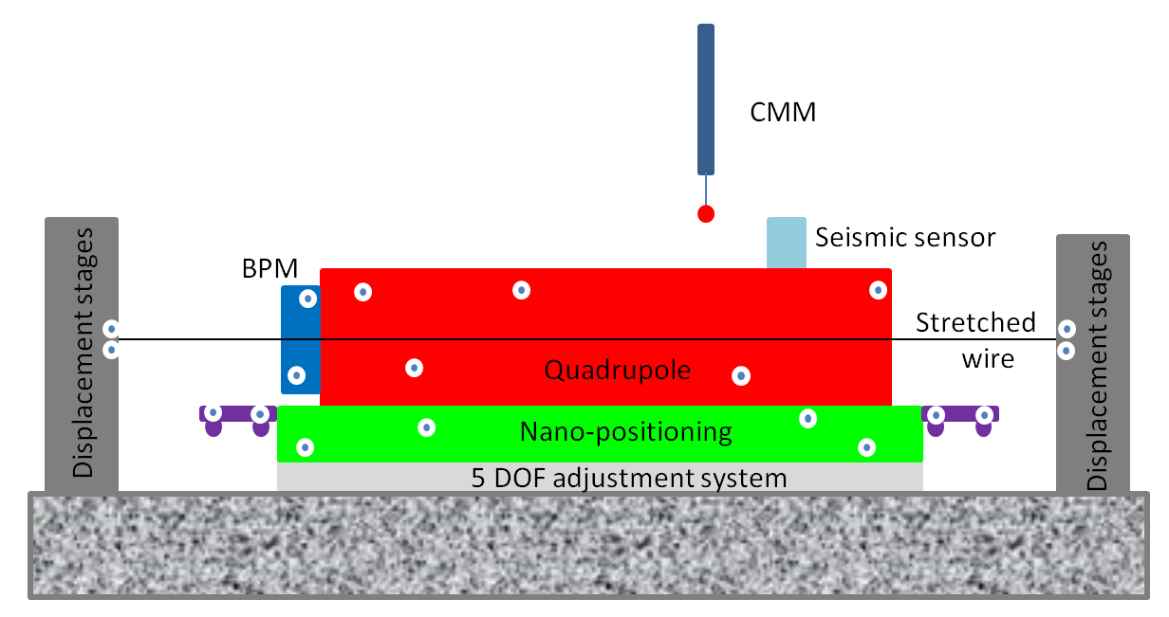
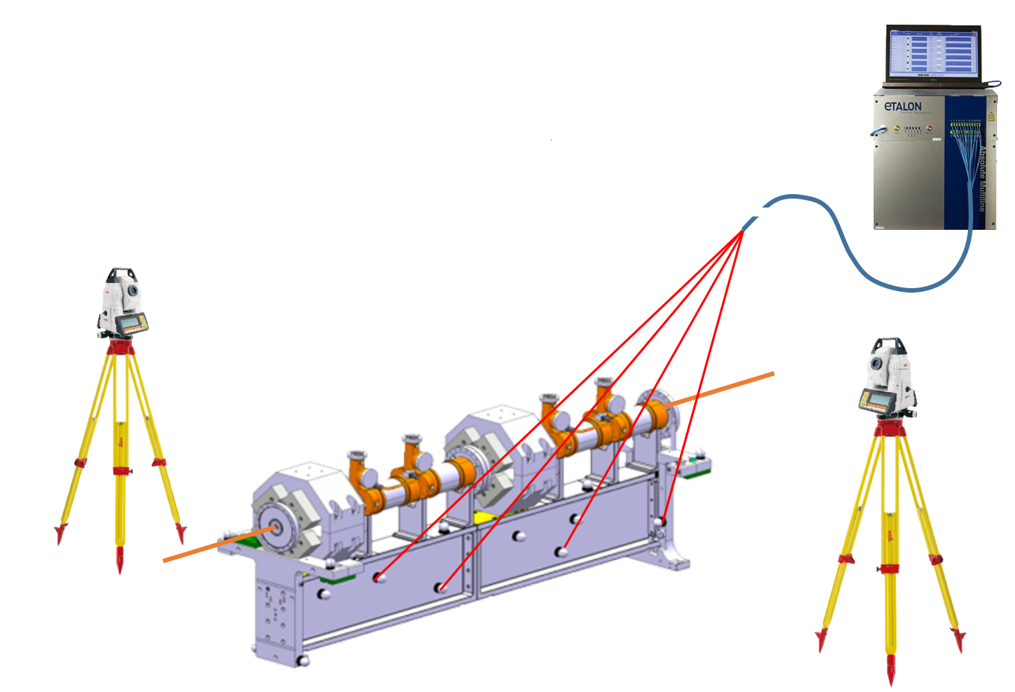
PACMAN and its possible impact on the CLIC modules
Combine references & methods of measurements in the same place to gain time and accuracy
Prove their feasibility on a final bench
Extrapolate the tools & methods developed to other projects
Development of a high accuracy portable solution (micro-triangulation + FSI), replacing CMM measurements:
Check in-situ fiducialisation + initial alignment of components (with stretched wire or using external alignment targets
Do in-situ fiducialisation + initial alignment in the tunnel, after transport

Slide 30
PACMAN and its possible impact on the CLIC modules
Nano-positioning needed for CLIC components like MBQ, any progress in devices, controls or cost will be directly beneficial
Development of a mobile alignment system based on laser trackers or similar technologies would be very convenient and would add flexibility to the production scenario.
Possibility to align or realign in the tunnel might be even essential !
Better knowledge of components functional centre of course great but does not solve the whole problem
Referencing the MB-BPM better with respect to the wire would have the biggest impact on emittance budget. Additional margins welcome.
Which level of alignment would be a game changer ?
Reduction of cost for alignment and fiducialisation of course very welcome

Slide 31
Further discussion
Can we integrate fiducials / position sensors into the components ?
Wake-field monitor with respect to structure centre using the wire
Can we gain on fabrication tolerances ?
Can we improve the reference line ? Currently one of the biggest errors
Can PACMAN improve the cost of the CLIC modules and assembly ?

Slide 32
Conclusions
CLIC two beam module R&D well advanced with very promising results and lots of lessons learned
Need to develop credible fabrication, alignment and installations scenarios (risk sharing between industry and CLIC)
Alignment is a critical step in this work flow
PACMAN clearly can have a big impact on the alignment scenario and its success. This would improve the performance of CLIC

Slide 33
END

Slide 34
Fabrication and Alignment Tolerances
Pre-alignment tolerances MB: 14 μm rms for rf structures, 17 μm rms for quads, BPMs 10 μm ,10 μm rms in BDS over 200 m with respect to the reference wire
Pre-alignment tolerances DB: Quads 20 μm, PETS 100 μm/ 1 mrad, BPMs 20 μm ?
Vibration tolerances MB: Quads 10 nm horizontal, 1.6 nm vertical; ACC 8 μm, 6 μrad horizontal, 1.4 μm, 1.1 μrad vertical
Structure straightness 5 μm, wake field monitor 3.5 μm ?
Delta T for one structure 5 deg, 10 deg for one superstructure ? Each SAS is individually regulated, one valve for PETS, MB Quad and DB quads per module
Girder deformation loaded 10 μm
Pre-alignment at 20 deg, calculate displacement with temperature
Installation sequence: Install support with wire system, align, install modules (girders with equipment)
Install components on girder with cradle, determine position, align (one girder/ full module on which reference ?), transfer to tunnel, link to wire already installed and aligned ?

Slide 35
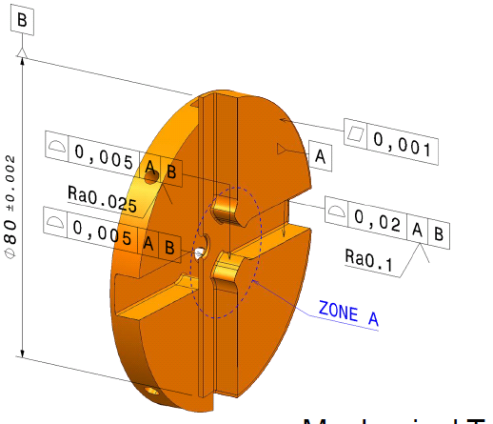

Shape tolerances for
AS and PETS
Dictated by beam physics and RF
➔ ultra high precision machining
Turning – milling
Several annealing steps
(no burrs, no scratches)
AS Disk
PETS bar

Slide 36





TBM main types
Standard Module
(L = 2010 mm)
DB (100 A)
4 PETS, 2 Quads with BPM
Each PETS feeds 2 AS
MB (1 A)
8 acc. structures
MB filling factor: 91%
CLIC Module Type 0
73 %
Module Type 1
3 %
Module Type 3
9 %
DB
Module Type 2
12 %
Module Type 4
3 %
1 to 4 pairs of AS replaced by
MB Quadrupoles
MB

