Slide 1
HIE-ISOLDE Users interface and beam properties for 2017
Lefteris Fadakis on behalf of BE-OP-ISO

Slide 2
Content
REX/HIE-ISOLDE Users Interface
  Vacuum system
  Diagnostics
  SRF
  Equipment Array
  Specification concerning final beam delivery checkpoint for OP
  Establish a fast separator course for newcomers prior to each experiment
Beam Properties
  Energy and Energy spectrum
  Time structure (Repetition rate, Pulse length, Slow extraction)
  A/q
Set Up Time
  Provide examples varying from best to worst case.

Slide 3
Content
REX/HIE-ISOLDE Users Interface
  Vacuum system
  Diagnostics
  SRF
  Equipment Array
  Specification concerning final beam delivery checkpoint for OP
  Establish a fast separator course for newcomers prior to each experiment
Beam Properties
  Energy and Energy spectrum
  Time structure (Repetition rate, Pulse length, Slow extraction)
  A/q
Set Up Time
  Provide examples varying from best to worst case.

Slide 4
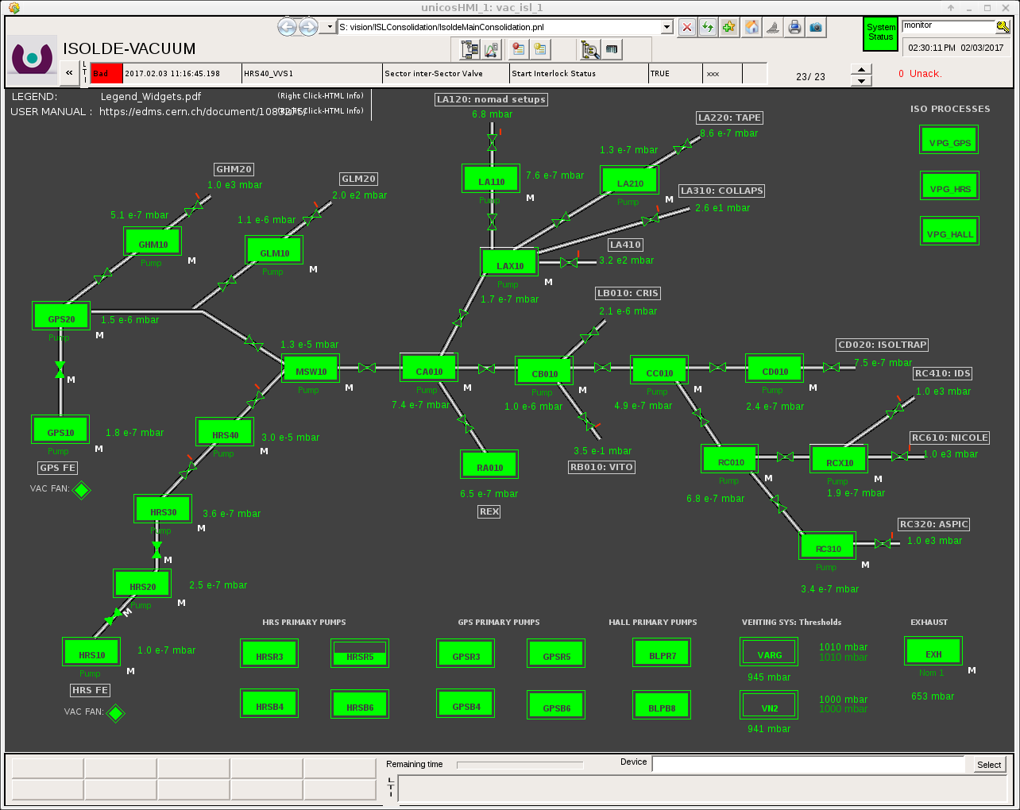
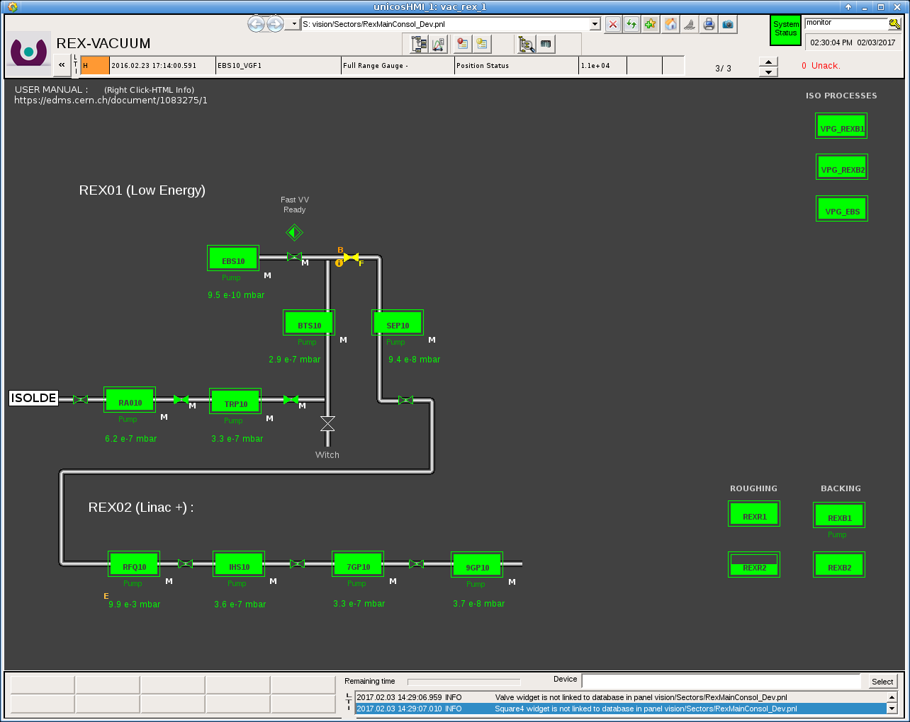
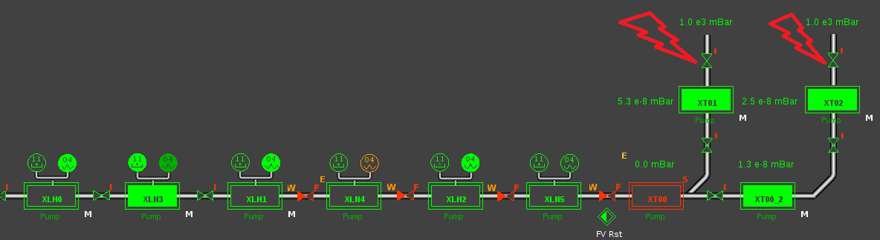
HIE-ISOLDE Users Interface - Vacuum system
Added labels for each experiment in the low energy panel.
Login for:
Low energy is isoop
Rex is rexop
HIE is your nice login which you need to provide at least a week in advance to grand access.
Penning Threshold
Valves to be closed if ANY
mechanical intervention takes place
on experiment side.
Pirani Threshold

Slide 5
Content
REX/HIE-ISOLDE Users Interface
  Vacuum system
  Diagnostics
  SRF
  Equipment Array
  Specification concerning final beam delivery checkpoint for OP
  Establish a fast separator course for newcomers prior to each experiment
Beam Properties
  Energy and Energy spectrum
  Time structure (Repetition rate, Pulse length, Slow extraction)
  A/q
Set Up Time
  Provide examples varying from best to worst case.

Slide 6
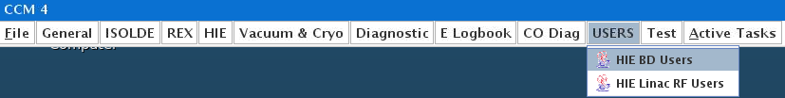
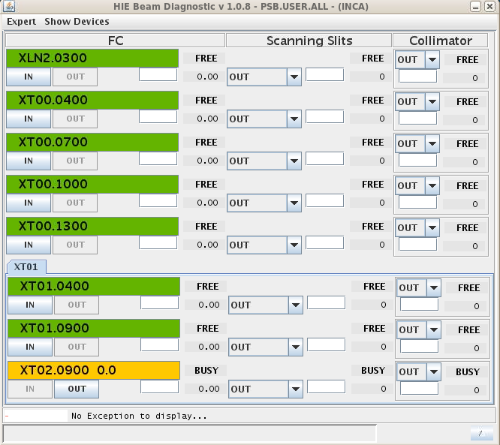
REX/HIE-ISOLDE Users Interface – Beam Diagnostics
<- Where to find it
<- GUI will evolve as the BI evolves (adding more equipment)
We will not add a bricolage/last minute solution for
any FC after the last diagnostic box into the existing
control system.
4
2
<- explanation of each element:
1. Current position acquisition
2. Layer availability
3. Offset movement in respect to current position
4. Go to default possible positions
2
4
2
3
1
3
1
3
1

Slide 7
Content
REX/HIE-ISOLDE Users Interface
  Vacuum system
  Diagnostics
  SRF
  Equipment Array
  Specification concerning final beam delivery checkpoint for OP
  Establish a fast separator course for newcomers prior to each experiment
Beam Properties
  Energy and Energy spectrum
  Time structure (Repetition rate, Pulse length, Slow extraction)
  A/q
Set Up Time
  Provide examples varying from best to worst case.

Slide 8
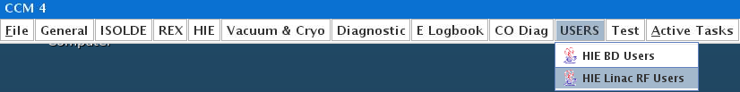
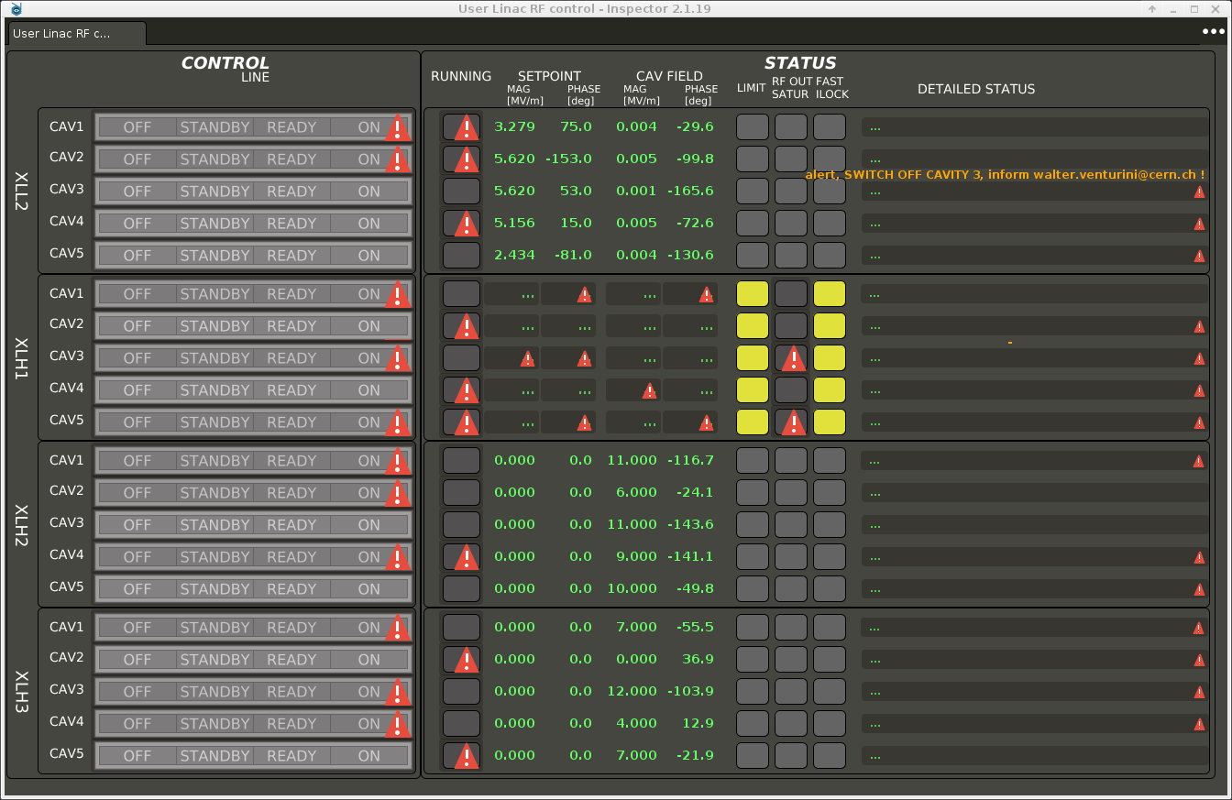
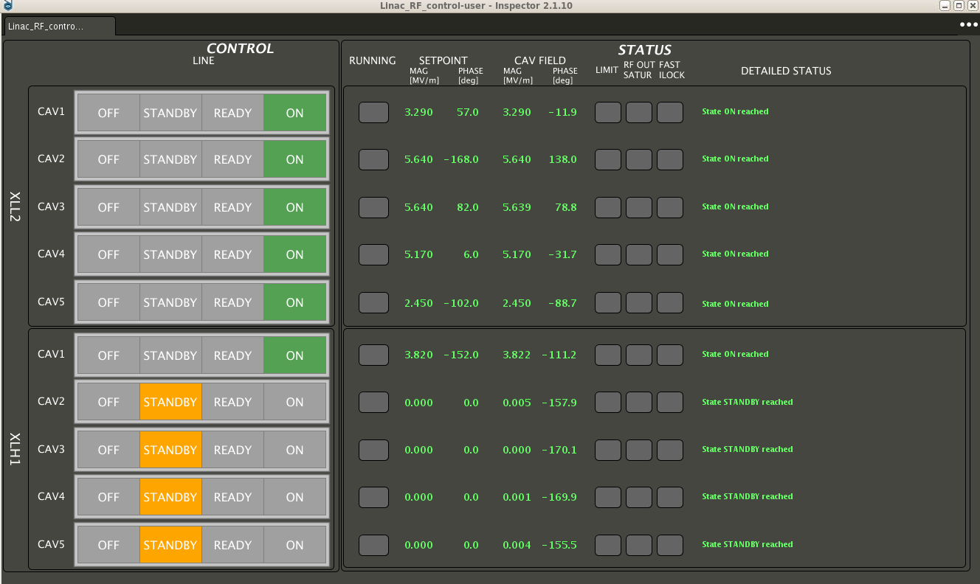
HIE-ISOLDE Users Interface – RF Controls
<- Where to find it

Slide 9
Content
REX/HIE-ISOLDE Users Interface
  Vacuum system
  Diagnostics
  SRF
  Equipment Array
  Specification concerning final beam delivery checkpoint for OP
  Establish a fast separator course for newcomers prior to each experiment
Beam Properties
  Energy and Energy spectrum
  Time structure (Repetition rate, Pulse length, Slow extraction)
  A/q
Set Up Time
  Provide examples varying from best to worst case.

Slide 10
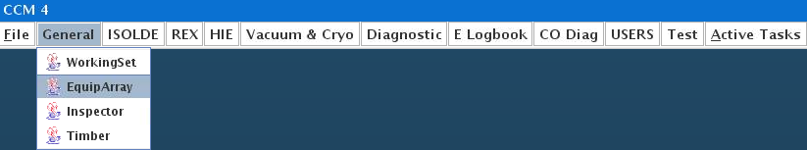
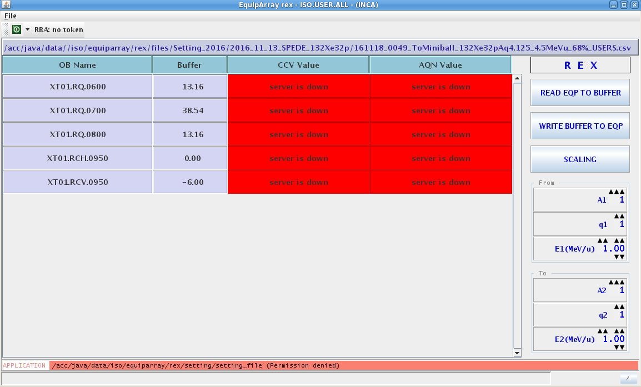
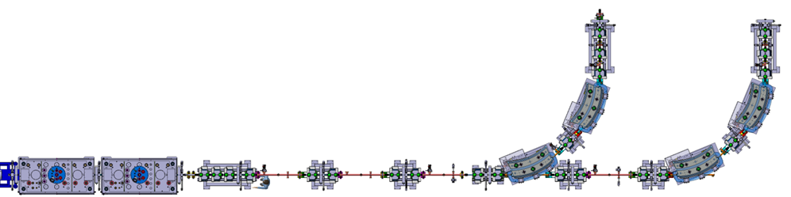
HIE-ISOLDE Users Interface – Equipment Array
<- Where to find it
1
2: Steerers
2
1: Triplet

Slide 11
Content
REX/HIE-ISOLDE Users Interface
  Vacuum system
  Diagnostics
  SRF
  Equipment Array
  Specification concerning final beam delivery checkpoint for OP
  Establish a fast separator course for newcomers prior to each experiment
Beam Properties
  Energy and Energy spectrum
  Time structure (Repetition rate, Pulse length, Slow extraction)
  A/q
Set Up Time
  Provide examples varying from best to worst case.

Slide 12
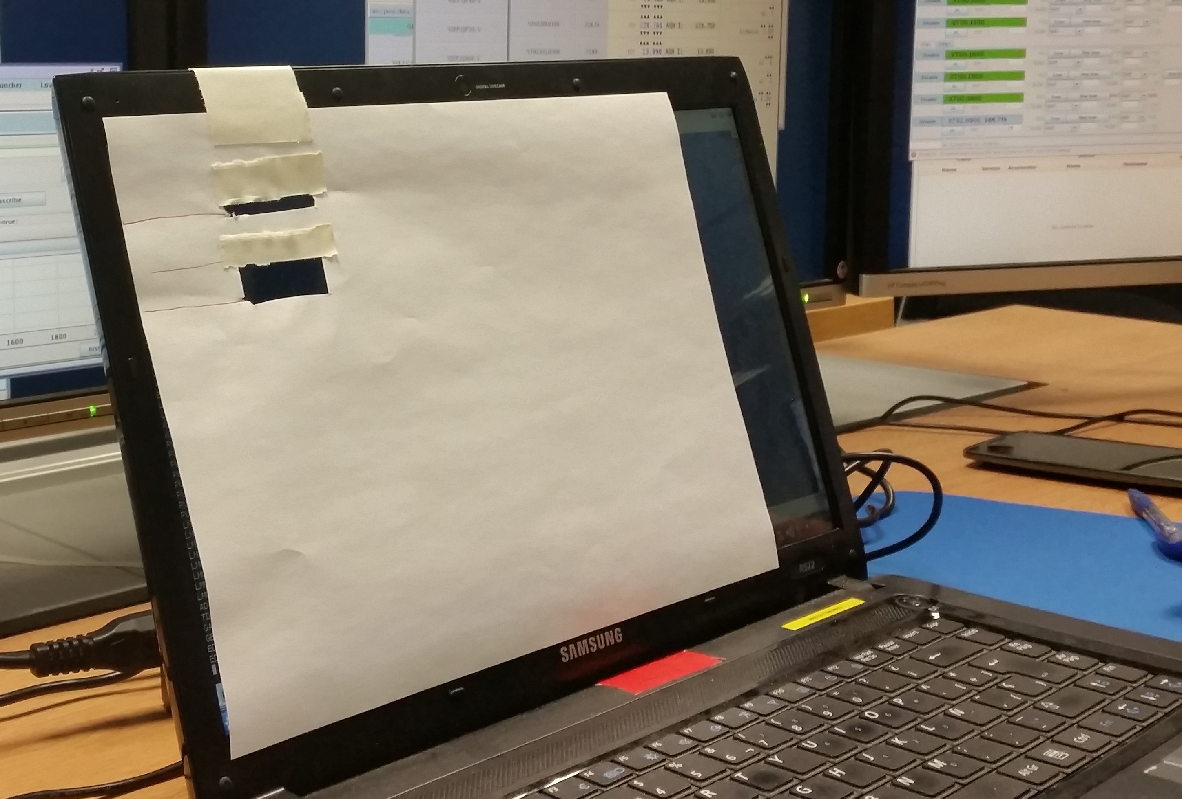
Final beam delivery checkpoint for OP
In 2017 OP will deliver beam as far as the faraday cup in the last diagnostics box before the experiment.
OP will not be responsible to inject beam into the users experiment.
Diagnostics
Diagnostics
End Tunnel
Diagnostics
Diagnostics
Diagnostics
SC Solenoid
SC Solenoid
Diagnostics
Diagnostics
Diagnostics
Diagnostics
Diagnostics
Quads
Steerers
Diagnostics
Diagnostics
Diagnostics
Notes:
Ne run was to verify the experimental station of Miniball and make sure every system was correct.

Slide 13
Content
REX/HIE-ISOLDE Users Interface
  Vacuum system
  Diagnostics
  SRF
  Equipment Array
  Specification concerning final beam delivery checkpoint for OP
  Establish a fast separator course for newcomers prior to each experiment
Beam Properties
  Energy and Energy spectrum
  Time structure (Repetition rate, Pulse length, Slow extraction)
  A/q
Set Up Time
  Provide examples varying from best to worst case.

Slide 14

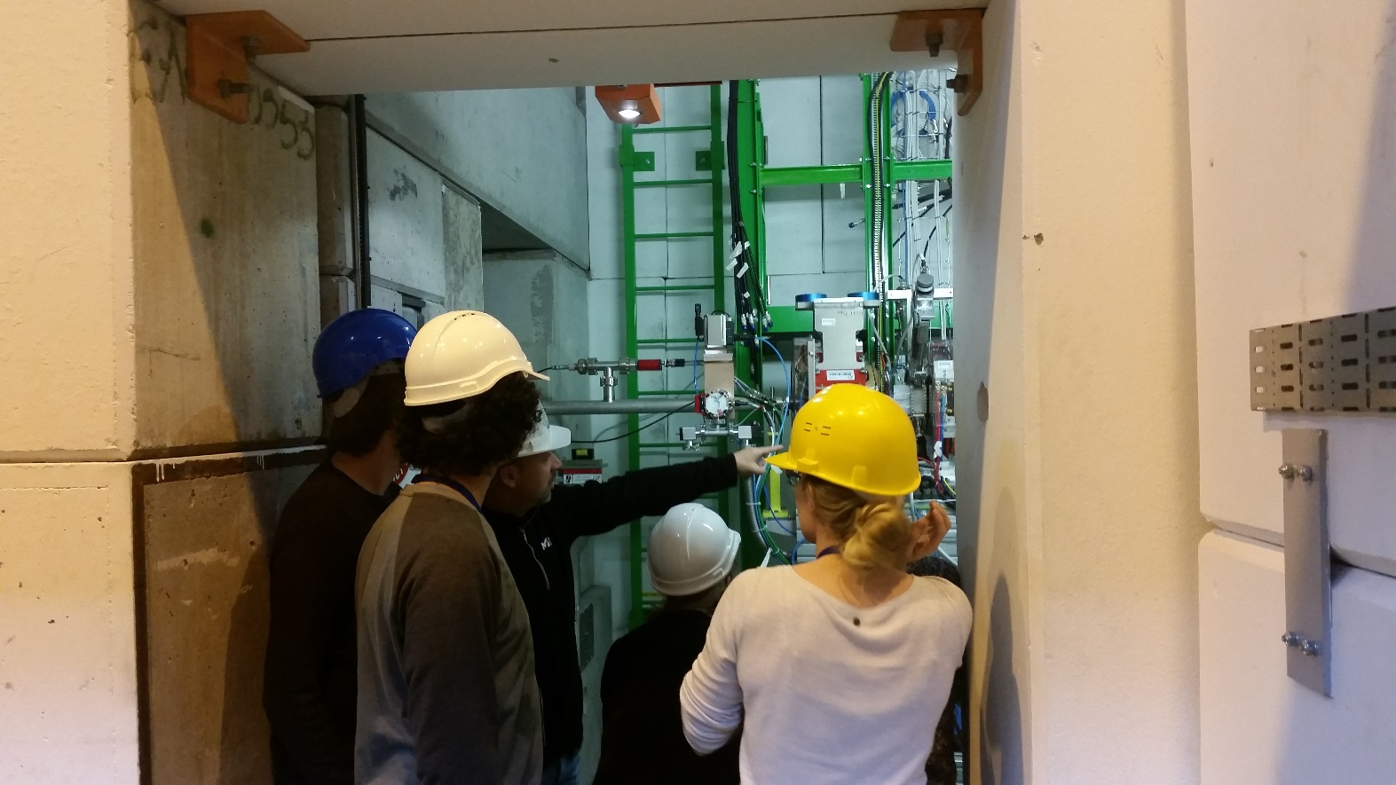
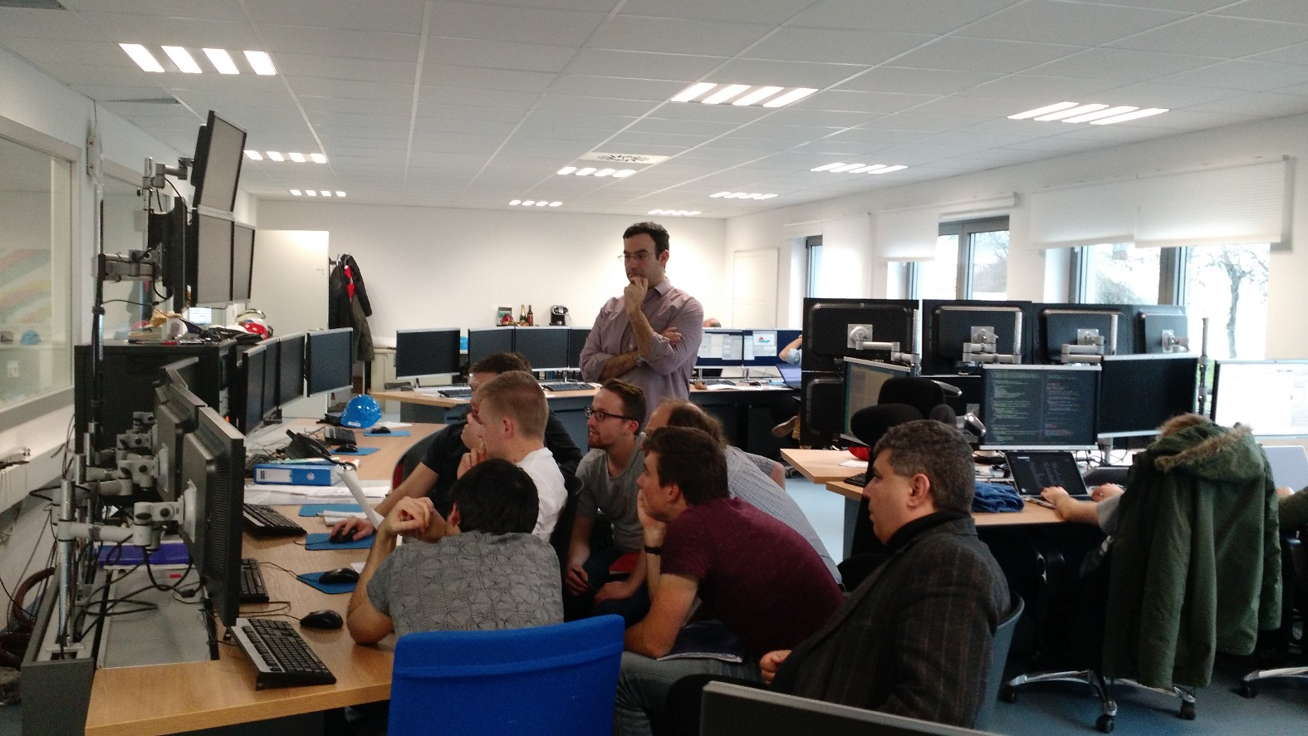
ISOLDE Separator course
Each year OP teaches the basics of ISOLDE to our new users.
  Beam set up, targets, beam diagnostics, call the PSB operator if there are no protons, etc
  Adding another day being considered, if people are interested in REX/HIE.

Slide 15
ISOLDE crush course before each experiment
In addition to the yearly separator course a crush course will be provided.
Before each experiment we cover the basics (if needed).
  Working sets/knobs
  Fixed displays screens
  Relevant applications (beam instrumentation etc)
Verify that each users account has been granted access in the vacuum system.

Slide 16
Content
HIE-ISOLDE Users Interface
  Vacuum system
  Diagnostics
  SRF
  Equipment Array
  Specification concerning final beam delivery checkpoint for OP
  Establish a fast separator course for newcomers prior to each experiment
Beam Properties
  Energy and Energy spectrum
  Time structure (Repetition rate, Pulse length, Slow extraction)
  A/q
Set Up Time
  Provide examples varying from best to worst case.

Slide 17
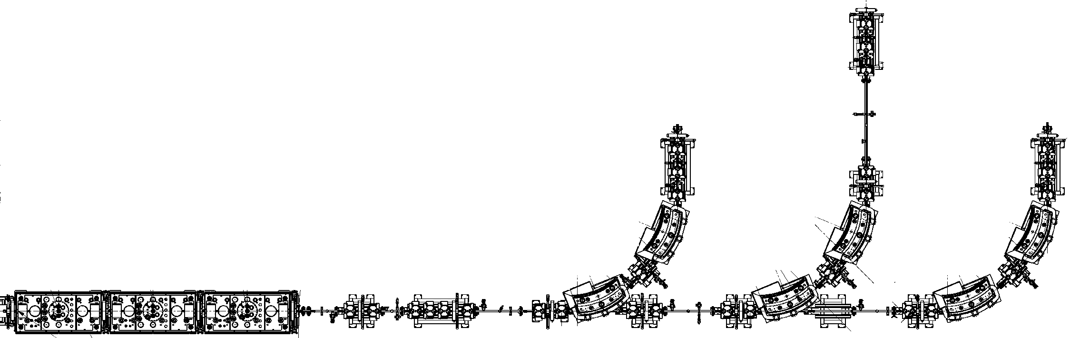
Beam Properties for 2017: Beam Energy and Energy Spread
Expected for 2017:
A third cryomodule is currently being installed and should be ready for the 2017 Physics campaign
The third HEBT line (XT03) should also be ready
Highest reachable energy of a beam with A/q = 4.0:
  If average SRF gradient is 6.0 MV/m: 8.2 MeV/u
  If average SRF gradient is 5.5 MV/m: 7.8 MeV/u
  If average SRF gradient is 5.0 MV/m: 7.3 MeV/u
Highest beam energy (assuming all cavities at 6MV/m) for different A/q
A/q | CM1 | CM2 | CM3 | CM4
2.5 | 5.5 | 8.6 | 11.4 | 14.2
3.0 | 5.0 | 7.6 | 10.0 | 12.4
3.5 | 4.7 | 6.9 | 9.0 | 11.1
4.0 | 4.4 | 6.3 | 8.2 | 10.1
4.3 | 4.3 | 6.1 | 7.8 | 9.5
XT02 ext.
(2017)
XT03
(2017)
Phase 2A of the HIE-ISOLDE project
# Cryomodules | 3
# HEBT lines | 3
E [MeV/u] (A/q = 2.5) | 11.4
E [MeV/u] (A/q = 4.3) | 7.8
Layout after Phase 2A
End Tunnel
CM1
CM2
CM3 (2017)

Slide 18
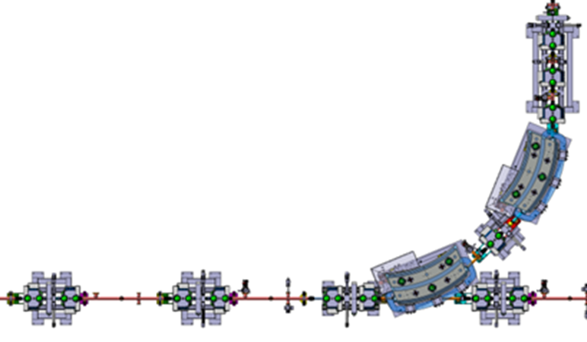
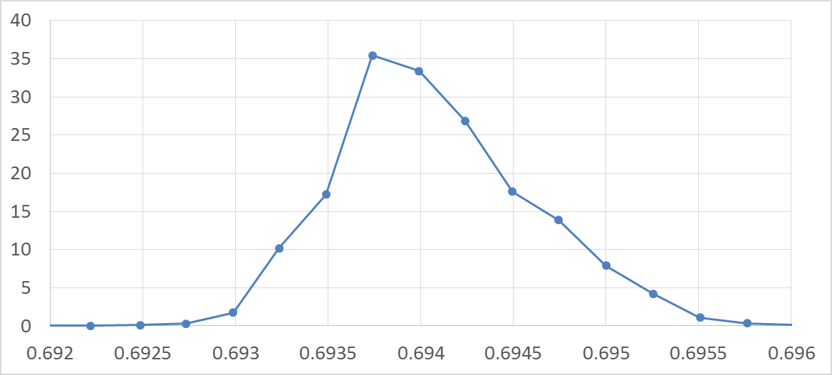
Beam Properties for 2017: Beam Energy and Energy Spread
In 2016:
Dedicated energy measurement
(~ 4 hours were needed) using the dipole done for the last four experiments
Due to problems with the machine
(9gap amplifier for ¹¹⁰Sn, target for ¹⁴²Xe), the dedicated measurements were not done in the first two experiments
Best guess Energy is based on the settings of the dipole when beam was delivered to the users. But, it is not corrected for steerers and quads kicks
Energy and Energy Spread for experiments in 2016
 | Nominal Energy [MeV/u] | Measured Energy [MeV/u] | Energy Spread HWHM [%] | Energy Best guess(1) [MeV/u] | Best guess / Measured
⁶⁶Ni¹⁶⁺ | 4.5 | 4.47 | 0.2 | 4.46 | 0.998
⁹Li³⁺ | 6.9 | 6.72 | 0.5 | 6.74 | 1.003
¹³²Sn³¹⁺ | 5.5 | 5.49 | 0.4 | 5.40 | 0.984
⁷⁸Zn²⁰⁺ | 4.3 | 4.27 | 0.3 | 4.30 | 1.007
¹⁴²Xe³³⁺ | 4.5 |  |  | 4.39
¹¹⁰Sn²⁶⁺ | 4.5 |  |  | 4.39
Dedicated Energy Measurement for ⁶⁶Ni
1 mm vertical slits
Silicon detector
I [a.u]
(1)
quads and steerers ON
Slits retracted
All quads and steerers off
B [T]

Slide 19
Beam Properties for 2017: Beam Energy and Energy Spread
Expected for 2017:
A new timing class for the Si detectors (including count rates) has been developed and will be commissioned this year
Energy measurements will be a lot faster (expected ~ 1 hour for the second half of the campaign)
Energy spread optimization may be possible to approach the theoretical 0.25% HWHM for all experiments
Energy and Energy Spread for experiments in 2016
 | Nominal Energy [MeV/u] | Measured Energy [MeV/u] | Energy Spread HWHM [%] | Best guess Energy [MeV/u] | Best guess / measured energy
⁶⁶Ni¹⁶⁺ | 4.5 | 4.47 | 0.2 | 4.46 | 0.998
⁹Li³⁺ | 6.9 | 6.72 | 0.5 | 6.74 | 1.003
¹³²Sn³¹⁺ | 5.5 | 5.49 | 0.4 | 5.40 | 0.984
⁷⁸Zn²⁰⁺ | 4.3 | 4.27 | 0.3 | 4.30 | 1.007
¹⁴²Xe³³⁺ | 4.5 |  |  | 4.39
¹¹⁰Sn²⁶⁺ | 4.5 |  |  | 4.39
Spokesperson should decide and inform in advance if a dedicated measurement is needed
OP will decide when to schedule it
1 mm vertical slits
Silicon detector
Dedicated Energy Measurement for ⁶⁶Ni
All quads and steerers off
I [a.u]
B [T]

Slide 20
Content
HIE-ISOLDE Users Interface
  Vacuum system
  Diagnostics
  SRF
  Equipment Array
  Specification concerning final beam delivery checkpoint for OP
  Establish a fast separator course for newcomers prior to each experiment
Beam Properties
  Energy and Energy spectrum
  Time structure (Repetition rate, Pulse length, Slow extraction)
  A/q
Set Up Time
  Provide examples varying from best to worst case.

Slide 21
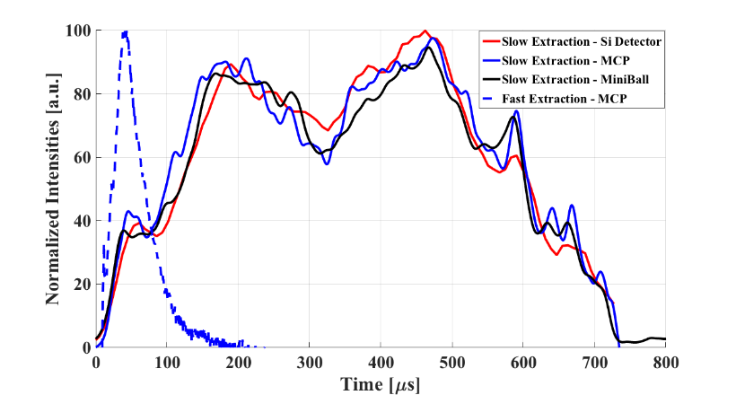
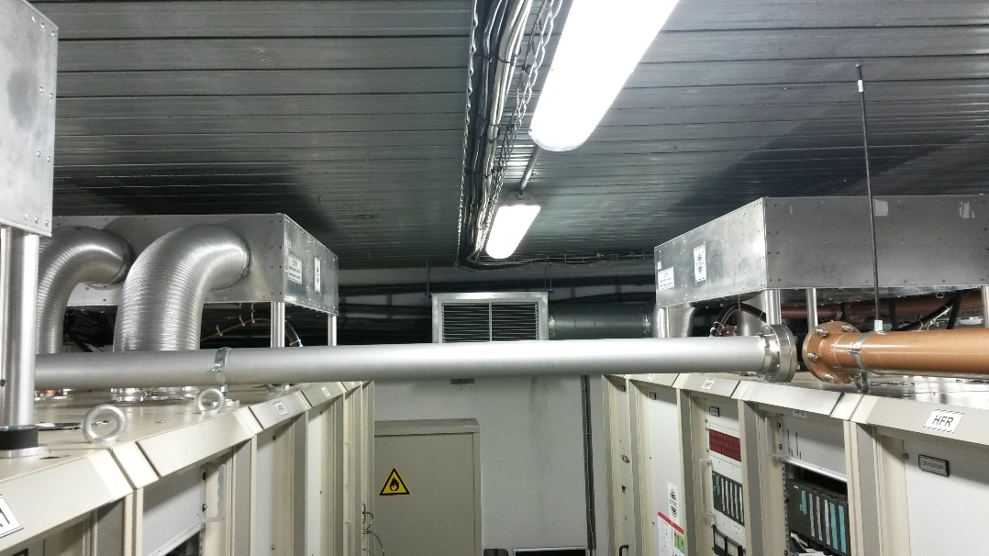
Beam Properties for 2017: Time Structure
In 2016:
Repetition rate: up to 50 Hz
RF Pulse length: up to 1 ms → Beam Pulse Length ~ 0.7 ms (with slow extraction)
Average power in 9gap < 2.5 kW
Natural Extraction vs. Slow Extraction during 2016
(Courtesy of N. Bidault)
Expected for 2017:
Repetition rate: up to 50 Hz
RF Pulse length 2 ms → Beam Pulse Length ~ 1.7 ms
  Heat exchangers installed during the technical stop
  Bertronix will be at CERN on wk. 7 and make the necessary modifications
Average power in 9gap < 2.5 kW
Spokesperson should inform OP if slow extraction is needed in advance (typically, a couple of hours are needed to set it up)

Slide 22
Content
HIE-ISOLDE Users Interface
  Vacuum system
  Diagnostics
  SRF
  Equipment Array
  Specification concerning final beam delivery checkpoint for OP
  Establish a fast separator course for newcomers prior to each experiment
Beam Properties
  Energy and Energy spectrum
  Time structure (Repetition rate, Pulse length, Slow extraction)
  A/q
Set Up Time
  Provide examples varying from best to worst case.

Slide 23
Beam Properties for 2017: A/q
Before 2016:
Nominal minimum A/q was 2.5
Nominal maximum A/q was 4.5
Since 2016:
Nominal minimum A/q still 2.5
Nominal maximum A/q changed to 4.33
  Several REX amplifiers not reliable at the power levels needed for beams with A/q = 4.5
Impact of the change in specs is limited (needs to be analysed case by case):
  Some light beams are not possible (ex: ⁹Li²⁺)
  Charge breeding efficiency for some heavy beams could become lower (by a factor 2-4)

Slide 24
Content
HIE-ISOLDE Users Interface
  Vacuum system
  Diagnostics
  SRF
  Equipment Array
  Specification concerning final beam delivery checkpoint for OP
  Establish a fast separator course for newcomers prior to each experiment
Beam Properties
  Energy and Energy spectrum
  Time structure (Repetition rate, Pulse length, Slow extraction)
  A/q
Set Up Time
  Provide examples varying from best to worst case.

Slide 25

HIE-ISOLDE Operations (Scenario 1):
Alternating high and low energy physics. GPS for HIE-ISOLDE physics preferred
Target installed on Friday, set-up Monday to Thursday, beam to users Thursday evening (earlier if lasers are not needed), Friday contingency
Monday beam characterization and isotope/energy change if needed
Target would reach its expected lifetime on Wednesday morning (1.8 μA avg. current assumed)
Stable beam could be sent to the users during the weekends
J.A. Rodriguez – GUI - Group for the Upgrade of the ISOLDE facility – Feb. 6th 2017

Slide 26
ISOLDE Beam Set Up Time Examples
Best Case #1
  Same isotope with different energies.
    If desired energies are known to OP then we can set up the machine the first time in a way that to change energy is a matter of switching off a number of cavities.
Best Case #2
  Different isotope but close in mass
Worst Case
  Completely different isotope in mass and energy

Slide 27
Summary
Users should communicate to us before their experiment if they require beam energy measurement to take place.
They should also provide a list of people to be granted access to the vacuum controls for the duration of their experiment.
OP will not invest time in any last minute beam instrumentation solutions.
Expected average SRF gradient for a beam with A/q = 4.0 to be 5.0 MV/m: 7.3 MeV/u.
Faster energy measurement in 2017.
RF Pulse length 2 ms → Beam Pulse Length ~ 1.7 ms (with slow extraction)
Nominal maximum A/q changed to 4.33.
46% of HIE RIB physics
20% of REX/HIE stable beam physics
40% low energy physics

Slide 28
Thank you
Questions?

