Slide 1
News of the ISOLDE Group
7th of February 2017
Maria J. G. Borge

Slide 2
Outline
Associates, Fellows and Students
Courses and activities 2017
Focus on Exotic beams at ISOLDE: A Laboratory portrait.
Long Range Plan
ENSAR2
Collaboration matters

Slide 3

Associates & Corresponding Associates & staff
Associates (9th March 2017)
  Bertram Blank (Sep 2016 – August 2017)
  Angela Bracco (Feb – July 2017)
  Andrei Andreyev (April 2017 – March 2018)
  Strong candidates
Corresponding Associates (9th March 2017)
  Joao Pedro Steves De Araujo (2 months, Jan-Feb 2017)
  Olof Tengblad (Feb-May 2017)
Staff members :
  Magda Kowlaska (Oct 2015 – Sep 2018) ERC betaDropNMR
  Stephan Ettenbauer (Feb 2017-Jan2021) ERC MIRACLS
ISOLDE User Support:
  Jennifer Weterings (2002 - )

Slide 4
Fellows & Associates & Corresponding Associates
Fellows: (28th of February 2017)
    Liam Gaffney (Oct 2016 – Sep 2019)
    Kara Lynch (Jan 2015 – Dec 2017)
    Vladimir Manea (Jan2016 – Dec 2017)
    Akira Miyazaki (June 2014- April 2017, SC cavities→ Manchester Contract)
    Lina Pallada (Applied Fellow, April 2017-, ERC)
    Andree Welker (June 2017 - ) (Applied Fellow, setting zero-spectrometer)
    Frank Wienholtz (Jan2016 – Dec2018) (Applied Fellow, ERC)
    Hope to get another Fellow in next call
    Need of excellent candidates!
    And many other paid by their home institution.

Slide 5
Doctoral Students
    Doctoral student
      CERN Doctoral Student for IDS:
        Razvan Lica (Sep2014 – August 2017)
      Doctoral Program for life sciences (50% GR, 33% CERN,11% Madga’s ERC )
        Stavroula Pallada (March 2014 - Feb 2017), Biophysics
      Doctoral Program with Germany
        Andree Werkens (Feb 2015-Jan2018) ISOLTRAP
      Doctoral student York-CERN (ERC)
        Rob Harding (presently covered by U. York)
      Doctoral student Lund - CERN
      Jacob Snall (August 2016 - Jun2019) HIE-ISOLDE Physics + zero spectrometer
And many other paid by their home institution.

Slide 6
Workshops / News
Courses
  Nuclear astrophysics 9-11 of May
  Given by: Francois de Oliveira
        Gabriel Martinez Pinedo
        Olivier Sorlin
NuPECC meeting @ CERN : 10-11 of March
Mini-workshop
Friday Morning opening by Eckhard Else
Visits to ALICE and ISOLDE
Workshop & conferences
  Next ISOLDE Workshop: 4-6 December 2017
  First meetings for EMIS 2018
Call for the Newsletter already launched, deadline 28 Feb 2017

Slide 7
ISOLDE Laboratory Portrait
Title: “Focus on exotic beams at ISOLDE: A laboratory Portrait ”
To be publish in J Phys G in 2017
Content planned:
  Experimental facilities and methods (on invitation). 15-20 pages
  16 invited papers
  3 invited contributions by theoreticians: A, Schrenk, A. Poves , J. Dobaczewski
  Articles by submission: expected 15 contributions
Content: 5 already fully accepted!!
  Experimental facilities and methods
    14 received and 4 pending to be received
  invited contributions by theoreticians
    2 received and 1 pending.
  Articles by submission:
    11 contributions received:
  Contact person in IOP Claire Fullarton: Claire.fullarton@iop.org

Slide 8

Management Group: ENSAR2
Coordinator: Muhsin N. Harakeh
Deputy Coordinator: Marek Lewitowicz
Manager: Ketel Turzó
Financial Officer: Veronique Vandevoorde
Administrative Officer: Sandrine Dubromel
Executive Board of PCC (first meeting 13th /10/2016)
TNAs: Maria G. Borge
Ari Jokinen
NAs: Andres Gadea
Olaf Tengblad
JRAs: Sylvia M. Lenzi
Christoph Scheidenberger

Slide 9
TNA
JRA
GANIL-SPIRAL2 (France)
    LNL-LNS (INFN, Italy)
    ISOLDE (CERN, Switzerland)
    JYFL (Finland)
    ALTO (CNRS, France)
    GSI (Germany)
    KVI-CART (The Netherlands)
    NLC (HIL/IFJ PAN, Poland)
    IFIN-HH/ELI-NP (Romania)
    ECT* (Italy)
    PASPAG: Particle and gamma detection Olof Tengblad
    PSeGe: AGATA detector + applications (Andres Gadea)
    TheoS: Theory of Nuclear Structure & Reactions (Denis Lacroix)
    RESIST: Resonant ionisation techniques for separators (Ian Moore)
    SATNuRSE: Simulations and analysis tools (Nasser Kalantar)
    EURISOL facility (all stages)
    Yorick Blumenfeld
    TecHIBA: Stable ion beams + medical isotopes (Faiçal Azaiez)
NA
FISCO,
NUSPRA (Ch Scheidenberger) , MIDAS (H. Koivisto), NUSPIN (S. Lenzi), MediNet ( P. Thirolf & G. Magrin), GDS (Grinyer), ENSAFF (S. Harisopulos), NuPIA (Nuclear phys Innovation)

Slide 10
ENSAR2 @ CERN
RILIS (V. Fedoseev) @ JRA RESIST 70.000→ (56.000) 60.200 euros
Target R&D (T. Stora) @ JRA EURISOL 112.000 →( 89.600) 96. 320 euros
EBIS (F. Wenander) @ JRA EURISOL 39.000 → (31.200) 33.540 euros
Chamber for irradiation (K. Johnston) @ JRA TECHIBA 42.500 → 34.000 euros
Representative in MediNet (Manjit Dosanjh) → 6000 euros
TNA ISOLDE: Users support 324.495→ (279.066) 259.596 euros
    Access cost 387.504 → 310.003 CHF
      1+1/2 Year post-doc 2018 to design the MR-ToF for ISOLDE
      A shared technician with EN. Help to cope with the safety regulations and with the higher complexity of the Facility. Project to be defined

Slide 11
ENSAR2-TNA @ ISOLDE
Selection committee:
B. Blank, K. Riisager, K. Blaum, P. Van Duppen, M.J. Garcia Borge, K. Johnston, J. Schell.
Three meetings: 21 / 3 / 2016, 6 / 6 / 2016 and 25 / 7 / 2016
  40 projects received support in 2016
  Total awarded days : 732 days to 3208 scheduled beam hours.
  588 days already paid corresponding to 71088 CHF
  Total days of the teams at ISOLDE : 4517
  Total days requested 1893
  Total days approved 688
  Total days paid 683
  Total expenditure 87288(*) /(T=259.596)
  (*) Allowance reduced from 138 CHF to 120 CHF due to overheads

Slide 12
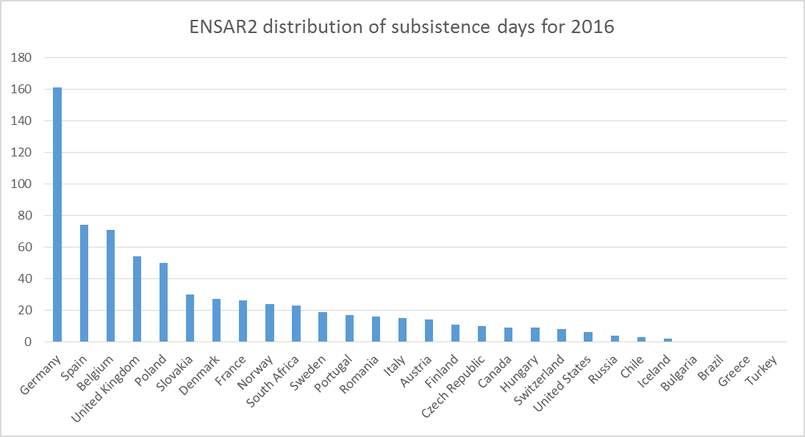

Slide 13
NuPECC News: Long Range Plan
The Nuclear Physics European Collaboration Committee has been working in the preparation of a new Long Range Plan for Nuclear Science in Europe.
6 chapters have been identified as in the editions of 2004 and 2010.
  1. Hadron Physics. Diego Bettoni (Ferrara) + Hartmut Wittig (Mainz)
  2. Properties of strong-interacting Matter (Silvia Masciocchi & Francois Gelis)
  3. Nuclear Structure and Reaction Dynamics (Elias Khan & John Simpson)
  4. Nuclear Astrophysics (Gabriel Martinez-Pinedo & Alison Laird)
  5. Symmetries and Fundamental Interactions (Klaus Blaum & K. Kirch)
  6. Applications and societal benefits (Marco Durante & Alain Letourneau)
The town meeting in Darmstadt 11 -13 of January 2017.
Recommendations: Strong support to construction and augmentation of innovative ISOL facilities in Europe.
The urgent completion of the ESFRI facility SPIRAL2 along with SPES and with the energy and intensity upgrade of HIE-ISOLDE (with the combined storage ring) will consolidate the leading role of Europe in the physics of nuclei far from stability.
Strong support to the EURISOL-DF new initiative, a collaborative effort of the above mentioned facilities and future partners which aims to maximize the common efforts to solve the associated scientific and technical challenges. The combined exploitation of beam and devices as well as joint R&D projects are crucial for a comprehensive understanding of open questions in the field

Slide 14
MoU
New MoU effective from January 2017 until 2019.
As it will have automatic renewal we consider important to reduce the period to facilitate the compromise and the update of annexes.
In the New MoU India and Ireland are not members.
Bulgaria and Portugal in the pipeline.
Request from Holland
Many countries has already signed the MoU (12/16):
Belgium, CERN, Denmark, Finland, France, Germany, Poland, Romania, Slovakia, South Africa, Sweden and UK.

Slide 15
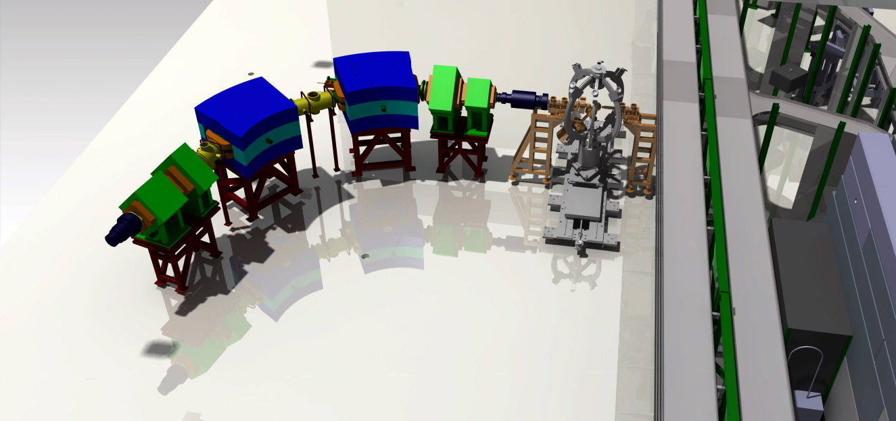
Request from Holland
Donation of the TRIμP from KVI→
in the process to sign an agreement
This zero-degree spectrometer is
planned to be placed after Miniball
The fundamental interactions and Symmetry group of U Groningen (L. Willmann and K. Jungmann) are very interested in preparing a setup to do measurements related to atomic parity violation. A letter of intend was submitted in may 2010 (INTC-I-115)
They show now renew interest and hope due to their investment at ISOLDE to get an equivalent status to a collaboration member to access to the service of the Facility.

Slide 16
Collaboration Budget
Healthy situation
  Started paying 140 kCHF of 1st loan + 400 kCHF (2nd loan to be signed).
  Greece paid 2012 in 2016 and secure the funds until 2014.
  Pending : Norway (60 KCHF), Greece (120 kCHF) and Poland (30KCHF)
Foreseen expediture for 2017 (expected income: 870 kCHF)
HIE-ISOLDE 2017 540.000 CHF
User Support 2017 35.000 →
Euroschool on exotic beams 3000 Euros 3.300
MINIBALL 3000 Euros 3.300
LN2 60.000
A. Miyazaki (HIE-ISOLDE) 23.200
RILIS Man power 45.000
Students 25.000
734.800 CHF

